Slide 1

Parallel Particle Iterators
A.Huebl¹, R.Widera¹, H. Burau^{1,2}, S.T. Hahn^{1,2}
¹ Helmholtz-Zentrum Dresden - Rossendorf
² Technische Universität Dresden
HZDR, Dresden
Notes:
- OpenSource
- Manicore
- Worlds Fastest PIC Code

Slide 2
1. Challenges, Objectives and Terms
2. Users View at DeepIterator
    Simple Example
    Kernel FillGaps
3. Developers View at DeepIterator
    Traits
    Categories
Notes:
- compete with conventional accelerators
Needs:
- high energy
- mono-energetic
- directed beams
- not yet achieved
- one concept are MLT

Slide 3
Challenges and Objectives
Notes:
- compete with conventional accelerators
Needs:
- high energy
- mono-energetic
- directed beams
- not yet achieved
- one concept are MLT

Slide 4
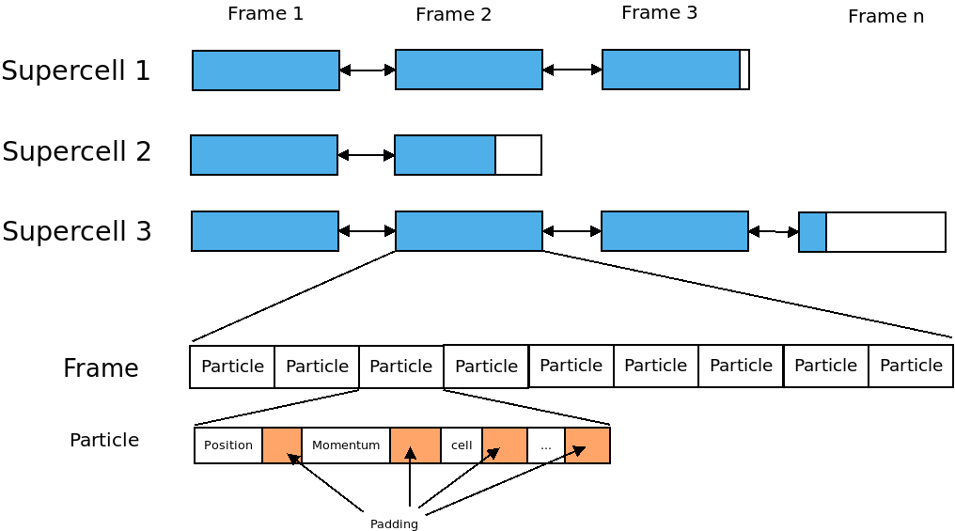

Slide 5
Objectives
Algorithms are independent of the data structures
Describe the parallelism one times and use it on different data structures
Opportunity for further optimizations
Reusability
Large range of functionality

Slide 6
Basic Terms:
Layers
Accessor
Navigator
Notes:
- compete with conventional accelerators
Needs:
- high energy
- mono-energetic
- directed beams
- not yet achieved
- one concept are MLT

Slide 7

Layer
A Layer is a description of a flat container. Examples:

Slide 8
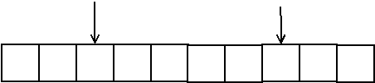
Accessor
An Accessor describes the current element
Access to the element
Compare with another positions (<, >, ==, !=)
Accessor (at positions 2 and 7)

Slide 9
Navigator
Describe the movement of the iterator
First, last element,
Next, previous element,
After-the-last-Element,
Before-the-first-element
Offset/Jumpsize/Slice
Offset: Distance from the beginning of the container to the first position of the iterator.
Jumpsize: Distance between two Elements
Slice: Restrict the container

Slide 10



Offset
Offset: Distance from the beginning of the container to the first position of the iterator.
Example:
Offset = 0
Offset = 2
Offset = 4

Slide 11


Jumpsize
Jumpsize: Distance between two Elements
Example:
Jumpsize = 0
Jumpsize = 2
Jumpsize = 4

Slide 12





Slice
Slice: Restrict the container. Two supported types: Distance and Ignore Last Elements
distance = 0
Ignore = 0
distance = 2
Ignore = 2
distance= 4
Ignore= 4

Slide 13
Slice
Slice: Restrict the container. Two supported types: Distance and Ignore Last Elements
Slice is applied after Offset and Jumpsize
distance = 0
Ignore = 0
distance = 2
Ignore = 2
distance= 4
Ignore= 4

Slide 14
Combined Examples
Off=1, Jump=2, Ignore=1
Off=1, Jump=2, Distance=1
Off=2, Jump=1, Ignore=2
Off=2, Jump=1, Distance=2

Slide 15
An example with two layers
Notes:
- compete with conventional accelerators
Needs:
- high energy
- mono-energetic
- directed beams
- not yet achieved
- one concept are MLT

Slide 16
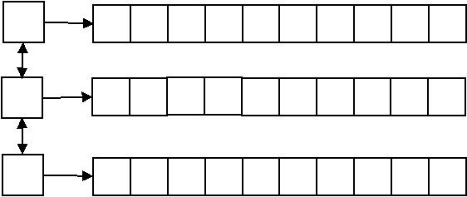
A list<array<int> > Container

Slide 17
A 2D-Prescription
Layer 1: Offset(0)/Jumpsize(1)
Layer 2: Offset(0)/Jumpsize(3)
auto && prescription = makeIteratorPrescription(
pmacc::makeAccessor(),
pmacc::makeNavigator(
Offset(0),
Jumpsize(1)
),
makeIteratorPrescription(
pmacc::makeAccessor(),
pmacc::makeNavigator(
Offset(0),
Jumpsize(3)
)
)
);

Slide 18
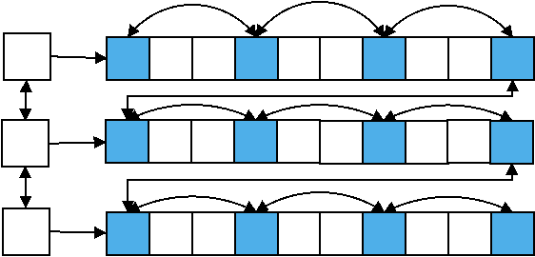
A View of the list<array<int> > Container
Layer 1: Offset(0)/Jumpsize(1)
Layer 2: Offset(0)/Jumpsize(3)
rend()
begin()
rbegin()
end()

Slide 19
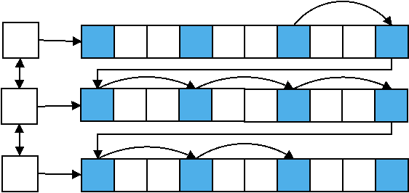
View: Iterator examples
for( auto it = view.begin()+2; it <= view.end()-1; ++it)

Slide 20
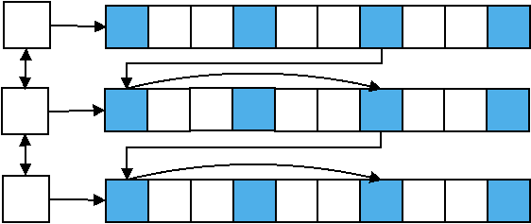
View: Iterator examples
for( auto it = view.begin()+2; it <= view.end()-1; it+=2)

Slide 21
Technicals example driven by kernel FillGaps
Prescription
View
Iterator
Notes:
- compete with conventional accelerators
Needs:
- high energy
- mono-energetic
- directed beams
- not yet achieved
- one concept are MLT

Slide 22
Include the DeepIterator
Two additional includes are necessary
#include <pmacc/memory/iterator/Prescription.hpp>
#include <pmacc/memory/iterator/View.hpp>

Slide 23
Prescription
A Prescription describes the behavior of one or more layers.
A Prescription consists of
Accessor/AccessorPrescription
Navigator/NavigatorPrescription
    Offset
    Jumpsize
Prescription (optionally)

Slide 24
Prescription in Kernel MoveAndMark
// define a compiletime Offset type, start at the first frame
using Offset = pmacc::IdentityValue<
uint_fast32_t,
0
>;
// define a compiletime Jumpsize type, iterate over all frames
using Jumpsize = pmacc::IdentityValue<
uint_fast32_t,
1
>;
// create the prescription
auto && prescription = pmacc::makeIteratorPrescription(
pmacc::makeAccessor(),
pmacc::makeNavigator(
Offset(),
Jumpsize()
)
);

Slide 25
Create a View in Kernel MoveAndMark
A View binds a prescription to a container.
// create a container. In this case we had written a wrapper around the particle box pb
//1. define the wrapper. This is your container.
// 2. specialize all traits which are needed (comes later)
FrameWrapper frameWrapper(
acc, // accelerator
pb, // particle memory, contains the frames
mapper // functor to map a block to a supercell
);
// create the view
auto && view = pmacc::makeView(
frameWrapper, // The container
prescription // the describtion of the iteration
);

Slide 26
Create the Iterator
The View can be used like a container from the STL.
The DeepIterator support the common operations:
++, ==, !=, - >
- -
-=, +=, +, -, <, >, >=, <=, []
// We create an iterator and set its pointer to the last frame.
auto && it = view.rbegin();
// We could also start at the first frame
// auto && it = view.begin()

Slide 27
Check if frames exist
Before:
// end kernel if we have no frames
if( !frame.isValid( ) )
return;
Now:
// end kernel if we have no frames
if( it == view.rend() )
return;

Slide 28
Iterate over all frames
Before:
while( frame.isValid( ) )
{
// loop over all particles in the frame
ForEachIdx< ParticleDomCfg >{ workerIdx }
(
{
ParticleFunctor(
acc,
*frame,
…
)
}
)
frame = pb.getPreviousFrame(frame)
}
Now:
for(;it != view.rend(); --it)
{
// loop over all particles in the frame
ForEachIdx< ParticleDomCfg >{ workerIdx }
(
{
ParticleFunctor(
acc,
*it,
…
)
}
)
}

Slide 29
Traits and Categories
Notes:
- compete with conventional accelerators
Needs:
- high energy
- mono-energetic
- directed beams
- not yet achieved
- one concept are MLT

Slide 30
Needed Traits for DeepIterator
Iterator Traits
Componenttype
HasConstantSize
NumberElements
IsBidirectional
IsRandomAccessable
IndexType,
RangeType
      Accessor Traits
Get
Equal
Ahead
Behind
      Navigator Traits
FirstElement
NextElement
AfterLastElement
LastElement
PreviousElement
BeforeFirstElement

Slide 31
Needed Traits for DeepIterator
Iterator Traits
Componenttype
HasConstantSize
NumberElements
IsBidirectional
IsRandomAccessable
IndexType,
RangeType
      Accessor Traits
Get
Equal
Ahead
Behind
      Navigator Traits
FirstElement
NextElement
AfterLastElement
LastElement
PreviousElement
BeforeFirstElement
(Possible) expensive for lists

Slide 32
Traits: Categories
Each Container need the following traits
Componenttype
HasConstantSize
NumberElements
The following Traits could be grouped by categories
IsBidirectional
IsRandomAccessable
IndexType,
RangeType
    Accessor Traits
get
equal
ahead
behind
    Navigator Traits
firstElement
nextElement
afterLastElement
lastElement
previousElement
beforeFirstElement
Categorie:
ArrayLike
SupercellLike
DoublylinklistLike

Slide 33
Conclusion?
Notes:
- compete with conventional accelerators
Needs:
- high energy
- mono-energetic
- directed beams
- not yet achieved
- one concept are MLT

Slide 34
Definitions
Accessor: Describes the Access to a value inside the container
Navigator: Describes the way to move inside the container
Layer: A flat container (exp. vector<int>)
Prescription: Describes the behavior of one or more layer.
View: binds a Prescription to a container.
DeepIterator: Move through the Data

Slide 35
Usage
Specialize the Traits
Create a Prescription
Create a View by binding a container to a Prescription
Use the View like a std container

Slide 36
Questions?
Notes:
- compete with conventional accelerators
Needs:
- high energy
- mono-energetic
- directed beams
- not yet achieved
- one concept are MLT

Slide 37
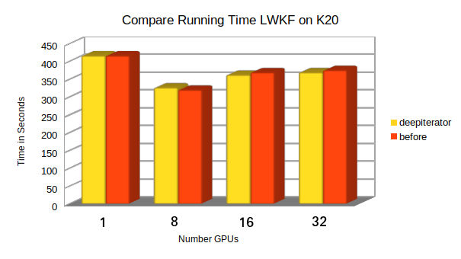
Running Time

Slide 38
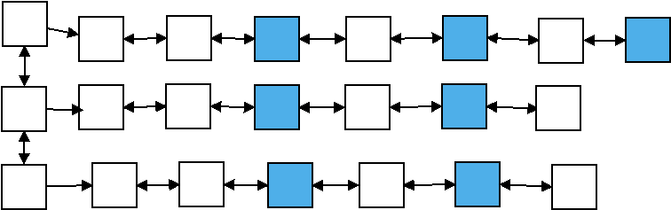
Why is Backward expensiv?
Example: Offset(2), Jumpsize(2)
Task: Find the previous / last element

Slide 39
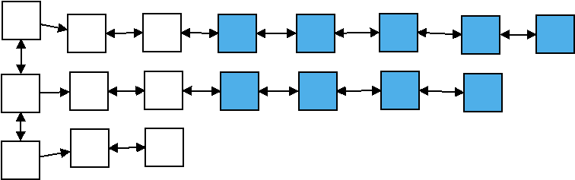
Why is Backward expensiv?
Example: Offset(2), Jumpsize(1)
Task: Find the last element
Last Element of iterator
Last Element of data structure

Slide 40
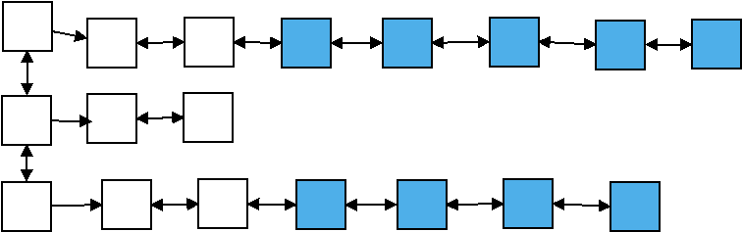
Why is Backward expensiv?
Example: Offset(2), Jumpsize(1)
Task: Find the previous element
Could also Forward happen

