Slide 1

Parallel Particle Iterators
A.Huebl¹, R.Widera¹, H. Burau^{1,2}, S.T. Hahn^{1,2}
¹ Helmholtz-Zentrum Dresden - Rossendorf
² Technische Universität Dresden
HZDR, Dresden
Notes:
- OpenSource
- Manicore
- Worlds Fastest PIC Code

Slide 2
Challenges and Objectives
Notes:
- compete with conventional accelerators
Needs:
- high energy
- mono-energetic
- directed beams
- not yet achieved
- one concept are MLT

Slide 3
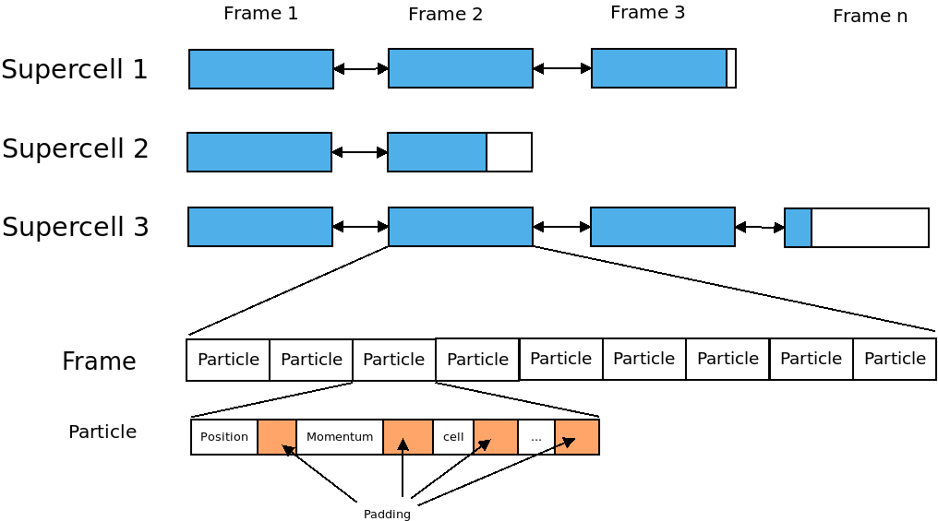

Slide 4
Objectives
Algorithms are independent of the data structures:
    Easy way to change the data structure
      Only one implementation
      Particle-Particle Interaction vs Mesh-Particle Interaction
Describe the parallelism one times and use it on different data structures
Opportunity for further optimizations
Reusability
large range of functionality
        Sequential/ Parallel
        Hierarchical heterogeneous data structures

Slide 5
Iterator: Different Types
Operations
Forward: Linked-List
++, ==, !=, ->

Slide 6
Iterator: Different Types
Operations
Forward: Linked-List
++, ==, !=, ->
Bidirectional: Doubly-Linked-List
- -

Slide 7

Iterator: Different Types
Operations
Forward: Linked-List
++, ==, !=, →, *
Bidirectional: Doubly-Linked-List
- -
Random-Accessable: Array
-, +, +=, -=, <, >, <=
>=, []

Slide 8
Basics:
Layers
Accessor
Navigator
Notes:
- compete with conventional accelerators
Needs:
- high energy
- mono-energetic
- directed beams
- not yet achieved
- one concept are MLT

Slide 9
Layer
A Layer is a description of a flat container. It need at
least three functions:
First-Element-Function,
Next-Element-Function, and
After-Last-Element-Check
Optional for Bidirectional:
Last-Element-Function,
Next-Element-Function, and
Before-First-Element-Check

Slide 10
Layer
A Layer is a description of a flat container. It need at
least three functions:
First-Element-Function,
Next-Element-Function, and
After-Last-Element-Check
Optional for Bidirectional:
Last-Element-Function,
Next-Element-Function, and
Before-First-Element-Check
Accessor
Describes the current element
Access to the element
Compare with another positions (<, >, ==, !=)

Slide 11
Layer
Layer
A Layer is a description of a flat container. It need at
least three functions:
First-Element-Function,
Next-Element-Function, and
After-Last-Element-Check
Optional for Bidirectional:
Last-Element-Function,
Next-Element-Function, and
Before-First-Element-Check
Accessor
Describes the current element
Access to the element
Compare with another positions (<, >, ==, !=)
Navigator
Offset/Jumpsize
Describe the movement of the iterator
Offset: Distance from the
beginning of the container to
the first position of the iterator.
Jumpsize: Distance between two
elements
First, last element,
Next, previous element,
After-the-last-Element,
Before-the-first-element

Slide 12

Example
Simple Layer: 1D-Array

Slide 13
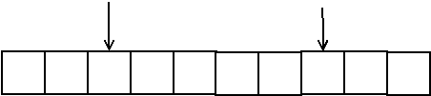
Example
Simple Layer: 1D-Array
Accessor (at 2 and 7)

Slide 14

Example
Simple Layer: 1D-Array
Accessor (at positions 2 and 7)
Navigator: Offset(1)/Jumpsize(3)

Slide 15
Technicals example driven by kernel MoveAndMark
Prescription
View
Iterator
Notes:
- compete with conventional accelerators
Needs:
- high energy
- mono-energetic
- directed beams
- not yet achieved
- one concept are MLT

Slide 16
Prescription
A Prescription describes the behavior of a layer.
A Prescription consists of
Accessor/AccessorPrescription
Navigator/NavigatorPrescription
    Offset
    Jumpsize
Prescription (optionally)

Slide 17
Prescription in Kernel MoveAndMark
// define a compiletime Offset type, start at the first frame
using Offset = pmacc::IdentityValue<
uint_fast32_t,
0
>;
// define a compiletime Jumpsize type, iterate over all frames
using Jumpsize = pmacc::IdentityValue<
uint_fast32_t,
1
>;
// create the prescription
auto && prescription = pmacc::makeIteratorPrescription(
pmacc::makeAccessor(),
pmacc::makeNavigator(
Offset(),
Jumpsize()
)
);

Slide 18
Create a View in Kernel MoveAndMark
A View binds a prescription to a container.
// create a container. In this case we had written a wrapper around the particle box pb
//1. define the wrapper. This is your container.
// 2. specialize all traits which are needed (comes later)
FrameWrapper frameWrapper(
acc, // accelerator
pb, // particle memory, contains the frames
mapper // functor to map a block to a supercell
);
// create the view
auto && view = pmacc::makeView(
frameWrapper, // The container
prescription // the describtion of the iteration
);

Slide 19
Create the Iterator
The View can be used like a container from the STL.
The DeepIterator support the common operations:
++, ==, !=, - >
- -
-=, +=, +, -, <, >, >=, <=, []
// We create an iterator and set its pointer to the last frame.
auto && it = view.rbegin();
// We could also start at the first frame
// auto && it = view.begin()

Slide 20
Check if frames exist
Before:
// end kernel if we have no frames
if( !frame.isValid( ) )
return;
Now:
// end kernel if we have no frames
if( it == view.rend() )
return;

Slide 21
Iterate over all frames
Before:
while( frame.isValid( ) )
{
// loop over all particles in the frame
ForEachIdx< ParticleDomCfg >{ workerIdx }
(
{
ParticleFunctor(
acc,
*frame,
…
)
}
)
frame = pb.getPreviousFrame(frame)
}
Now:
for(;it != view.rend(); --it)
{
// loop over all particles in the frame
ForEachIdx< ParticleDomCfg >{ workerIdx }
(
{
ParticleFunctor(
acc,
*it,
…
)
}
)
}

Slide 22
An example with two layers
Notes:
- compete with conventional accelerators
Needs:
- high energy
- mono-energetic
- directed beams
- not yet achieved
- one concept are MLT

Slide 23
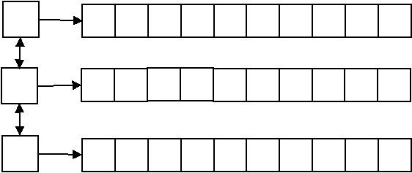
A list<array<int> > Container

Slide 24
A 2D-Prescription
Layer 1: Offset(0)/Jumpsize(1)
Layer 2: Offset(0)/Jumpsize(3)
auto && prescription = makeIteratorPrescription(
pmacc::makeAccessor(),
pmacc::makeNavigator(
Offset(0),
Jumpsize(1)
),
makeIteratorPrescription(
pmacc::makeAccessor(),
pmacc::makeNavigator(
Offset(0),
Jumpsize(3)
)
)
);

Slide 25
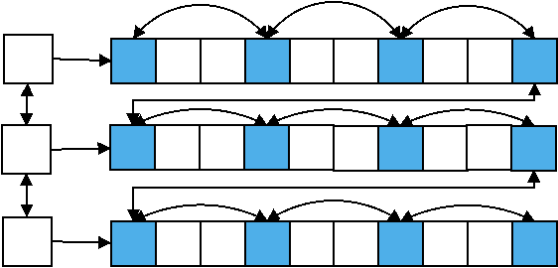
A View of the list<array<int> > Container
Layer 1: Offset(0)/Jumpsize(1)
Layer 2: Offset(0)/Jumpsize(3)
rend()
begin()
rbegin()
end()

Slide 26
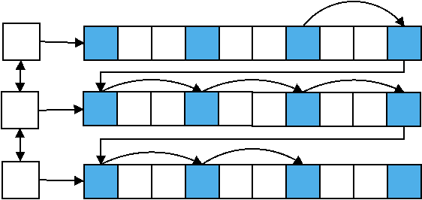
View: Iterator examples
Support the common operations:
++, ==, !=, - >
- -
-=, +=, +, -, <, >, >=, <=, []
for( auto it = view.begin()+2; it <= view.end()-1; ++it)

Slide 27
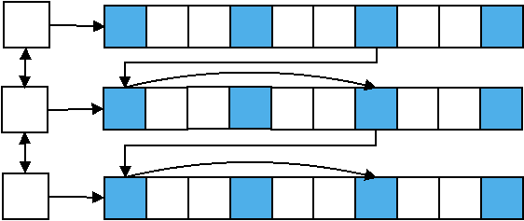
View: Iterator examples
Support the common operations:
++, ==, !=, - >
- -
-=, +=, +, -, <, >, >=, <=, []
for( auto it = view.begin()+2; it <= view.end()-1; it+=2)

Slide 28
Traits and Categories
Notes:
- compete with conventional accelerators
Needs:
- high energy
- mono-energetic
- directed beams
- not yet achieved
- one concept are MLT

Slide 29
Needed Traits for DeepIterator
Iterator Traits
Componenttype
HasConstantSize
NumberElements
IsBidirectional
IsRandomAccessable
IndexType,
RangeType
      Accessor Traits
Get
Equal
Ahead
Behind
      Navigator Traits
FirstElement
NextElement
AfterLastElement
LastElement
PreviousElement
BeforeFirstElement

Slide 30
Needed Traits for DeepIterator
Iterator Traits
Componenttype
HasConstantSize
NumberElements
IsBidirectional
IsRandomAccessable
IndexType,
RangeType
      Accessor Traits
Get
Equal
Ahead
Behind
      Navigator Traits
FirstElement
NextElement
AfterLastElement
LastElement
PreviousElement
BeforeFirstElement
(Possible) expensive for lists

Slide 31
Traits: Categories
Each Container need the following traits
Componenttype
HasConstantSize
NumberElements
The following Traits could be grouped by categories
IsBidirectional
IsRandomAccessable
IndexType,
RangeType
    Accessor Traits
get
equal
ahead
behind
    Navigator Traits
firstElement
nextElement
afterLastElement
lastElement
previousElement
beforeFirstElement
Categorie:
ArrayLike
SupercellLike
DoublylinklistLike

Slide 32
Questions?
Notes:
- compete with conventional accelerators
Needs:
- high energy
- mono-energetic
- directed beams
- not yet achieved
- one concept are MLT

Slide 33
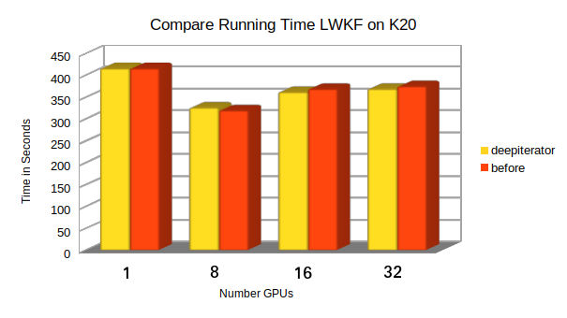
Running Time

Slide 34
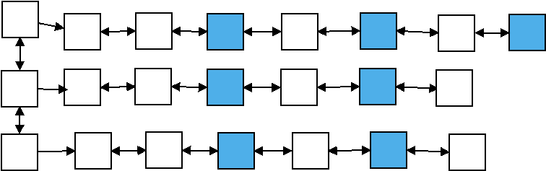
Why is Backward expensiv?
Example: Offset(2), Jumpsize(2)
Task: Find the previous / last element

Slide 35
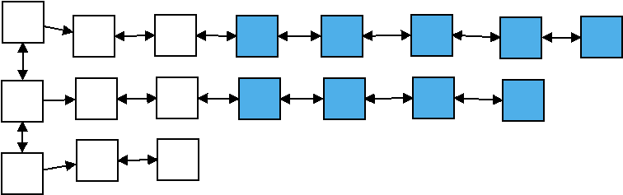
Why is Backward expensiv?
Example: Offset(2), Jumpsize(1)
Task: Find the last element
Last Element of iterator
Last Element of data structure

Slide 36
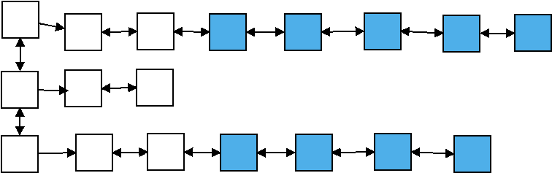
Why is Backward expensiv?
Example: Offset(2), Jumpsize(1)
Task: Find the previous element
Could also Forward happen

