Slide 1

DeepIterator
A.Huebl¹, R.Widera¹, H. Burau^{1,2}, S.T. Hahn^{1,2}
¹ Helmholtz-Zentrum Dresden-Rossendorf
² Technische Universität Dresden
Notes:
- OpenSource
- Manicore
- Worlds Fastest PIC Code

Slide 2
1. Challenges, Objectives and Terms
2. Users View at DeepIterator
    Simple Example
    Kernel MoveAndMark
3. Developers View at DeepIterator
    Traits
    Categories
Notes:
- compete with conventional accelerators
Needs:
- high energy
- mono-energetic
- directed beams
- not yet achieved
- one concept are MLT

Slide 3
Challenges and Objectives
Notes:
- compete with conventional accelerators
Needs:
- high energy
- mono-energetic
- directed beams
- not yet achieved
- one concept are MLT

Slide 4
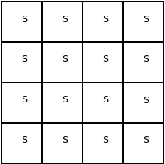
Simulated Space

Slide 5
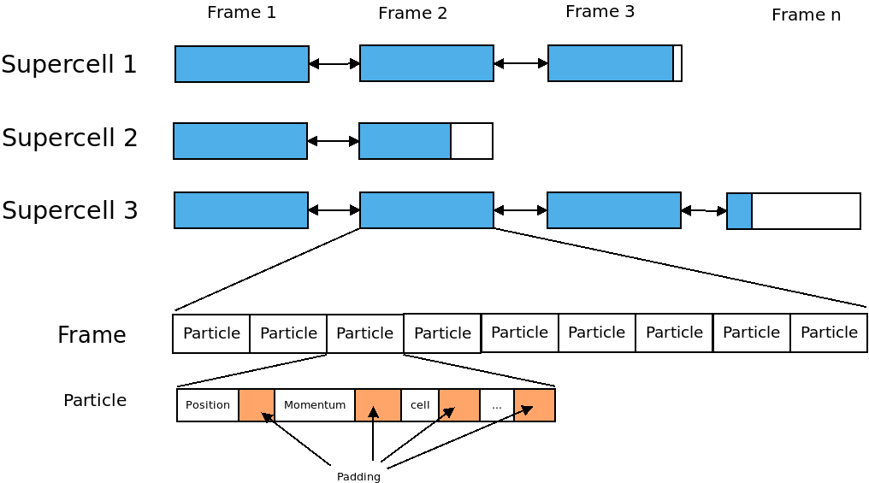

Slide 6
Objectives
Support of heterogeneous hierarchical Data structures
Support of heterogeneous Hardware
Highly specifiable for Developers
High Level API for Users
      Separation of access and data

Slide 7
Prescription
Notes:
- compete with conventional accelerators
Needs:
- high energy
- mono-energetic
- directed beams
- not yet achieved
- one concept are MLT

Slide 8
Motivation
//Iterate over all Particles in Supercell
for(frame in supercell)
for(particle in frame)
// do something

Slide 9
Motivation
//Iterate over all Particles in Supercell
for(frame in supercell)
for(particle in frame)
// do something
Problems:
1. Need knowledge
2. Every time the same
Solution: Prescription

Slide 10
Motivation
//Iterate over all Particles in Supercell
for(frame in supercell)
for(particle in frame)
// do something
A Prescription defines the movement
through the container in a hierarchical way.
It consists of an Accessor, a Navigator and
a optional Prescription.
A Prescription defines a concept of how a
iterator moves through the datastructure.
Problems:
1. Need knowledge
2. Every time the same
Solution: Prescription

Slide 11
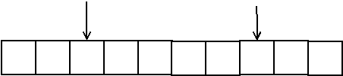
Accessor
An Accessor describes the current element
Access to the element
Compare with another indices (<, >, ==, !=)
Accessor (at position 2 and 7)

Slide 12
Navigator
Describe the movement of the iterator
Begin, RBegin element,
Next, Previous element,
End Element,
REnd element
Offset/Jumpsize/Slice
Offset: Distance from the beginning of the container to the first position of the iterator.
Jumpsize: Distance between two Elements
Extent: Restrict the container
Offset and Jumpsize can be used for parallel access.

Slide 13






Offset
Offset: Distance from the beginning of the container to the first position of the iterator.
Example:
Offset = 0
Offset = 2
Offset = 4

Slide 14




Jumpsize
Jumpsize: Distance between two Elements
Example:
Jumpsize = 1
Jumpsize = 2
Jumpsize = 4

Slide 15


Extent
Extent: Restrict the container. Two supported types:
Number Elements, and
Ignore Last Elements
Extent = 0
Extent = -2
Extent = 2
Extent= -4
Extent= 4

Slide 16
Extent
Extent: Restrict the container. Two supported types:
Number Elements, and
Ignore Last Elements
Extent is applied after Offset and Jumpsize
Extent = 0
Extent = -2
Extent = 2
Extent= -4
Extent= 4

Slide 17

Combined Examples
Off=2, Jump=1, Extent=-1
Off=2, Jump=1, Extent=1
Off=2, Jump=1, Extent=-2
Off=2, Jump=1, Extent=2
Off=1, Jump=2, Extent=-2
Off=0, Jump=2, Extent=2

Slide 18






Combined Examples Solution
Off=2, Jump=1, Extent=-1
Off=2, Jump=1, Extent=1
Off=2, Jump=1, Extent=2
Off=2, Jump=1, Extent=-2
Off=1, Jump=2, Extent=-2
Off=0, Jump=2, Extent=2

Slide 19
A stacked Prescription
An example with two layers
Notes:
- compete with conventional accelerators
Needs:
- high energy
- mono-energetic
- directed beams
- not yet achieved
- one concept are MLT

Slide 20
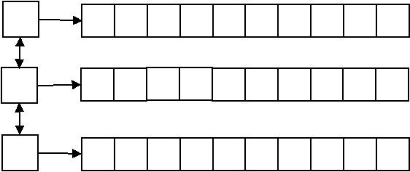
A list<array<int> > Container

Slide 21
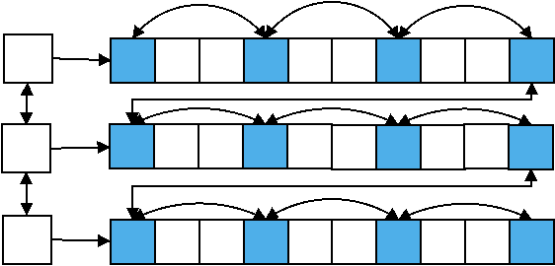
An Example of a Supercell
Each Frame: Offset(0)/Jumpsize(1)
Each third Particle: Offset(0)/Jumpsize(3)

Slide 22
Source for a 2D-Prescription
auto && prescription = makeIteratorPrescription(
makeAccessor(),
makeNavigator(
Offset(0),
Jumpsize(1)
),
makeIteratorPrescription(
makeAccessor(),
makeNavigator(
Offset(0),
Jumpsize(3)
)
)
);

Slide 23
Introduction of View
An example with two layers
Notes:
- compete with conventional accelerators
Needs:
- high energy
- mono-energetic
- directed beams
- not yet achieved
- one concept are MLT

Slide 24
The View
// example
auto && view = makeView(
supercell,
prescription
)
The View binds a prescription
to a container.
The View has functionality
similar to a STD-Container

Slide 25
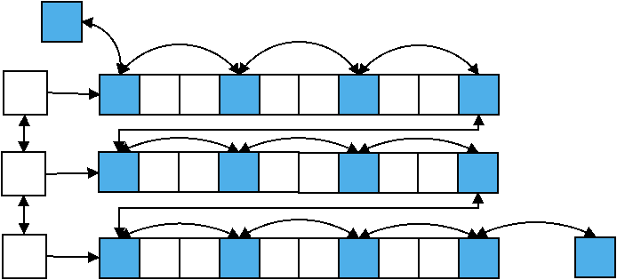
The View
// example
auto && view = makeView(
supercell,
prescription
)
rend()
begin()
end()
rbegin()

Slide 26
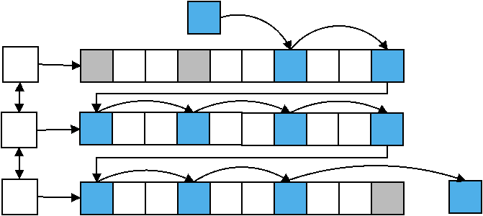
View: Iterator examples
for( auto it = view.begin()+2; it <= view.end()-1; ++it)
rend()
end()

Slide 27
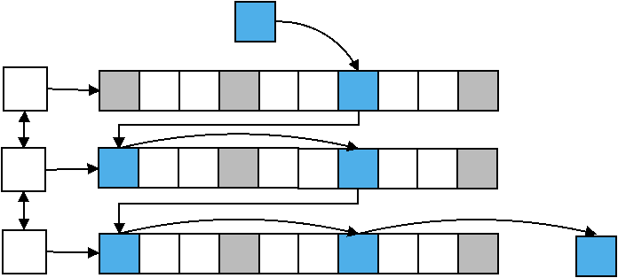
View: Iterator examples
for( auto it = view.begin()+2; it <= view.end()-1; it+=2)
rend()
end()

Slide 28
Technicals example driven by kernel MoveAndMark
Prescription
View
Iterator
Notes:
- compete with conventional accelerators
Needs:
- high energy
- mono-energetic
- directed beams
- not yet achieved
- one concept are MLT

Slide 29
Include the DeepIterator
#include “deepiterator/Deepiterator.hpp”

Slide 30
Prescription in Kernel MoveAndMark (Frame)
// define a compiletime Offset type, start at the first frame
using OffsetFrame = deepiterator::IdentityValue<
uint32_t,
0
>;
// define a compiletime Jumpsize type, iterate over all frames
using JumpsizeFrame = deepiterator::IdentityValue<
uint32_t,
1
>;
// create the prescription
auto && prescrFrame = deepiterator::makeIteratorPrescription(
deepiterator::makeAccessor(),
deepiterator::makeNavigator(
OffsetFrame(),
JumpsizeFrame()
)
);

Slide 31
Prescription in Kernel MoveAndMark (Supercell)
// define a compiletime Offset type, start at the first frame
using OffsetSupercell = deepiterator::IdentityValue<
RangeTypeSupercell < simDim >,
>;
// create the prescription
auto && receptionSupercell = deepiterator::makeIteratorPrescription(
deepiterator::makeAccessor(),
deepiterator::makeNavigator(
OffsetSupercell(
mapper.getSuperCellIndex( DataSpace< simDim >( blockIdx )
),
Jumpsize(),
deepiterator::Extent<1>()
),
receptionFrame
);

Slide 32
Create a View in Kernel MoveAndMark
A View binds a prescription to a container.
// create a container. In this case we had written a wrapper around the particle
// box pb, since we need additional information
SupercellWrapper supercellWrapper(
pb, // particle memory, contains the frames
mapper.getSuperCellIndex( DataSpace< simDim >( blockIdx )
);
// create the view
auto && view = deepIterator::makeView(
supercellWrapper, // The container
receptionSupercell // the describtion of the iteration
);

Slide 33
Create the Iterator
The View can be used like a container from the STL.
The DeepIterator support the common operations:
++, ==, !=, - >
- -
-=, +=, +, -, <, >, >=, <=, []
// We create an iterator and set its pointer to the last frame.
auto && it = view.rbegin();
// We could also start at the first frame
// auto && it = view.begin()

Slide 34
Check if frames exist
Before:
// end kernel if we have no frames
if( !frame.isValid( ) )
return;
Now:
// end kernel if we have no frames
if( it == view.rend() )
return;

Slide 35
Iterate over all frames
Before:
while( frame.isValid( ) )
{
// loop over all particles in the frame
ForEachIdx<ParticleDomCfg>{workerIdx}
(
{
ParticleFunctor(
acc,
*frame,
…
)
}
)
frame = pb.getPreviousFrame(frame)
}
Now:
for(;it != view.rend(); --it)
{
// loop over all particles in the frame
ForEachIdx< ParticleDomCfg >{ workerIdx }
(
{
ParticleFunctor(
acc,
*it,
…
)
}
)
}

Slide 36
Reuse Reception: Make View in other Kernel
// create a container. In this case we had written a wrapper around the
// particle box pb, since we need additional information
SupercellWrapper supercellWrapper(
pb, // particle memory, contains the frames
mapper.getSuperCellIndex( DataSpace< simDim >( blockIdx )
);
// create the view
auto && view = deepIterator::makeView(
supercellWrapper, // The container
receptionSupercell // reuse from MoveAndMark
);

Slide 37
Traits and Categories
Notes:
- compete with conventional accelerators
Needs:
- high energy
- mono-energetic
- directed beams
- not yet achieved
- one concept are MLT

Slide 38
Needed Traits for DeepIterator
Iterator Traits
Componenttype
HasConstantSize
NumberElements
IsBidirectional
IsRandomAccessable
IndexType,
RangeType
      Accessor Traits
At
Equal
Ahead
Behind
      Navigator Traits
BeginElement
NextElement
EndElement
RBeginElement
PreviousElement
REndElement

Slide 39
Needed Traits for DeepIterator
Iterator Traits
Componenttype
HasConstantSize
NumberElements
IsBidirectional
IsRandomAccessable
IndexType,
RangeType
      Accessor Traits
At
Equal
Ahead
Behind
      Navigator Traits
BeginElement
NextElement
EndElement
RBeginElement
PreviousElement
REndElement
(Possible) expensive for lists

Slide 40
Traits: Categories
Each Container need the following traits
Componenttype
HasConstantSize
NumberElements
The following Traits could be grouped by categories
IsBidirectional
IsRandomAccessable
IndexType,
RangeType
    Accessor Traits
At
Equal
Ahead
Behind
    Navigator Traits
BeginElement
NextElement
EndElement
RBeginElement
PreviousElement
REndElement
Categorie:
ArrayLike
SupercellLike
DoublylinklistLike

Slide 41
Conclusion?
Notes:
- compete with conventional accelerators
Needs:
- high energy
- mono-energetic
- directed beams
- not yet achieved
- one concept are MLT

Slide 42
Definitions
Accessor: Describes the access to a value inside the container
Navigator: Describes the way to move inside the container
Layer: A flat container (example vector<int>)
Prescription: Describes the behavior of one or more layer.
View: binds a Prescription to a container.
DeepIterator: Move through the Data

Slide 43
Usage
Specialize the Traits
Create a Prescription
Create a View by binding a container to a Prescription
Use the View like a std container

Slide 44
Questions?
Notes:
- compete with conventional accelerators
Needs:
- high energy
- mono-energetic
- directed beams
- not yet achieved
- one concept are MLT

Slide 45
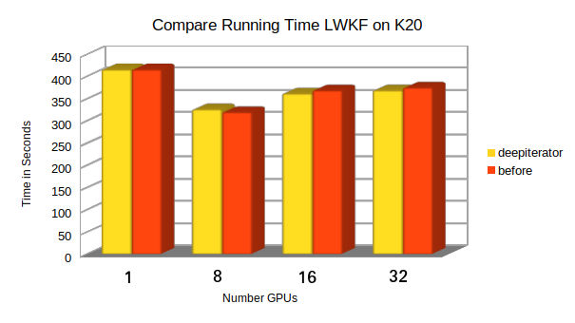
Running Time

Slide 46
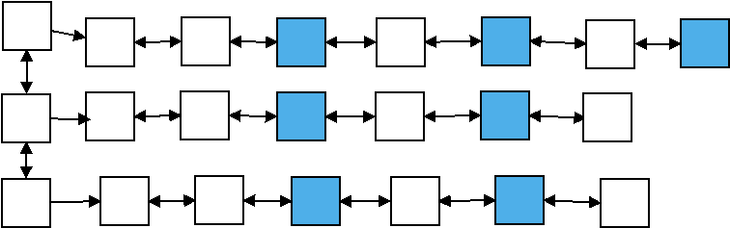
Why is Backward expensiv?
Example: Offset(2), Jumpsize(2)
Task: Find the previous / last element

Slide 47
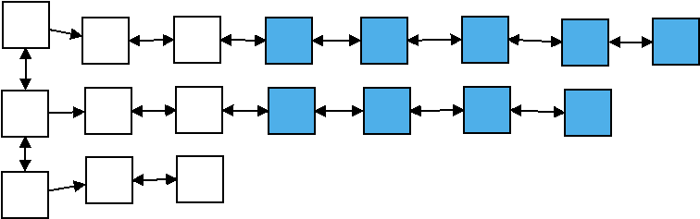
Why is Backward expensiv?
Example: Offset(2), Jumpsize(1)
Task: Find the last element
Last Element of iterator
Last Element of data structure

Slide 48
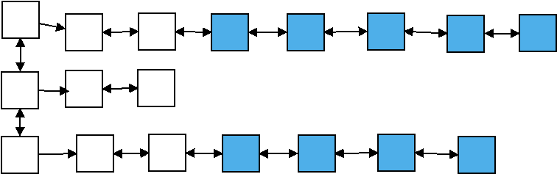
Why is Backward expensiv?
Example: Offset(2), Jumpsize(1)
Task: Find the previous element
Could also Forward happen

