Slide 1


Advanced Processor Organization and Performance Optimization
Chapter TWO
CA_OS- CH2 – Advanced Processor Organization and Performance Optimization

Slide 2
CH-2 Contents
RISC and CISC processor
Performance optimization
Improvements in chip organization and architecture
Pipelining and Multithreading

Slide 3
Reduced & Complex Instruction Set
Reduced Instruction Set Architecture (RISC)
The main idea behind this is to simplify hardware by using an instruction set composed of a few basic steps for loading, evaluating, and storing operations just like a load command will load data, a store command will store the data.
Complex Instruction Set Architecture (CISC)
The main idea is that a single instruction will do all loading, evaluating, and storing operations just like a multiplication command will do stuff like loading data, evaluating, and storing it, hence it’s complex.

Slide 4
Characteristics of RISC
Simpler instruction, hence simple instruction decoding.
Instruction comes undersize of one word.
Instruction takes a single clock cycle to get executed.
More general-purpose registers.
Simple Addressing Modes.
Fewer Data types.
A pipeline can be achieved.

Slide 5
Advantages of RISC
Simpler instructions: which makes them easier to decode and execute quickly. This results in faster processing times.
Faster execution: they can execute instructions faster than CISC processors.
Lower power consumption: making them ideal for portable devices.
Disadvantages of RISC
More instructions required: require more instructions to perform complex tasks than CISC processors.
Increased memory usage: require more memory to store the additional instructions needed to perform complex tasks.
Higher cost: Developing and manufacturing RISC processors can be more expensive than CISC processors.

Slide 6
Characteristics of CISC
Complex instruction, hence complex instruction decoding.
Instructions are larger than one-word size.
Instruction may take more than a single clock cycle to get executed.
Less number of general-purpose registers as operations get performed in memory itself.
Complex Addressing Modes.
More Data types.

Slide 7
Advantages of CISC
Reduced code size: reducing the amount of code needed to perform a task.
More memory efficient: they require fewer instructions to perform complex tasks, it is more memory-efficient code.
Widely used: they have a larger user base and more available software.
Disadvantages of CISC
Slower execution: take longer to execute instructions and need more time to decode them.
More complex design: which makes them more difficult to design and manufacture.
Higher power consumption: CISC processors consume more power than RISC processors

Slide 8

CPU Performance
Both approaches try to increase the CPU performance
RISC: Reduce the cycles per instruction at the cost of the number of instructions per program.
CISC: The CISC approach attempts to minimize the number of instructions per program but at the cost of an increase in the number of cycles per instruction.

Slide 9
Basic measures of computer performance
In computer, performance refers to the speed and efficiency at which a computer system can execute tasks and process data.
A high-performing computer system is one that can perform tasks quickly and efficiently while minimizing the amount of time and resources required to complete these tasks.
There are several factors that can impact the performance of a computer system, including:
Processor speed, memory, storage, I/O devices and software optimization

Slide 10
Processor speed
The speed of the processor, measured in GHz (gigahertz), determines how quickly the computer can execute instructions and process data.
Memory
The amount and speed of the memory, including RAM (random access memory) and cache memory, can impact how quickly data can be accessed and processed by the computer.
Storage
The speed and capacity of the storage devices, including hard drives and solid-state drives (SSDs), can impact the speed at which data can be stored and retrieved.
I/O devices
The speed and efficiency of input/output devices, such as keyboards, mice, and displays, can impact the overall performance of the system.
Software optimization
The efficiency of the software running on the system, including operating systems and applications, can impact how quickly tasks can be completed.

Slide 11
Improving the performance of a computer system typically involves optimizing one or more of these factors to reduce the time and resources required to complete tasks. This can involve
Upgrading hardware components,
Optimizing software, and
Using specialized performance-tuning tools to identify and address bottlenecks in the system.

Slide 12
Computer performance is the amount of work accomplished by a computer system. The word performance in computer performance means “How well is the computer doing the work it is supposed to do?”.
It basically depends on
The response time,
Throughput, and
Execution time of a computer system.

Slide 13
Response time is the time from the start to completion of a task. This also includes:
Operating system overhead.
Waiting for I/O and other processes
Accessing disk and memory
Time spent executing on the CPU or execution time.
Throughput is the total amount of work done in a given time.
CPU execution time is the total time a CPU spends computing on a given task.
It also excludes time for I/O or running other programs. This is also referred to as simply CPU time.

Slide 14
Performance is determined by execution time as performance is inversely proportional to execution time.
Performance = (1 / Execution time)
and
(Performance of A / Performance of B) = (Execution Time of B / Execution Time of A)
If given that Processor A is faster than processor B, that means execution time of A is less than that of execution time of B.

Slide 15
Example:
Machine A runs a program in 100 seconds, Machine B runs the same program in 125 seconds
(Performance of A / Performance of B) = (Execution Time of B / Execution Time of A)
= 125 / 100 = 1.25
That means machine A is 1.25 times faster than Machine B. And, the time to execute a given program can be computed as:
Execution time = CPU clock cycles x clock cycle time

Slide 16
The number of CPU clock cycles can be determined by,
CPU clock cycles
= (No. of instructions / Program ) x (Clock cycles / Instruction)
= Instruction Count x CPI (Clock per Instruction)
Which gives,
Execution time
= Instruction Count x CPI x clock cycle time
= Instruction Count x CPI / clock rate

Slide 17
Units of CPU Execution Time
How to Improve Performance?
To improve performance you can either:
Decrease the CPI by using new Hardware.
Decrease the clock time or Increase clock rate by reducing propagation delays or by use pipelining.
Decrease the number of required cycles or improve Instruction Set Architecture (ISA) or Compiler.

Slide 18
Problem?
While processor power has raced ahead at breakneck speed, other critical components of the computer have not kept up.
The result is a need to look for performance balance.
It is an adjustment/tuning of the organization and architecture to compensate for the mismatch among the capabilities of the various components.
The problem created by such mismatches is particularly critical at the interface between processor and main memory.

Slide 19
Processor vs Memory
A system architect can attack this problem in a number of ways, all of which are reflected in contemporary computer designs. Consider the following examples:
Increase the number of bits that are retrieved at one time by making DRAMs “wider” rather than “deeper” and by using wide bus data paths.
Change the DRAM interface to make it more efficient by including a cache 1 or other buffering scheme on the DRAM chip.
Reduce the frequency of memory access by incorporating increasingly complex and efficient cache structures between the processor and main memory.
This includes the incorporation of one or more caches on the processor chip as well as on an off-chip cache close to the processor chip.
Increase the interconnect bandwidth between processors and memory by using higher-speed buses and a hierarchy of buses to buffer and structure data flow
Notes:
While processor speed has grown rapidly, the speed with which data can be transferred between main memory and the processor has lagged badly.

Slide 20
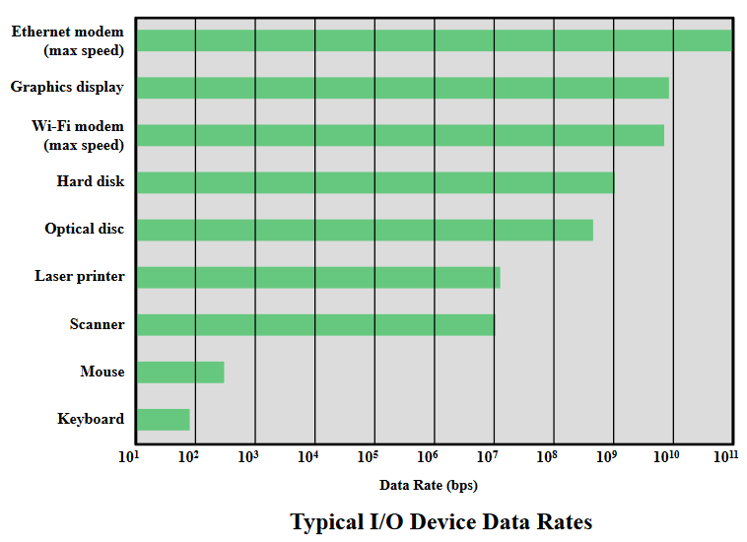
Processor vs I/O Devices
Another area of design focus is the handling of I/O devices.
As computers become faster and more capable, more sophisticated applications are developed that support the use of peripherals with intensive I/O demands.

Slide 21
Above figure gives some examples of typical peripheral devices in use on personal computers and workstations.
These devices create tremendous data throughput demands.
While the current generation of processors can handle the data pumped out by these devices, there remains the problem of getting that data moved between processor and peripheral.
Strategies here include caching and buffering schemes plus the use of higher-speed interconnection buses and more elaborate interconnection structures.
In addition, the use of multiple-processor configurations can aid in satisfying I/O demands.

Slide 22
The key in all this is balance.
Designers constantly strive to balance the throughput and processing demands of the processor components, main memory, I/O devices, and the interconnection structures.
This design must constantly consider the two evolving factors:
The rate at which performance is changing in the various technology areas (processor, buses, memory, peripherals) differs greatly from one type of element to another.
New applications and new peripheral devices constantly change the nature of the demand on the system in terms of typical instruction profile and the data access patterns.

Slide 23
Improvements in chip organization and architecture
There are three approaches to achieving increased processor speed:
Increase the hardware speed of the processor.
Fundamentally due to shrinking logic gate size
More gates, packed more tightly, increasing clock rate
Propagation time for signals reduced
Increase the size and speed of caches
Dedicating part of processor chip
Cache access times drop significantly
Make changes to the processor organization and architecture
Increase effective speed of instruction execution
Parallelism

Slide 24
Traditionally, the dominant factor in performance gains has been in increases in clock speed due and logic density.
However, as clock speed and logic density increase, a number of obstacles become more significant:
Power: As the density of logic and the clock speed on a chip increase, so does the power density (Watts/cm2 ).
The difficulty of dissipating the heat generated on high-density, high-speed chips is becoming a serious design issue.

Slide 25
RC delay: The speed at which electrons can flow on a chip between transistors is limited by the resistance and capacitance of the metal wires connecting them; specifically, delay increases as the RC product increases.
As components on the chip decrease in size, the wire interconnects become thinner, increasing resistance. Also, the wires are closer together, increasing capacitance.
Memory latency and throughput: Memory access speed (latency) and transfer speed (throughput) lag processor speeds.

Slide 26
Pipelining and Multithreading
Pipelining is the process of accumulating instruction from the processor through a pipeline.
It allows storing and executing instructions in an orderly process. It is also known as pipeline processing.
It is a technique where multiple instructions are overlapped during execution.
Pipeline is divided into stages and these stages are connected with one another to form a pipe like structure. Instructions enter from one end and exit from another end.
Pipelining increases the overall instruction throughput.

Slide 27
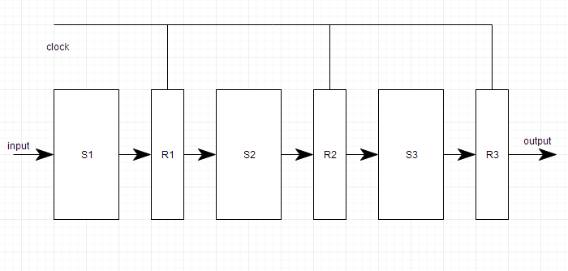
In pipeline system, each segment consists of an input register followed by a combinational circuit.
The register is used to hold data and combinational circuit performs operations on it.
The output of combinational circuit is applied to the input register of the next segment.

Slide 28
Pipeline system is like the modern day assembly line setup in factories.
For example in a car manufacturing industry, huge assembly lines are setup and at each point, there are robotic arms to perform a certain task, and then the car moves on ahead to the next arm.
Types of Pipeline
It is divided into 2 categories:
Arithmetic Pipeline
Instruction Pipeline

Slide 29
Arithmetic Pipeline
Arithmetic pipelines are usually found in most of the computers. They are used for floating point operations, multiplication of fixed point numbers etc.
For example: The input to the Floating Point Adder pipeline is:
X = A*2ª
Y = B*2^{b}
Here A and B are mantissas (significant digit of floating point numbers), while a and b are exponents.

Slide 30
The floating point addition and subtraction is done in 4 parts:
Compare the exponents.
Align the mantissas.
Add or subtract mantissas
Produce the result.
Registers are used for storing the intermediate results between the above operations.

Slide 31
Instruction Pipeline
In this a stream of instructions can be executed by overlapping fetch, decode and execute phases of an instruction cycle.
This type of technique is used to increase the throughput of the computer system.
An instruction pipeline reads instruction from the memory while previous instructions are being executed in other segments of the pipeline.
Thus we can execute multiple instructions simultaneously.
The pipeline will be more efficient if the instruction cycle is divided into segments of equal duration.

Slide 32
Pipeline Conflicts
There are some factors that cause the pipeline to deviate its normal performance. Some of these factors are given below:
Timing Variations
All stages cannot take same amount of time. This problem generally occurs in instruction processing where different instructions have different operand requirements and thus different processing time.
Data Hazards
When several instructions are in partial execution, and if they reference same data then the problem arises. We must ensure that next instruction does not attempt to access data before the current instruction, because this will lead to incorrect results.

Slide 33
Branching
In order to fetch and execute the next instruction, we must know what that instruction is. If the present instruction is a conditional branch, and its result will lead us to the next instruction, then the next instruction may not be known until the current one is processed.
Interrupts
Interrupts set unwanted instruction into the instruction stream. Interrupts effect the execution of instruction.
Data Dependency
It arises when an instruction depends upon the result of a previous instruction but this result is not yet available.

Slide 34
Advantages of Pipelining
The cycle time of the processor is reduced.
It increases the throughput of the system
It makes the system reliable.
Disadvantages of Pipelining
The design of pipelined processor is complex and costly to manufacture.
The instruction latency is more.

Slide 35
Multithreading is a function of the CPU that permits multiple threads to run independently while sharing the same process resources.
A thread is a conscience sequence of instructions that may run in the same parent process as other threads.
Multithreading allows many parts of a program to run simultaneously.
These parts are referred to as threads, and they are lightweight processes that are available within the process.
As a result, multithreading increases CPU utilization through multitasking.

Slide 36
In multithreading, a computer may execute and process multiple tasks simultaneously.
Multithreading needs a detailed understanding of these two terms: process and thread.
A process is a running program, and a process can also be subdivided into independent units called threads.

Slide 37
Examples of Multithreading
Multiple threads run behind the scenes in most of the applications you use regularly.
At any given time, you may have numerous tabs open in the system and every tab displaying different types of content.
Many threads of execution are used to display animations, load content, play a video, etc.
A word processor is another instance of a multithreaded program with which you are all familiar.
Multiple threads are used to show the content, asynchronously check content's spelling and grammar, and generate a PDF version of content while typing. These are all happening simultaneously, with independent threads doing these tasks internally.

Slide 38
Benefits of Multithreading
Various benefits of multithreading in the operating system are as follows:
Responsiveness
Multithreading in an interactive application enables a program to continue running even if a section is blocked or executing a lengthy process, increasing user responsiveness.
A server in a non-multithreading environment listens to a port for a request, processes the request, and then resumes listening for another request. Other users are made to wait unnecessarily because of the time it takes to execute a request. Instead, a better approach will be to pass the request to a worker thread while listening on a port.
For instance, a multithreaded web browser permits the user interaction in one thread while a video is loading in another thread. As a result, instead of waiting for the entire web page to load, the user can continue viewing a section of a web page.

Slide 39
Resource Sharing
Processes can only share the resources only via two techniques such as:
Message Passing
Shared Memory
The programmer must explicitly structure such strategies. On the other hand, by default, threads share the memory and resources of the process they belong to.
The advantage of sharing code and data is that it permits an app to execute multiple code threads in the same address space.
Economy
Allocating memory and resources for process creation is an expensive procedure because it is a time and space-consuming task.
Because threads share a memory with the process to which they belong, establishing and context switching threads is more cost-effective. In general, generating and managing processes takes far more time than threads.

Slide 40
Scalability
The advantages of multi-programming become much more apparent in the case of multiprocessor architecture, when threads may execute in parallel on many processors. When there is just one thread, it is impossible to break the processes into smaller jobs performed by different processors.
A single-threaded process could only run on one processor, despite the number of processors available. Multithreading on multiple CPU machines increases parallelism.
Better Communication
Thread synchronization functions could be used to improve inter-process communication. Moreover, sharing huge amounts of data across multiple threads of execution inside the same address space provides extremely high-bandwidth, low-latency communication across various tasks within an application.

Slide 41
Utilization of multiprocessor architecture
The advantages of multithreading might be considerably amplified in a multiprocessor architecture, where every thread could execute in parallel on a distinct processor.
A single-threaded task could only run on one of them, no matter how many CPUs are available. On a multi-CPU machine, multithreading enhances concurrency.
The CPU switches among threads so quickly in single-processor architecture that it creates the illusion of parallelism, but only one thread is running at a particular time.
Minimized system resource usage
Threads have a minimal influence on the system's resources. The overhead of creating, maintaining, and managing threads is lower than a general process.

Slide 42
Disadvantages of Multithreading
There are various disadvantages of multithreading in the operating system, and some of the disadvantages are as follows:
It needs more careful synchronization.
It can consume a large space of stocks of blocked threads.
It needs support for thread or process.
If a parent process has several threads for proper process functioning, the child processes should also be multithreaded because they may be required.
It imposes context switching overhead.

Slide 43
Questions?

Slide 44
Thank You

