Slide 1


Processes and Thread
Chapter Four
CA_OS- CH4 – Processes and Thread

Slide 2
CH-4 Contents
Introduction
Process life cycle
Process Control Block (PCB)
Context switching
Process Scheduler
Thread and Multithreading
Process Synchronization
Inter Process Communication (IPC)

Slide 3
Brainstorm Questions
What is a program, process and thread?
How is a program executed?
Why is synchronization required when executing processes?
How can processes communicate?

Slide 4
Introduction
Program vs Process
A program is a set of instructions to complete a specific task.
It is a passive entity that resides in secondary memory, such as the file’s contents stored on a disk.
A program consists of two logical components: code and data.
A process, also known as a job, refers to program code loaded into a computer's memory so the CPU can execute it.
An instance of a program running on a computer or as an entity that can be assigned to and executed on a processor
When a program is loaded into memory, it becomes an active process.

Slide 5
“Execution of program started via GUI mouse clicks, command line entry of its name, by execution of another program etc
One program can be several processes
Consider multiple users executing the same program or
A single user executing multiple instances of the same program E.g. web browsers
A process will need certain resources such as CPU time, memory, files, and I/O devices to accomplish its task.
These resources are typically allocated to the process while it is executing.

Slide 6
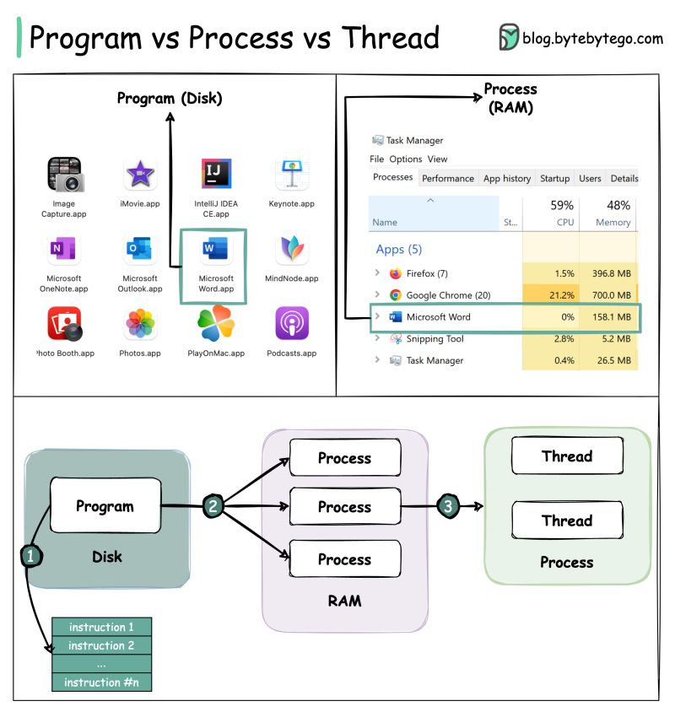

Slide 7
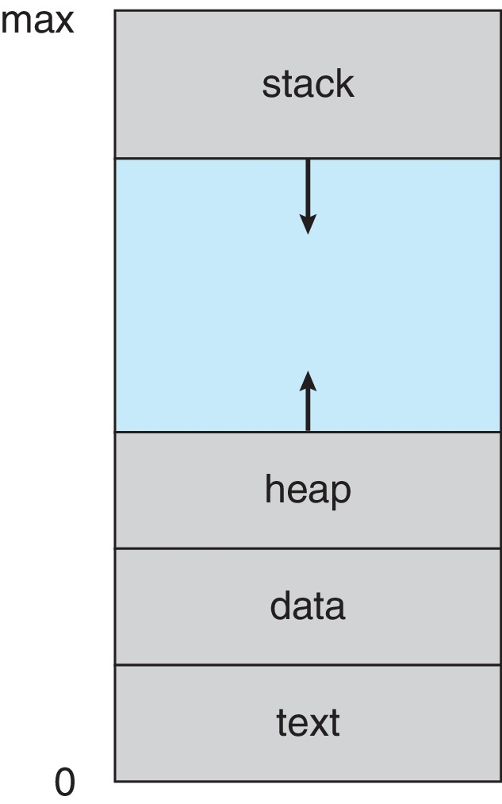
Memory layout of a process
Stack containing temporary data
Function parameters, return addresses, local variables
Heap: a memory that is dynamically allocated during run time
Data section: global and static variables
Text Section: the program (executable) code

Slide 8
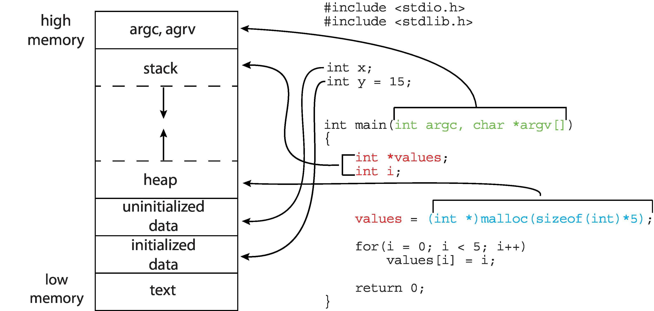
Memory Layout of a C Program

Slide 9
Process life cycle
When a process executes, it passes through different states: These stages may differ in different operating systems,
New: the process is being created
Ready: the process is waiting to be assigned to a processor
Running: instructions are being executed
Waiting: the process is waiting for some event to occur
Terminated: the process has finished execution

Slide 10
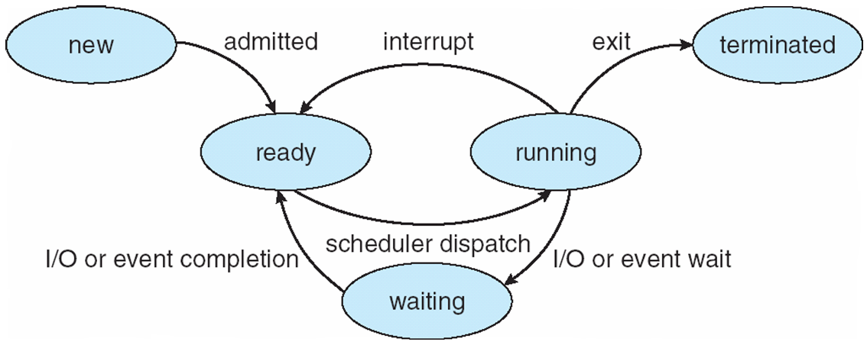
Notes:
1. System initialization. 2. Execution of a process-creation system call by a running process. 3. A user request to create a new process. 4. Initiation of a batch job.
1. Normal exit (voluntary). 2. Error exit (voluntary). 3. Fatal error (involuntary). 4. Killed by another process (involuntary).

Slide 11
New →Ready
Admitted to ready queue;
Can now be considered by CPU scheduler
Ready →Running
CPU scheduler chooses that process to execute next, according to some scheduling algorithm
Running →Ready
Process has used up its current time slice or
Interrupt has been detected
Running →Waiting
Process is waiting for some event to occur (for I/O operation to complete, etc.)
Waiting → Ready
Whatever event the process was waiting on has occurred

Slide 12
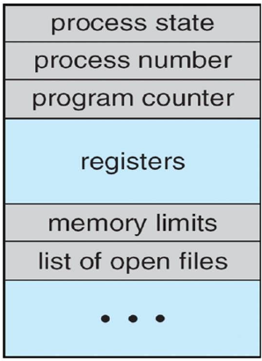
Process Control Block (PCB)
It is a data structure in OS that contains information associated with each process (also called task control block/task descriptor)
A PCB is created in the kernel whenever a new process is started.
A PCB will include:
Process ID and State
CPU register and Program counter
CPU scheduling and Memory management Information
Accounting and I/O status Information

Slide 13
A Process ID (PID): Every process is assigned a unique id
Process state – It stores the respective state of the process.
Program counter – contains the address of the next instruction
CPU registers – contents of all process-centric registers
CPU scheduling information- priorities, scheduling queue pointers
Memory-management information – memory allocated to the process
Accounting information – CPU used, clock time elapsed since start, time limits
I/O status information – I/O devices allocated to process, list of open files

Slide 14


Context Switching
Interrupts cause the operating system to change a CPU from its current task and to run a kernel routine.
When an interrupt occurs, the system need to save the current CONTEXT of the process currently running on the CPU so that it can restore that context when its processing is done, essentially suspending the process and then resuming it.
The process of changing the CPU hardware state from one process to another is called a Context Switch
This can happen 100 or 1000 times a second!
When CPU switches to another process,
The system must save the state of the old process and
Load the saved state for the new process via a context switch

Slide 15
Context of a process represented in the PCB
Context-switch time is overhead;
The system does no useful work while switching
The more complex the OS and the PCB → the longer the context switch
Time for context switch is dependent on hardware support
Some hardware provides multiple sets of registers per CPU
Multiple contexts loaded at once
Context switch time will be minimal

Slide 16
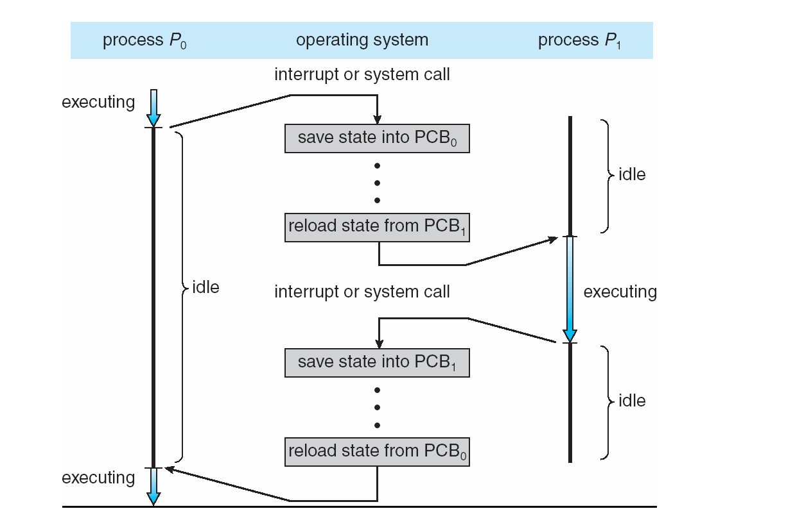
CPU Switch From Process to Process

Slide 17
Process Scheduler
The process scheduler in an operating system is responsible for managing the execution of processes by the CPU.
It decides the order in which processes are assigned CPU time, aiming to optimize performance, ensure fairness, and achieve efficient utilization of resources
The process manager’s activity is process scheduling, which involves removing the running process from the CPU and selecting another process based on a specific strategy.
Process scheduling is an essential part of a Multiprogramming operating system.

Slide 18
Objectives of Process Scheduling:
Maximizing CPU Utilization: Ensure that the CPU is always busy executing tasks and not sitting idle.
Minimizing Turnaround Time: Reduce the time taken for a process to complete from submission to termination.
Fair Allocation of Resources: Ensure all processes get fair access to CPU resources, avoiding starvation.
Maximizing Throughput: Increase the number of processes completed per unit time.

Slide 19
Types of Process Schedulers
Process schedulers are categorized based on their roles in managing the life cycle of a process:
Long-Term Scheduler (Job Scheduler)
Brings new processes to the ‘Ready’ state. It controls the degree of multiprogramming by selecting processes from the job pool.
Short-Term Scheduler (CPU Scheduler)
Selects one of the processes from the ready queue and allocates the CPU to it.
Medium-Term Scheduler
Suspends and resumes processes, effectively managing the degree of multiprogramming

Slide 20
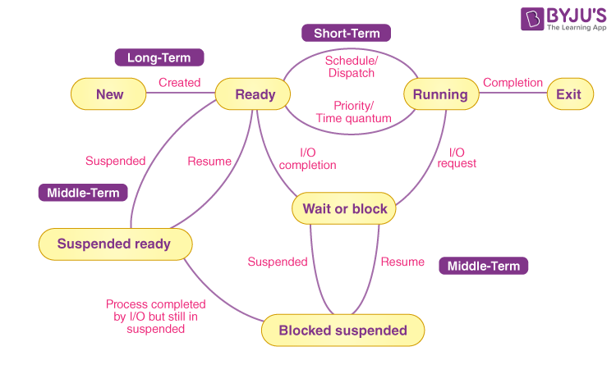

Slide 21
Thread and Multithreading
A thread is a basic unit of CPU utilization and flow of control within a process
A process might have many threads.
Thread can comprises
Thread-id, program counter, register set, and a stack.
It shares code section, data section, open files and other system resources with other threads living in the same process

Slide 22
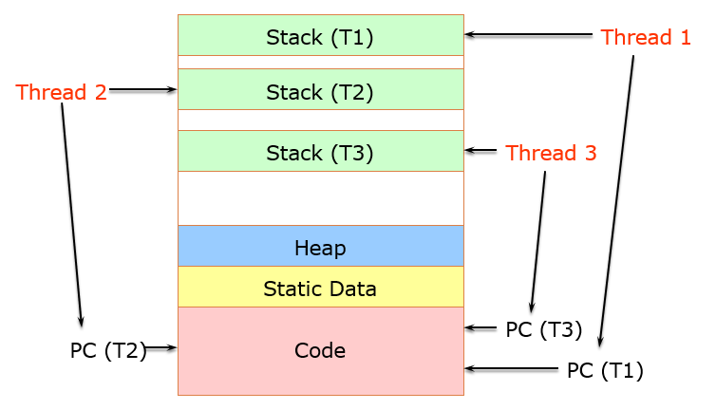
Thread in a Process

Slide 23
Threads have some of the properties of processes(also known as light weight process):
Threads share CPU and only one thread active (running) at a time.
Threads within a processes execute sequentially.
If one thread is blocked, another thread can run.
Threads are different from processes:
All threads can access every address in the task/process.
Threads are designed to assist one other (processes might be cooperating or independent)

Slide 24
Application of Thread
Threads are very useful in modern programming
For example, word processor may have a thread
For displaying graphics,
Another thread for responding to keystrokes from the user, and
A third thread for performing spelling and grammar checking in the background.
A fourth does periodic automatic backups of the file being edited.
Another example is a web server - Multiple threads allow for multiple requests to be satisfied simultaneously

Slide 25
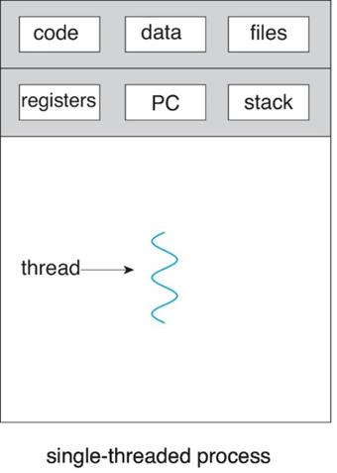
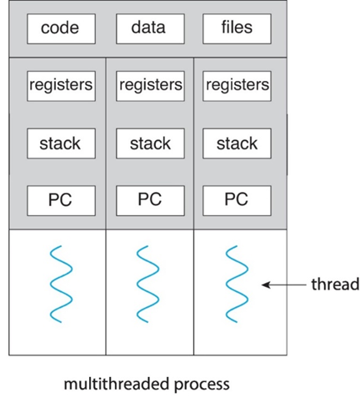
Single and Multithreaded Processes
Traditional ( heavyweight ) processes have a single thread of control
There is one program counter, and one sequence of instructions that can be carried out at any given time.
Multi-threaded applications have multiple threads within a single process, each having their own program counter, stack, and set of registers
But sharing common code, data, and certain structures, such as open files

Slide 26
Benefits of Thread
Responsiveness – may allow continued execution if part of process is blocked, especially important for user interfaces
Resource Sharing – threads share resources of process, easier than shared memory or message passing
Economy – cheaper than process creation, thread switching has lower overhead than context switching
Scalability – multithreading can take advantage of multiprocessor architectures

Slide 27
Process Synchronization
Process Synchronization is the coordination of execution of multiple processes in a multi-process system to ensure that they access shared resources in a controlled and predictable manner.
It aims to resolve the problem of race conditions and other synchronization issues in a concurrent system.
To achieve this, various synchronization techniques such as semaphores, monitors, and critical sections are used.

Slide 28
The Need for Synchronization: Example: Bank Account Balance Update
Imagine an online banking system where multiple users (or processes) can deposit or withdraw money from the same bank account simultaneously.
Here’s what might happen if synchronization is not implemented:
Initial Balance: Suppose the bank account has a balance of 100 Birr.
Simultaneous Transactions:
Process A wants to withdraw 50 Birr.
Process B wants to deposit 30 Birr.

Slide 29
Race Condition:
Both processes read the current balance ($100) at the same time.
Process A calculates the new balance after withdrawal:
100 – 50 = 50
Process B calculates the new balance after deposit:
100 + 30 = 150
Each process updates the balance with its own calculated result.
Resulting Data Inconsistency:
If Process A’s update occurs last, the balance will incorrectly show 50 Birr.
If Process B’s update occurs last, the balance will incorrectly show 130 Birr.
The correct balance after both operations should be: 100−50+30=80 Birr, but due to the race condition, we end up with an incorrect result

Slide 30
How Synchronization Prevents the Issue
Synchronization mechanisms such as locks can ensure that only one process accesses and updates the account balance at a time:
When Process A or Process B wants to update the balance, it first acquires a lock on the account.
While one process holds the lock, the other must wait until the balance update is complete and the lock is released.
This ensures that each transaction is completed before another one begins, preventing data inconsistency.

Slide 31
Race Condition
A situation where several processes manipulate the same data concurrently and the outcome of the execution depends on the particular order in which the access takes place, is called a race condition.
Example: In the bank account example, if two processes read and modify the balance concurrently without synchronization, the final balance could be incorrect due to simultaneous updates.
Race conditions can lead to data inconsistency, unpredictable behavior, and difficult-to-debug issues, especially in multithreaded or distributed systems.

Slide 32
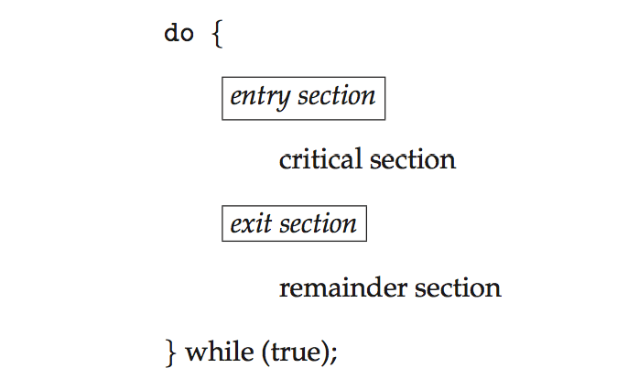
Critical Section Problem
The critical section refers to the part of a program where shared resources are accessed or modified.
The critical section problem is to ensure that only one process or thread can execute in its critical section at any given time to prevent race conditions.

Slide 33
A solution to the critical-section problem must satisfy the following three requirements:
Mutual Exclusion: Only one process can be in the critical section at a time.
This prevents concurrent access to shared resources, avoiding data conflicts.
Progress: If no process is in the critical section, a process waiting to enter should be allowed to do so without unnecessary delays.
This ensures that processes don't wait indefinitely for access to the critical section.
Bounded Waiting: A process should not have to wait indefinitely to enter its critical section.
There should be a bound on how many times other processes can enter the critical section before a waiting process gets its turn.

Slide 34
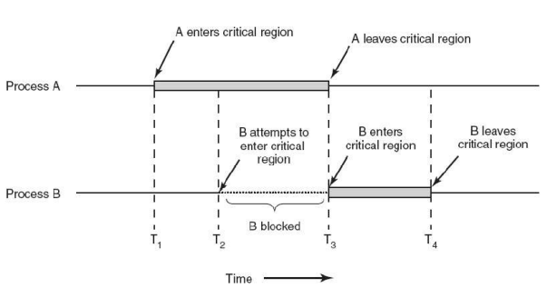
How synchronization looks like ?

Slide 35
Solutions to the Critical Section Problem
To prevent race conditions in the critical section, several synchronization mechanisms are used:
Peterson’s Solution
Locks
Semaphores
Monitors
Mutexes . . .

Slide 36
Inter Process Communication (IPC)
Processes within a system may be independent or cooperating
Cooperating process can affect or be affected by other processes, including sharing data
Independent process cannot affect or be affected by the execution of another process
Reasons for cooperating processes (Advantages):
Computation speedup
By overlapping activities or performing work in parallel
Modularity
Better code structure and hence easier to work with

Slide 37
Convenience
Even an individual user may work on many tasks at the same time. For instance, editing, listening to music, and compiling in parallel.
Information sharing
Providing concurrent access to shared information for all users interested in that information
Issues:
How do the processes communicate?
How do the processes share data?

Slide 38
Cooperating processes need inter-process communication (IPC) mechanism
Message passing
Pipes
Message Queues
Shared Memory
Sockets . . .

Slide 39
Questions?

Slide 40
Assignment-2
Topics:
Solutions to the Critical Section Problem
To prevent race conditions in the critical section, several synchronization mechanisms: Peterson’s Solution, Locks, Semaphores, Monitors, Mutexes . . .
Inter-process communication (IPC)
Cooperating processes need inter-process communication (IPC) mechanism: Message passing, Pipes, Message Queues, Shared Memory, Sockets . . .
Note
You are required to prepare a 10-minute presentation covering the above topics. Please ensure that your presentation consists of a maximum of 10 slides.

Slide 41
Thank You

