Slide 1


CPU Scheduling and Deadlock
Chapter Five
CA_OS- CH5 – CPU Scheduling and Deadlock

Slide 2
CH-5 Contents
Introduction
CPU scheduling objectives and criteria
Scheduling algorithms
Algorithms Evaluation
Deadlocks
Methods for handling deadlocks

Slide 3
Brainstorm Questions
What is CPU scheduling, and why is it essential in a multi-programming environment?
Why might an operating system need to prioritize certain processes over others, and what are some ways to achieve this?
How does the First-Come, First-Served (FCFS) scheduling algorithm work, and what are its advantages and disadvantages?
What is a deadlock, and how does it differ from simple resource contention?

Slide 4
CH-5 Contents
Introduction
CPU scheduling objectives and criteria
Scheduling algorithms
Algorithms Evaluation
Deadlocks
Methods for handling deadlocks

Slide 5
Introduction
In a multi-programmed computer, multiple processes or threads often compete for CPU time.
This happens when two or more are in the ready state simultaneously.
If only one CPU is available, the system must decide which process to run next.
This decision-making process is called scheduling.
CPU Scheduling is a task of selecting a process/thread from a ready queue and assigning it to the CPU for execution
This is done by a scheduler also called dispatcher, and the algorithm it uses is called the scheduling algorithm.

Slide 6
Types of Scheduler
Non-Preemptive Scheduler:
A process keeps the CPU until it voluntarily releases it, such as completing execution or waiting for I/O.
Preemptive Scheduler:
A process can be interrupted and descheduled at any time, allowing the CPU to be reassigned to another process.
When to Perform Scheduling?
New Job Arrival: A new job is submitted and needs CPU allocation.
Job Completion: The currently running job finishes its execution.
Job Blocking: The running job is blocked and cannot continue execution.
I/O Interrupt: An I/O operation completes, making some processes ready to run.
Timer interrupt
Every 10 milliseconds (Linux 2.4)
Every 1 millisecond (Linux 2.6)

Slide 7
Terminologies Used in CPU Scheduling
Arrival Time(AT): Time at which the process arrives in the ready queue.
Burst Time(BT): Time required by a process for CPU execution.
Completion Time(CT): Time at which process completes its execution.
Turn Around Time(TAT): Time Difference between completion time and arrival time.
Turn Around Time = Completion Time – Arrival Time
Waiting Time(WT): Time Difference between turn around time and burst time.
Waiting Time = Turn Around Time – Burst Time

Slide 8
CH-5 Contents
Introduction
CPU scheduling objectives and criteria
Scheduling algorithms
Algorithms Evaluation
Deadlocks
Methods for handling deadlocks

Slide 9
CPU Scheduling Objectives and Criteria
CPU Scheduling Objectives
Fairness: Distribute CPU access fairly to minimize wait times and prevent starvation.
Priority Handling: Schedule processes by priority, with critical tasks given precedence.
Efficiency: Maximize CPU use by reducing idle time and optimizing resource allocation.
Encourage Good Behavior: Incentivize efficient processes that release resources promptly.
Graceful Degradation Under Heavy Load: Ensure stable performance under heavy load, with smooth degradation.
Adaptability: Tailor scheduling to meet the demands of various workloads (e.g., interactive, real-time).

Slide 10
CPU Scheduling/ Performance Criteria
There are several different criteria to consider when trying to select the "best" scheduling algorithm for a particular situation and environment, including:
CPU utilization – keep the CPU as busy as possible
Throughput – # of processes that complete their execution per time unit
Turnaround time – The interval from the time of submission of a process to the time of completion.
Sum of the periods spent waiting to get into memory, waiting in the ready queue, executing on the CPU, and doing I/O.
Waiting time – amount of time a process has been waiting in the ready queue
Response time – amount of time it takes from when a request was submitted until the first response is produced, not output (for time-sharing environment)

Slide 11
Different Systems, Different Focuses
Batch Systems (e.g., billing, accounts receivable, accounts payable, etc.)
Max throughput, max CPU utilization
Interactive Systems (e.g., our PC)
Min. response time
Real-time system (e.g., airplane, Flight Control has strictly higher priority than Environmental Control)
Priority, meeting deadlines

Slide 12
CH-5 Contents
Introduction
CPU scheduling objectives and criteria
Scheduling algorithms
Algorithms Evaluation
Deadlocks
Methods for handling deadlocks

Slide 13
Scheduling Algorithms
First Come First Serve (FCFS)
Short Job First (SJF)
Shortest Remaining Time First(SRTF)
Priority Scheduling
Round Robin
Multi-level Queue
Multi-Level Feedback
Rate monotonic Scheduling
Earliest Deadline First Scheduling
Batch
Systems
Interactive
Systems
Real-time
Systems

Slide 14
Gantt Chart
A visual representation that shows how processes or jobs are scheduled and executed over time on the CPU.
Example:
Process A: 10 units of time
Process B: 2 units of time
Process C: 4 units of time
A
B
C
0
10
12
16
Time

Slide 15
First- Come, First-Served (FCFS) Scheduling
It is a simple, non-preemptive scheduling algorithm where processes are executed in the order they arrive in the ready queue.
Key Characteristics of FCFS:
Order of Execution: The first process to enter the queue is the first to get the CPU.
Non-Preemptive: Once a process starts executing, it runs until completion without interruptions.
Easy to Implement: Simple to manage as it only requires tracking process arrival order.

Slide 16
Example:
Consider the processes P1, P2, P3 given in the below table, arrives for execution in the same order, with Arrival Time 0, and given Burst Time,
Process Burst Time
P₁ 24
P₂ 3
P₃ 3
The Gantt Chart for the schedule is:
Waiting time for P₁ = 0; P₂ = 24; P₃ = 27
Average waiting time: (0 + 24 + 27)/3 = 17

Slide 17
Suppose that the processes arrive in the order:P₂, P₃, P₁
The Gantt chart for the schedule is
Waiting time for P1 = 6; P2 = 0; P3 = 3
Average waiting time: (6 + 0 + 3)/3 = 3
Much better than previous case

Slide 18
FCFS is suitable for batch processing systems where execution order is based on arrival and where predictability is more important than efficiency or responsiveness.
Advantages:
Simplicity: Easy to implement with a straightforward queue structure.
Fairness in Order: Processes are treated in the order of arrival, which is fair on a first-come basis.
Disadvantages:
Convoy Effect: Shorter processes can get stuck behind longer ones, leading to increased waiting time.
High Average Waiting Time: Due to the convoy effect, average waiting time can be higher compared to other algorithms.

Slide 19
Shortest-Job-First (SJF) Scheduling
It selects the process with the shortest estimated burst time (execution time) for execution next.
It can be implemented in two ways:
Preemptive (Shortest Remaining Time First) and
Non-preemptive
Key Characteristics of SJF (Shortest Job Next-SJN):
Order of Execution: Processes with shorter burst times are prioritized.
Optimal for Waiting Time: Minimizes average waiting time as shorter tasks complete quickly.

Slide 20
Example
ProcessAa l TimeBurst Time
P₁ 0.0 6
P₂ 2.0 8
P₃ 4.0 7
P₄ 5.0 3
SJF scheduling chart
Average waiting time = (3 + 16 + 9 + 0) / 4 = 7

Slide 21

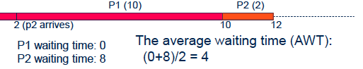
SJF is not always optimal
Is SJF optimal if not all the processes are available simultaneously?

Slide 22
What if both arrived simultaneously ?
P1 waiting time: 2-0=2
P2 waiting time: 0-0=0
The average waiting time: (2+0)/2=1
P2
P1
0
2
12

Slide 23
SJF is ideal in environments where processes can be easily estimated in advance, such as batch processing systems.
However, it’s less practical for general-purpose systems due to the difficulty in predicting burst times accurately.
Advantages:
Low Average Waiting Time: SJF achieves the lowest average waiting time of all scheduling algorithms when implemented ideally.
Efficiency: Short processes complete faster, increasing system throughput.
Disadvantages:
Requires Burst Time Prediction: Accurate burst time estimation is difficult, and errors can affect performance.
Risk of Starvation: Long processes may wait indefinitely if shorter processes keep arriving (especially in preemptive SJF).

Slide 24
Shortest-Remaining-Time-First (SRTF)
It is a preemptive version of the Shortest Job First (SJF) scheduling algorithm.
In SRTF, the CPU always selects the process with the shortest remaining execution time to run next, even if it means interrupting an ongoing process.
Key Characteristics of SRTF:
Preemptive: If a new process arrives with a shorter remaining time than the current process, the current process is preempted.
Focus on Remaining Time: Prioritizes processes based on how much time they have left until completion.

Slide 25
Example
Now we add the concepts of varying arrival times and preemption to the analysis
Process Arrival Time Burst Time
P1 0 8
P2 1 4
P3 2 9
P4 3 5
SRTF Gantt Chart

Slide 26
Average waiting time
WT for P1: (0-0) + (10-1)=9
WT for P2= 1 – 1= 0
WT for P3: 17 – 2= 15
WT for P4: 5-3= 2
Therefore, the AWT :
[(10-1)+(1-1)+(17-2)+5-3)]/4 = 26/4 = 6.5

Slide 27
SRTF is suitable for time-sensitive applications where quick response is needed, and process burst times are known or can be estimated.
However, due to its complexity and risk of starvation, it is less commonly used in general-purpose systems.
Advantages:
Minimizes Average Waiting Time: Achieves very low waiting times by allowing shorter tasks to complete sooner.
Responsive for Short Tasks: Short tasks are quickly executed, increasing responsiveness.
Disadvantages:
High Overhead: Frequent context switches can increase CPU overhead.
Starvation Risk: Long processes may face starvation if shorter processes keep arriving.

Slide 28
Exercise-1
Consider the set of 5 processes (P1, P2, P3, P4, P5 ) whose arrival time and burst time are given below
Process Id | Arrival Time | Burst Time
P1 | 3 | 1
P2 | 1 | 4
P3 | 4 | 2
P4 | 0 | 6
P5 | 2 | 3

Slide 29
Draw three Gantt charts that illustrate the execution of these processes using the following scheduling algorithms: FCFS, SJF, and SRJF?
Determine the turnaround time for each process under each scheduling algorithm.
Determine the waiting time for each process under each scheduling algorithm
Identify which algorithm yields the minimum average waiting time across all processes.
Compute the total throughput for the system, which is the number of processes completed per unit of time.

Slide 30
Priority Scheduling
It is a CPU scheduling algorithm that selects processes based on priority levels.
Each process is assigned a priority, and the CPU is allocated to the process with the highest priority. (smallest integer highest priority)
Key Characteristics of Priority Scheduling:
Priority-Based: Processes are scheduled according to their priority levels, with higher-priority processes being served first.
Preemptive or Non-Preemptive: In preemptive Priority Scheduling, a running process can be interrupted if a higher-priority process arrives. In non-preemptive scheduling, a process completes its burst before the CPU moves to a higher-priority process.

Slide 31

Example of Priority Scheduling
Process Burst Time Priority
P1 10 3
P2 1 1
P3 2 4
P4 1 5
P5 5 2
Priority scheduling Gantt Chart
Average waiting time = 8.2

Slide 32
Priority Scheduling is useful in systems where certain processes require immediate attention, such as real-time or interactive systems where critical tasks must run promptly
Advantages:
Important Tasks First: Ensures that critical or high-priority tasks are executed before others.
Flexible for Various Needs: Allows customization for different process requirements based on priority levels.
Disadvantages:
Risk of Starvation: Lower-priority processes may wait indefinitely if higher-priority tasks keep arriving.
Solution to Starvation: Aging: Gradually increases the priority of processes waiting in the queue for a long time, preventing starvation.
Complexity in Priority Assignment: Assigning accurate priorities to processes can be challenging, and improper assignment can impact performance.

Slide 33
Round Robin (RR)
It is a preemptive CPU scheduling algorithm designed for time-sharing systems.
Each process is assigned a fixed time slice (or quantum) during which it can execute.
If the process doesn’t finish within its time slice, it is moved to the end of the ready queue, and the CPU is allocated to the next process.
Key Characteristics of Round Robin:
Time Slice: Each process gets a fixed amount of CPU time in a cyclic order.
Preemptive: If a process doesn't complete within its allocated time, it is preempted and returned to the ready queue.

Slide 34
Example of RR with Time Quantum = 4
Process Burst Time
P1 24
P2 3
P3 3
The Gantt chart is:
Typically, higher average turnaround than SJF, but better response
q should be large compared to context switch time
q usually 10ms to 100ms, context switch < 10 usec

Slide 35
Round Robin is widely used in time-sharing and interactive systems, where responsiveness and fairness are important.
It’s suitable for environments where all processes are of equal priority.
Advantages:
Fairness: Every process gets an equal opportunity to execute, making it ideal for interactive systems.
Low Waiting Time for Short Processes: Shorter processes finish faster because they are guaranteed CPU access within a fixed interval.
Disadvantages:
High Context-Switching Overhead: Frequent context switches can reduce CPU efficiency, especially with a small time slice.
Performance Depends on Quantum Size:
If the quantum is too large, it behaves like FCFS, leading to longer response times.
If the quantum is too small, context-switching overhead becomes significant

Slide 36
Multilevel Queue Scheduling
It is a CPU scheduling algorithm that divides the ready queue into multiple separate queues, each with a predefined priority or category.
Processes are permanently assigned to a queue based on their characteristics, such as priority, process type (foreground/background), or resource requirements.
Key Characteristics of Multilevel Queue Scheduling:
Multiple Queues: Each queue represents a different type of process (e.g., system processes, interactive processes, batch processes).
Fixed Queue Priority: Queues have a fixed priority order, meaning processes in higher-priority queues are executed before those in lower-priority queues.
Scheduling Within Queues: Each queue can have its own scheduling algorithm (e.g., FCFS for one queue, Round Robin for another).

Slide 37
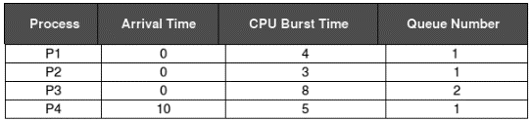

Example Multilevel Queue Scheduling
Consider the below table of four processes under Multilevel queue scheduling. Queue number denotes the queue of the process.
Priority of queue 1 is greater than queue 2.
queue 1 uses Round Robin (Time Quantum = 2) and queue 2 uses FCFS.
Below is the Gantt chart of the problem:

Slide 38
Multilevel Queue Scheduling is ideal for systems with distinctly different types of processes, such as operating systems handling system, interactive, and batch tasks simultaneously.
It ensures a tailored approach to scheduling, improving overall system performance.
Example:
Queue 1 (Highest Priority): System processes (Round Robin with a small time quantum).
Queue 2: Interactive processes (Round Robin with a larger time quantum).
Queue 3 (Lowest Priority): Batch processes (FCFS scheduling).

Slide 39
Advantages:
Specialized Handling: Different scheduling algorithms for different types of processes optimize performance.
Predictability: High-priority tasks are guaranteed CPU access, ensuring critical tasks are not delayed.
Disadvantages:
Rigid Assignment: Processes are permanently assigned to a queue, which can lead to inefficiency if priorities or requirements change during execution.
Starvation Risk: Lower-priority queues may face starvation if higher-priority queues are consistently busy.

Slide 40
Multilevel Feedback Queue Scheduling
It is an advanced CPU scheduling algorithm that allows processes to move between multiple queues based on their behavior or execution characteristics.
Unlike Multilevel Queue Scheduling, where processes are permanently assigned to a queue, this algorithm dynamically adjusts a process's priority and queue placement.
Key Characteristics of Multilevel Feedback Queue Scheduling:
Multiple Queues: Each queue typically has a different priority level and scheduling algorithm (e.g., shorter time quantum in higher-priority queues).
Dynamic Movement: Processes can move between queues based on factors like CPU burst time, wait time, or system requirements.
Aging Mechanism: Prevents starvation by promoting long-waiting processes to higher-priority queues.

Slide 41
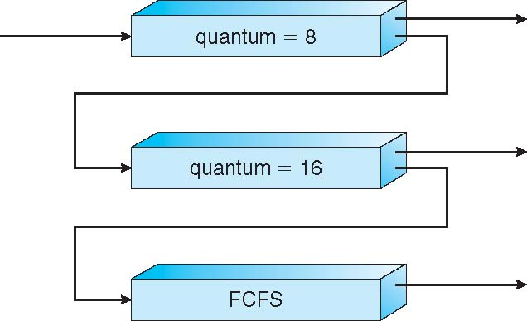
Example:
A system has three queues, Q0, Q1, and Q2.
Q0 is the highest priority queue and uses Round-Robin scheduling with a time quantum of 8 milliseconds.
Q1 uses Round-Robin scheduling with a time quantum of 16 milliseconds, and
Q2 uses First-Come-First-Serve (FCFS) scheduling.
New processes are assigned to Q0, and their priority decreases as they spend more time in the system.
If a process completes its time quantum in Q0, it is moved to Q1. If it completes its time quantum in Q1, it is moved to Q2

Slide 42
Multilevel Feedback Queue Scheduling is suitable for environments with diverse workloads, such as operating systems supporting interactive, real-time, and batch processes.
Its adaptability makes it a powerful choice for systems requiring fairness and efficiency.
Example:
Queue 1 (Highest Priority): Shortest time quantum for quick responsiveness, suitable for interactive tasks.
Queue 2: Larger time quantum for longer tasks.
Queue 3 (Lowest Priority): FCFS for batch processes that don't require immediate attention.
Process Movement:
A CPU-bound process may be demoted to a lower-priority queue due to longer bursts.
An I/O-bound process may be promoted to a higher-priority queue for faster execution.

Slide 43
Advantages:
Flexibility: Dynamically adapts to process behavior, ensuring better responsiveness for short tasks while efficiently handling long tasks.
Starvation Avoidance: Aging ensures that no process is indefinitely stuck in lower-priority queues.
Optimized Performance: Combines the benefits of multiple scheduling algorithms.
Disadvantages:
Complexity: Difficult to implement and configure due to the dynamic nature and multiple parameters.
Overhead: Managing queue transitions and determining priorities introduces additional overhead.

Slide 44
Rate Monotonic Scheduling (RMS)
It is a fixed-priority scheduling algorithm used in real-time systems. In RMS, processes (tasks) are assigned priorities based on their periodicity: the shorter the period (higher frequency), the higher the priority.
Key Characteristics of RMS:
Fixed Priority: Priorities are determined statically based on the task's period. Tasks with shorter periods (frequent execution) are given higher priority.
Preemptive: A higher-priority task can preempt a lower-priority task at any time.
Optimal for Fixed-Priority Systems: RMS is proven to be optimal among fixed-priority scheduling algorithms, meaning no other fixed-priority algorithm can schedule more tasks under the same conditions.

Slide 45
Assumptions:
Tasks are periodic, with known periods and deadlines.
Each task’s deadline is equal to its period.
Task execution times are constant and known in advance.
Context switching and preemption overhead are negligible.
Example:
Tasks:
Task A: Period = 5ms, Execution Time = 2ms.
Task B: Period = 10ms, Execution Time = 3ms.
Task C: Period = 20ms, Execution Time = 5ms.
Priority Assignment:
Task A (highest priority), Task B, Task C (lowest priority).
Execution: Task A preempts Task B or Task C whenever it arrives, ensuring it meets its deadline.

Slide 46
Rate Monotonic Scheduling is widely used in embedded systems and hard real-time systems where tasks have periodic deadlines, such as automotive control systems, avionics, and industrial automation.
It is favored for its simplicity and mathematical guarantees of schedulability.
Advantages:
Predictability: The deterministic nature of RMS makes it easier to analyze system performance.
Efficiency: RMS provides high CPU utilization for real-time systems when tasks meet the schedulability condition.
Disadvantages:
Limited Utilization: The maximum CPU utilization under RMS is bounded by Umax = n(21/n – 1) , where n is the number of tasks. For large n, Umax ~ 69.3%
Not Suitable for Aperiodic Tasks: RMS is designed only for periodic tasks and struggles with dynamic or aperiodic workloads.

Slide 47
Earliest Deadline First (EDF) Scheduling
It is a dynamic priority scheduling algorithm used in real-time systems. In EDF, the process with the earliest deadline is given the highest priority and scheduled to execute first.
Key Characteristics of EDF:
Dynamic Priority: Task priorities are determined at runtime based on their deadlines, which means priorities can change as tasks approach their deadlines.
Preemptive: Higher-priority tasks (tasks with earlier deadlines) can preempt lower-priority tasks at any time.

Slide 48
Example:
Tasks:
Task A: Deadline = 10ms, Execution Time = 4ms.
Task B: Deadline = 8ms, Execution Time = 3ms.
Task C: Deadline = 12ms, Execution Time = 2ms.
Scheduling Order:
Task B (earliest deadline), then Task A, and finally Task C.
Comparison with RMS:
EDF dynamically adjusts priorities based on deadlines, while RMS assigns fixed priorities based on periods.
EDF achieves higher CPU utilization but has more runtime overhead compared to RMS.

Slide 49
EDF is widely used in real-time systems where tasks have strict deadlines, such as multimedia streaming, robotics, and safety-critical systems in avionics and automotive applications. Its ability to handle varying workloads makes it ideal for dynamic environments.
Advantages:
Optimality: EDF is an optimal scheduling algorithm for uniprocessor systems, meaning it can schedule all feasible task sets that meet their deadlines.
High CPU Utilization: EDF can theoretically achieve 100% CPU utilization in uniprocessor systems under ideal conditions.
Disadvantages:
Complexity: EDF involves dynamic priority adjustments, which require more computational overhead compared to fixed-priority algorithms like Rate Monotonic Scheduling (RMS).
Difficult Analysis: In multiprocessor systems, analyzing EDF’s behavior and guaranteeing task deadlines can be complex.
Preemption Overhead: Frequent preemptions due to dynamic priority changes may increase overhead.

Slide 50
Multiple-Processor Scheduling
In systems containing more than one processor, multiple-processor scheduling addresses task allocations to multiple CPUs.
This will involve higher throughputs since several tasks can be processed concurrently in separate processors.
It would also involve the determination of which CPU handles a particular task and balancing loads between available processors.
Characteristics of Multiple-Processor Scheduling
Challenges and Advantages
Scheduling Algorithms for Multiple Processors . . .

Slide 51
CH-5 Contents
Introduction
CPU scheduling objectives and criteria
Scheduling algorithms
Algorithms Evaluation
Deadlocks
Methods for handling deadlocks

Slide 52
Algorithm Evaluation
It is difficult we select a CPU scheduling algorithm for a particular system because every scheduling algorithm has its own parameter.
To select an algorithm, we first decide which elements are relatively important
Some criteria may include several measures:
Maximizing CPU utilization under the constraint that the maximum response time is 1 second
Maximizing throughput such that turnaround time is (on average) linearly proportional to total execution time
Minimizing waiting time.

Slide 53
After deciding the selection criteria for analyzing the algorithms, we want to evaluate scheduling algorithms under consideration.
Here are the various evaluation methods:
Deterministic modeling
Queuing models
Simulation
implementation

Slide 54
CH-5 Contents
Introduction
CPU scheduling objectives and criteria
Scheduling algorithms
Algorithms Evaluation
Deadlocks
Methods for handling deadlocks

Slide 55
Deadlocks
A system consists of a finite number of resources to be distributed among a number of competing processes
Resource types R₁, R₂, . . ., R_{m}
CPU cycles, memory space, I/O devices
Each process utilizes a resource as follows:
Request: the process requests the resource. If the request cannot be granted immediately then the requesting process must wait until it can acquire the resource.
Use: the process can operate on the resource (for example, if the resource is a printer, the process can print on the printer).
Release: the process releases the resource

Slide 56

In a multiprogramming system, processes request resources.
If those resources are being used by other processes then the process enters a waiting state. However, if other processes are also in a waiting state, we have deadlock.
The formal definition of deadlock is as follows:
A set of processes is in a deadlock state if every process in the set is waiting for an event (release) that can only be caused by some other process in the same set.
Example

Slide 57
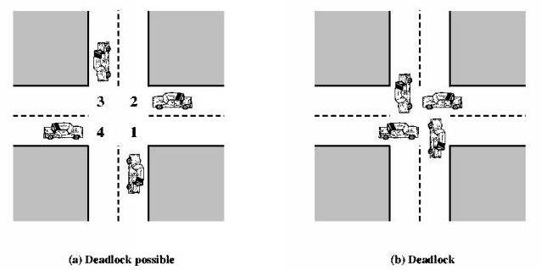
We shall analyze deadlocks with the following assumptions:
A process must request a resource before using it.
It must release the resource after using it. (request → use → release)
A process cannot request a number more than the total number of resources available in the system.

Slide 58
Deadlock Characterization
Deadlock can arise if four conditions hold simultaneously.
Mutual exclusion: only one process at a time can use a resource
Hold and wait: a process holding at least one resource is waiting to acquire additional resources held by other processes
No preemption: a resource can be released only voluntarily by the process holding it, after that process has completed its task
Circular wait: there exists a set {P0, P1, …, Pn} of waiting processes such that P0 is waiting for a resource that is held by P1, P1 is waiting for a resource that is held by P2, …, Pn–1 is waiting for a resource that is held by Pn, and Pn is waiting for a resource that is held by P0.

Slide 59
Resource Allocation Graph(RAG): is a directed graph used to model deadlock
It has a set of vertices V and a set of edges E.
Vertices (V) is partitioned into two types:
P = {P₁, P₂, …, P_{n}}, the set consisting of all the processes in the system
R = {R₁, R₂, …, R_{m}}, the set consisting of all resource types in the system
Edge (E) are of two types
Request edge – directed edge P_{i} → R_{j}
Assignment edge – directed edge R_{j}→ P_{i}

Slide 60
Process
Resource Type with 4 instances
P_{i} requests instance of R_{j}
P_{i} is holding an instance of R_{j}
P_{i}
P_{i}

Slide 61
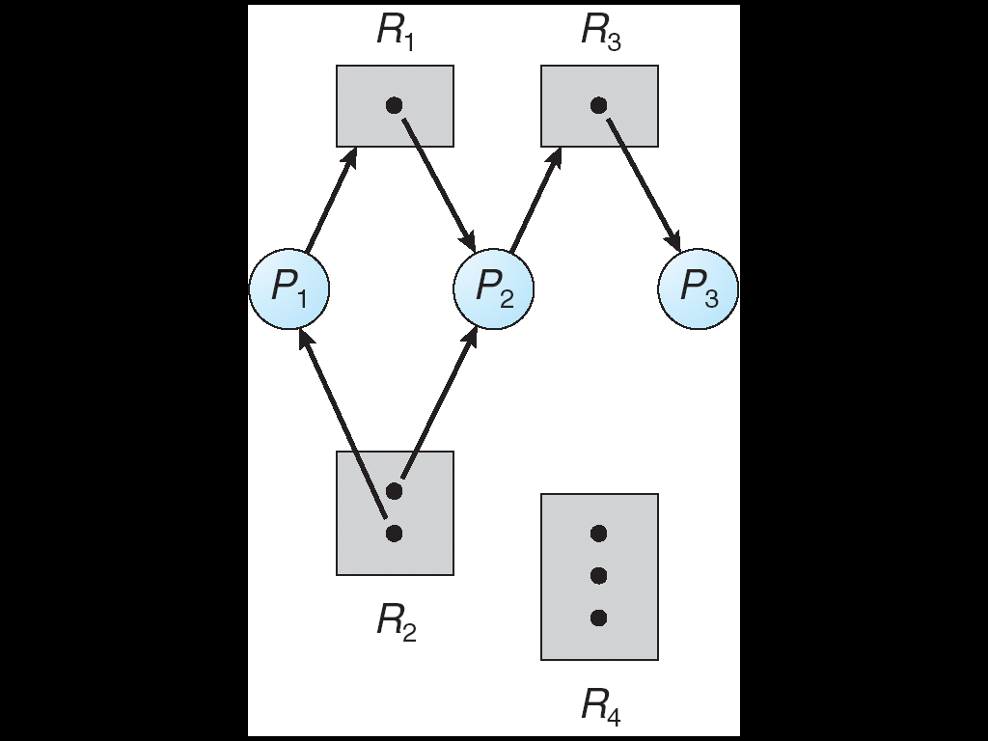
The following RAG depicts the following situation.
The sets P, R, and E:
P={P₁, P₂, P₃}
R={R₁, R₂, R₃, R₄}
E={P₁→R₁, P₂→R₃, R₁→P₂, R₂→P₂, R₂→P₁, R₃→P₃}
One instance of R1
Two instances of R2
One instance of R3
Three instance of R4
P1 holds one instance of R2 and is waiting for an instance of R1
P2 holds one instance of R1, one instance of R2, and is waiting for an instance of R3
P3 is holds one instance of R3

Slide 62
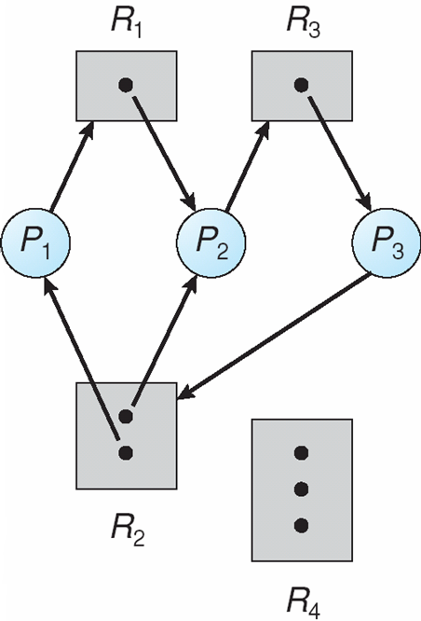
If the resource allocation graph contains no cycles then there is no deadlock in the system at that instance.
If the resource allocation graph contains a cycle then a deadlock may exist.
If there is a cycle, and the cycle involves only resources which have a single instance, then a deadlock has occurred
There exist two cycles
P₁→R₁→P₂→R₃→P₃→R₂→P₁
P₂→R₃→P₃→R₂→P₂

Slide 63
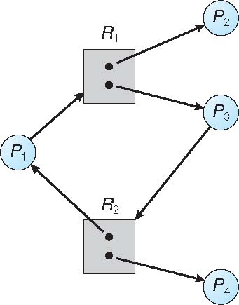
Graph With A Cycle But No Deadlock
Here also we have a cycle
P1→R1→P3→R2→P1
But no deadlock since
Process P4 may release its instance of resource type R2 and that resource can then be allocated to P3, breaking the cycle.
Process P2 may release its instance of resource type R1 and that resource can then be allocated to P1, breaking the cycle.

Slide 64
CH-5 Contents
Introduction
CPU scheduling objectives and criteria
Scheduling algorithms
Algorithms Evaluation
Deadlocks
Methods for handling deadlocks

Slide 65
Methods for handling deadlocks
There are four approaches to deal with deadlocks.
Deadlock Ignorance: Pretend as if there is no deadlock
Deadlock Prevention
Negating one of the four necessary condition
Deadlock Avoidance
Careful resource allocation
Ensure that the system will never enter a deadlock state:
Deadlock Detection and Recovery
Allow the system to enter a deadlock state and then recover

Slide 66
Deadlock Ignorance
The OS acts like the deadlock never occurs and completely ignores it even if the deadlock occurs.
This method only applies if the deadlock occurs very rarely and the cost of prevention is high.
The algorithm is very simple. It says, ” if the deadlock occurs, simply reboot the system and act like the deadlock never occurred.” That’s why the algorithm is called the Ostrich Algorithm.
UNIX and Windows takes this approach for some of the more complex resource relationships to manage

Slide 67
Advantages
Ostrich Algorithm is relatively easy to implement and is effective in most cases.
It helps in avoiding the deadlock situation by ignoring the presence of deadlocks.
Disadvantages
Ostrich Algorithm does not provide any information about the deadlock situation.
It can lead to reduced performance of the system as the system may be blocked for a long time.

Slide 68
Deadlock Prevention
Design the system in such a way that the possibility of deadlock is excluded.
To prevent the system from deadlocks violate one of the four conditions at any time then the deadlock can never occur in the system
Mutual exclusion
Hold and wait
No pre-emption
Circular Wait

Slide 69
Eliminating Mutual Exclusion:
If possible, resources should be made shareable so that multiple processes can use them concurrently without conflict.
This is often not possible for physical resources like printers, but may be applicable for resources like memory or file systems.
Eliminating Hold and Wait:
Processes are required to request all the resources they will need at once, before starting their execution.
This way, they do not hold any resources while waiting for others.
This approach can lead to resource underutilization and inefficiency, but it prevents hold and wait.
Alternatively, processes may release all resources they currently hold before requesting new ones.

Slide 70
Eliminating No Preemption:
If a process is holding resources and requesting others that are not available, the system may preempt resources from the process (i.e., forcibly take resources away from it).
The preempted resources are then given to the requesting process, and the preempted process must restart its execution later.
This method works well with resources that can be easily saved and restored, such as CPU time, memory, or registers.
Eliminating Circular Wait:
A circular wait can be avoided by imposing a strict ordering on the resources.
If each process is required to request resources in a predefined order, it is impossible for a circular chain of waiting processes to form.
This strategy ensures that processes acquire resources in a way that prevents cycles in the resource allocation graph.

Slide 71
Deadlock Avoidance
This approach requires that the system has some additional a priori information available
Simplest and most useful model requires that each process declare the maximum number of resources of each type that it may need
The deadlock-avoidance algorithm dynamically examines the resource-allocation state to ensure that there can never be a circular-wait condition
Resource-allocation state ( safe or unsafe) is defined by
The number of available resources
The number of allocated resources, and
The maximum resource demands of the processes

Slide 72
When a process requests an available resource, system must decide if immediate allocation leaves the system in a safe state.
Safe State: is safe if the system can allocate resources to each process in some order (up to its maximum requirement) while avoiding a deadlock.
Unsafe State: If the operating system is unable to prevent processes from requesting resources, resulting in Deadlock, then the system is said to be in an Unsafe State.
Unsafe State may lead to a deadlock.

Slide 73
Example
Consider a system with 12 tape drives, allocated as follows.
Is this a safe state? What is the safe sequence?
Yes it is in safe state, since
The sequence <P1, P0, P2> satisfies the safety condition.
What happens to the above table if process P2 requests and is granted one more tape drive?
 | Maximum Needs | Current Allocation
P0 | 10 | 5
P1 | 4 | 2
P2 | 9 | 2

Slide 74
Deadlock Avoidance can be solved by two different algorithms:
Resource allocation Graph
Single instance of a resource type
Banker’s Algorithm
Multiple instances of a resource type

Slide 75
A Resource Allocation Graph (RAG)
It is a directed graph used to represent the allocation of resources to processes in an operating system.
It is particularly useful for detecting and analyzing deadlocks.
Resource Allocation Graph for a Single Instance of a Resource Type:
In the case of a single instance of each resource type, the graph has the following elements:
Nodes:
Processes (P): Represented as circles (e.g., P1,P2).
Resources (R): Represented as rectangles (e.g., R1,R2)

Slide 76
Edges:
Request Edge (P → R): A directed edge from a process P to a resource R indicates that the process is requesting the resource.
Assignment Edge (R → P): A directed edge from a resource R to a process P indicates that the resource is allocated to the process.
Claim edge (P-->R): indicates that process P may request resource R at some point in the future.
When 𝑃 actually requests 𝑅, the claim edge is converted into a request edge.
If 𝑅 is allocated to 𝑃, the request edge becomes an assignment edge.
Deadlock Detection:
If the graph contains a cycle, a deadlock exists because the processes involved are waiting for resources held by each other in a circular dependency.

Slide 77
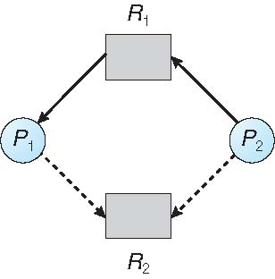
What happens if process P2 requests resource R2 and that request is granted ?

Slide 78
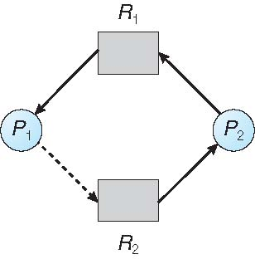
Unsafe State In Resource-Allocation Graph
The resulting resource-allocation graph would have a cycle in it, and so the request cannot be granted.
NOTE
Suppose that process P_{i} requests a resource R_{j} , the request can be granted only iff
Converting the request edge to an assignment edge does not result in the formation of a cycle in the resource allocation graph

Slide 79
Advantages:
Easy-to-understand graph representation of resources and process relationships.
Helps identify deadlocks in systems with a single instance of resources.
Quick to analyze resource usage and dependencies.
Disadvantage:
Becomes complex as the system grows.
Less effective in systems with multiple instances of resources.
Difficult to maintain with frequent resource request/allocations.

Slide 80
Banker’s Algorithm
It is a deadlock avoidance method designed for resources with multiple instances.
It requires each process to declare its maximum resource needs before execution.
When a process requests resources, it may be asked to wait if granting the request would leave the system in an unsafe state.
Once all its requested resources are allocated, the process is expected to release them within a finite period.

Slide 81
Data Structures for the Banker’s Algorithm
Let n = number of processes, and m = number of resources types.
Available: Vector of length m. If Available [j] = k, there are k instances of resource type Rj available
Max: n x m matrix. If Max [i,j] = k, then process Pi may request at most k instances of resource type Rj
Allocation: n x m matrix. If Allocation[i,j] = k then Pi is currently allocated k instances of Rj
Need: n x m matrix. If Need[i,j] = k, then Pi may need k more instances of Rj to complete its task
Need [i,j] = Max[i,j] – Allocation [i,j]

Slide 82
Safety Algorithm
Let Work and Finish be vectors of length m and n, respectively. Initialize:
Work = Available
Finish [i] = false for i = 0, 1, …, n- 1
Find an i such that both:
Finish [i] = false && Need_{i} <= Work
If no such i exists, go to step 4
Work = Work + Allocation
Finish[i] = true
go to step 2
If Finish [i] == true for all i, then the system is in a safe state and unsafe otherwise

Slide 83
Resource-Request Algorithm for Process P_{i}
Request_{i} = request vector for process P_{i}.
If Requesti [j] = k then process Pi wants k instances of resource type Rj
If Request_{i} <= Need_{i} go to step 2. Otherwise, raise error condition, since process has exceeded its maximum claim
If Request_{i} <= Available, go to step 3. Otherwise Pi must wait, since resources are not available
Pretend to allocate requested resources to Pi by modifying the state as follows:
Available = Available – Request_{i};
Allocation_{i} = Allocation_{i} + Request_{i};
Need_{i} = Need_{i} – Request_{i};
Run the safety algorithm then
If safe ➔ the resources are allocated to Pi
If unsafe ➔ Pi must wait, and the old resource-allocation state is restored

Slide 84
Example: Considering a system with
5 processes P₀ through P₄;
3 resource types:
A (10 instances)
B (5instances), and
C (7 instances)
Suppose at time t₀ following snapshot of the system has been taken:
Process | Alloc |  |  |  | Max |  |  |  |  | Available
 | A | B | C |  | A | B | C |  |  | A | B | C
P0 | 0 | 1 | 0 |  | 7 | 5 | 3 |  |  | 3 | 3 | 2
P1 | 2 | 0 | 0 |  | 3 | 2 | 2
P2 | 3 | 0 | 2 |  | 9 | 0 | 2
P3 | 2 | 1 | 1 |  | 2 | 2 | 2
P4 | 0 | 0 | 2 |  | 4 | 3 | 3

Slide 85
Q1: What will be the content of the Need matrix?
Need [i, j] = Max [i, j] – Allocation [i, j] So, the content of Need Matrix is:
Process |  | Need |  |  |  |  | Available
 |  | A | B | C |  |  | A | B | C
P0 |  | 7 | 4 | 3 |  |  | 3 | 3 | 2
P1 |  | 1 | 2 | 2
P2 |  | 6 | 0 | 0
P3 |  | 0 | 1 | 1
P4 |  | 4 | 3 | 1

Slide 86
Q2: Is the system in a safe state? If Yes, then what is the safe sequence?
Applying the Safety algorithm on the given system,
Find a process whose need is less than available and modify available as available plus allocation
If succeeded for all Processes, then it is in safe sate
For this particular case, the system is in a safe state since the sequence < P1, P3, P4, P2, P0> satisfies safety criteria

Slide 87
Q3: What will happen if process P1 requests (1,0,2)?
To decide whether the request is granted we use Resource-Request algorithm
Process | Alloc |  |  |  | Need |  |  |  |  | Available
 | A | B | C |  | A | B | C |  |  | A | B | C
P0 | 0 | 1 | 0 |  | 7 | 4 | 3 |  |  | 2 | 3 | 0
P1 | 3 | 0 | 2 |  | 0 | 2 | 0
P2 | 3 | 0 | 2 |  | 6 | 0 | 0
P3 | 2 | 1 | 1 |  | 0 | 1 | 1
P4 | 0 | 0 | 2 |  | 4 | 3 | 1

Slide 88
We must determine whether this new system state is safe. To do so, we again execute Safety algorithm
So P1 Allocation (1 0 2) Is Safe
Process | Alloc |  |  |  | Max |  |  |  | Need |  |  |  | Available
 | A | B | C |  | A | B | C |  | A | B | C |  | A | B | C
P0 | 0 | 1 | 0 |  | 7 | 5 | 3 |  | 7 | 4 | 3 |  | 3 | 3 | 2
P1 | 3 | 0 | 2 |  | 3 | 2 | 2 |  | 0 | 2 | 0 |  | 2 | 3 | 0
P2 | 3 | 0 | 0 |  | 9 | 0 | 2 |  | 6 | 0 | 2
P3 | 2 | 1 | 1 |  | 2 | 2 | 2 |  | 0 | 1 | 1
P4 | 0 | 0 | 2 |  | 4 | 3 | 3 |  | 4 | 3 | 1

Slide 89
Example-2
Is allocation (0 2 0) to P0 Safe?
Try to allocate 2 of resource B to P₀…
Process | Alloc |  |  |  | Max |  |  |  | Need |  |  |  | Available
 | A | B | C |  | A | B | C |  | A | B | C |  | A | B | C
P0 | 0 | 3 | 0 |  | 7 | 5 | 3 |  | 7 | 2 | 3 |  | 2 | 3 | 0
P1 | 3 | 0 | 2 |  | 3 | 2 | 2 |  | 0 | 2 | 0 |  | 2 | 1 | 0
P2 | 3 | 0 | 0 |  | 9 | 0 | 2 |  | 6 | 0 | 2
P3 | 2 | 1 | 1 |  | 2 | 2 | 2 |  | 0 | 1 | 1
P4 | 0 | 0 | 2 |  | 4 | 3 | 3 |  | 4 | 3 | 1

Slide 90
Run safety test
Try to find a process whose need is less than available
There is no one.
So Unsafe State ⟹ Do Not Enter
Return to safe state; do not allocate resource
Process | Alloc |  |  |  | Max |  |  |  | Need |  |  |  | Available
 | A | B | C |  | A | B | C |  | A | B | C |  | A | B | C
P0 | 0 | 1 | 0 |  | 7 | 5 | 3 |  | 7 | 4 | 3 |  | 2 | 3 | 0
P1 | 3 | 0 | 2 |  | 3 | 2 | 2 |  | 0 | 2 | 0
P2 | 3 | 0 | 0 |  | 9 | 0 | 2 |  | 6 | 0 | 2
P3 | 2 | 1 | 1 |  | 2 | 2 | 2 |  | 0 | 1 | 1
P4 | 0 | 0 | 2 |  | 4 | 3 | 3 |  | 4 | 3 | 1

Slide 91
The Banker’s Algorithm prevents deadlocks by ensuring resource allocation keeps the system in a safe state.
Advantages
Ensures deadlock avoidance.
Supports systems with multiple resource instances.
Efficient for systems with known resource requirements.
Disadvantages
Requires processes to declare maximum needs upfront.
Introduces computational overhead due to safety checks.
May cause delays or starvation for low-priority processes.

Slide 92
Deadlock Detection and Recovery
If a system has no deadlock prevention and no deadlock avoidance scheme, then it needs a deadlock detection scheme with recovery from deadlock capability.
For this, information should be kept on the allocation of resources to processes, and on outstanding allocation requests.
Then, an algorithm is needed which will determine whether the system has entered a deadlock state.
This algorithm must be invoked periodically

Slide 93
Single Instance of Each Resource Type
Maintain wait-for graph
Nodes are processes
Pi → Pj if Pi is waiting for Pj
Periodically invoke an algorithm that searches for a cycle in the graph.
Then, If there is a cycle in the graph, there exists a deadlock

Slide 94
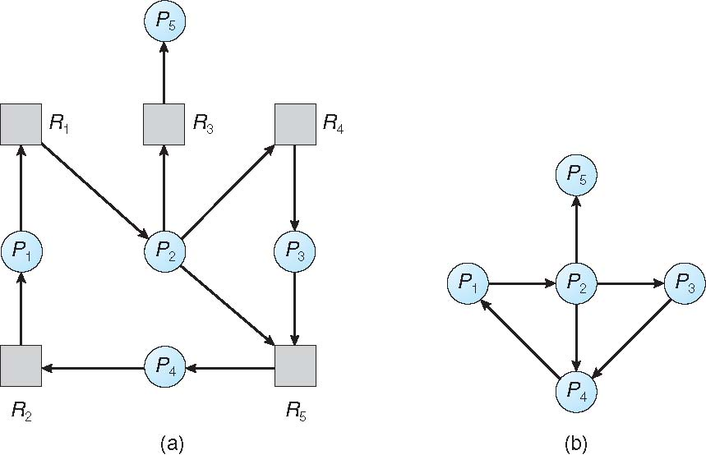
Resource-Allocation Graph and Wait-for Graph for deadlock detection
Resource-Allocation Graph
Corresponding wait-for graph

Slide 95
Several Instances of a Resource Type
Available: A vector of length m indicates the number of available resources of each type
Allocation: An n x m matrix defines the number of resources of each type currently allocated to each process
Request: An n x m matrix indicates the current request of each process. If Request [i][j] = k, then process Pi is requesting k more instances of resource type Rj.

Slide 96
Detection Algorithm
Initialize Work = Available
For i = 1 to n do
If Allocation(i) = 0 then Finish[i] = true else Finish[i] = false
Search an i such that
Finish[i] = false and Request(i) ≤ Work
If no such i can be found, go to step 4
For that i found in step 2 do:
Work = Work + Allocation(i)
Finish[i] = true
Go to step 2
If Finish[i] ≠ true for a some i then the system is in deadlock state else the system is safe

Slide 97
Example
Five processes P0 through P4
3 resource types:
A (7 instances), B (2 instances), and C (6 instances)
Sequence <P0, P2, P3, P1, P4> will result in Finish[i] = true for all i
Process | Alloc |  |  |  | Request |  |  |  |  | Available
 | A | B | C |  | A | B | C |  |  | A | B | C
P0 | 0 | 1 | 0 |  | 0 | 0 | 0 |  |  | 0 | 0 | 0
P1 | 2 | 0 | 0 |  | 2 | 0 | 2
P2 | 3 | 0 | 3 |  | 0 | 0 | 0
P3 | 2 | 1 | 1 |  | 1 | 0 | 0
P4 | 0 | 0 | 2 |  | 0 | 0 | 2

Slide 98
Example-2
P2 requests an additional instance of type C
State of system?
Can reclaim resources held by process P0, but insufficient resources to fulfill other processes; requests
Deadlock exists, consisting of processes P1, P2, P3, and P4
Process | Alloc |  |  |  | Request |  |  |  |  | Available
 | A | B | C |  | A | B | C |  |  | A | B | C
P0 | 0 | 1 | 0 |  | 0 | 0 | 0 |  |  | 0 | 0 | 0
P1 | 2 | 0 | 0 |  | 2 | 0 | 2
P2 | 3 | 0 | 3 |  | 0 | 0 | 1
P3 | 2 | 1 | 1 |  | 1 | 0 | 0
P4 | 0 | 0 | 2 |  | 0 | 0 | 2

Slide 99
Detection-Algorithm Usage
When, and how often, to invoke depends on:
How often is a deadlock likely to occur
How many processes will be affected by deadlock when it happens
If deadlocks occur frequently, then the algorithm should be invoked frequently.
Extreme: invoke the algorithm every time a request is denied
Alternative: invoke the algorithm at less frequent time intervals:
Once per hour
Whenever CPU utilization < 40%
Issue:
If detection algorithm is invoked arbitrarily, there may be many cycles in the resource graph and so we would not be able to tell which of the many deadlocked processes “caused” the deadlock.

Slide 100
Deadlock Recovery:
Once a deadlock is detected, the system must recover by taking action, which could involve:
Process Termination:
Abort a process: Kill one or more processes in the deadlock cycle.
Rollback a process: Roll back the process to a safe state to release resources.
In which order should we choose to abort?
Priority of the process
How long process has computed, and how much longer to completion
Resources the process has used
Resources process needs to complete
How many processes will need to be terminated
Is process interactive or batch?

Slide 101
Resource Preemption:
Forcefully take resources away from processes in the cycle and allocate them to others.
This requires carefully selecting which resources to preempt to avoid further complications.
Issues that need to be addressed in this approach:
Selecting a victim: Which resources and which processes are to be preempted?
Rollback – return process to some safe state and restart it from that state
Starvation – same process may always be picked as victim

Slide 102
Questions?

Slide 103
Assignment-3
Topics:
Multiple-Processor Scheduling
In systems containing more than one processor, multiple-processor scheduling addresses task allocations to multiple CPUs.
Characteristics of Multiple-Processor Scheduling, Challenges and Advantages, Scheduling Algorithms for Multiple Processors
Algorithm evaluation methods:
Deterministic modeling, Queuing models, Simulation, implementation . . .
Note
You are required to prepare a 10-minute presentation covering the above topics. Please ensure that your presentation consists of a maximum of 10 slides.

Slide 104
Thank You

