Slide 1


Memory Management
Chapter Six
CA_OS- CH6 – Memory Management

Slide 2
CH-6 Contents
Introduction
Memory hierarchy and Mass Storage Structure
Key Aspects of Memory Management
Contiguous memory allocation
Paging and Segmentation
Virtual memory and demand paging
Page replacement algorithms
Thrashing and its prevention

Slide 3
Brainstorm Questions
What are the key levels in the memory hierarchy, and how do they differ in speed and size?
What challenges arise when managing memory in modern computing environments?
What is virtual memory, and how does it extend physical memory?
What is thrashing, and why does it occur in a system?

Slide 4
Introduction
Memory refers to storage needed by the kernel, the other components of the operating system and the user programs.
In a multi-processing, multi-user system, the structure of the memory is quite complex.
Efficient memory management is very critical for good performance of the entire system.
Goals of memory management
Allocate memory resources among competing processes,
Maximizing memory utilization and system throughput
Provide isolation between processes
No process shall overwrite other process’s location
Provide a convenient abstraction for programming (and for compilers, etc.)

Slide 5
Terminologies Used in Memory Management
Logical address – is address generated by the CPU;
It also referred to as virtual address
Logical address space is the set of all logical addresses generated by a program
Physical address – address seen by the memory unit
Physical address space is the set of all physical addresses generated by a program
Memory-Management Unit (MMU)
Hardware device that maps virtual to physical address at run time

Slide 6
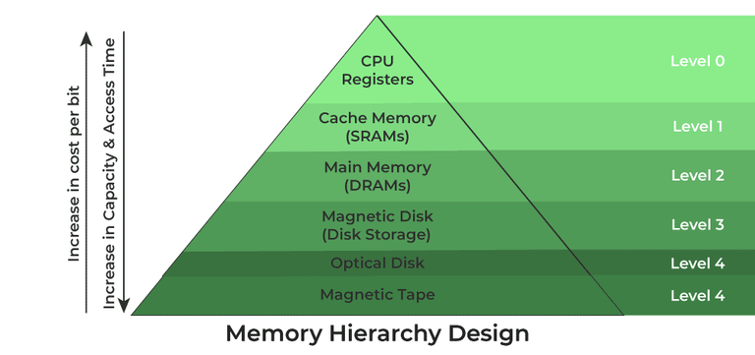
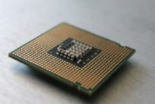
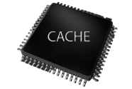

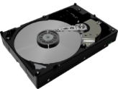

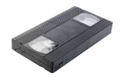
Memory hierarchy and Mass Storage Structure
Memory is primarily of two types
Internal Memory – registers, cache memory and primary/main memory
External Memory - magnetic disk, optical disk, magnetic tape etc.

Slide 7
Storage systems and their technology
The computer stores everything using binary format [Text, image, Audio and Video]
Computer storage is measured in bytes, kilobytes (KB), megabytes (MB), gigabytes (GB) and increasingly terabytes (TB).
One byte is one character of information, and is comprised of eight bits (or eight digital 1's or 0's).
Technically a kilobyte is 1024 bytes, a megabyte 1024 kilobytes, a gigabyte 1024 megabytes, and a terabyte 1024 gigabytes.
Storage technologies
Paper storage, magnetic storage devices, optical storage devices, flash memory devices, online and cloud

Slide 8
Key Aspects of Memory Management
Memory management is a critical function of operating systems, ensuring the efficient use of memory resources to meet the needs of processes.
There are three key aspects of memory management:
Memory management requirements: The key objectives that guide the allocation, protection, and efficient use of memory.
Memory management techniques: The practical methods employed to divide, allocate, and manage memory effectively.
Memory management strategies: The policies and approaches used to optimize memory allocation, replacement, and overall system performance.

Slide 9
Memory Management Requirements
Relocation: Processes should be able to move within memory without altering their functionality.
Protection: Safeguard processes from interfering with each other.
Sharing: Enable multiple processes to access shared resources without conflicts.
Logical and Physical Organization: Abstract complexity for users and align memory structure with data organization.
Efficiency and Flexibility: Optimize resource utilization and adapt to changing workload demands.

Slide 10
Memory Management Techniques
Techniques are the practical methods used to implement memory management in line with these objectives:
Contiguous Memory Allocation: Allocates memory in continuous blocks, which is simple but may lead to fragmentation.
Non-contiguous memory allocation
Paging: Divides memory into fixed-sized pages, eliminating external fragmentation and allowing efficient use.
Segmentation: Organizes memory into variable-sized segments based on logical divisions like code and data.
Virtual Memory: Extends physical memory using secondary storage, allowing larger processes to execute.
Swapping: Temporarily moves inactive processes to disk, freeing up physical memory for active ones.

Slide 11
Strategies for Optimizing Memory Management
Strategies determine how memory is allocated, reclaimed, or replaced during execution. They leverage techniques to achieve the objectives:
Allocation Policies:
First-Fit: Allocates the first suitable memory block.
Best-Fit: Allocates the smallest block that meets the requirement, reducing fragmentation.
Next-Fit: Allocate the next available block that is large enough after the location of the last placement
Worst-Fit: Allocates the largest block, leaving maximum free space.

Slide 12
Replacement Policies:
FIFO (First In, First Out): Replaces the oldest page in memory.
LRU (Least Recently Used): Replaces the least recently accessed page.
Optimal Replacement: Theoretically replaces the page not needed for the longest time.
LFU(Least Frequently used) : move out the page that is not used often in the past.
Clock policy : Combination of FIFO and LRU
Fragmentation Management: Uses techniques like compaction to address memory fragmentation.
Thrashing Prevention: Adjusts process workloads to minimize excessive paging activity.

Slide 13
Contiguous Memory Allocation
It is a memory management technique where each process is allocated a single contiguous block of memory in the system's physical address space.
This approach simplifies memory allocation by allowing processes to occupy a continuous sequence of memory addresses.
While this technique is straightforward and easy to implement, it can lead to fragmentation and inefficient memory use.
Contiguous Memory Allocation has two types:
Fixed(or Static) Partition
Variable(or Dynamic) Partitioning

Slide 14
Fixed(or Static) Partition
The main memory is divided into fixed sized partitions which can be of equal or unequal size
Equal-size Partitions
The entire memory is divided into partitions of the same size, and each partition can hold a single process
Placement Algorithm: because all partitions are of equal size, it does not matter which partition is used
Advantage: Simple, efficient allocation for uniform processes, quick allocation
Disadvantage: Internal fragmentation, inefficient for large or variable sized processes

Slide 15
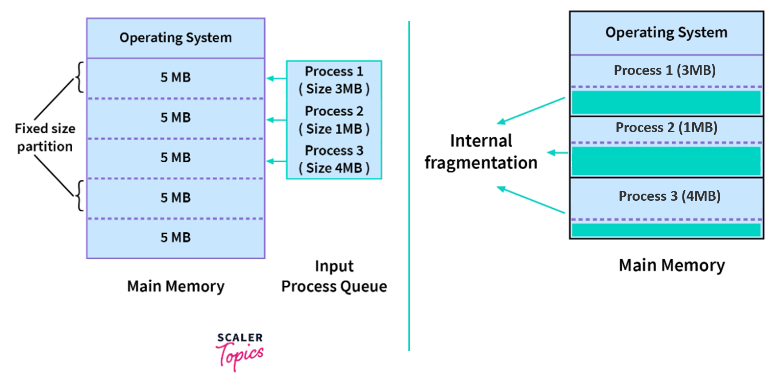
Example: Fixed Equal Size Partition

Slide 16
Unequal-size Partitions
Memory is divided into partitions of varying sizes to better match the diverse memory requirements of different processes
Advantage: Reduced internal fragmentation, greater flexibility
Disadvantage: complex allocation
Placement Algorithm: can assign each process to the smallest partition within which it will fit

Slide 17
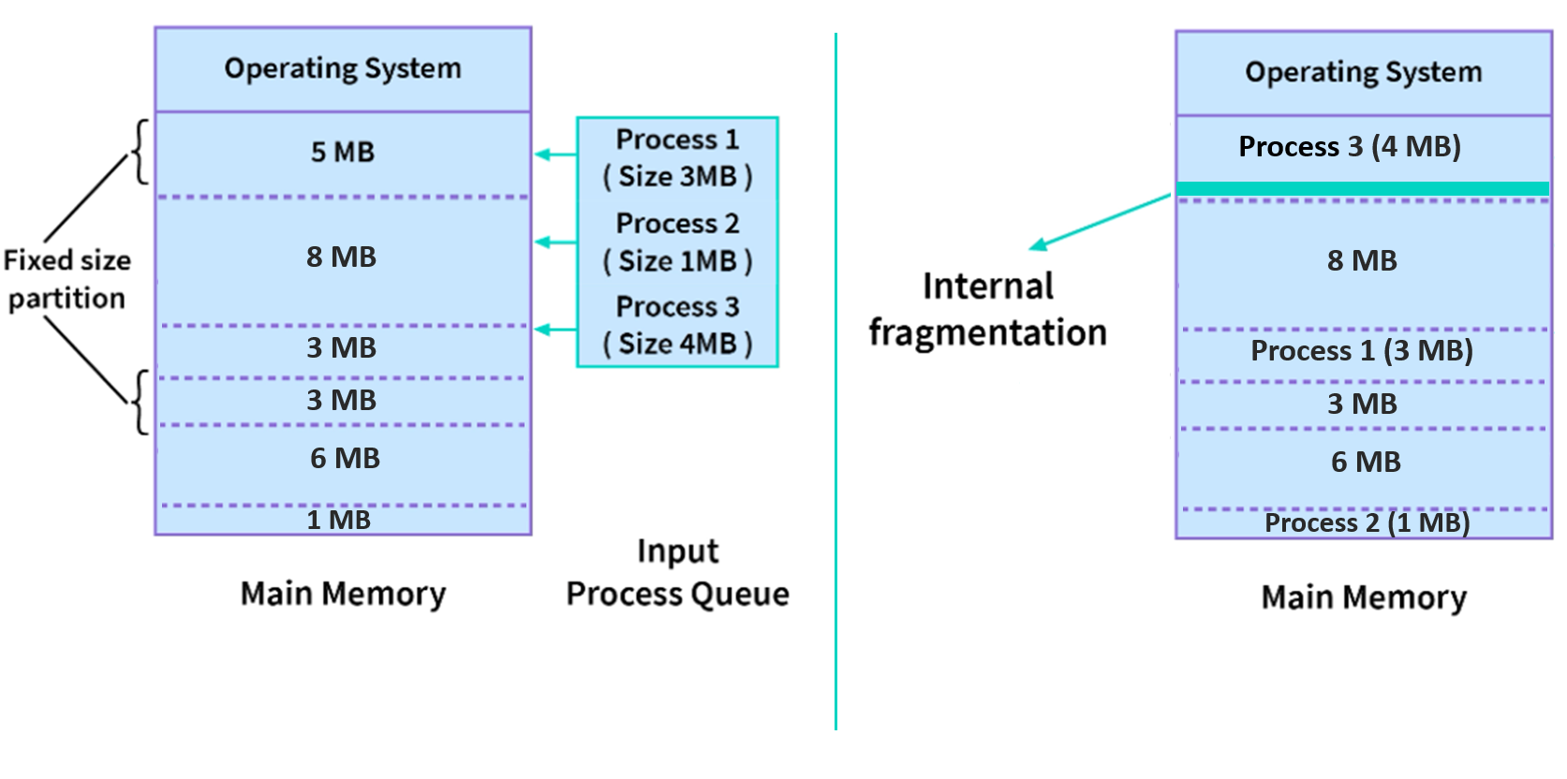
Example: Fixed Unequal Size Partition

Slide 18
Variable (Dynamic) Partition
The main memory is divided into partitions of variable size, created dynamically to fit the exact size of the process being allocated.
Partitions are created as needed, based on the size of the incoming process.
Unlike fixed partitioning, dynamic partitioning allows the memory to be utilized more efficiently as it avoids the limitations of pre-defined partition sizes

Slide 19
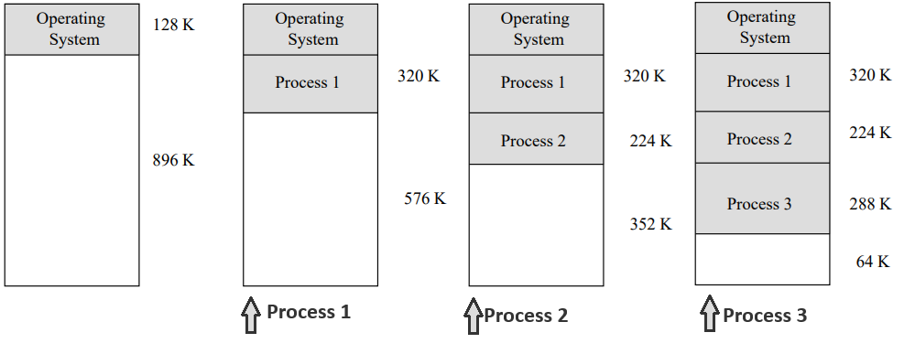
Example: Variable (Dynamic) Partition

Slide 20
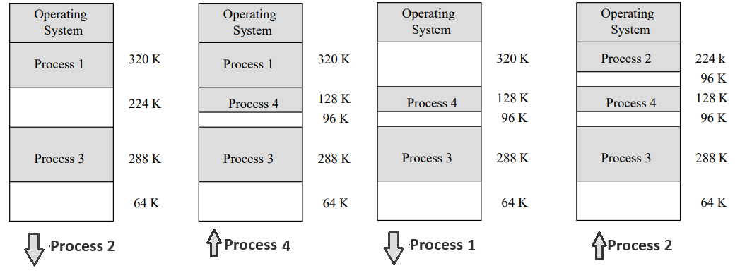
Continue…

Slide 21
Advantage
No Internal Fragmentation: Partitions are created based on process size, leaving no unused space.
No Size Limitation: Process size is not restricted since partitions are dynamically allocated.
Dynamic Multiprogramming: More processes can be accommodated due to efficient memory usage.
Disadvantage
External Fragmentation: Unused memory gaps form as processes are loaded and removed.
Complexity: Managing dynamic partitions and performing compaction is complex.
Compaction Overhead: Shifting processes to reduce fragmentation adds computational overhead.

Slide 22
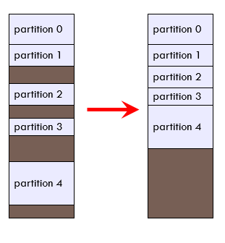
Compaction : Dealing with external fragmentation
Compaction:- is a technique for overcoming external fragmentation
OS shifts processes so that they are contiguous
Free memory is together in one block
Very expensive
Time consuming and wastes CPU time

Slide 23
Dynamic Partitioning Placement Algorithm
Because memory compaction is time consuming, So how to assign processes to memory (how to plug the holes) if there is more than one free block of memory of sufficient size, then the operating system must decide which free block to allocate.
First-fit
Begins to scan memory from the beginning and chooses the first available block that is large enough
Next-fit
Begins to scan memory from the location of the last placement and chooses the next available block that is large enough
Worst Fit
Allocate the largest free block to the process
Chooses the block that is closest in size to the request
Best-fit

Slide 24
Example
Given five memory partitions of 100 KB, 500 KB, 200 KB, 300 KB, and 600 KB (in order).
How would each of the first-fit, best-fit, next-fit, and worst-fit algorithms place processes of 212 KB, 417 KB, 112 KB, and 426 KB (in order)?
Which algorithm makes the most efficient use of memory?

Slide 25
Solution
First Fit
P1 [212]>>> 100, 500, 200, 300, 600
P2 [417]>>> 100, 288, 200, 300, 600
P3 [112]>>> 100, 288, 200, 300, 183
Unused memory >>> 100, 176, 200, 300, 183 KB
P4 [426]>>> Fits in no partition (must wait)
Best Fit
P1 [212]>>> 100, 500, 200, 300, 600
P2 [417]>>> 100, 500, 200, 88, 600
P3 [112]>>> 100, 83, 200, 88, 600
P4 [426]>>> 100, 83, 88, 88, 600
Unused memory >>> 100, 83, 88, 88, 174 KB

Slide 26
Next Fit
P1 [212]>>> 100, 500, 200, 300, 600
P2 [417]>>> 100, 288, 200, 300, 600
P3 [112]>>> 100, 288, 200, 300, 183
Unused memory >>> 100, 176, 200, 300, 183
P4 [426]>>> Fits in no partition (must wait)
Worst Fit
P1 [212]>>> 100, 500, 200, 300, 600
P2 [417]>>> 100, 500, 200, 300, 388
P3 [2]>>> 100, 83, 200, 300, 388
Unused memory >>> 100, 83, 200, 300, 276
P4 [426]>>> Fits in no partition (must wait)

Slide 27
Paging and Segmentation
Paging and segmentation are parts of the non-contiguous allocation of memory which is a memory management technique.
Paging divides memory into fixed-size blocks called pages, simplifying management by treating memory as a uniform structure.
Segmentation, in contrast, divides memory into variable-sized segments based on logical units, offering flexibility in organizing data and code.
Both methods have distinct advantages and are chosen based on the specific needs and complexities of applications and system architectures.

Slide 28
Paging
It is a static memory allocation method that allows a process's physical address space to be of non-contiguous memory type.
Partition memory into small equal-size chunks and divide each process into the same size chunks
The chunks of a process (logical memory space) are called pages and
The chunks of memory (Physical memory) are called frames

Slide 29
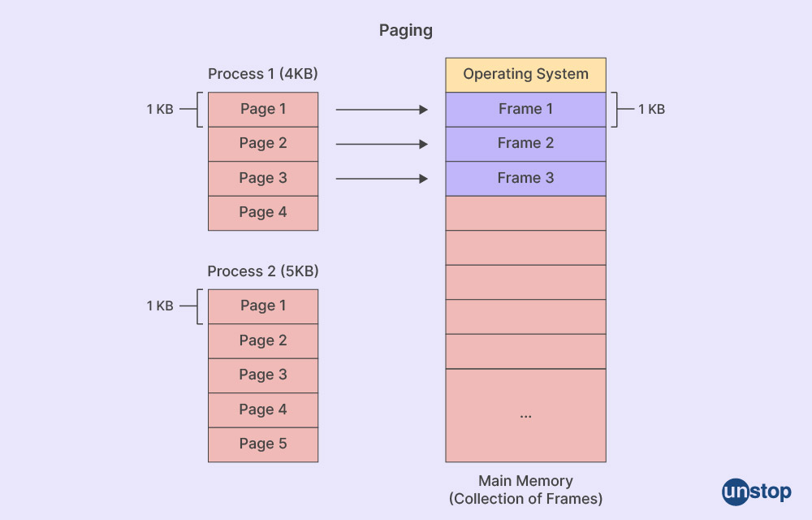

Slide 30
Operating system maintains a page table for each process that maps its pages to the frames in physical memory.
The page table contains:
Page Number: Index of the page in the logical address.
Frame Number: Corresponding frame in physical memory.
Address Translation:
The CPU generates a logical address (page number + offset).
Memory address within the program consist of a page number and offset within the page
The page number is used to find the corresponding frame in the page table.
The physical address is then computed as:
Physical Address = Frame Base Address + Offset

Slide 31
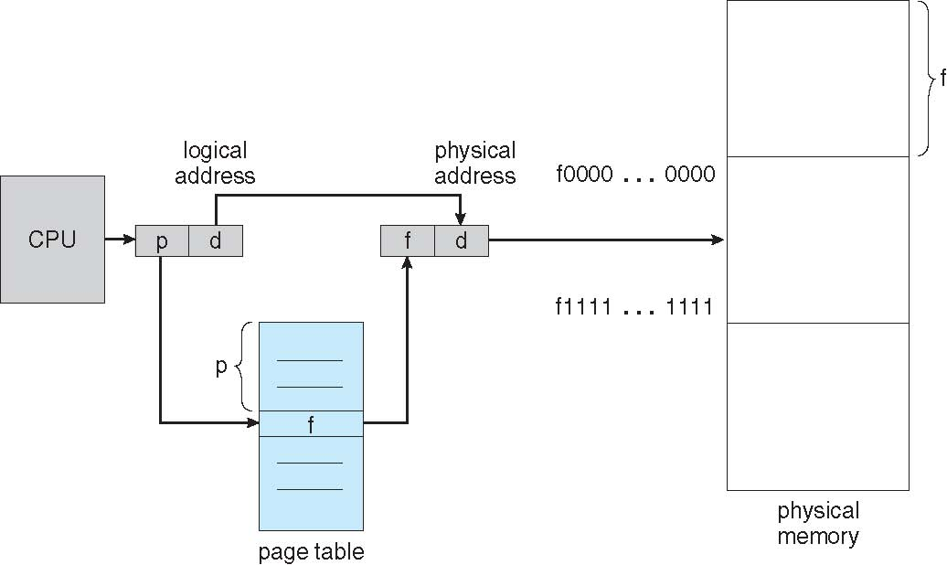
Paging Hardware

Slide 32
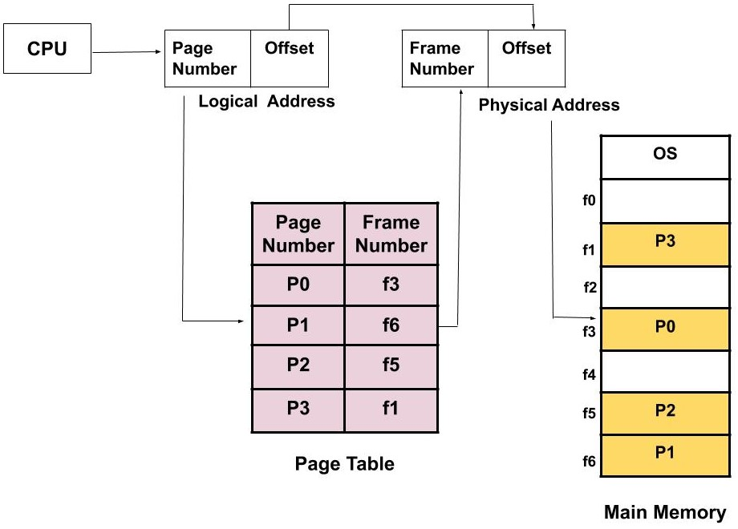
Example: Paging

Slide 33
Advantages:
Efficient memory management with simple, non-contiguous allocation.
Easy memory allocation and sharing.
Eliminates external fragmentation, no need for compaction.
Supports efficient swapping.
Disadvantages:
Internal fragmentation (last page).
Requires specialized hardware for address translation.
Page tables increase memory overhead.
Slower memory access due to multi-level paging and address translation delays.

Slide 34
Segmentation
Segmentation divides memory into variable-sized segments based on the logical division of a program (e.g., code, stack, heap, data).
Unlike paging, segments are of different sizes and correspond to high-level program divisions.
A program is a collection of segments
A segment is a logical unit such as:
Main program
Procedure
Function
Method
Object
Local variables
Global variables
Common block
Stack
Symbol table
Arrays

Slide 35
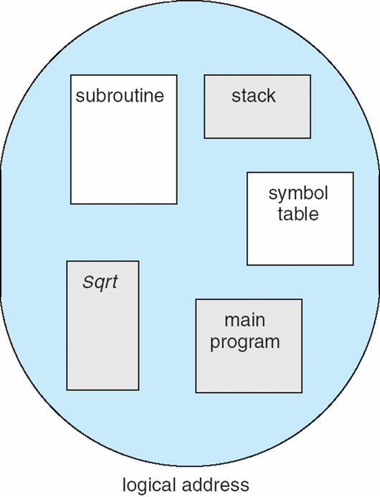
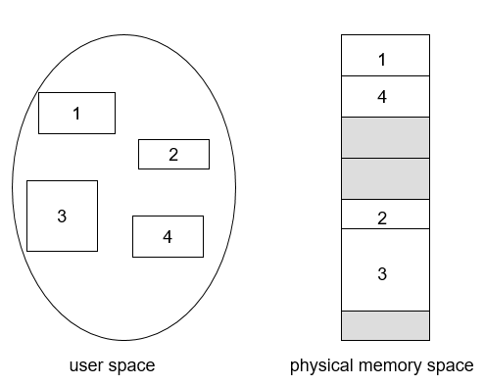
User’s View of a Program
Logical View of Segmentation

Slide 36
Characteristics
The size of partitions depend on the length of modules.
The partitions of secondary memory are called as segments.
Segmentation Architecture
Logical address consists of a two parts: <segment-number, offset>,
Segment table – It maps two-dimensional Logical address into one-dimensional Physical address.
Each table entry has:
Base – contains the starting physical address where the segments reside in memory
Limit – specifies the length of the segment

Slide 37
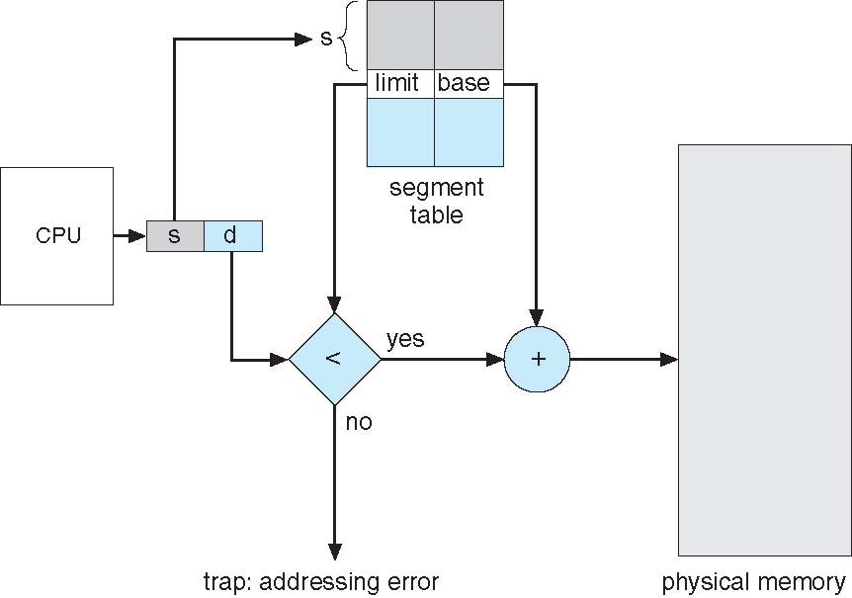
Segmentation Hardware

Slide 38
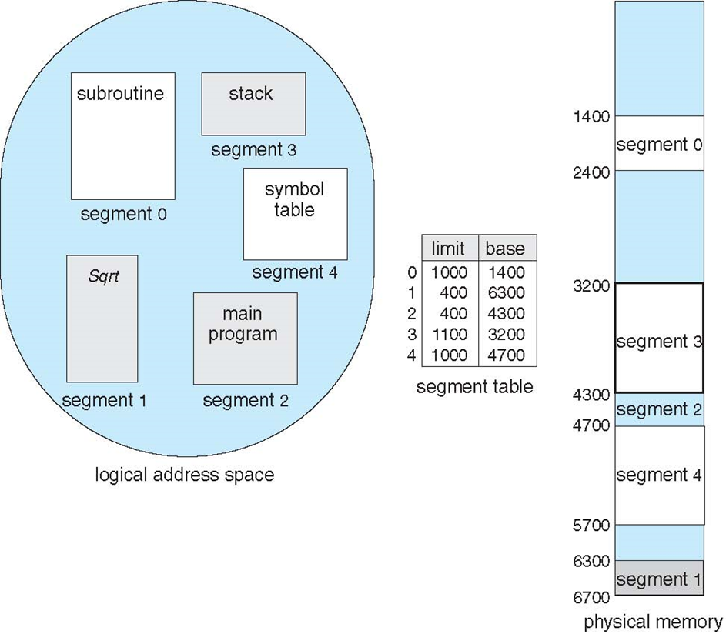
Example: Segmentation

Slide 39
Advantages:
No internal fragmentation.
Smaller segment table with fewer entries.
Supports larger segment sizes with less overhead.
Efficient translation and flexible protection per segment.
Allows sharing and easier relocation of segments.
Disadvantages:
Prone to external fragmentation.
Expensive and complex memory management.

Slide 40
Virtual Memory and Demand paging
A virtual memory is a techniques for using the secondary storage to extend the apparent limited size of the physical memory beyond its actual physical size.
Instead of relying solely on physical addresses, programs use virtual addresses to store instructions and data.
During execution, these virtual addresses are translated into real memory addresses

Slide 41
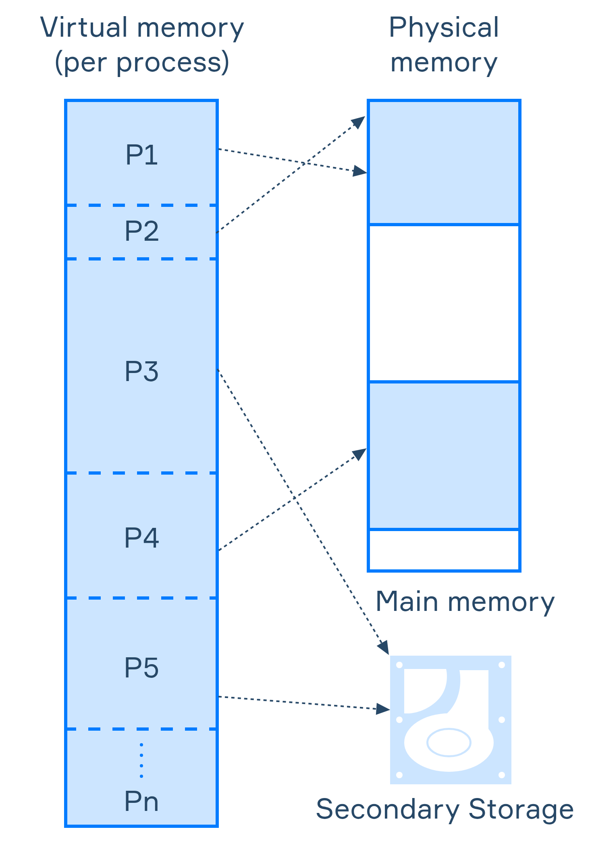

Slide 42
How does it work
To manage this process, the operating system divides virtual memory into pages, each containing a fixed number of addresses.
Pages are stored on the disk until needed. When a page is required, the operating system:
Copies it from disk into main memory.
Translates virtual addresses to real addresses for the program's use.
This system enables programs to use more memory than what is physically available, providing flexibility and scalability.

Slide 43
The Role of the MMU (Memory Management Unit)
Virtual memory functionality is made possible by the Memory Management Unit (MMU), a hardware component. The MMU:
Translates virtual addresses into physical addresses via page tables.
Facilitates table lookups to ensure smooth address translation.
Detects and handles situations like page faults, where the requested page is not in main memory (handled by the operating system).
By bridging the gap between virtual and physical memory, the MMU allows efficient use of memory resources.

Slide 44
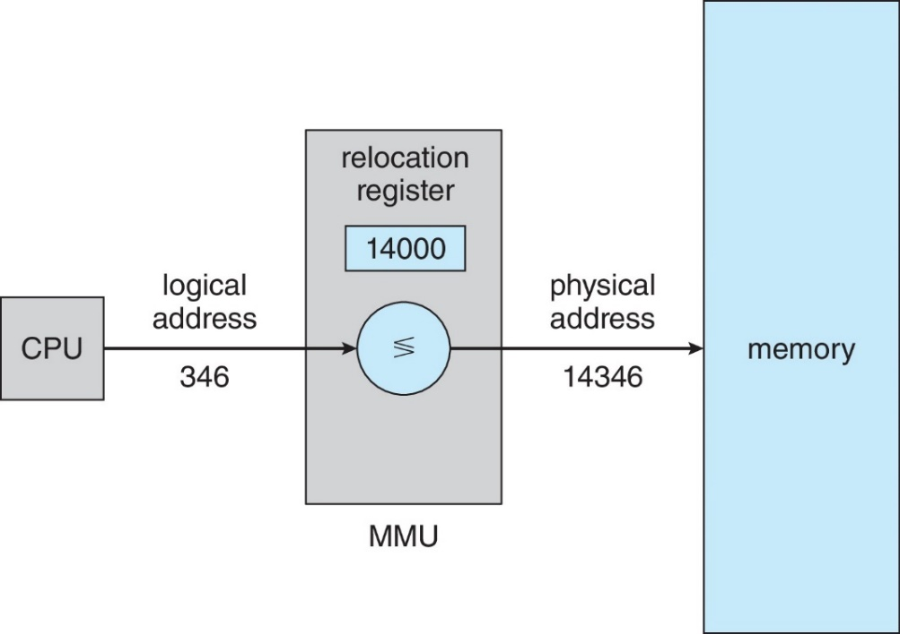
The logical addresses can be translated into physical address in different ways
Consider simple scheme. which is a generalization of the base-register scheme.
The base register now called relocation register
The value in the relocation register is added to every address generated by a user process at the time it is sent to memory

Slide 45
Virtual Memory Implementation Techniques
There are several techniques that enable efficient management of memory and allow programs to use more memory than physically available.
The main techniques include:
Paging
Segmentation
Demand paging
Combined paging and segmentation
Swapping

Slide 46
Page Replacement Algorithms
It manages which pages of memory should be swapped out when a new page needs to be loaded but the physical memory is full.
They are essential for implementing demand paging, a method of virtual memory management.
When a page fault occurs (i.e., a program tries to access a page that is not in memory), the system must decide which page in memory to evict to make room for the new page.
This decision is made using page replacement algorithms.

Slide 47
List of Known Page Replacement Algorithms
OPT(Optimal) : eliminate the page that be not expected to be used.
FIFO(first input/first output) : rather than choosing the victim page at random, the oldest page is the first to be removed.
LRU(Least Recently used) : move out the page that is the least rarely used.
LFU(Least Frequently used) : move out the page that is not used often in the past.
Clock policy : Combination of FIFO and LRU

Slide 48
Example
Consider the following reference string of pages made by a processor: 2, 3, 2, 1, 5, 2, 4, 5, 3, 2, 5, 2.
Assume that the number of page frames allocated in the main memory is THREE.
Compute the number of page faults generated if the replacement algorithm used is:
OPT(Optimal)
FIFO
LRU
Clock

Slide 49
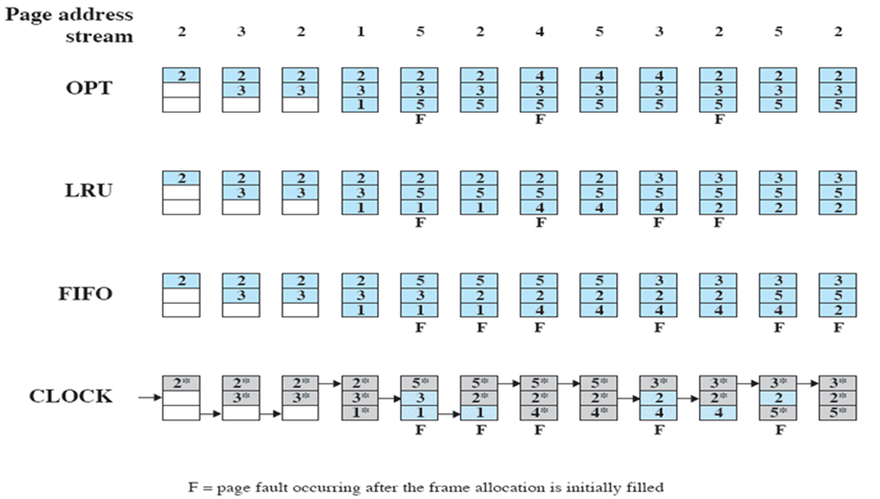
Solution

Slide 50
Thrashing and its prevention
Thrashing is a situation in an operating system where computer's operating system spends most of its time swapping data between RAM and disk instead of executing processes
This happens when the system is overwhelmed by frequent page swaps, causing poor performance as it focuses more on paging than on executing programs.
Causes of Thrashing
High degree of multiprogramming
Insufficient physical memory (RAM)
Poor page replacement algorithm

Slide 51
The OS should use various techniques to prevent thrashing by addressing its root causes, and if thrashing occurs, it should implement recovery mechanisms to restore normal operation.
Prevention of Thrashing: Multiple techniques are used to prevent thrashing by tackling its underlying causes.
Recovery from Thrashing: Different recovery mechanisms are employed once the system enters a thrashing state.

Slide 52
Questions?

Slide 53
Assignment-4
Topics:
Virtual Memory Implementation Techniques
There are several techniques that enable efficient management of memory and allow programs to use more memory than physically available. The main techniques include: Paging, Segmentation, Demand paging, Combined paging and segmentation, Swapping . . .
Prevention of Thrashing and Recovery:
The OS should use various techniques to prevent thrashing by addressing its root causes, and if thrashing occurs, it should implement recovery mechanisms to restore normal operation
Note
You are required to prepare a 10-minute presentation covering the above topics. Please ensure that your presentation consists of a maximum of 10 slides.

Slide 54
Thank You

