Slide 1
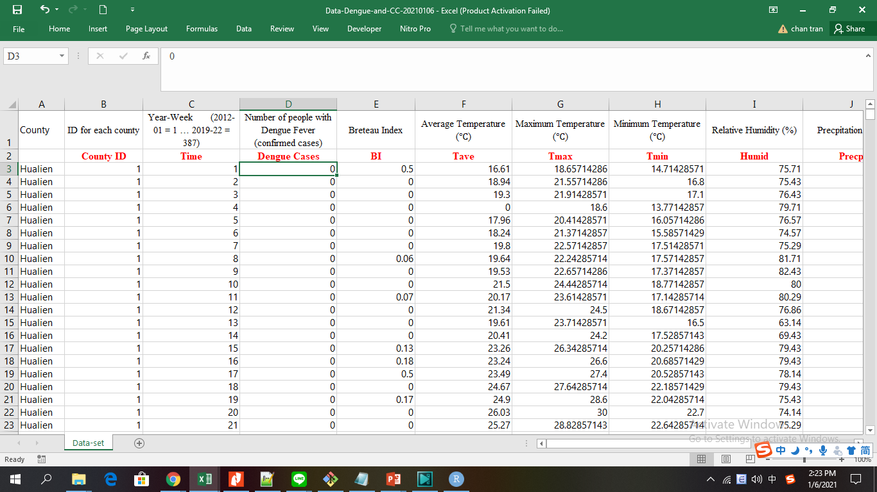
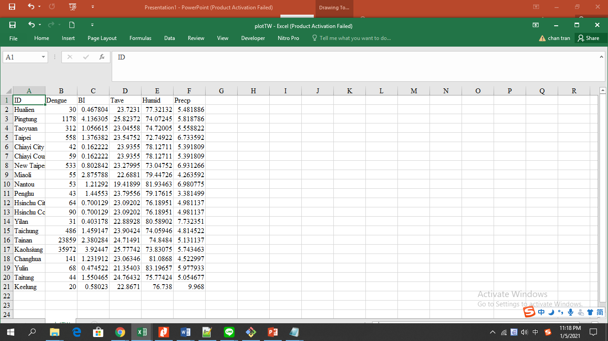
0513367_陳中堅 R_2020 Project Introduction
Data Source
Dengue case surveillance data: In Taiwan, dengue fever (台灣瘧疾)is classified as a notifiable infectious disease and suspected cases must be reported to a clinic for diagnosis within 24 hours.
These data obtained from the web-based National Infectious Disease Statistics System (https://nidss.cdc.gov.tw/en/SingleDisease.aspx?dc=1&dt=4&disease=061&position=1)under the Notifiable Disease Surveillance System (NDSS) of the Taiwan Center for Disease Control.(from January 2012 to May 2019)

Slide 2
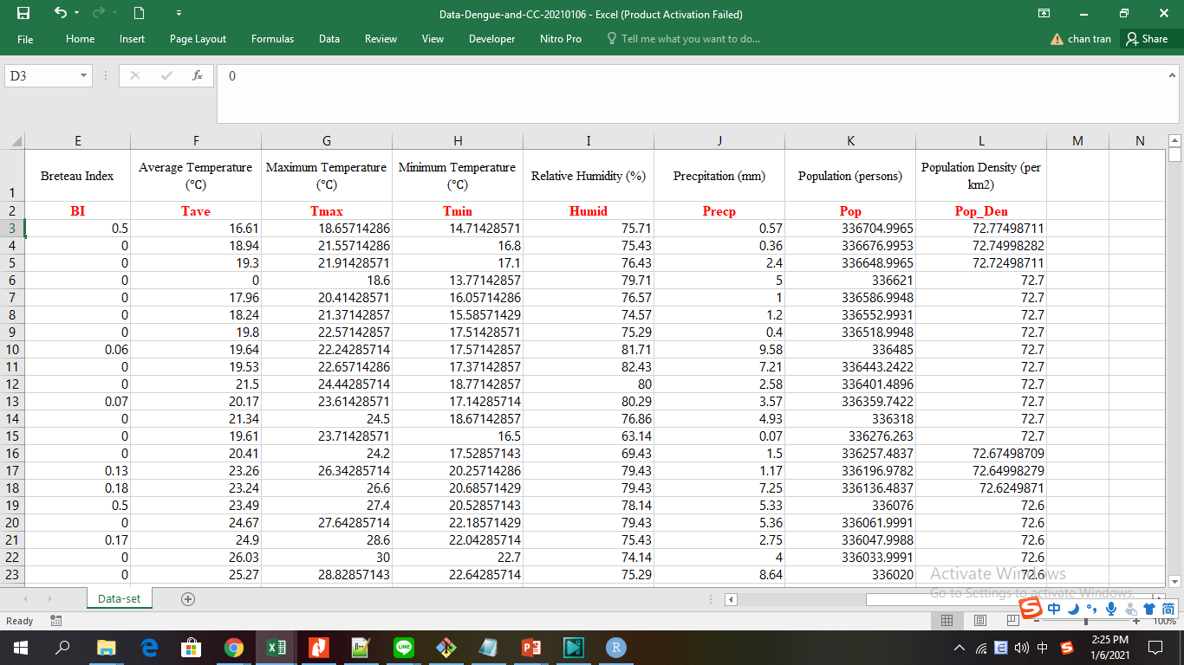
Introduction
According to the computerized database of the surveillance system by Taiwan Center for
Disease Control (Taiwan-CDC) [29], in the period of 2006 to 2012, there were 10,094 confirmed cases of
dengue virus infections, or an average of about 1442 cases per year. However, from 2012 to 2018, the
Taiwan-CDC recorded 63,471 confirmed cases of dengue, or an average of about 9067 cases per year.
Thus, the annual average number of dengue cases has increased by 529% in the past seven years
compared with the period from 2006 to 2012.
Analysis of this data is primarily intended to determine the geographic distribution of dengue cases across Taiwan's provinces.
Simultaneously with the visualization of the density distribution of mosquito larvae, providing convincing proof of the leading cause of dengue fever, plus the influence of population density has led to the difference in rate as well as the number of cases between Taiwan's provinces.

Slide 3
Code
#code at kaggle
#https://www.kaggle.com/lefeulien/notebook0f66b16139
library(tidyverse) # metapackage of all tidyverse packages
list.files(path = "../input")
library(caret)
install.packages("geojsonio")
library("geojsonio")
require("dplyr")
require("stringr")
require("data.table")
require("ggplot2")
require("maptools")
require("knitr")
require("kableExtra")
require("mapproj")
require("sf")
require("RColorBrewer")
path = "../input/data-deng-bi/plotTW.csv"
df <- read.csv(path, h=T)
df <-data.frame(df)
distill_data <- df
kable(distill_data)
summary(distill_data)
taiwan.map <- st_read("../input/tw-map-shp/gadm36_TWN_2.shp")
print(taiwan.map, n = 22)
plot(taiwan.map[1])
#plot(taiwan.map[2:13], max.plot = 12)
plot(st_geometry(taiwan.map))
#plot(taiwan.map["NAME_2"], axes = TRUE)
st_geometry(taiwan.map)
my.taiwan.map.data$Dengue3 <- cut(my.taiwan.map.data$Dengue,breaks = c(-Inf, 61, 501, 1001, Inf),right = FALSE)# divide into 4 section for clearly revealization
ggplot(data = my.taiwan.map.data) +
geom_sf(aes(fill = Dengue3)) +
#scale_fill_distiller(name="Count", palette = "RdYlGn")
#scale_fill_distiller(palette = "Spectral", name = "台灣瘧疾Denguge Cases") +
scale_fill_manual(breaks=c("[-Inf,61)", "[61,501)", "[501,1e+03)","[1e+03, Inf)"),
name = "Dengue Cases",
values = c("lightyellow", "yellow","orange", "red"),
labels = c("0-60","61-500","501-1000",">1001"))
my.taiwan.map.data$BI3 <- cut(my.taiwan.map.data$BI,breaks = c(-Inf, 1, 2, 3, Inf),right = FALSE)# divide into 4 section for clearly revealization
#BI is Mosquito larva density parameter
ggplot(data = my.taiwan.map.data) +
geom_sf(aes(fill = BI)) +
# scale_fill_distiller(name="Count", palette = "RdYlGn")
scale_fill_distiller(palette = "Spectral", name = "Mosquito larva density distribution")
ggplot(data = my.taiwan.map.data) +
geom_sf(aes(fill = BI3)) +
scale_fill_manual(breaks=c("[-Inf,1)", "[1,2)", "[2,3)","[3, Inf)"),
name = "Mosquito larva density distribution",
values = c("lightyellow", "yellow","orange", "red"),
labels = c("0-1","1-2","2-3","3-4"))
ggplot(data = taiwan.map) +
geom_sf(aes(fill = NAME_2)) +
scale_fill_manual(name = "縣市區",
values = colorRampPalette(brewer.pal(8, "Accent"))(22)) +
labs(title = "Taiwan map")
print(distill_data$ID)
distill_data$ID <- as.character(distill_data$ID)
head(distill_data)
tmp <- (min(distill_data$Dengue) - max(distill_data$Dengue))
tmp
distill_data$Dengue_Nornalize <- (distill_data$Dengue - min(distill_data$Dengue)) / (max(distill_data$Dengue) - min(distill_data$Dengue))
distill_data
my.taiwan.map <- taiwan.map[c("NAME_2", "geometry")]
my.taiwan.map$NAME_2 <- as.character(my.taiwan.map$NAME_2)
head(my.taiwan.map)
my.taiwan.map.data <- left_join(my.taiwan.map, distill_data,
c("NAME_2" = "ID"))
dim(my.taiwan.map.data)
ggplot(data = my.taiwan.map.data) +
geom_sf(aes(fill = Dengue_Nornalize)) +
# scale_fill_distiller(name="Count", palette = "RdYlGn")
scale_fill_distiller(palette = "Spectral", name = "Dengue Cases")

Slide 4
Project Questions Where is the area with the most mosquitoes in Taiwan? Which is the region with the most dengue cases? Analysis the relationship between number of Dengue cases with mosquito density and provincial population density

Slide 5
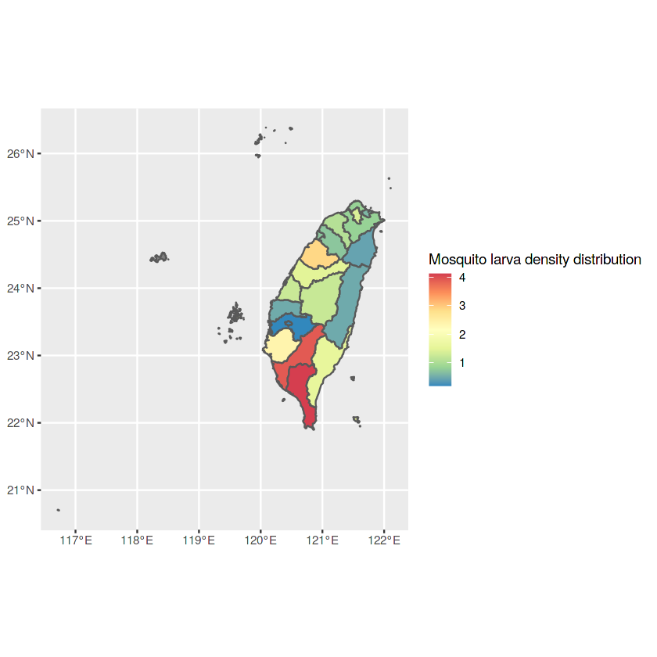
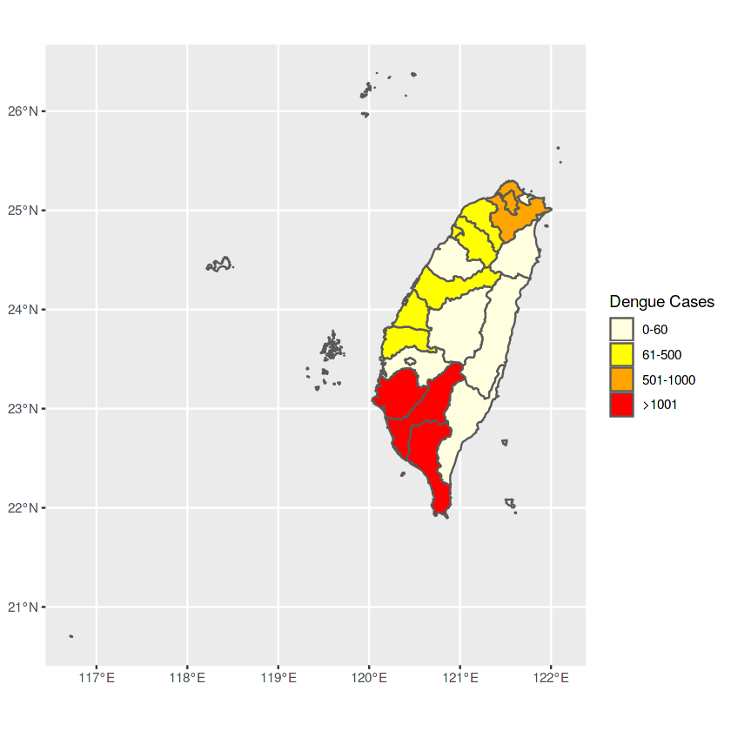
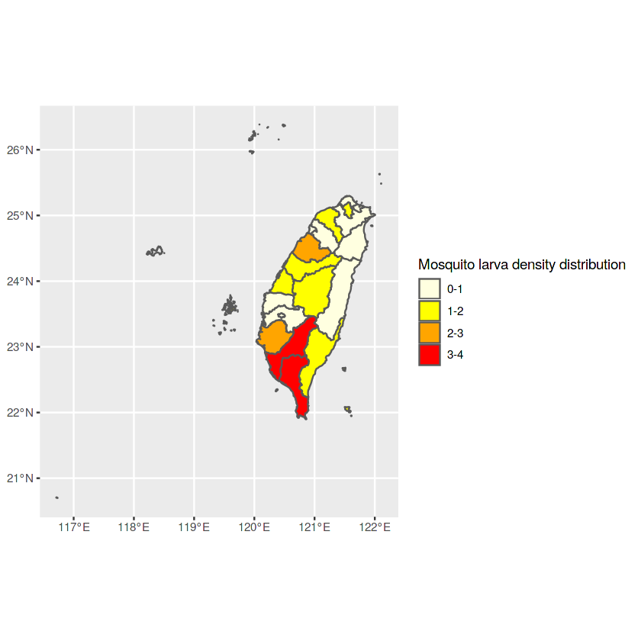
台灣瘧疾分佈
Jan 2012 to May 2019
台灣孑孓密度分佈

Slide 6
Result analysis
From the visualization graphs we can see the significant relationship between about Mosquito larva density and the number cases of Dengue, It also reveal an important relationship between cases of Dengue and population density with temperature of each Taiwan's province.
We can see that BI, mosquito larval distribution density is an important parameter affecting the number of dengue cases in the regions. However, there are some exceptions. For example, the Miaoli area has a high density of mosquito larvae but the incidence is low, most likely because this is a sparsely populated area, there are many mosquitoes in the wilderness, so there is no Affect the dengue fever.
Similarly, the Xinbei area with low mosquito density but high prevalence, it can only be explained because it's high population density.

