Slide 1
Introduction to options in DHCP messages
2017-06-01

Slide 2
DHCP Message Format
0
8
16
24
31
OP | HTYPE | HLEN | HOPS
TRANSACTION ID
SECONDS |  | FLAGS
CLIENT IP ADDRESS (ciaddr)
YOUR IP ADDRESS (yiaddr)
SERVER IP ADDRESS (siaddr)
ROUTER IP ADDRESS (giaddr)
CLIENT HARDWARE ADDRESS (16B) · · ·
SERVER HOST NAME (64B) · · ·
BOOT FILE NAME (128B) · · ·
OPTIONS (variable) · · ·

Slide 3
Fields by DHCP Client(1)^{[RFC2131]}
Field | DHCPDISCOVER | DHCPREQUEST | DHCPINFORM | DHCPRELEASE
OP | request | request | request | request
HTYPE | Ethernet(1) | 1 | 1 | 1
HLEN | 6 | 6 | 6 | 6
HOPS | 0 | 0 | 0 | 0
TransactionID | selected by client | copied from DHCPOFFER | selected by client | selected by client
Seconds | 0 or seconds since DHCP process started | 0 or seconds since DHCP process started | 0 or seconds since DHCP process started | 0
Flags | broadcast(0x8000) | broadcast in address acquisition; unicast in lease renewal | unicast(0) | unicast(0)

Slide 4
Fields by DHCP Client(2)
Field | DHCPDISCOVER | DHCPREQUEST | DHCPINFORM | DHCPRELEASE
ciaddr | 0 | 0 in address acquisition; client’s IP address in lease renewal | client’s IP address | client’s IP address
yiaddr | 0 | 0 | 0 | 0
siaddr | 0 | 0 | 0 | 0
giaddr | 0 | 0 | 0 | 0
cliendhardwareaddress | MAC address of client, padded with 0 | MAC address of client, , padded with 0 | MAC address of client, padded with 0 | MAC address of client, padded with 0
server host name | 0 | 0 | 0 | 0
boot file name | 0 | 0 | 0 | 0
magic cookie(用于和Bootp兼容) | 99 130 83 99(4个十进制数) | 99 130 83 99 | 99 130 83 99 | 99 130 83 99
Notes:
获得MAC地址
struct ifreq ifreq;
strcpy (ifreq.ifr_name, "eth1");
if (ioctl (sock, SIOCGIFHWADDR, &ifreq) < 0)
perror ("ioctl");

Slide 5
Options by DHCP Client(T-L-V format)
Field | DHCPDISCOVER | DHCPREQUEST | DHCPINFORM | DHCPRELEASE
Message Type(3B) | 53 1 1 | 53 1 3 | 53 1 8 | 53 1 7
Requested IP address | Must not | must in address acquisition, must not in renewal | must not | must not
IP address lease time | must not | may | must not | must not
Client Identifier | may | may | may | may
Host name | may | may | may | may
Vendor class identifier | may | may | may | must not
Server Identifier | must not | must in address acquisition, must not in renewal | must not | must
Parameter request list | must | must | must | must not
Notes:
获得MAC地址
struct ifreq ifreq;
strcpy (ifreq.ifr_name, "eth1");
if (ioctl (sock, SIOCGIFHWADDR, &ifreq) < 0)
perror ("ioctl");

Slide 6
Fields by DHCP Server(1)
Field | DHCPOFFER | DHCPACK | DHCPNAK
OP | reply | reply | reply
HTYPE | Ethernet(1) | 1 | 1
HLEN | 6 | 6 | 6
HOPS | 0 | 0 | 0
TransactionID | copied from DHCPDISCOVER | copied from DHCPREQUEST or DHCPINFORM | copied from DHCPREQUEST
Seconds | 0 | 0 | 0
Flags | copied from DHCPDISCOVER | copied from DHCPREQUEST or DHCPINFORM | copied from DHCPREQUEST

Slide 7
Fields by DHCP Server(2)
Field | DHCPOFFER | DHCPACK | DHCPNAK
ciaddr | 0 | 0 or 'ciaddr' from DHCPREQUEST(DHCPINFORM) | 0
yiaddr | IP address offered | IP address assigned or copied from DHCPINFORM | 0
siaddr | 0 | 0 | 0
giaddr | 0 | 0 | 0
cliendhardwareaddress | copied from DHCPDISCOVER, padded with 0 | copied from DHCPREQUEST(DHCPINFORM), padded with 0 | copied from DHCPREQUEST, padded with 0
server host name | 0 | 0 | 0
boot file name | 0 | 0 | 0
magic cookie(用于和Bootp兼容) | 99 130 83 99 | 99 130 83 99 | 99 130 83 99
Notes:
获得MAC地址
struct ifreq ifreq;
strcpy (ifreq.ifr_name, "eth1");
if (ioctl (sock, SIOCGIFHWADDR, &ifreq) < 0)
perror ("ioctl");

Slide 8
Options by DHCP Server(T-L-V format)
Field | DHCPOFFER | DHCPACK | DHCPNAK
Message Type(3B) | 53 1 2 | 53 1 5 | 53 1 6
Requested IP address | Must not | must not | must not
IP address lease time | must not | must in reply to DHCPREQUEST, must not in reply to DHCPINFORM | must not
Client Identifier | must not | must not | may
Vendor class identifier | may | may | may
Server Identifier | must | must | must
Parameter request list | must not | must not | must not
subnet mask | must | must | must not
router | must | must | must not
domain name server | must | must | must not
renewal time value | must | must | must not
rebinding time value | must | must | must not
Notes:
获得MAC地址
struct ifreq ifreq;
strcpy (ifreq.ifr_name, "eth1");
if (ioctl (sock, SIOCGIFHWADDR, &ifreq) < 0)
perror ("ioctl");

Slide 9
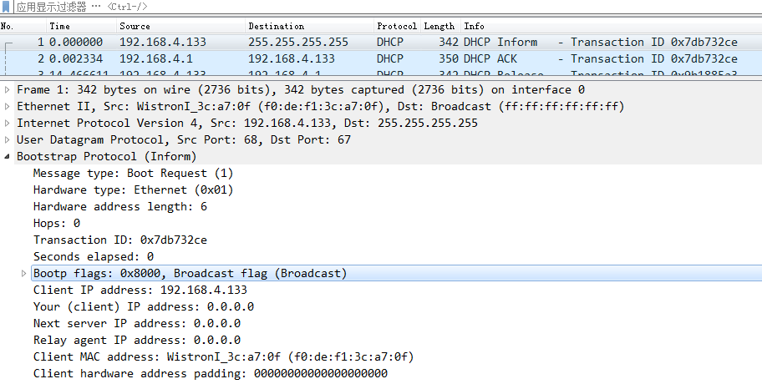
Example of DHCPINFORM
should be replaced by
IP address of DHCP Server
replaced with unicast

Slide 10
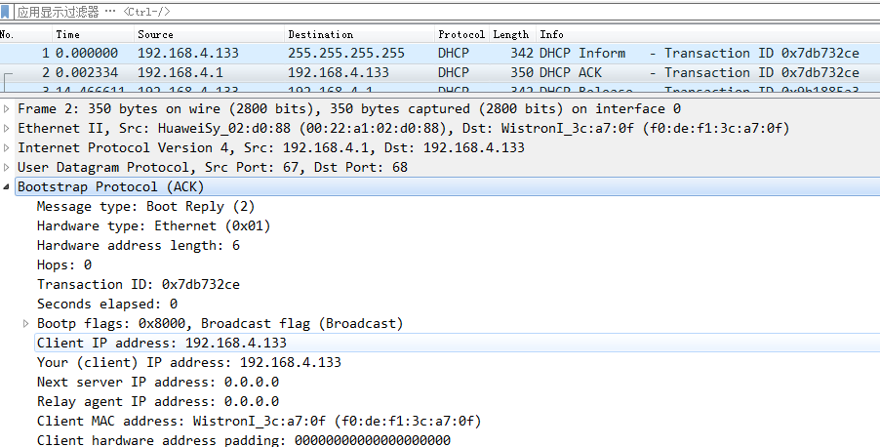
Example of corresponding DHCPACK
replaced with unicast

