Slide 1

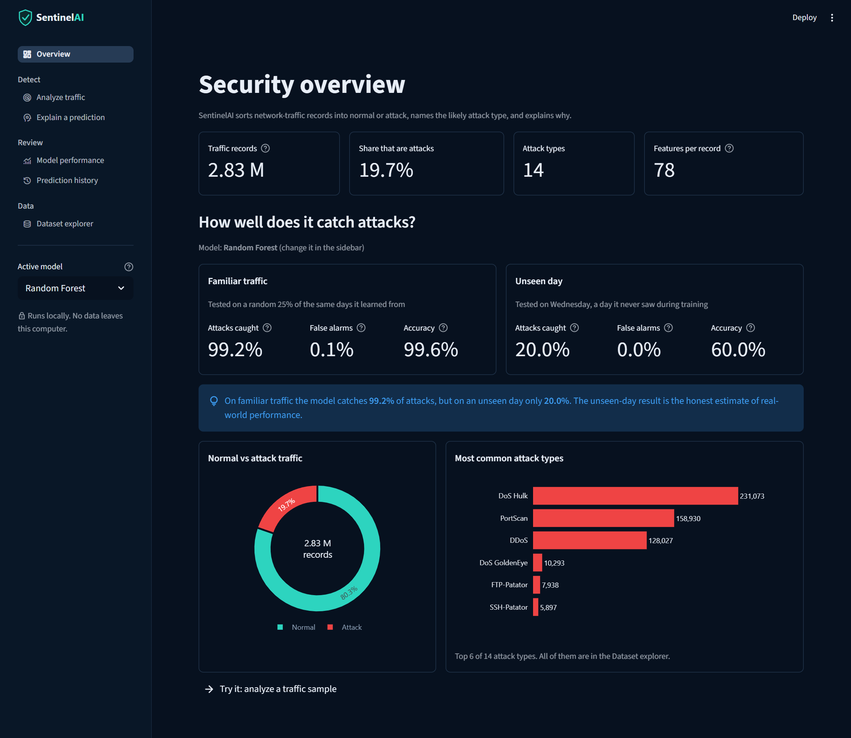
SentinelAI
Explainable machine learning for detecting malicious network traffic
23AI2001 AI for Cyber Security · Skill-Based Evaluation (III Internal)
Nitish (URK24CS5030) · Alston Renz (URK24CS5052) · Ferdinand Garson (URK24CS5068)
Fevin (URK24CS5067) · Jeffrey Joshua (URK24CS5065) · Venkat Gonuguntla (URK24CS5048)
Guide: Mr. Harivignesh K S, Assistant Professor
Notes:
Introduce the team and the project: SentinelAI is a local, explainable intrusion-detection prototype built on the CICIDS2017 dataset. It classifies traffic records as benign or malicious, names the likely attack type, and explains each decision.

Slide 2
Too much network traffic to check by hand
Most traffic is benign, but a small share is an attack: floods, scans, brute force, web attacks and bots.
An intrusion detection system (IDS) flags the suspicious records so a security team can respond.
Machine learning can learn attack patterns from labelled traffic, but analysts also need to know why a record was flagged.
SentinelAI combines detection, attack-type naming and SHAP explanations in one local dashboard.
2.83 M
network-flow records in CICIDS2017
78
numeric features per record
14
attack types, about 20% of records
Notes:
Explain the scale of the problem and why explainability matters. CICIDS2017 was recorded over five working days by the Canadian Institute for Cybersecurity; about 80% of the 2.83 million records are benign.

Slide 3






Problem statement and objectives
Analyze
Classify
Problem
Accept and validate CSV traffic data
Label each record BENIGN or MALICIOUS
Build a system that checks uploaded traffic data, predicts whether each record is benign or malicious, explains the prediction, and reports honestly how well it works on traffic it has never seen.
Identify
Explain
Name the likely attack type, or say uncertain
Show which features drove a prediction
Evaluate
Record
Compare models on familiar and unseen traffic
Keep a local history of predictions
Notes:
State the problem in one sentence, then walk through the six objectives. Classify, Explain and Evaluate are the core; Analyze, Identify and Record support them.

Slide 4
Literature review
Area | Key work | What SentinelAI takes from it
Intrusion detection | Denning (1987); Buczak & Guven (2016) | Separate normal from malicious activity
ML and DL for IDS | Liu & Lang (2019); Ahmad et al. (2021) | Wide range of models; supports a two-model comparison
Model foundations | Breiman (2001); Hosmer et al. (2013) | Basis for Random Forest and Logistic Regression
Datasets | Ring et al. (2019); Sharafaldin et al. (2018) | CICIDS2017's day-by-day capture enables holdout tests
Evaluation pitfalls | Sommer & Paxson (2010); Arp et al. (2022) | Random splits can make results look better than they are
Explainable AI | Ribeiro et al. (2016); Lundberg & Lee (2017) | SHAP explains individual predictions
Key gap: few student IDS projects test on a held-out day or explain their predictions.
Notes:
Highlight two threads: Sommer & Paxson and Arp et al. warn that random-split evaluation overstates performance, and Lundberg & Lee's SHAP gives per-prediction explanations. SentinelAI acts on both.

Slide 5



Existing systems and their limitations
Signature-based IDS
Anomaly-based IDS
Typical ML studies
Matches traffic against known attack patterns (e.g. Snort rules).
Models normal behaviour and flags deviations.
Train a classifier on a labelled dataset and report accuracy.
Precise for known attacks
Cannot recognise new attacks
Rules need constant updates
Can flag unfamiliar behaviour
Many false alarms
Hard to say why an alert fired
Very high reported accuracy
Black-box predictions
Usually tested on a random split only
Notes:
Each approach has a gap. Signature IDS misses new attacks, anomaly IDS raises false alarms, and many ML papers report near-perfect accuracy without testing on genuinely new traffic or explaining decisions.

Slide 6





Proposed system: SentinelAI
Two-stage detection
Honest uncertainty
SHAP explanations
A binary model (Random Forest or Logistic Regression) flags attacks; a second Random Forest names the attack type.
Below 0.60 confidence, or for attack types too rare to learn, the type is reported as uncertain instead of guessed.
For any record, the dashboard shows which features pushed the model toward attack or normal.
Unseen-day evaluation
Local dashboard
Memory-conscious pipeline
Models are tested on a random split and on a whole held-out day (Wednesday).
A Streamlit app with six pages that runs offline; no data leaves the computer.
Chunked reading and a bounded sample keep training within 8 GB of RAM.
Notes:
Map each feature back to a limitation on the previous slide: naming attacks and admitting uncertainty, explaining decisions, and testing on an unseen day.

Slide 7
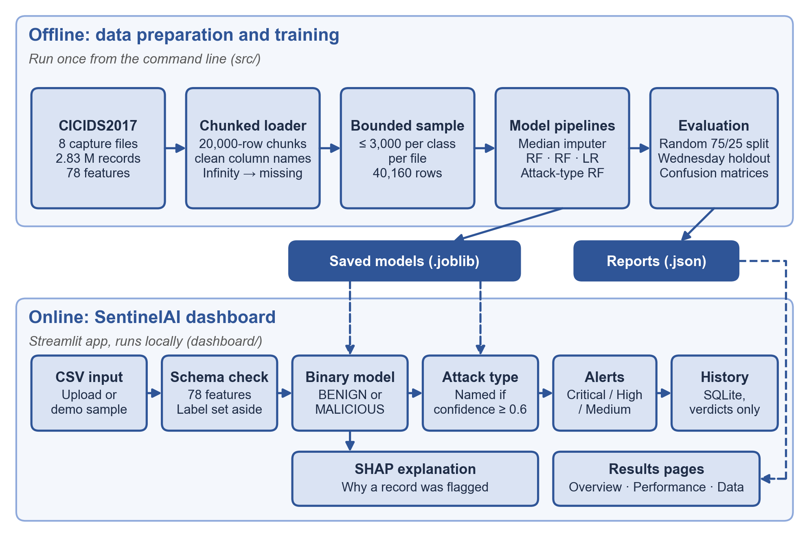
System architecture
Offline
Clean, sample and train once; save models and reports.
Online
The dashboard loads the saved models, checks each file, and returns alerts and explanations.
Notes:
Walk the diagram top to bottom. Offline: CICIDS2017 is read in 20,000-row chunks, cleaned, sampled to 40,160 rows, and used to train the pipelines. Online: the Streamlit dashboard validates uploads against the 78-feature schema, runs the binary and attack-type models, and shows alerts, SHAP explanations and history.

Slide 8

Methodology
1
2
3
4
5
6
Inspect
Clean
Sample
Train
Evaluate
Explain
8 files, 2.83 M rows, schema and label counts
Standard column names; Infinity and NaN become missing
≤ 3,000 rows per class per file: 40,160 rows
Median imputation fitted on training rows only
Random 75/25 split and Wednesday holdout
SHAP values per record and overall
No data leakage: every model is a scikit-learn pipeline, so imputation and scaling are learned from training rows only. Wednesday is removed from training entirely to test on genuinely new traffic, and Monday (benign only) cannot measure attack recall.
Notes:
Emphasise steps 4 and 5. Fitting preprocessing on training rows only and holding out a whole day are what make the results trustworthy.

Slide 9



Implementation
Python · pandas
scikit-learn 1.7.2
Module | Role
src/data_pipeline.py | Streaming inspection and cleaning
src/train.py | Bounded sample, RF baseline, Wednesday holdout
src/compare_models.py | Three-model comparison, per-attack recall
src/threat_type.py | 11-label attack-type model
dashboard/app.py | Streamlit pages and alert rules
dashboard/dashboard_utils.py | Upload validation, SHAP, SQLite
NumPy; chunked data pipeline
Random Forest, Logistic Regression
SHAP
Streamlit · Plotly
Tree and linear explainers
Six-page local dashboard
SQLite
pytest
Prediction history (verdicts only)
19 automated tests, all passing
Notes:
The project is plain Python. Models are saved as complete scikit-learn pipelines, so the dashboard applies exactly the same preprocessing as training. 19 pytest tests cover the pipeline, training helpers and dashboard utilities.

Slide 10
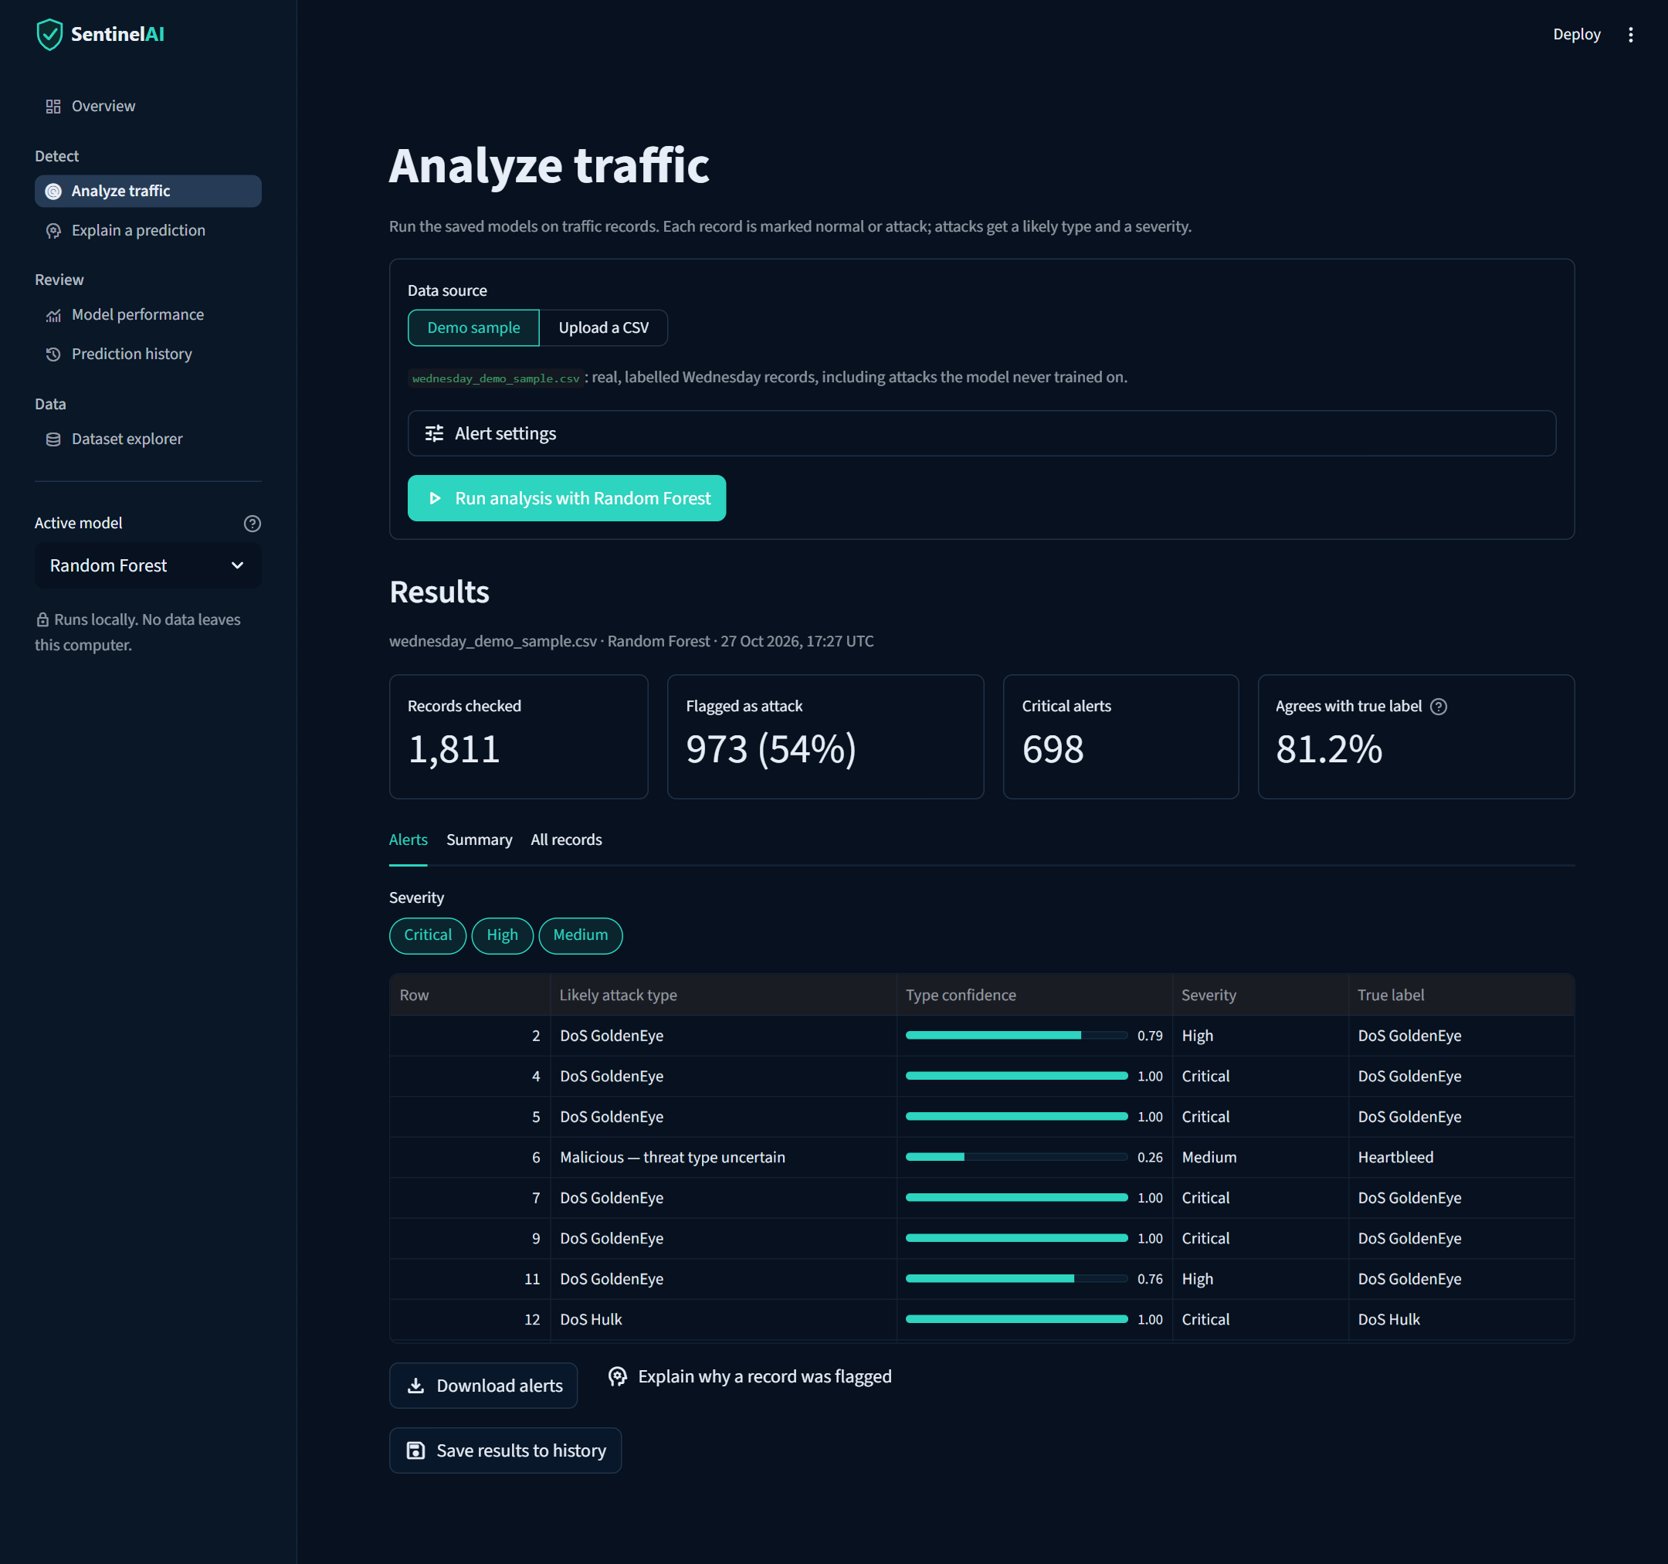
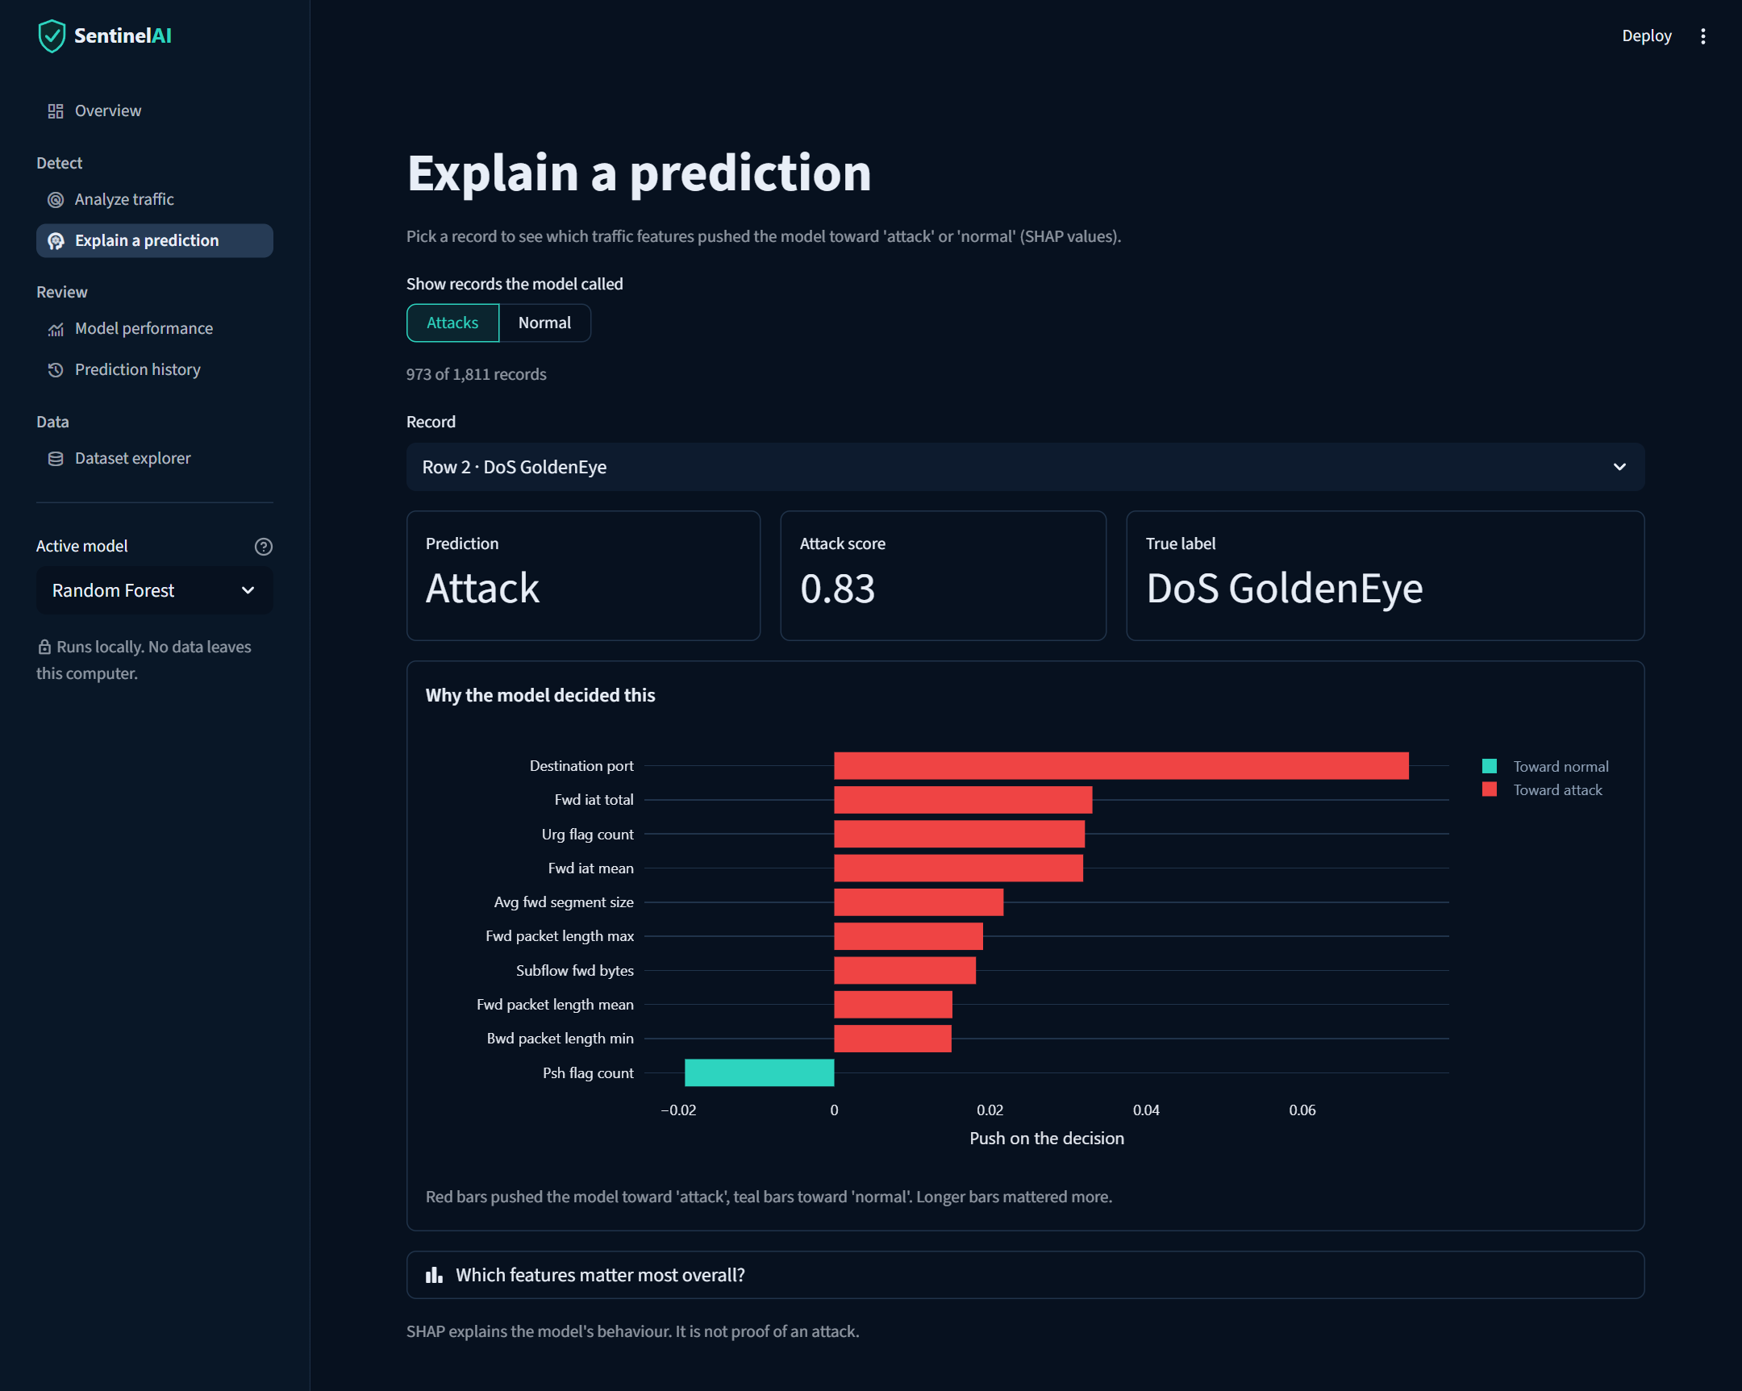
Results and output: the dashboard in action
6 pages
Overview
Analyze
Explain
Performance
History
Dataset
Analyze traffic
Demo sample: 973 of 1,811 records flagged, 698 Critical; 81.2% agree with the true labels.
Explain a prediction
Row 2 (DoS GoldenEye): destination port and packet timing pushed toward attack.
Notes:
Show the live demo here if possible. Point out row 6: a Heartbleed attack is flagged as malicious but its type is shown as uncertain, because Heartbleed has only 11 records in the whole dataset.

Slide 11
99% on familiar traffic, but only 20–33% on an unseen day
0.995
F1-score, random split (Random Forest)
20.0%
attacks caught on unseen Wednesday (RF)
32.9%
attacks caught on Wednesday (LR), with 6.0% false alarms
Notes:
This is the key finding. On a random split the Random Forest scores F1 0.995 with 8 false alarms out of 6,000. On Wednesday, which it never saw, it catches 600 of 3,000 attacks. Logistic Regression catches 986 but raises 181 false alarms. It is a trade-off, and it shows why unseen-day testing matters.

Slide 12

Conclusion
A working prototype
Explainable by design
Detects, names and explains attacks in a local six-page dashboard.
SHAP shows which traffic features drove every alert.
Honest about limits
Main lesson
Near-perfect on familiar data, but much weaker on an unseen day.
How a model is tested matters as much as the model itself.
Notes:
Close on the main lesson: reporting only the 99% random-split score would have hidden that the model misses most attacks on a new day.

Slide 13




Future scope
Validate on more held-out days
Leave out each day in turn to confirm and explain the drop in recall.
Tune thresholds and calibrate scores
Choose the alert threshold on validation data, not the test set.
Live and newer traffic
Add live capture and newer datasets such as CSE-CIC-IDS2018.
Stronger models
Try gradient boosting and deep learning against the same unseen-day test.
Reproducibility
Pin every dependency and add edge-case tests (malformed and oversized files).
Notes:
The highest-value next step is broader validation across several held-out days; the rest builds on it.

Slide 14
References
D. E. Denning, "An Intrusion-Detection Model," IEEE Trans. Software Eng., 1987.
A. L. Buczak and E. Guven, "A Survey of Data Mining and Machine Learning Methods for Cyber Security Intrusion Detection," IEEE Comm. Surveys & Tutorials, 2016.
L. Breiman, "Random Forests," Machine Learning, vol. 45, 2001.
I. Sharafaldin, A. H. Lashkari and A. A. Ghorbani, "Toward Generating a New Intrusion Detection Dataset and Intrusion Traffic Characterization," ICISSP, 2018.
M. Ring et al., "A survey of network-based intrusion detection data sets," Computers & Security, 2019.
R. Sommer and V. Paxson, "Outside the Closed World: On Using Machine Learning for Network Intrusion Detection," IEEE S&P, 2010.
D. Arp et al., "Dos and Don'ts of Machine Learning in Computer Security," USENIX Security, 2022.
M. T. Ribeiro, S. Singh and C. Guestrin, "Why Should I Trust You?: Explaining the Predictions of Any Classifier," KDD, 2016.
S. M. Lundberg and S.-I. Lee, "A Unified Approach to Interpreting Model Predictions," NeurIPS, 2017.
S. M. Lundberg et al., "From local explanations to global understanding with explainable AI for trees," Nature Machine Intelligence, 2020.
Notes:
Full reference list with page numbers is in the project report.

