Slide 1
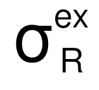
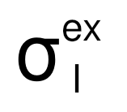

Experiment setup
Reaction cross section:
σ_{inel,bs}
Relation:

Slide 2
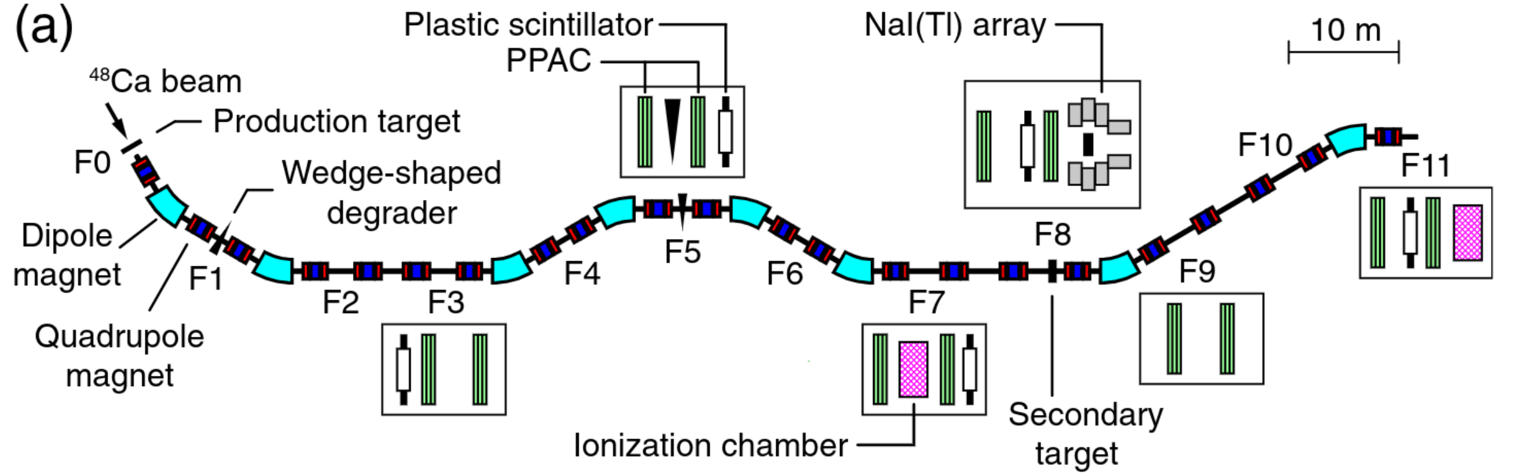
Experiment setup
generate F isotopes
separate contaminants

Slide 3
Experiment setup
in-flight energy deposit (ΔE)
time of flight (TOF)
magnetic rigidity (Bρ)

Slide 4
Experiment setup
number of incident nuclei : N_{in}
number of unreacted flourine : N_{out}

