Slide 1



Ab initio nuclear scattering and reaction calculations
Xilin Zhang (FRIB)
Online Seminar for Jin Lei’s group, Sep. 2021
Thank my collaborators: R. J. Furnstahl, Chan Gwak, A. J. Garcia, J. D. Holt, J. A. Melendez, P. Navrátil, and S. R. Stroberg

Slide 2
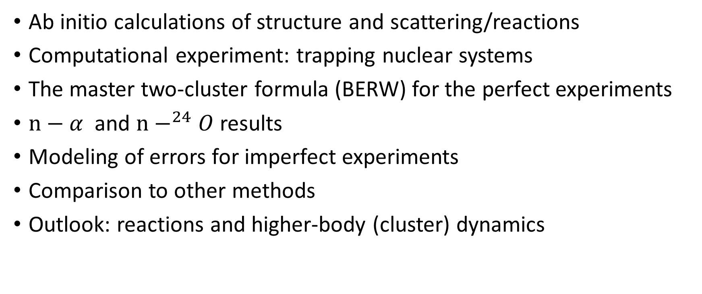
Outline
Ab initio calculations of structure and scattering/reactions
Computational experiment: trapping nuclear systems
The master two-cluster formula (BERW) for the perfect experiments
$n−α$ and $n−^{24}O$ results
Modeling of errors for imperfect experiments
Comparison to other methods
Outlook: reactions and higher-body (cluster) dynamics
Notes:
Too many bullets and too long,

Slide 3
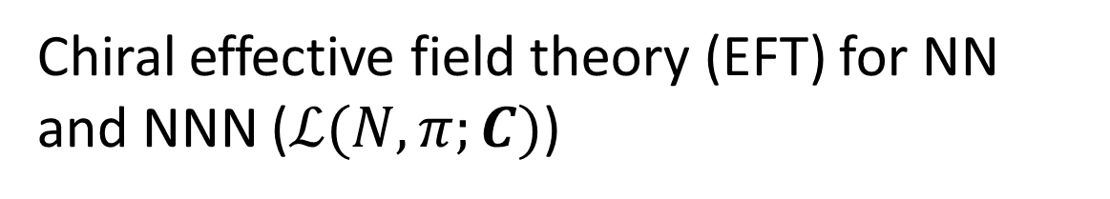
A main paradigm in nuclear theory since 90s
Quantum chromodynamics
(QCD),Lattice QCD
Chiral effective field theory (EFT) for NN and NNN ($ℒ(N,π;C)$)
Ab initio calculations
Few-nucleon systems
Many-nucleon systems
Bound state
Scattering/reactions
Compact nuclei
Dripline (unstable) nuclei
Scattering/reactions
To compute nuclear dynamics with full accounting of errors

Slide 4
Motivations
Nuclear reaction with astrophysical relevance
Experimental tools for studying nuclear structure
Single framework for structure and scattering/reactions at drip-line
Amazing progress by the structure calculations, but scattering and reactions still limited
Heiko Hergert , 2008.05061
Can we take advantage of progress to compute scattering/reactions?

Slide 5
Key idea
Eigen-energies of trapped projectile-target system computed by ab initio energy calculation → scattering info (phase-shift) at those energies
Interpolating between eigen-energies gives the scattering phase-shift as function of scattering energy
The method should work with nuclear systems (e.g., neutron-nucleus) that can be computed by the ab initio structure methods.

Slide 6
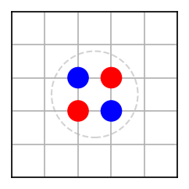
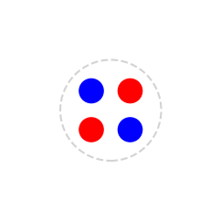
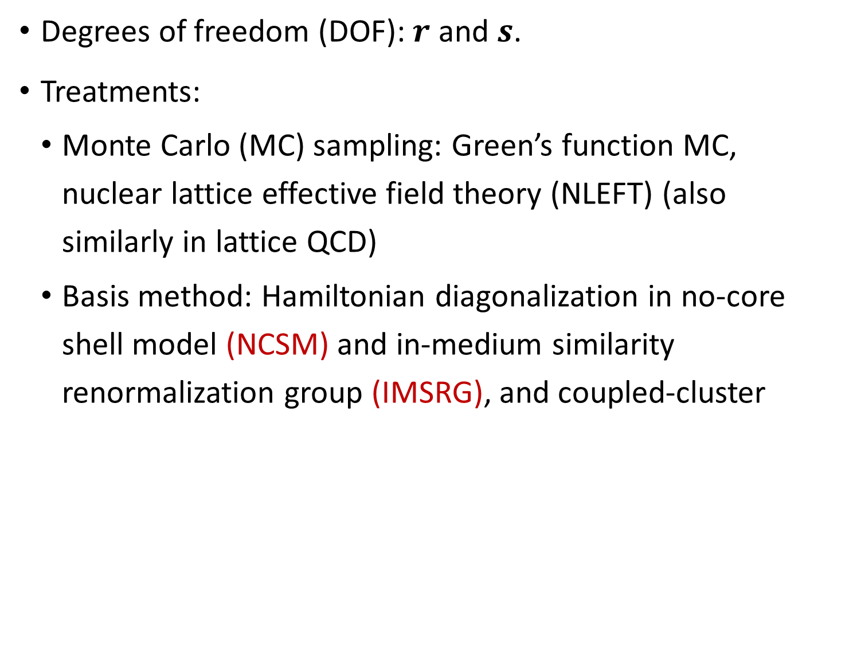
Ab initio calculations of bound nuclei
Degrees of freedom (DOF): $r$ and $s$.
Treatments:
Monte Carlo (MC) sampling: Green’s function MC, nuclear lattice effective field theory (NLEFT) (also similarly in lattice QCD)
Basis method: Hamiltonian diagonalization in no-core shell model (NCSM) and in-medium similarity renormalization group (IMSRG), and coupled-cluster
Infinite→ finite
Method-errors due to truncations
NN-interaction errors
Notes:
C12, Nmax 14, 10^12 dim, for A~60, it gets to 10^20

Slide 7
Ab initio calculations of scattering/reactions
Much more DOF. Methods:
Again MC-sampling of important configurations: NLEFT, GFMC, Lattice QCD
NCSM + continuum
Continuum shell-model
Gamow shell-model
Ab initio optical potential
Errors analysis more challenging and limited

Slide 8
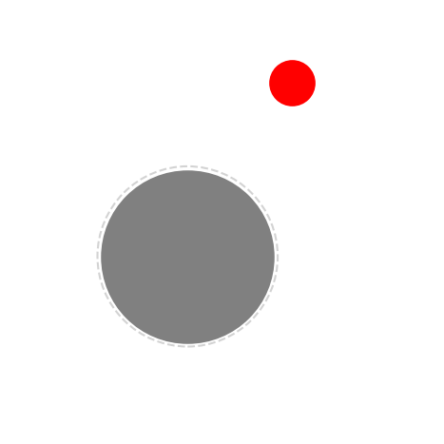
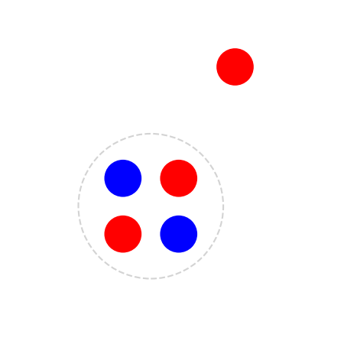
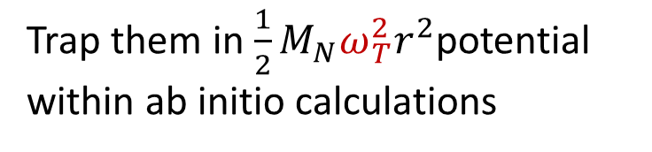

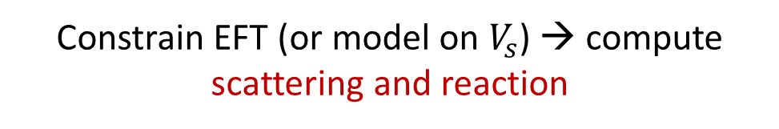
Computer experiment (CE)
Operator matrix elements → effective cluster-level operators (for EW processes)
Works for systems computable by structure methods (traps are important!)
Matches nucleon-level and cluster-level theories through observables (other methods could exist)
Cluster theory restores free-space asymptotic behavior
Not just for two-cluster systems
$$V_{s}$$
Continuum
Trap them in $\frac{1}{2}M_{N}ω_{T}^{2}r^{2}$potential
within ab initio calculations
Bound State
Constrain EFT (or model on $V_{s}$) → compute scattering and reaction

Slide 9
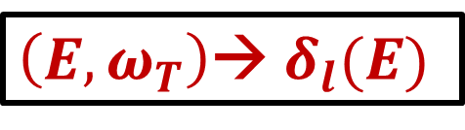

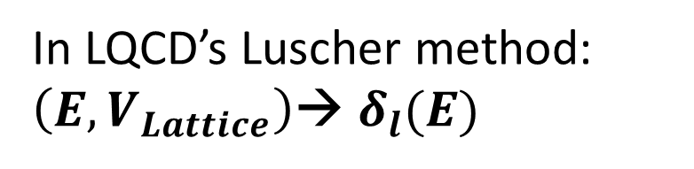
Simplification for two-body scattering
In LQCD’s Luscher method: $\left(E, V_{Lattice}\right)$→ $δ_{l}(E)$
A universal formula (BERW) works for any cluster interaction
$\left(E, ω_{T}\right)$→ $δ_{l}(E)$
Briceno et.al., RMP.90.025002 (2018)
$$σ_{l}\left(E\right)∝ \sin^{2}{δ_{l}(E)}$$
Harmonic potential is well suited here
Reduces DOF → enable ab initio calculations
Decouples the center of mass (CM) and internal DOFs
Preserves rotational invariance

Slide 10
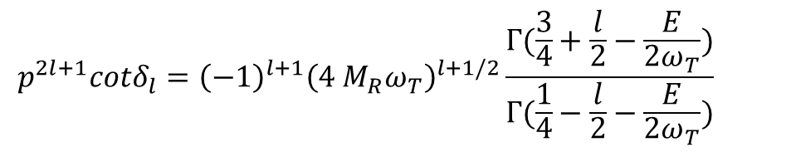
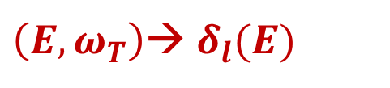
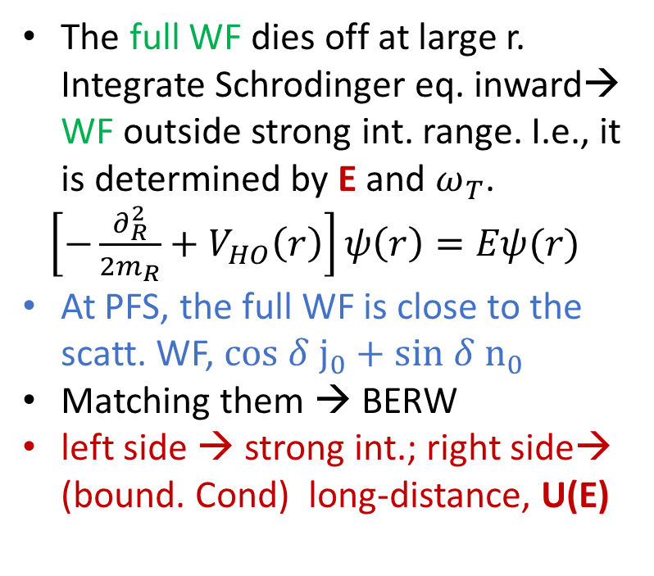
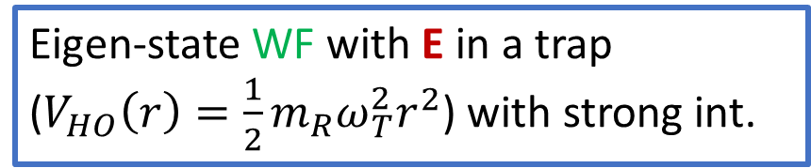
The formula: intuition
Busch, et.al., (1998); Blume & Greene (2002); Block & Holthaus (2002); Bolda, et.al., (2002); Stetcu, et.al., (2007, 2010); Luu, et.al., (2010).
$$p^{2l+1}cotδ_{l}={\left(−1\right)}^{l+1}{\left(4 M_{R}ω_{T}\right)}^{l+1/2}\frac{Γ(\frac{3}{4}+\frac{l}{2}−\frac{E}{2ω_{T}})}{Γ(\frac{1}{4}−\frac{l}{2}−\frac{E}{2ω_{T}})}$$
Suppose we know the eigen-energy (E) of the sys. in a trap for s-wave.
$\left(E, ω_{T}\right)$→ $δ_{l}(E)$
Scattering WF in free space at E with strong-int.
Scattering wave function (WF) in free space at E
Pseudo-free-space (PFS)
The full WF dies off at large r. Integrate Schrodinger eq. inward→ WF outside strong int. range. I.e., it is determined by E and $ω_{T}$.
$\left[−\frac{∂_{R}^{2}}{2m_{R}}+V_{HO}\left(r\right)\right]ψ\left(r\right)=Eψ(r)$
At PFS, the full WF is close to the scatt. WF, $cos δ j_{0}+sin δ n_{0}$
Matching them → BERW
left side → strong int.; right side→ (bound. Cond) long-distance, U(E)
Eigen-state WF with E in a trap
($V_{HO}\left(r\right)=\frac{1}{2}m_{R}ω_{T}^{2}r^{2}$) with strong int.

Slide 11
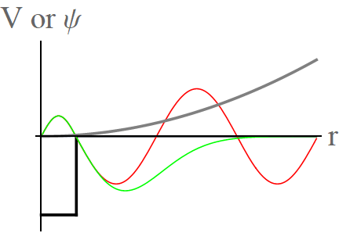
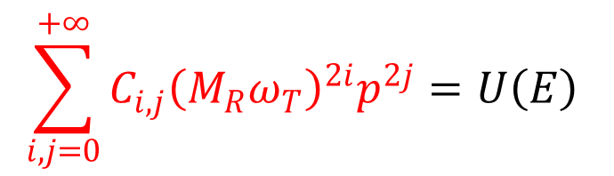
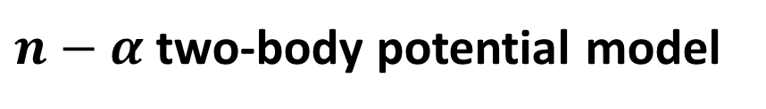
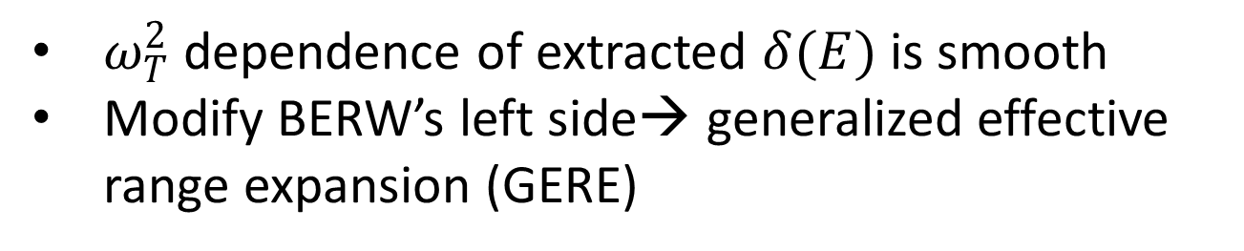
BERW formula: the issue
XZ, PRC.101.051602(R) (2020) [1905.05275]
$n−α$ two-body potential model
However, PFS is not real free space.
$ω_{T}^{2}$dependence of extracted $δ(E)$ is smooth
Modify BERW’s left side→ generalized effective range expansion (GERE)
$$\sum_{i,j=0}^{+∞}{C_{i,j}{\left(M_{R}ω_{T}\right)}^{2i}p^{2j}}=U\left(E\right)$$

Slide 12
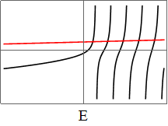


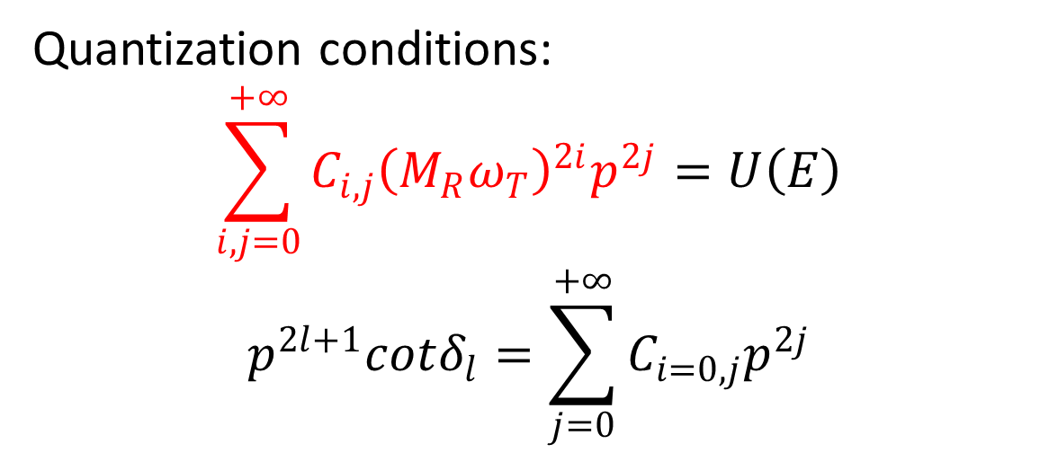



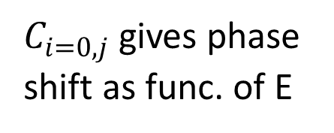
The perfect computer expt. (no errors!)
Quantization conditions:
$$\sum_{i,j=0}^{+∞}{C_{i,j}{\left(M_{R}ω_{T}\right)}^{2i}p^{2j}}=U\left(E\right)$$
$$p^{2l+1}cotδ_{l}=\sum_{j=0}^{+∞}{C_{i=0,j}p^{2j}}$$
$GERE(ω_{T};E)$
$$E$$
$U(E)$
Bound State
$C_{i=0,j}$ gives phase shift as func. of E
Trap them
within ab initio calculations
U(E) at E
Fit them using GERE expansion
Notes:
In a trap, U has an infinite number of poles
E<0, U is close to the U in the free space (Infrared extrapolation for bound state )
In the free space, bound states have E<0
Turning off short-range interaction, crossings happen at eigen-energies for $H_{ω_{T}}$

Slide 13
Before error analysis, let’s first see results
Two sets of results based on NCSM and IMSRG output
XZ et.al., PRL 125, 112503 (2020) [2004.13575 ]

Slide 14
n-α scatterings in s and p waves
General agreement between the NCSM extraction and NCSMC
The IMSRG agrees with NCSMC in p-3/2 but not in p-1/2
N: NCSM, IM: IMSRG,
Dashed line: NCSM+continuum

Slide 15
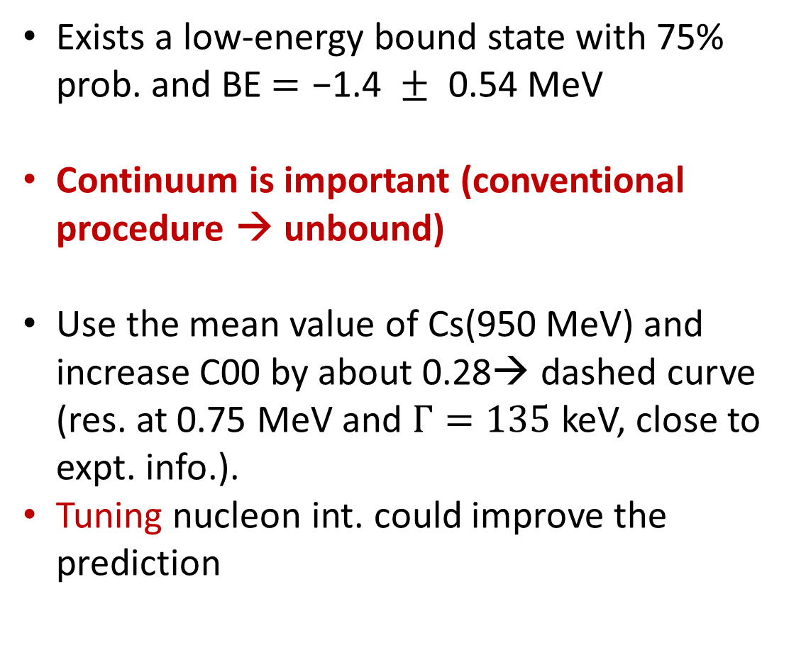
n-O24 scattering in d-3/2 channel
Exists a low-energy bound state with 75% prob. and BE $=\text{−1.4 }±\text{ 0.54}$MeV
Continuum is important (conventional procedure → unbound)
Use the mean value of Cs(950 MeV) and increase C00 by about 0.28→ dashed curve (res. at 0.75 MeV and $Γ=135$ keV, close to expt. info.).
Tuning nucleon int. could improve the prediction

Slide 16
Here comes the messy part

Slide 17
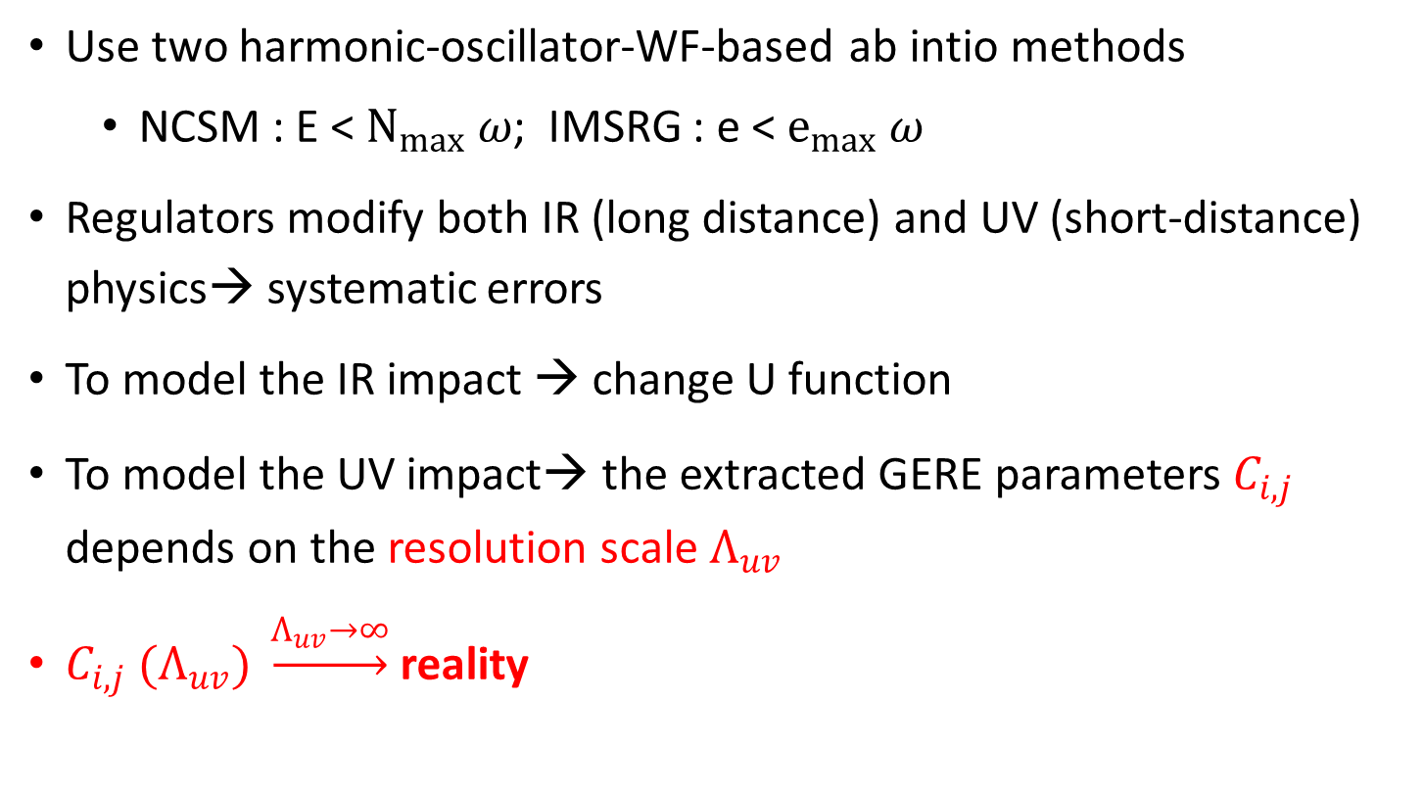
Imperfect expts: ab-initio calculations have truncations on Hilbert-space (regulator)
Use two harmonic-oscillator-WF-based ab intio methods
NCSM : E < $N_{max} ω$; IMSRG : e < $e_{max} ω$
Regulators modify both IR (long distance) and UV (short-distance) physics→ systematic errors
To model the IR impact → change U function
To model the UV impact→ the extracted GERE parameters $C_{i,j}$ depends on the resolution scale $Λ_{uv}$
$C_{i,j} (Λ_{uv}) \underset{→}{Λ_{uv}→∞}$reality
Notes:
Point out different strategy for handling IR and UV errors, as in LQCD practice.

Slide 18
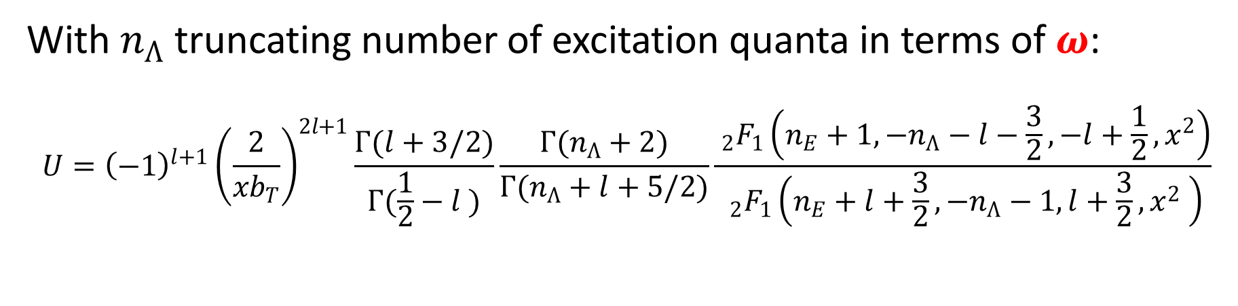
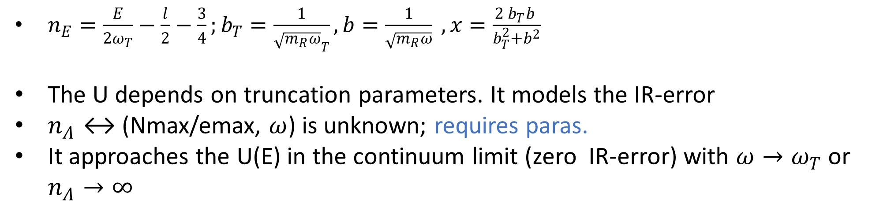
Model the IR-error
With $n_{Λ}$ truncating number of excitation quanta in terms of $ω$:
$$U={\left(−1\right)}^{l+1}{\left(\frac{2}{{xb}_{T}}\right)}^{2l+1}\frac{Γ(l+3/2)}{Γ(\frac{1}{2}−l )}\frac{Γ(n_{Λ}+2)}{Γ(n_{Λ}+l+5/2)}\frac{ _{2}F_{1}\left(n_{E}+1, −n_{Λ}−l−\frac{3}{2},−l+\frac{1}{2},x^{2}\right)}{ _{2}F_{1}\left(n_{E}+l+\frac{3}{2},−n_{Λ}−1,l+\frac{3}{2},x^{2} \right)}$$
$n_{E}=\frac{E}{2ω_{T}}−\frac{l}{2}−\frac{3}{4};b_{T}=\frac{1}{{\sqrt{m_{R}ω}}_{T}},b=\frac{1}{\sqrt{m_{R}ω}} , x=\frac{2 b_{T}b }{b_{T}^{2}+b^{2}}$
The U depends on truncation parameters. It models the IR-error
$n_{Λ}↔$ (Nmax/emax, $ω$) is unknown; requires paras.
It approaches the U(E) in the continuum limit (zero IR-error) with $ω→ω_{T}$ or $n_{Λ}→∞$

Slide 19
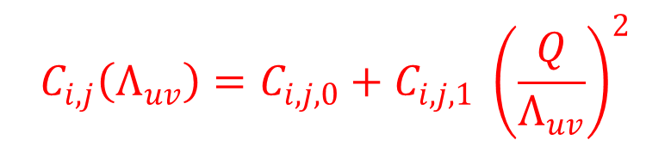

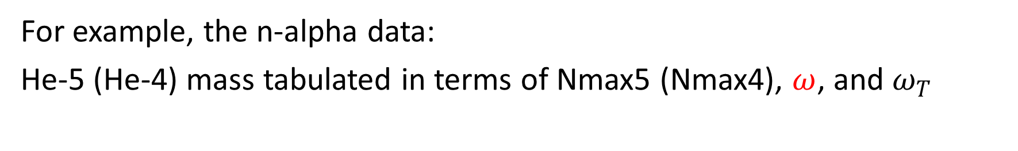
Access the UV-error (besides series truncation error in GERE)
Use the following as interpolator over a small $Λ_{uv}$ bin (less than 100 MeV). $C_{i,j,0}$ $C_{i,j,1}$ and $Q$ are fitting parameters
$$C_{i,j}\left(Λ_{uv}\right)=C_{i,j,0}+C_{i,j,1} {\left(\frac{Q}{Λ_{uv}}\right)}^{2}$$
Another error
For example, the n-alpha data:
He-5 (He-4) mass tabulated in terms of Nmax5 (Nmax4), $ω$, and $ω_{T}$
$$E\left(N_{\max{5}}, ω,ω_{T}\right)=E_{He5}\left(N_{\max{5}}, ω,ω_{T}\right)−E_{He4}\left(N_{\max{4}}, ω,ω_{T}\right)$$
$N_{\max{5}}↔N_{\max{4}}$ is unknown; requires paras.

Slide 20
A digression to Bayesian inference
$$\text{pr}\text{(}\text{C}\text{,}\text{d}\text{|}\text{D}\text{,}\text{T}\text{,}\text{I}\text{)}∝\text{pr}\text{(}\text{D}\text{|}\text{C}\text{,}\text{d}\text{,}\text{T}\text{,}\text{I}\text{)}\text{pr}\text{(}\text{C}\text{,}\text{d}\text{|}\text{I}\text{)}$$
Posterior distribution
Likelihood function
Prior distribution
C are the GERE parameters; d are the other parameters describing the IR and UV error

Slide 21
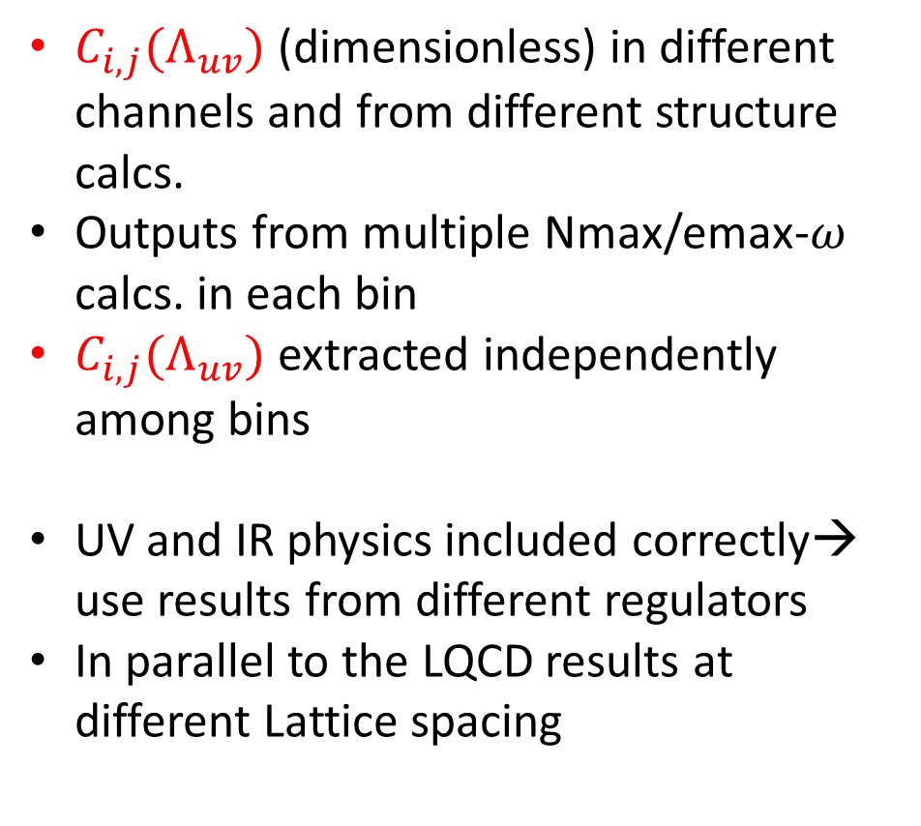
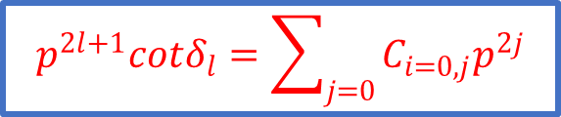
n-α scatterings in s and p waves
$$p^{2l+1}cotδ_{l}=\sum_{j=0}{C_{i=0,j}p^{2j}}$$
$C_{i,j}(Λ_{uv})$ (dimensionless) in different channels and from different structure calcs.
Outputs from multiple Nmax/emax-$ω$ calcs. in each bin
$C_{i,j}(Λ_{uv})$ extracted independently among bins
UV and IR physics included correctly→ use results from different regulators
In parallel to the LQCD results at different Lattice spacing
N: NCSM, IM: IMSRG, Dashed line: NCSM+continuum

Slide 22
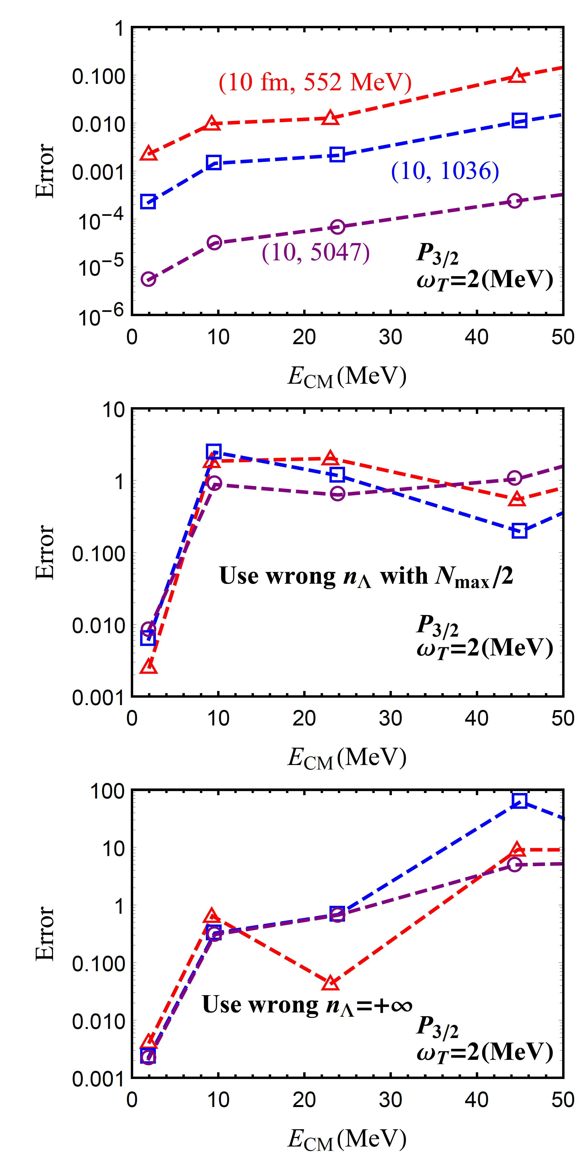
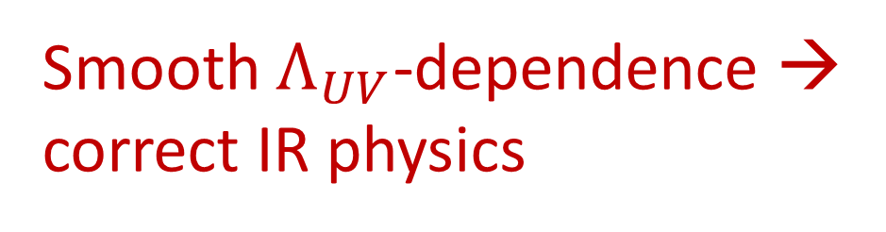
Nontriviality
The errors of the extracted GERE functions in a two-body toy model
(see the supplemental materials in [2004.13575])
Smooth $Λ_{UV}$-dependence →
correct IR physics

Slide 23
n-O24 scattering in d-3/2 channel
Clear UV-scale evolution
It is smooth

Slide 24
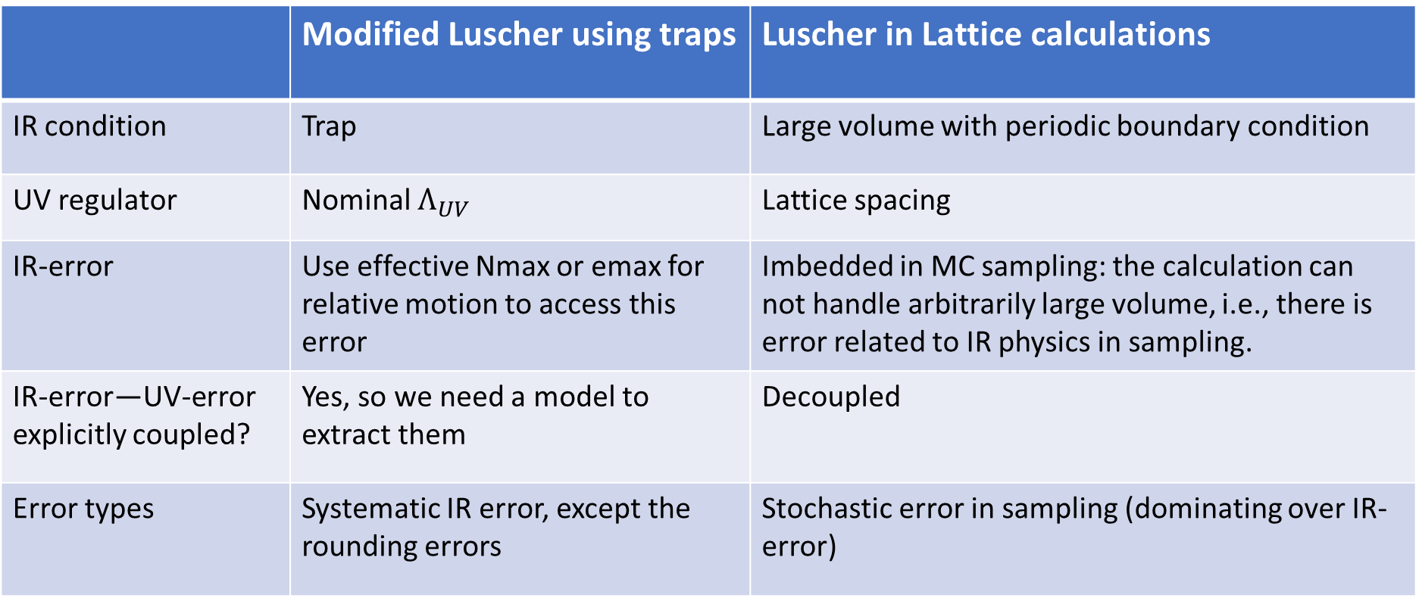
Comparison to the Luscher method in LQCD
 | Modified Luscher using traps | Luscher in Lattice calculations
IR condition | Trap | Large volume with periodic boundary condition
UV regulator | Nominal $Λ_{UV}$ | Lattice spacing
IR-error | Use effective Nmax or emax for relative motion to access this error | Imbedded in MC sampling: the calculation can not handle arbitrarily large volume, i.e., there is error related to IR physics in sampling.
IR-error—UV-error explicitly coupled? | Yes, so we need a model to extract them | Decoupled
Error types | Systematic IR error, except the rounding errors | Stochastic error in sampling (dominating over IR-error)
In our approach, if the base frequency approaches trap frequency, the IR-error would disappear. While doing so, to reduce the UV error, Nmax/emax has to be increased significantly. So perhaps quantum computer is one way to go.

Slide 25
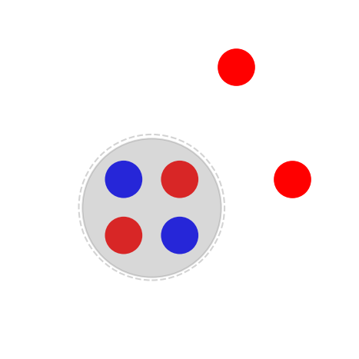

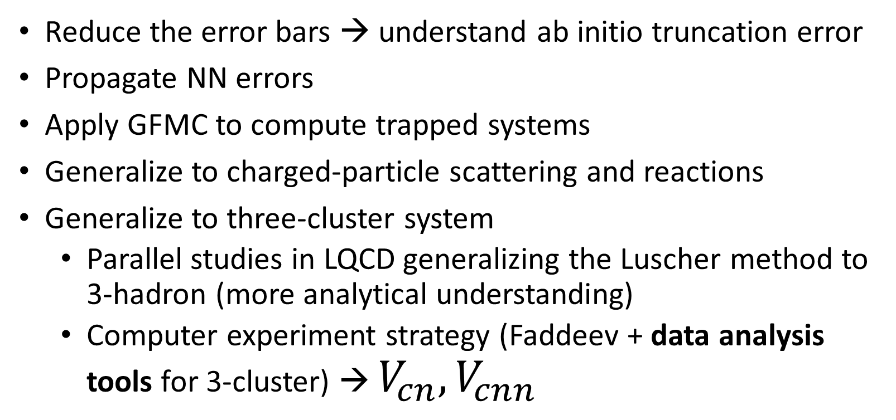


More to be done
$$n$$
$$n$$
$$C$$
Reduce the error bars → understand ab initio truncation error
Propagate NN errors
Apply GFMC to compute trapped systems
Generalize to charged-particle scattering and reactions
Generalize to three-cluster system
Parallel studies in LQCD generalizing the Luscher method to 3-hadron (more analytical understanding)
Computer experiment strategy (Faddeev + data analysis tools for 3-cluster) → $V_{cn}, V_{cnn}$
Notes:
Mention that the computer experiment strategy could be a new way to handle 3 hadrons in LQCD as well.
However, data analysis involving three-body system scattering is hard, since solving Faddeve equation is time consuming. I will come back to this in the last part of the talk.

Slide 26
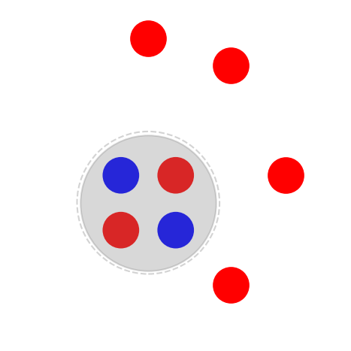
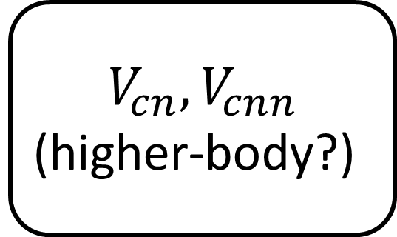
Towards dripline neutron by neutron
Exp.
Abi.
Include continuum using few-many-body solver
Comp. exp. using traps
Gamow-shell-model with core?
Faddeev approach?
Lattice calculation?
…
$$V_{cn}, V_{cnn}$$
(higher-body?)
J. Rotureau and U. van Kolck (2012) on He-6
K. Fossez, J. Rotureau, and W. Nazarewicz (2018) on He isotopes N. Michel, J. G. Li, F. R. Xu et.al., (2020) on A~20 proton-rich
J.G. Li, B.S. Hu, F.R. Xu et. al., (2020) on Ca isotopes
A playground for 4-body force

Slide 27
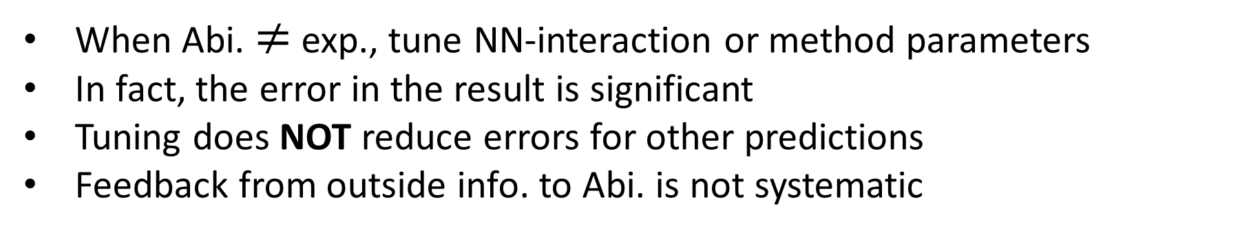
Relationships among exp., ab initio calculations, and phen. (cluster theory/optical potentials/R-matrix)
Exp.
Exp.
Abi.
Or, in the data era
Phen.
Abi.
Phen.
When Abi. $≠$ exp., tune NN-interaction or method parameters
In fact, the error in the result is significant
Tuning does NOT reduce errors for other predictions
Feedback from outside info. to Abi. is not systematic
Information can be combined in cluster level theories

Slide 28
Summary
The Luscher method used in LQCD is generalized to work with ab initio nuclear structure methods (NCSM and IMSRG)
The extracted n-α phase-shifts are compatible with the existing ab initio results using the same nucleon interaction
The n- O24 scattering calculation demonstrates the method’s capability to study systems heavier (it is based on bound-state spectrum calculation)
The UV and IR physics are correctly modeled → results from different regulators are consistent (smooth UV-scale dependence)
We now report results as function of UV scale, a practice common in Lattice methods (Lattice QCD, NLEFT), but not in other ab intio calculations

Slide 29
Outlook
Need to understand the origin of the parameters modeling errors in our “data” analysis in terms of microscopic picture
Explore other observables
To compute reactions, need to study coupled-channel problem within traps. EFT provide one way to approach this problem
Generalization to the higher-body-cluster dynamics (Emulator will be useful)
“Nuclear reactions in artificial traps”, Peng Guo and Bingwei Long, 2101.03901
“Trapped two-nucleon system in energy-dependent effective field theory”, Chenbo Li, Jiexin Yu, Rui Peng, Songlin Lyu, and Bingwei Long

Slide 30
In retrospect
In the harmonic-oscillator-basis structure calculations, the clustering physics already exists, i.e., the basis can handle continuum physics with the help of a trap
The key is to understand properly the IR physics/condition in terms of clusters.
Our IR is dictated by the trap. Truncation leads to IR error and approaches to zero in the continuum limit

Slide 31
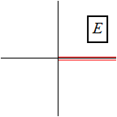


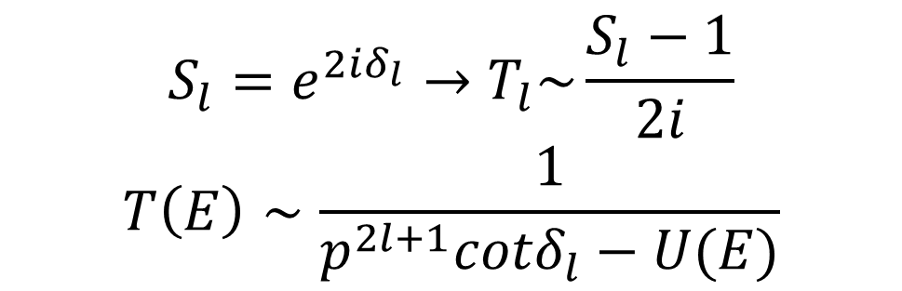



Cure the BERW formula with the UV-defect
$$S_{l}=e^{2iδ_{l}}→T_{l}\sim \frac{S_{l}−1}{2i}$$
$$T\left(E\right)∼\frac{1}{p^{2l+1}cotδ_{l}−U(E)}$$
T-matrix in free space
Non-analyticity from IR physics: $U\left(E\right)=ip^{2l+1}$ (note $ip=\sqrt{−E}$)
Analytical expansion from UV physics, i.e., effective range expansion (ERE):
$p^{2l+1}cotδ_{l}=\sum{C_{i=0,j}p^{2j}}$
EFT derivation :
$$+$$
$$+…$$

Slide 32
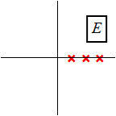





Cure the BERW formula with the UV-defect
In a harmonic trap: $U\left(E\right)=ip^{2l+1}$
$U\left(E\right)={\left(−1\right)}^{l+1}{\left(4 M_{R}ω_{T}\right)}^{l+\frac{1}{2}}\frac{Γ\left(\frac{3}{4}+\frac{l}{2}−\frac{E}{2ω_{T}}\right)}{Γ\left(\frac{1}{4}−\frac{l}{2}−\frac{E}{2ω_{T}}\right)}$
+ loop diags :
Generalized ERE and quantization conditions
$\sum_{i,j=0}^{+∞}{C_{i,j}{\left(M_{R}ω_{T}\right)}^{2i}p^{2j}}=U\left(E\right)$
${ p}^{2l+1}Cotδ_{l}=\sum_{j=0}^{+∞}{C_{i=0,j}p^{2j}}$
XZ, 1905.05275.

Slide 33
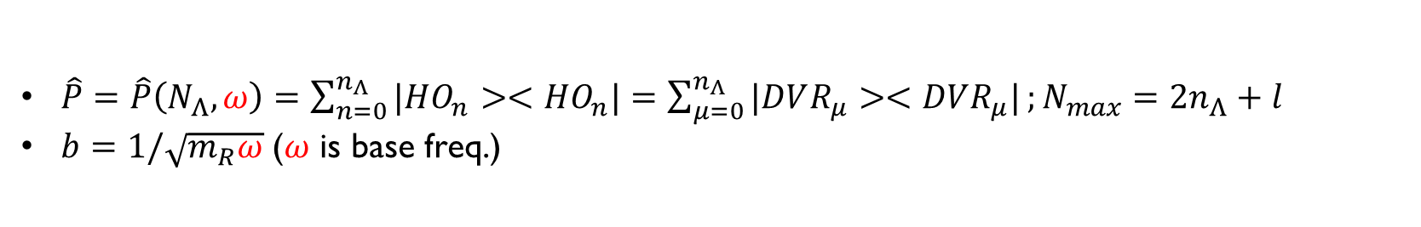
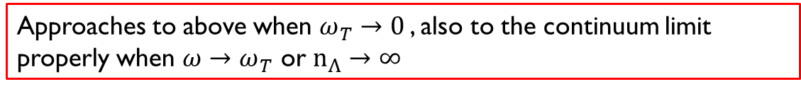


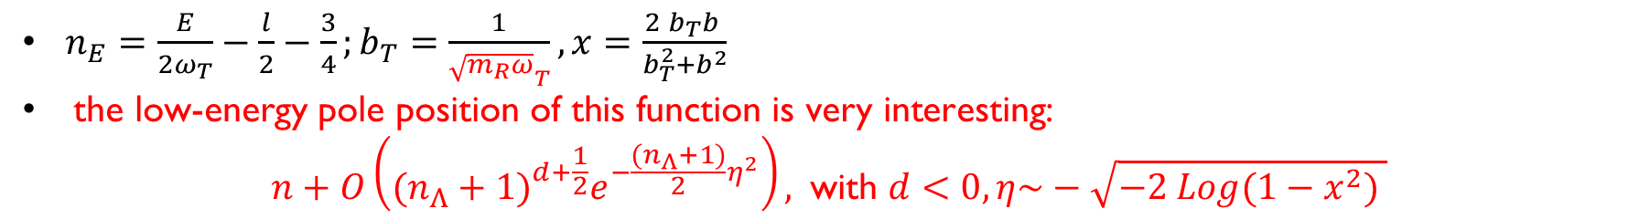
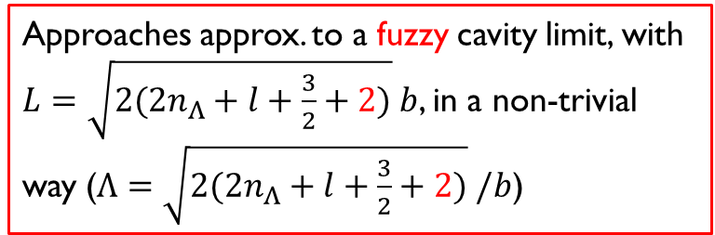
U(E) in the finite model space (H.O. basis, NCSM)
Approaches approx. to a fuzzy cavity limit, with $L=\sqrt{2(2n_{Λ}+l+\frac{3}{2}+2)} b$, in a non-trivial way ($Λ=\sqrt{2(2n_{Λ}+l+\frac{3}{2}+2)} /b$)
In a “cavity” for relative motion with radius L
$U=p^{2l+1}\frac{y_{l}(Lp)}{j_{l}(Lp)}$ $← <i\left|V_{s}\frac{1}{E−H_{0}}V_{s}\right|i>$
In Nmax truncation scheme for two-body relative motion (“U for the un-trapped and the truncated”):
$U=\frac{{\left(−1\right)}^{l+1}}{b^{2l+1} }\frac{Γ(l+3/2)}{Γ(\frac{1}{2}−l )}\frac{Γ(n_{Λ}+2)}{Γ(n_{Λ}+l+5/2)}\frac{M\left(−n_{Λ}−l−\frac{3}{2},−l+\frac{1}{2},p^{2}b^{2}\right)}{M\left(−n_{Λ}−1,l+\frac{3}{2},p^{2}b^{2}\right)}$ $←<i\left|V_{s}\hat{P}\frac{1}{E−H_{0}}\hat{P}V_{s}\right|i>$
Now with the trapping potential, with $ω_{T}$ frequency (“U for the trapped and truncated”)
$$U={\left(−1\right)}^{l+1}{\left(\frac{2}{{xb}_{T}}\right)}^{2l+1}\frac{Γ(l+3/2)}{Γ(\frac{1}{2}−l )}\frac{Γ(n_{Λ}+2)}{Γ(n_{Λ}+l+5/2)}\frac{ _{2}F_{1}\left(n_{E}+1, −n_{Λ}−l−\frac{3}{2},−l+\frac{1}{2},x^{2}\right)}{ _{2}F_{1}\left(n_{E}+l+\frac{3}{2},−n_{Λ}−1,l+\frac{3}{2},x^{2} \right)}$$
$$H_{0}→H_{ω_{T}}$$
$\hat{P}=\hat{P}\left(N_{Λ},ω\right)=\sum_{n=0}^{n_{Λ}}{|HO_{n}><HO_{n}|}=\sum_{μ=0}^{n_{Λ}}{|DVR_{μ}><DVR_{μ}|};N_{max}=2n_{Λ}+l$
$b=1/\sqrt{m_{R}ω}$ ($ω$ is base freq.)
Approaches to above when ${ω_{T}→0}_{ }$, also to the continuum limit properly when $ω→ω_{T}$ or $n_{Λ}→∞$
$n_{E}=\frac{E}{2ω_{T}}−\frac{l}{2}−\frac{3}{4};b_{T}=\frac{1}{{\sqrt{m_{R}ω}}_{T}},x=\frac{2 b_{T}b }{b_{T}^{2}+b^{2}}$
$\text{the} \text{low}\text{−}\text{energy} \text{pole} \text{position} \text{of} \text{this} \text{function} \text{is} \text{very} \text{interesting}\text{: }$
$$n+O\left({(n_{Λ}+1)}^{d+\frac{1}{2}}e^{−\frac{(n_{Λ}+1)}{2}η^{2}}\right), \text{with} d<0, η\sim −\sqrt{−2 Log(1−x^{2}) }$$

Slide 34




The pole structures of the U function converge to the continuum limit in terms Exp( - C*Nmax)

Slide 35










NN model:(G)ERE extractions for the s-wave, for both trapped and non-trapped system.
The markers are $L$and $Λ$ as defined before
UV error scales as $1/LΛ^{3}$ at leading order
Different IR modification is disentangled from UV error
The UV error can be reduced by improving potential’s UV behavior
This also suggests that if NN is optimized, adding further trap doesn’t require further optimization

Slide 36




Cavity boundary condition (for relative motion)
Scattering wave function (WF) at E with strong-interaction and infinite potential wall at r=Rc
$${tanδ}_{l}×n_{l}\left(kR_{c}\right)$$
$+j_{l}\left(kR_{c}\right)=0$
I.e., $\left(E, R_{c}\right)$→ $δ_{l}(E)$
$$R_{c}$$
Corresponding scattering WF at E in free space without any potential

Slide 37

Analyze He4 and He5 energies from NCSM and extract n-α scattering in P-3/2 channel
$C_{i,j}(Λ_{uv})$ are the GERE parameters (dimensionless).
The error band partially comes from IR-error, while the UV-error (not in the band) approaches zero with large $Λ_{uv}$
Different data sets (using different Nmax and $ω)$are grouped in different $Λ_{UV}$ bins.
The parameters are extracted independently among these bins.
Smooth $Λ_{UV}$-dependence, a signal that the IR physics is under control
Notes:
$ω_{T}=$2,4,6,8,10,12,14,16 for $ω$=28 MeV; $ω_{T}=$4,6,8,10 for $ω$=20 and 15 MeV. The Nmax is upto 16 for all these cases.
In the legend, 12,14,16 (28): 900 MeV, “12,14,16” are Nmax, “28” is the $ω$, “900 MeV” is the $Λ_{UV}$

Slide 38

Analyze He4 and He5 energies from NCSM and extract n-α scattering in P-3/2 channel
Lowering $Λ_{UV}$ has a trend to turn a resonance to bound state (also seen in p-½ channel)
The extraction agrees with Petr’s direct phase-shift calculation below 5 MeV with high $Λ_{UV}$
Since we model both UV and IR physics components, we can use most (Nmax, $ω$) results and extract phase-shifts. This is like LQCD producing results at different Lattice spacing.
Notes:
$ω_{T}=$2,4,6,8,10,12,14,16 for $ω$=28 MeV; $ω_{T}=$4,6,8,10 for $ω$=20 and 15 MeV. The Nmax is upto 16 for all these cases.
In the legend, 12,14,16 (28): 900 MeV, “12,14,16” are Nmax, “28” is the $ω$, “900 MeV” is the $Λ_{UV}$

Slide 39
n-α in P-1/2 channel from NCSM
Similar conclusions can be drawn as in P-3/2

Slide 40
n-α in S-1/2 channel from NCSM
Less data
Mean values agree with NCSMC quite well
Notes:
Please note, the much larger error bar in the s-wave is because the energy data here are sitting in 10 MeV range, while the p-waves have energy in a few MeV range. And there are much less data below
Alpha excitation energy (about 20 MeV) in the s-wave channel than those in the p-waves.
Still the qualitative behavior of the phase shift is consistent with Petr’s direct phase-shift calculation. What is not shown is the mean curve of those error band, corresponding to the mean/median values of the GERE parameters are quite close to Petr’s phase shift.

Slide 41
n-α in P-3/2 channel from IMSRG
Notes:
More $ω_{T}$and $ω$are available: $ω_{T}$= 2,3,4,5,6,7,8,9,10,12,14 MeV.

Slide 42
n-α in P-1/2 channel from IMSRG
Notes:
More $ω_{T}$and $ω$are available: $ω_{T}$= 2,3,4,5,6,7,8,9,10 MeV.

Slide 43

Analyze O24 and O25 energies from IMSRG and extract n-O24 scattering in d-3/2 channel
C00 decreases with increasing $Λ_{UV}$ (smooth evolution: C00~0.1, NOT 10 or 0.001)
C01 and C10 have also some UV dependence
Approaching to the continuum limit, no resonance behavior in scattering
If C00 were positive, the resonance shows up (NOT the prediction of the used nucleon interaction)

