Slide 1

1
组会报告1
陆亚洲

Slide 2
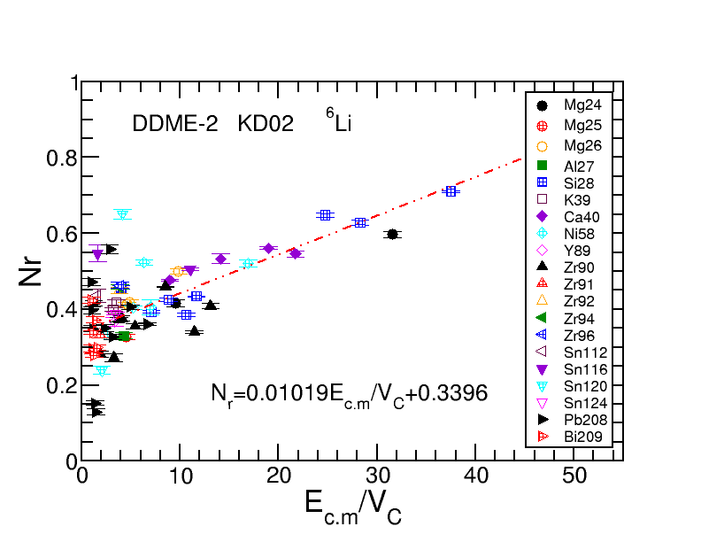
2

Slide 3
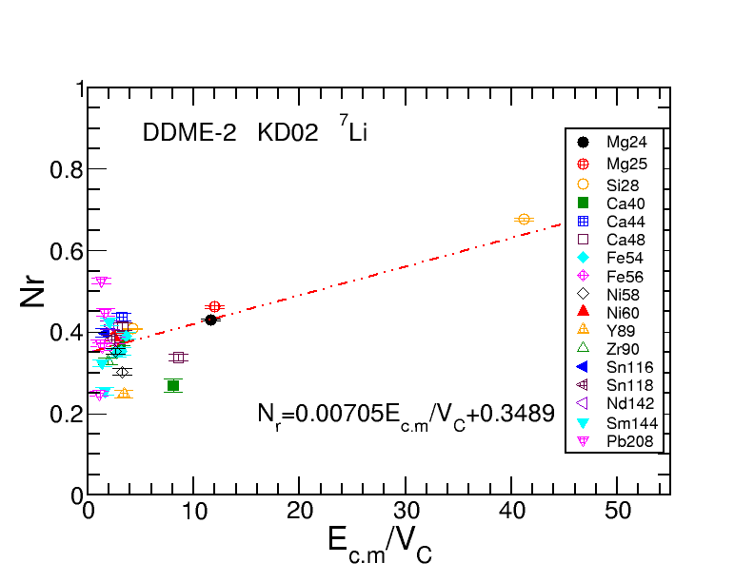
3

Slide 4
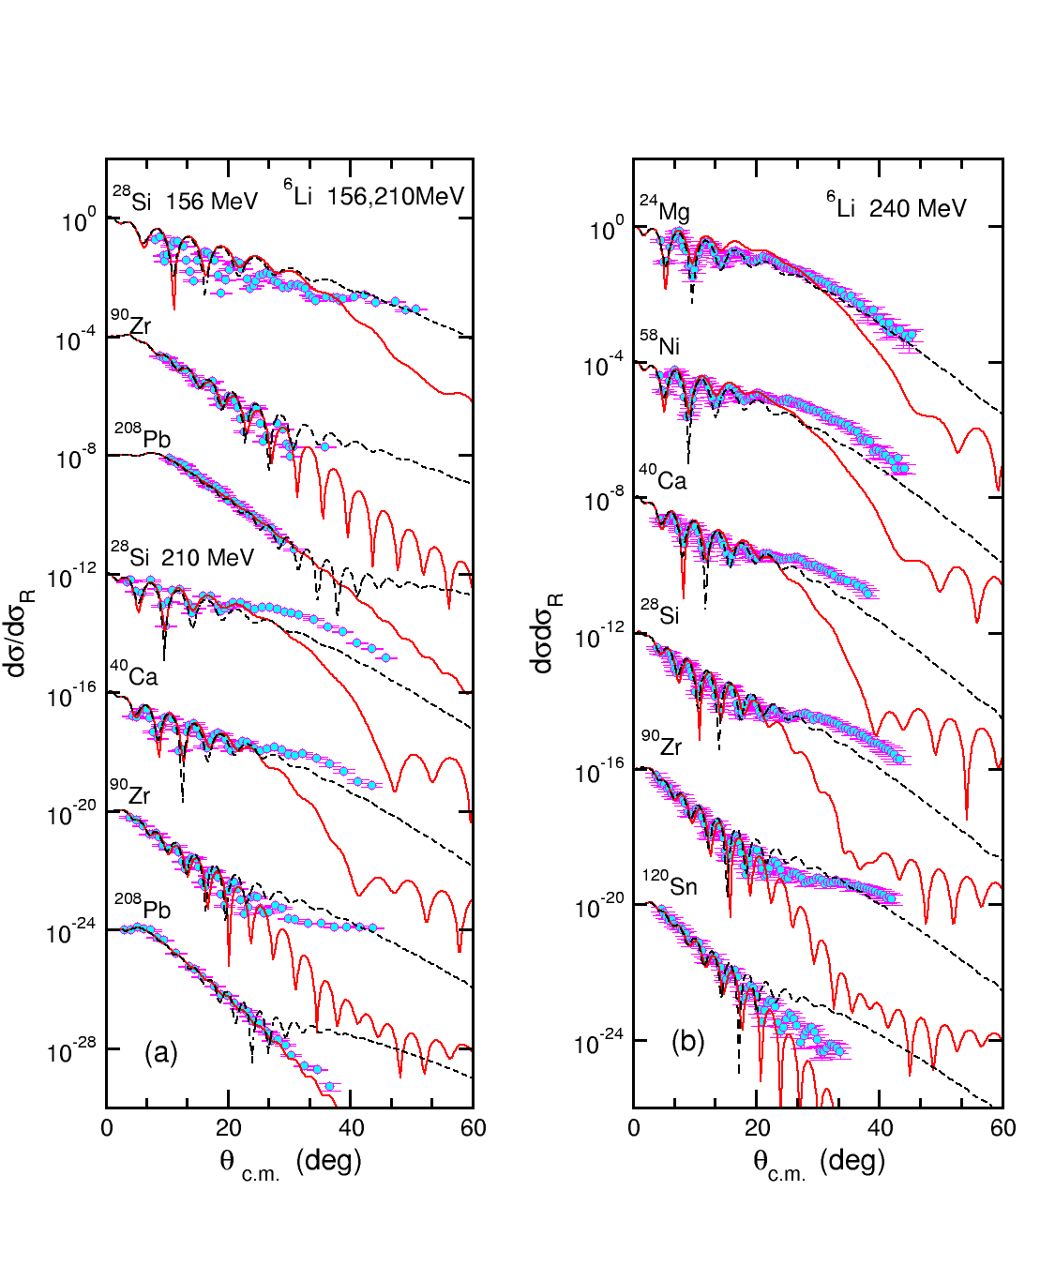
4

Slide 5
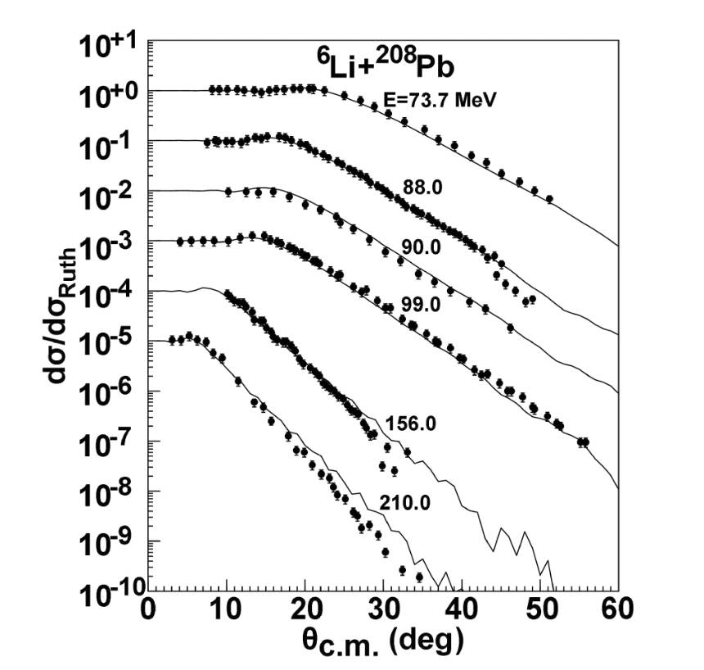
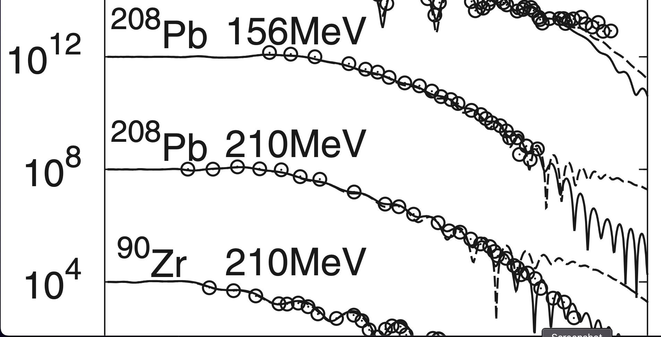
4

Slide 6
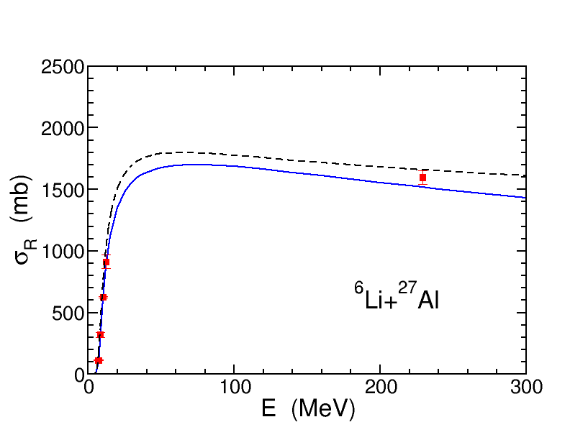
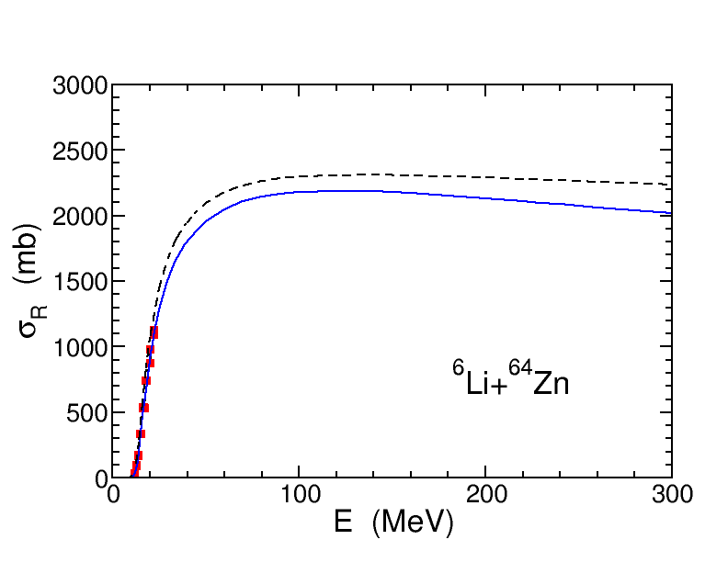
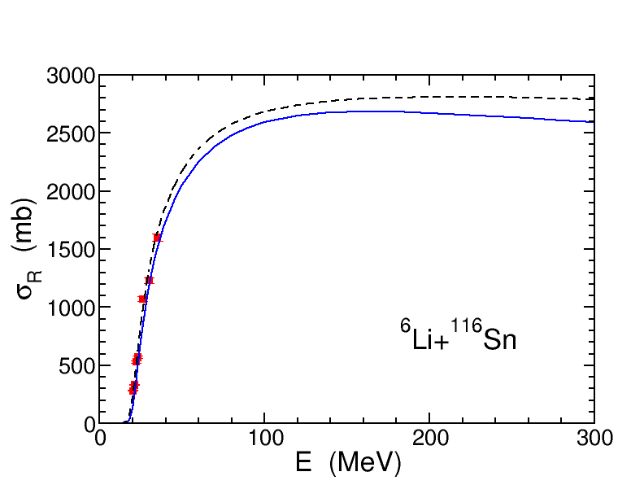
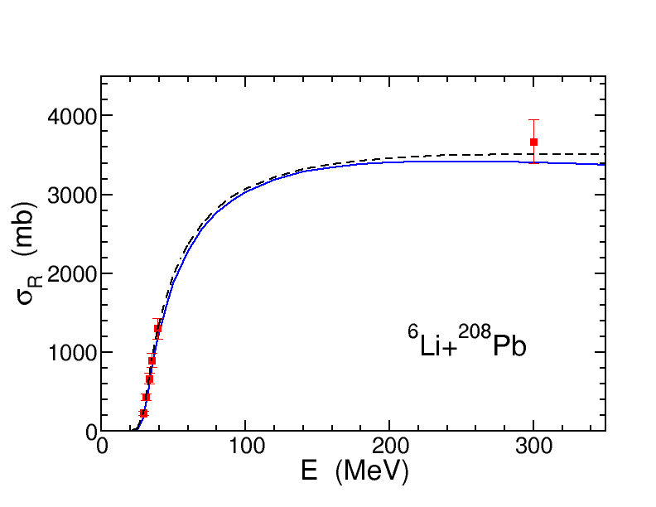
5

Slide 7
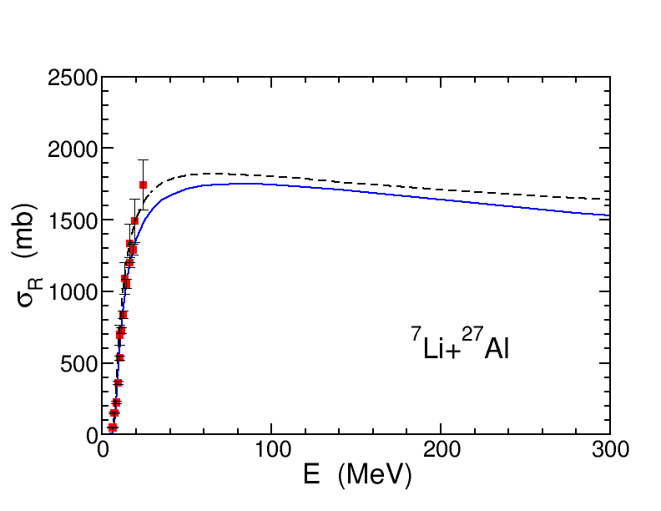
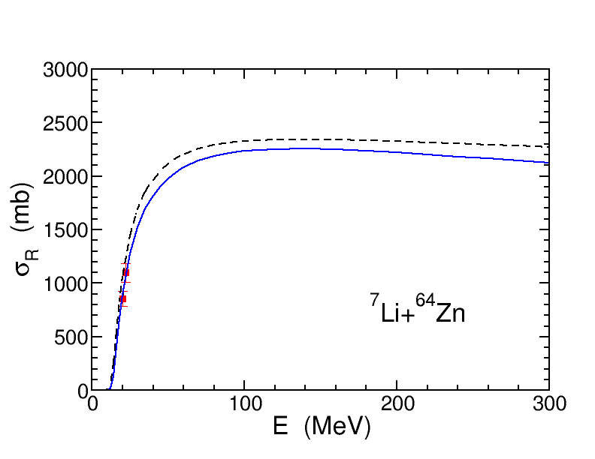
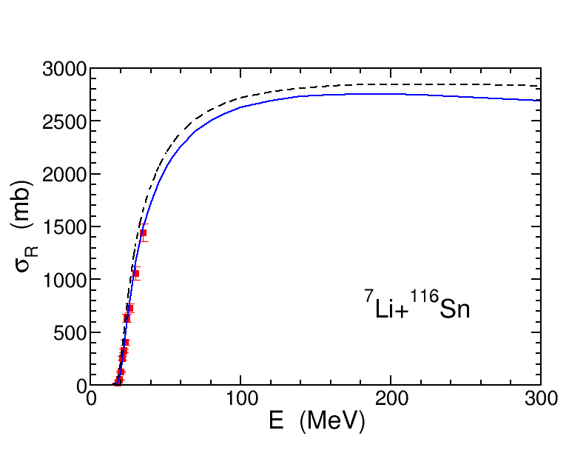
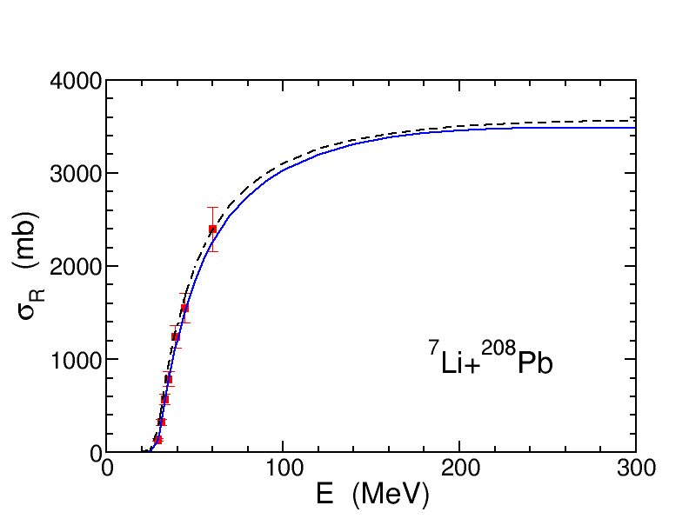
6

Slide 8
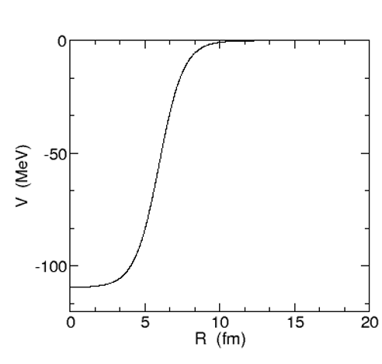
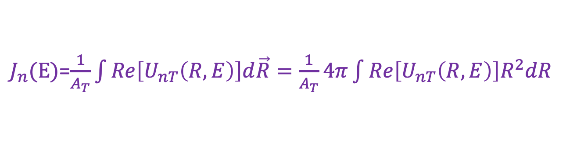
7
$J_{n}(E)$=$\frac{1}{A_{T}}\int{Re\left[U_{nT}\left(R,E\right)\right]d\vec{R}}=\frac{1}{A_{T}}4π\int{Re\left[U_{nT}\left(R,E\right)\right]R^{2}dR}$

Slide 9
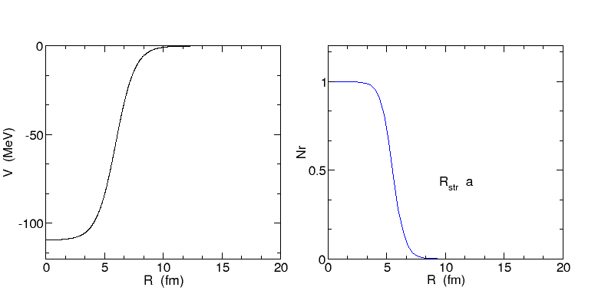
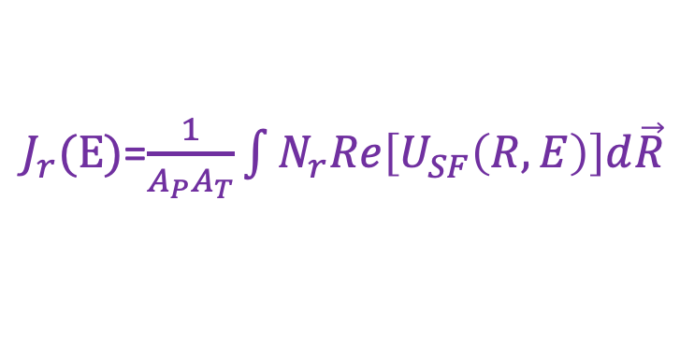
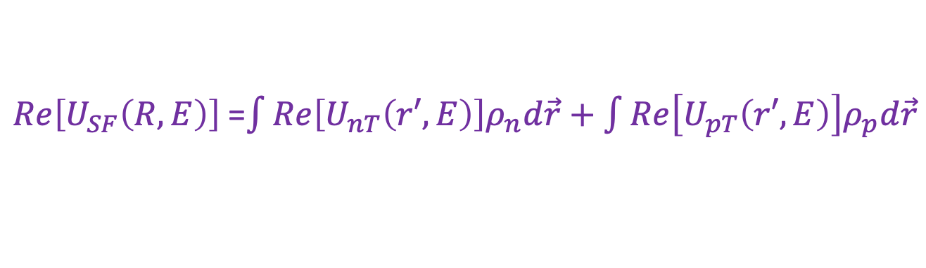
7
$J_{r}(E)$=$\frac{1}{A_{P}A_{T}}\int{N_{r}Re\left[U_{SF}\left(R,E\right)\right]d\vec{R}}$
$Re\left[U_{SF}\left(R,E\right)\right]$=$\int{Re\left[U_{nT}\left(r′,E\right)\right]ρ_{n}d\vec{r}+\int{Re\left[U_{pT}\left(r′,E\right)\right]ρ_{p}d\vec{r}}}$

Slide 10
7

Slide 11
8

Slide 12
9

Slide 13
10

Slide 14
11

Slide 15
12
4.谢谢观看

