Slide 1

1
组会报告3
陆亚洲

Slide 2
2
基础知识
[1] G. R. Satchler, Introduction to Nuclear Reactions (Red Globe Press London, 1990).
[2] G. R. Satchler, Direct nuclear reactions (Oxford University Press, New York, 1983).
[3] M. Brandan and G. Satchler, The interaction between light heavy-ions and what it tells us, Physics Reports 285, 143 (1997).
[4] G. Satchler and W. Love, Folding model potentials from realistic interactions for heavy-ion scattering, Physics Reports 55, 183 (1979).

Slide 3
3
光学势的分类
局域光学势（local）
光学势
全域光学势（global）
完全唯象的（Pure phenomenological）
半微观的（Semimicroscopic）
光学势
微观的（microscopic）

Slide 4
3
核子的光学势（质子）
[5] F. G. Perey, Optical-model analysis of proton elastic scattering in the range of 9 to 22 mev, Phys. Rev. 131, 745(1963).
[6] S. Hama, B. C. Clark, E. D. Cooper, H. S. Sherif, and R. L. Mercer, Global dirac optical potentials for elastic proton scattering from heavy nuclei, Phys.Rev. C 41, 2737 (1990).
[7] E. D. Cooper, S. Hama, B. C. Clark, and R. L. Mercer, Global dirac phenomenology for proton-nucleus elastic scattering, Phys. Rev. C 47, 297 (1993).
[8] E. D. Cooper, S. Hama, and B. C. Clark, Global dirac optical potential from helium to lead, Phys. Rev. C 80, 034605 (2009).

Slide 5
4
核子的光学势（中子）
[9] P. E. Hodgson, The neutron optical potential, Reports on Progress in Physics 47, 613 (1984).
[10] J. Rapaport, V. Kulkarni, and R. Finlay, A global optical-model analysis of neutron elastic scattering data, Nuclear Physics A 330, 15 (1979).
[11] S. Qing-biao, F. Da-chun, and Z. Yi-zhong, Neutron relativistic phenomenological and microscopic optical potential, Phys. Rev. C 43, 2773 (1991).

Slide 6
5
核子的光学势（中子和质子）
完全唯象的
[12] A. Koning and J. Delaroche, Local and global nucleon optical models from 1 kev to 200 mev, Nuclear Physics A 713, 231 (2003).
[13] R. Varner, W. Thompson, T. McAbee, E. Ludwig, and T. Clegg, A global nucleon optical model potential, Physics Reports 201, 57 (1991).
[14] F. D. Becchetti and G. W. Greenlees, Nucleon-nucleus optical-model parameters, A>40 , E<50 MeV, Phys. Rev. 182, 1190 (1969).
半微观的
[15] E. Bauge, J. P. Delaroche, and M. Girod, Semimicroscopic nucleon nucleus spherical optical model for nuclei with A>40 at energies up to 200 Mev, Phys. Rev. C 58, 1118 (1998).
[16] E. Bauge, J. P. Delaroche, and M. Girod, Lane-consistent, semimicroscopic nucleon-nucleus optical model, Phys. Rev. C 63, 024607 (2001).

Slide 7
6
核子的光学势（中子和质子）
微观的
[17] R. Xu, Z. Ma, Y. Zhang, Y. Tian, E. N. E. van Dalen, and H. M ̈uther, Global analysis of isospin dependent microscopic nucleon-nucleus optical potentials in a dirac-brueckner-hartree-fock approach, Phys. Rev. C 94, 034606 (2016).
[18] T. Furumoto, K. Tsubakihara, S. Ebata, and W. Horiuchi, Microscopic global optical potential for nucleon-nucleus systems in the energy range 50–400 MeV, Phys. Rev. C 99, 034605 (2019).

Slide 8
7
氘核的光学势
[19] C. M. Perey and F. G. Perey, Deuteron optical-model analysis in the range of 11 to 27 mev, Phys. Rev. 132, 755 (1963).
[20] W. W. Daehnick, J. D. Childs, and Z. Vrcelj, Global optical model potential for elastic deuteron scattering from12 to 90 mev, Phys. Rev. C 21, 2253 (1980).
[21] J. Lohr and W. Haeberli, Elastic scattering of 9–13 mev vector polarized deuterons, Nuclear Physics A 232, 381(1974).
[22] J. Bojowald, H. Machner, H. Nann, W. Oelert, M. Rogge, and P. Turek, Elastic deuteron scattering and optical model parameters at energies up to 100 mev, Phys. Rev. C 38, 1153 (1988).
[23] H. An and C. Cai, Global deuteron optical model potential for the energy range up to 183 mev, Phys. Rev. C 73, 054605 (2006).
[24] Y. Han, Y. Shi, and Q. Shen, Deuteron global opticalmodel potential for energies up to 200 mev, Phys. Rev. C 74, 044615 (2006).
[25] Y. Zhang, D. Y. Pang, and J. L. Lou, Optical model potential for deuteron elastic scattering with 1p-shell nuclei, Phys. Rev. C 94, 014619 (2016).

Slide 9
8
A=3核的光学势
氚核
[26] X. Li, C. Liang, and C. Cai, Global triton optical model potential, Nuclear Physics A 789, 103 (2007).
³He
[27] H.-J. Trost, P. Lezoch, and U. Strohbusch, Simple optical model treatment of the elastic 3he scattering, Nuclear Physics A 462, 333 (1987).
[28] C.-T. Liang, X.-H. Li, and C.-H. Cai, Global 3he optical model potential below 270 mev, Journal of Physics G: Nuclear and Particle Physics 36, 085104 (2009).
[29] X. Yong-li, G. Hai-Rui, Y. Han, and S. Qing-Biao, Global phenomenological optical model potentials for 8,10,11 b projectiles, nternational Journal of Modern Physics E 27 (2018).
[30] H. Guo, Y. Zhang, Y. Han, and Q. Shen, Helium-3 microscopic optical model potential based on the skyrme interaction, Phys. Rev. C 79, 064601 (2009).

Slide 10
8
A=3核的光学势
[31] F. D. Becchetti, Jr and G. W. Greenlees, General set of sup ³he and triton optical-model potentials for A>40, E <40 mev., pp 682-3 of Polarization Phenomena in Nuclear Reactions. / Barschall, H. H. (ed.). Madison, Wis.Univ.of Wisconsin Press (1971). 999, (1971).
[32] D. Y. Pang, P. Roussel-Chomaz, H. Savajols, R. L. Varner, and R. Wolski, Global optical model potential for a = 3 projectiles, Phys. Rev. C 79, 024615 (2009).
[33] D. Y. Pang, W. M. Dean, and A. M. Mukhamedzhanov, Optical model potential of a = 3 projectiles for 1p-shell nuclei, Phys. Rev. C 91, 024611 (2015).

Slide 11
9
ALPHA粒子的光学势
[34] M. Nolte, H. Machner, and J. Bojowald, Global optical potential for α particles with energies above 80 mev, Phys. Rev. C 36, 1312 (1987).
[35] A. Kumar, S. Kailas, S. Rathi, and K. Mahata, Global alpha-nucleus optical potential, Nuclear Physics A 776, 105 (2006).
[36] V. Avrigeanu, P. E. Hodgson, and M. Avrigeanu, Global optical potentials for emitted alpha particles, Phys. Rev.C 49, 2136 (1994).
[37] Guo, Hairui, Su, Xinwu, Liang, Haiying, Xu, Yongli, Han, Yinlu, and Shen, Qingbiao, Global phenomenological and microscopic optical model potentials for alpha, EPJ Web Conf. 146, 12011 (2017).

Slide 12
10
ALPHA粒子的光学势
[38] M. Avrigeanu, W. von Oertzen, A. Plompen, and V. Avrigeanu, Optical model potentials for-particles scattering around the coulomb barrier on a100 nuclei, Nuclear Physics A 723, 104 (2003).
[39] M. Avrigeanu, A. Obreja, F. Roman, V. Avrigeanu, and W. von Oertzen, Complementary optical-potential analysis of -particle elastic scattering and induced reactions at low energies, Atomic Data and Nuclear Data Tables 95, 501 (2009).
[40] D. Y. Pang, Y. L. Ye, and F. R. Xu, Application of the bruy`eres jeukenne-lejeune-mahaux model potential to composite nuclei with a single-folding approach, Phys. Rev. C 83, 064619 (2011).
[41] D. Y. Pang, Y. L. Ye, and F. R. Xu, Energy dependent optical model potentials for and deuteron with 12c, Journal of Physics G: Nuclear and Particle Physics 39, 095101 (2012).

Slide 13
11
稍重核的光学势
[42] J. Cook, Global optical-model potentials for the elastic scattering of ^{6,} ⁷li projectiles, Nuclear Physics A 388, 153 (1982).
[43] Y. Xu, Y. Han, J. Hu, H. Liang, Z. Wu, H. Guo, and C. Cai, ⁶Li global phenomenological optical model potential, Phys. Rev. C 98, 024619 (2018).
[44] Y. Xu, Y. Han, J. Hu, H. Liang, Z. Wu, H. Guo, and C. Cai, Global phenomenological optical model potential for the ⁷Li projectile nucleus, Phys. Rev. C 97, 014615 (2018).

Slide 14
11
稍重核的光学势
[45] Y. Xu, Y. Han, H. Liang, Z. Wu, H. Guo, and C. Cai, Global optical model potential for the weakly bound projectile ⁹Be, Phys. Rev. C 99, 034618 (2019).
[46] Y. Kucuk, I. Boztosun, and T. Topel, Global optical potential for the elastic scattering of ⁶He at low energies, Phys. Rev. C 80, 054602 (2009).
[47] X. Yong-li, G. Hai-Rui, Y. Han, and S. Qing-Biao, Globalphenomenological optical model potentials for ^{8,10,11} B projectiles, International Journal of Modern Physics E 27 (2018).
[48] Z.-H. Sun, Y.-L. Xu, X.-J. Sun, Y.-L. Han, and C.-H.Cai, Global phenomenological optical model potential for ¹⁴N-nucleus elastic scattering, International Journal of Modern Physics E 31, 2250001 (2022).

Slide 15
2
[49] Y. P. Xu and D. Y. Pang, Toward a systematic nucleus-nucleus potential for peripheral collisions, Phys. Rev. C 87, 044605 (2013).
[50] L. C. Chamon, B. V. Carlson, L. R. Gasques, D. Pereira,C. De Conti, M. A. G. Alvarez, M. S. Hussein, M. A.Cˆandido Ribeiro, E. S. Rossi, and C. P. Silva, Toward a global description of the nucleus-nucleus interaction, Phys. Rev. C 66, 014610 (2002).
[51] M. Alvarez, L. Chamon, M. Hussein, D. Pereira, L. Gasques, E. Rossi, and C. Silva, A parameter-free optical potential for the heavy-ion elastic scattering process,Nuclear Physics A 723, 93 (2003).
[52] T. Furumoto, W. Horiuchi, M. Takashina, Y. Yamamoto, and Y. Sakuragi, Global optical potential for nucleus-nucleus systems from 50 mev/u to 400 mev/u, Phys. Rev. C 85, 044607 (2012).

Slide 16
2

Slide 17
2

Slide 18
3

Slide 19
4

Slide 20
4

Slide 21
4

Slide 22
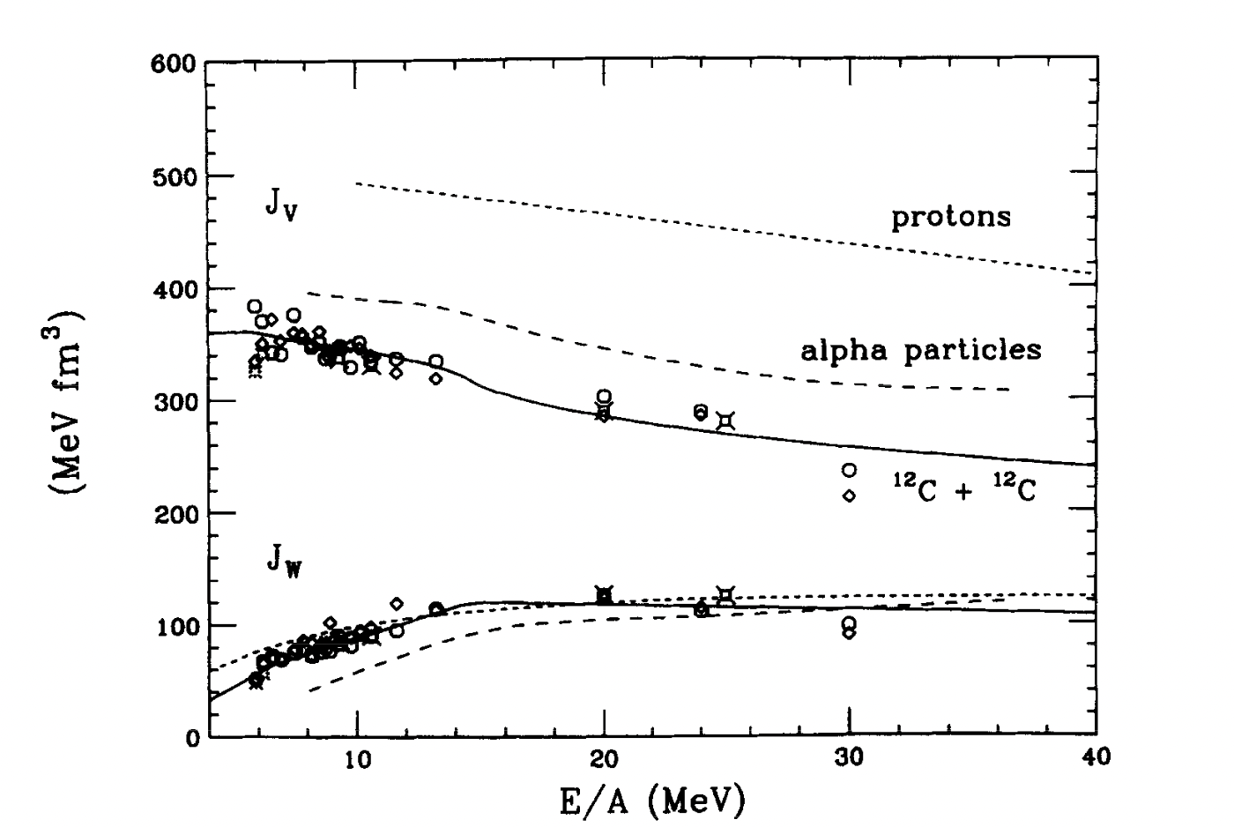
5
1.体积分的实部的能量依赖对所有画出的体系都是一样的。
2.但是随着弹核质量数的增大，一直到¹²C，J_{V}的大小有一个系统性的减小。这种行为是上面已经预期到的，它是由于核子相互作用势的密度依赖引起的。

Slide 23
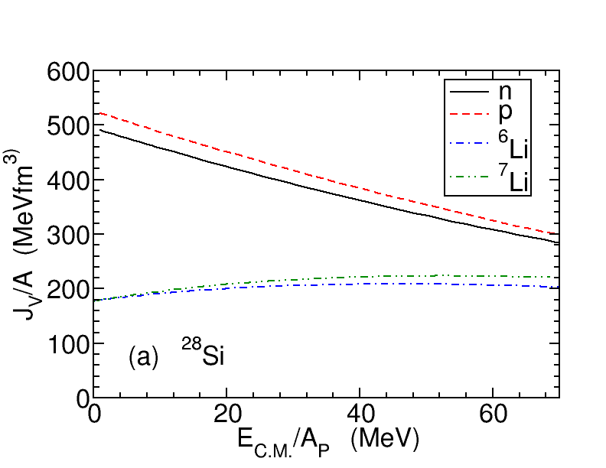
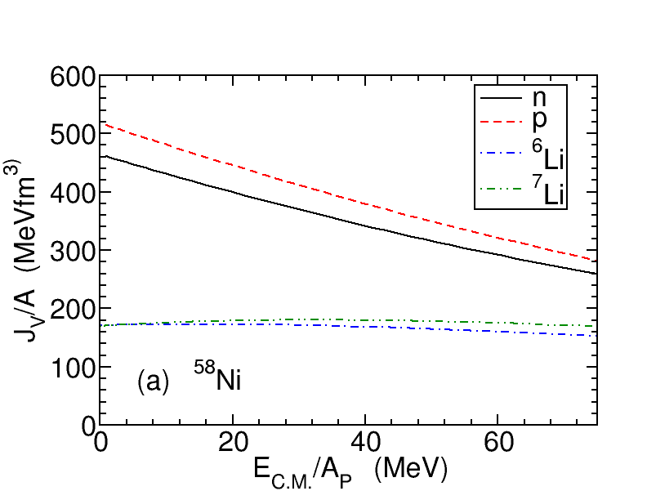
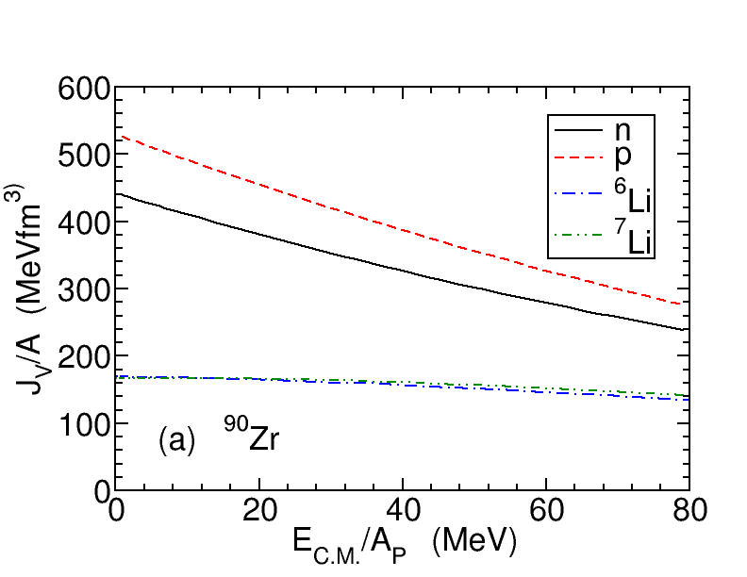
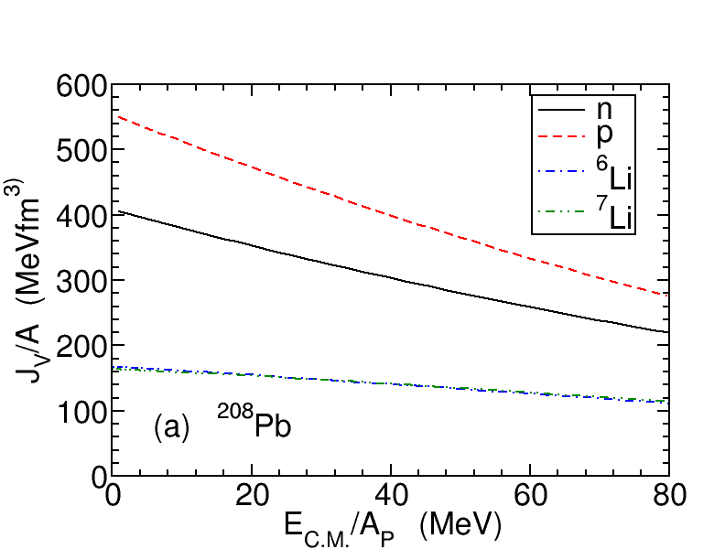
6

Slide 24
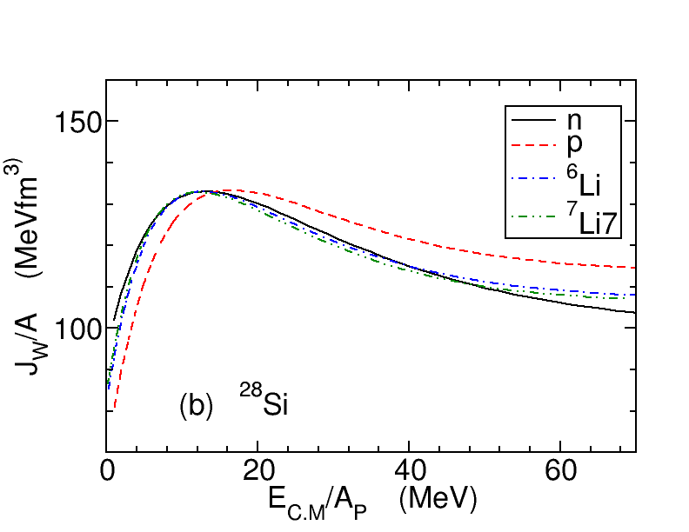
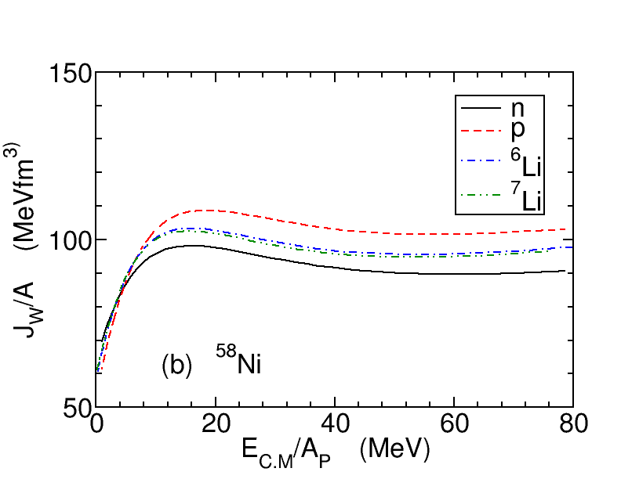
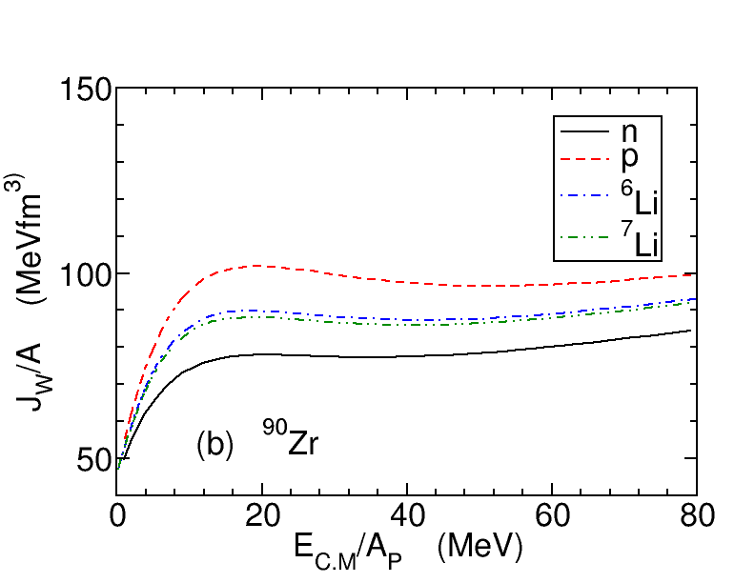
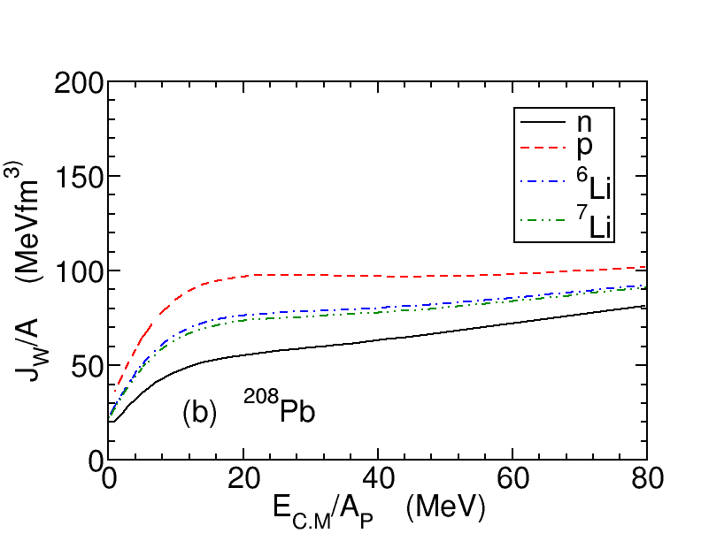
7

Slide 25
7

Slide 26
7

Slide 27
8

Slide 28
9

Slide 29
10

Slide 30
11

Slide 31
12
4.谢谢观看

