Slide 1

1
组会报告4
陆亚洲

Slide 2
结构
3
光学势的作用
光学势的作用
唯象光学势的作用
系统性光学势的作用
Introduction
⁶Li，⁷Li系统性的光学势的回顾
当前工作的模型特点
当前工作与之前工作的区别以及当前工作的目的
当前工作所用核子光学势的特点
当前工作所用参数的特点

Slide 3
光学势的作用
2
1.The nucleon—nucleus optical model is the reduction of the complicated many-body problem of the scattering of a nucleon from a nucleus to the scattering of a single particle from a complex one-body potential.
2.it determines the formation of compound nuclei in the initial stage of a reaction.
3.it supplies the transmission coefficients for branching into the various final states.
4.it is widely used more complicated reactions through the distorted-wave Born approximation DWBA or coupled-channel formalisms.

Slide 4
3
唯象光学势的作用
1.they can be used to test microscopically calculated potentials.

Slide 5
4
系统性光学势的作用
1.global optical potentials can be used to predict nucleon—nucleus potentials if elastic scattering data cannot be obtained.
2.useful information about nuclear forces and nuclear structure can be made using the systematic analysis of nucleon elastic scattering.
3.systematic OMP allow people to study nuclear reactions consistently.

Slide 6
5
⁶Li，⁷Li系统性的光学势的回顾
1.For decades, the reactions for some light heavy-ion projectiles were intensively studied both theoretically and experimentally due to their important role in our understanding of the intrinsic structure and the reaction dynamics. In particular, the reactions involving tightly bound, stable-weakly bound, radioactive-halo nuclei on the different targets have been of interest ranging from astrophysics to applied nuclear physics.
2.J.Cook firstly proposed a global OMP for the two lithium isotopes[5].
3.With the abundance of the experimental data at some special bombing energiesand reaction systems, investigations have been carried out to seek a global phenomenological OMP which covers a larger range incident energy.

Slide 7
6
当前工作的模型特点
1.The folding model is a powerful tool to derive optical potentials for complex nuclei. In the model, the optical potential for a composite nucleus is considered as the sum of the optical potentials for its constituent nucleons averaged over their internal motion within the composite particle.
2.one important property of the SFM is that it connects the properties of simple systems, the nucleon-nucleus potential, to that of a complex systems, the AA potential.

Slide 8
7
当前工作所用核子光学势的特点
1.KD02 potential is widely used in theoretical calculations and it has a good performance in predicting nucleon scattering which guarantees our adjustment of the real part of the SF potential mainly due to compound effect of nucleon.
2.For each (near-)spherical nucleus for which appropriate experimental data exists, we have constructed local neutron and proton OMPs for the entire 1 keV– 200 MeV energy region without any discontinuities in their parameter values. In addition, we have constructed global neutron and proton OMPs for the same energy region and for nearly the whole periodic table of elements (more precisely, for 24 < A < 209).

Slide 9
当前工作所用参数的特点
6
1.In any fit there is a tradeoff in the number of parameters used; too few and the fits are not high quality, too many and the potentials can become unsystematic. The fit of Ref. [3] has few parameters and very systematic behavior, whereas we have used more parameters and pushed for a higher quality fit.
2.These approaches have, however, considered only the energy dependence of the potential parameters. In this work we present a global optical potential treatment which includes both the energy (E) and mass number ( A) dependence of the Dirac optical potential parameters.

Slide 10
7

Slide 11
8
A=3核的光学势
氚核
[26] X. Li, C. Liang, and C. Cai, Global triton optical model potential, Nuclear Physics A 789, 103 (2007).
³He
[27] H.-J. Trost, P. Lezoch, and U. Strohbusch, Simple optical model treatment of the elastic 3he scattering, Nuclear Physics A 462, 333 (1987).
[28] C.-T. Liang, X.-H. Li, and C.-H. Cai, Global 3he optical model potential below 270 mev, Journal of Physics G: Nuclear and Particle Physics 36, 085104 (2009).
[29] X. Yong-li, G. Hai-Rui, Y. Han, and S. Qing-Biao, Global phenomenological optical model potentials for 8,10,11 b projectiles, nternational Journal of Modern Physics E 27 (2018).
[30] H. Guo, Y. Zhang, Y. Han, and Q. Shen, Helium-3 microscopic optical model potential based on the skyrme interaction, Phys. Rev. C 79, 064601 (2009).

Slide 12
8
A=3核的光学势
[31] F. D. Becchetti, Jr and G. W. Greenlees, General set of sup ³he and triton optical-model potentials for A>40, E <40 mev., pp 682-3 of Polarization Phenomena in Nuclear Reactions. / Barschall, H. H. (ed.). Madison, Wis.Univ.of Wisconsin Press (1971). 999, (1971).
[32] D. Y. Pang, P. Roussel-Chomaz, H. Savajols, R. L. Varner, and R. Wolski, Global optical model potential for a = 3 projectiles, Phys. Rev. C 79, 024615 (2009).
[33] D. Y. Pang, W. M. Dean, and A. M. Mukhamedzhanov, Optical model potential of a = 3 projectiles for 1p-shell nuclei, Phys. Rev. C 91, 024611 (2015).

Slide 13
9
ALPHA粒子的光学势
[34] M. Nolte, H. Machner, and J. Bojowald, Global optical potential for α particles with energies above 80 mev, Phys. Rev. C 36, 1312 (1987).
[35] A. Kumar, S. Kailas, S. Rathi, and K. Mahata, Global alpha-nucleus optical potential, Nuclear Physics A 776, 105 (2006).
[36] V. Avrigeanu, P. E. Hodgson, and M. Avrigeanu, Global optical potentials for emitted alpha particles, Phys. Rev.C 49, 2136 (1994).
[37] Guo, Hairui, Su, Xinwu, Liang, Haiying, Xu, Yongli, Han, Yinlu, and Shen, Qingbiao, Global phenomenological and microscopic optical model potentials for alpha, EPJ Web Conf. 146, 12011 (2017).

Slide 14
10
ALPHA粒子的光学势
[38] M. Avrigeanu, W. von Oertzen, A. Plompen, and V. Avrigeanu, Optical model potentials for-particles scattering around the coulomb barrier on a100 nuclei, Nuclear Physics A 723, 104 (2003).
[39] M. Avrigeanu, A. Obreja, F. Roman, V. Avrigeanu, and W. von Oertzen, Complementary optical-potential analysis of -particle elastic scattering and induced reactions at low energies, Atomic Data and Nuclear Data Tables 95, 501 (2009).
[40] D. Y. Pang, Y. L. Ye, and F. R. Xu, Application of the bruy`eres jeukenne-lejeune-mahaux model potential to composite nuclei with a single-folding approach, Phys. Rev. C 83, 064619 (2011).
[41] D. Y. Pang, Y. L. Ye, and F. R. Xu, Energy dependent optical model potentials for and deuteron with 12c, Journal of Physics G: Nuclear and Particle Physics 39, 095101 (2012).

Slide 15
11
稍重核的光学势
[42] J. Cook, Global optical-model potentials for the elastic scattering of ^{6,} ⁷li projectiles, Nuclear Physics A 388, 153 (1982).
[43] Y. Xu, Y. Han, J. Hu, H. Liang, Z. Wu, H. Guo, and C. Cai, ⁶Li global phenomenological optical model potential, Phys. Rev. C 98, 024619 (2018).
[44] Y. Xu, Y. Han, J. Hu, H. Liang, Z. Wu, H. Guo, and C. Cai, Global phenomenological optical model potential for the ⁷Li projectile nucleus, Phys. Rev. C 97, 014615 (2018).

Slide 16
11
稍重核的光学势
[45] Y. Xu, Y. Han, H. Liang, Z. Wu, H. Guo, and C. Cai, Global optical model potential for the weakly bound projectile ⁹Be, Phys. Rev. C 99, 034618 (2019).
[46] Y. Kucuk, I. Boztosun, and T. Topel, Global optical potential for the elastic scattering of ⁶He at low energies, Phys. Rev. C 80, 054602 (2009).
[47] X. Yong-li, G. Hai-Rui, Y. Han, and S. Qing-Biao, Globalphenomenological optical model potentials for ^{8,10,11} B projectiles, International Journal of Modern Physics E 27 (2018).
[48] Z.-H. Sun, Y.-L. Xu, X.-J. Sun, Y.-L. Han, and C.-H.Cai, Global phenomenological optical model potential for ¹⁴N-nucleus elastic scattering, International Journal of Modern Physics E 31, 2250001 (2022).

Slide 17
2
[49] Y. P. Xu and D. Y. Pang, Toward a systematic nucleus-nucleus potential for peripheral collisions, Phys. Rev. C 87, 044605 (2013).
[50] L. C. Chamon, B. V. Carlson, L. R. Gasques, D. Pereira,C. De Conti, M. A. G. Alvarez, M. S. Hussein, M. A.Cˆandido Ribeiro, E. S. Rossi, and C. P. Silva, Toward a global description of the nucleus-nucleus interaction, Phys. Rev. C 66, 014610 (2002).
[51] M. Alvarez, L. Chamon, M. Hussein, D. Pereira, L. Gasques, E. Rossi, and C. Silva, A parameter-free optical potential for the heavy-ion elastic scattering process,Nuclear Physics A 723, 93 (2003).
[52] T. Furumoto, W. Horiuchi, M. Takashina, Y. Yamamoto, and Y. Sakuragi, Global optical potential for nucleus-nucleus systems from 50 mev/u to 400 mev/u, Phys. Rev. C 85, 044607 (2012).

Slide 18
2

Slide 19
2

Slide 20
3

Slide 21
4

Slide 22
4

Slide 23
4

Slide 24
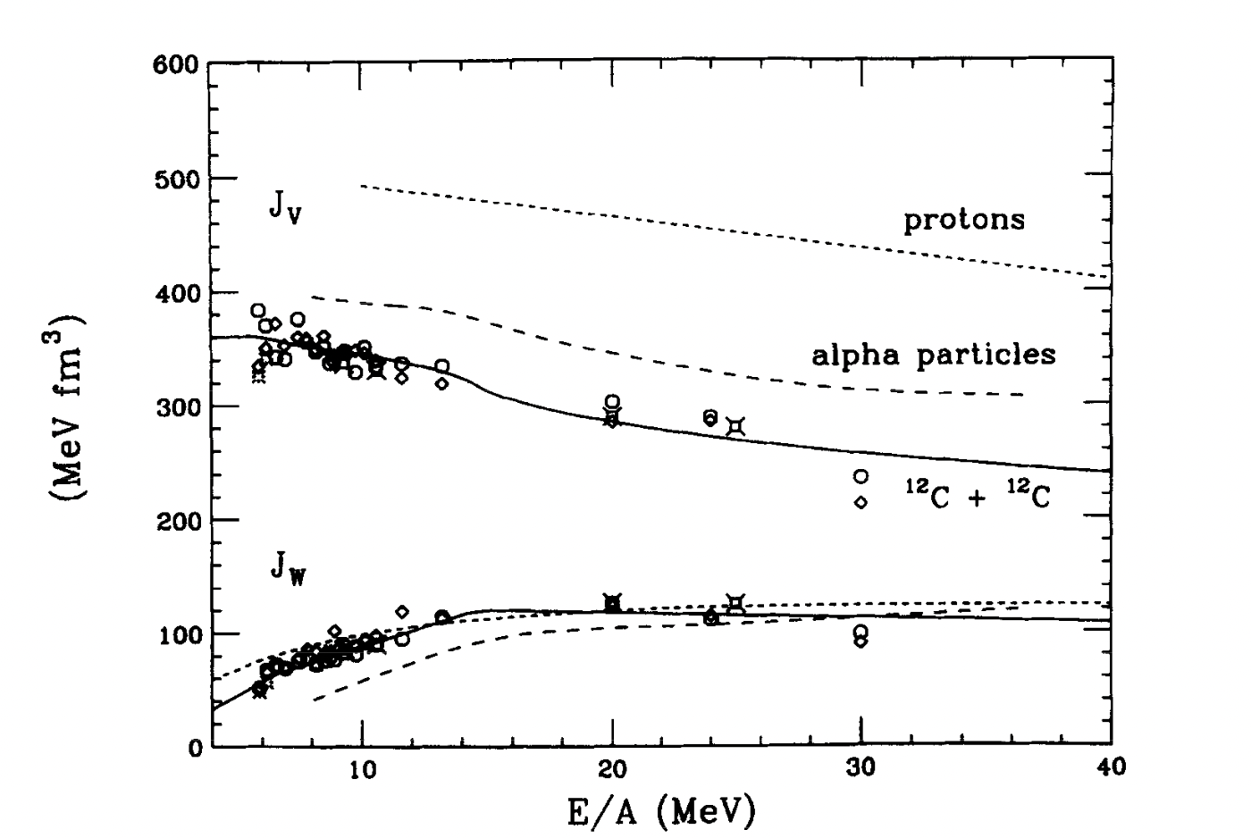
5
1.体积分的实部的能量依赖对所有画出的体系都是一样的。
2.但是随着弹核质量数的增大，一直到¹²C，J_{V}的大小有一个系统性的减小。这种行为是上面已经预期到的，它是由于核子相互作用势的密度依赖引起的。

Slide 25
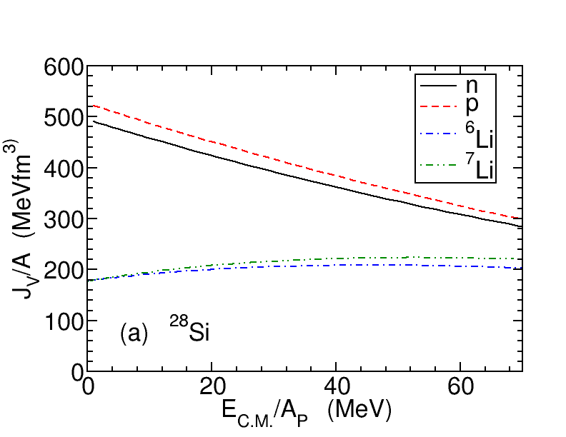
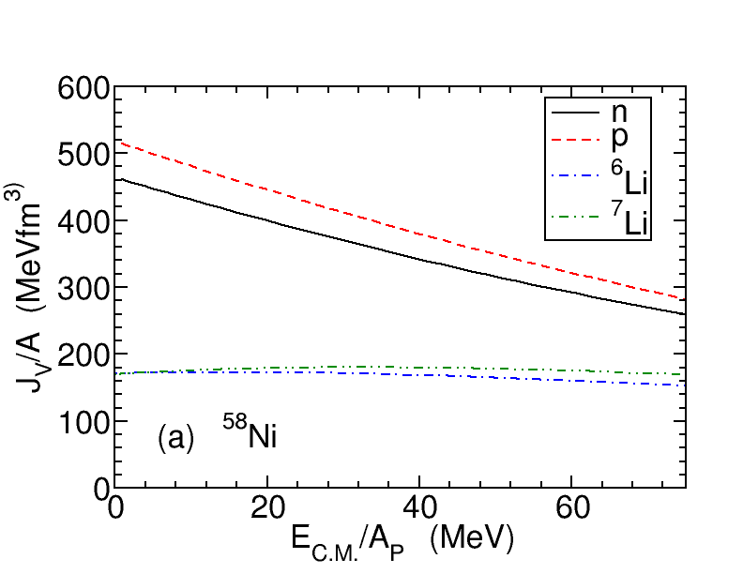
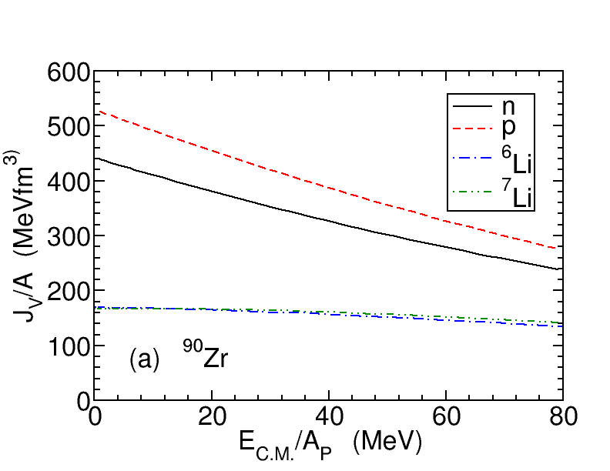
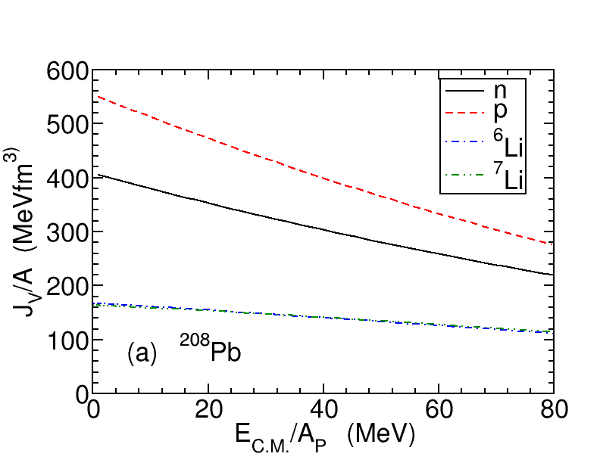
6

Slide 26
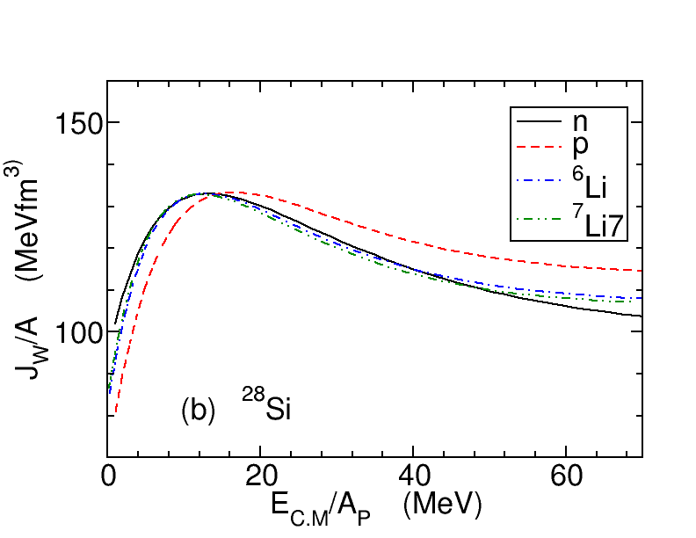
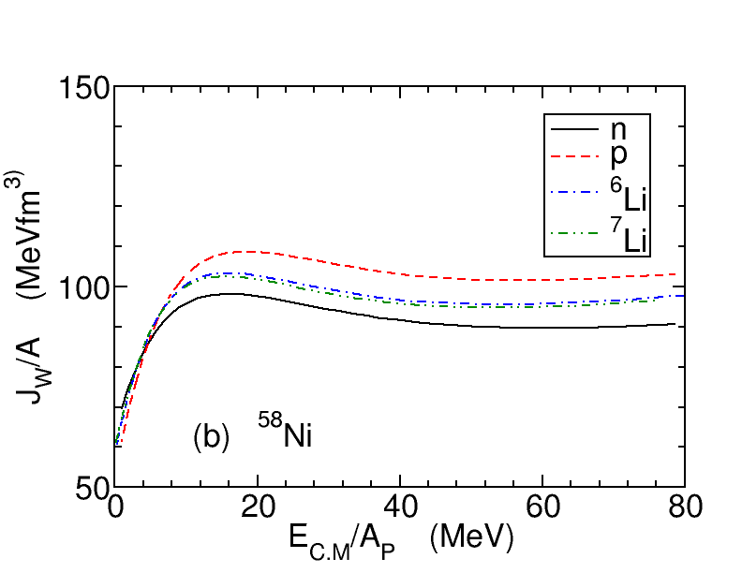
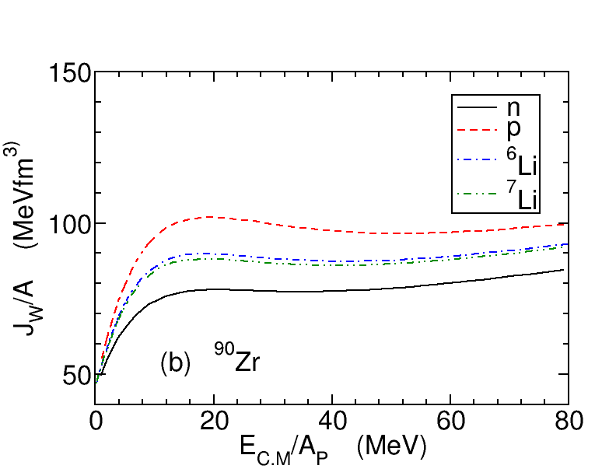
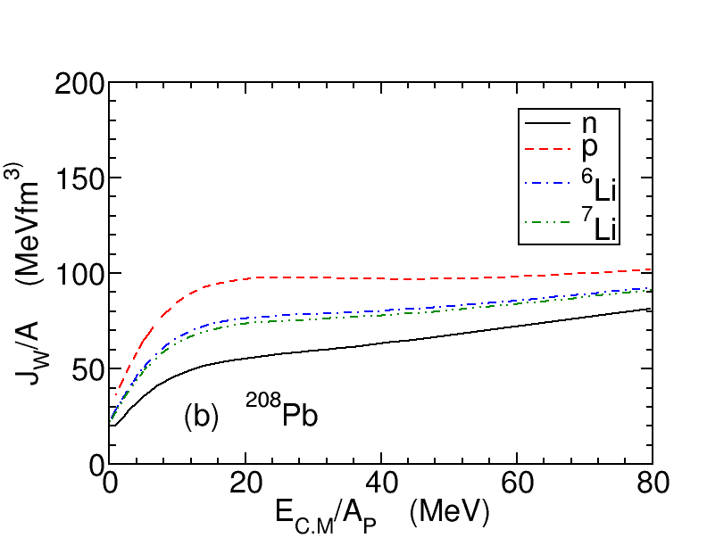
7

Slide 27
7

Slide 28
7

Slide 29
8

Slide 30
9

Slide 31
10

Slide 32
11

Slide 33
12
4.谢谢观看

