Slide 1
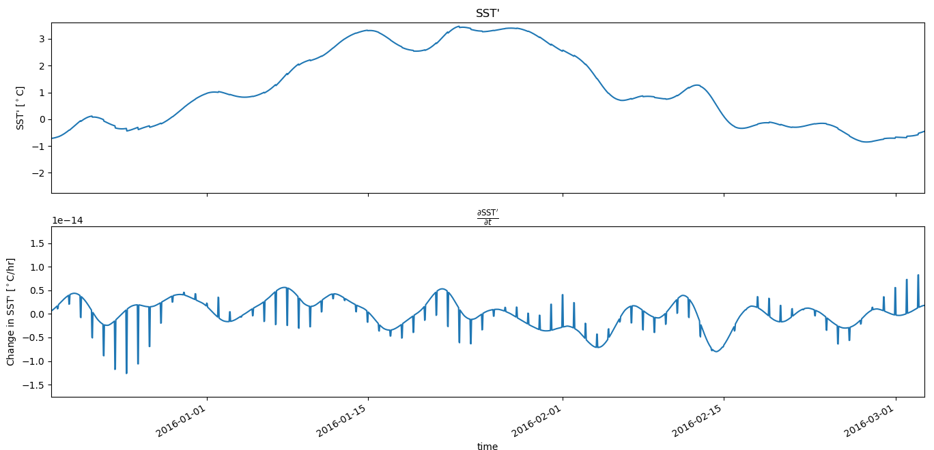
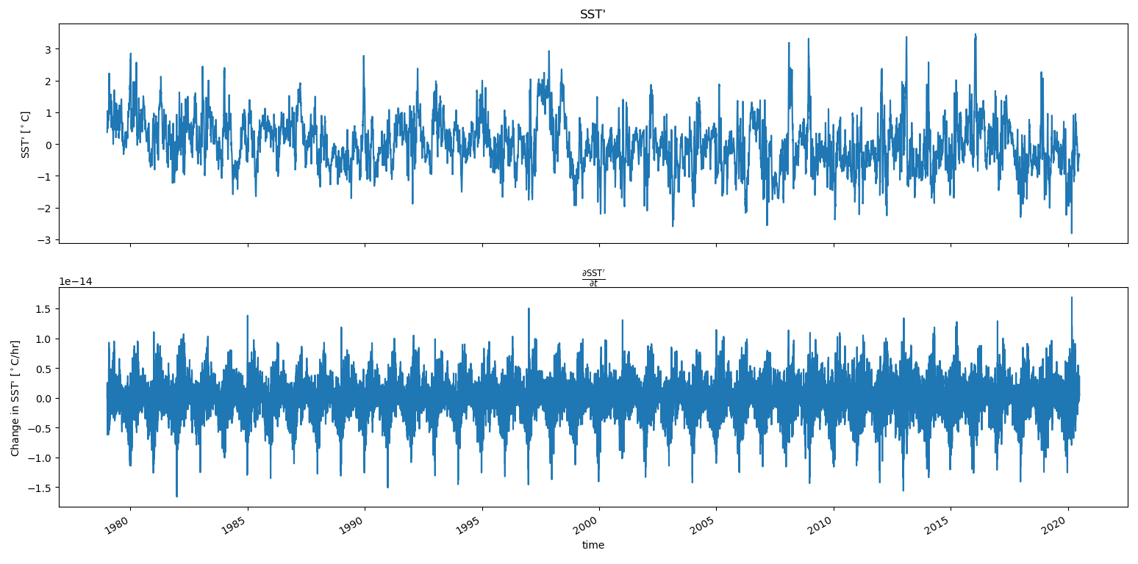
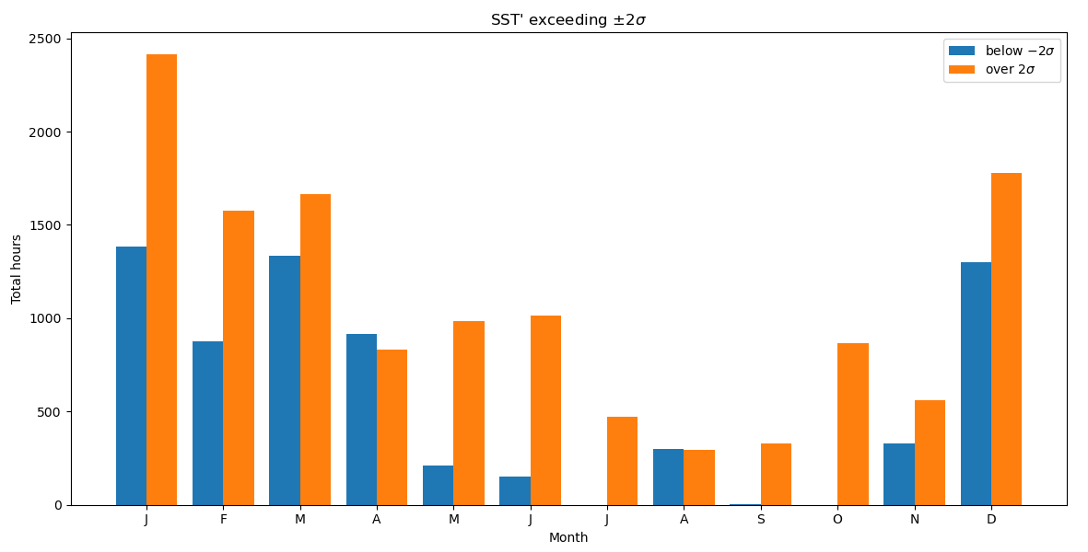
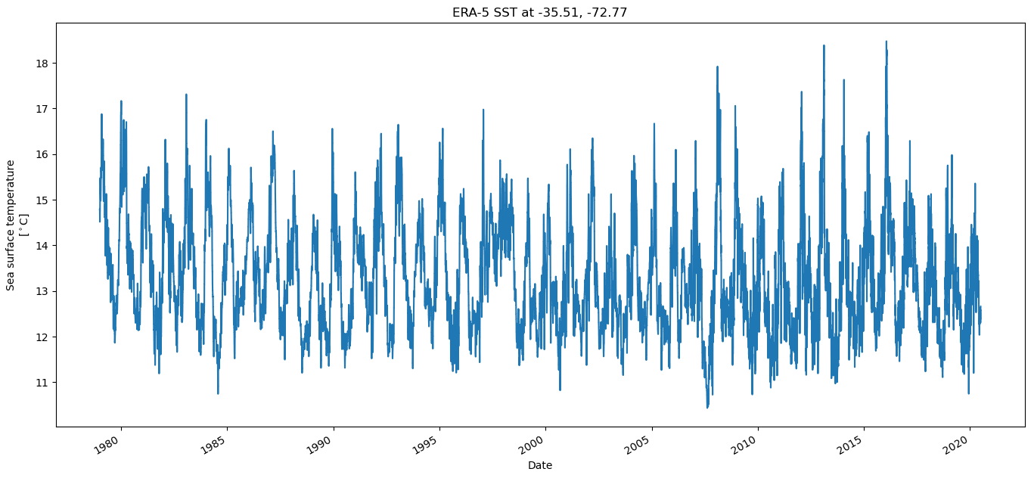
Marine heat waves in the Chile-Peru Eastern Boundary Upwelling System: rates of change in sea-surface temperature anomalies near a major upwelling center
Kylene Cooley, Melanie R. Fewings, Jim Lerczak
Oregon State University, CEOAS
cooleyky@oregonstate.edu
Abstract: In the Chile-Peru eastern boundary upwelling system (EBUS), scientists do not yet understand which forcing mechanisms dominate the surface ocean heat budget during marine heat waves. Although primary contributing processes and extent of warming may vary, worldwide EBUS are sensitive to prolonged periods of extreme warming, which may affect their ability to serve as important biological and economic centers. In the California Current System (CCS), there are apparent dipole patterns in SST anomalies and in surface wind stress measurements during wind relaxations. Previous studies found that SST anomalies during wind relaxation events were preconditioned to be colder than average, but still showed heating during the relaxation via advection of SST gradients from farther south, decreased entrainment and Ekman pumping at the base of the mixed layer, and some combination of cloudiness and SST feedback. We analyzed SST anomalies surrounding the Punta Lavapié upwelling center for time periods of extreme ocean warming during 1979-2020. These were defined as times where the SST anomaly relative to an annual climatology exceeded two standard deviations, and included analysis of annual distributions by season and month. We used the fifth generation European Centre for Medium-Range Weather Forecasts reanalysis (ERA5) hourly SST and filtered the signal to obtain a record of anomalies that occur on time scales of a week to 30 days. Through this a heat budget analysis we will identify how marine heat waves in the Chile-Peru System compare to those observed and better understood in the CCS.
What? [Jump to the conclusion here]
How does it happen? [methods maybe, as a caption]
Why do we care? [Any impacts of this or future work]
References and Acknowledgements: Flynn et al. (2017)

Slide 2
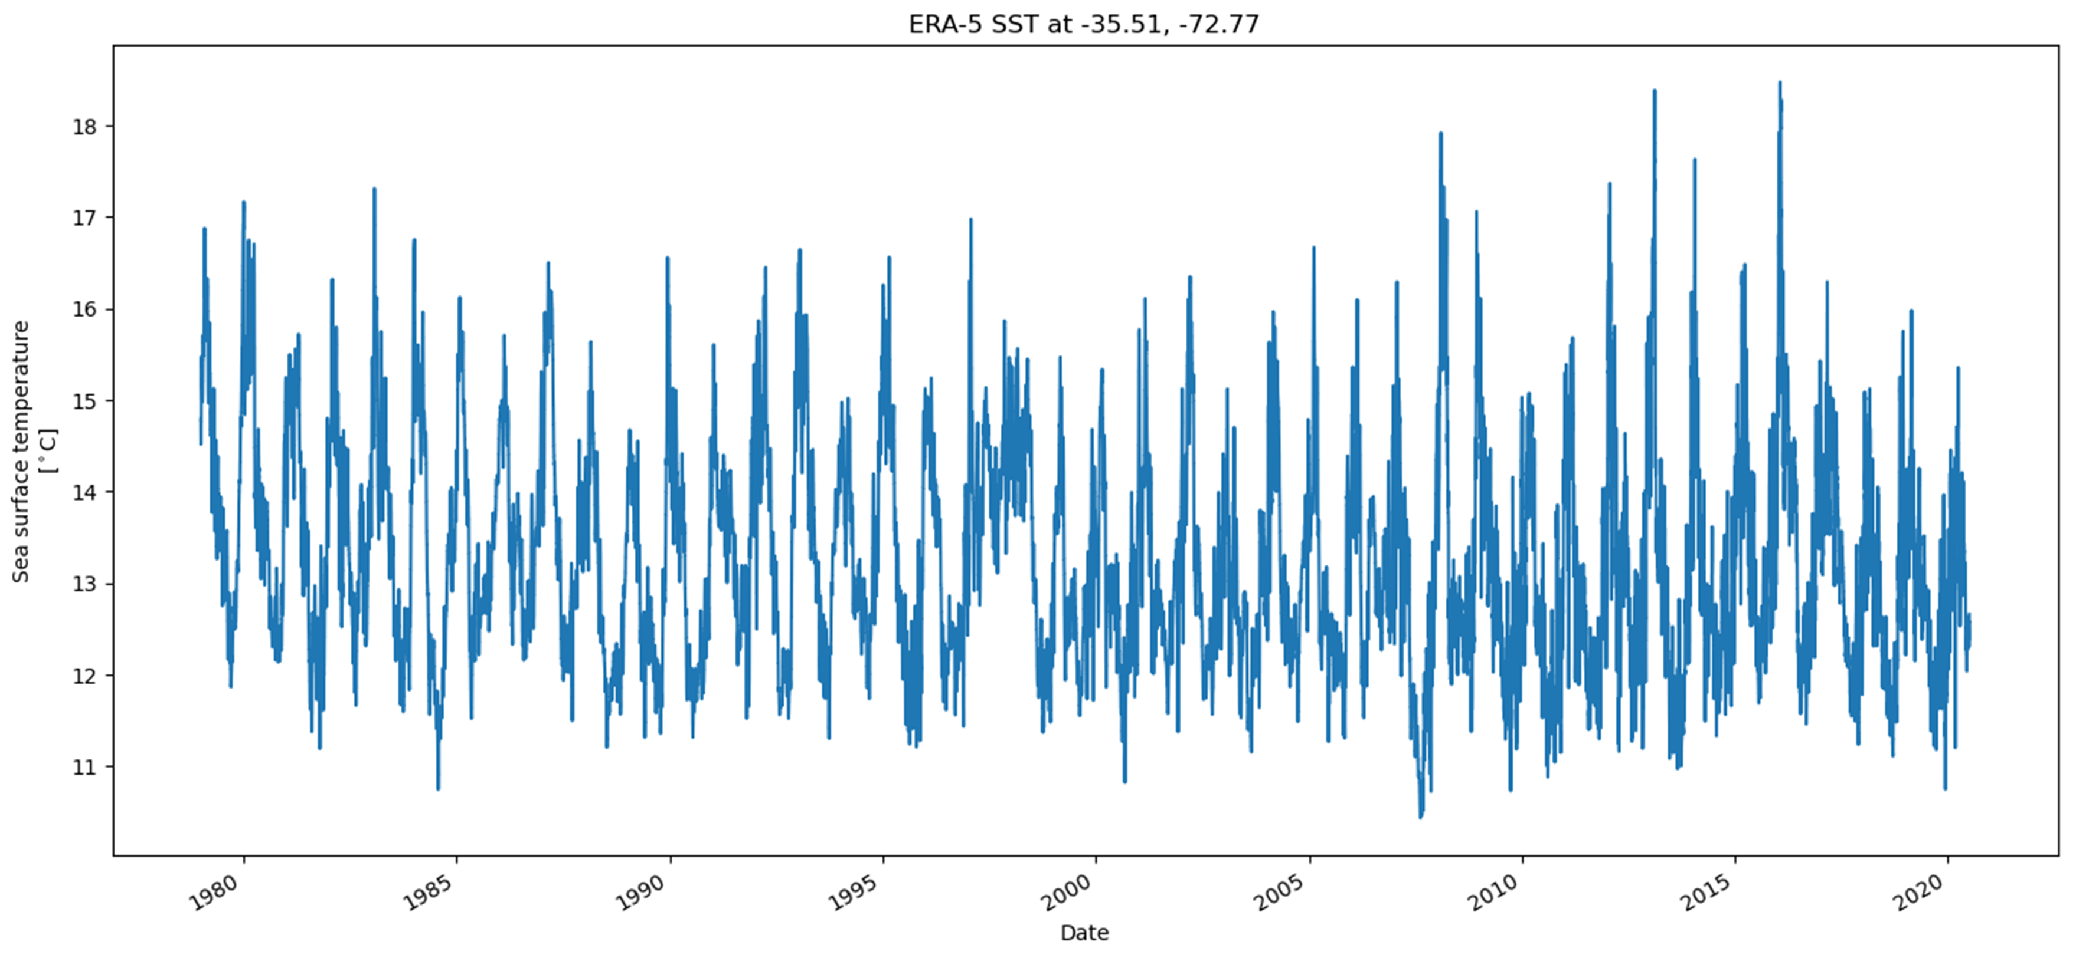

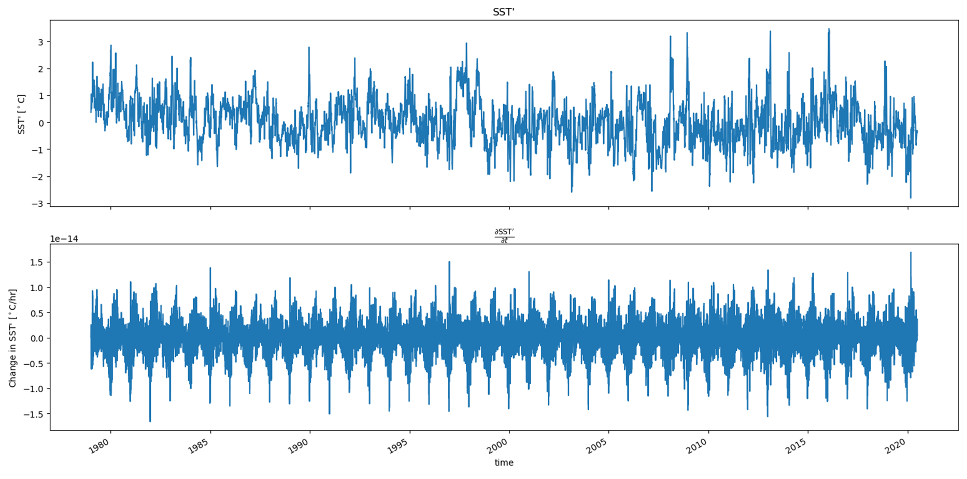

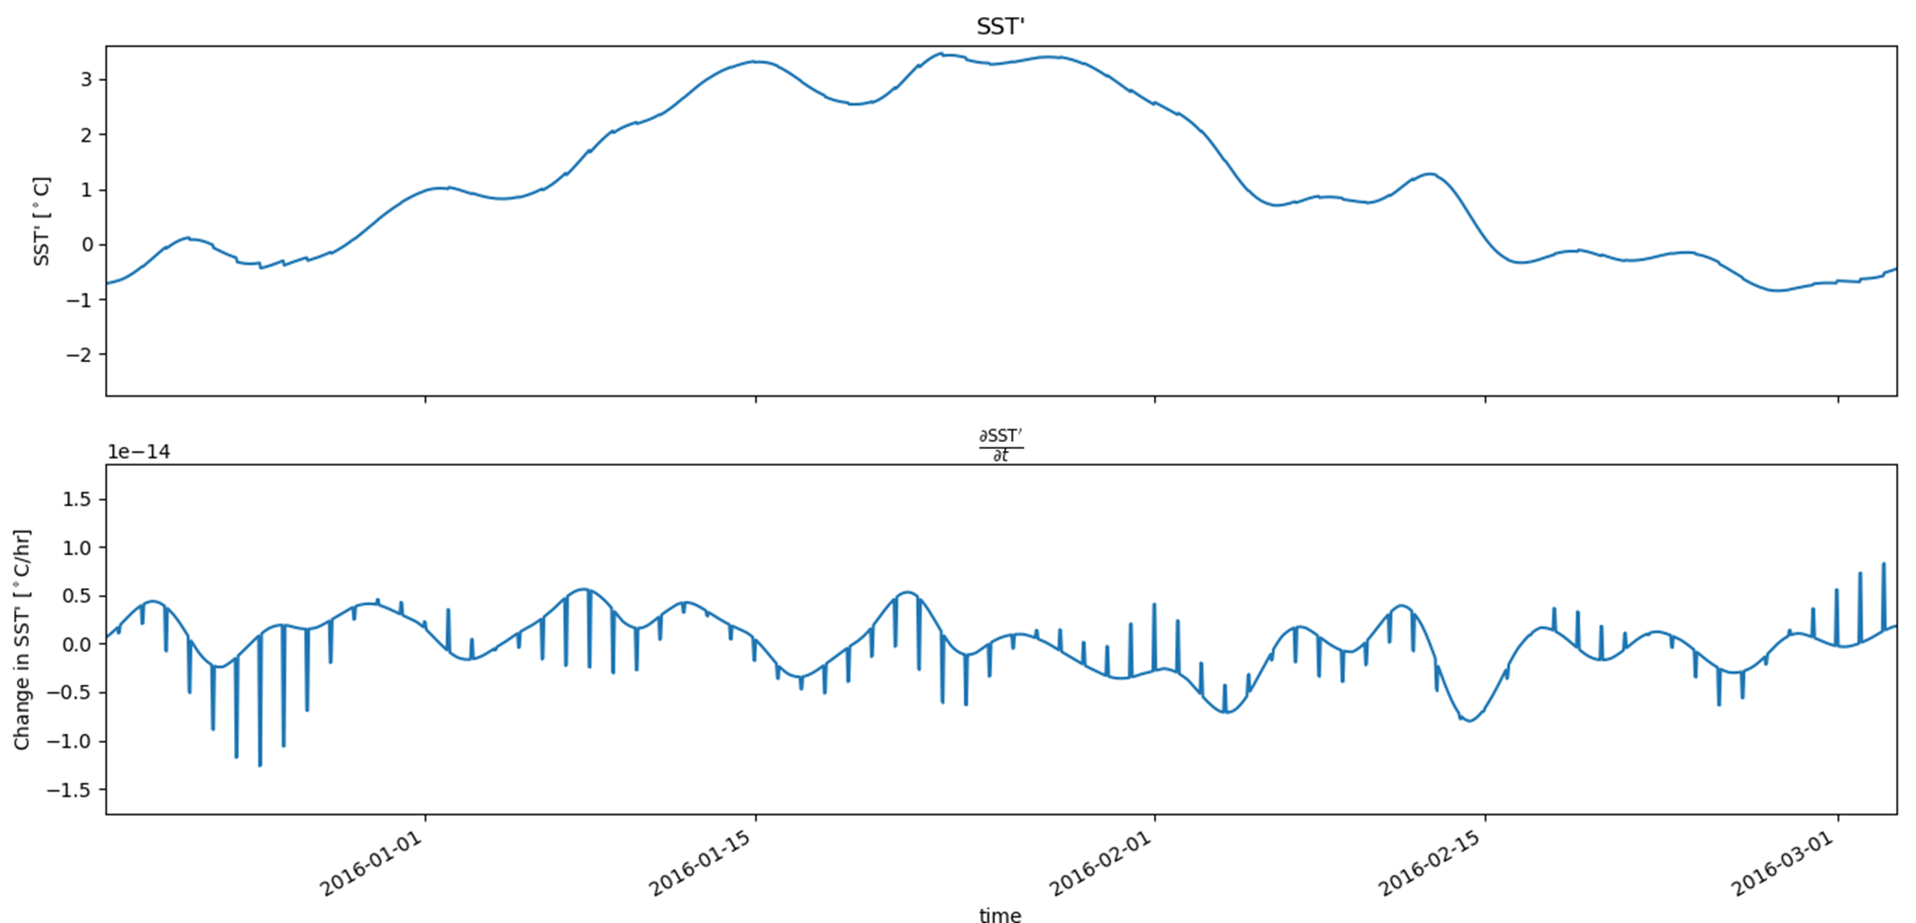
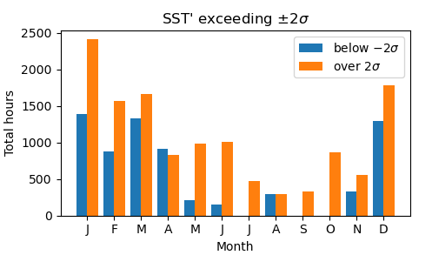
Marine heat waves in the Chile-Peru Eastern Boundary Upwelling System:
~~~~Ammo Bar ~~~~
rates of change in sea-surface temperature anomalies near a major upwelling center
Presenter:
Kylene Cooley
Background:
Marine heat waves like those in the California Current System (CCS) have also been observed in the Chile-Peru System (CPS)
Dominant forcings of wind relaxations in the CCS have been found through analysis of the surface ocean heat budget
Of all SST anomalies in the Punta Lavapie Upwelling Center, the most extreme are dominated by positive anomalies which occur most often in the Austral Summer.
Methods:
Obtain European Centre for Medium-Range Weather Forecasts reanalysis (ERA5) hourly SST
Define periods of intense warming as departures from climatology
Sort these times based on annual and seasonal occurrence
Take time derivative of SST’ for rates of anomalous warming
Authors:
Kylene Cooley, Melanie R. Fewings, Jim Lerczak
Oregon State University, CEOAS
cooleyky@oregonstate.edu
Results:
Future Work:
examine terms in the sea surface heat budget for which are dominant during different times
References and Acknowledgements: Flynn et al. (2017)

Slide 3
Marine heat waves in the Chile-Peru Eastern Boundary Upwelling System:
rates of change in sea-surface temperature anomalies near a major upwelling center
Presenter:
Kylene Cooley
cooleyky@oregonstate.edu
Authors:
Kylene Cooley, Melanie R. Fewings, Jim Lerczak
Oregon State University, CEOAS

Slide 4
Background:
Marine heat waves like those in the California Current System (CCS) have also been observed in the Chile-Peru System (CPS)
Dominant forcings of wind relaxations in the CCS have been found through analysis of the surface ocean heat budget
Flynn et al. (2017)

Slide 5
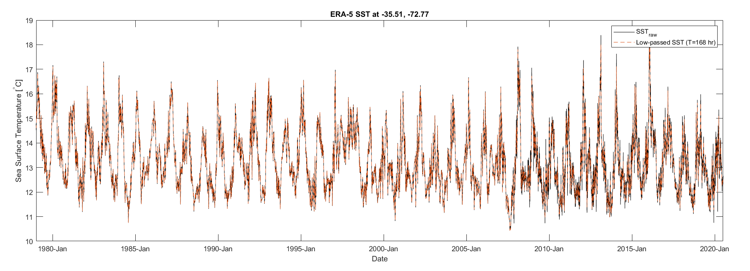
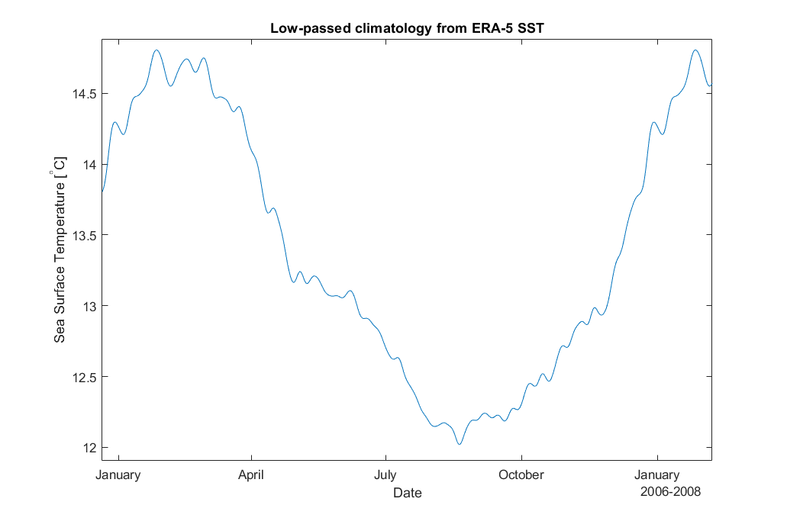
Methods:
Obtain European Centre for Medium-Range Weather Forecasts reanalysis (ERA5) hourly SST
Define periods of intense warming as departures from climatology
Sort these times based on annual and seasonal occurrence
Take time derivative of SST’ for rates of anomalous warming

Slide 7

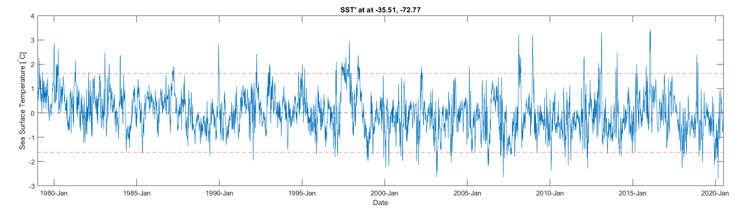

Slide 8
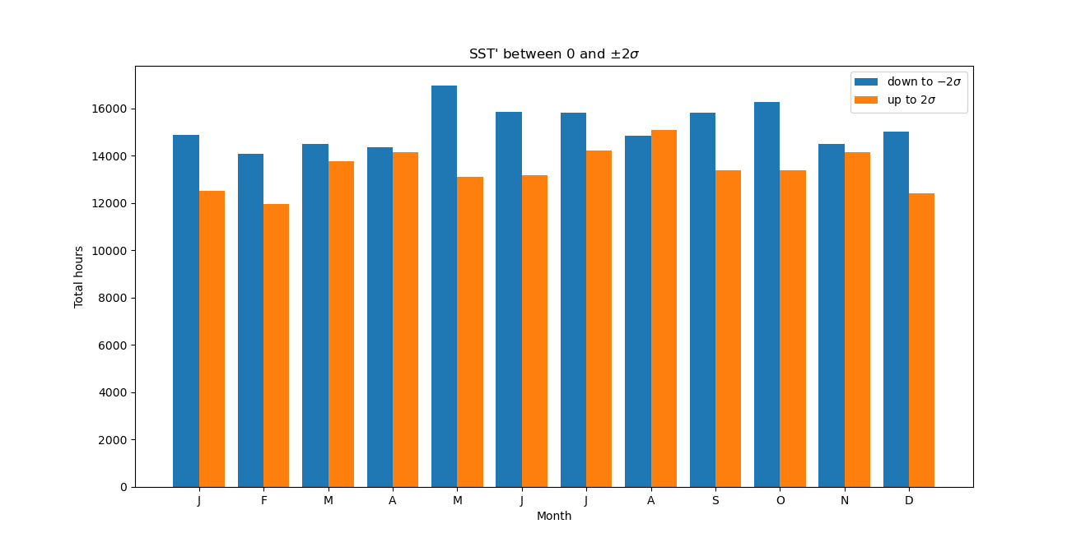

Slide 9
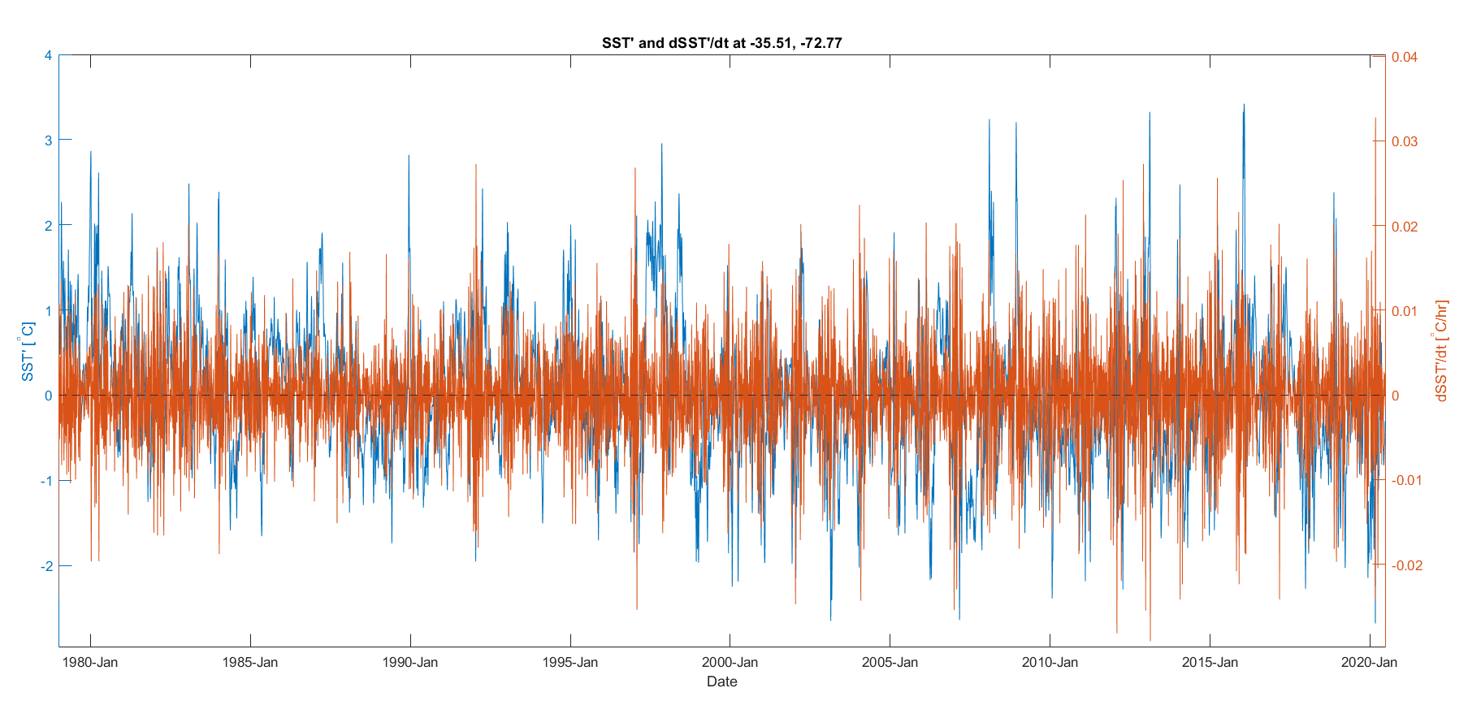
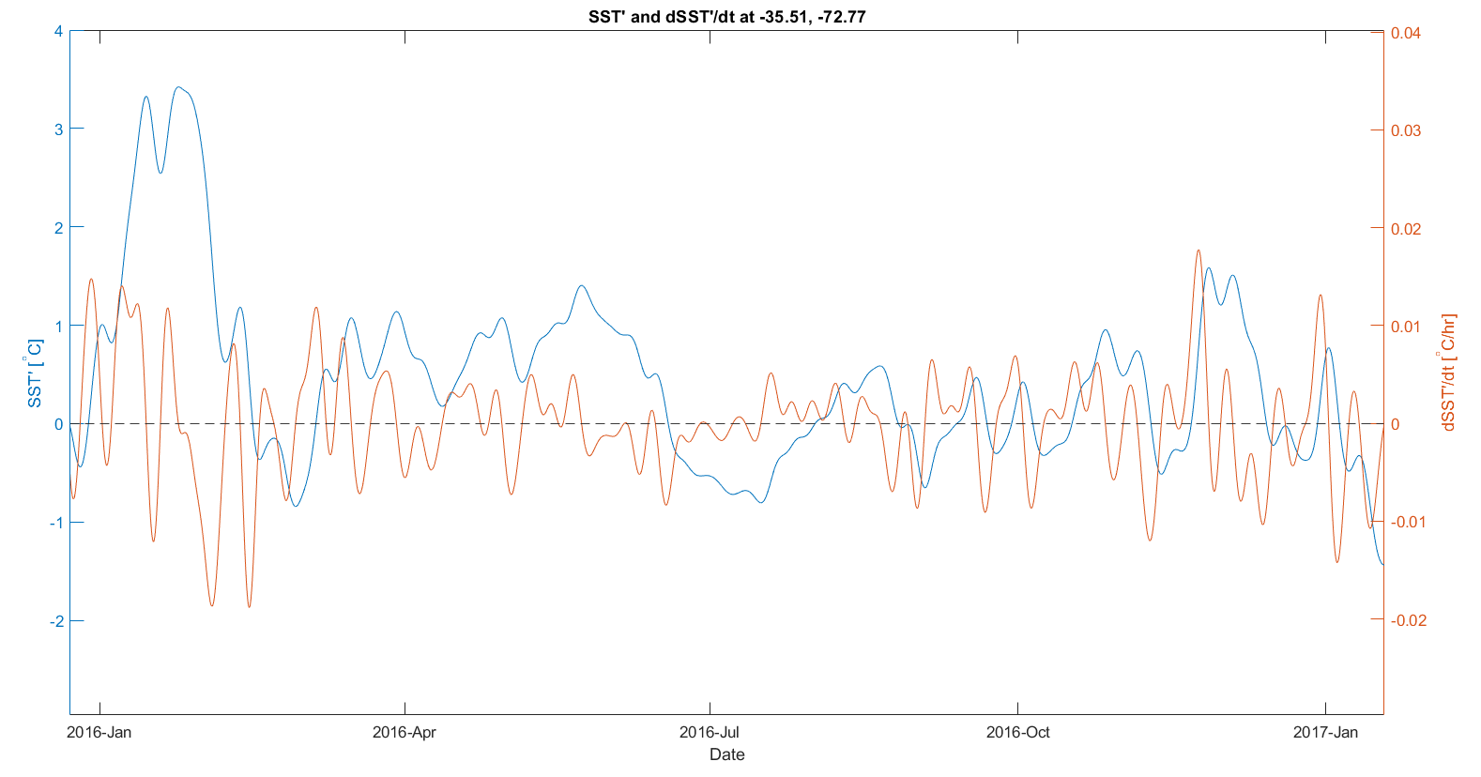

Slide 10
Future Work:
examine terms in the sea surface heat budget for which are dominant during different times
What do I hypothesize finding?

