Slide 1
Scalable OCR With NiFi & Tesseract
Casey Stella & Michael Miklavcic

Slide 2
Introduction
About the Speakers
Casey Stella
Currently a data scientist on Apache Metron
Previously Architect in Hortonworks Professional Services
Michael Miklavcic
Currently an engineer on Apache Metron
Previously Architect in Hortonworks Professional Services

Slide 3
OCR At Scale: The Challenge
Unstructured data is growing aggressively
Much of this data is in the form of PDF images of text
This appears to be the case inside of organizations much more than on the internet
There is much we can do to extract meaning from this
NLP is one of our most mature and rich branches of machine learning
Simple textual analysis would be sufficient to have rich insights
OCR enables us to extract textual information from images in an intelligent way

Slide 4
OCR At Scale: Use-cases in Medicine
The Problem
Radiologists make notes about patients
Doctors interpret these notes and make diagnoses based on the radiologist findings
Sometimes, the radiologists find things that are serendipitous or are not definitive.
The Value Proposition
Building a data pipeline at scale to analyze radiologist reports and look for indications of missed diagnoses
This is correct place for advanced analytics: in the loop with humans

Slide 5
OCR At Scale: Use-cases in Journalism
The Problem
Journalists are now asked to analyze large volumes of data
The Panama Papers alone were 2.6TB of data, much of it in scanned images of pages
FOIA requests can quickly outstrip the reading capability of a single person or team
The Value Proposition
Building a scalable data pipeline to extract the text from the data journalists are asked to mine enables more advanced analytics and better reporting.
This is a tool to enable better journalism

Slide 6
Methodology : OCR
Conversion
Take PDF’s and turn them into TIFF files, page-wise
GhostScript via Ghost4j
Preprocessing
Prepare images by enhancing text and cleaning up artifacts
Enable cleaner text extraction
A preprocessing pipeline using ImageMagick under the hood
Extraction
OCR phase using Tesseract

Slide 7
Image Preprocessing
ImageMagick is a standard open source library and tool to do rich and robust image processing.
ImageMagick is great ☺
There is a large and mature community of users
It has been around for years and has all the primitives that you could ask for
ImageMagick is confusing 😐
Image preprocessing can be a daunting task for the user
ImageMagick can be arcane at times

Slide 8
Image Preprocessing
Community + ImageMagick = Magical
People have started making layers on top of ImageMagick to do common tasks aimed at a certain domain
Fred Weinhaus did this for text cleaning!
What we did is port this interface over to Java and expose it as a library
It currently supports
Unrotation (i.e. straightening images)
Greyscale
Enhance brightness
Text Smoothing
More!

Slide 9
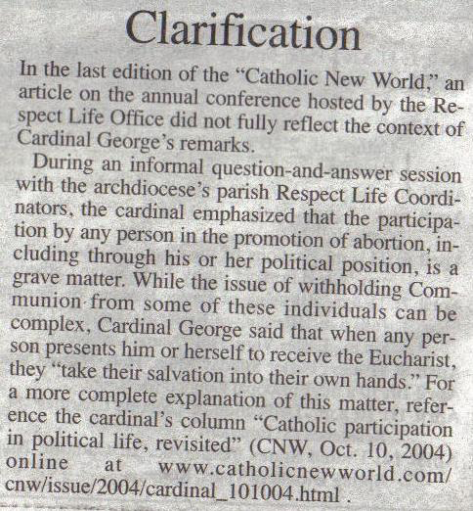
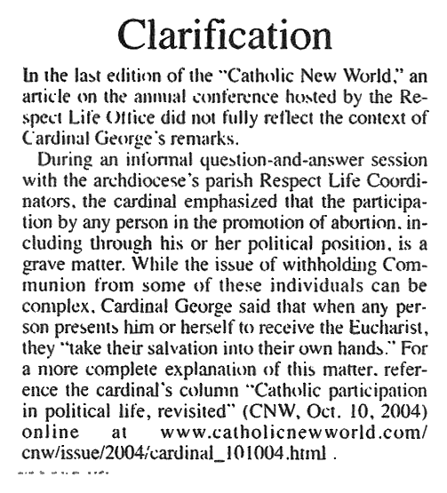
Preprocessing - Before and After
-g -e stretch -f 25 -o 20 -t 30 -u -s 1 -T -p 20

Slide 10
Methodology : Scale
Apache Nifi is an easy-to-use, highly customizable data processing system firmly integrated with the Hadoop Ecosystem
Configurable prioritization, throughput/latency tradeoffs
Full data provenance across the pipeline
Easy to use interface for customizing the pipeline
Each of the phases in the pipeline becomes NIFI Processors
This allows for a highly customizable tool

Slide 11
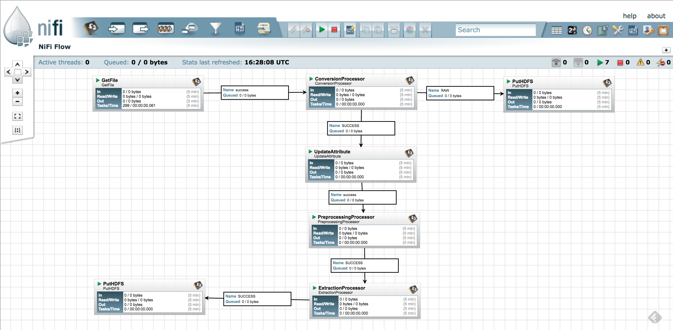
NiFi + Hadoop

Slide 12
DEMO

Slide 13
OCR is necessary, but not sufficient
Providing this kind of utility is a necessary step, but there are missing pieces
Does not handle human handwriting as of yet
Deep learning advances are closing the gap on this
Even with very good image preprocessing, errors can creep into documents
Kerning errors : rn -> m
Unresolvable blemishes leading to random noise
Good error correction can be require advanced NLP and can be domain specific
See patent #20160019430: “Targeted optical character recognition for medical terminology”

Slide 14
Questions?
All of this software shown in this presentation is open source and located at https://github.com/mmiklavc/scalable-ocr

