Slide 1

Forecasting: Principles and Practice, 3rd ed.
Authors: Rob j. hyndman & George Athanasopolous

Slide 2



Resources
Session methodology
Chapter I discussion

Slide 3

Textbook link
https://otexts.com/fpp3/
Github repository
https://github.com/robjhyndman/ETC3550Slides
Bookclub notes
https://r4ds.github.io/bookclub-fpp/

Slide 4
YouTube videos
https://www.youtube.com/@abhishekkrthakur
https://www.youtube.com/@BusinessScience
My personal repository
https://github.com/rserran/fpp3_exercises
Modeltime R package
https://cran.r-project.org/web/packages/modeltime/vignettes/getting-started-with-modeltime.html

Slide 5
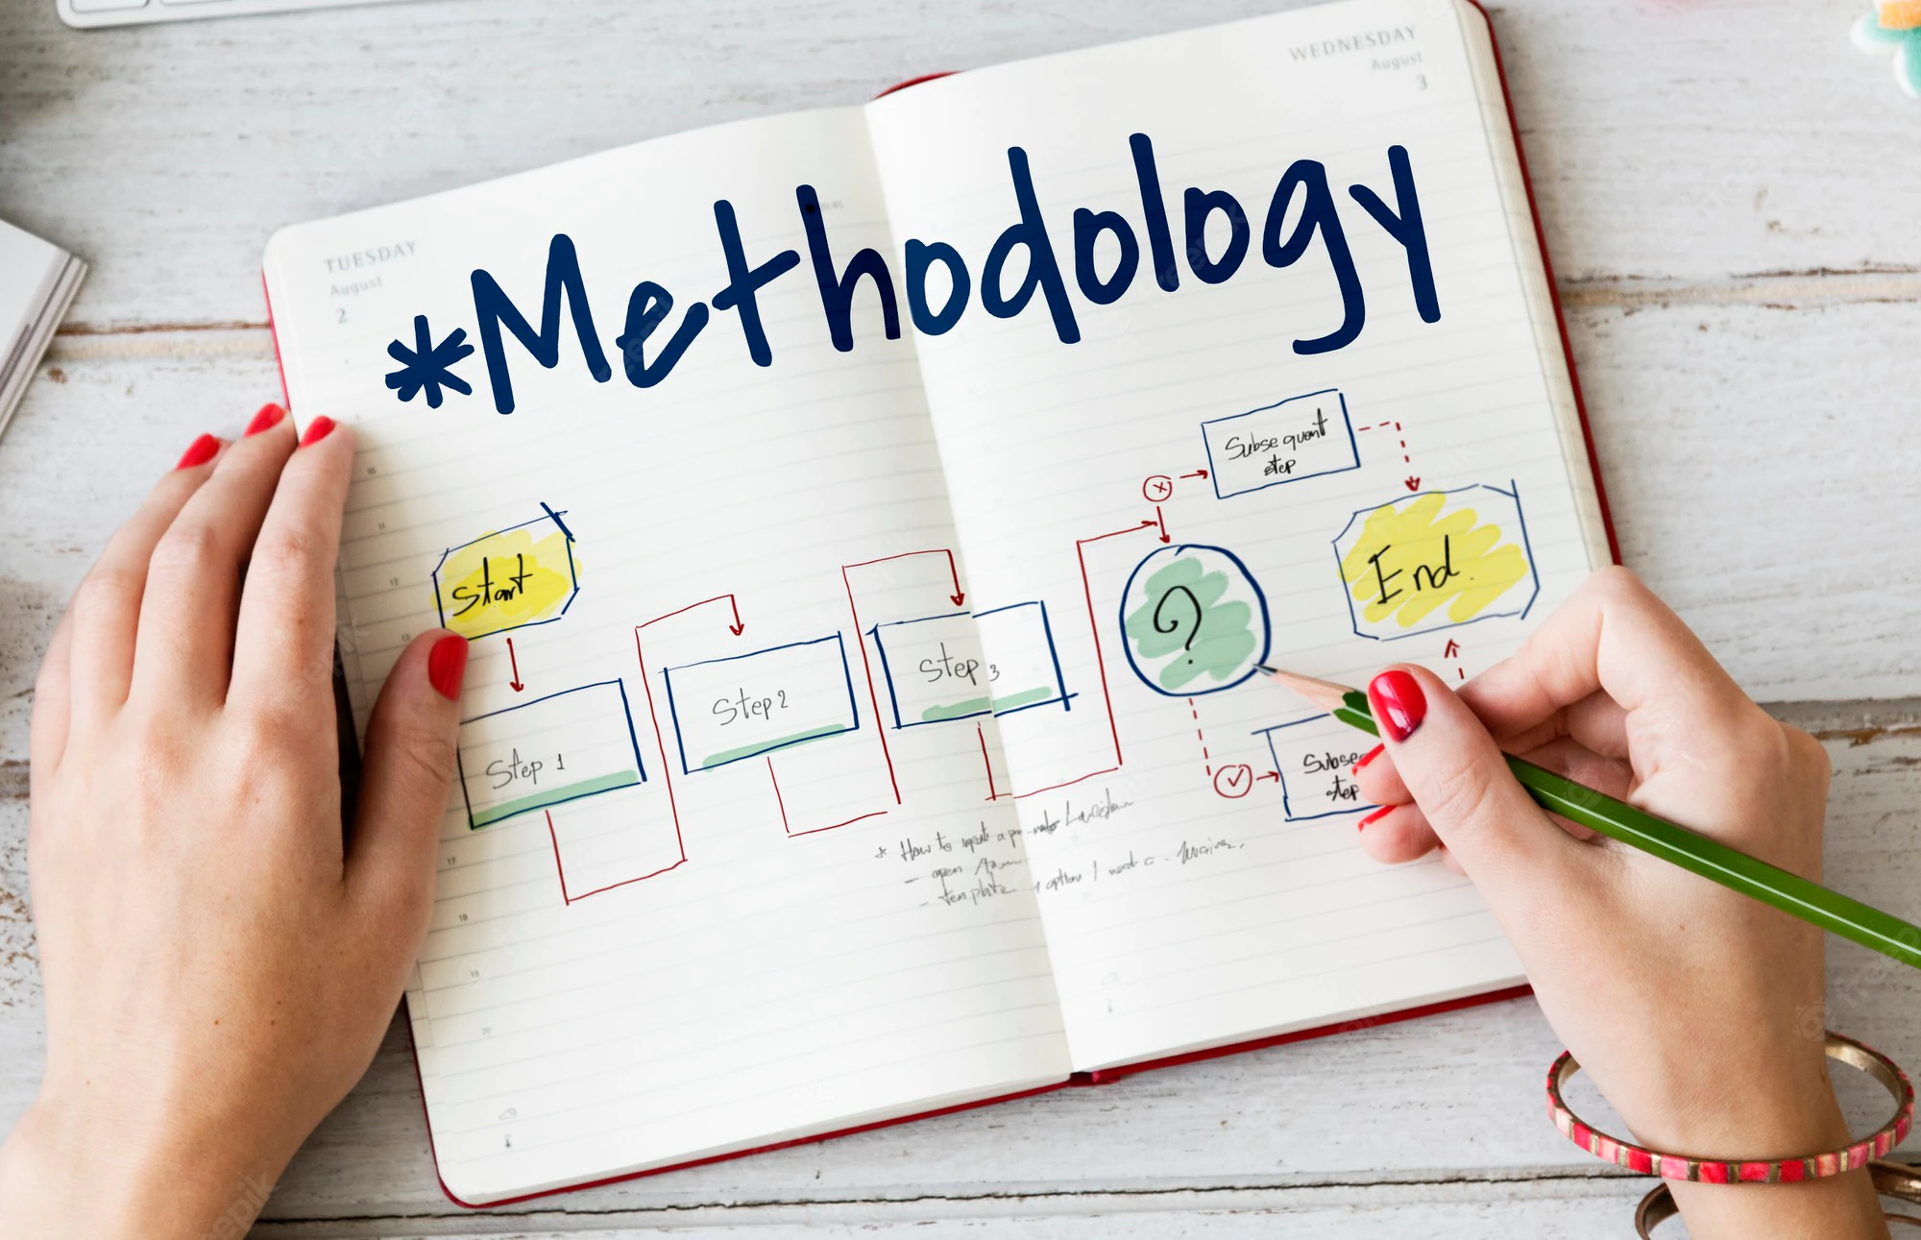
Each session will consist of two sections:
Chapter (theory) discussion
Exercises (practice)

