Slide 1

DATA SCIENCE PROJECT PRESENTATION ON
“CUSTOMER PERSONALITY ANALYSIS”
Presentation By: Group- 04
Name
MR. AHIMSA DE SILVA
MR. AKASH JAGADALE
MR. HAKIM FAKRUDDIN SADIK
MR. NIKHIL SANJAY VAIDYA
MS. RUTHUJA THANAJI PATIL
MR. TEJAS GIRISH KULKARNI

Slide 2
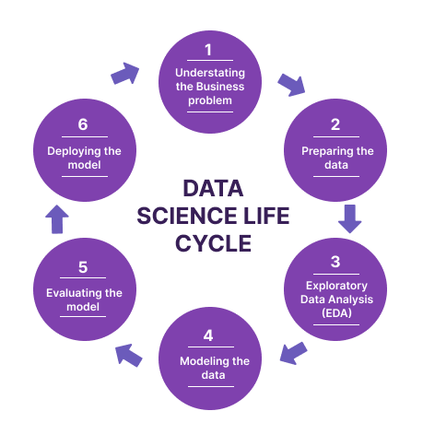
CONTENTS
INTRODUCTION
UNDERSTANDING THE DATA
EXPLORATORY DATA ANALYSIS
MODEL BUILDING
EVALUTING THE MODEL
DEPLOYING THE MODEL

Slide 3
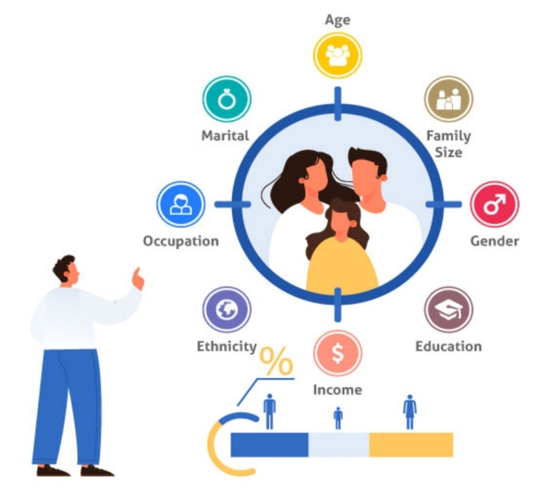
INTRODUCTION
Customer Personality Analysis is a detailed analysis of a company’s ideal customers.
It helps a business to better understand its customers and makes it easier for them to modify products according to the specific needs, behaviours and concerns of different types of customers.
Customer personality analysis helps a business to modify its product based on its target customers from different types of customer segments.

Slide 4
UNDERSTANDING THE DATA
Attributes
People
ID: Customer's unique identifier
Year_Birth: Customer's birth year
Education: Customer's education level
Marital_Status: Customer's marital status
Income: Customer's yearly household income
Kidhome: Number of children in customer's household
Teenhome: Number of teenagers in customer's household
Dt_Customer: Date of customer's enrollment with the company
Recency: Number of days since customer's last purchase
Complain: 1 if the customer complained in the last 2 years, 0 otherwise
‹#›

Slide 5
UNDERSTANDING THE DATA
Products
MntWines: Amount spent on wine in last 2 years
MntFruits: Amount spent on fruits in last 2 years
MntMeatProducts: Amount spent on meat in last 2 years
MntFishProducts: Amount spent on fish in last 2 years
MntSweetProducts: Amount spent on sweets in last 2 years
MntGoldProds: Amount spent on gold in last 2 years
‹#›

Slide 6
UNDERSTANDING THE DATA
Promotion
AcceptedCmp1: 1 if customer accepted the offer in the 1st campaign, 0 otherwise
AcceptedCmp2: 1 if customer accepted the offer in the 2nd campaign, 0 otherwise
AcceptedCmp3: 1 if customer accepted the offer in the 3rd campaign, 0 otherwise
AcceptedCmp4: 1 if customer accepted the offer in the 4th campaign, 0 otherwise
AcceptedCmp5: 1 if customer accepted the offer in the 5th campaign, 0 otherwise
Response: 1 if customer accepted the offer in the last campaign, 0 otherwise

Slide 7
UNDERSTANDING THE DATA
Place
NumDealsPurchases: Number of purchases made with a discount
NumWebPurchases: Number of purchases made through the company’s website
NumCatalogPurchases: Number of purchases made using a catalogue
NumStorePurchases: Number of purchases made directly in stores
NumWebVisitsMonth: Number of visits to company’s website in the last month

Slide 8
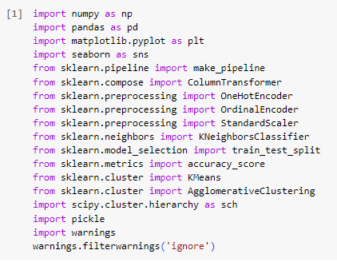
IMPLEMENTATION
IMPORTING THE PACKAGES

Slide 9
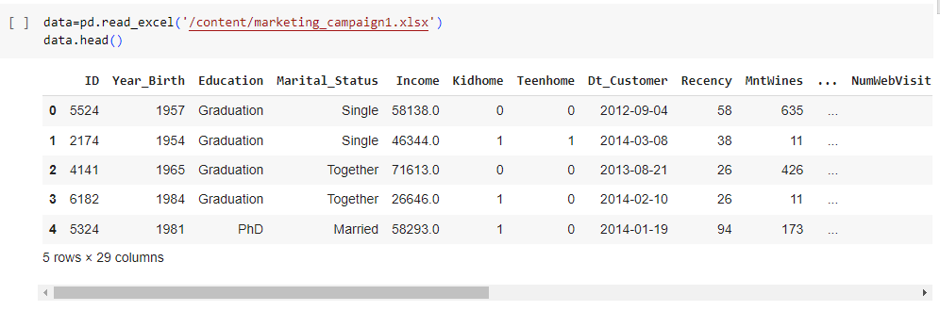
IMPLEMENTATION
IMPORTING THE DATASET

Slide 10
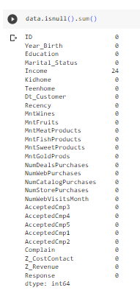
IMPLEMENTATION
CHECKING FOR MISSING OR NULL VALUES
We Found that there are 24 Null values in the Income Column
IMPLEMENTATIONIMPLEMENTATION

Slide 11
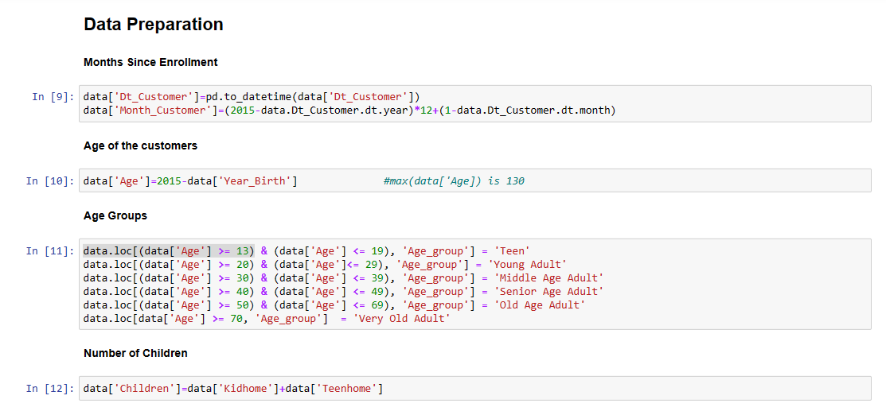
FEATURE ENGINEERING
DATA PREPARATION

Slide 12
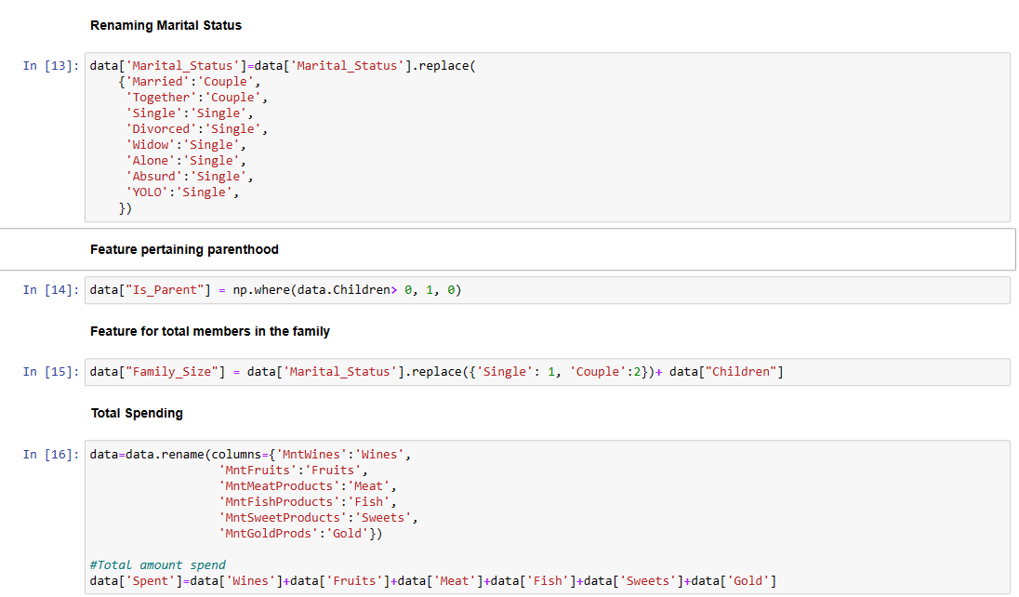
FEATURE ENGINEERING

Slide 13
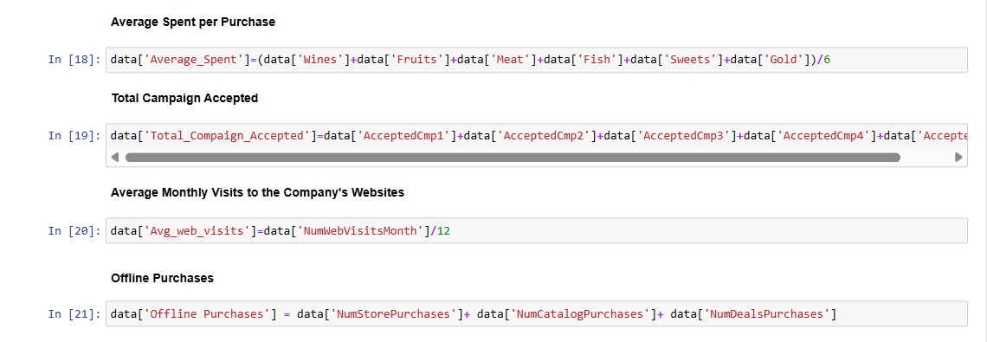
FEATURE ENGINEERING

Slide 14
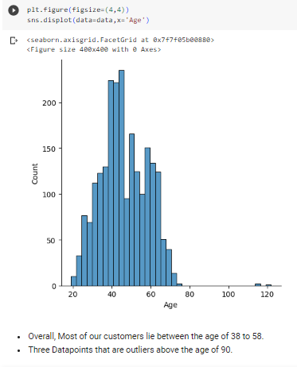
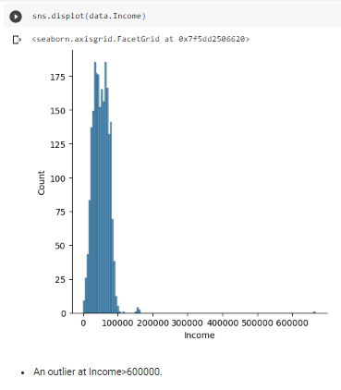
VISUALIZATION
DATA VISUALIZATION

Slide 15
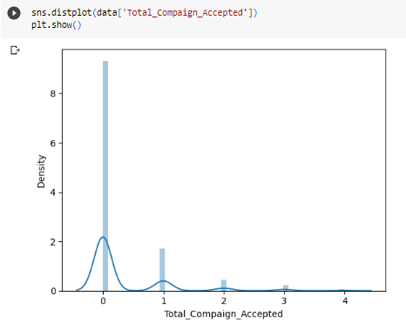
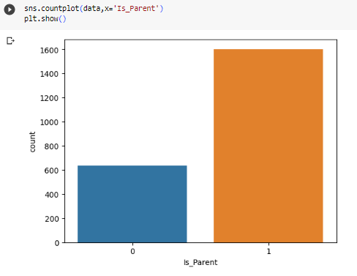
VISUALIZATION

Slide 16
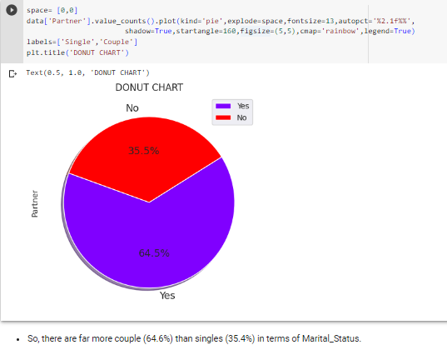
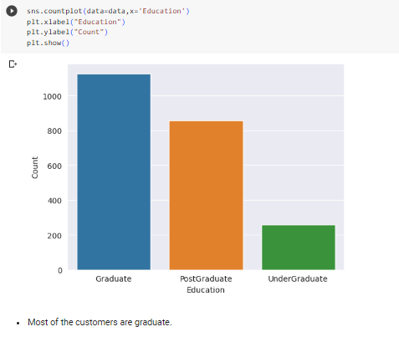
VISUALIZATION

Slide 17

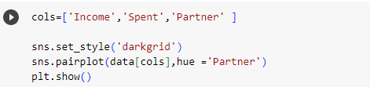
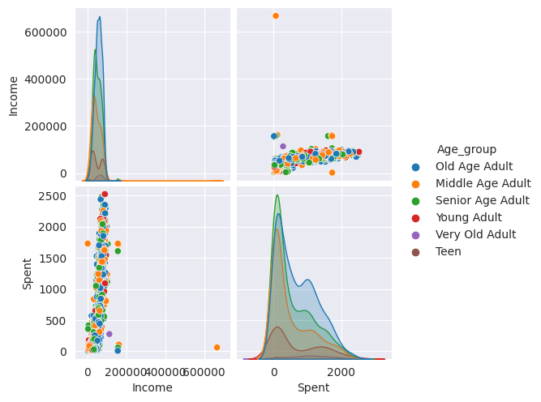
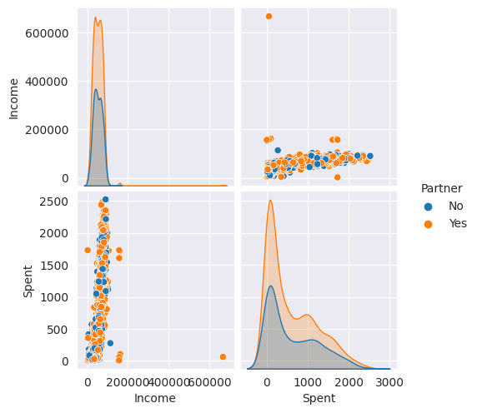


VISUALIZATION

Slide 18


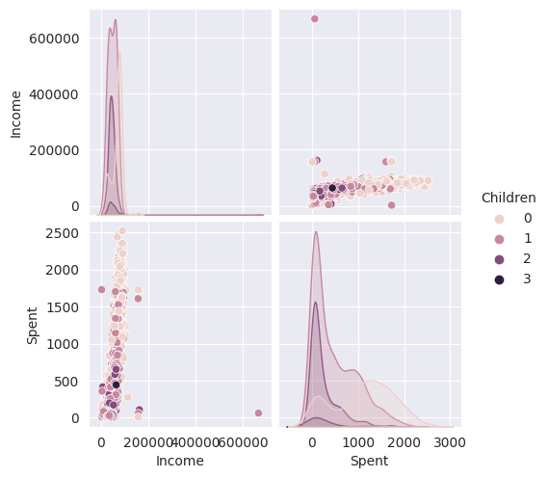
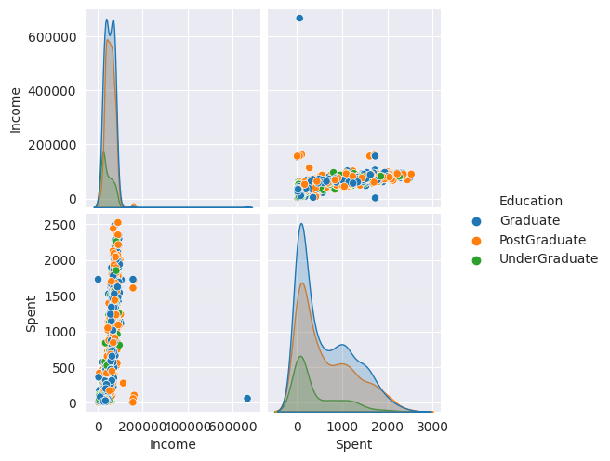

VISUALIZATION

Slide 19
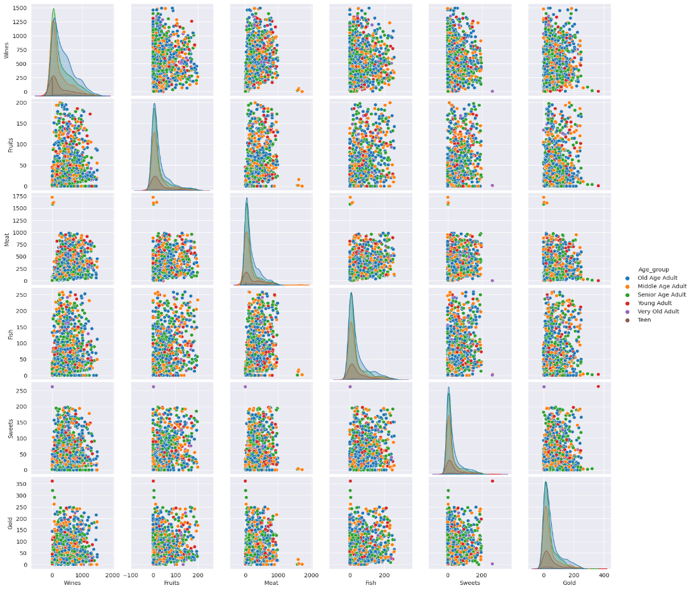

VISUALIZATION

Slide 20
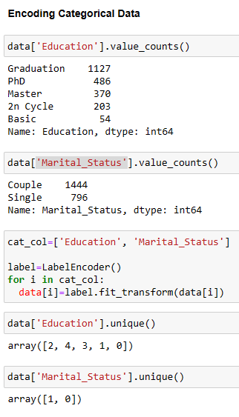
ENCODING CATEGORICAL DATA
ENCODING CATEGORICAL COLUMNS

Slide 21
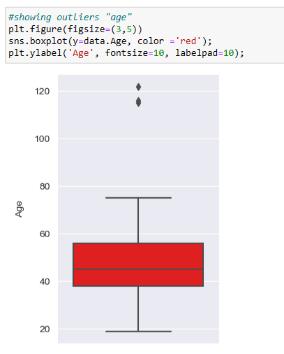
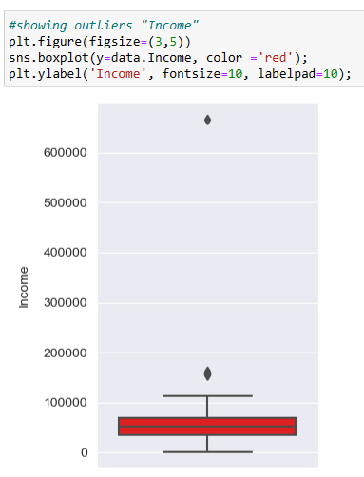

REMOVING OUTLIERS
REMOVING THE OUTLIERS

Slide 22
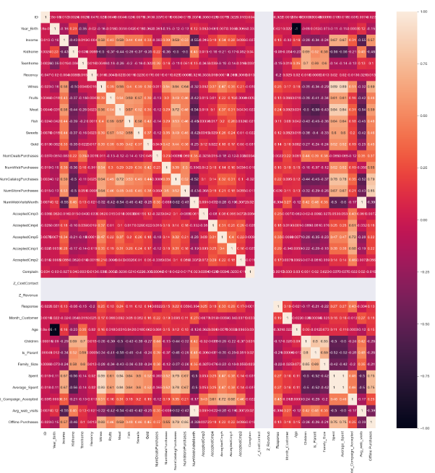
HEATMAP

Slide 23
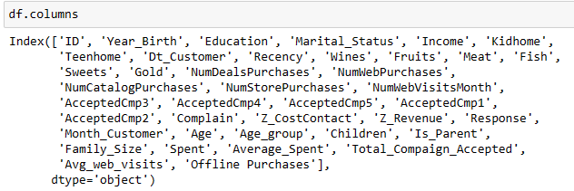
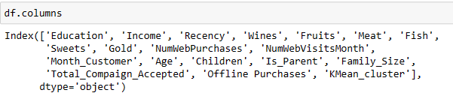
DROPPING COLUMNS

Slide 24
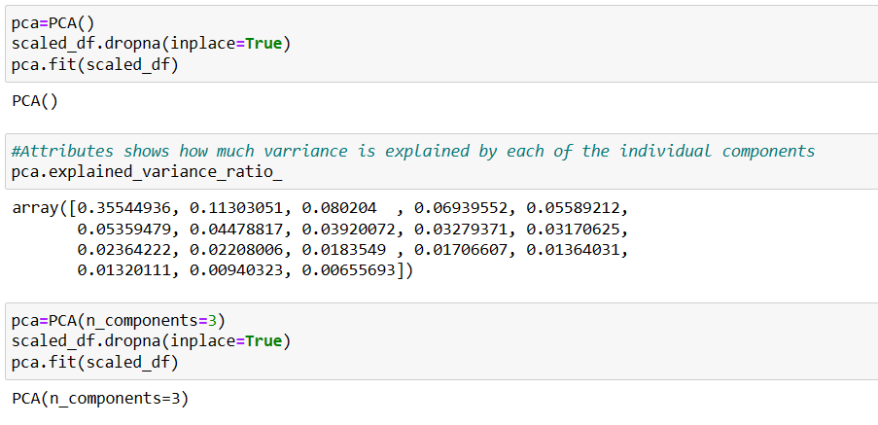
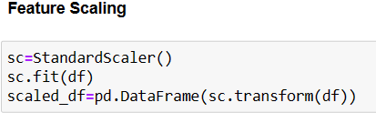
SCALING THE DATASET & PCA

Slide 25
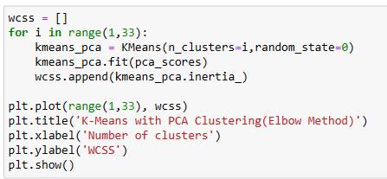
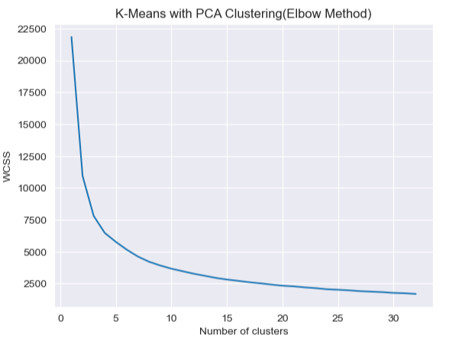
KMEANS CLUSTERING
KMEANS
First, to decide the number of clusters ,we’ve an Elbow plot i.e., plotting wcss against the number of components

Slide 26
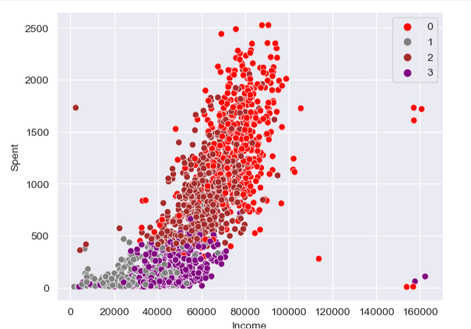
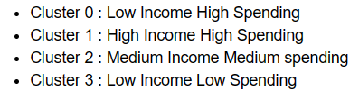
KMEANS CLUSTERING

Slide 27
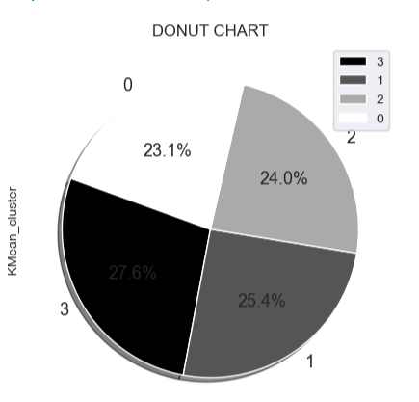
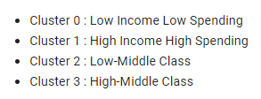
KMEANS CLUSTERING
Almost all the data points are equally distributed

Slide 28
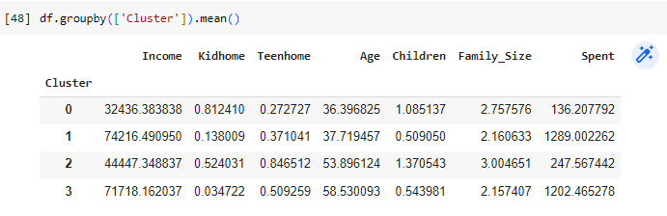
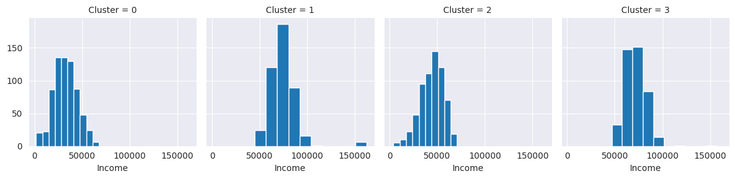
KMEANS CLUSTERING

Slide 29
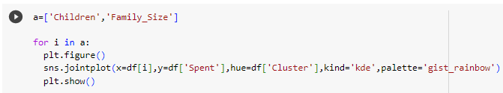
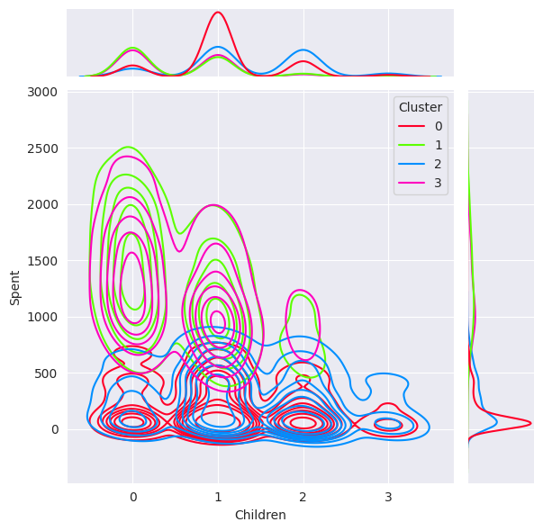
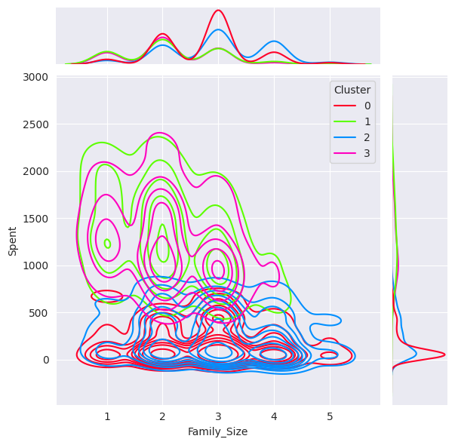
KMEANS CLUSTERING
CHARACTERISTICS OF CLUSTER

Slide 30
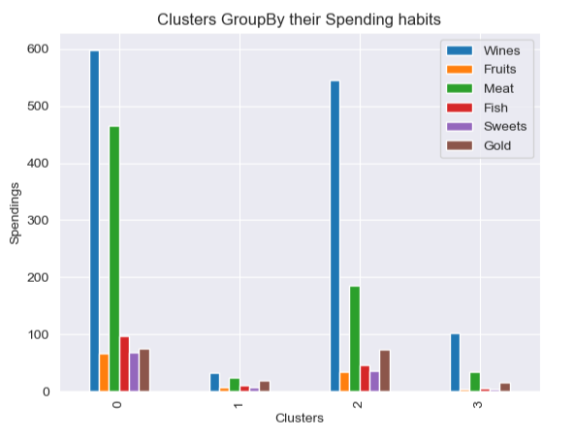
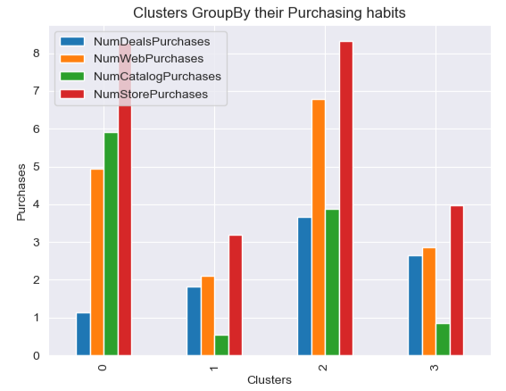
IMPLEMENTATION

Slide 31
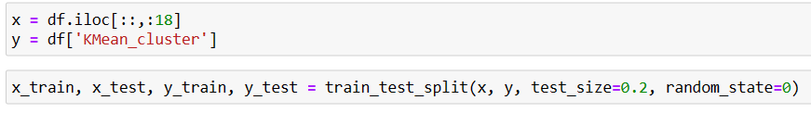
SPLITTING THE DATASET

Slide 32
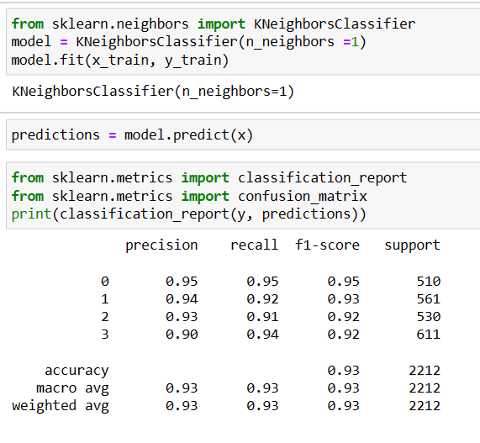
KNN MODEL BUILDING

Slide 33
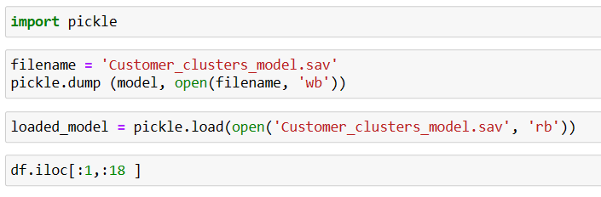
DEPLOYING THE MODEL
USING PICKLE TO SAVE THE MODEL

Slide 34
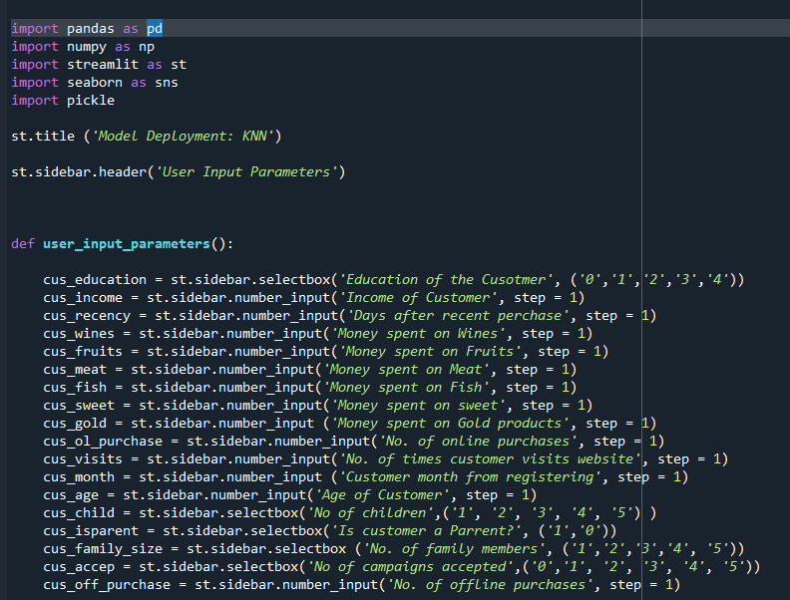
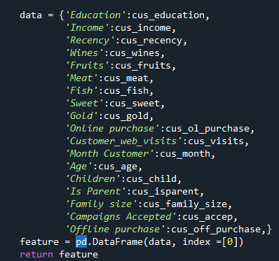
DEPLOYING THE MODEL

Slide 35
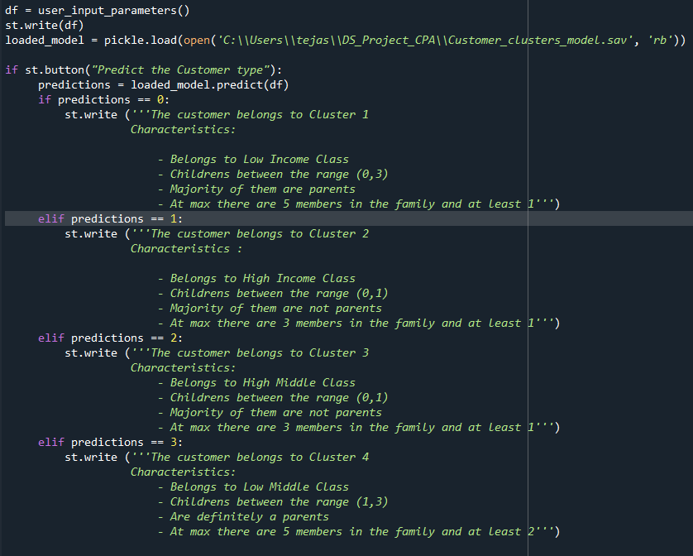
DEPLOYING THE MODEL

Slide 36
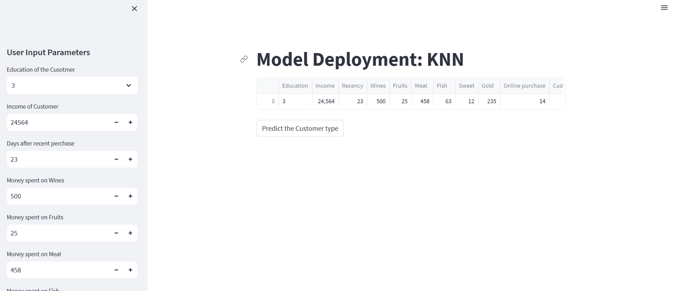
DEPLOYING THE MODEL

Slide 37



