Slide 1

AMCAT Data Analysis

Slide 2
About me
Completed B-Tech in MLR Institute of Technology from Computer Science Engineering(CSE) stream.
I am very much interested in working with the data field domain, which is very enthusiastic in generating the insights and building models which reduces the human hurdles and which helps in finding the difficulties in business growth or expansion.
Worked as Custom Software Engineering Analyst at Accenture for 3 years.
www.linkedin.com/in/fhanindhar-reddy-koppunooru
https://github.com/Fhani-03/

Slide 3
Problem Statement :
To find the average salary of the candidates who are graduated from Computer Science Engineering and other streams.
To find whether a relationship exists between gender and Specialization i.e. to check whether preference of Specialization depends on Gender.

Slide 4
Summary of Data:
The dataset mainly focuses on how employment outcomes of engineering graduates varies with Salary , Job Title and Job locations along with scores obtained by students in cognitive skills , technical and personality skills.
The dataset consists of around 40 independent variables and around 4000 data points.
Independent variables are both numerical and categorical in nature.

Slide 5
Exploratory data Analysis:
1. Data Cleaning
Understanding about the data like number of rows and columns and getting familiar with the columns and their datatypes before cleaning.
Renaming the column names which are not in proper format and making them short for better understanding.
Checking for missing values if any in each column of the data frame.
Checking for duplicate values if any in the data frame.
Checking for empty strings if any in the data frame.
Checking for outliers in each and every column and getting rid from them.

Slide 6
2. Univariate Analysis
Analysing numerical columns using Boxplots.
Analysing numerical columns using Histograms.
Analysing categorical columns using Count plots.
Generating insights from the analysis.

Slide 7
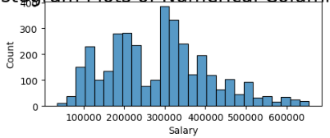
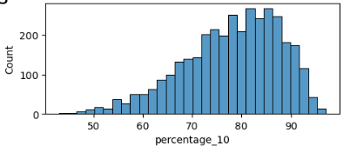
2.1 Analysing numerical columns using Histograms.
For approximately 400 candidates the Annual CTC offered is 300000.
For approximately 50 candidates the Annual CTC offered is 600000.
Salary range for most of the candidates is 200000 to 400000.
For most of the candidates the CGPA secured in 10th standard is between 8.0 to 9.0.

Slide 8
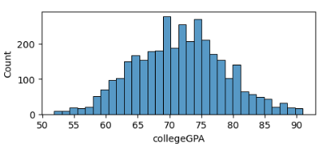
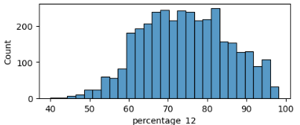
Around 300 candidates got 83% in Intermediate.
Percentage range for most of the candidates is between 60% to 80%.
Approximately 300 candidates got 70 GPA,250 candidates got 73 GP A, approximately 280 candidates got 75 GPA in their graduation.
Most of the candidates College GPA lies in between 65 - 80.

Slide 9
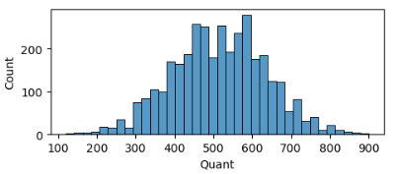
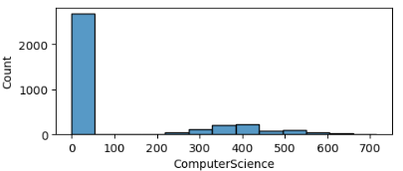
Around 300 candidates got 600 score in AMCAT Quant section.
Most of the candidates secured score between 400 to 700 in AMCAT Quant section.
2681 candidates got failed in AMCAT Computer Science section.
Approximately 100 - 200 people got 300 - 500 score in AMCAT Computer Science section.

Slide 10
3.Bivariate Analysis
Analysing Numerical vs Numerical columns with Scatter plots.
Analysing Numerical vs Categorical columns with Box plots.
Analysing Categorical vs Categorical columns with Grouped bar charts.
Generating insights from each of the plots.

Slide 11
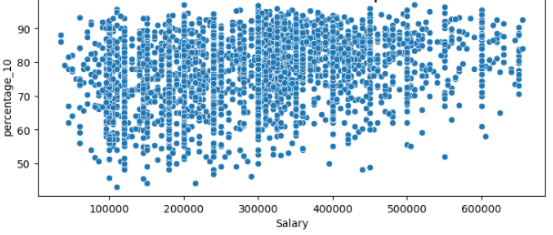
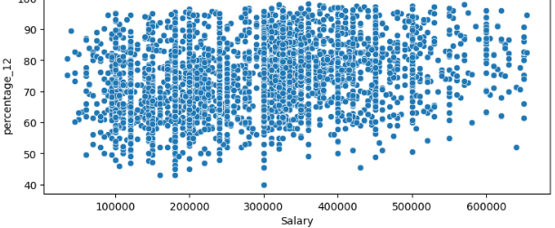
3.1 Analysing Numerical vs Numerical columns with Scatter plots.
Most of the candidates salaries lies between 200000 to 500000 and whose 10th standard percentage lies between 60 - 90.
One candidate got good package(550000) , even though the percentage in 10th standard is around 50%.
One candidate not got best package(<100000) , even though the percentage in intermediate is >90%.

Slide 12
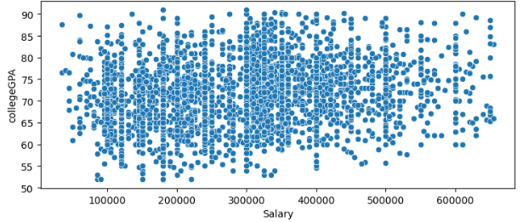
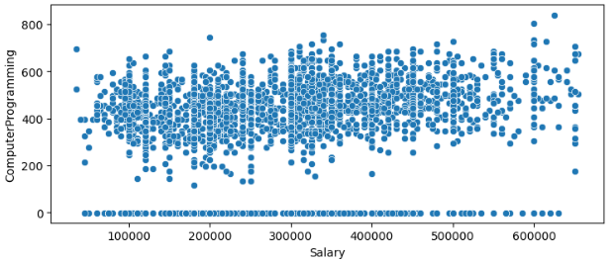
Most of the candidates salaries lies between 200000 to 500000 and whose college GPA lies between 60 - 90.
One candidate got not a good package(<100000) , even though the college GPA is 90.
695 candidates who got failed in Computer Programming also got placed with all sort of salary ranges.
Some failed candidates are also equally competing with the candidates who got good score in Computer Programming.

Slide 13
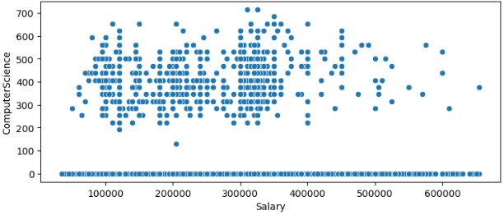
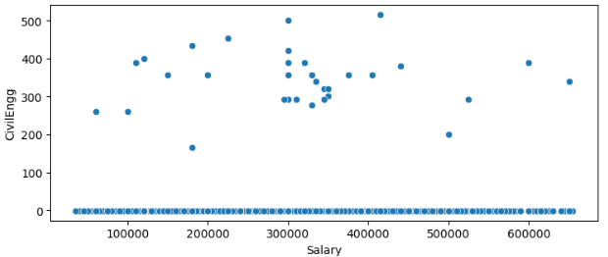
2681 candidates who got failed in Computer Science also got placed with all sort of salary ranges.
Some candidates who got best score in Computer Science also didn't got good packages when compared to the candidates who got failed.
3470 candidates who got failed in Civil Engg also got placed with all sort of salary ranges.
Only few candidates who got best score in Civil Engg also didn't got good packages when compared to the candidates who got failed.

Slide 14
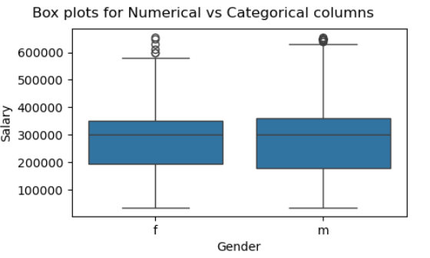
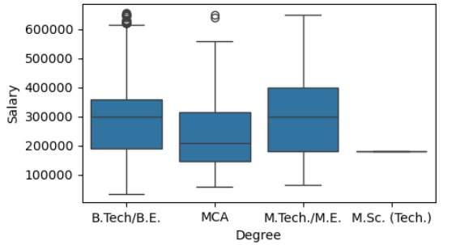
3.2 Analysing Numerical vs Categorical columns with Box plots.
Average Salaries of males(2633) and females(869) are almost equal which is nearly 300000.
Average Salary of M.Tech./M.E. candidates is first highest among all degrees average salaries.
Average Salary of B.Tech/B.E. candidates is second higher among all degrees average salaries.

Slide 15
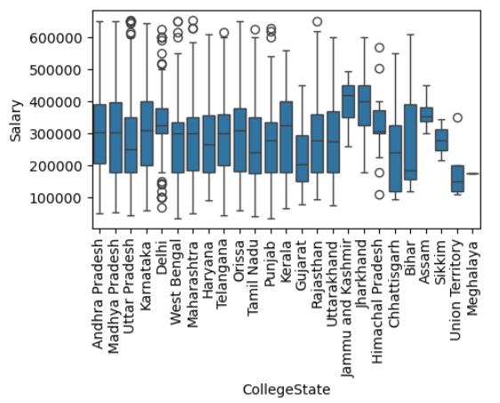
Candidates who belongs to "Jharkhand" has the highest average salary among all the states average salaries.
Candidates who belongs to "Meghalaya" has the least average salary among all the states average salaries.
State wise average salaries of candidates lies between the range 200000 - 350000.

Slide 16
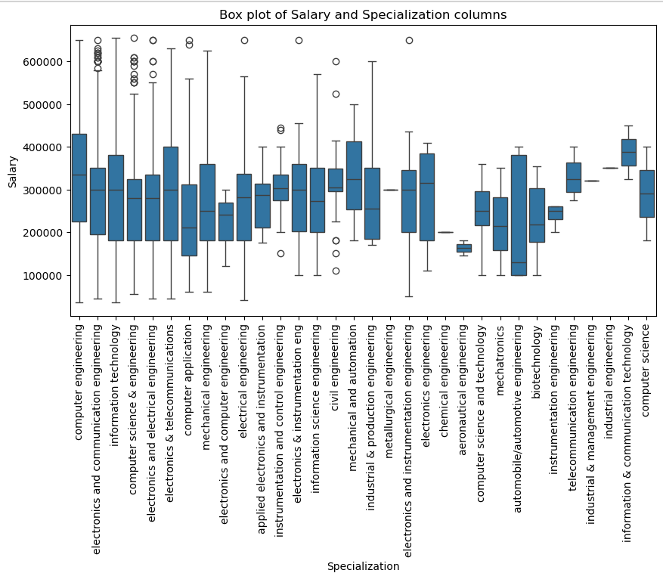
Candidates who belongs to "information & communication technology" Specialization has the first highest average salary among all the specializations.
Candidates who belongs to "aeronautical engineering" Specialization has the least average salary among all the specializations.

Slide 17
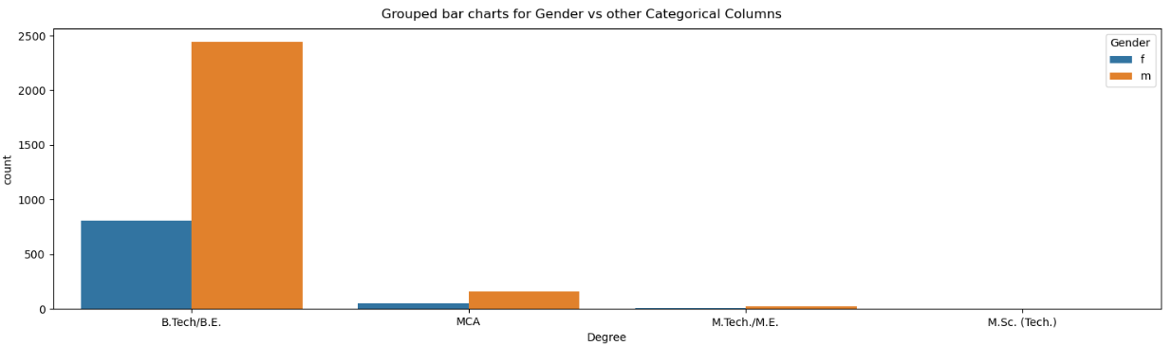
3.3 Analysing Categorical vs Categorical columns with Box plots.
2443 candidates are males in B.Tech/B.E. and 807 candidates are females.
Only one female candidate is there in "M.Sc. (Tech.)" degree.
Rest of the candidates are from "MCA"(males = 163 and females = 55) and "M.Tech./M.E."(males = 27 and females = 6).

Slide 18
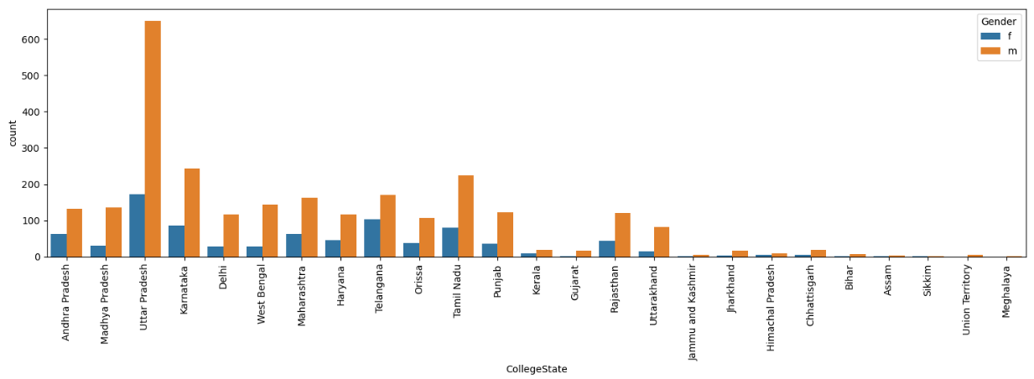
Uttar Pradesh state has first highest number of candidates among them males are 651 and females are 173.
Karnataka state has second highest number of candidates among them males are 243 and females are 87.

Slide 19
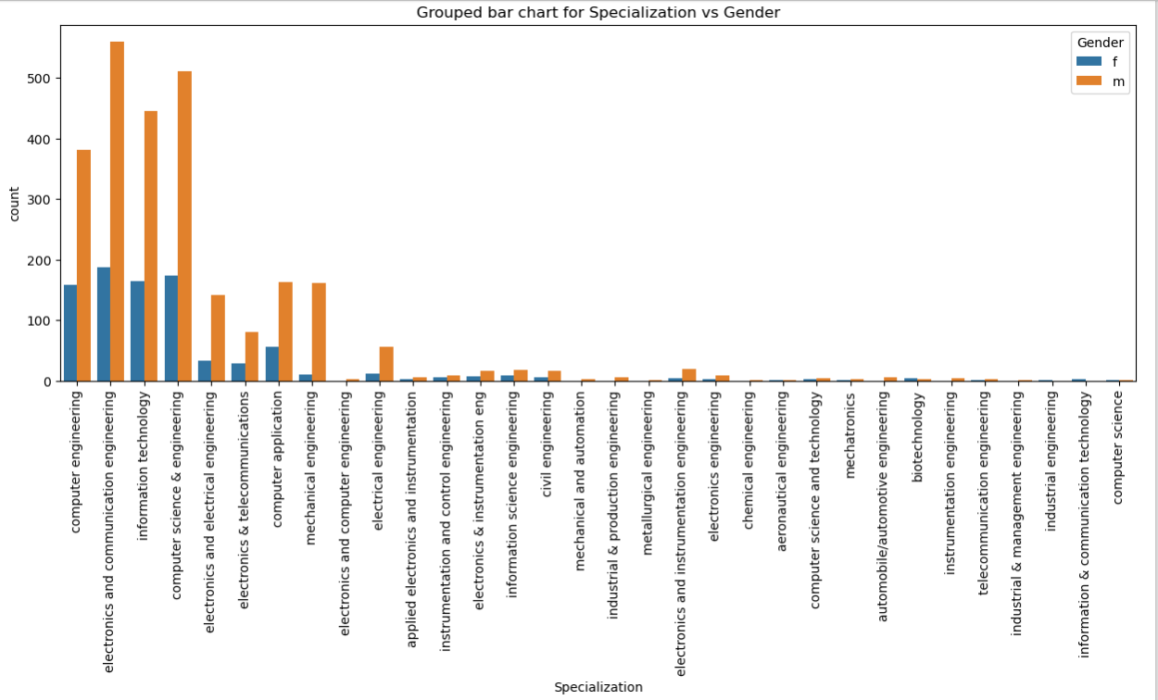
ECE specialization has the highest number of candidates among them males are 560 and females are 187.
Most of the candidates are from CSE,IT,CS and ECE.
On the whole in each and every specialization the count of males is higher than the count of females.

Slide 20
Conclusion:
The claim given by Times of India that the average salary of fresh graduates is around 2.5 to 3 lakhs is true. The analysis on the given data has given the insight that average salary of fresh graduates is around 2 to 4 lakhs and this proves the claim given by Times of India is true.
There is no particular relation between gender and specialization, why because as per the analysis it is proved that in each and every specialization the males count is higher than females, none of the specialization has female count more than males. So from this we can conclude that there is no particular relation between gender and specialization.

Slide 21


Slide 22

THANK YOU

