Slide 1
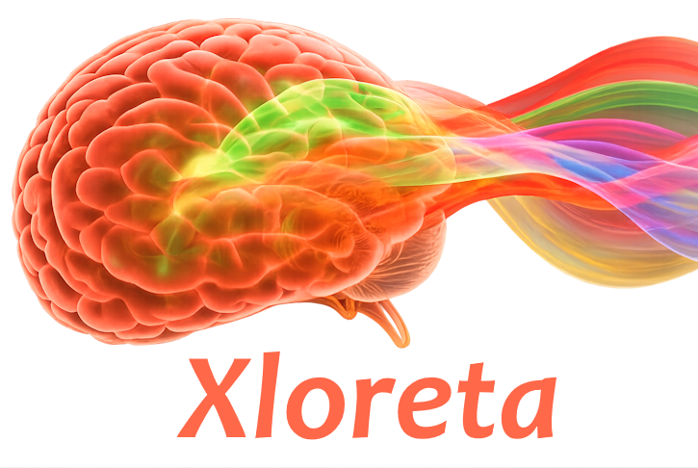

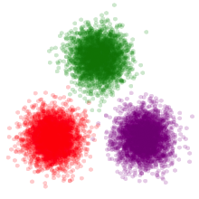
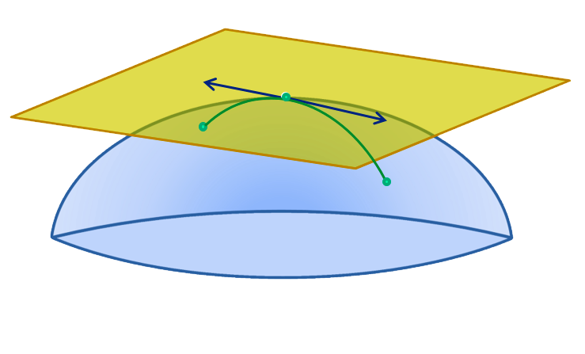
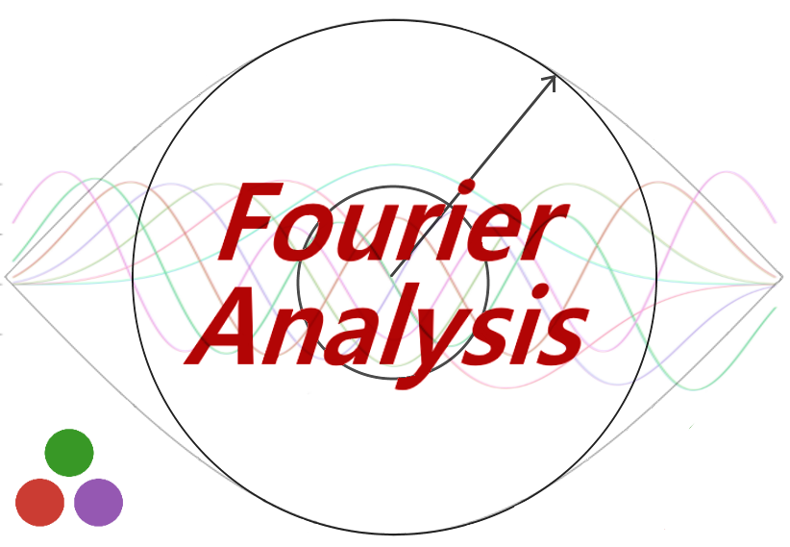
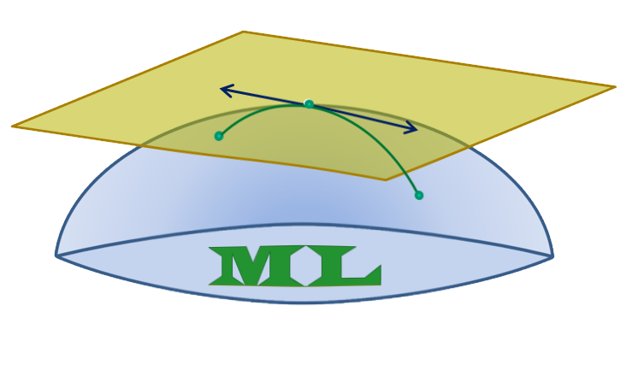

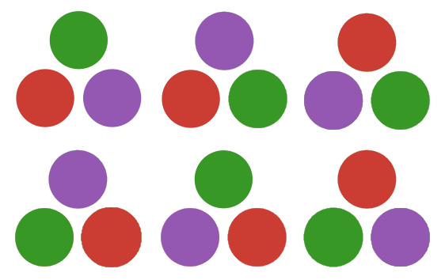

Eegle Integration
Powered by
PosDefManifold.jl
Inverse Solutions
Riemannian
geometry
LinearAlgebra.jl
FourierAnalysis.jl
PosDefManifoldML.jl
Linear Algebra, BLAS, LAPACK
Eegle
StatsBase.jl, Statistics.jl,
Distributions.jl
Statistics, Probability distributions
and functions
Spectral analysis,
Time-frequency analysis,
Coherence, Connectivity
Riemannian
machine learning
DSP.jl
Digital Signal Processing
PermutationTests.jl
Diagonalizations.jl
CovarianceEstimations.jl
Covariance Estimation
Bonito.jl
Web GUIs
Statistical testing
Spatial filters, Blind Source Separation

