Slide 1
A Brief Introduction To Stack-Oriented Programming Languages

Slide 2
Agenda
Part 1: What are stack-oriented language?
Part 2: Why stack-oriented?
Part 3: A brief history of stack-oriented languages
Part 4: Stuff to take home and play with
Q&A

Slide 3
Part 1: What are stack-oriented languages?

Slide 4
What Is A Stack-Oriented Language?
‘Stack-oriented’ refers to the method of passing parameters between functions in a language
Traditionally arguments are specified for each function call in turn
But in a stack-oriented language the arguments are passed through a data stack, with functions picking data from the stack that they need, and returning data via the stack

Slide 5
Stack-Oriented Languages You’ve Already Used
You’ve likely used a stack-oriented language without even realising it!
The Java Virtual Machine (JVM) is stack based, meaning every line of Java, Kotlin etc. ultimately compiles to a stack language
Postscript, the document format used to produce most PDFs, is stack-oriented
Other examples include: Emacs Calc and old RPN Calculators

Slide 6
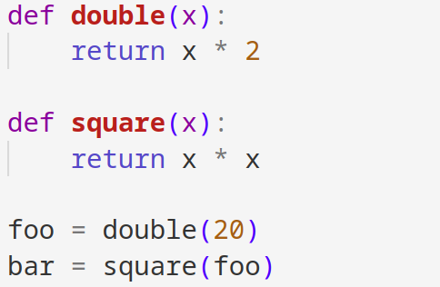
A Short Example: Doubling
Python code to double then square an integer:
Notice that we must explicitly specify the arguments for each function

Slide 7
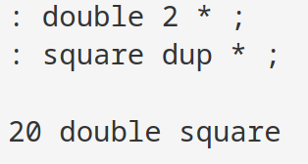
A Short Example: Doubling
Meanwhile in the most famous stack-oriented language, Forth, we implicitly pass the parameters from one argument to another:
We must consciously consider what values are passed to functions and returned via the stack
We can see that this can also lead to simpler code when functions have to juggle few variables

Slide 8
Part 2: Why stack-oriented?

Slide 9
Why Stack-Oriented?
Removes the needs for brackets in expressions or working out the order for operations, as evaluation order is explicit
Extremely simple to implement
Can’t suffer from buffer overflows (if data is kept to the stack, which is proper style)
Extremely compact (Since calls are implicit, Forth beats assembly for size, which seems impossible!)
Very fast (Forth began life on punch-card machines!)

Slide 10
How Forth Is Smaller Than Assembly!
This seems nonsensical at first, since it must eventually run as machine code, but it’s true!
Stack-oriented programs don’t need to call functions using the assembly ‘call’ instruction
Since there’s no arguments we can just jump to functions!
This means stack-oriented code can be represented as just a list of addresses, with no need to parameter passing and call operations
Instead a small pilot interpreter simply reads function addresses, jumps to them and then jumps back to the next, never using ‘call’!

Slide 11
Part 3: A brief history of stack-oriented languages

Slide 12

1960 - 1970
The first major stack-oriented language was Forth, created by Charles (Chuck) Moore in the late 1960s
Forth began life as a language to control
radio telescopes
It was designed as a simple interpreter
for punch-card style computers
Forth’s interactivity enabled Moore to run multiple programs a day, instead of just one
It was designed to be simple to implement on new systems as he moved jobs, with him saying he ‘discovered’ it, not invented

Slide 13
1970 - 1980
Throughout the 1970s Forth gained popularity in fields that demanded real-time control, such as embedded systems
Its compact nature made it ideal for systems with limited resources, and its interactive nature allowed programmers to test and debug code on the fly
In the 1980s, Forth was standardized by the Forth Standards Team, leading to the publication of ANSI Forth, which most Forth’s nowadays implement
The first ever real-time strategy game, Cosmic Conquest, was written in Forth

Slide 14
1970 - 1980
Throughout the 1970s, Forth gained popularity in fields that demanded real-time control, such as embedded systems
In the 1980s, Forth was standardized by the Forth Standards Team, leading to the publication of ANSI Forth, which most Forth’s nowadays implement
The first ever real-time strategy game, Cosmic Conquest, was written in Forth in 1983

Slide 15
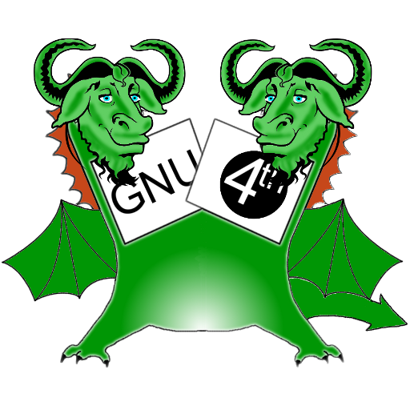
1980 - 2000
PostScript was invented in 1982 and became the dominant language for document creation
A GNU implementation of Forth was created in 1992 (Gforth)
Gforth aimed to become the standard desktop Forth, following the ANSI standard perfectly and clearly specifying where it did not
In 1994 the JVM was introduced, spreading stack-oriented machine code to almost every computer worldwide!

Slide 16
2000 - Present
Forth has made a small comeback today, as have stack-oriented languages in general
Two new major stack languages emerged:
  Factor – A functional stack language which uses the concept of ‘stack-combinators’ to express computations elegantly
  Joy – A purely functional language that accidentally converged to a stack-oriented model whilst following academic ideas on function composition
There are many Forth implementations, even commercial ones
It has become popular to implement your own Forth due to the simplicity of doing so (resources in the next part!)

Slide 17
Part 4: Stuff to take home and play with

Slide 18
GForth
The standard Forth implementation everyone uses
Free to download and available on most Linux distros via the package manager
Runs on MacOS, Windows, Linux, Android and even certain microcontrollers
Available at https://gforth.org/

Slide 19
JonesForth
The go-to guide for implementing your own Forth
Written as a commented assembly file, you can find translations to lots of other languages online
  Using ASM expresses the trick of just jumping to addresses (called direct threading) so try to handle it :)
Available at https://github.com/nornagon/jonesforth

Slide 20
Thinking Forth
The classic Forth learning book, a great companion to GForth!
Available free online:
  https://www.forth.com/wp-content/uploads/2018/11/thinking-forth-color.pdf
Or as a physical book
Touches on cool topics not discussed here like metaprogramming (You can implement OOP, structs and more, and it’s even more expressive than Lisp!)

Slide 21
Factor
The most popular and modern stack-oriented language, with innovations still happening today
Has a huge standard library, with features such as a built-in cross-platform GUI library
The name is a reference to ‘factoring’ in Forth code, where functions are split and rewritten to shrink the program and increase clarity at the same time!
Available at https://factorcode.org/

Slide 22
Any Questions?

