Slide 1
Multi-fidelity Bayesian Neural Networks:
Algorithm & Applications
Xuhui Meng
Crunch Group

Slide 2

Outline
Multi-fidelity Bayesian neural networks (MBNNs)
Function approximation: Linear/Nonlinear correlation
Inverse PDE Problems: Linear/Nonlinear correlation
Active Learning
Crunch Group

Slide 3
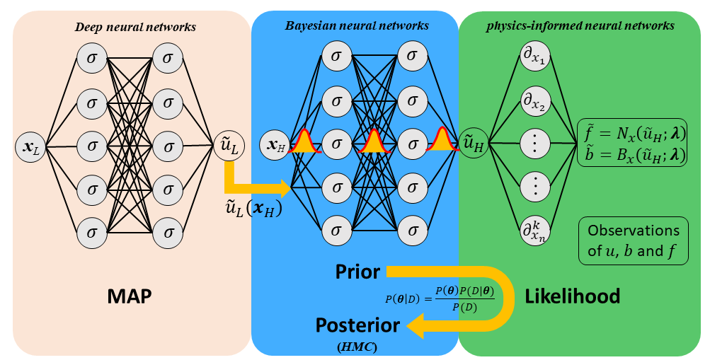



Multi-fidelity Bayesian neural networks
$$u_{H}=F(x,u_L)$$
Low-fidelity Training:
Maximum a posteriori probability
Posterior sampling
(Hamiltonian Monte Carlo)
High-fidelity Training:
All measurement errors are assumed to be Gaussian

Slide 4
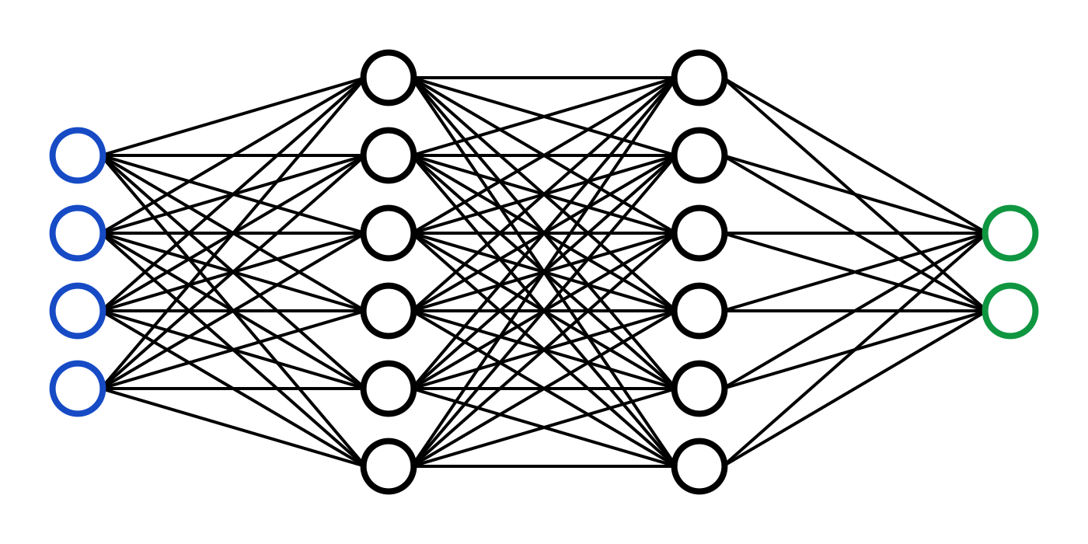
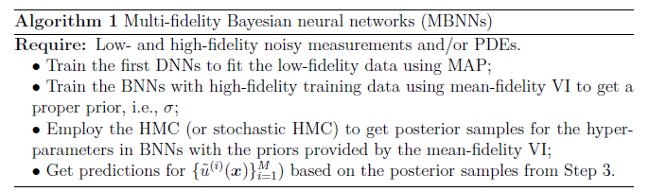


Multi-fidelity Bayesian neural networks: prior distribution
$$σ_{w,b} \sim N(0, σ_{w,b}^{2})$$
$$σ_{w,l}=\frac{σ}{\sqrt{H_{l}}},σ_{b}=1$$
$σ:$ standard deviation for prior distribution (Gaussian)

Slide 5
Function approximation (i) : Nonlinear correlation (1D)
Low-fidelity data
High-fidelity data
100 uniformly distributed low-fidelity data
14 high-fidelity noisy measurements
Low-fidelity NN: 2 hidden layers with 20 neurons per layer
BNNs: 1 hidden layer with 50 neurons

Slide 6
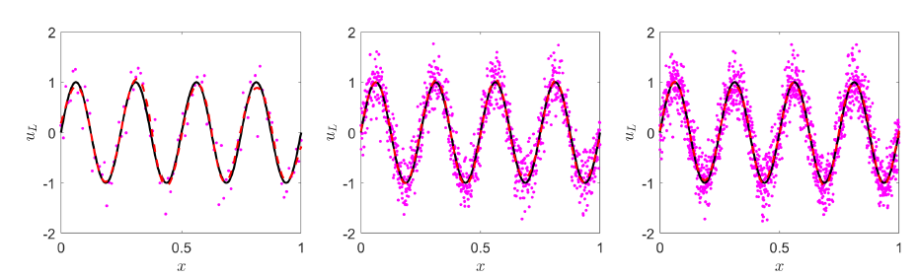
Function approximation (i) : Low-fidelity with larger noise
Low-fidelity data
High-fidelity data

Slide 7
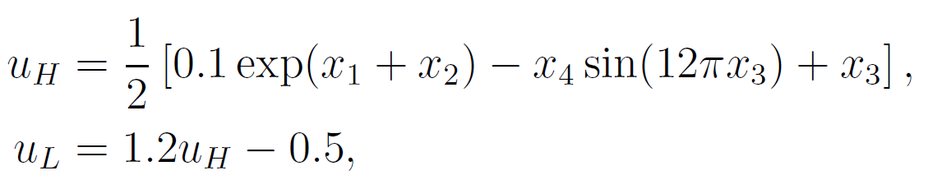
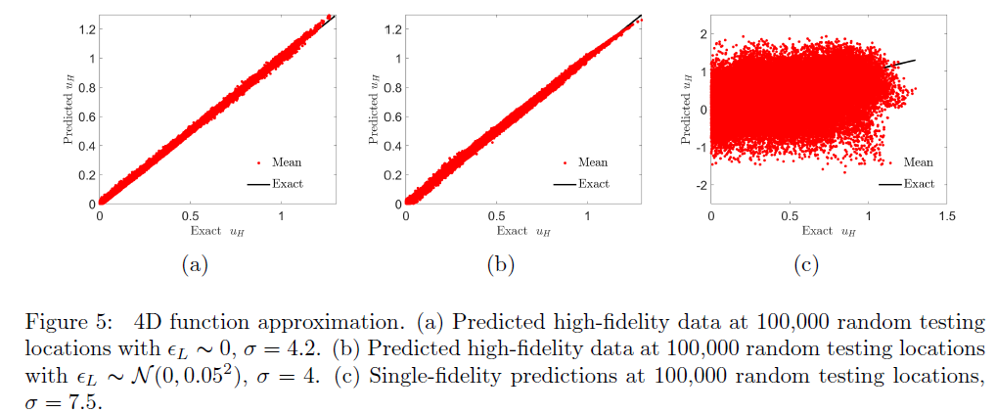
Function approximation (ii) : Linear correlation (4D)
High-fidelity data
Low-fidelity data
25,000 randomly distributed low-fidelity data
150 random high-fidelity noisy measurements
Low-fidelity NN: 2 hidden layers with 50 neurons per layer
BNNs: 1 hidden layer with 50 neurons

Slide 8
Sea Surface Temperature
Low-fidelity NN: 2 hidden layers with 40 neurons per layer
BNNs: 1 hidden layer with 50 neurons

Slide 9
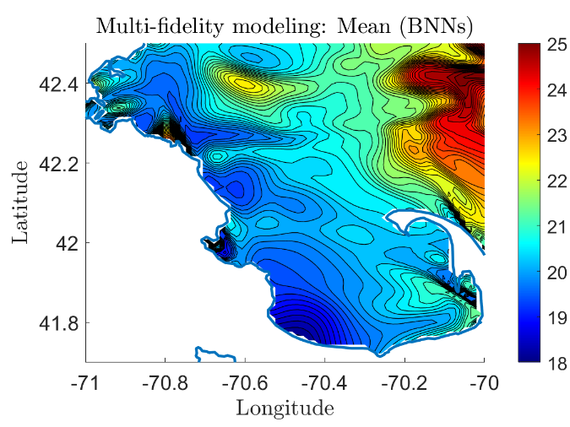
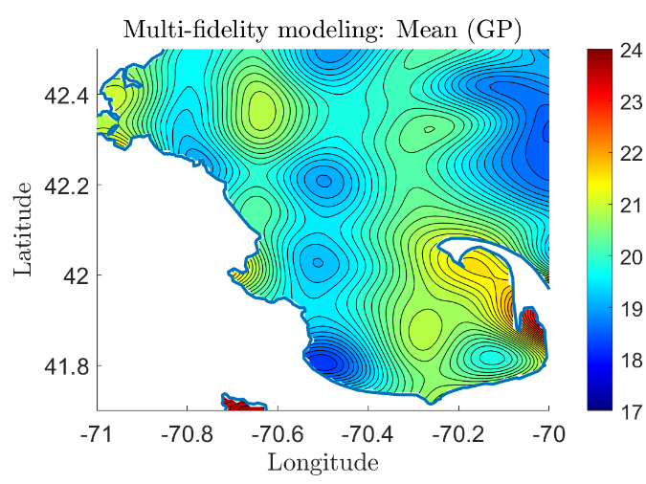
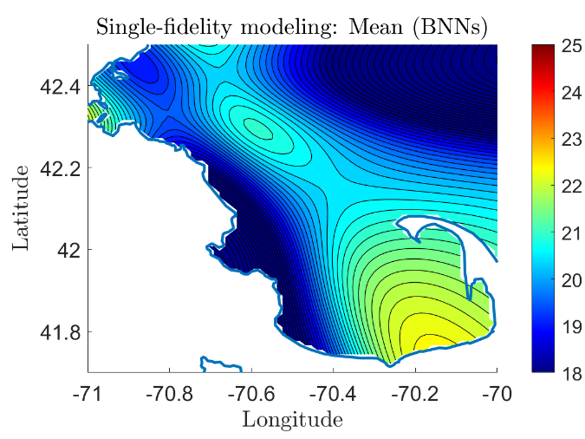
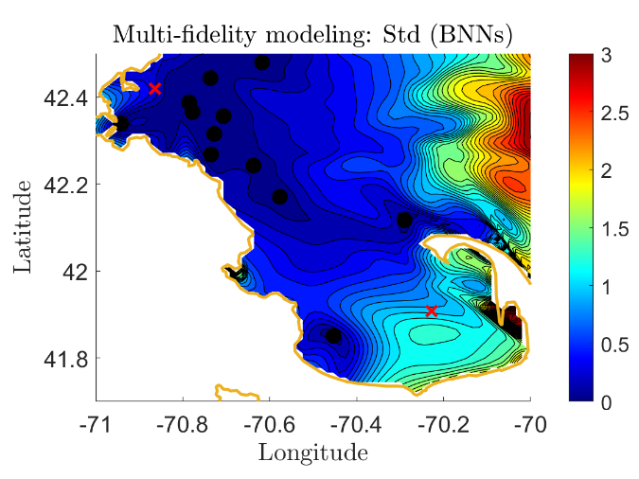
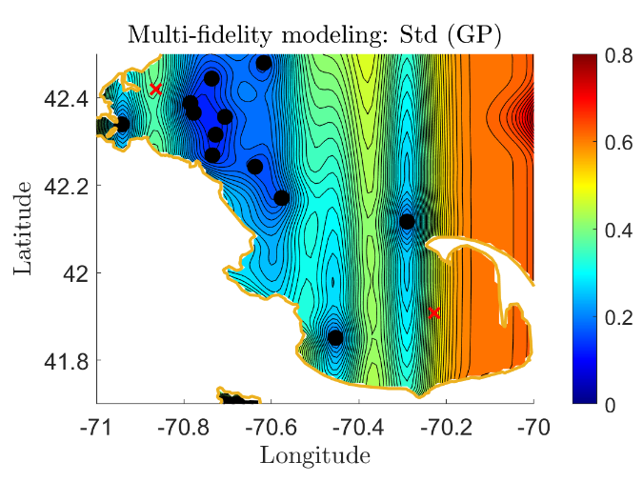
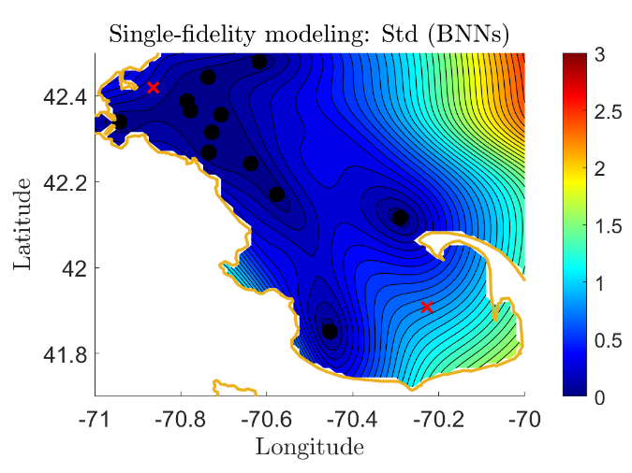
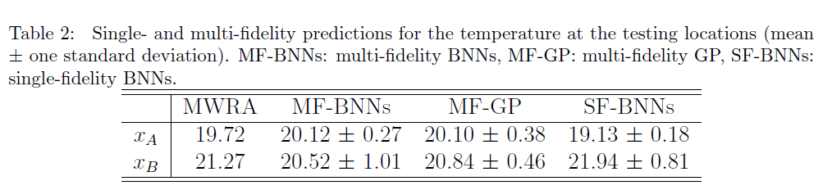
Sea Surface Temperature

Slide 10
Inverse PDE Problem (i): Diffusion-reaction system (1D)
Diffusion-reaction system
Exact solution:
k = 1,
High-fidelity training data: 10 random high-fidelity noisy measurements for u and f
Low-fidelity training data:
100 randomly distributed data without noise
100 randomly distributed data with noise
Objective: (1) Infer the reaction rate k
(2) Reconstruct u and f
Low-fidelity NN: 2 hidden layers with 20 neurons per layer
BNNs: 1 hidden layer with 50 neurons

Slide 11
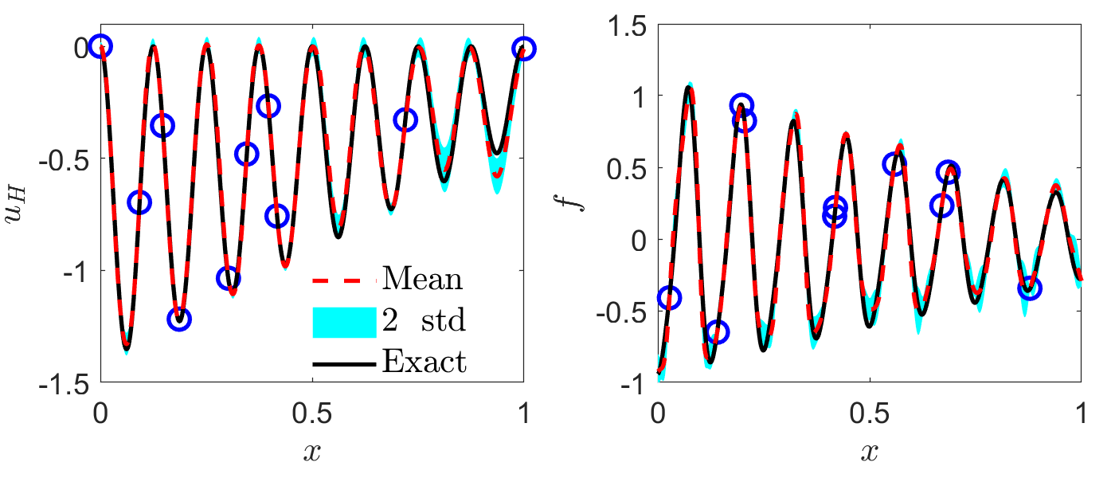
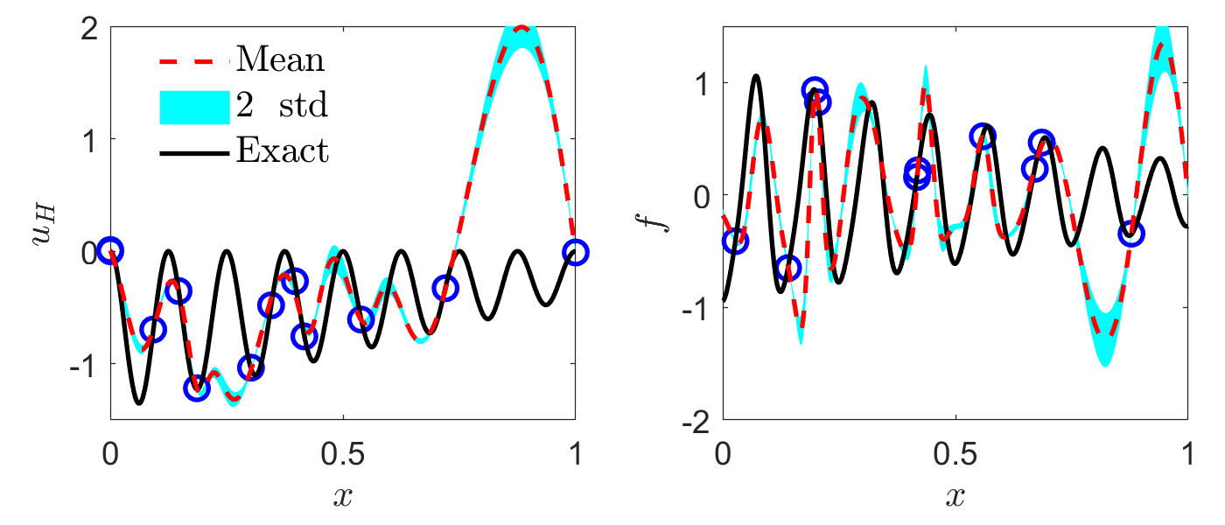
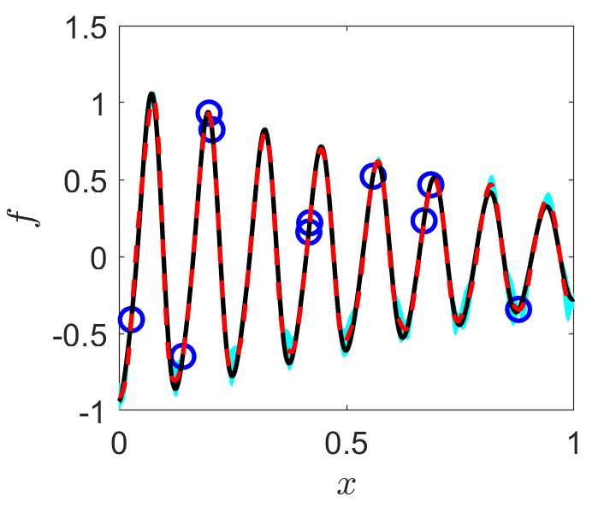
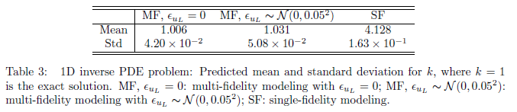
Inverse PDE Problem (i): Diffusion-reaction system (1D)
Predicted k:

Slide 12

Inverse PDE Problem (ii): Diffusion-reaction system (2D)
Diffusion-reaction system
Exact solution:
k = 1,$λ=0.01, u_{H}=\sin\left(2πx\right)sin⁡(2πy)$
High-fidelity training data: 10 random high-fidelity noisy measurements for u
20 random high-fidelity noisy measurements for f
Low-fidelity training data:
$$u_{L}=0.8u_{H}+0.2$$
6,000 randomly distributed data without noise
Objective: (1) Infer the reaction rate k
(2) Reconstruct u and f
Low-fidelity NN: 2 hidden layers with 20 neurons per layer
BNNs: 1 hidden layer with 50 neurons

Slide 13
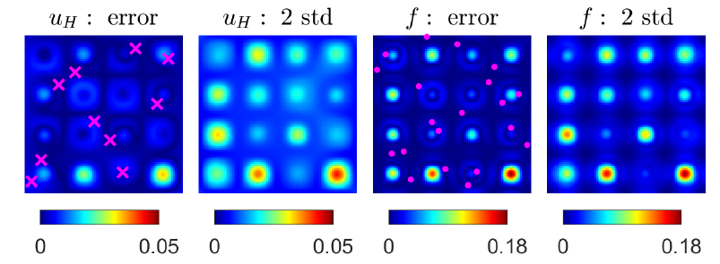
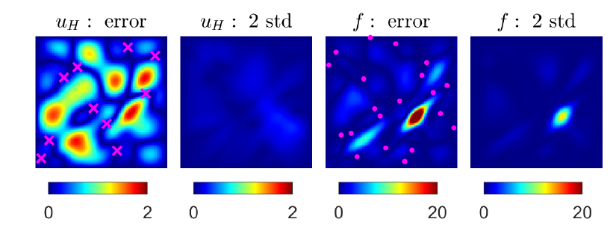
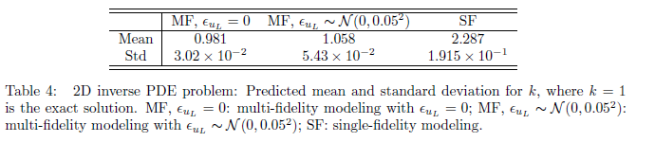
Inverse PDE Problem (ii): Diffusion-reaction system (2D)
Single-fidelity
Predicted k:
(Exact k=1)

Slide 14
Active Learning (i): Function approximation
100 uniformly distributed low-fidelity data
10 high-fidelity noisy measurements (initial training data)
Low-fidelity NN:
2 hidden layers with 20 neurons per layer
BNNs:
1 hidden layer with 50 neurons

Slide 15
Active Learning (ii): Inverse PDE Problem
Diffusion-reaction system
Exact solution:
k = 1,
High-fidelity training data: 3 random high-fidelity noisy measurements for u
10 random high-fidelity noisy measurements for f
Low-fidelity training data:
100 randomly distributed data without noise
Objective: (1) Infer the reaction rate k
(2) Reconstruct u and f
Low-fidelity NN: 2 hidden layers with 20 neurons per layer
BNNs: 1 hidden layer with 50 neurons

Slide 16
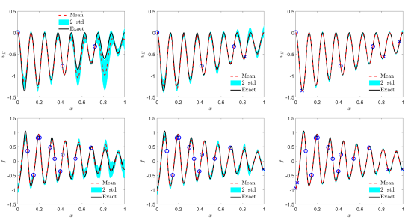
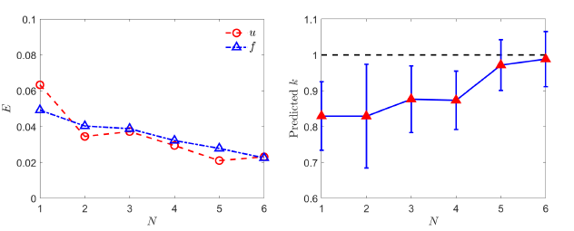

Active Learning (ii): Inverse PDE Problem
Iteration: 0
Iteration: 1
Iteration: 4
Predicted u
Predicted f
Errors for u and f
Predicted k

Slide 17
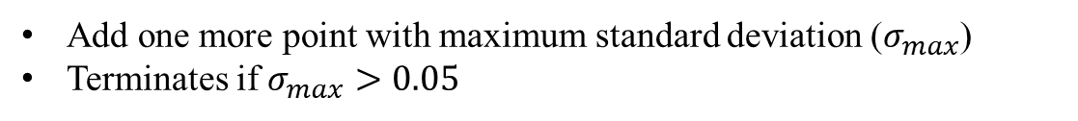
Active Learning (ii): Inverse PDE Problem (Animation)
Add one more point with maximum standard deviation ($σ_{max}$)
Terminates if $σ_{max}>0.05$

