Slide 1


A composite neural network that learns from multi-fidelity data: Function Approximation and Inverse PDE Problems
Xuhui Meng, George Em Karniadakis
Division of Applied Mathematics, Brown University
{xuhui_meng@brown.edu}
6/28/2019
Meng&Karniadakis
MPINNs
Deep Learning

Slide 2

Outline
I. Background
II. Composite neural network for multi-fidelity data
III. Function approximation
IV. Inverse PDE problems
V. Summary
Meng&Karniadakis
MPINNs
Deep Learning

Slide 3
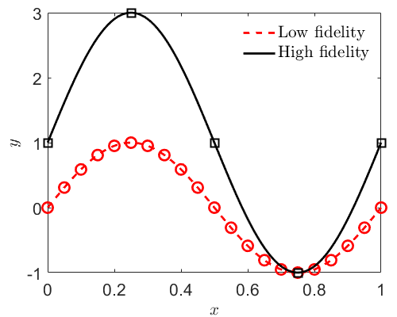
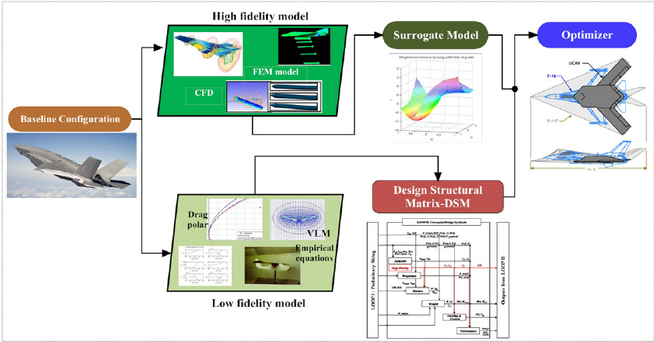
Background: Multi-fidelity model
…
Aircraft design(Nguyen, et al, ATIO, 2009)
Sea surface temperature forecast(Bababee et al, 2016)
Meng&Karniadakis
MPINNs
Deep Learning

Slide 4
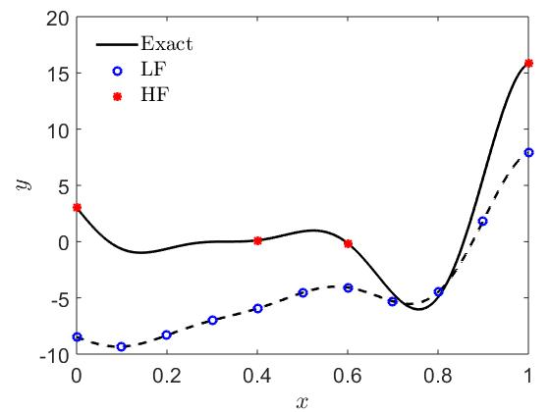
Multi-Fidelity model
A large number of accurate training data
Multi-fidelity model | Low-fidelity data | Less accurate, cheap | Large amount | Numerical simulations /empirical models
 | High-fidelity data | Accurate, expensive | Scarce | Experiment /observations
Infer the correlation between low- and high-fidelity data
Supply the trend towards the high-fidelity data
Fernandez-Godino, et al.. arXiv 2017
Meng&Karniadakis
MPINNs
Deep Learning

Slide 5
Review on multi-fidelity model: Gaussian Process Regression
1. Linear correlation between low-and high-fidelity data:
optimization
2. Non-linear correlation between low-and high-fidelity data:
optimization
Limitations:
Not suitable for high-dimensional problems
Difficult to train
Raissi, et al. J. Compt. Phys. 2017
Perdikaris, et al. Proc. R. Soc. A, 2017
Meng&Karniadakis
MPINNs
Deep Learning

Slide 6
Outline
I. Background
II. Composite neural network for multi-fidelity data
III. Function approximation
IV. Inverse PDE problems
V. Summary
Meng&Karniadakis
MPINNs
Deep Learning

Slide 7
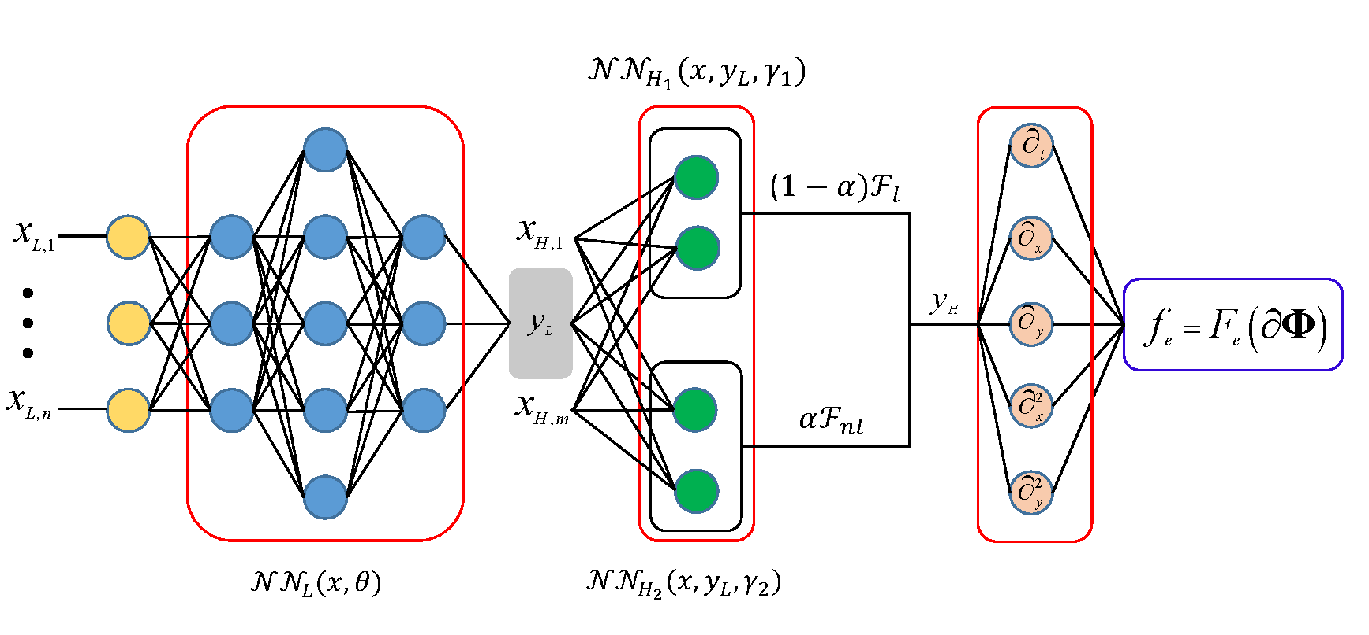
Composite neural network for multi-fidelity data: Function approximation
General formula for low- and high-fidelity data:
F: unknown function to be learned from data
Meng, et al. arxiv, 2019
Meng&Karniadakis
MPINNs
Deep Learning

Slide 8
Composite neural network for multi-fidelity data: Inverse PDE problems
General formula for low- and high-fidelity data:
F: unknown function to be learned from data
Meng, et al. arxiv, 2019
Meng&Karniadakis
MPINNs
Deep Learning

Slide 9
Outline
I. Background
II. Composite neural network for multi-fidelity data
III. Function approximation
IV. Inverse PDE problems
V. Summary
Meng&Karniadakis
MPINNs
Deep Learning

Slide 10
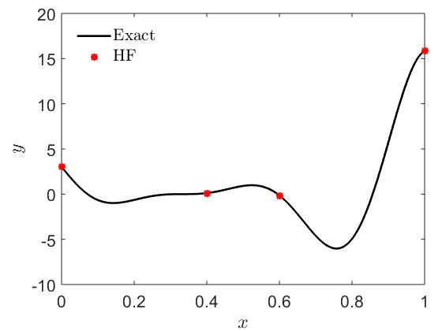
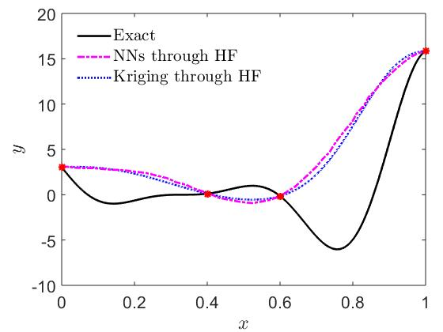
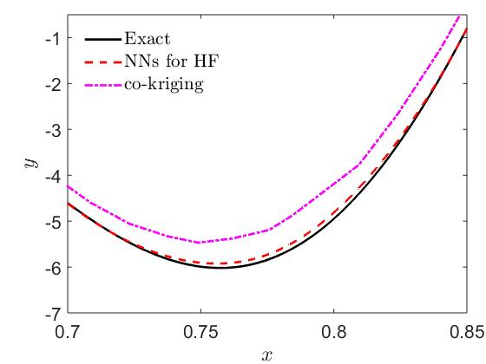
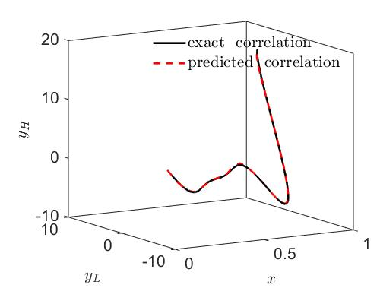
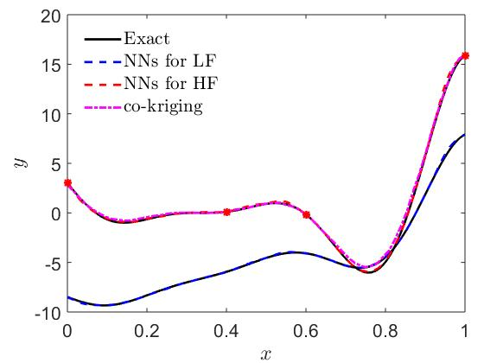

Function approximation: Continuous function: Linear correlation
single-fidelity
Training data
Predictions
(width $×$ depth)
multi-fidelity
Training data
Predictions
Forrester, et al. Proc. R. Soc. A, 2007
Meng&Karniadakis
MPINNs
Deep Learning

Slide 11
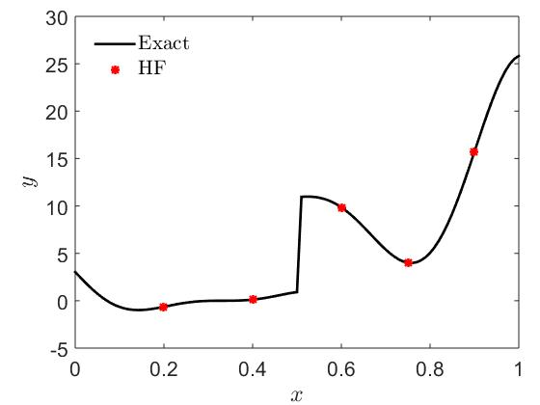
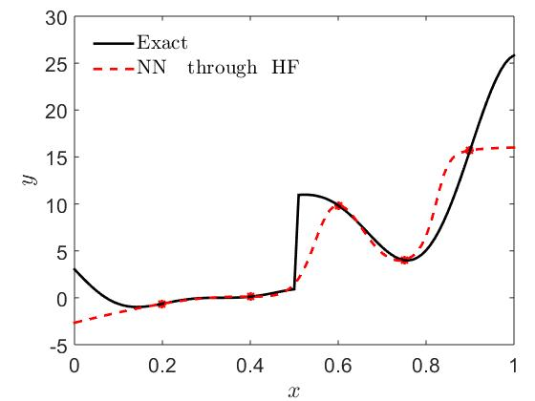
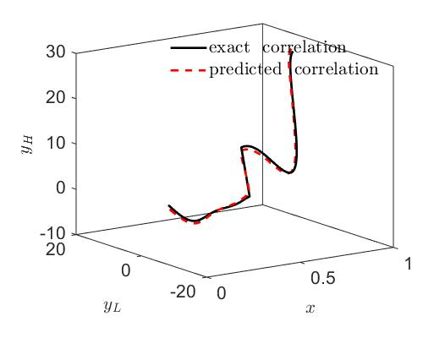
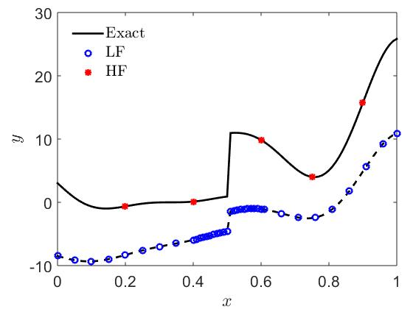
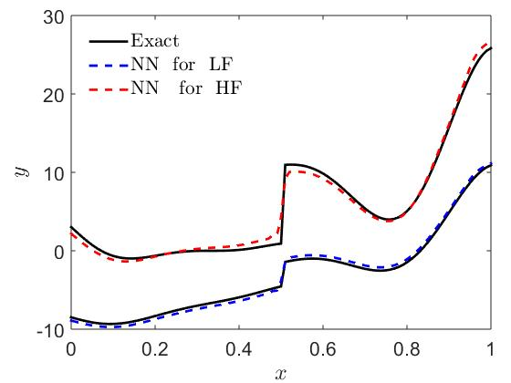
Function approximation: Discontinuous function: Forrester function with jump
single-fidelity
multi-fidelity
Meng&Karniadakis
MPINNs
Deep Learning

Slide 12
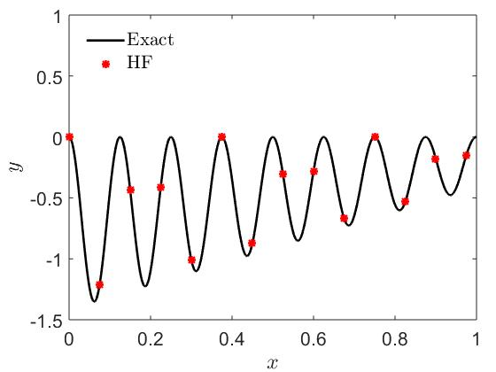
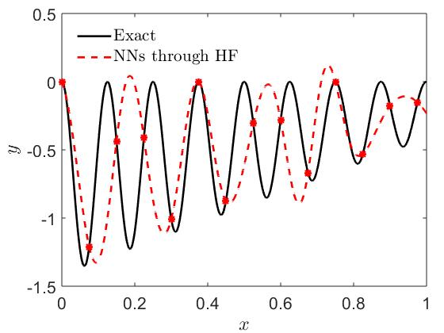
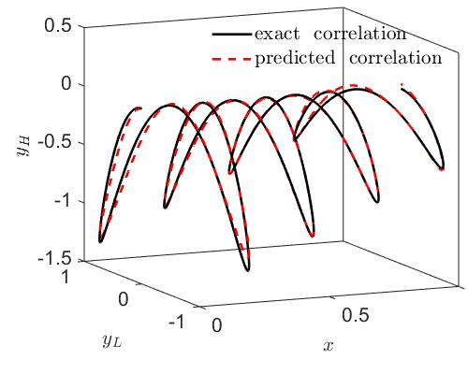
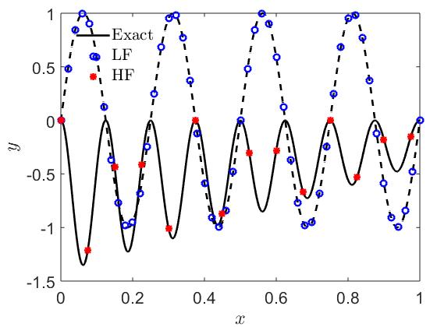
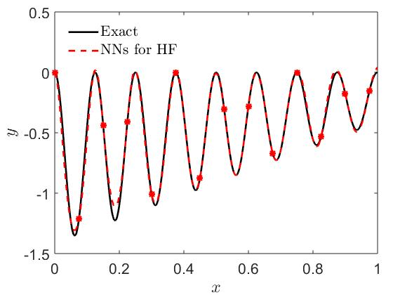
Function approximation: Continuous function: Nonlinear correlation
single-fidelity
multi-fidelity
Perdikaris, et al. Proc. R. Soc. A, 2017
Meng&Karniadakis
MPINNs
Deep Learning

Slide 13
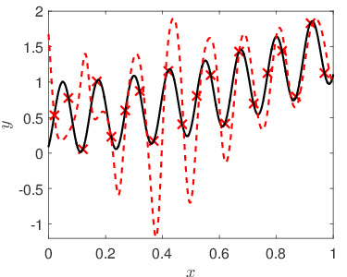
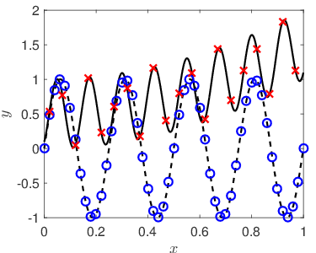
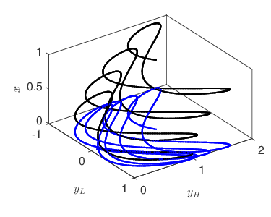
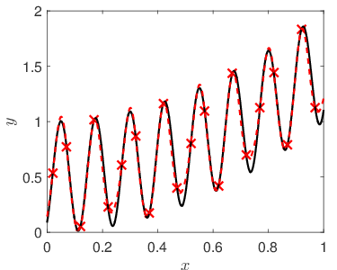
Function approximation: Phase error
single-fidelity
51 LF
16 HF
multi-fidelity
Meng&Karniadakis
MPINNs
Deep Learning

Slide 14
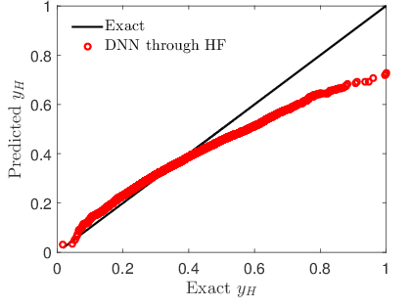
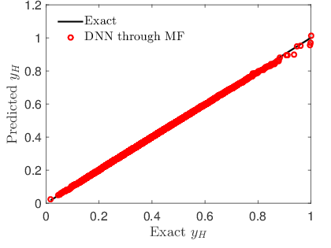
Function approximation: 20-dimensional function
single-fidelity (5000 random HF)
multi-fidelity(5000 HF, 30000 LF)
Meng&Karniadakis
MPINNs
Deep Learning

Slide 15
Outline
I. Background
II. Composite neural network for multi-fidelity data
III. Function approximation
IV. Inverse PDE problems
V. Summary
Meng&Karniadakis
MPINNs
Deep Learning

Slide 16
Inverse problem: porous media flows
1D unsaturated flows with constant water content
Van Genuchten soil water retention model
Boundary conditions
Exact values:
High-fidelity data (lattice Boltzmann simulations 400 lattices):
Low-fidelity data (lattice Boltzmann simulations 100 lattices):
(initial guess)
Meng&Karniadakis
MPINNs
Deep Learning

Slide 17
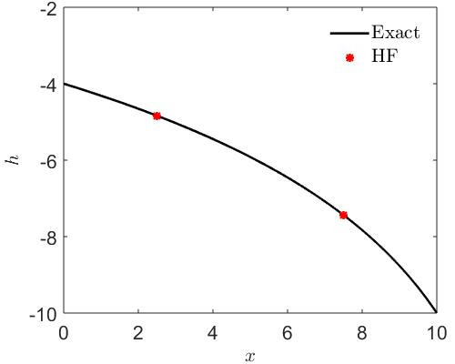
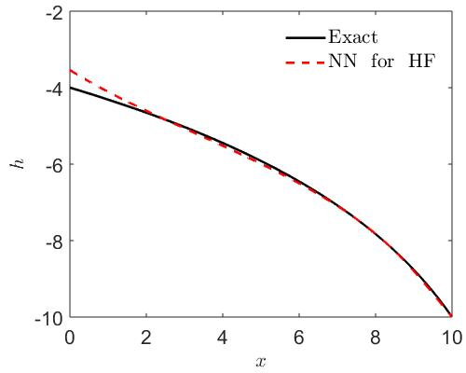
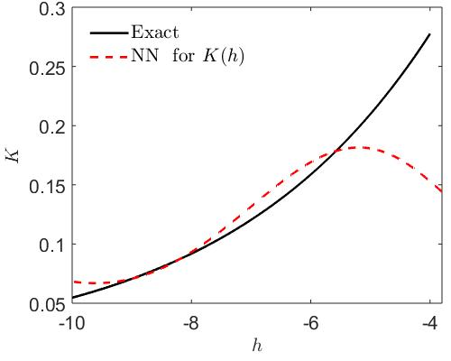
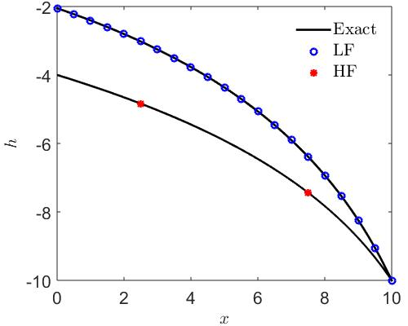
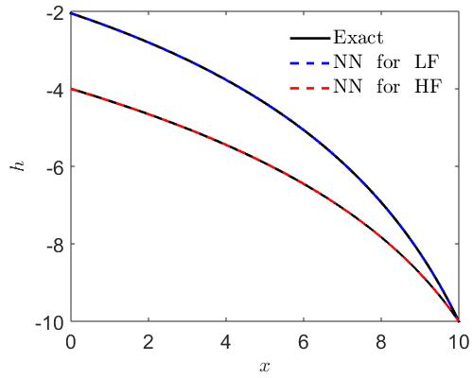
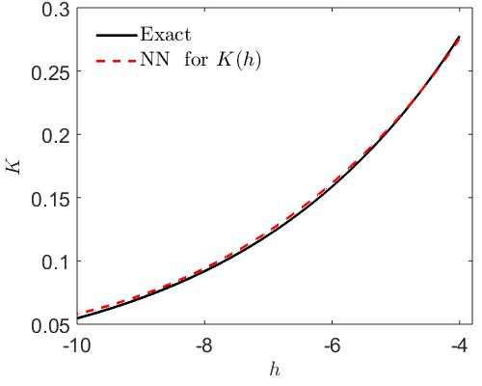
Inverse problem: Unsaturated flows
single-fidelity
multi-fidelity
Meng&Karniadakis
MPINNs
Deep Learning

Slide 18
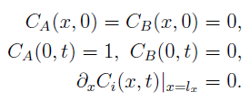
Inverse problem: reactive transport
1D reactive transport:
Boundary conditions
Training data for high fidelity
Low-fidelity data (lattice Boltzmann simulations):
(10 different initial guess)
 | Equation
Identified equation from HF
Identified equation from MF
Exact equation
Meng&Karniadakis
MPINNs
Deep Learning

Slide 19
Outline
I. Background
II. Composite neural network for multi-fidelity data
III. Function approximation
IV. Inverse PDE problems
V. Summary
Meng&Karniadakis
MPINNs
Deep Learning

Slide 20
Summary
Advantages of the present multi-fidelity physics-informed neural networks (MPINNs):
Adaptively learn both the linear and complex nonlinear correlations between the low- and high-fidelity data
Capable of handling inverse problems with strong nonlinearities, such as unsaturated flows, biogeochemical reactions, etc.
Problems with multiple fidelities.
Easy to train for high-dimensional problems
Meng&Karniadakis
MPINNs
Deep Learning

