Slide 1
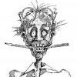
Multi-fidelity modeling of vortex-induced vibrations of marine risers in modal space with uncertainty quantification
Xuhui Meng¹, Zhicheng Wang¹, Dixia Fan²,
Michael Triantafyllou², George Em Karniadakis¹
¹Division of Applied Mathematics, Brown University
²Department of Mechanical Engineering, MIT
November 17, 2020
Crunch Group

Slide 2
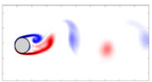
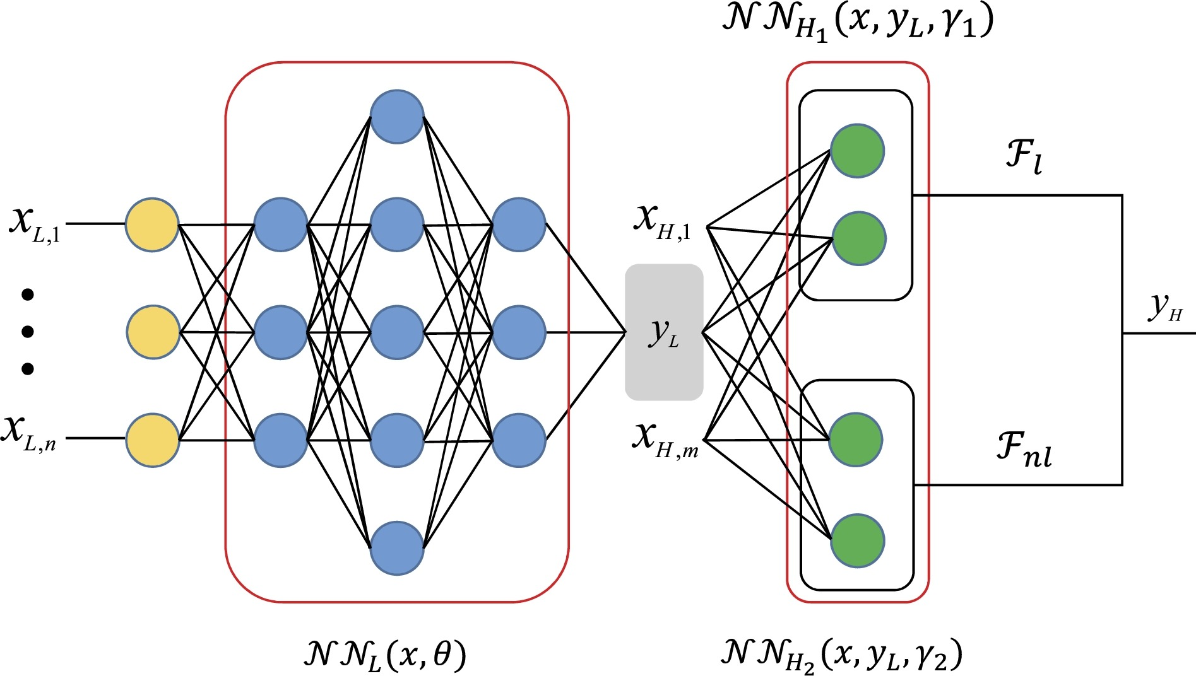
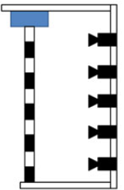
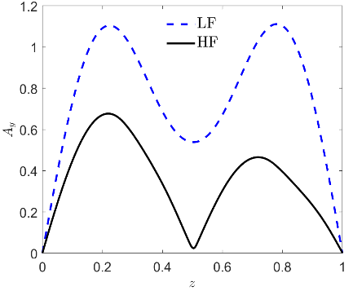
UNIT 3: Multi-fidelity modeling for riser displacement reconstruction with few sensor and LF missing physics
High fidelity
Low fidelity
Multi-fidelity modeling
Experiment
Vortex induced vibration simulation
(displacement)
(displacement)
Low-fidelity data
High-fidelity data
Data assimilation
Crunch Group

Slide 3
Outline
Multi-fidelity modeling of vortex-induced vibrations (VIV-MFnet) Use VIVA as LF model and few sensor data as HF
Approaches for training:
(I) Maximum a posteriori probability (MAP): fast but no UQ
(II) Bayesian inference with uncertainty quantification
Crunch Group

Slide 4
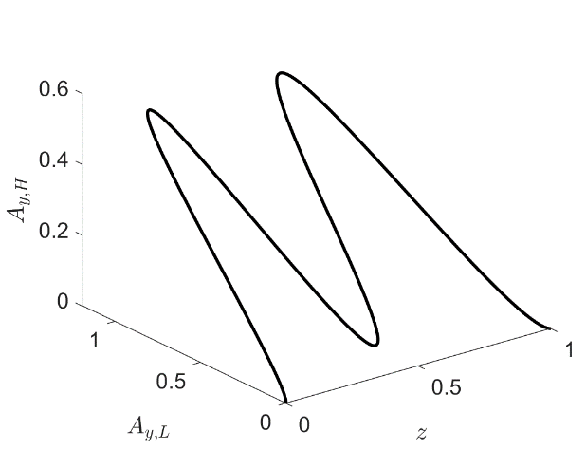
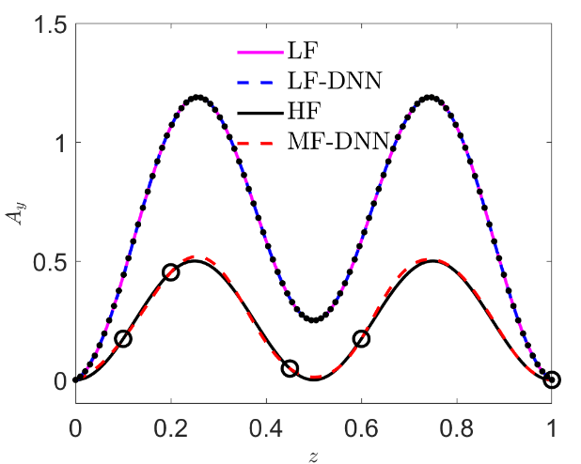
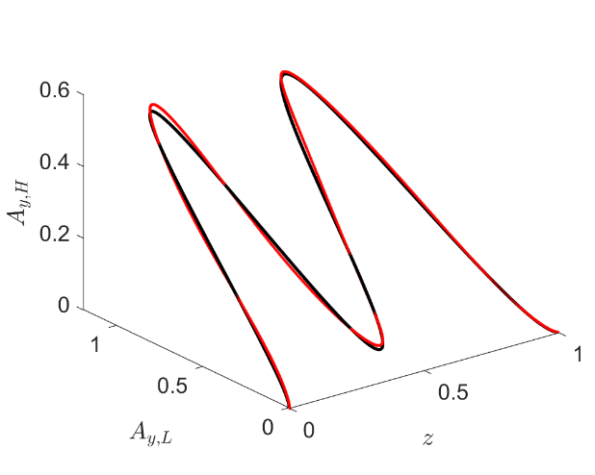
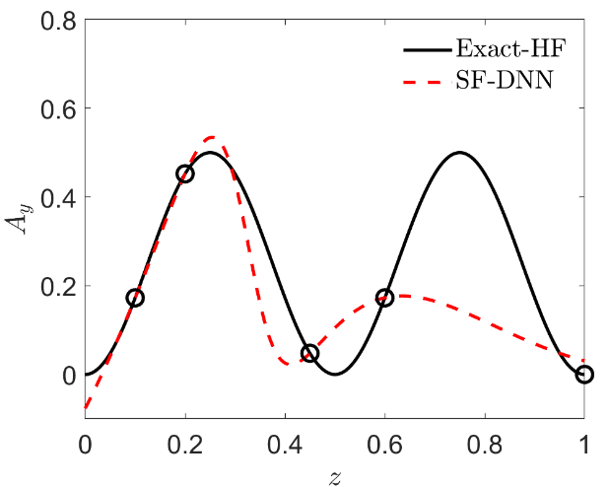
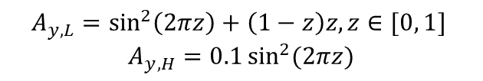
Motivation (1/2) : Multi-fidelity DNNs (A math example)
Low-fidelity (LF)
$$A_{y,L}=\sin^{2}\left(2πz\right)+\left(1−z\right)z, z∈[0, 1]$$
$$A_{y,H}=0.1\sin^{2}{(2πz)}$$
High-fidelity (HF)
Correlation between LF and HF
Multi-fidelity modeling
Predicted correlation
DNN for LF: 2 hidden layers with
20 neurons per layer
DNN for HF: 2 hidden layers with
10 neurons per layer
Single-fidelity modeling
Crunch Group

Slide 5
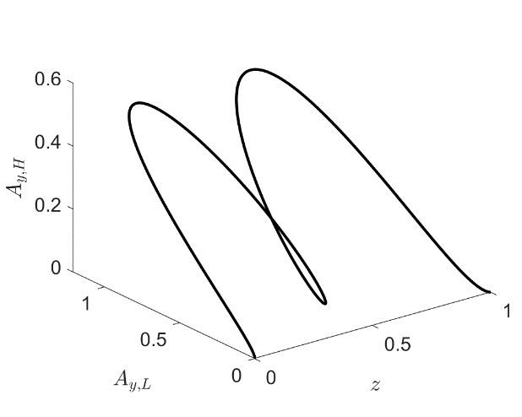
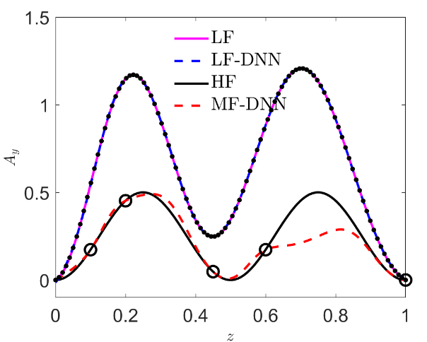
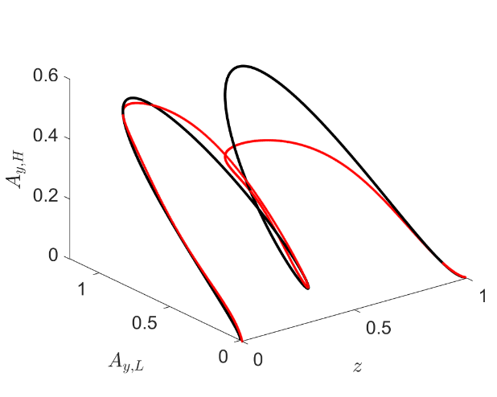
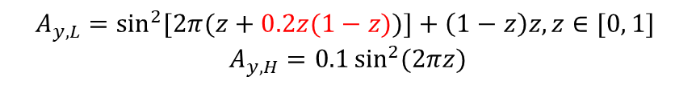
Motivation (2/2) : Multi-fidelity DNNs (A math example)
Phase error case
Low-fidelity (LF)
$$A_{y,L}=\sin^{2}{[2π(z+0.2z(1−z))]+\left(1−z\right)z, z∈[0, 1]}$$
$$A_{y,H}=0.1\sin^{2}{(2πz)}$$
High-fidelity (HF)
Correlation between LF and HF
Multi-fidelity modeling
Predicted correlation
DNN for LF: 2 hidden layers with
20 neurons per layer
DNN for HF: 2 hidden layers with
10 neurons per layer
Single-fidelity modeling
Crunch Group

Slide 6
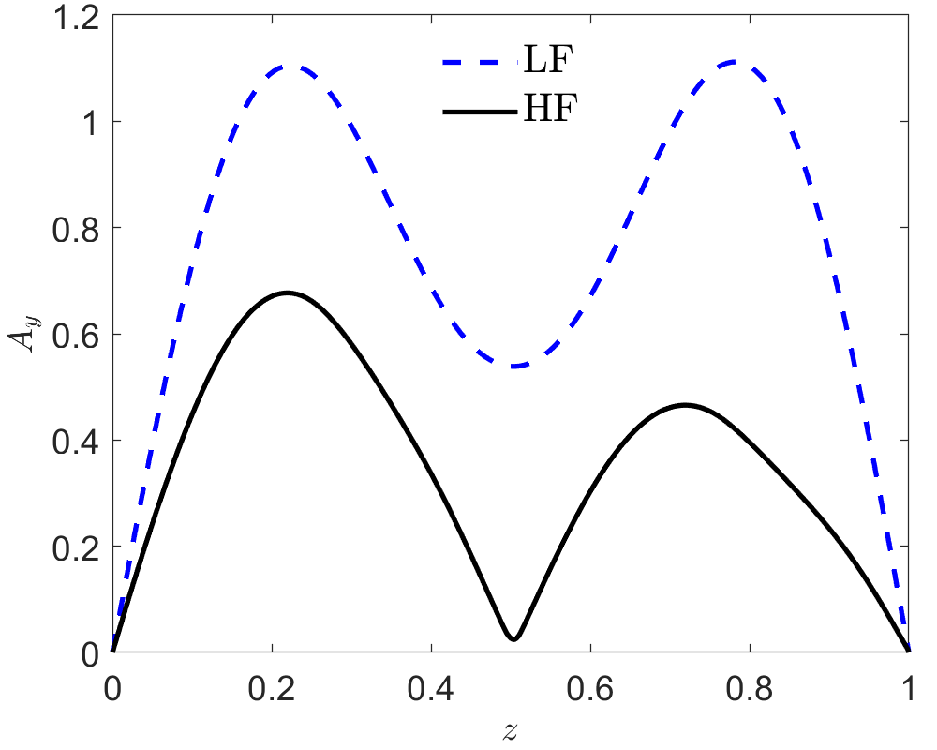
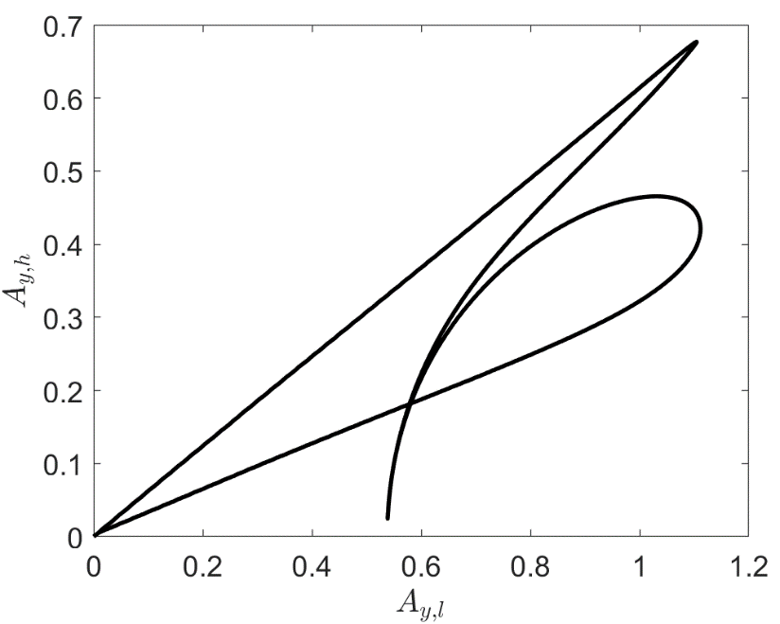
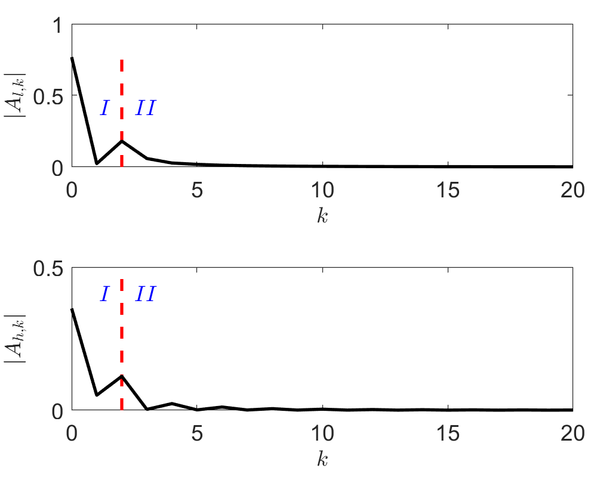


VIV-MFnet: Multi-fidelity modeling in modal space (1/2)
WORKING IN MODAL SPACE IS A BREAKTHROUGH
Correlation between LF and HF
Modal space
FFT
(fast Fourier transform)
$$A_{y,l}$$
Low-fidelity (LF)
FFT
(fast Fourier transform)
$$A_{y,h}$$
High-fidelity (HF)
Crunch Group

Slide 7
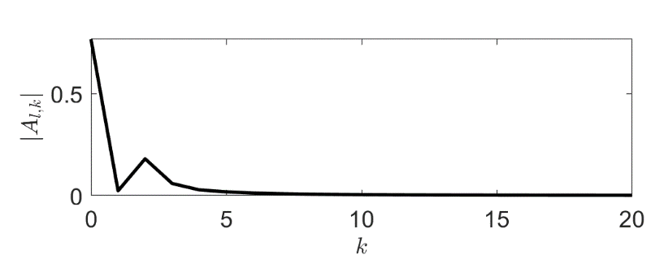
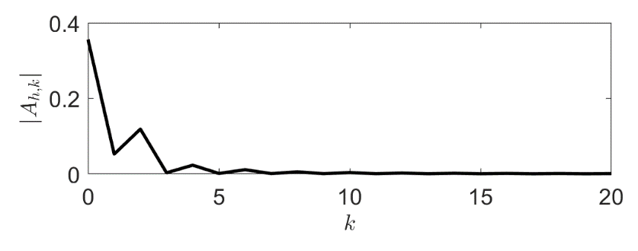



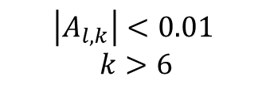

VIV-MFnet: Multi-fidelity modeling in modal space (2/2)
Physical space
Modal space
FFT
(fast Fourier transform)
$$A_{y,l}$$
$$\left|A_{l,k}\right|<0.01$$
$$k>6$$
iFFT
(inverse fast Fourier transform)
FFT
$$A_{y,h}$$
$$[α_{0}, α_{1},…,α_{6},0,0,…]$$
iFFT
$$A_{y,h}\left(α\right) ?$$
Crunch Group

Slide 8


VIV-MFnet: Training Approach (I): MAP
Maximum a posteriori probability
Low-fidelity data
(Modal space)
Objective function:
$$loss={(A_{y,h}(α)−A_{y,h}^{∗})}^{2} + λ{|α|}^{2}$$
$${\left(A_{y,h}−A_{y,h}^{∗}\right)}^{2}\sim O\left({10}^{−4}\right)$$
$$α_{I}\sim O\left(0.1\right), { α}_{II}\sim O\left(0.01\right)$$
$$λ_{I}=0.01, λ_{II}=\frac{λ_{I}α_{Imax}^{2}}{α_{II,max}^{2}}$$
Mean square error
L₂ Regularization
Mean square error for data:
Amplitudes in two subdomains:
Weights for waves in two subdomains:
Crunch Group

Slide 9
VIV-MFnet: Low-fidelity data matters
VIV-MFnet works well if well regularized (Bottom left)
Correlation
Low-fidelity
LF: VIVA
HF: Lab Experiment
High-fidelity

Slide 10
VIV-MFnet: MAP for uniform flows U = 26.26
Example I: 5th mode
Correlation
LF: VIVA
HF: Lab Experiment
Low-fidelity
High-fidelity
Crunch Group

Slide 11
VIV-MFnet: MAP for uniform flows U = 35.28
Example II: 7th mode
LF: VIVA
HF: Lab Experiment
Correlation
Low-fidelity
High-fidelity
Crunch Group

Slide 12
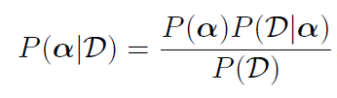




VIV-MFnet: Training Approach (II)--Bayesian inference Provides Uncertainty quantification
Low-fidelity data
(Modal space)
$$A_{y,h}\left(α\right) ?$$
$$[α_{0}, α_{1},…, 0,0,…]$$
iFFT
(Unknown coefficients in modal space)
Bayes’ rule for coefficients in Modal space:
Posterior for coefficients:
Prior for coefficients:
$$P\left(α_{I}\right)\sim N\left(0, {0.1}^{2}\right),P\left(α_{II}\right)\sim N\left(0, {0.01}^{2}\right)$$
Likelihood:
$$P\left(D|α\right)\sim N\left(0, σ^{2}\right), σ=0.01$$
Sampling
Hamiltonian Monte Carlo
$$P(α|D)$$
Crunch Group

Slide 13
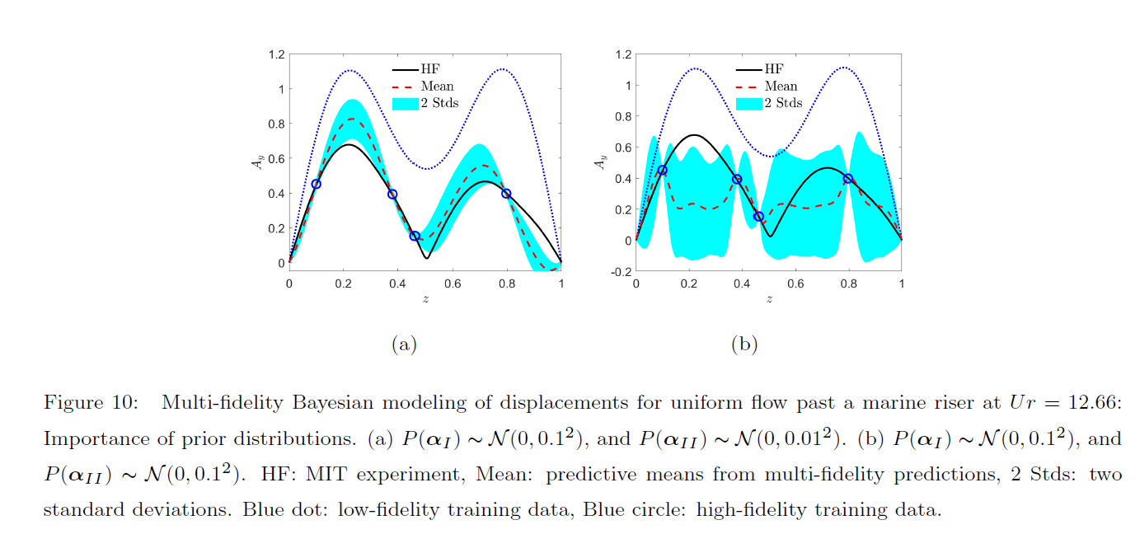
VIV-MFnet: Uncertainty quantification—Prior matters
Good Prior
Poor Prior
HF: Lab Experiment
Crunch Group

Slide 14
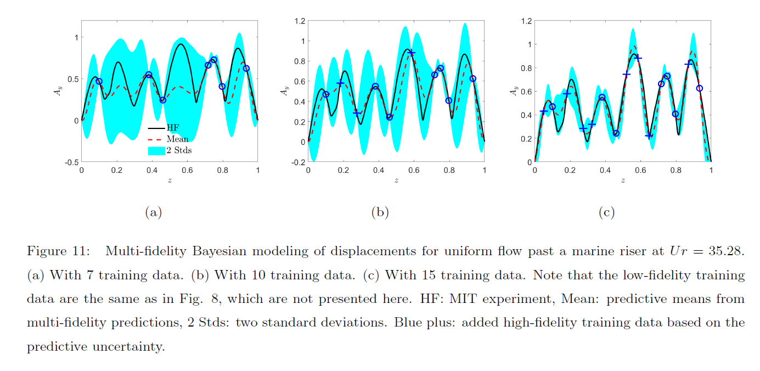
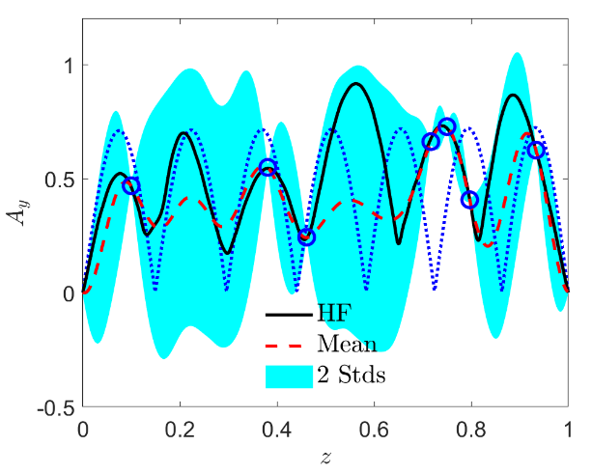
VIV-MFnet: Exploit UQ to find the best sensor locations (1/2):
Active learning to improve accuracy
Active learning: Acquire one more high-fidelity measurement at the location where the uncertainty is maximized
7 training data
10 training data
15 training data
HF: Lab Experiment

Slide 15
VIV-MFnet: Active learning to reduce uncertainties (Animation)

Slide 16
VIV-MFnet: Exploit UQ to find the best sensor locations (2/2):
Active learning to improve accuracy
Low-fidelity
HF: NDP data
Correlation
High-fidelity
16 training data
24 training data
28 training data
Crunch Group

Slide 17
Thank you!
Crunch Group

