Slide 1


Scientific Machine Learning
Lecture 4: On Universal Approximation Theorem
孟旭辉
数学与统计学院数学与应用学科交叉创新研究院
办公室：欣苑2栋111室
Email：xuhui_meng@hust.edu.cn
3/15/2024

Slide 2
Contents
Deep Neural Networks
ReLU NN with single hidden layer
On Universal Approximation Theorem

Slide 3
Contents
Deep Neural Networks
ReLU NN with single hidden layer
On Universal Approximation Theorem

Slide 4
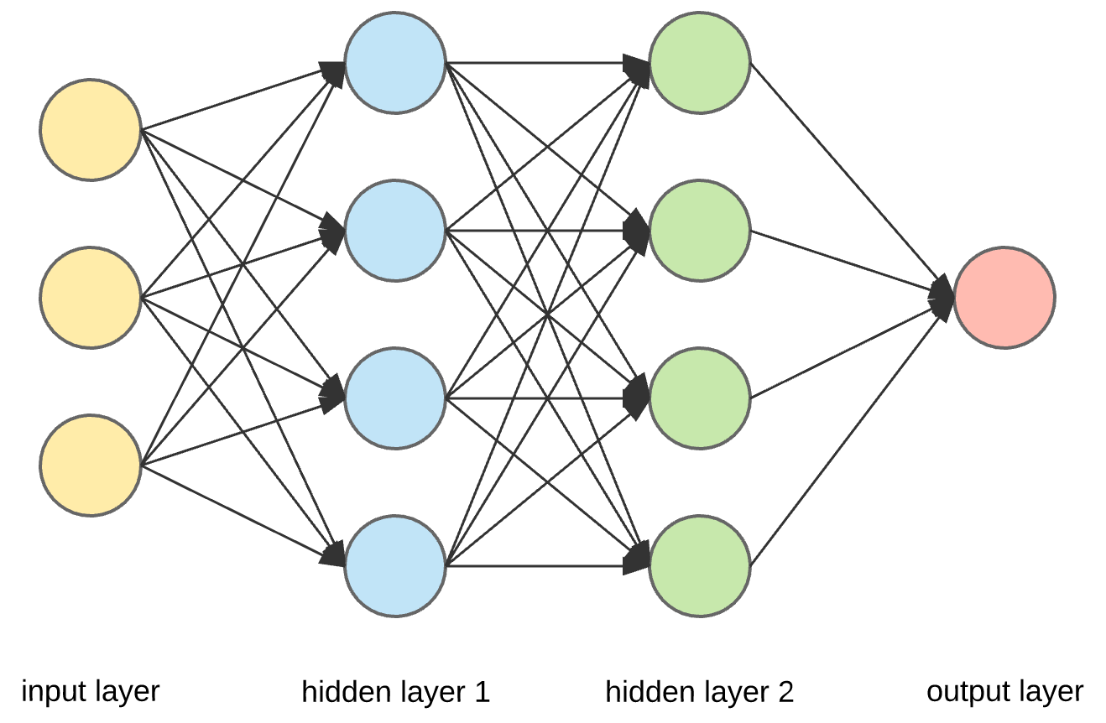














Deep Neural Networks (DNNs): Universal Approximation Theorem
$$w_{ij}$$
$$w_{ij}$$
$$σ$$
$$σ$$
$$y_{1}=σ(W_{1}^{T}x+b_{1})$$
$$w_{ij}$$
$$σ$$
$$σ$$
$$y_{2}=σ\left(W_{2}^{T}y_{1}+b_{2}\right)$$
…
$$y=W_{l}^{T}y_{l−1}+b_{l}$$
y
$$σ$$
$$σ$$
$$σ$$
$$σ$$
$$σ:sigmoid, tanh$$
Standard multilayer feedforward networks are capable of approximating any measurable function to any desired degree of accuracy
Convergence rate increases as the number of hidden units grows
K. Hornik, etc, Neural Networks, 1989

Slide 5
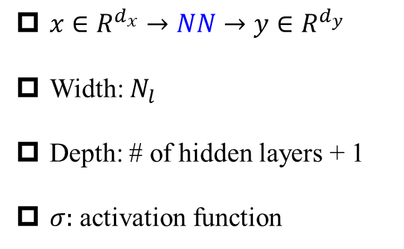
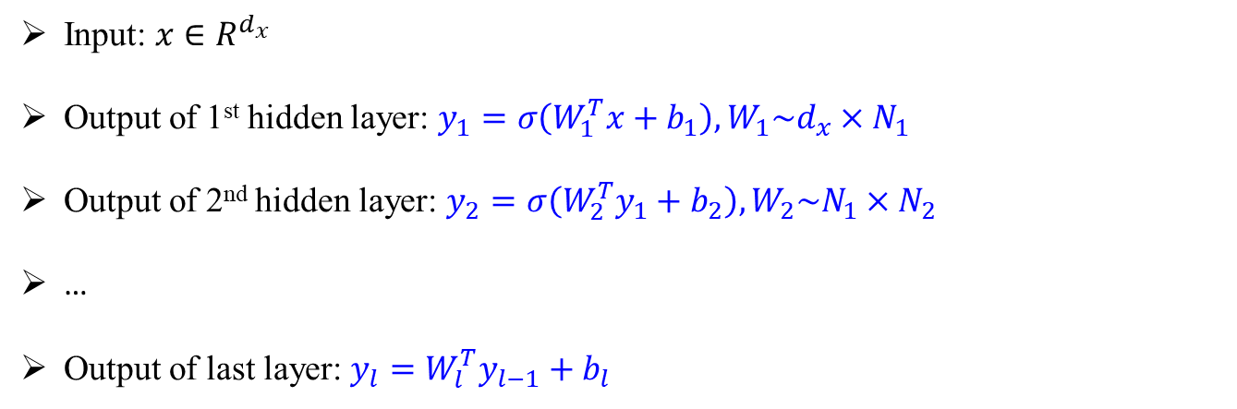
Deep Neural Networks (DNNs): Universal Approximation Theorem
$$w_{ij}$$
$$w_{ij}$$
$$σ$$
$$σ$$
$x∈R^{d_{x}}→NN→y∈R^{d_{y}}$
Width: $N_{l}$
Depth: # of hidden layers + 1
$σ:$ activation function
$$w_{ij}$$
$$σ$$
$$σ$$
y
$$σ$$
$$σ$$
$$σ$$
$$σ$$
Input: $x∈R^{d_{x}}$
Output of 1st hidden layer: $y_{1}=σ\left(W_{1}^{T}x+b_{1}\right), W_{1}\sim d_{x}×N_{1}$
Output of 2nd hidden layer: $y_{2}=σ\left(W_{2}^{T}y_{1}+b_{2}\right),W_{2}\sim N_{1}×N_{2}$
…
Output of last layer: $y_{l}=W_{l}^{T}y_{l−1}+b_{l}$
Hornik, et al, Neural Networks, 1989

Slide 6
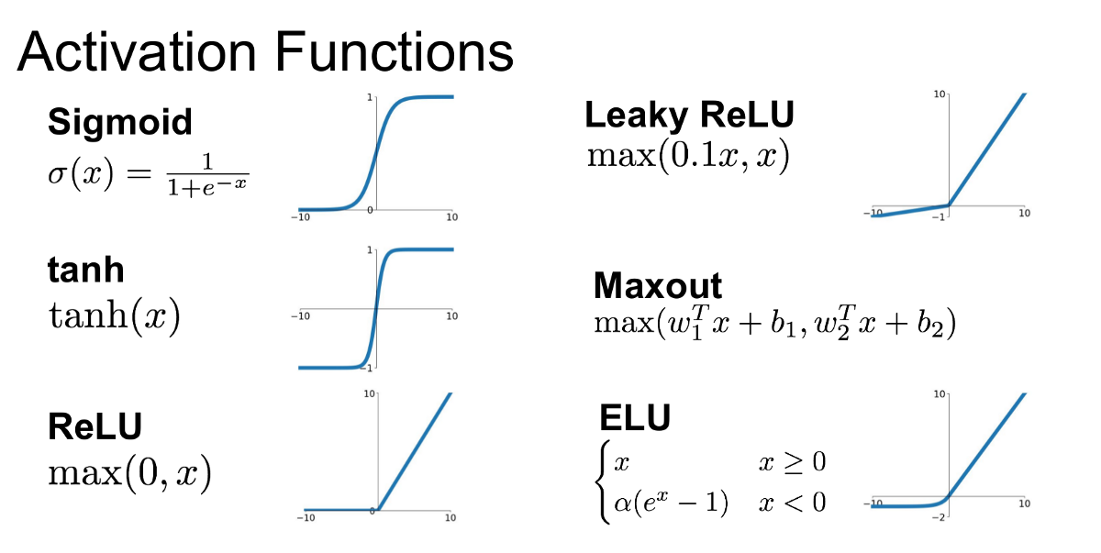
DNNs: About activation functions
Remarks:
First choice: tanh
For very deep NNs, try ReLU-type activation function first

Slide 7




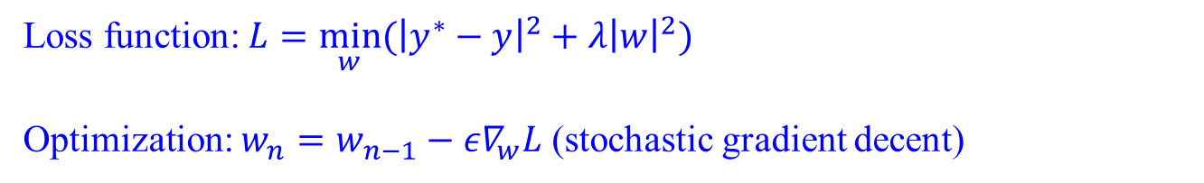
DNNs: Optimization
$$w_{ij}$$
$$w_{ij}$$
$$σ$$
$$σ$$
$$w_{ij}$$
$$y_{1}=σ(W_{1}^{T}x+b_{1})$$
$$σ$$
$$σ$$
$$y_{2}=σ\left(W_{2}^{T}y_{1}+b_{2}\right)$$
…
$$y=W_{l}^{T}y_{l−1}+b_{l}$$
y
$$σ$$
$$σ$$
$$σ$$
$$σ$$
$$σ:sigmoid, tanh$$
Standard multilayer feedforward networks are capable of approximating any measurable function to any desired degree of accuracy
Convergence rate increases as the number of hidden units grows
Loss function: $L={\min_{w}⁡(\left|y^{∗}−y\right|}^{2}+λ{\left|w\right|}^{2})$
Optimization: $w_{n}=w_{n−1}−{ε∇}_{w}L$ (stochastic gradient decent)
Hornik, et al, Neural Networks, 1989

Slide 8
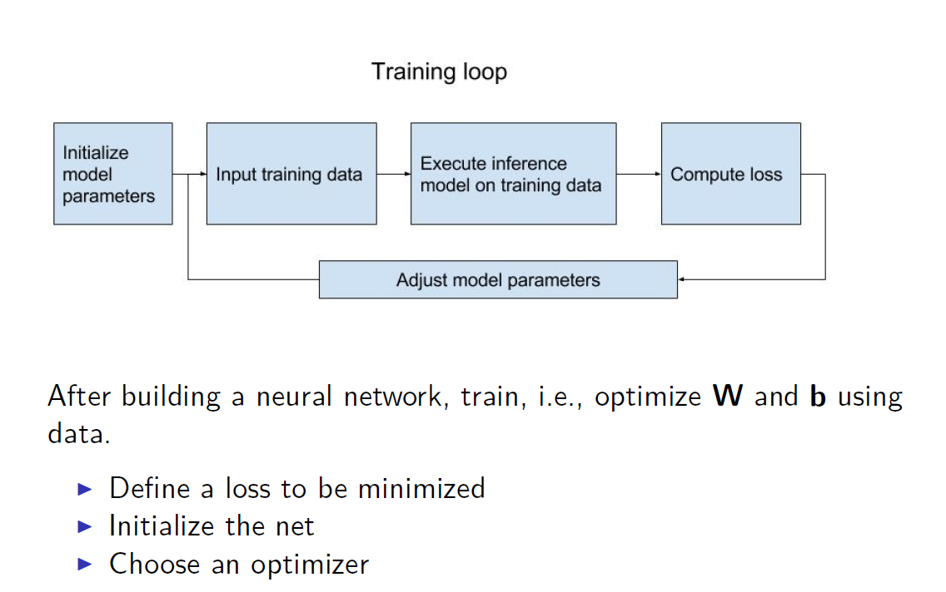
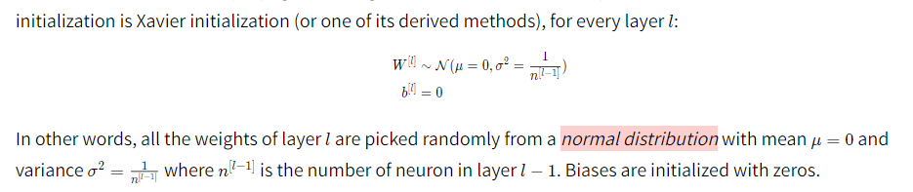
NN for regression problems
Adam

Slide 9
Contents
Deep Neural Networks
ReLU NN with single hidden layer
On Universal Approximation Theorem

Slide 10
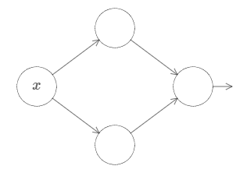
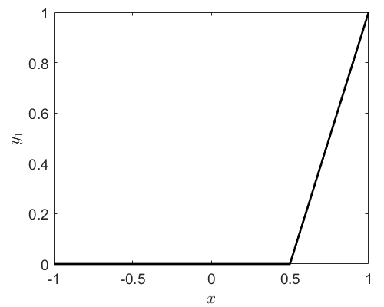
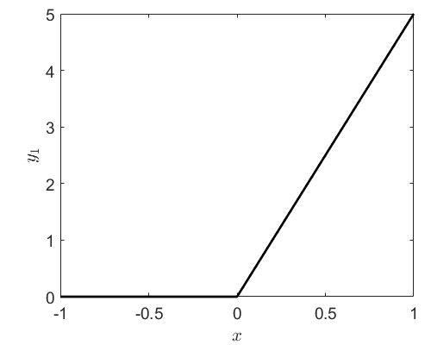





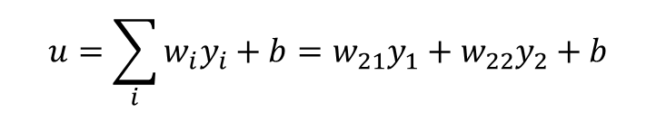



ReLU NN with a single hidden layer
$${y_{1}=ReLU(w}_{11}x+b_{11})$$
$$w_{11}x+b_{11}$$
$$w_{21}y_{1}$$
$$u=\sum_{i}{{w_{i}y}_{i}+b=w_{21}y_{1}+w_{22}y_{2}+b}$$
$$w_{12}x+b_{12}$$
$$w_{22}y_{1}$$
$${y_{2}=ReLU(w}_{12}x+b_{12})$$
$$w_{11}=2,b_{11}=−1$$
$$w_{12}=5,b_{12}=0$$

Slide 11
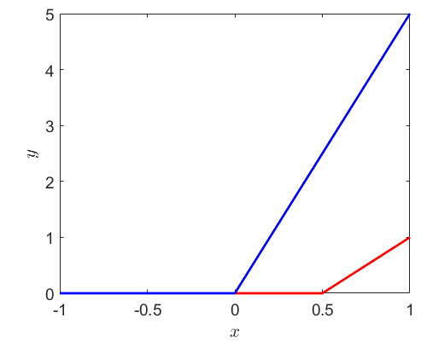
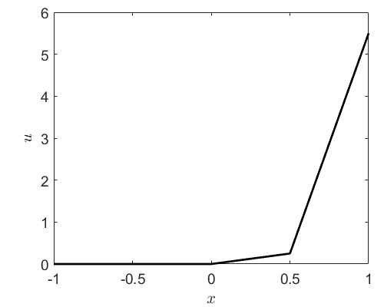



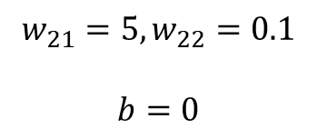

ReLU NN with a single hidden layer
$${y_{1}=ReLU(w}_{11}x+b_{11})$$
$$w_{11}x+b_{11}$$
$$w_{21}y_{1}$$
$$u=\sum_{i}{{w_{i}y}_{i}+b=w_{21}y_{1}+w_{22}y_{2}+b}$$
$$w_{12}x+b_{12}$$
$$w_{22}y_{1}$$
$${y_{2}=ReLU(w}_{12}x+b_{12})$$
$$w_{11}=2,b_{11}=−1$$
$$w_{12}=5,b_{12}=0$$
$$w_{21}=5,w_{22}=0.1$$
$$b=0$$
$$y_{2}$$
$$y_{1}$$

Slide 12
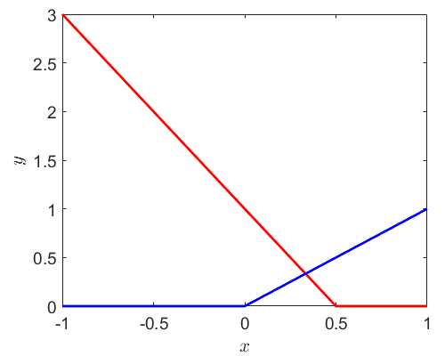
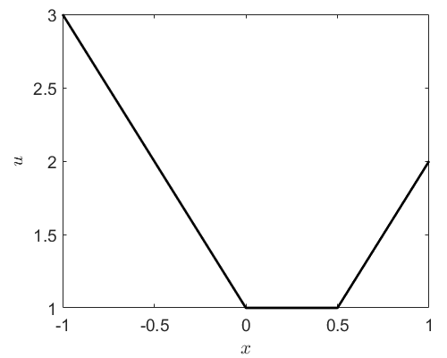
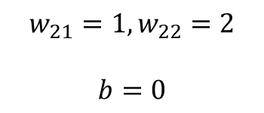


ReLU NN with a single hidden layer
$${y_{1}=ReLU(w}_{11}x+b_{11})$$
$$w_{11}x+b_{11}$$
$$w_{21}y_{1}$$
$$u=\sum_{i}{{w_{i}y}_{i}+b=w_{21}y_{1}+w_{22}y_{2}+b}$$
$$w_{12}x+b_{12}$$
$$w_{22}y_{1}$$
$${y_{2}=ReLU(w}_{12}x+b_{12})$$
$$w_{11}=−2,b_{11}=1$$
$$w_{21}=1,w_{22}=2$$
$$b=0$$
$$w_{12}=2,b_{12}=0$$

Slide 13
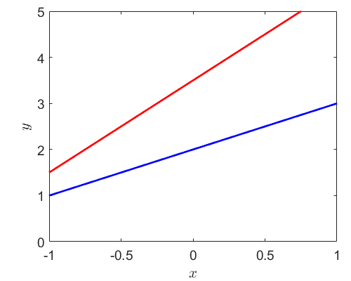
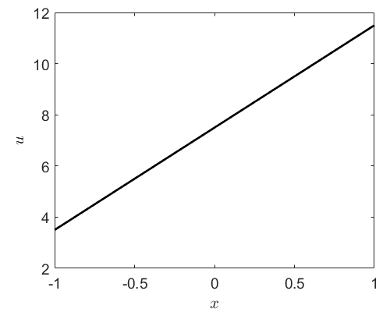



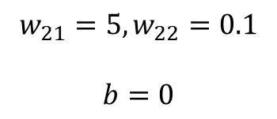

ReLU NN with a single hidden layer
$${y_{1}=ReLU(w}_{11}x+b_{11})$$
$$w_{11}x+b_{11}$$
$$w_{21}y_{1}$$
$$u=\sum_{i}{{w_{i}y}_{i}+b=w_{21}y_{1}+w_{22}y_{2}+b}$$
$$w_{12}x+b_{12}$$
$$w_{22}y_{1}$$
$${y_{2}=ReLU(w}_{12}x+b_{12})$$
$$w_{11}=2,b_{11}=3$$
$$y_{1}$$
$$w_{21}=5,w_{22}=0.1$$
$$b=0$$
$$y_{2}$$
$$w_{12}=1,b_{12}=2$$

Slide 14
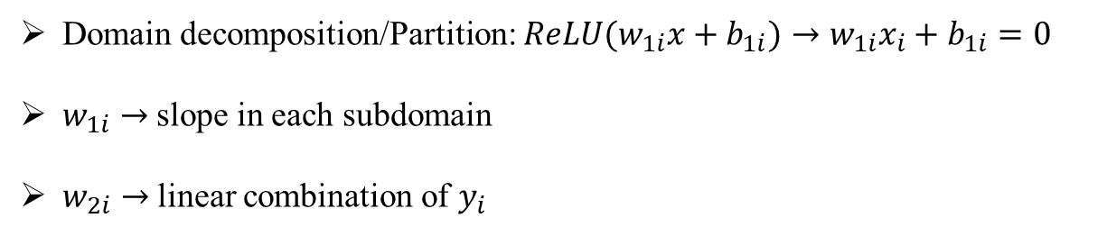
ReLU NN with a single hidden layer
$${y_{1}=ReLU(w}_{11}x+b_{11})$$
$$w_{11}x+b_{11}$$
$$w_{21}y_{1}$$
$$u=\sum_{i}{{w_{i}y}_{i}+b=w_{21}y_{1}+w_{22}y_{2}+b}$$
$$w_{12}x+b_{12}$$
$$w_{22}y_{1}$$
$${y_{2}=ReLU(w}_{12}x+b_{12})$$
Remarks:
Domain decomposition/Partition: ${ReLU(w}_{1i}x+b_{1i})→w_{1i}x_{i}+b_{1i}=0$
$w_{1i}→$ slope in each subdomain
$w_{2i}→$ linear combination of $y_{i}$

Slide 15
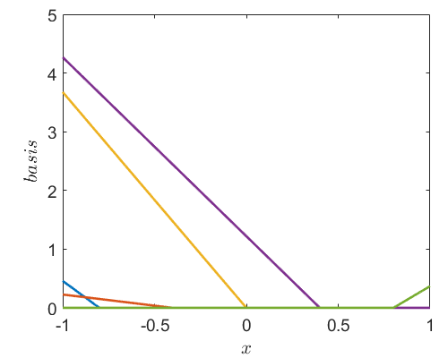




ReLU NN with a single hidden layer
$${y_{1}=ReLU(w}_{11}x+b_{11})$$
$$w_{11}x+b_{11}$$
…
$$w_{12}x+b_{12}$$
$${y_{n}=ReLU(w}_{1n}x+b_{1n})$$
3
4
5
6
1
2

Slide 16
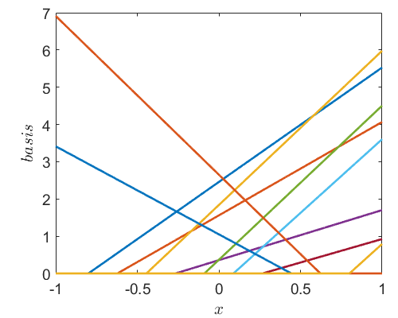
ReLU NN with a single hidden layer
$${y_{1}=ReLU(w}_{11}x+b_{11})$$
$$w_{11}x+b_{11}$$
…
$$w_{12}x+b_{12}$$
$${y_{n}=ReLU(w}_{1n}x+b_{1n})$$

Slide 17





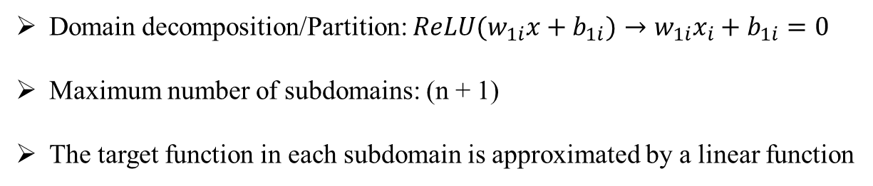
ReLU NN with a single hidden layer
$${y_{1}=ReLU(w}_{11}x+b_{11})$$
$$w_{11}x+b_{11}$$
…
$$u=\sum_{i}{{w_{i}y}_{i}+b}$$
$$w_{12}x+b_{12}$$
$${y_{n}=ReLU(w}_{1n}x+b_{1n})$$
Remarks:
Domain decomposition/Partition: ${ReLU(w}_{1i}x+b_{1i})→w_{1i}x_{i}+b_{1i}=0$
Maximum number of subdomains: (n + 1)
The target function in each subdomain is approximated by a linear function

Slide 18
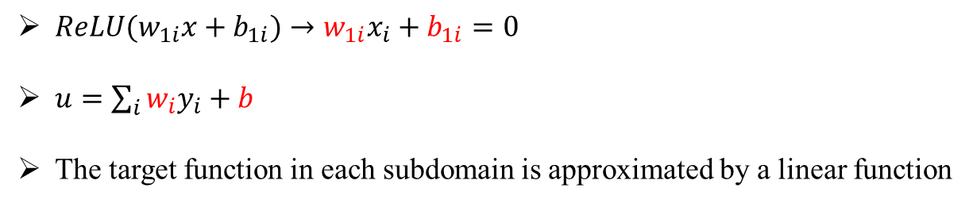
Training NNs is difficult
$${y_{1}=ReLU(w}_{11}x+b_{11})$$
$$w_{11}x+b_{11}$$
…
$$u=\sum_{i}{{w_{i}y}_{i}+b}$$
$$w_{12}x+b_{12}$$
$${y_{n}=ReLU(w}_{1n}x+b_{1n})$$
Training a neural networks:
${ReLU(w}_{1i}x+b_{1i})→w_{1i}x_{i}+b_{1i}=0$
$u=\sum_{i}{{w_{i}y}_{i}}+b$
The target function in each subdomain is approximated by a linear function

Slide 19
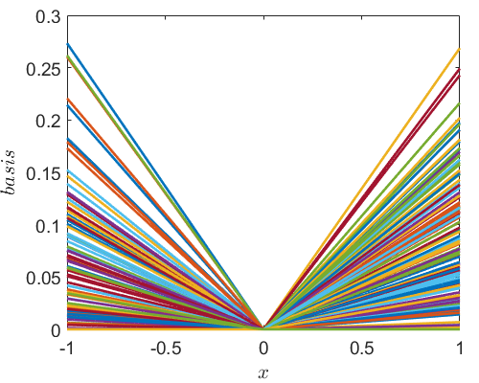
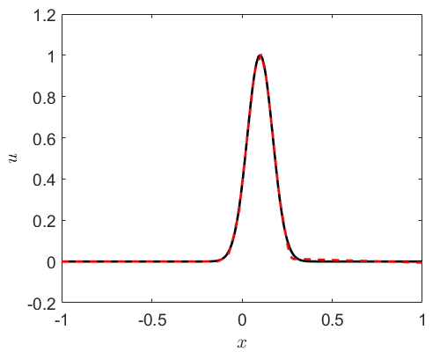
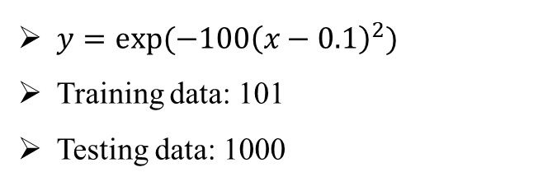
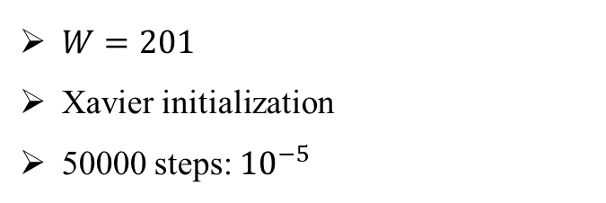
ReLU NN with a single hidden layer
$y=exp⁡(−100{\left(x−0.1\right)}^{2})$
Training data: 101
Testing data: 1000
$W=201$
Xavier initialization
50000 steps: ${10}^{−5}$

Slide 20
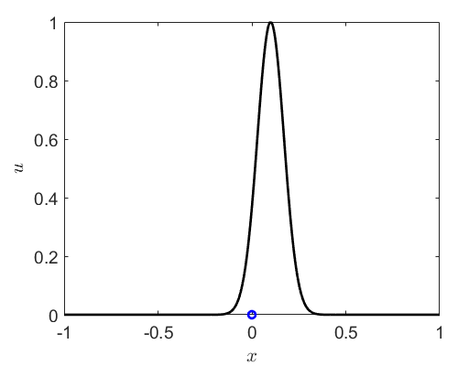
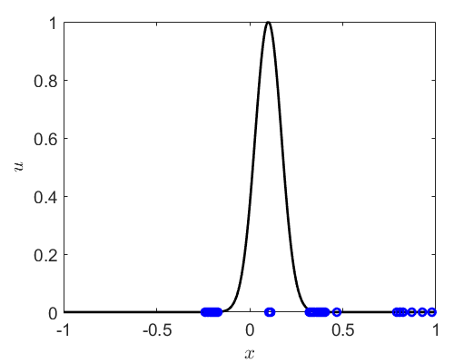
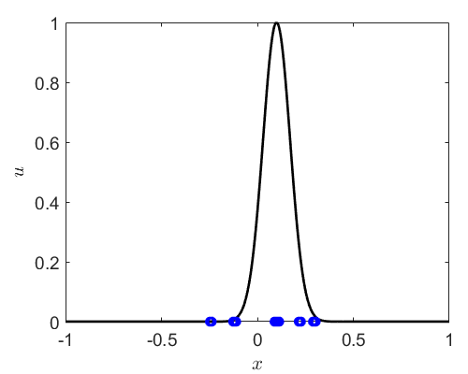
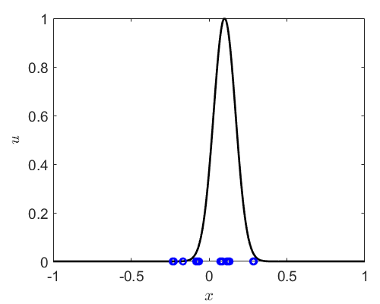
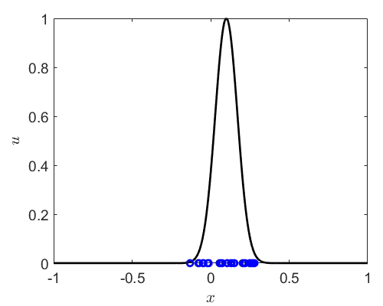

ReLU NN with a single hidden layer
$y=exp⁡(−100{\left(x−0.1\right)}^{2})$
Training data: 101
Testing data: 1000
$W=201$
step: 0
step: 100
step: 200
step: 300
step: 2000

Slide 21
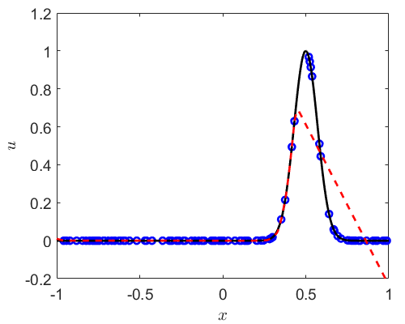
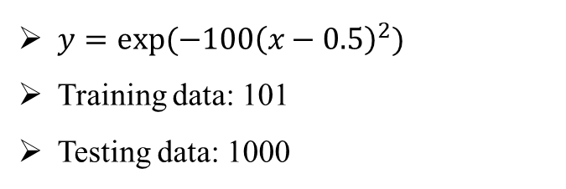
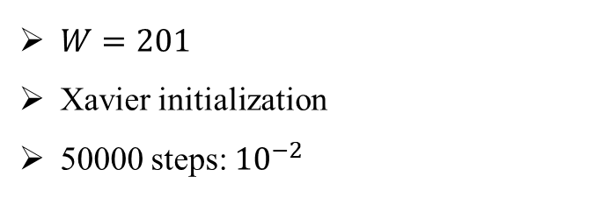
ReLU NN with a single hidden layer
$y=exp⁡(−100{\left(x−0.5\right)}^{2})$
Training data: 101
Testing data: 1000
$W=201$
Xavier initialization
50000 steps: ${10}^{−2}$

Slide 22
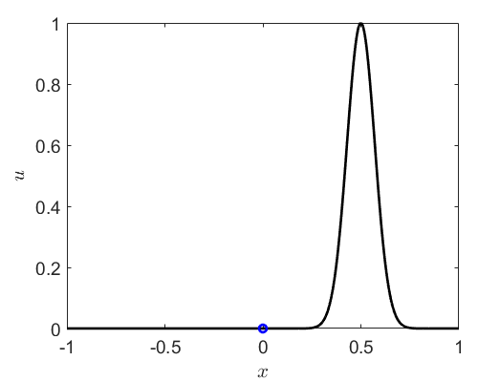
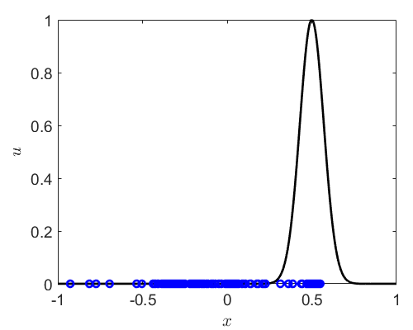
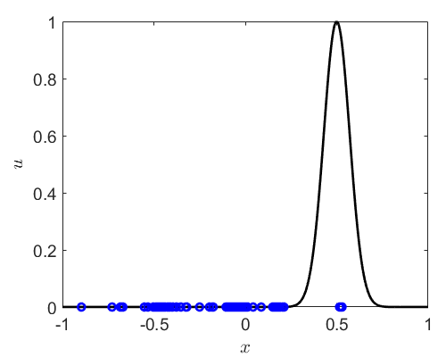
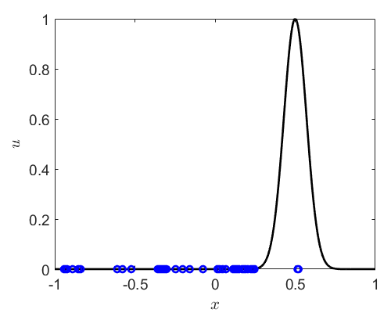
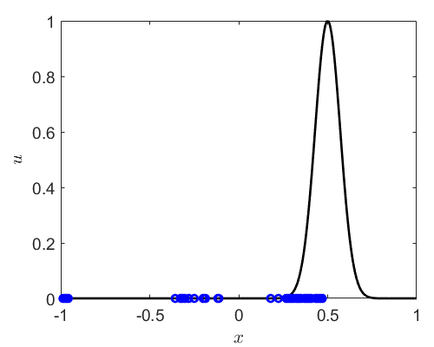
ReLU NN with a single hidden layer
$y=exp⁡(−100{\left(x−0.5\right)}^{2})$
Training data: 101
Testing data: 1000
$W=201$
step: 0
step: 100
step: 200
step: 300
step: 50000

Slide 23
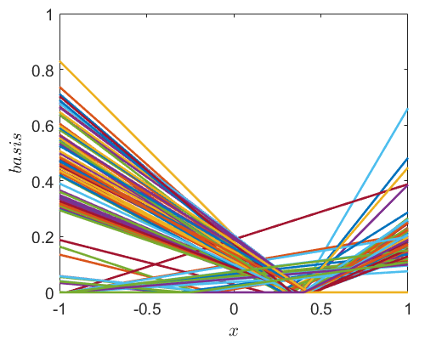
ReLU NN with a single hidden layer
$y=exp⁡(−100{\left(x−0.5\right)}^{2})$
Training data: 101
Testing data: 1000
$W=201$
step: 50000

Slide 24
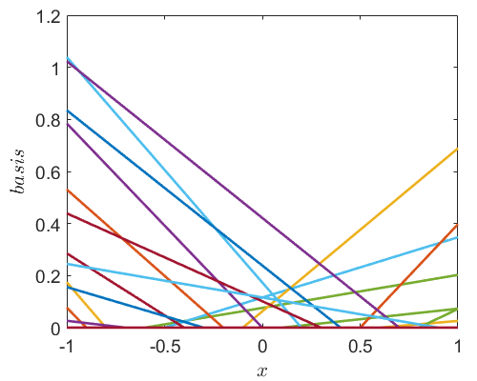
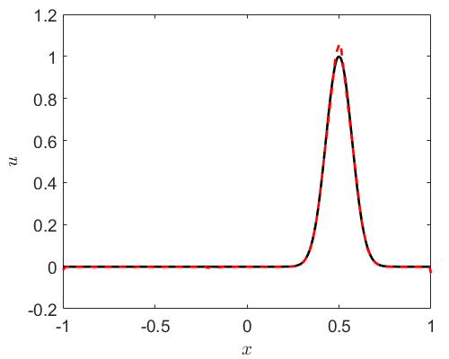
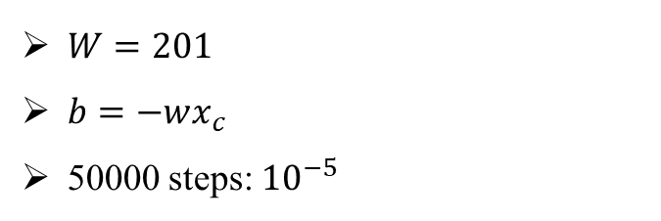
ReLU NN with a single hidden layer
$y=exp⁡(−100{\left(x−0.5\right)}^{2})$
Training data: 101
Testing data: 1000
$W=201$
$b=−wx_{c}$
50000 steps: ${10}^{−5}$

Slide 25
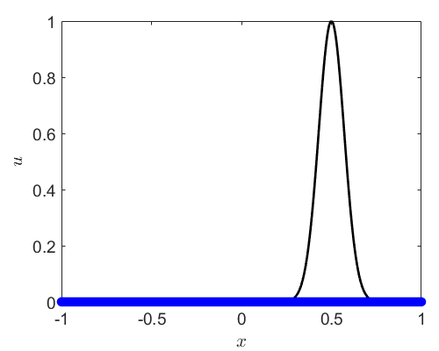

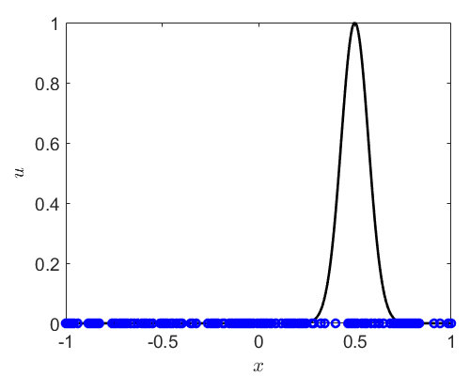


ReLU NN with a single hidden layer
$y=exp⁡(−100{\left(x−0.5\right)}^{2})$
Training data: 101
Testing data: 1000
$W=201$
step: 0
step: 100
step: 200
step: 300
step: 50000

Slide 26

ReLU NN with a single hidden layer
$y=exp⁡(−100{\left(x−0.5\right)}^{2})$
Training data: 101
Testing data: 1000
$W=201$
step: 50000

Slide 27




ReLU NN with a single hidden layer
$y=exp⁡(−100{\left(x−0.5\right)}^{2})$
Training data: 101
Testing data: 1000
$W=201$
$b=−wx_{c},x_{c}=0.5$

Slide 28






ReLU NN with a single hidden layer
$y=exp⁡(−100{\left(x−0.5\right)}^{2})$
Training data: 101
Testing data: 1000
$w=201$
step: 0
step: 100
step: 200
step: 300
step: 50000

Slide 29

ReLU NN with a single hidden layer
$y=exp⁡(−100{\left(x−0.5\right)}^{2})$
Training data: 101
Testing data: 1000
$w=201$
step: 50000

Slide 30






ReLU NN with a single hidden layer
$y=exp⁡(−100{\left(x−0.5\right)}^{2})$
Training data: 101
Testing data: 1000
$W=201$
$wx_{c}+b=0$
$$wx_{c}+b=0$$
$$x_{c}=0$$
$$x_{c}=U[−1,1]$$
$$x_{c}=0.5$$

Slide 31



ReLU NN with 2 hidden layers
$y=exp⁡(−100{\left(x−0.5\right)}^{2})$
Training data: 101
Testing data: 1000
$W=\left[20\right]∗2$
Xavier initialization

Slide 32

ReLU NN with 2 hidden layers
$y=exp⁡(−100{\left(x−0.5\right)}^{2})$
Training data: 101
Testing data: 1000
$W=\left[20\right]∗2$
Xavier initialization

Slide 33



From 1D to nD
$$wx_{c}+b=0$$

Slide 34


On Universal Approximation Theorem
$wx_{c}+b=0$: Adaptive partition
Different activation functions

Slide 35

ReLU NN with a single hidden layer
$${y_{1}=ReLU(w}_{11}x+b_{11})$$
$$w_{11}x+b_{11}$$
…
$$u=\sum_{i}{{w_{i}y}_{i}+b}$$
$$w_{12}x+b_{12}$$
$${y_{n}=ReLU(w}_{1n}x+b_{1n})$$
Convergence rate:
$$f\left(x\right)=a_{0}+a_{1}x+a_{2}x^{2}+…$$
Taylor expansion:
$$f\left(x\right)=f\left(x_{0}\right)+f^{′}\left(x_{0}\right)Δx+\frac{1}{2}f^{′′}\left(x_{0}\right)Δx^{2}+…$$
$$=f\left(x_{0}\right)+f^{′}\left(x_{0}\right)Δx+O(Δx^{2})$$

Slide 36



ReLU NN with a single hidden layer
Convergence rate:
$$f\left(x\right)=a_{0}+a_{1}x+a_{2}x^{2}+…$$
Taylor expansion:
$$f\left(x\right)=f\left(x_{0}\right)+f^{′}\left(x_{0}\right)Δx+\frac{1}{2}f^{′′}\left(x_{0}\right)Δx^{2}+…$$
$$=f\left(x_{0}\right)+f^{′}\left(x_{0}\right)Δx+O(Δx^{2})$$
$y=x^{2}$
Training data: 101
Testing data: 1000
$E=\frac{\sqrt{{\left(u_{NN}−u^{∗}\right)}^{2}}}{\sqrt{{(u}^{∗})2}}$
$y=ax+b,a≈2.09$
slope: 2

Slide 37

Thank you for your attention!

