Slide 1


Scientific Machine Learning
Lecture 9: Physics-informed Generative Adversarial Networks
孟旭辉
数学与统计学院数学与应用学科交叉创新研究院
办公室：欣苑2栋111室
Email：xuhui_meng@hust.edu.cn
https://github.com/XuhuiM/SciML-Course
4/3/2023

Slide 2
Contents
Stochastic differential equation (SDE)
Brief review on generative adversarial networks (GANs)
Physics-informed generative adversarial networks (PI-GAN)
Forward and Inverse SDE problems

Slide 3
Contents
Stochastic differential equation (SDE)
Brief review on generative adversarial networks (GANs)
Physics-informed generative adversarial networks (PI-GAN)
Forward and Inverse SDE problems

Slide 4
Stochastic differential equation

Slide 5
Contents
Stochastic differential equation (SDE)
Brief review on generative adversarial networks (GANs)
Physics-informed generative adversarial networks (PI-GAN)
Forward and Inverse SDE problems

Slide 6
Generative models
Cao, et al. arXiv:2209.02646. 2022

Slide 7
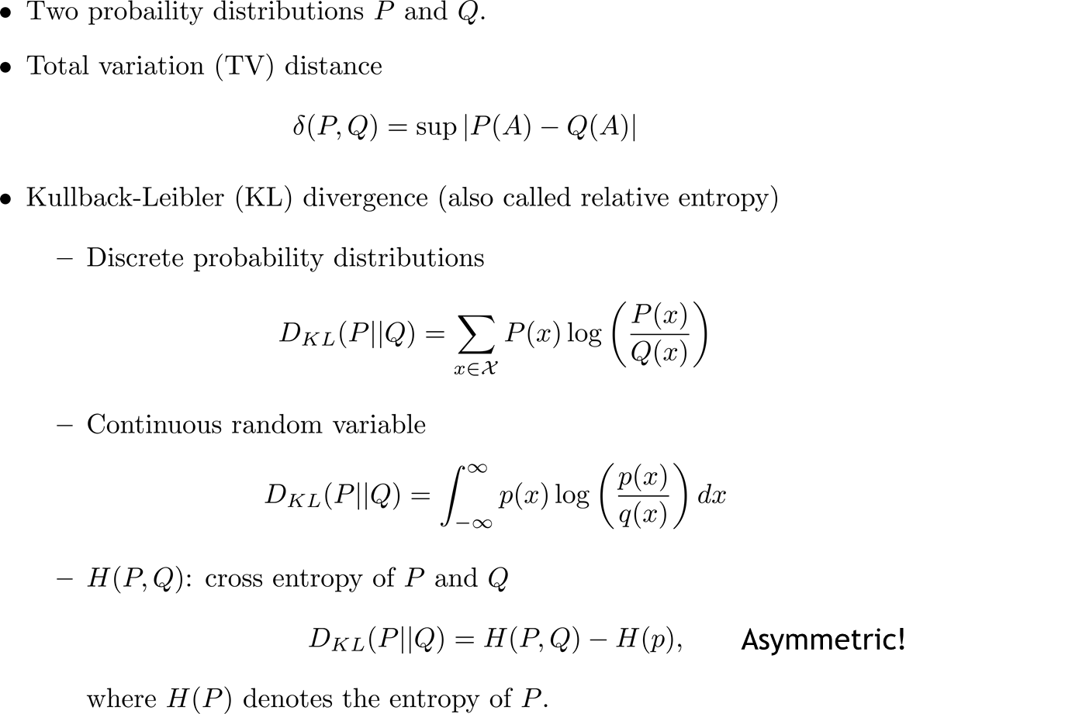
Similarity between two distributions

Slide 8
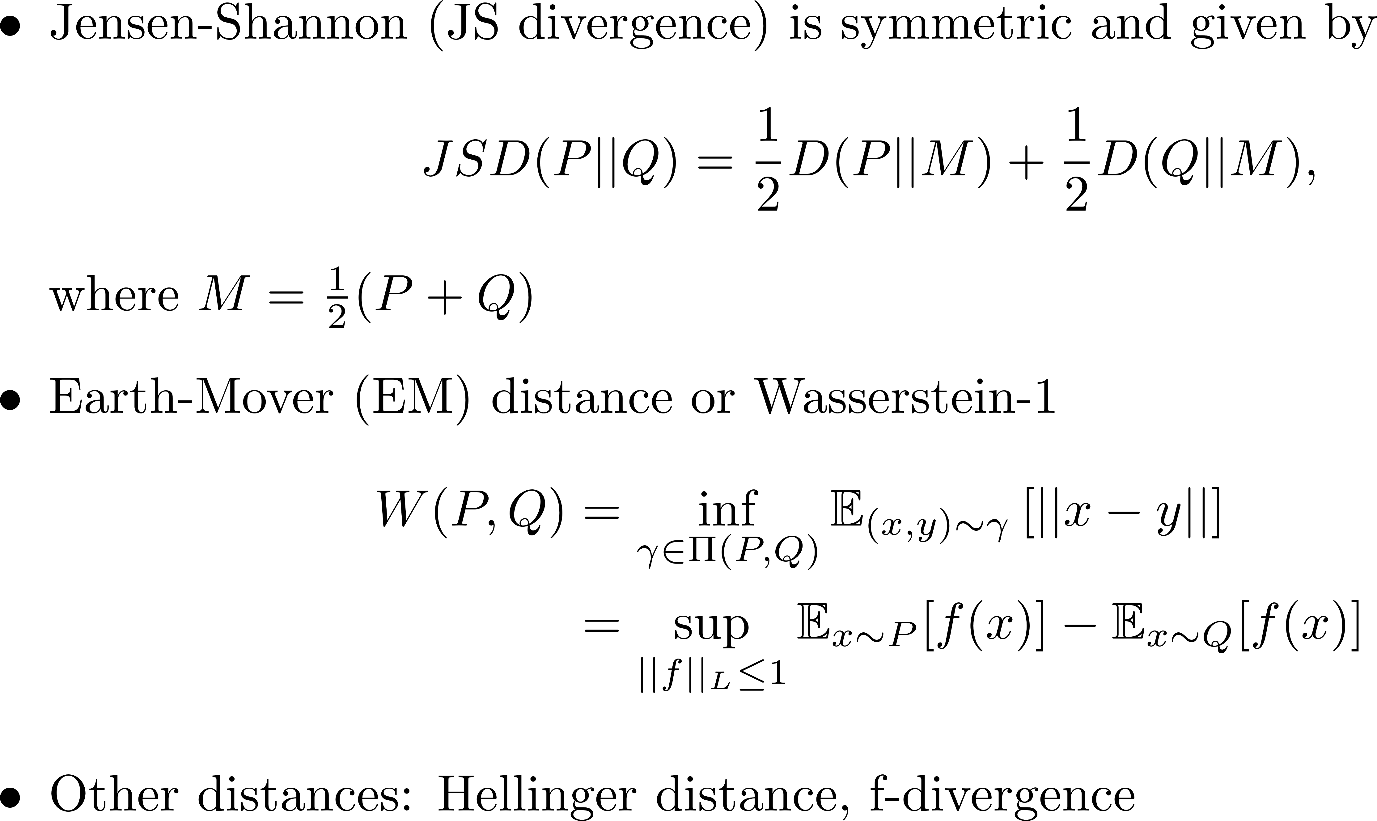
Similarity between two distributions

Slide 9
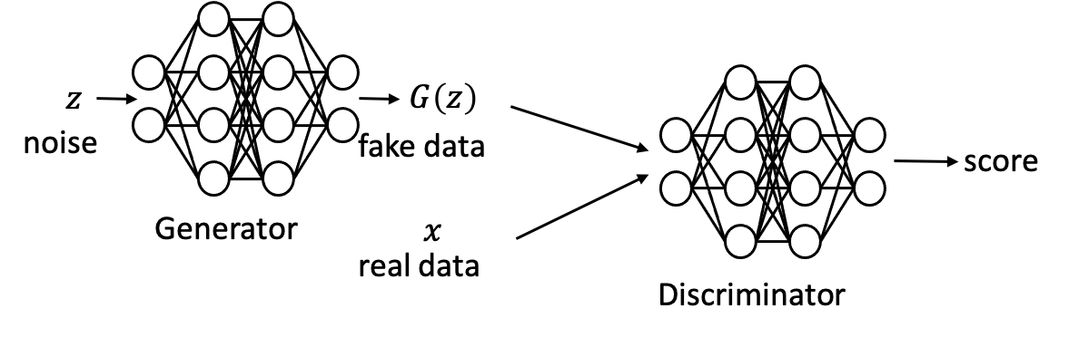

Vanilla GAN
It is a two-player zero-sum game between the generator and the discriminator.
The discriminator gives the distance between the generated distribution and the target distribution in a variational form.
J-S divergence
Goodfellow, et al. Neurips. 2014

Slide 10
Issues with vanilla GAN
1. Hard to achieve Nash equilibrium.
2. If the discriminator does a great job, the gradient of the loss function drops down
to close to zero and the learning becomes super slow or even jammed.
3. If the discriminator behaves badly, the generator does not have accurate feedback
and the loss function cannot represent the reality.
4. Mode collapse: the generator always produces same outputs.
Improved GAN Training: One-sided Label Smoothing, Adding Noises, etc.

Slide 11
Issues with vanilla GAN
1. Hard to achieve Nash equilibrium.
2. If the discriminator does a great job, the gradient of the loss function drops down
to close to zero and the learning becomes super slow or even jammed.
3. If the discriminator behaves badly, the generator does not have accurate feedback
and the loss function cannot represent the reality.
4. Mode collapse: the generator always produces same outputs.
Improved GAN Training: One-sided Label Smoothing, Adding Noises, etc.

Slide 12
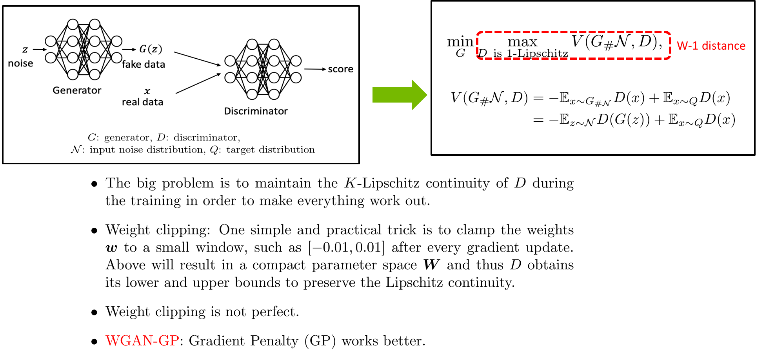
Wasserstein GAN
Arjovsky et al., ICML, 2017.

Slide 13
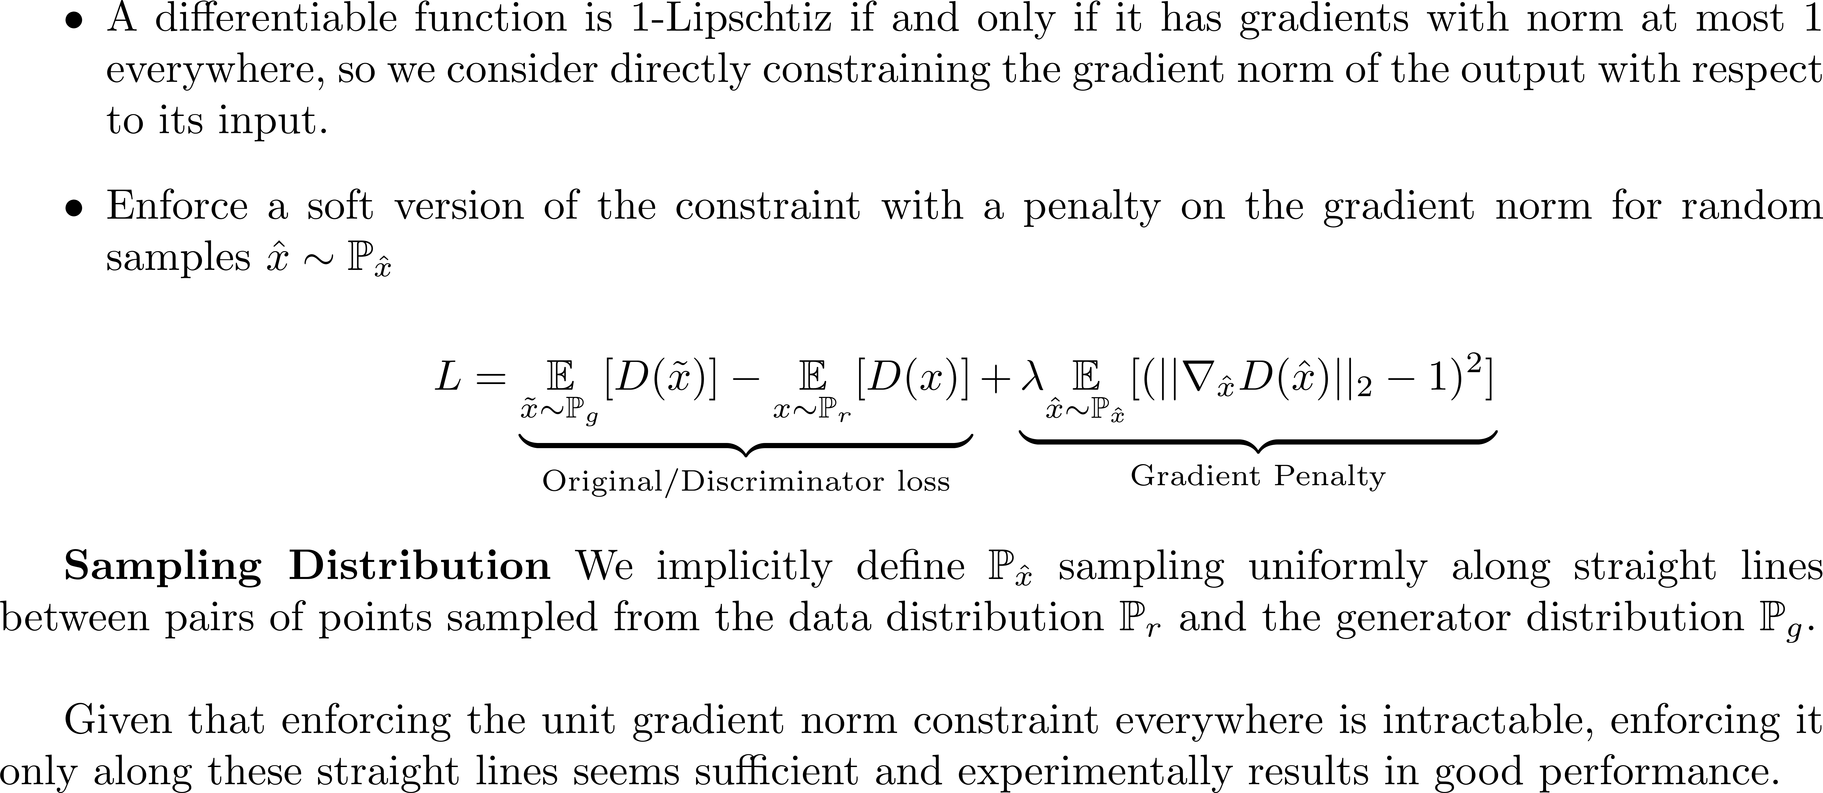
WGAN-GP
Gulrajani et al., arXiv 2017.

Slide 14
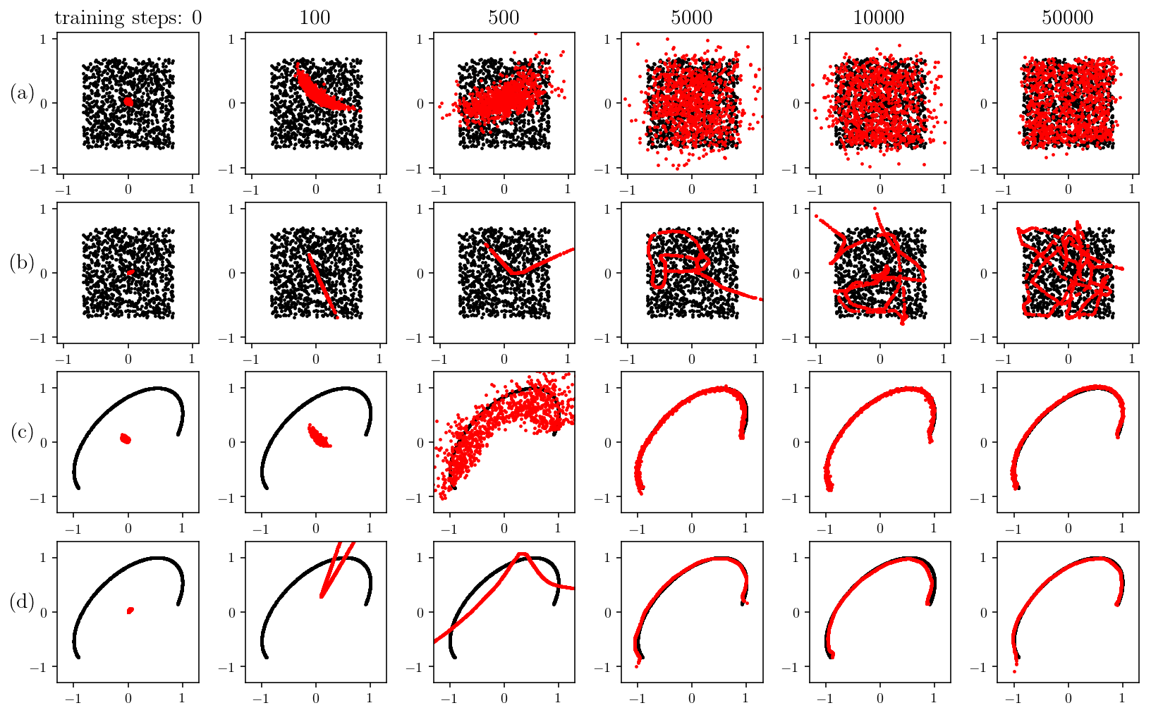
WGAN-GP: Approximating a distribution
Black dots: real distribution samples (data)
Red dots: generated distribution samples

Slide 15
Contents
Stochastic differential equation (SDE)
Brief review on generative adversarial networks (GANs)
Physics-informed generative adversarial networks (PI-GAN)
Forward and Inverse SDE problems

Slide 16
GANs + SDEs
Liu et al., SISC 2020.

Slide 17
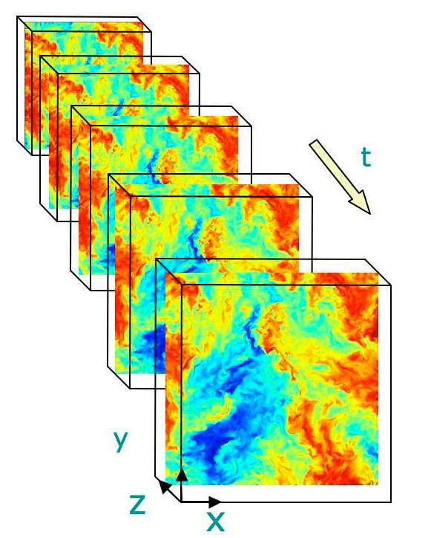
Training data

Slide 18
Loss function-Stochastic Process

Slide 19
Loss function-SDEs

Slide 20
Contents
Stochastic differential equation (SDE)
Brief review on generative adversarial networks (GANs)
Physics-informed generative adversarial networks (PI-GAN)
Forward and Inverse SDE problems

Slide 21
Example I: Stochastic process
Gaussian process
Liu et al., SISC 2020.

Slide 22
Example I: Stochastic process
Liu et al., SISC 2020.

Slide 23
Example I: Stochastic process
Liu et al., SISC 2020.

Slide 24
Example I: Stochastic process
Gaussian process
Liu et al., SISC 2020.

Slide 25
Example I: Stochastic process
Liu et al., SISC 2020.

Slide 26
WGAN-GP vs GAN
Liu et al., SISC 2020.

Slide 27
WGAN-GP vs GAN
Liu et al., SISC 2020.

Slide 28
Example II: Forward SDE
Liu et al., SISC 2020.

Slide 29
Example II: Forward SDE
Liu et al., SISC 2020.

Slide 30
Example II: Forward SDE
Liu et al., SISC 2020.

Slide 31

Example II: Forward SDE
$$a=0.08, 0.02$$
Liu et al., SISC 2020.

Slide 32
Example II: Forward SDE
Liu et al., SISC 2020.

Slide 33
Example II: Inverse or Mixed Problem
Liu et al., SISC 2020.

Slide 34
Example II: Inverse or Mixed Problems
Liu et al., SISC 2020.

Slide 35
Example III: SDEs
Liu et al., 2019.

Slide 36
Example III: SDEs
Liu et al., 2019.

Slide 37

Thank you for your attention!

