Slide 1


Scientific Machine Learning
Lecture 13: Learning numerical schemes for PDEs via deep learning
孟旭辉
数学与统计学院数学与应用学科交叉创新研究院
办公室：欣苑2栋111室
Email：xuhui_meng@hust.edu.cn
https://github.com/XuhuiM/SciML-Course
5/10/2023

Slide 2
Contents
Brief review on FDM/FVM
Learning numerical schemes from data
Applications to PDEs
…

Slide 3
Contents
Brief review on FDM/FVM
Learning numerical schemes from data
Applications to PDEs
…

Slide 4
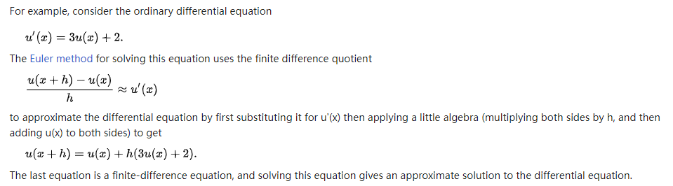
Finite Difference Method (FDM)
From Wiki

Slide 5
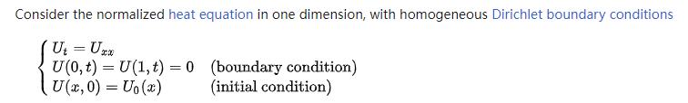
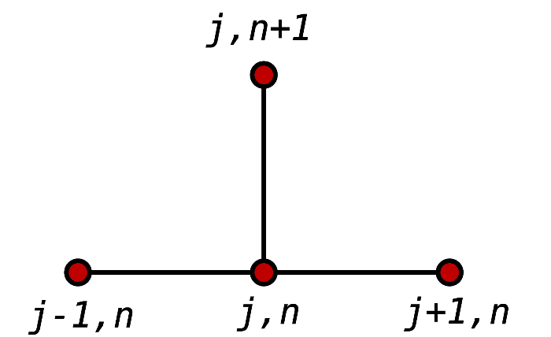
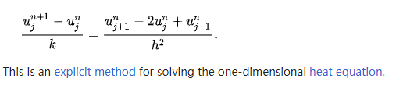
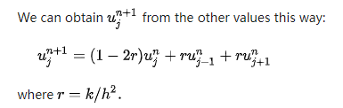
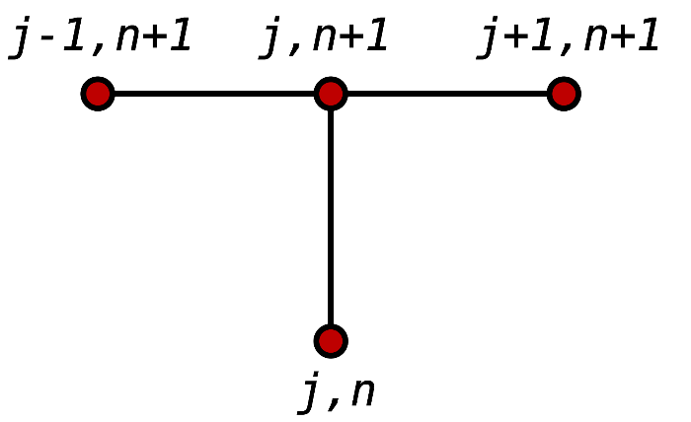
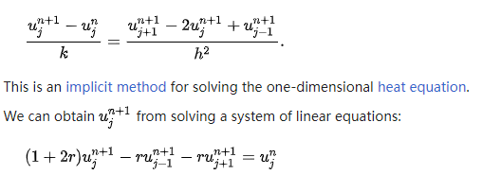
Finite Difference Method (FDM)
From Wiki

Slide 6
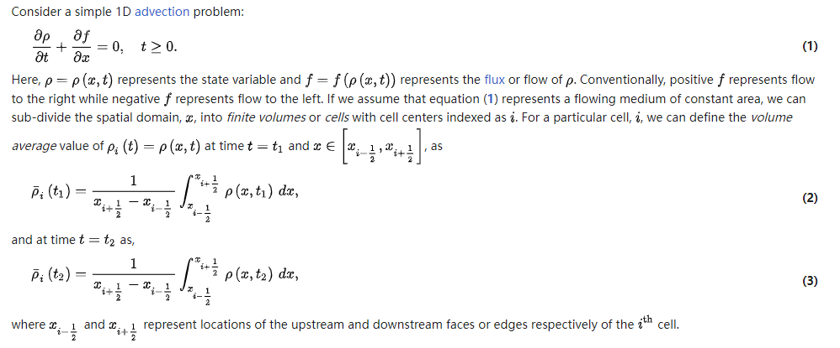

Finite Volume Method (FVM)
From Wiki

Slide 7
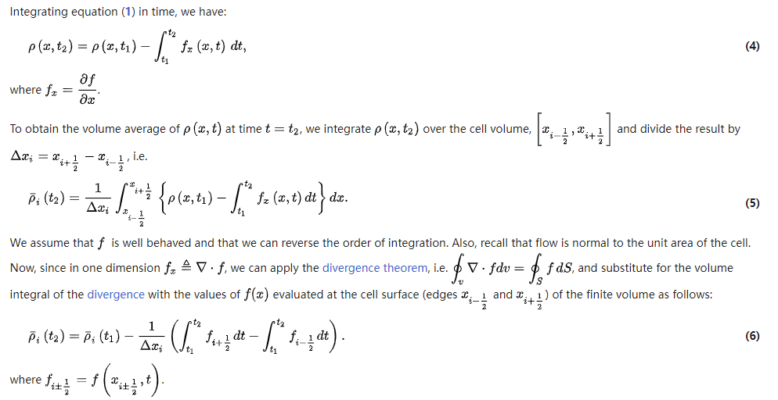
Finite Volume Method (FVM)
From Wiki

Slide 8
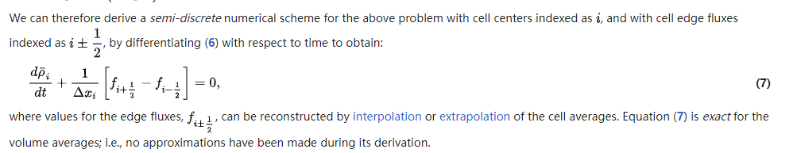
Finite Volume Method (FVM)
From Wiki

Slide 9
Contents
Brief on FDM/FVM
Learning numerical schemes from data
Applications to PDEs
…

Slide 10


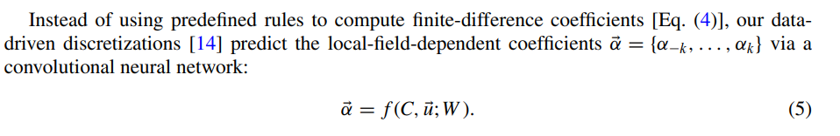
Learning numerical schemes from data
Zhuang, et al, PRF, 2021

Slide 11
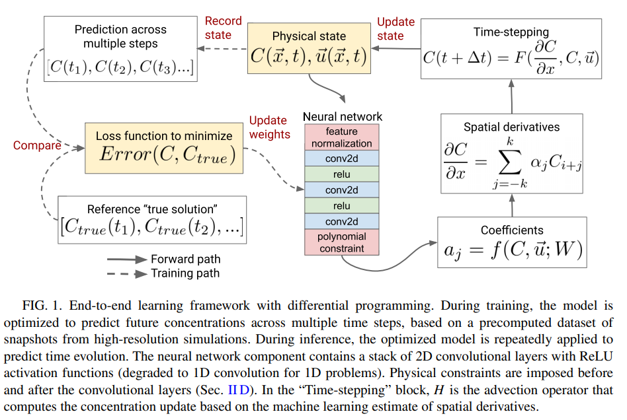
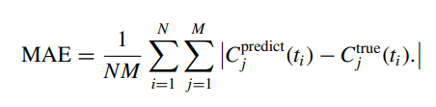
Learning numerical schemes from data
Zhuang, et al, PRF, 2021

Slide 12
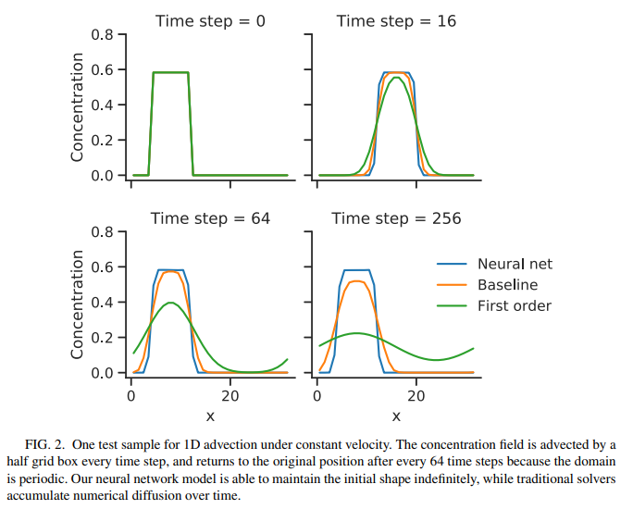
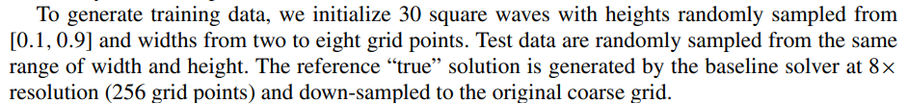
Example: 1D advection equation
$α:$ 4 convolutional layers with 32 filters per layer
Zhuang, et al, PRF, 2021

Slide 13
Example: 1D advection equation
$α:$ 4 convolutional layers with 32 filters per layer
Zhuang, et al, PRF, 2021

Slide 14
Example: 1D advection equation
Zhuang, et al, PRF, 2021

Slide 15
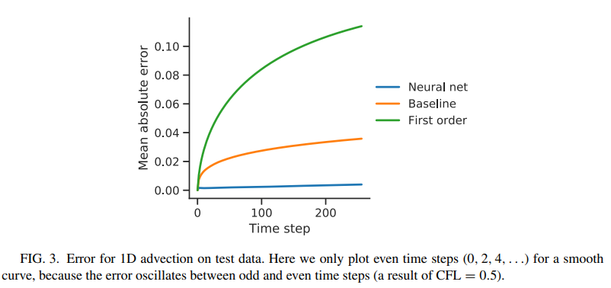
Example: 1D advection equation
Zhuang, et al, PRF, 2021

Slide 16
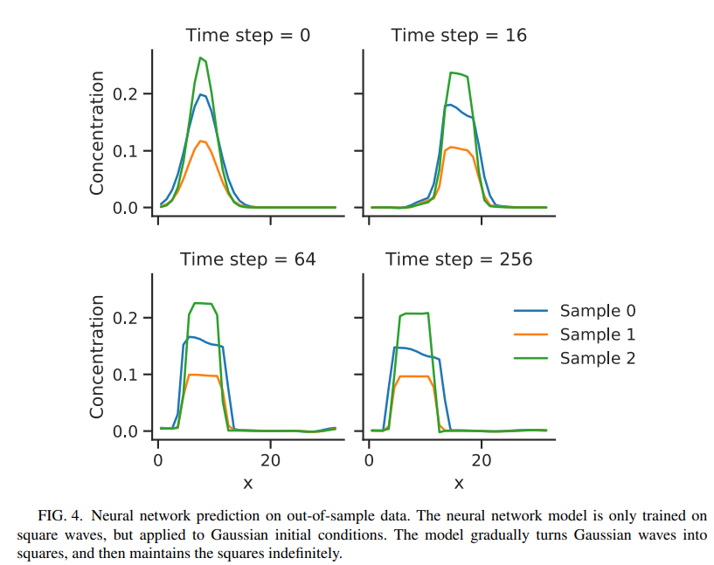
Example: 1D advection equation
Zhuang, et al, PRF, 2021

Slide 17
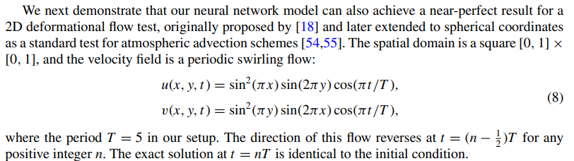
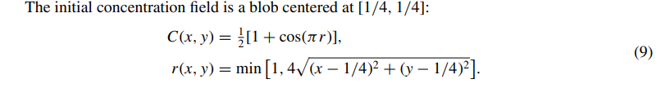
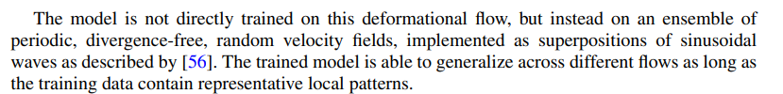
Example: 2D deformational flow
Zhuang, et al, PRF, 2021

Slide 18
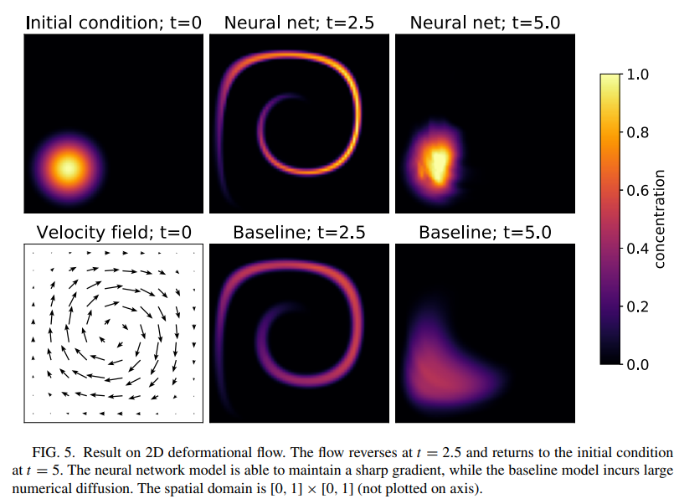
Example: 2D deformational flow
Zhuang, et al, PRF, 2021

Slide 19
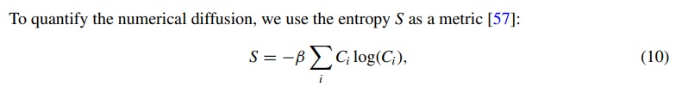
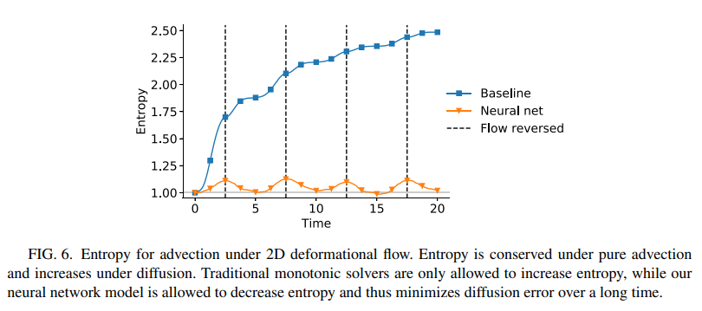
Example: 2D advection equation
Zhuang, et al, PRF, 2021

Slide 20
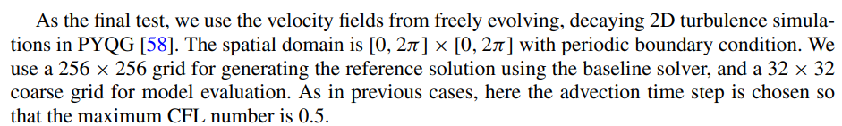
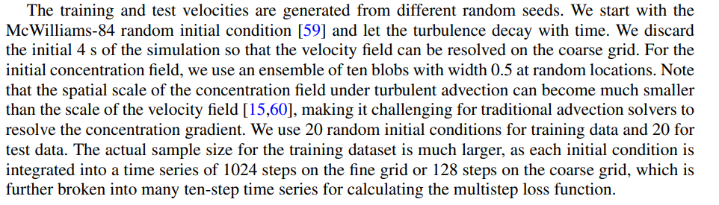
Example: 2D Turbulence
Zhuang, et al, PRF, 2021

Slide 21
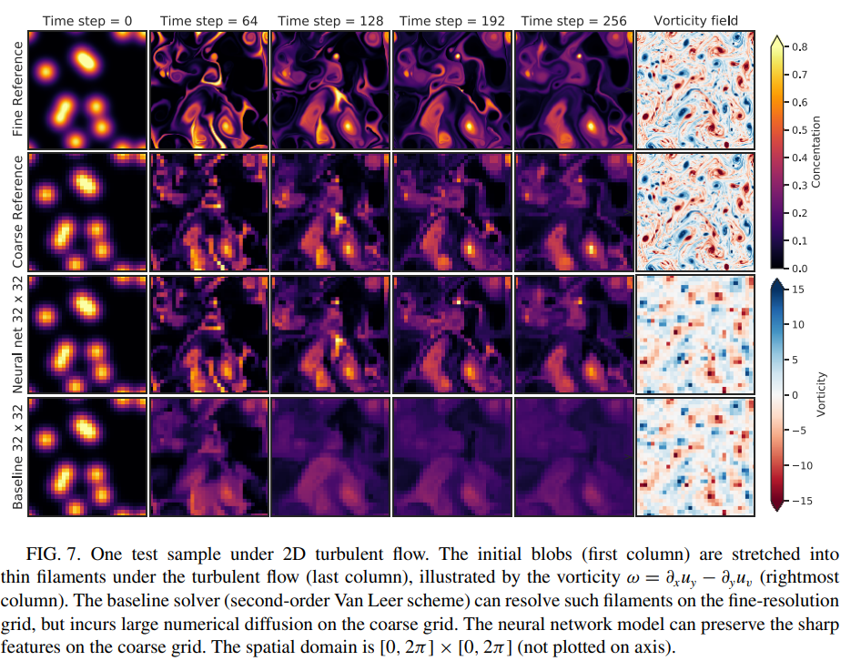
Example: 2D Turbulence
Zhuang, et al, PRF, 2021

Slide 22
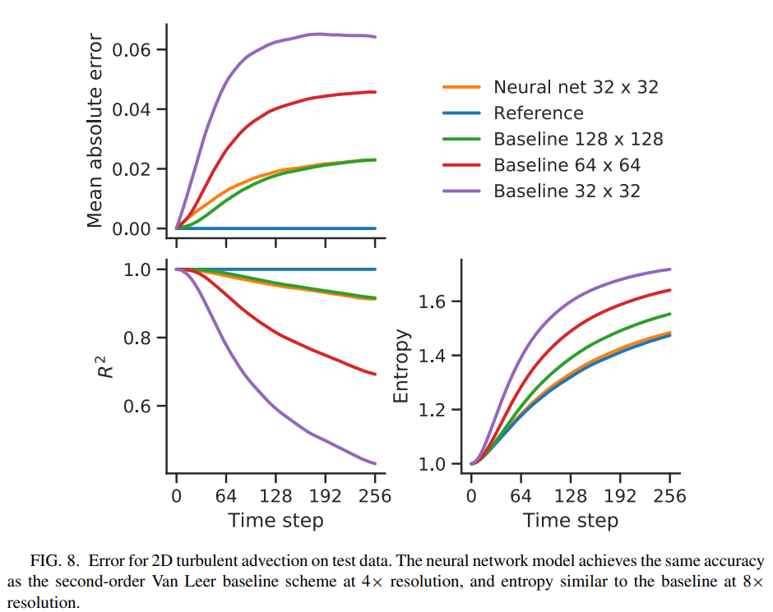
Example: 2D Turbulence
Zhuang, et al, PRF, 2021

Slide 23
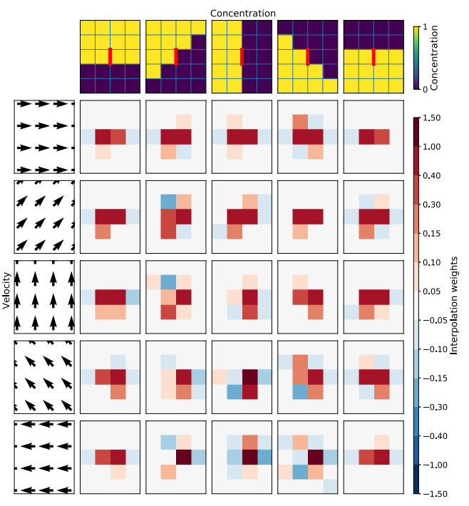
Example: 2D Turbulence
Zhuang, et al, PRF, 2021

Slide 24
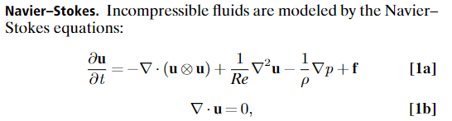
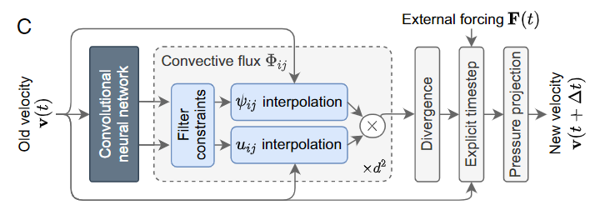

Example: Turbulence (FVM)
Kochkov, et al, PNAS, 2021

Slide 25
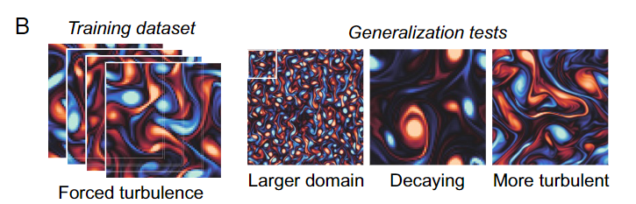
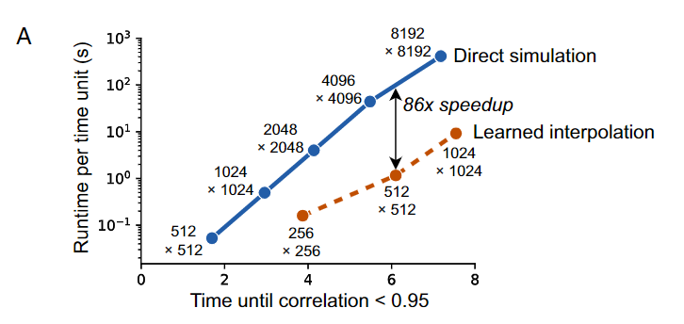
Example: Turbulence (FVM)
Kochkov, et al, PNAS, 2021

Slide 26
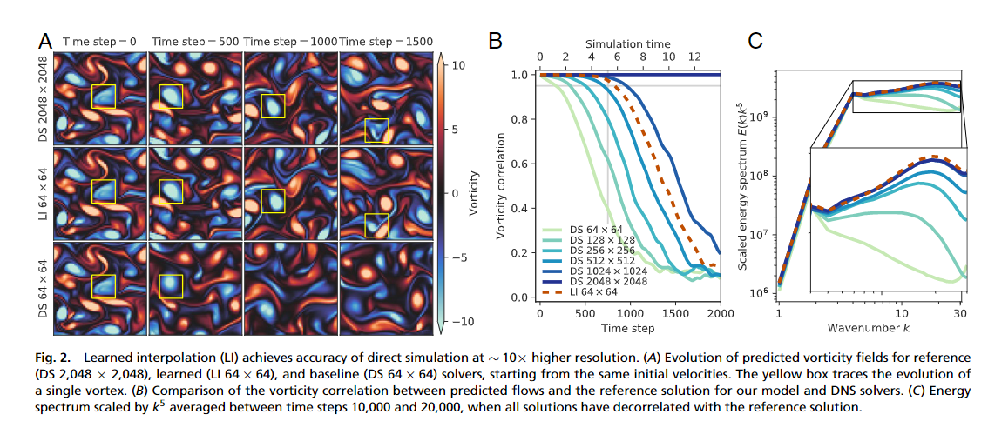
Example: Turbulence (FVM)
Kochkov, et al, PNAS, 2021

Slide 27
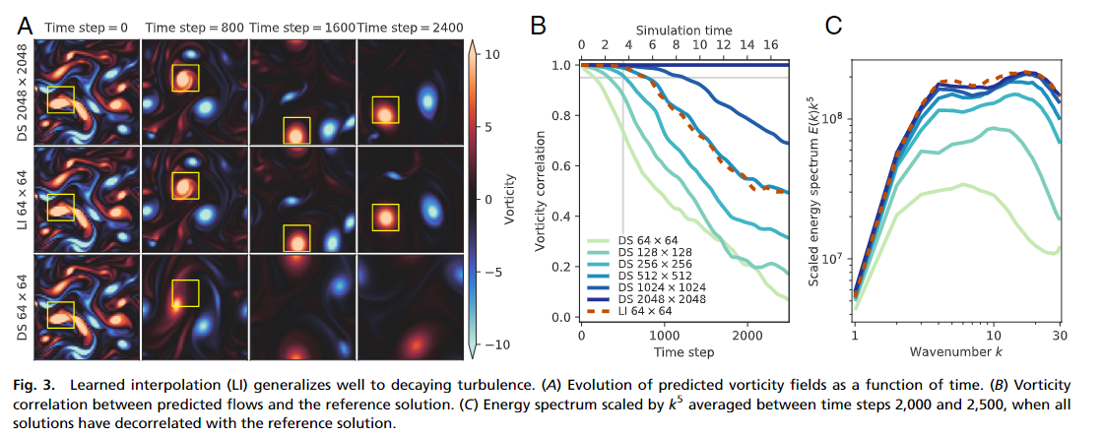
Example: Turbulence (FVM)
Kochkov, et al, PNAS, 2021

Slide 28
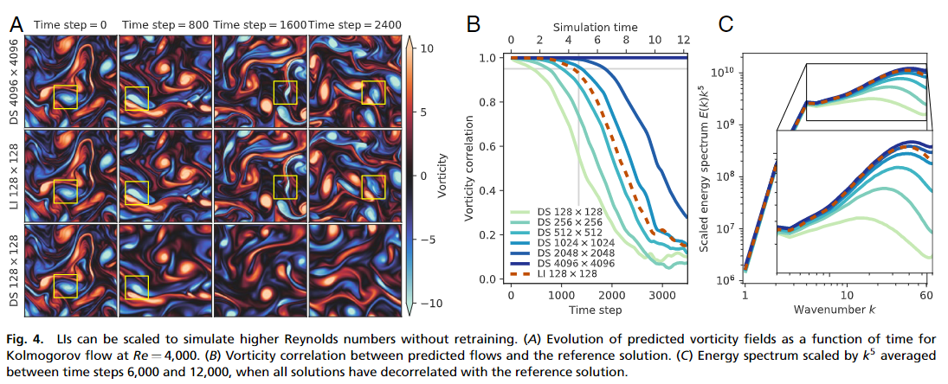
Example: Turbulence (FVM)
Kochkov, et al, PNAS, 2021

Slide 29

Thank you for your attention!

