Slide 1
Lecture 2 Software Installation
Zhiping Mao
School of Mathematical Sciences Xiamen University

Slide 2
Contents
Introduction to Deep Learning (Software Installation)
Data-driven for Solving PDEs
Physics-informed Neural Networks for Solving PDEs
Deep Operator Neural Networks for Solving PDEs

Slide 3
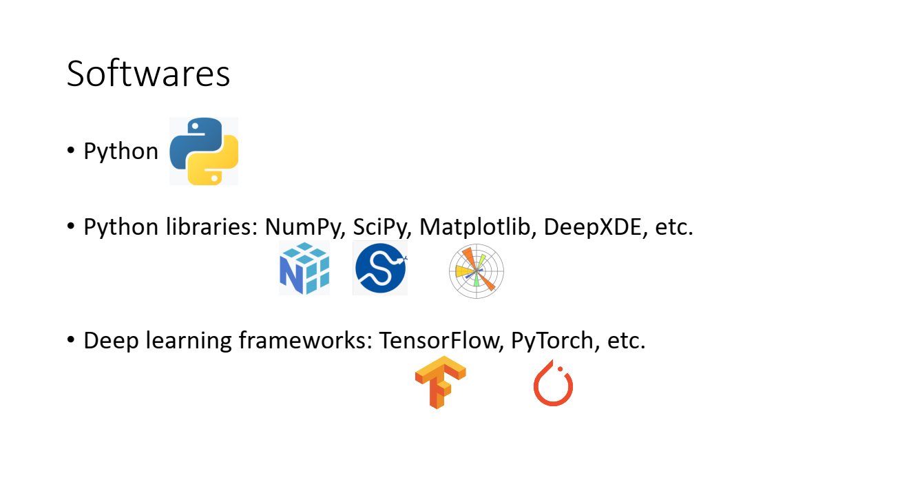

Slide 4

Install Anaconda
Download Anaconda (https://www.anaconda.com)
Windows:
Install directly (double click)
Install Spyder/Jupyter/PyCharm etc.
Linux:
./excutable_file (for example: ./Anaconda3-2021.11-Linux-x86_64.sh)

Slide 5
Create/remove environment
Create a new environment:
conda create -n my_env_name
conda create -n my_env_name python=3.7 (指定python版本)
Check available environments:
conda env list
Activate an environment:
conda activate my_env_name
Deactivate the environment:
conda deactivate
Remove an environment:
conda remove -n my_env_name --all

Slide 6
Install or delete a package
Install a package:
conda install package_name
pip install package_name
Delete a package:
conda remove –name $my_env_name $package_name

Slide 7
Install pytorch (Windows)
Method 1: Install directly.
Method 2: using the command line:
conda install pytorch
Check if pytorch is available
GPU version
conda install pytorch torchvision torchaudio cudatoolkit=11.6 -c pytorch -c conda -forge
import torch
x = torch.rand(5, 3)
print(x)

Slide 8
Install pytorth (Linux)
conda install pytorch
Check if pytorch is available
GPU version
conda install pytorch torchvision torchaudio cudatoolkit=11.6 -c pytorch -c conda -forge
import torch
x = torch.rand(5, 3)
print(x)

Slide 9
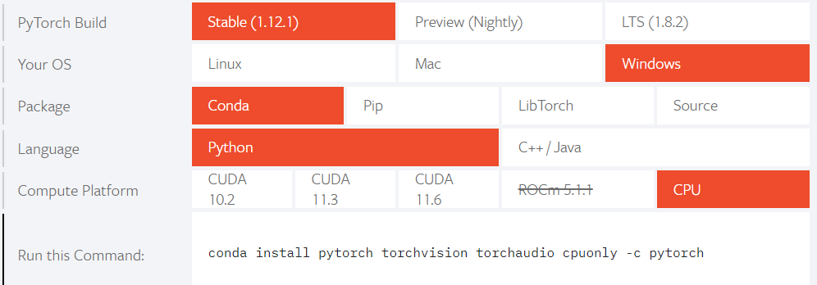
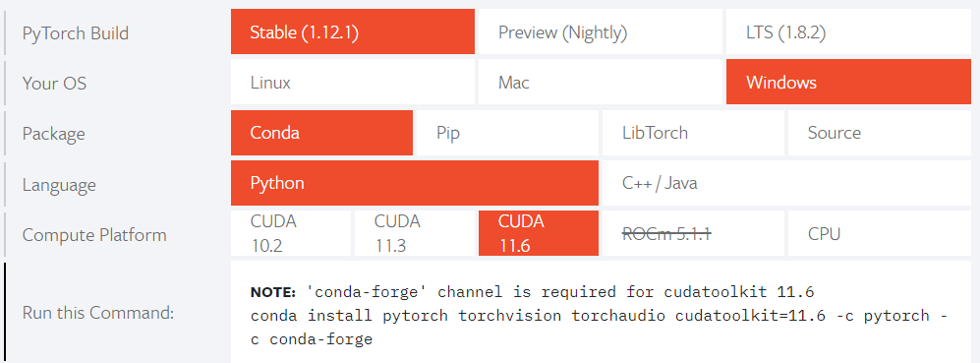
CPU
Pytorch (Windows)
https://pytorch.org
GPU

Slide 10
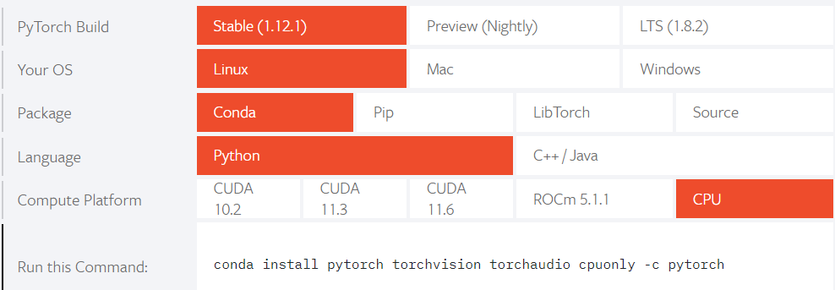
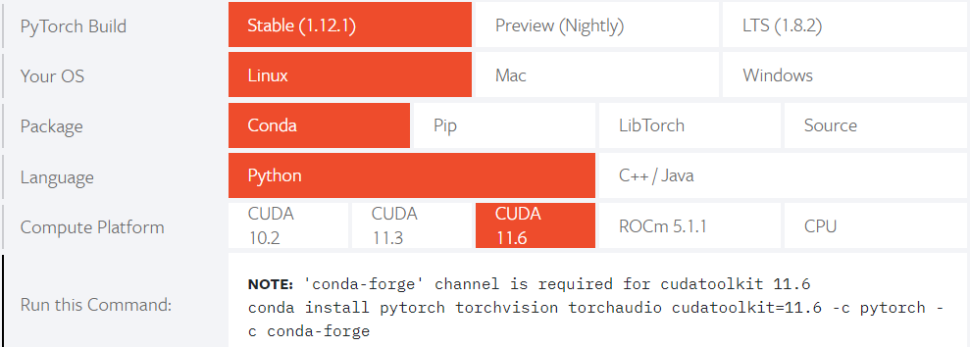
CPU
Pytorch (Linux)
https://pytorch.org
GPU

Slide 11
Install tensorflow (Windows)
Method 1: Install directly.
Method 2: using the command line:
conda install tensorflow==1.15 (1.x or 2.x; 1.x version is compatible with python 3.6/3.7)
conda install tensorflow-gpu==1.15 (GPU version)
Check if tensorflow is available
import tensorflow as tf
print (tf.__version__)

Slide 12
Install tensorflow (Linux)
conda install tensorflow==1.15
conda install tensorflow-gpu==1.15 (GPU version)
Check if tensorflow is available
import tensorflow as tf
print (tf.__version__)

Slide 13
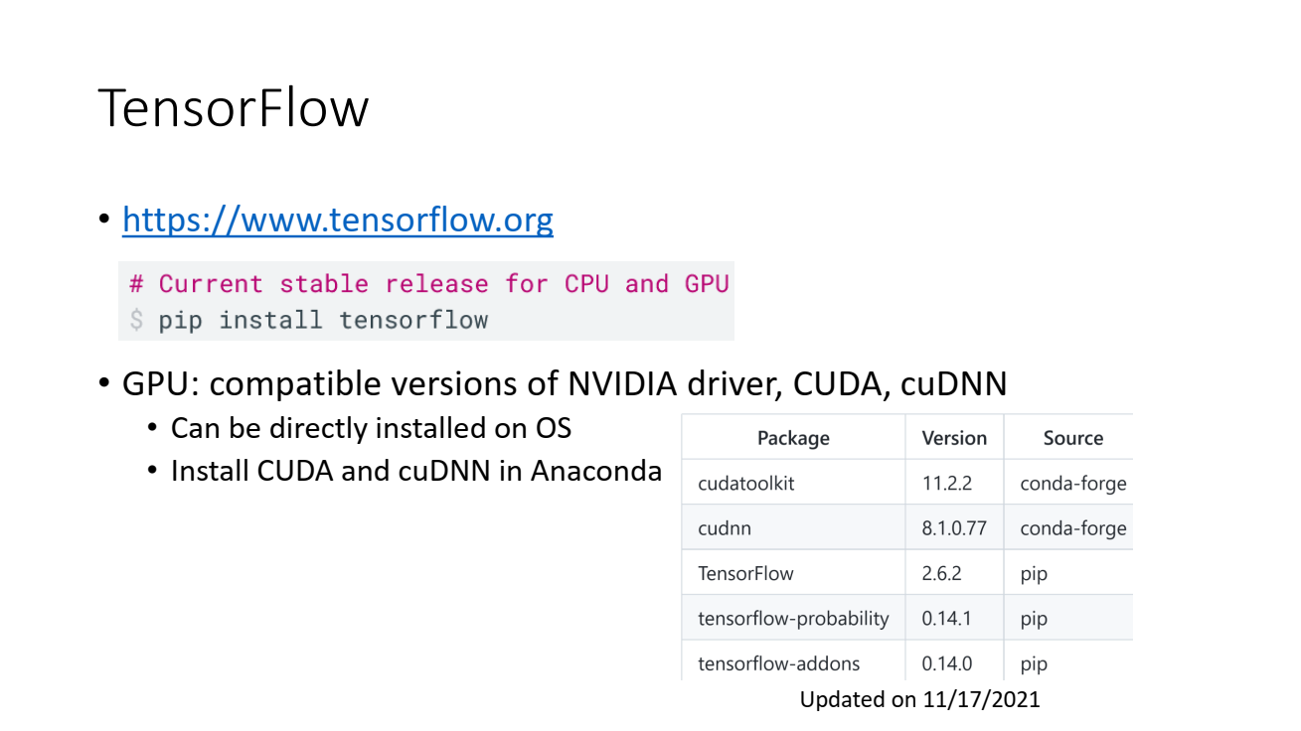

Slide 14
