Slide 1


Horovod: Distributed training framework
Xuhui Meng, Khemraj Shukla
Division of Applied Mathematics, Brown University
September 27th , 2019

Slide 2
Outline
What’s Horovod?
How to use?
Examples for function approximation/PINN
Data parallelism
Ensemble training
Data parallelism
Ensemble training

Slide 3
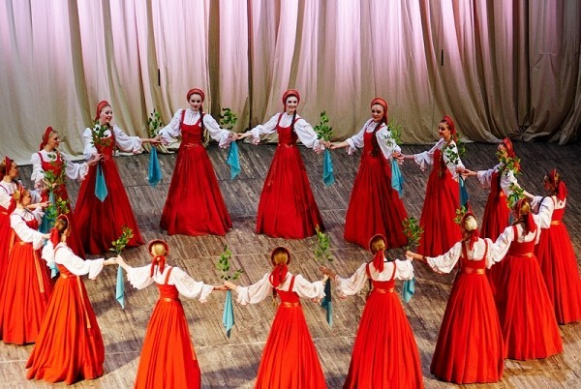
What’s Horovod?

Slide 4
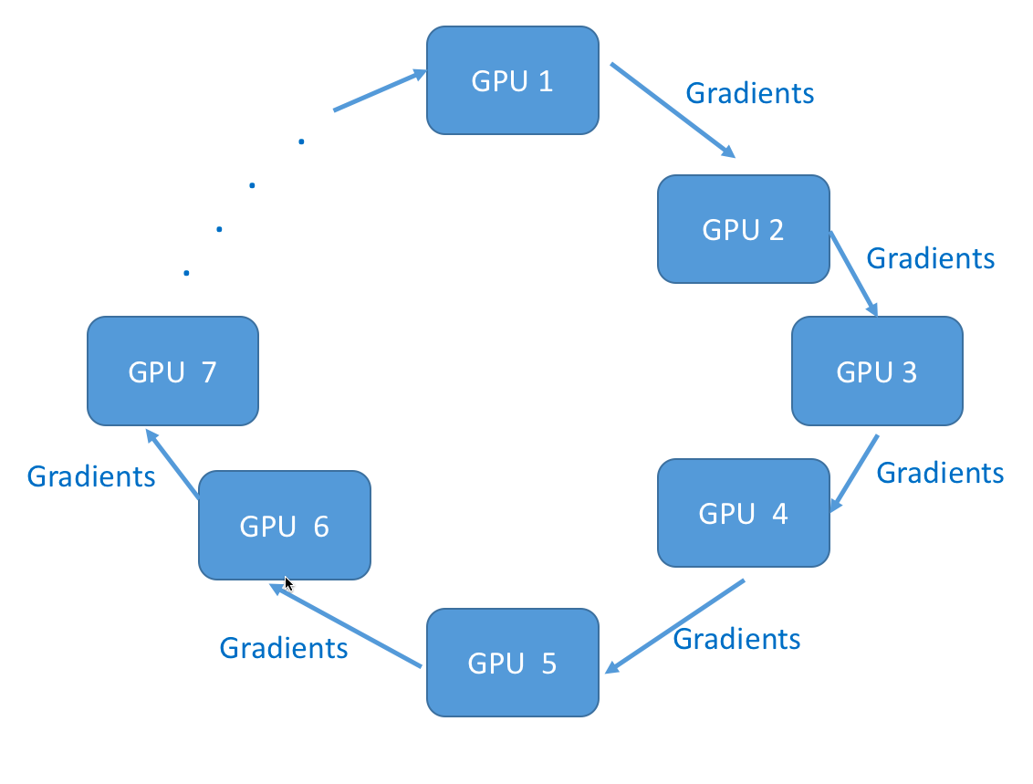

What’s Horovod?

Slide 5
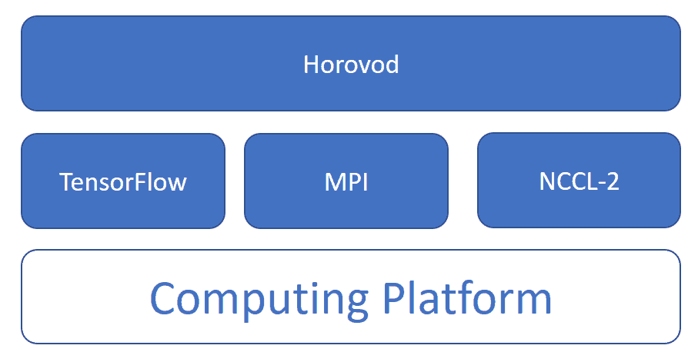
What’s Horovod?

Slide 6
Data parallelism & Ensemble training
Data parallelism
Dataset
GPU 1
GPU 2
……
GPU (n-1)
GPU n
DNN
DNN
……
DNN
DNN
Ensemble training
DNNs
DNN 1
DNN 2
……
DNN (n-1)
DNN n
GPU 1
GPU 2
……
GPU (n-1)
GPU n

Slide 7
Outline
What’s Horovod?
How to use?
Examples for function approximation/PINN
Data parallelism
Ensemble training
Data parallelism
Ensemble training

Slide 8
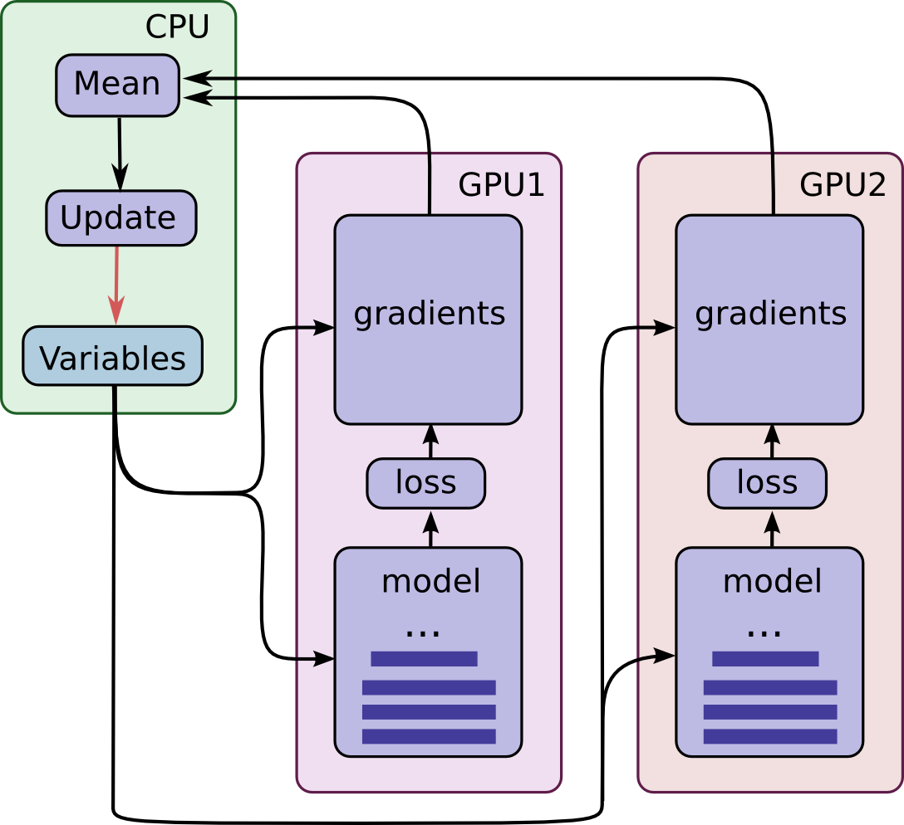
How to use Horovod – Data parallelism
1. Run multiple copies of the training
scripts, and each copy:
Reads a chunk of data
Train the model
Compute the gradients
2. Average the gradients from all the
copies
3. Update the model
4. Repeat 1-3
Same initializations!

Slide 9
Show me the code: Data parallelism
import tensorflow as tf
import horovod.tensorflow as hvd
hvd.init() #initialize the environment
#pin one GPU to each tensorflow process
config = tf.ConfigProto()
config.gpu_options.visible_device_list
= str(hvd.local_rank())
if hvd.rank() == 0: #read data
read_chunk_0
else:
read_chunk_n…
# Build model...
loss = ...
opt = tf.train.AdamOptimizer(learning_rate * hvd.size())
# Add Horovod Distributed Optimizer
opt = hvd.DistributedOptimizer(opt)
train = opt.minimize(loss)
init = tf.global_variables_initializer()
sess.run(init)
#broadcast the initialization to all processes
bcast = hvd.broadcast_global_variables(0)
sess.run(bcast)
while train_step < step_max:
sess.run([train, loss], feed_dict=…)
horovodrun/mpirun –np NP –H localhost:NP
python *.py
mpirun –np NP –H
server 1:np…server n: np …
python *.py

Slide 10
Show me the code: Data parallelism
import tensorflow as tf
import horovod.tensorflow as hvd
hvd.init()
config = tf.ConfigProto()
config.gpu_options.visible_device_list
= str(hvd.local_rank())
if hvd.rank() == 0:
read_chunk_0
else:
read_chunk_n…
loss = ...
opt = tf.train.AdamOptimizer(learning_rate * hvd.size())
opt = hvd.DistributedOptimizer(opt)
train = opt.minimize(loss)
init = tf.global_variables_initializer()
sess.run(init)
bcast = hvd.broadcast_global_variables(0)
sess.run(bcast)
while train_step < step_max:
sess.run([train, loss], feed_dict=…)
1
2
7
3
4
5
6

Slide 11
How to use Horovod – Ensemble training
1. Run multiple copies of the training
scripts, and each copy:
Reads a chunk of data
Train the model
Compute the gradients
2. Update the model using its
own gradient
3. Repeat 1-2

Slide 12
Show me the code: Ensemble training
import tensorflow as tf
import horovod.tensorflow as hvd
hvd.init() #initialize the environment
#pin one GPU to each tensorflow process
config = tf.ConfigProto()
config.gpu_options.visible_device_list
= str(hvd.local_rank())
if hvd.rank() == 0: #read data
read_chunk_0
else:
read_chunk_n…
# Build model...
loss = ...
opt = tf.train.AdamOptimizer(learning_rate)
# Add Horovod Distributed Optimizer
#opt = hvd.DistributedOptimizer(opt)
train = opt.minimize(loss)
init = tf.global_variables_initializer()
sess.run(init)
#broadcast the initialization to all processes
bcast = hvd.broadcast_global_variables(0)
sess.run(bcast)
while train_step < step_max:
sess.run([train, loss], feed_dict=…)

Slide 13
Show me the code: Ensemble training
import tensorflow as tf
import horovod.tensorflow as hvd
hvd.init()
config = tf.ConfigProto()
config.gpu_options.visible_device_list
= str(hvd.local_rank())
if hvd.rank() == 0:
read_chunk_0
else:
read_chunk_n…
loss = ...
opt = tf.train.AdamOptimizer(learning_rate)
#opt = hvd.DistributedOptimizer(opt)
train = opt.minimize(loss)
init = tf.global_variables_initializer()
sess.run(init)
bcast = hvd.broadcast_global_variables(0)
sess.run(bcast)
while train_step < step_max:
sess.run([train, loss], feed_dict=…)
1
2
5
3
4

Slide 14
Outline
What’s Horovod?
How to use?
Examples for function approximation/PINN
Data parallelism
Ensemble training
Data parallelism
Ensemble training

Slide 15
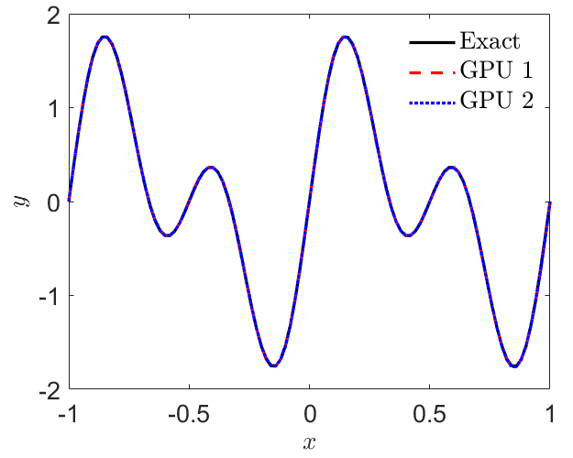
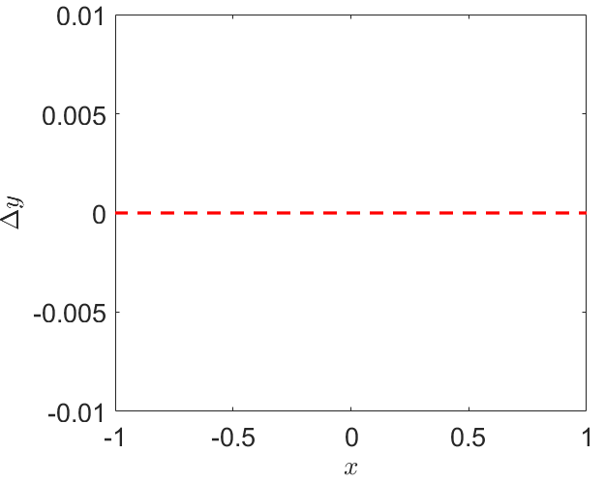
Example 1: Function approximation (Data parallelism)
GPU 1
GPU 2
GPU 1
GPU 2
y_pred (GPU 1) – y_pred (GPU 2)

Slide 16
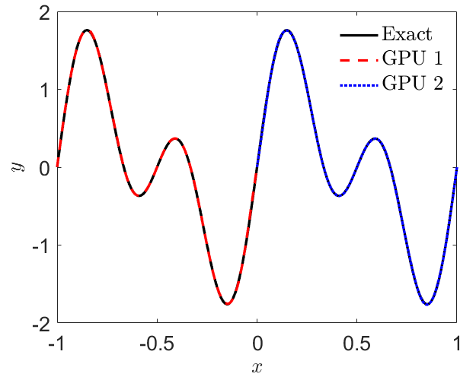
Example 2: Function approximation (Ensemble training)
GPU 1
GPU 2
GPU 1
GPU 2
GPU 1
GPU 2

Slide 17
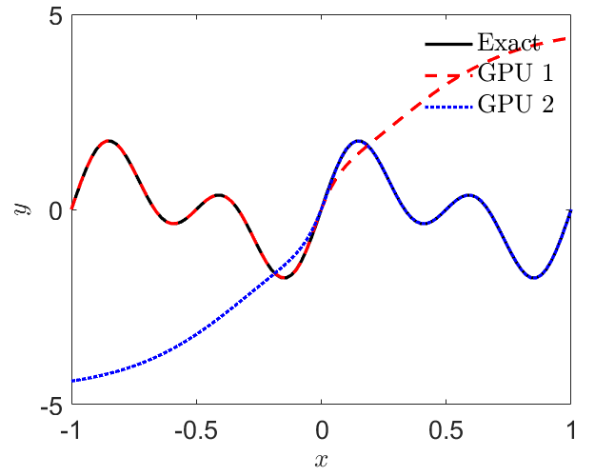
Example 2: Function approximation (Ensemble training)
GPU 1
GPU 2
GPU 1
GPU 2
GPU 1
GPU 2

Slide 18
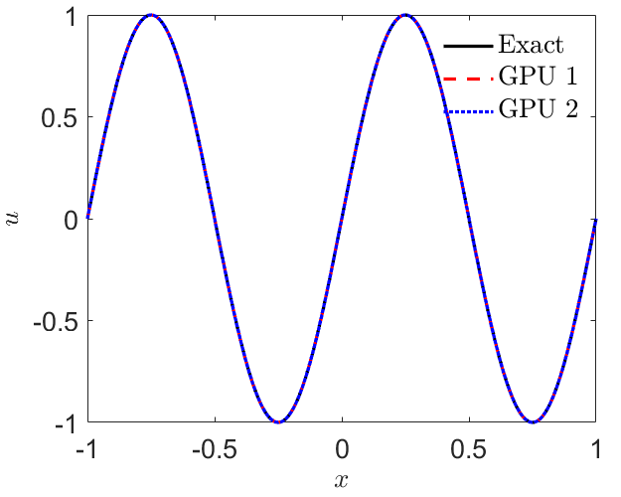

Example 3: PINNs (Data parallelism)
GPU 1
GPU 1
GPU 2
GPU 2
u_pred (GPU 1) – u_pred (GPU 2)
GPU 1
GPU 2

Slide 19
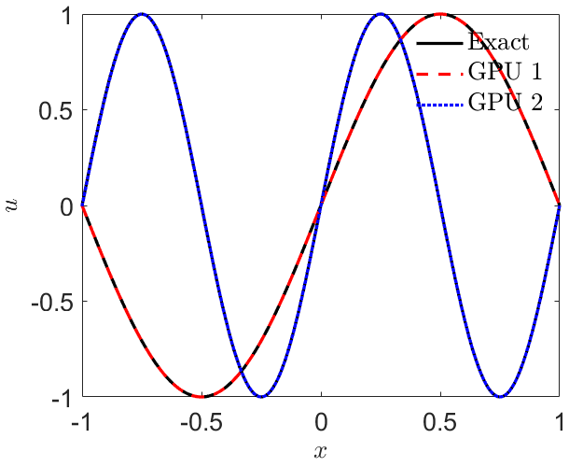
Example 4: PINNs (Ensemble training)
GPU 1
GPU 2
GPU 1
GPU 2
GPU 1
GPU 2
GPU 1
GPU 2

Slide 20
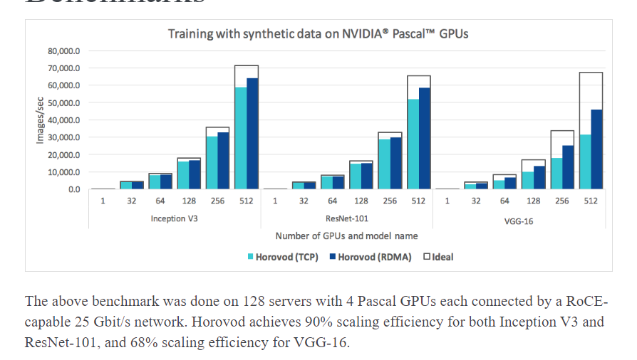
Scaling efficiency

Slide 21
Installation & Code
Installation
CCV: Oscar
module load horovod/0.16
https://github.com/horovod/horovod
Code download
https://github.com/XuhuiM/Distributed-training-Horovod.git

Slide 22
Thank you!

