Slide 1


Scientific Machine Learning
Lecture 16: In-context learning
孟旭辉
数学与统计学院数学与应用学科交叉创新研究院
办公室：欣苑2栋111室
Email：xuhui_meng@hust.edu.cn
https://github.com/XuhuiM/SciML-Course
5/28/2023

Slide 2
Contents
Transfer learning
Meta learning
In-context learning
…

Slide 3
Contents
Transfer learning
Meta learning
In-context learning
…

Slide 4
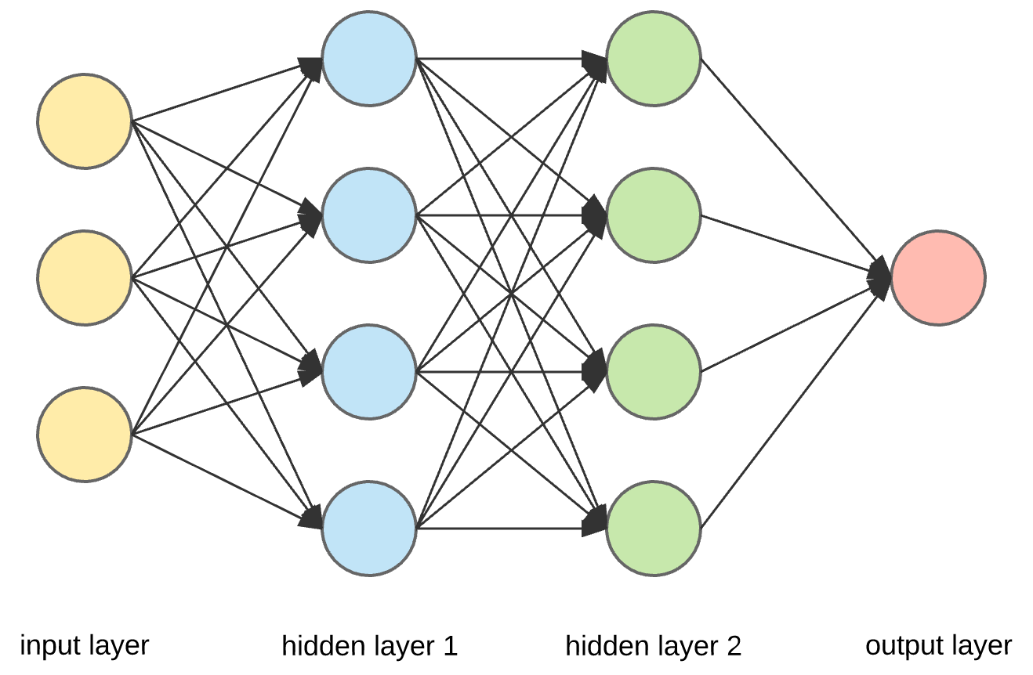










Transfer learning
$$y=\sin\left(2x\right), x∈[−1,1]$$
$$σ$$
$$σ$$
$$σ$$
$$σ$$
$$y$$
$$σ$$
$$σ$$
$$σ$$
$$σ$$
$$W_{init}=W_{Xavier}$$
$$W_{opt}=W_{1}$$

Slide 5

Transfer learning
$$y=\sin\left(3x\right), x∈[−1,1]$$
$$σ$$
$$σ$$
$$σ$$
$$σ$$
$$y$$
$$σ$$
$$σ$$
$$σ$$
$$σ$$
$$W_{init}=W_{1}$$

Slide 6
Contents
Transfer learning
Meta learning-Model agnostic meta learning (MAML)
In-context learning
…

Slide 7

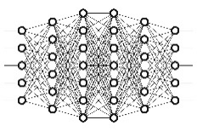
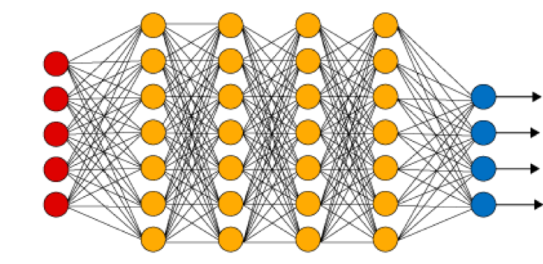







MAML: Good initialization for new task
…
$$θ_{1}$$
$$θ_{2}$$
$$θ_{3}$$
$$θ_{4}$$
$$θ_{5}$$
$$θ_{6}$$
$$θ=f(θ_{1},…,θ_{N})$$

Slide 8
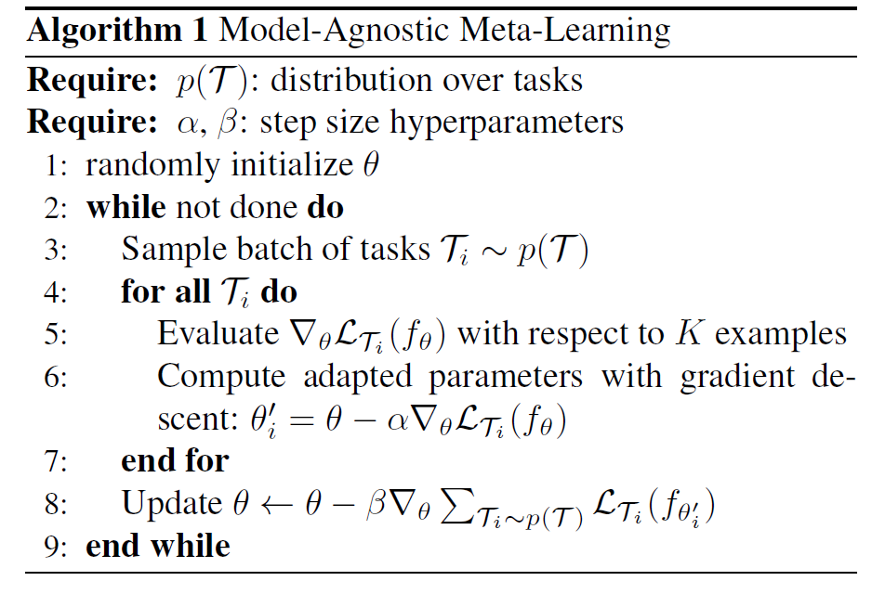
MAML
Training data
B
Test data
meta learner
Finn et al. MAML, 2017

Slide 9
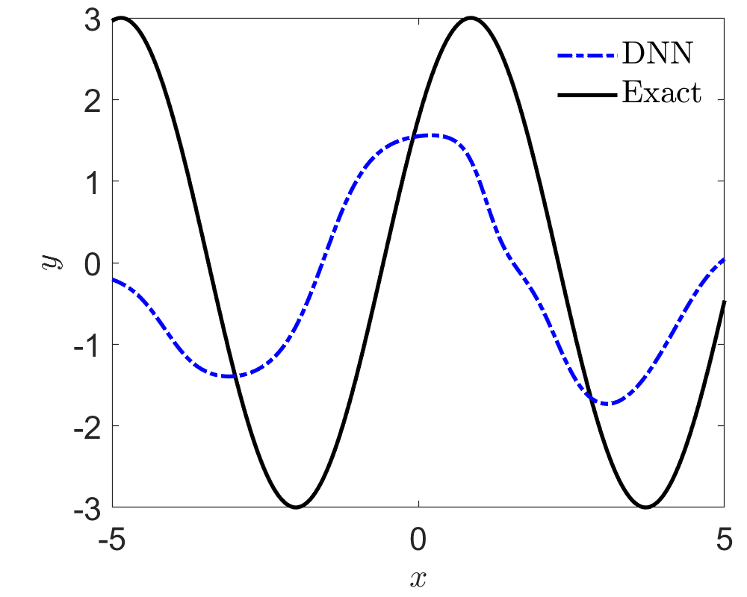
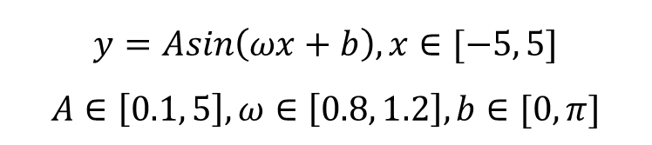
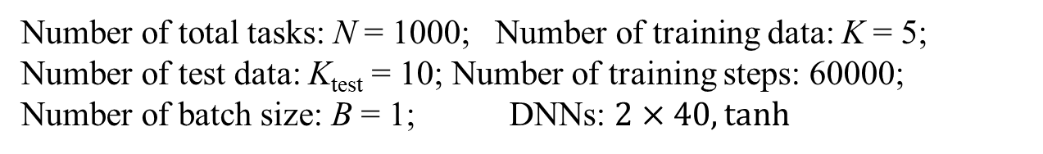
MAML for Function Approximation: few-shot learning
$$y=Asin\left(ωx+b\right), x∈[−5, 5]$$
$$A∈\left[0.1, 5\right], ω∈\left[0.8, 1.2\right], b∈[0, π]$$
Number of total tasks: N = 1000; Number of training data: K = 5;
Number of test data: K_{test} = 10; Number of training steps: 60000;
Number of batch size: B = 1; DNNs: $2×40, tanh$
Finn et al. MAML, 2017

Slide 10
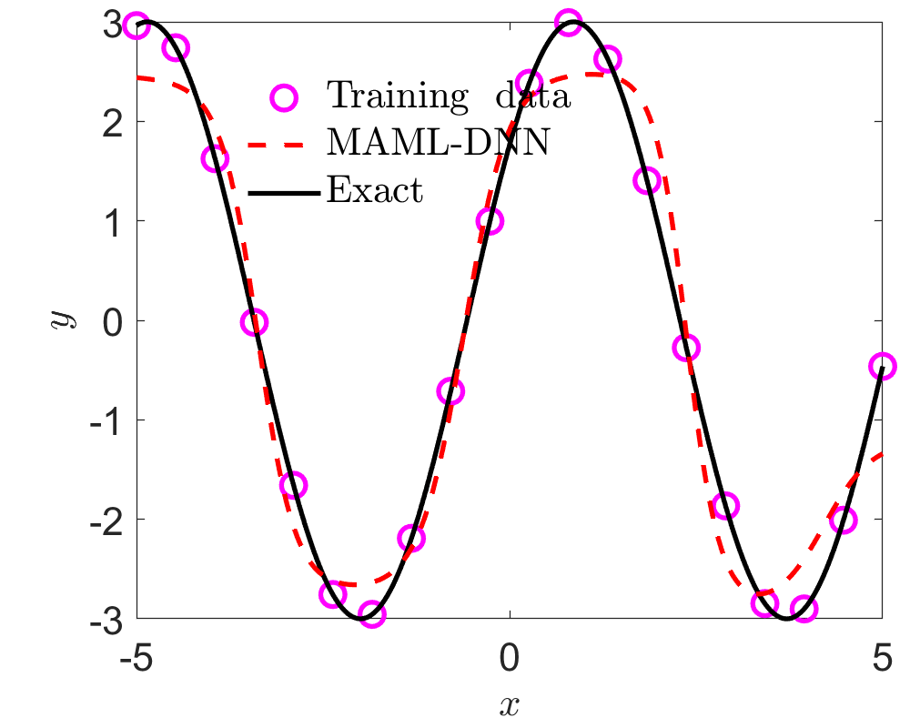
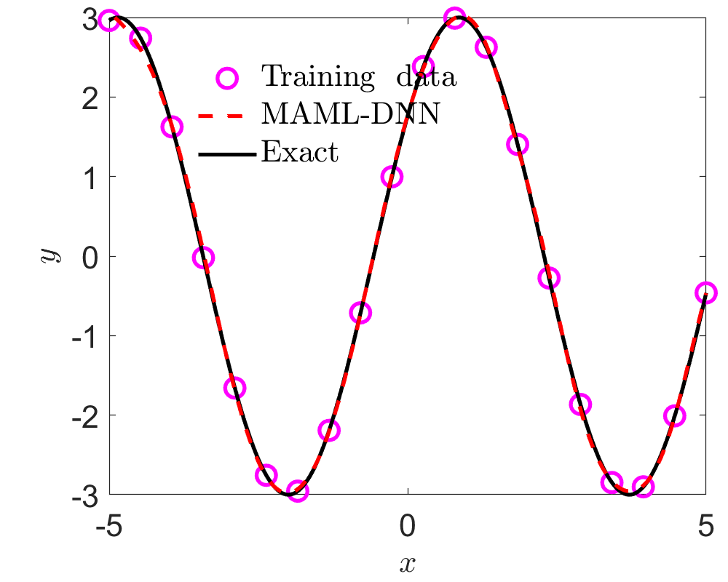
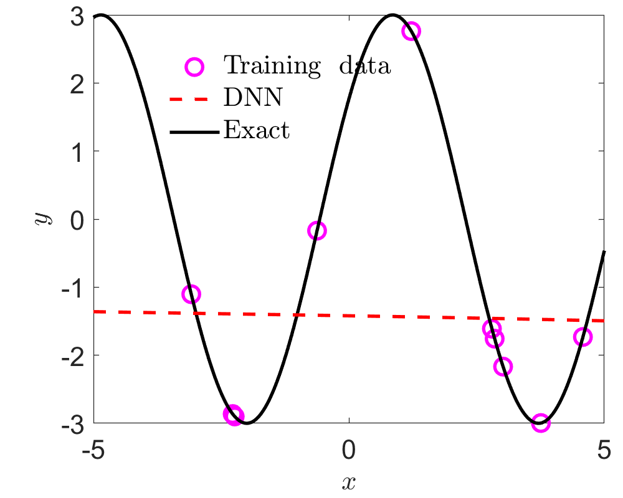
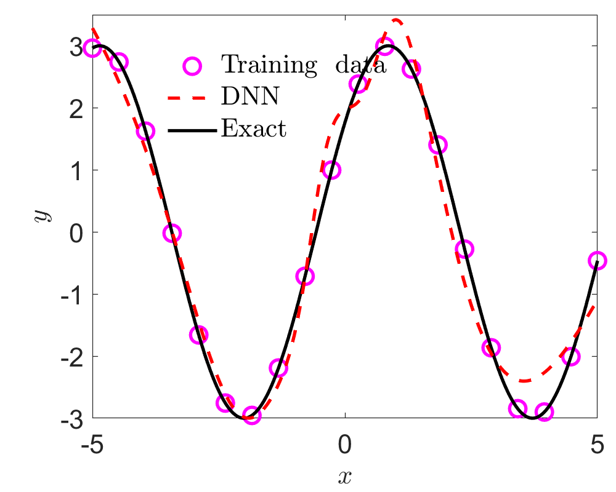

MAML for Function Approximation:
$$y=3sin\left(1.1x+0.2π\right)$$
Epoch = 10
Epoch = 100
MAML
DNN

Slide 11
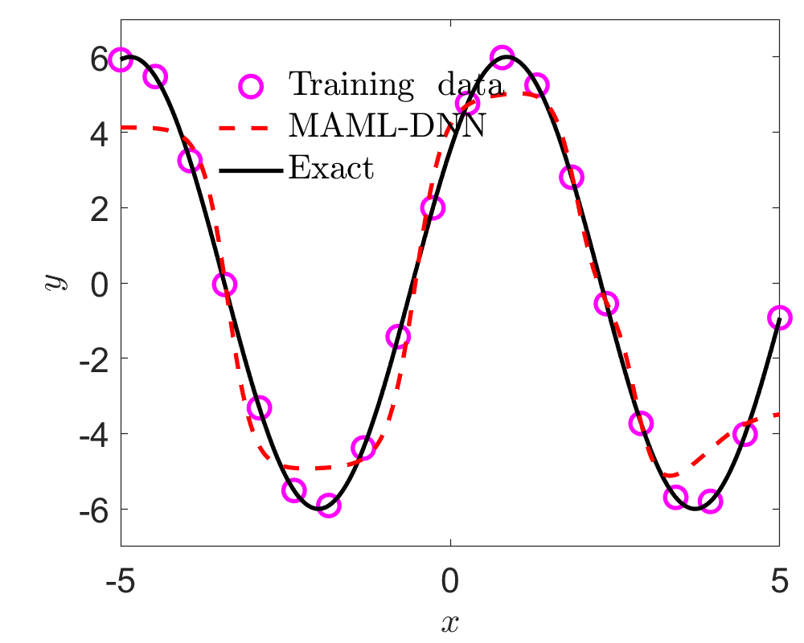
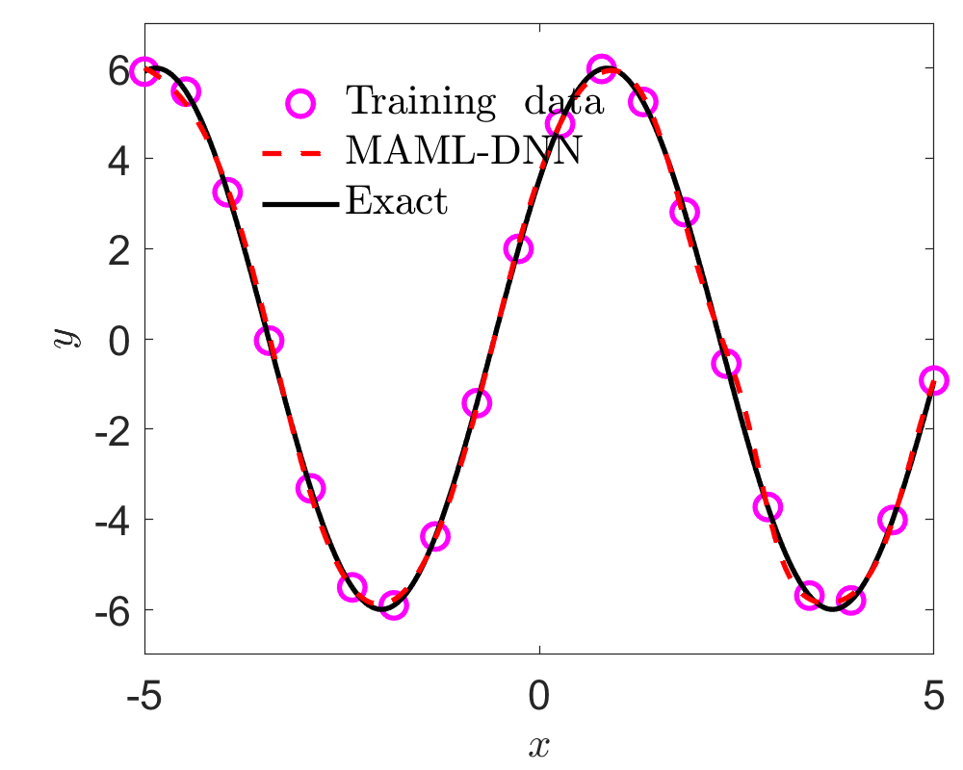
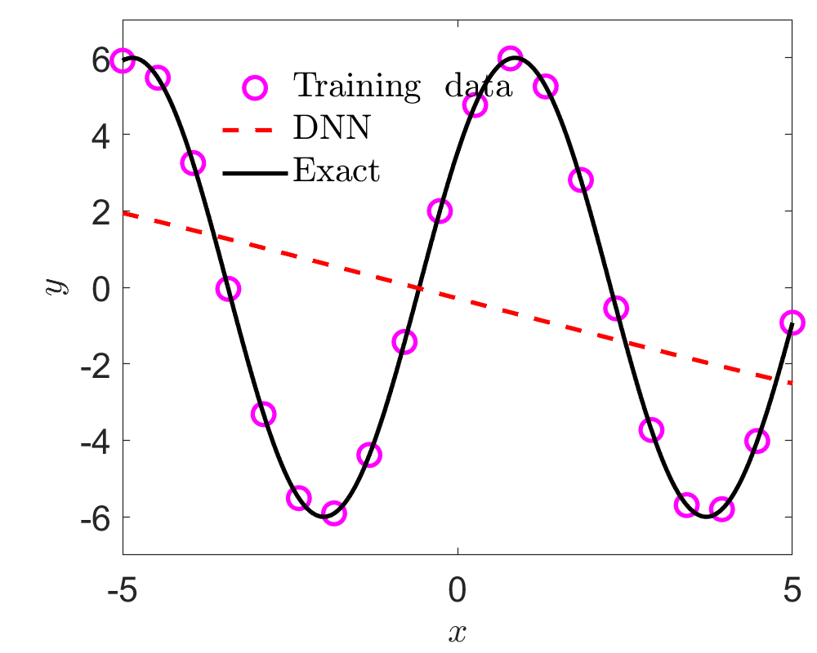
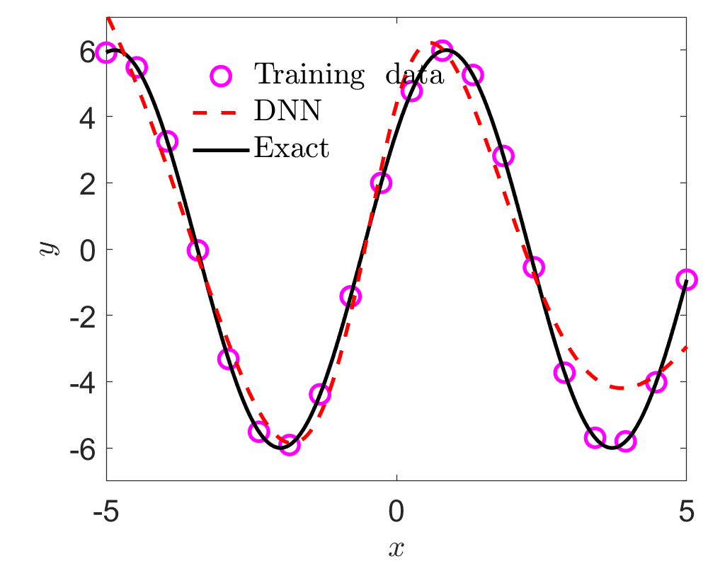

MAML for Function Approximation:
$$y=6sin\left(1.1x+0.2π\right)$$
Epoch = 10
Epoch = 100
MAML
DNN

Slide 12
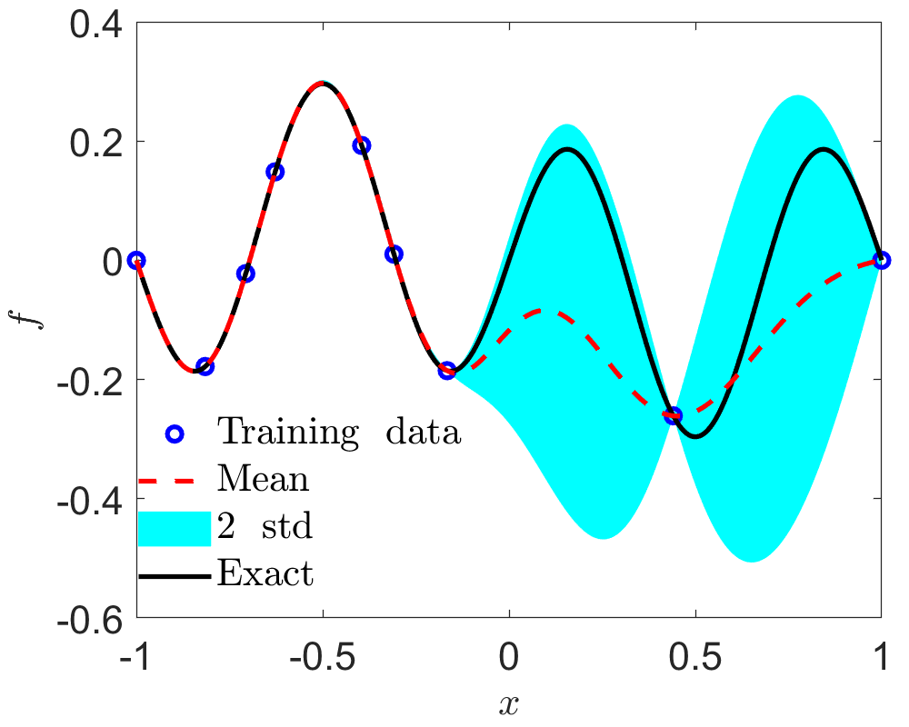

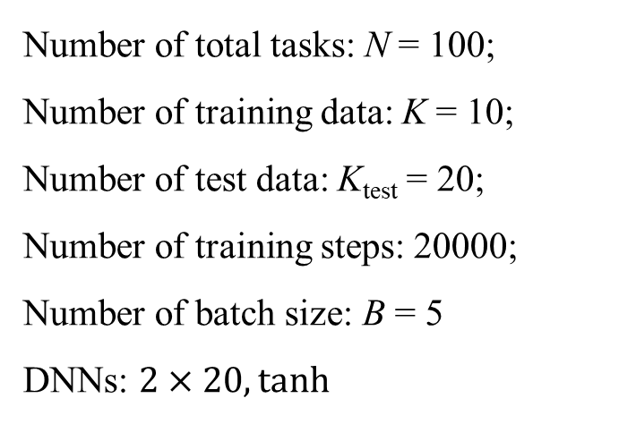
MAML for PDEs: Forward problem
$${D∂}_{x}^{2}u=f, x∈[−1, 1]$$
$$D=0.01, u=\sin^{3}{(πx)}$$
Gaussian Process Regression
Number of total tasks: N = 100;
Number of training data: K = 10;
Number of test data: K_{test} = 20;
Number of training steps: 20000;
Number of batch size: B = 5
DNNs: $2×20, tanh$

Slide 13
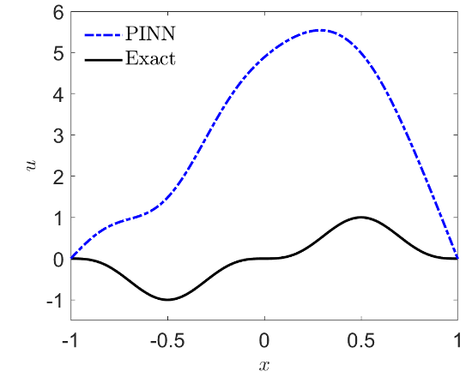
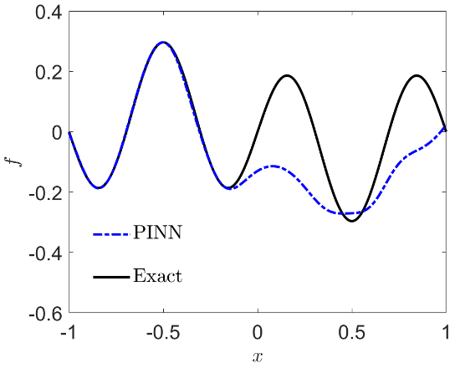
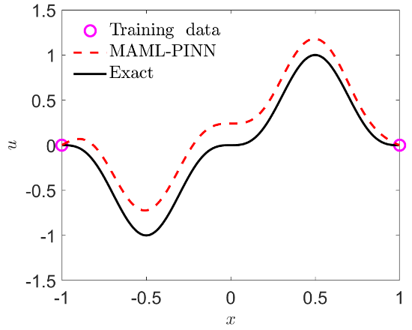
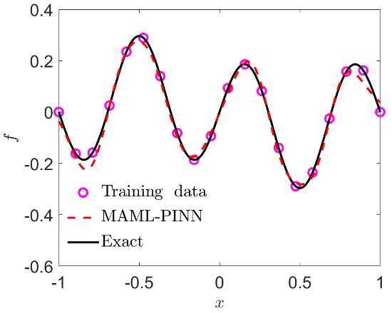
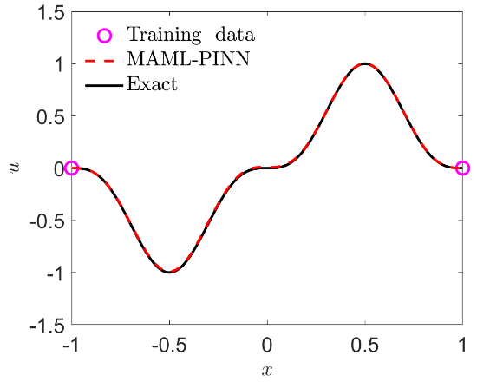
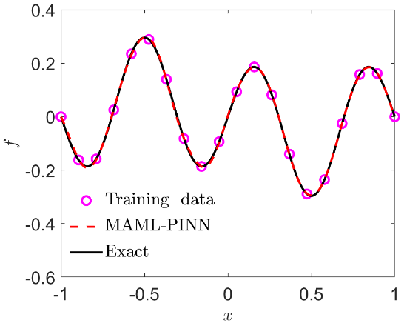
MAML for PDEs: Forward problem--MAML
Epoch = 0
Epoch = 100
Loss~O(10⁻⁴)
Epoch = 560
Loss~O(10⁻⁶)

Slide 14
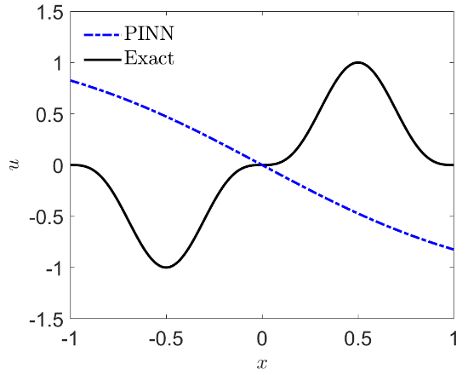
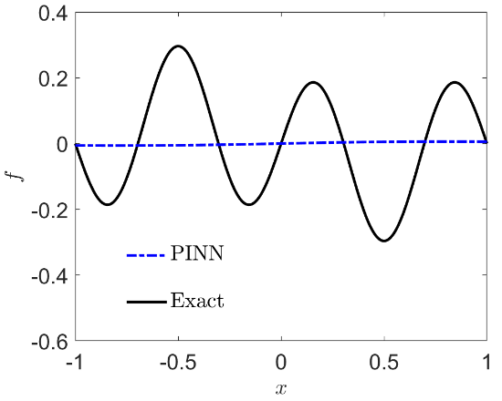
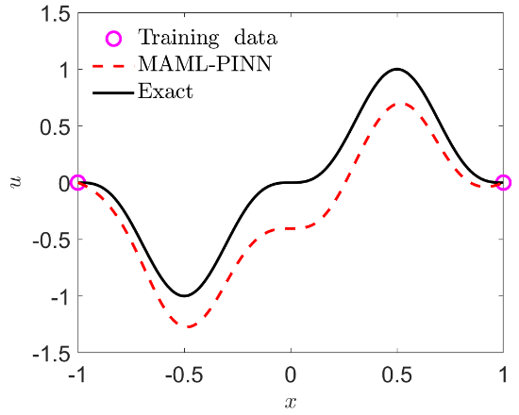
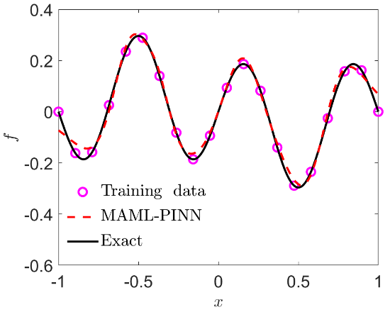
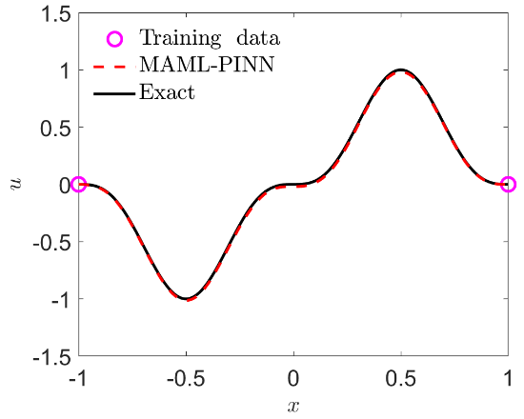
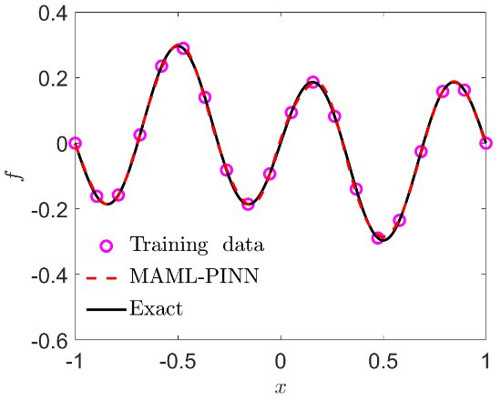
MAML for PDEs: Forward problem--PINNs
Epoch = 0
Epoch = 560
Loss~O(10⁻⁴)
Epoch = 2000
Loss~O(10⁻⁵)

Slide 15
Contents
Transfer learning
Meta learning
In-context learning
…

Slide 16
In-context learning
The ability to learn at inference time is called in-context learning.
When we use a GPT model, we can observe strange behavior. If we type a prompt and the model cannot produce a useful result, we can often improve the outcome by prepending our prompt with one or several examples. When we do it, the model can deal with a task it couldn’t handle without those examples. In short, GPT learned from the examples provided in the context of our prompt. Hence, the name: in-context learning.
Of course, whatever the model learns is available only during the single inference action. Models don’t memorize those examples forever.
https://www.mikulskibartosz.name/in-context-learning-prompt-engineering/

Slide 17
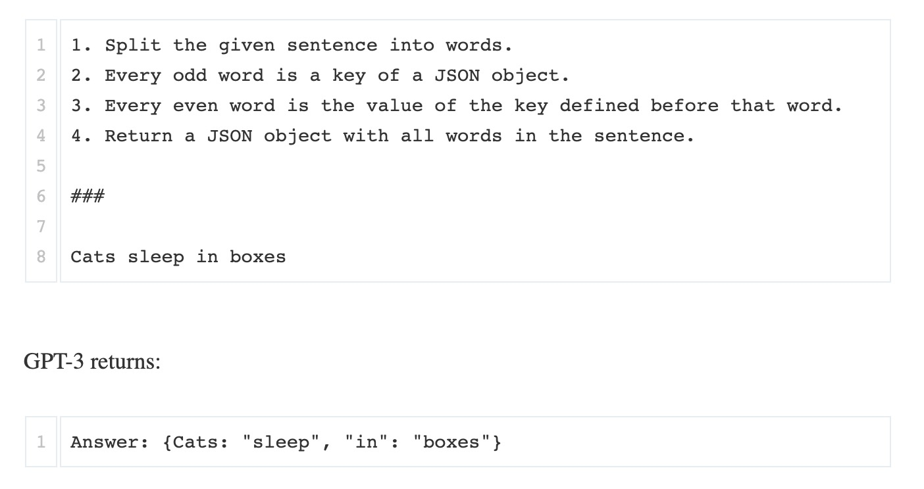
In-context learning
https://www.mikulskibartosz.name/in-context-learning-prompt-engineering/

Slide 18
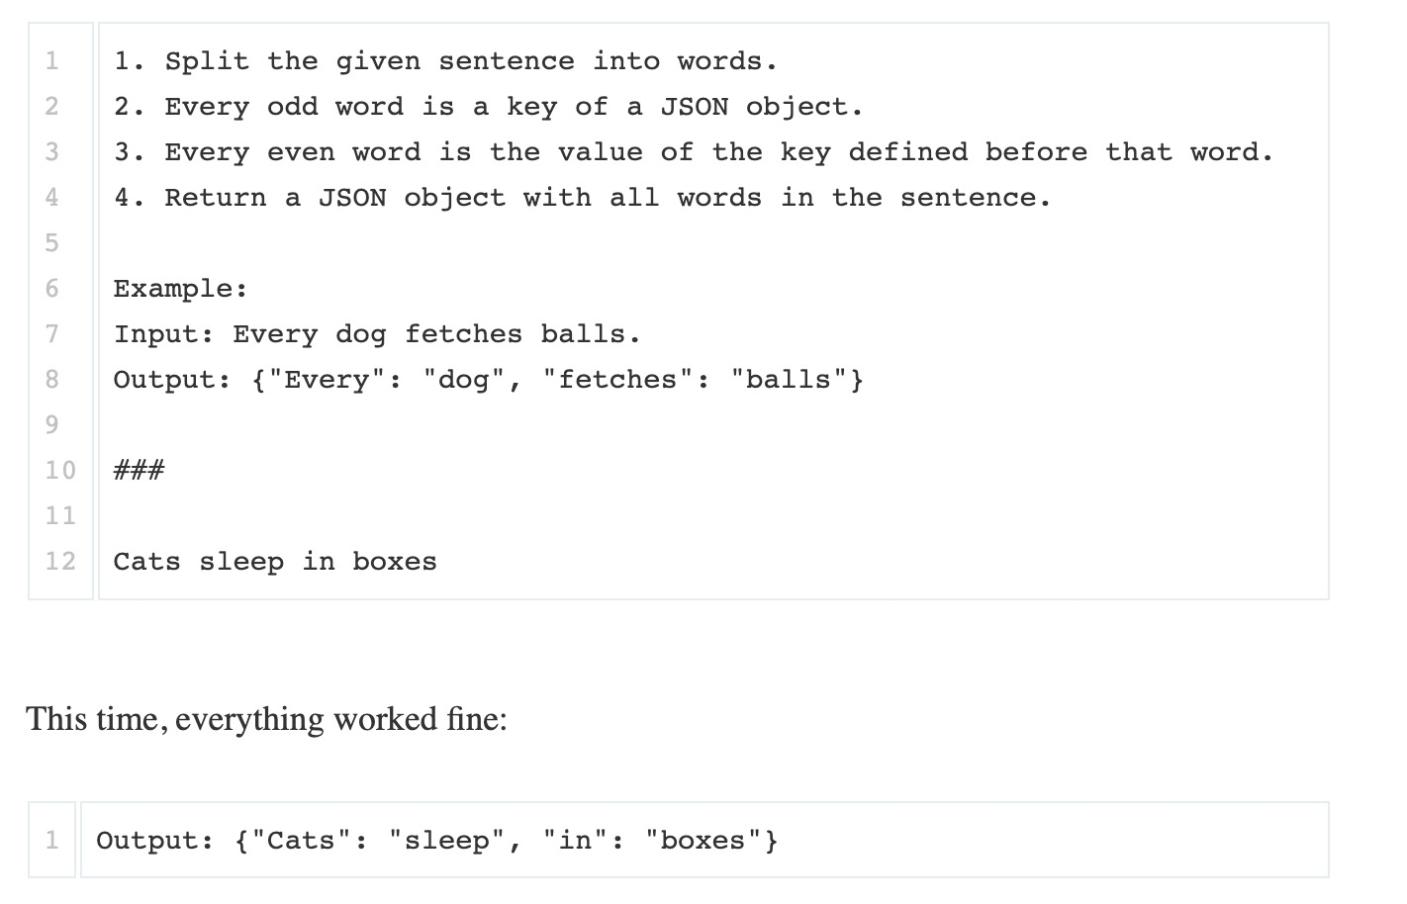
In-context learning: One-shot learning

Slide 19
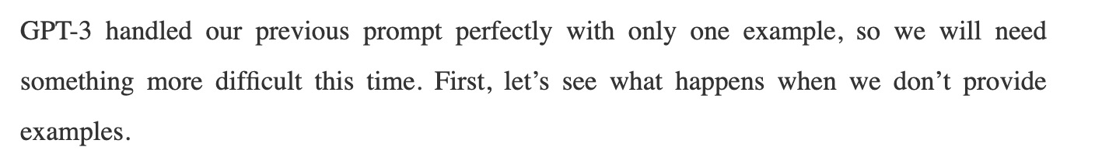
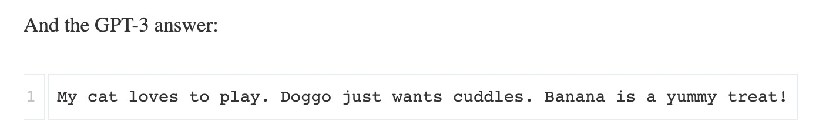
In-context learning
Every line contains a number and one word.
Write a sentence containing the word. The sentence length (in words) should be equal to the given number.
###
cat 4
dog 3
banana 4

Slide 20
In-context learning
Every line contains a number and one word.
Write a sentence containing the word. The sentence length (in words) should be equal to the given number.
###
cat 4
dog 3
banana 4

Slide 21
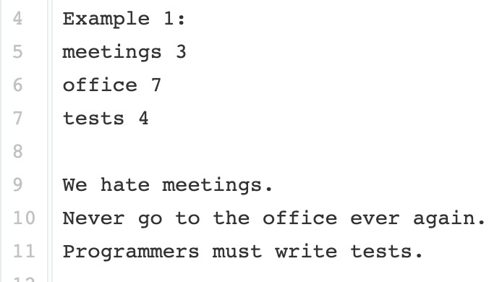
In-context learning: Few-shot learning
Every line contains a number and one word.
Write a sentence containing the word. The sentence length (in words) should be equal to the given number.

Slide 22
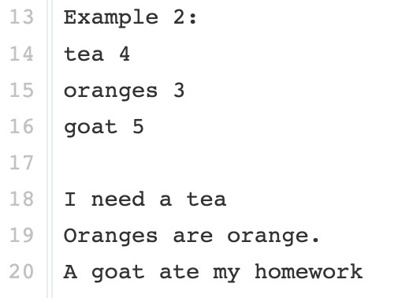
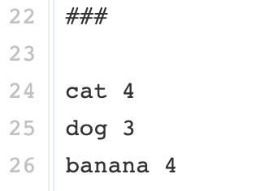
In-context learning: Few-shot learning

Slide 23
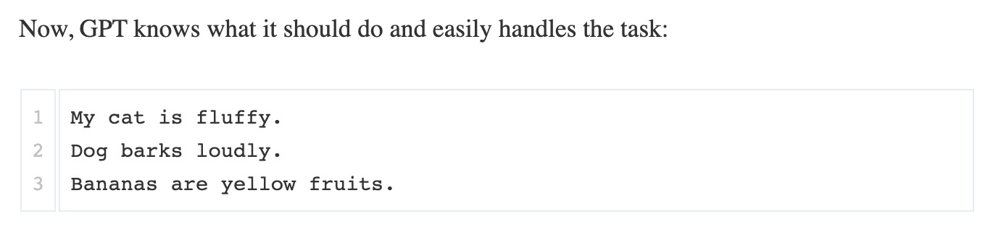
In-context learning: Few-shot learning

Slide 24
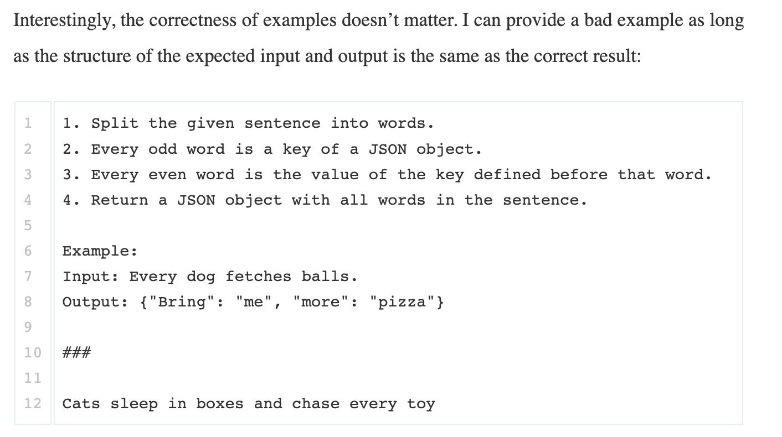
Do you need to provide correct examples?

Slide 25
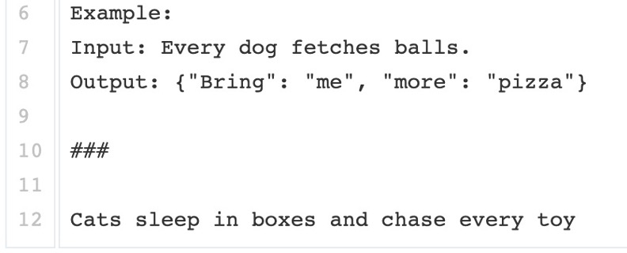
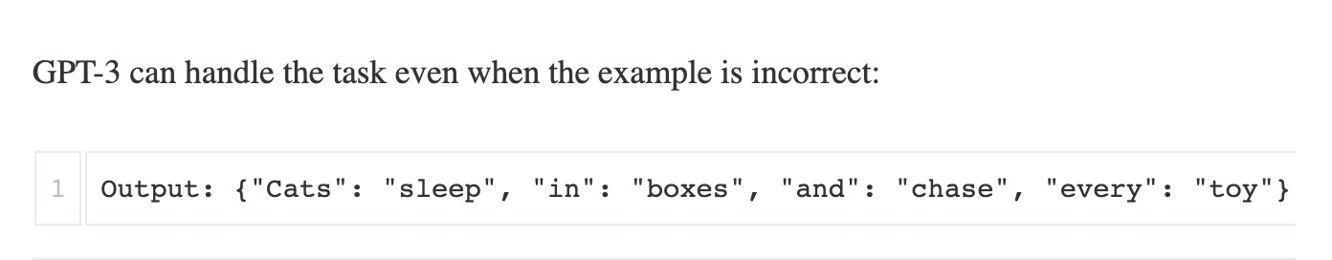
Do you need to provide correct examples?

Slide 26
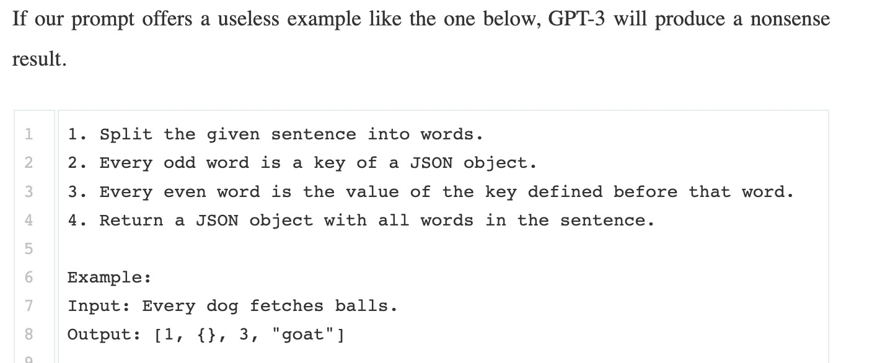
Do you need to provide correct examples?

Slide 27
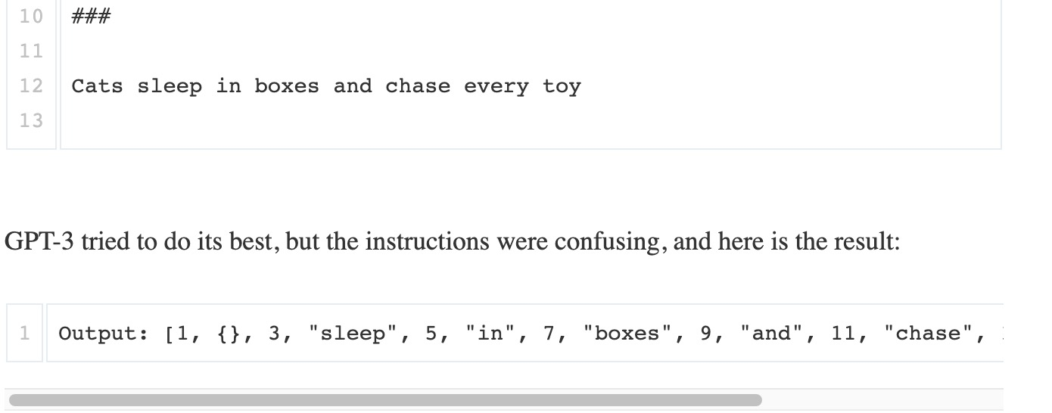
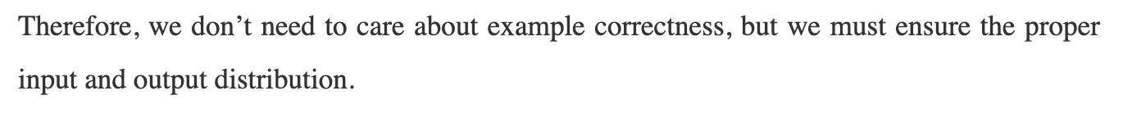
Do you need to provide correct examples?

Slide 28

Thank you for your attention!

