Slide 1


Scientific Machine Learning
Lecture 12: Machine learning for multi-scale problems
孟旭辉
数学与统计学院数学与应用学科交叉创新研究院
办公室：欣苑2栋111室
Email：xuhui_meng@hust.edu.cn
https://github.com/XuhuiM/SciML-Course
5/8/2023

Slide 2


Data-driven discovery of governing equations for
fluid dynamics based on molecular simulation
J. Fluid Mech. (2020), vol. 892, A5
Jun Zhang, Wenjun Ma
School of Aeronautic Science and Engineering,
Beihang University, China
Presented by Xuhui Meng
Crunch Group

Slide 3
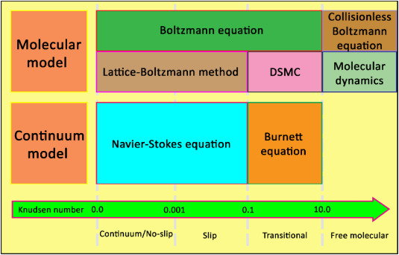
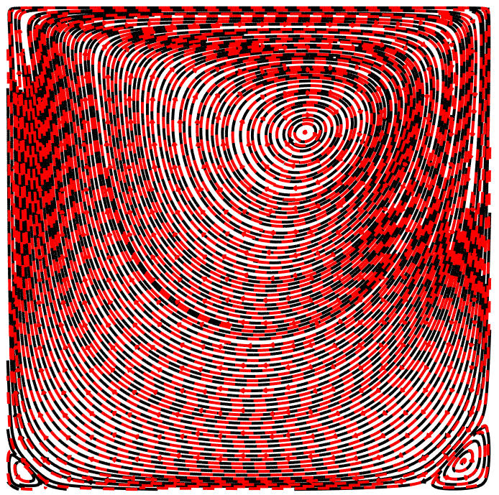


Background (1/2): Gas flow regimes
$$λ$$
$$Kn=\frac{λ}{H}$$
H
Re = 100
Red: LBM Black: Nektar
L2 error: u: 0.12% v: 0.16%

Slide 4

Background (2/2): Upscaling vs Downscaling
Microscopic
Macroscopic
upscaling
downscaling
$$ρ, u$$
Crunch Group

Slide 5
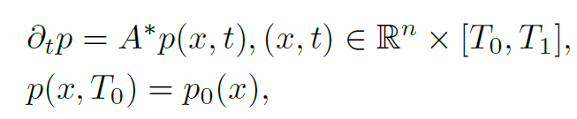
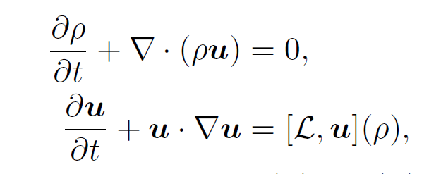
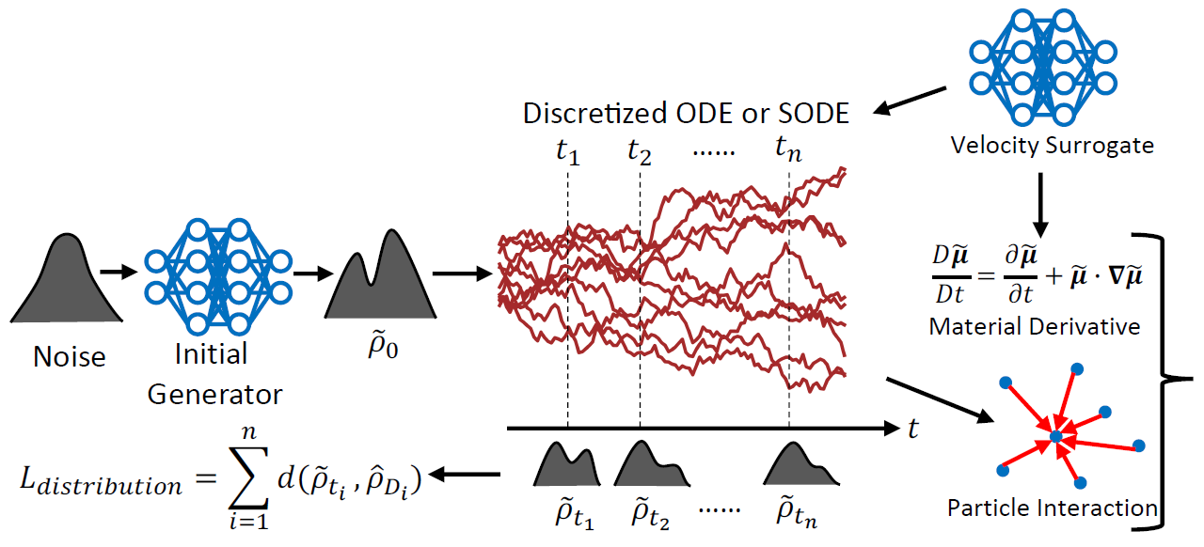
Background (2/2): Upscaling vs Downscaling: PINNs
Microscopic
Macroscopic
upscaling
Chen, et al, SISC. (2021)
downscaling
Liu Yang, et al, arxiv. (2021)

Slide 6
Motivation
Direct Simulation Monte Carlo (DSMC)
Boltzmann equation
upscaling
(Generalized) NS equations
Bird, et al, POF. (1963)
White, et al, CPC, (2017)

Slide 7
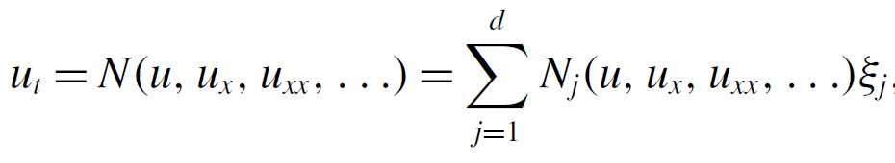
Methodology
Finite Difference
Crunch Group

Slide 8
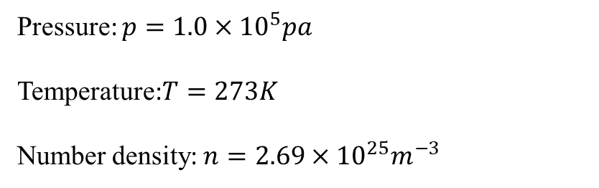
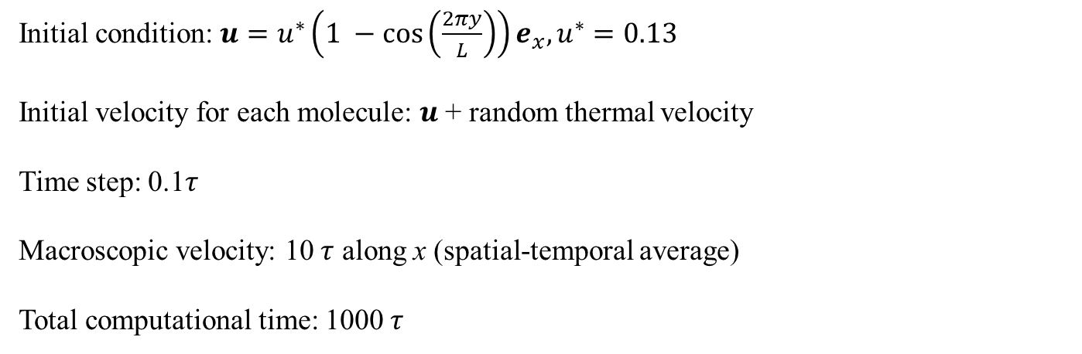
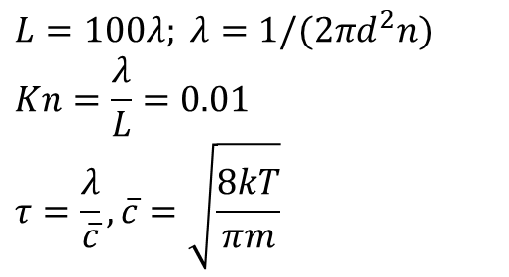
Results (1/3): Shear flow (Argon gas)
Pressure: $p=1.0×{10}^{5}pa$
Temperature:$T=273K$
Number density: $n=2.69×{10}^{25}m^{−3}$
$$L=100λ; λ=1/(2πd^{2}n)$$
$$Kn=\frac{λ}{L}=0.01$$
$$τ=\frac{λ}{\overline{c}}, \overline{c}=\sqrt{\frac{8kT}{πm}}$$
L
Grid: $256×256$; 4000 molecules in each cell
Initial condition: $u=u^{∗}\left(1 −\cos\left(\frac{2πy}{L}\right)\right)e_{x}, u^{∗}=0.13$
Initial velocity for each molecule: $u$ + random thermal velocity
Time step: 0.1$τ$
Macroscopic velocity: 10 $τ$ along x (spatial-temporal average)
Total computational time: 1000 $τ$
Crunch Group

Slide 9
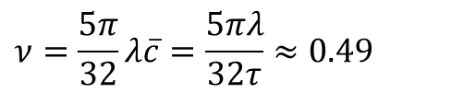

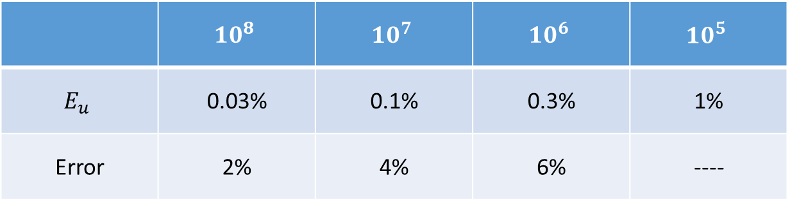


Results (1/3): Shear flow (Argon gas)
$$\frac{∂u}{∂t}=ν\frac{∂^{2}u}{∂^{2}y}$$
$$ν=\frac{5π}{32}λ\overline{c}=\frac{5πλ}{32τ}≈0.49$$
L
$$E_{u}≈\frac{1}{\sqrt{N}Ma}, Ma=\frac{u}{\overline{c}}≈0.3$$
$$N=4000×100×256$$
$$E_{u}≈0.03\%$$
$$\frac{∂u}{∂t}=(0.49±0.01)\frac{∂^{2}u}{∂^{2}y}$$
 | $$10^{8}$$ | $$10^{7}$$ | $$10^{6}$$ | $$10^{5}$$
$$E_{u}$$ | 0.03% | 0.1% | 0.3% | 1%
Error | 2% | 4% | 6% | ----

Slide 10
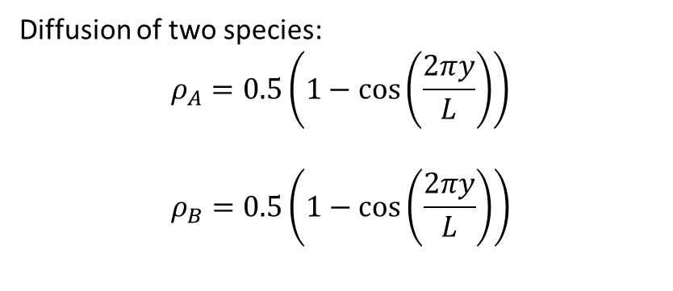
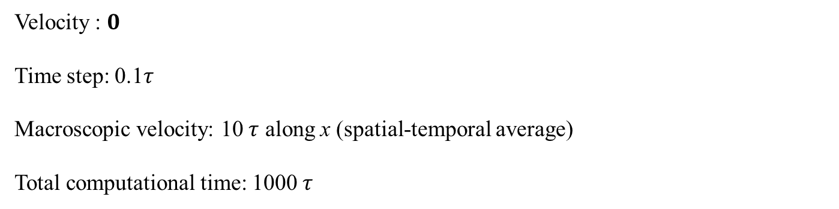
Results (2/3): Diffusion problem
Diffusion of two species:
$$ρ_{A}=0.5\left(1−\cos\left(\frac{2πy}{L}\right)\right)$$
$$ρ_{B}=0.5\left(1−\cos\left(\frac{2πy}{L}\right)\right)$$
L
Grid: $256×256$; 4000 molecules in each cell (representing $4×{10}^{6}$real molecules)
Velocity : $0$
Time step: 0.1$τ$
Macroscopic velocity: 10 $τ$ along x (spatial-temporal average)
Total computational time: 1000 $τ$
Crunch Group

Slide 11
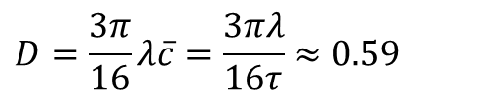


Results (2/3): Diffusion problem
$$\frac{∂ρ}{∂t}=D\frac{∂^{2}ρ}{∂^{2}y}$$
$$D=\frac{3π}{16}λ\overline{c}=\frac{3πλ}{16τ}≈0.59$$
L
$$\frac{∂ρ}{∂t}=(0.59±0.01)\frac{∂^{2}ρ}{∂^{2}y}$$
$$N=4000×100×256$$
Crunch Group

Slide 12

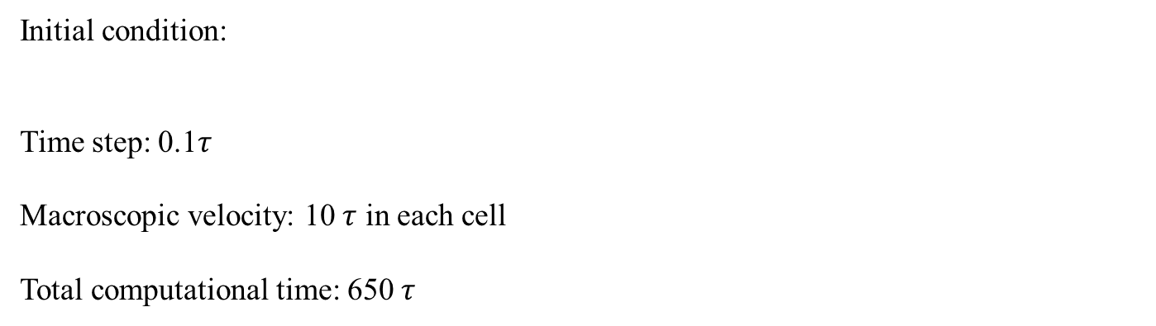

Results (3/3): Taylor-Green vortex
L
Grid: $64×64$; $4×{10}^{5}$ molecules in each cell
Initial condition:
Time step: 0.1$τ$
Macroscopic velocity: 10 $τ$ in each cell
Total computational time: 650 $τ$
$$L=200λ$$
Crunch Group

Slide 13
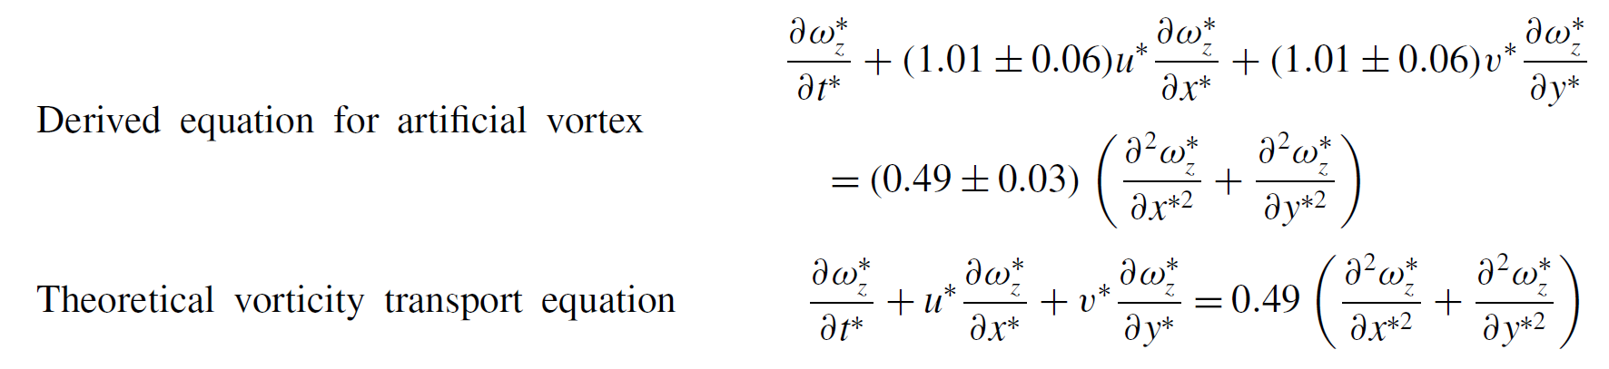


Results (3/3): Taylor-Green vortex
L
$$E_{u}≈0.05\%$$
$$u^{∗}=v^{∗}=1.01$$
Crunch Group

Slide 14
Summary
DSMC → Macroscopic governing equations (Continuum regime)
Physics-informed Neural Networks: Automatic Differentiation vs Finite Difference
Physics-informed Neural Networks: Arbitrary measurements vs X
Discover equations beyond Navier-Stokes equations – Kn > 0.1
……
Crunch Group

Slide 15
Solving Inverse Stochastic Problems from Discrete Particle Observations Using the Fokker--Planck Equation and Physics-Informed Neural
Networks
SISC, 43:B811-B830, 2021
Xiaoli Chen, et al

Slide 16


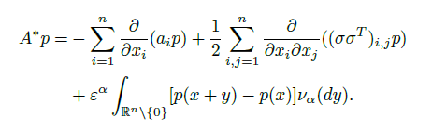
Background

Slide 17
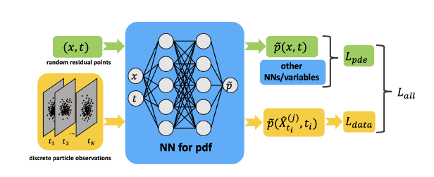
PINN for inverse FP equation problem

Slide 18
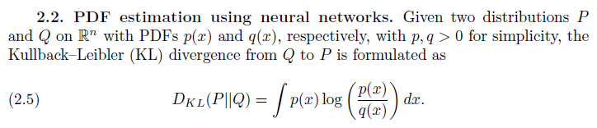
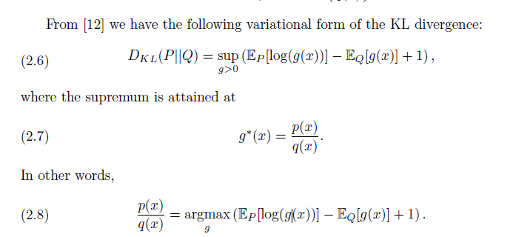
PINN for inverse FP equation problem

Slide 19
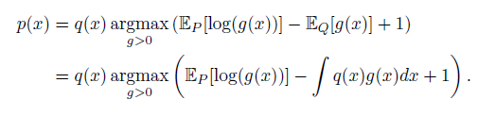
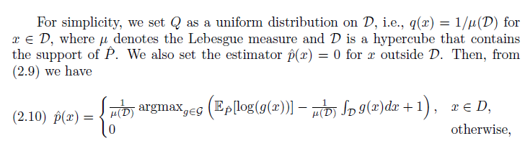
PINN for inverse FP equation problem

Slide 20

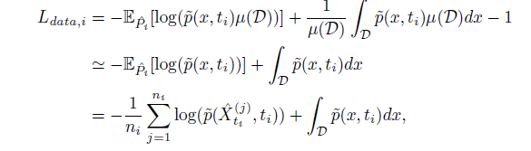
PINN for inverse FP equation problem

Slide 21
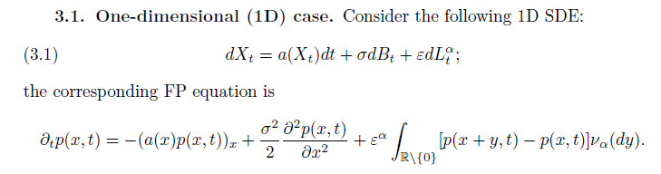
PINN for inverse FP equation problem：1D case

Slide 22
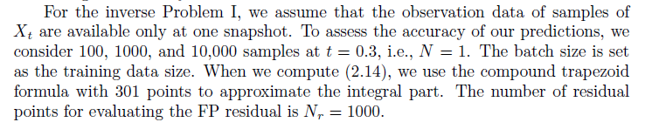
PINN for inverse FP problem：1D Brownian noise
$$a=x−x^{3};σ=1;ε=0$$

Slide 23
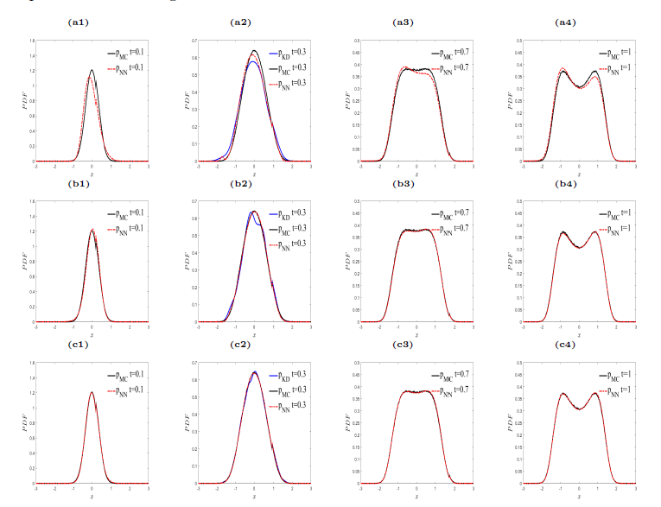
PINN for inverse FP problem：1D Brownian noise

Slide 24
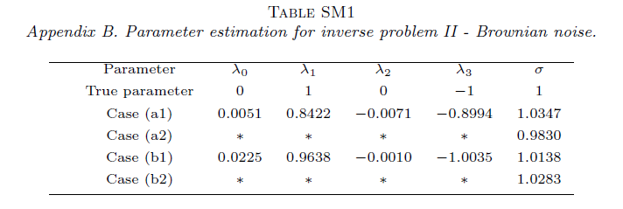
PINN for inverse FP problem：1D Brownian noise
$$a=x−x^{3};σ=1;ε=0$$

Slide 25
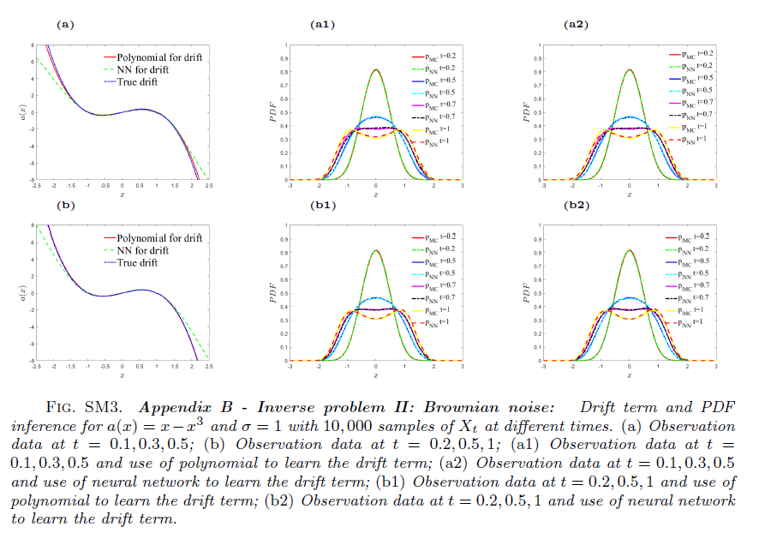
PINN for inverse FP problem：1D Brownian noise

Slide 26

PINN for inverse FP problem：1D Brownian+Levy noise
$$a=x−x^{3};α=1.5; σ=1;ε=1$$

Slide 27
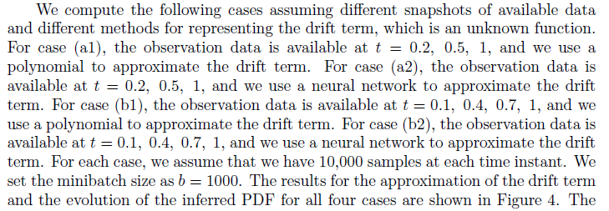
PINN for inverse FP problem：1D Brownian+Levy noise

Slide 28
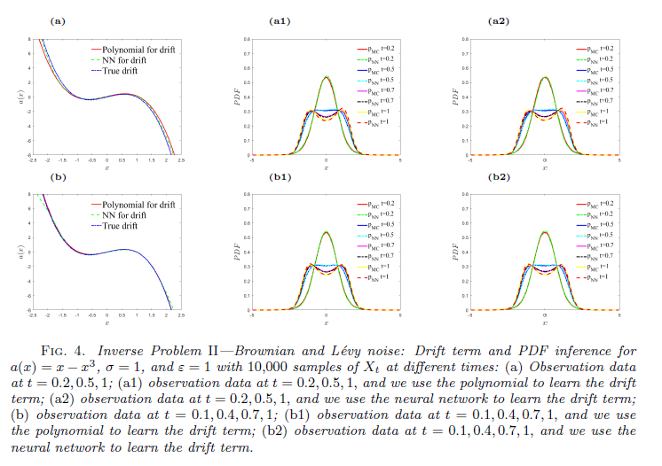
PINN for inverse FP problem：1D Brownian+Levy noise

Slide 29
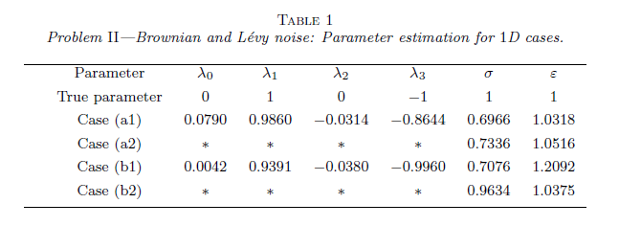
PINN for inverse FP problem：1D Brownian+Levy noise

Slide 30
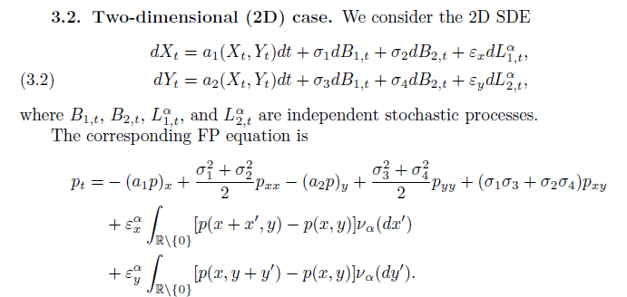
PINN for inverse FP problem：2D case

Slide 31
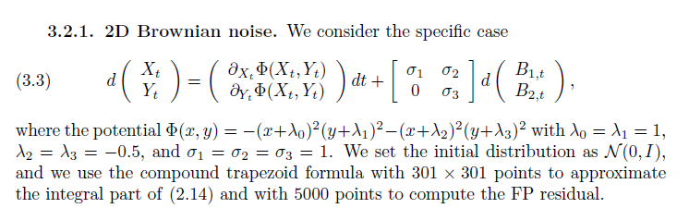
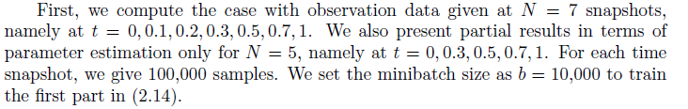
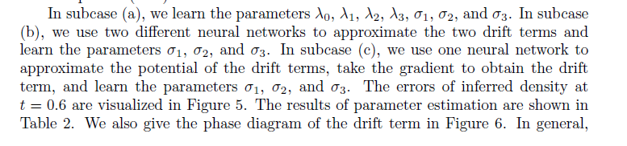
PINN for inverse FP problem：2D Brownian case

Slide 32
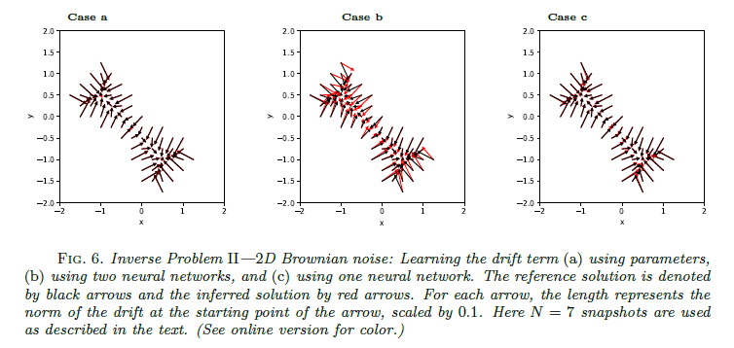
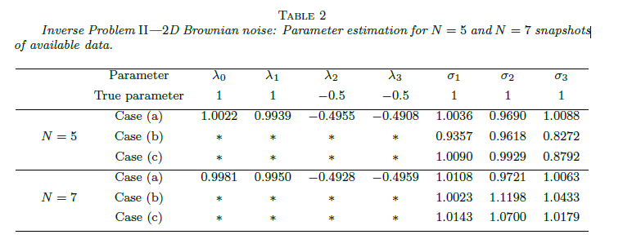
PINN for inverse FP problem：2D Brownian case

Slide 33
Background: Upscaling vs Downscaling: PINNs
Microscopic
Macroscopic
upscaling
Chen, et al, SISC. (2021)
downscaling
Liu Yang, et al, arxiv. (2021)

Slide 34
From Macroscopic to Microscopic
downscaling
Liu Yang, et al, arxiv. (2021)

Slide 35
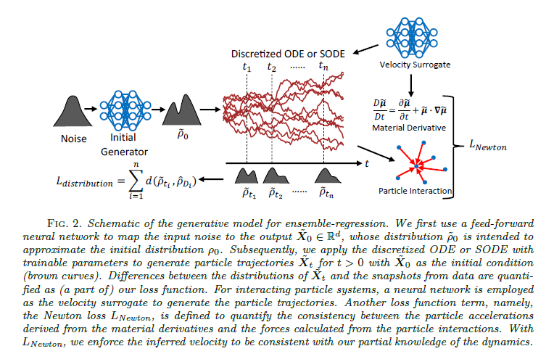
From Macroscopic to Microscopic
Liu Yang, et al, arxiv. (2021)

Slide 36
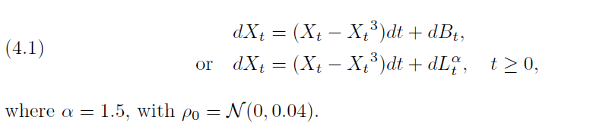
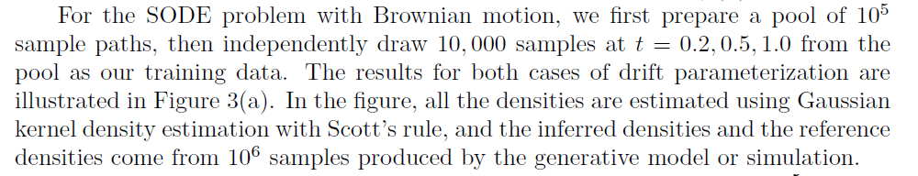
Example: 1D case
Liu Yang, et al, arxiv. (2021)

Slide 37
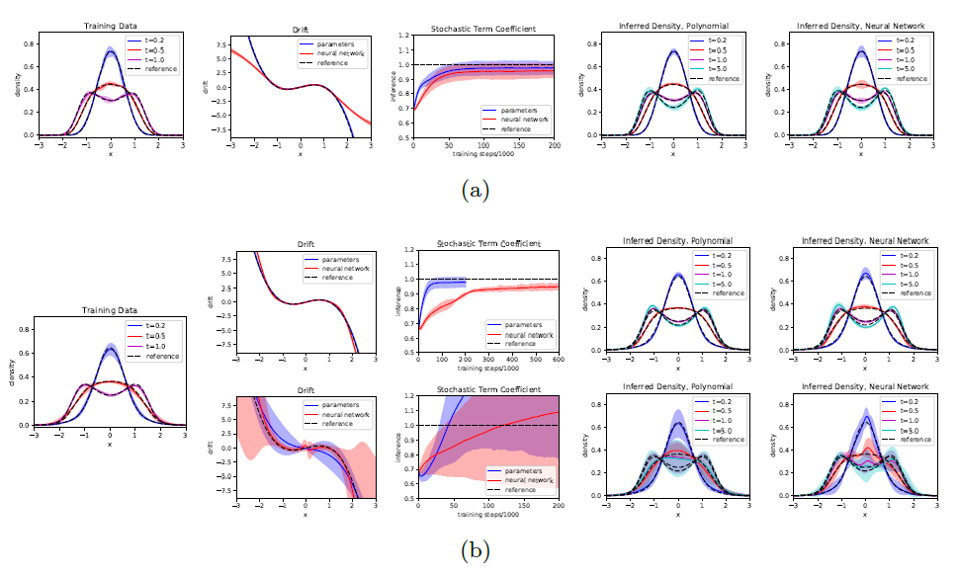
Example: 1D case
Liu Yang, et al, arxiv. (2021)

Slide 38

Thank you for your attention!

