Slide 1
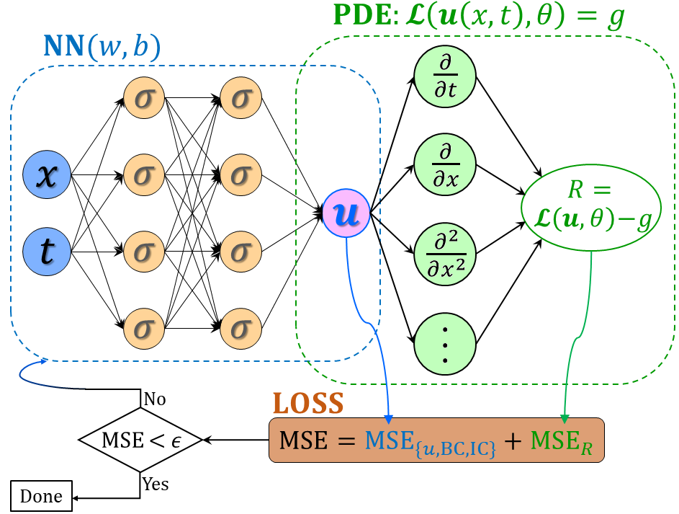

PINNs for forward/inverse O/PDE problems
$$ℒ\left(u\left(x,t\right),θ\right)$$
$$θ=θ_{NN}∪λ$$
$$L={\left|R\right|}^{2}+{\left|u_{bc}−u_{bc}^{∗}\right|}^{2}+{\left|u_{ic}−u_{ic}^{∗}\right|}^{2}$$
Forward:
Inverse:
$$L={\left|R\right|}^{2}+{\left|u_{bc}−u_{bc}^{∗}\right|}^{2}+{\left|u_{ic}−u_{ic}^{∗}\right|}^{2}+{\left|u−u^{∗}\right|}^{2}$$

Slide 2
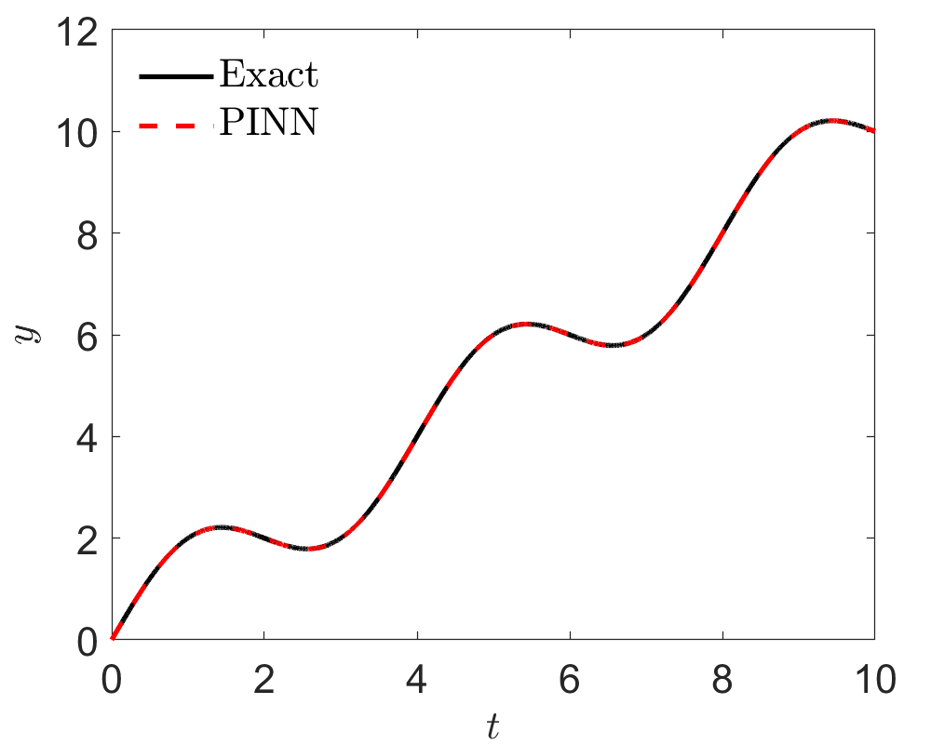

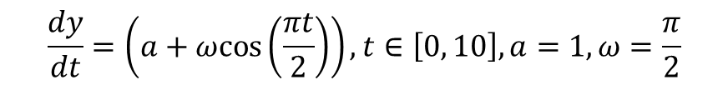

Forward Problem
$$\frac{dy}{dt}=\left(a+ωcos\left(\frac{πt}{2}\right)\right), t∈\left[0, 10\right], a=1,ω=\frac{π}{2}$$
Solution:
$$y=t+sin(πt/2)$$
$$L={\left|R\right|}^{2}+{\left|y_{ic}−y_{ic}^{∗}\right|}^{2}$$
Loss:

Slide 3
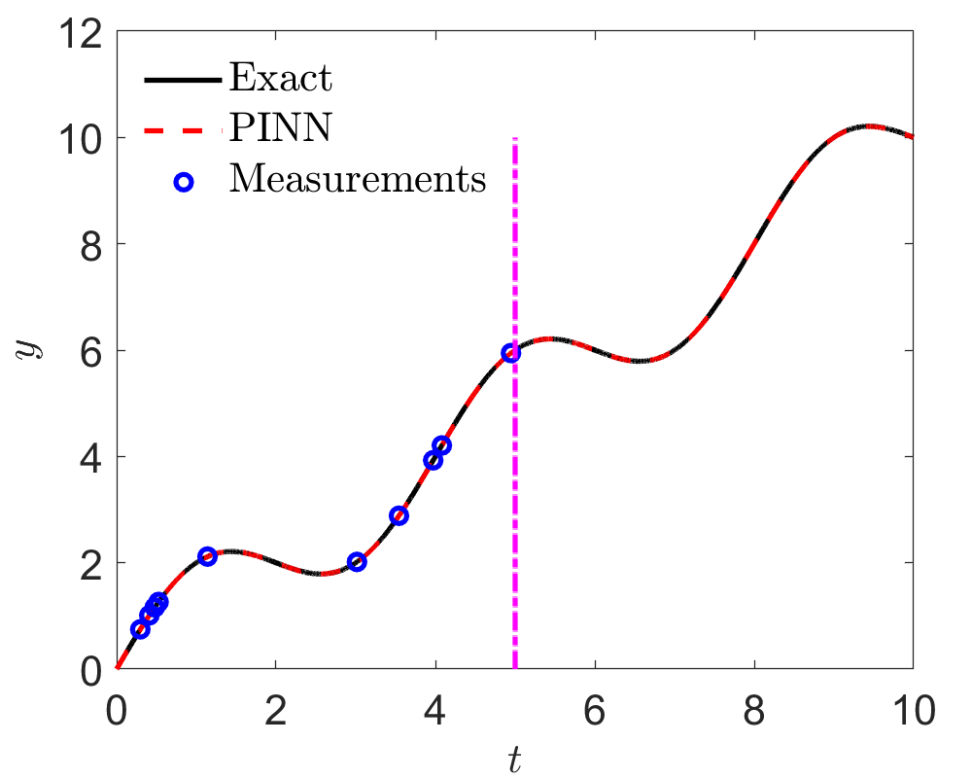

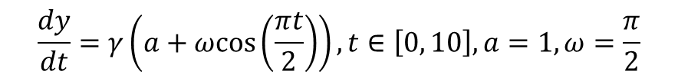

Inverse Problem
$$\frac{dy}{dt}=γ\left(a+ωcos\left(\frac{πt}{2}\right)\right), t∈\left[0, 10\right], a=1,ω=\frac{π}{2}$$
Inverse: $γ$ unknown, partial observations on y at $t∈[0,5]$
Solution:
$$y=t+sin(πt/2)$$
$$L={\left|R\right|}^{2}+{\left|y_{ic}−y_{ic}^{∗}\right|}^{2}+{\left|y−y^{∗}\right|}^{2}$$
Loss:

