Slide 1


Scientific Machine Learning
Lecture 17: Transformers Learn In-Context by Gradient Descent
孟旭辉
数学与统计学院数学与应用学科交叉创新研究院
办公室：欣苑2栋111室
Email：xuhui_meng@hust.edu.cn
https://github.com/XuhuiM/SciML-Course
6/5/2023

Slide 2
Contents
Brief review on Transformer and meta-learning
Transformers learn in-context by gradient descent
…
…

Slide 3
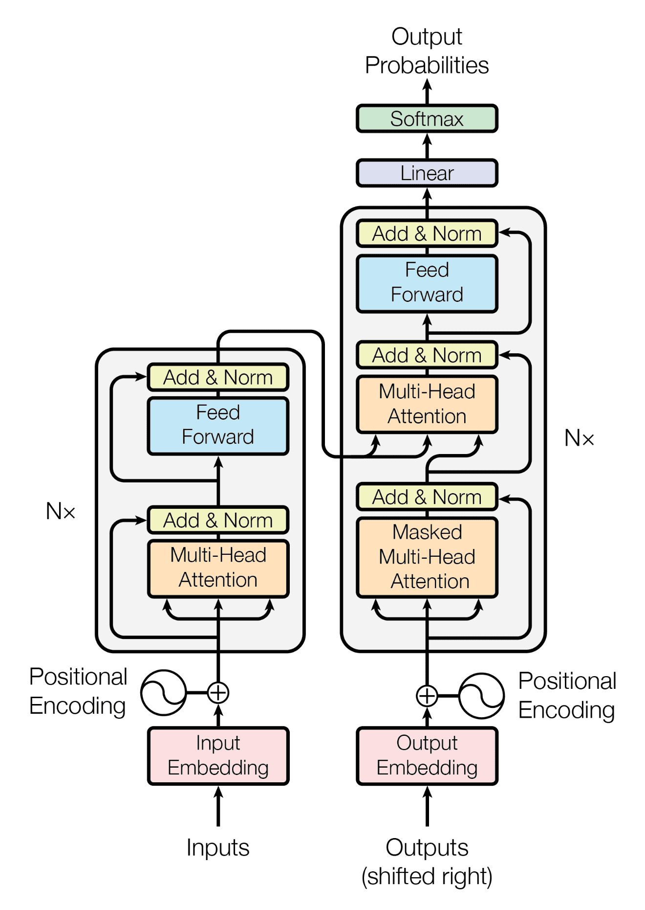
Transformer
Vaswani et al. Neurips, 2017

Slide 4
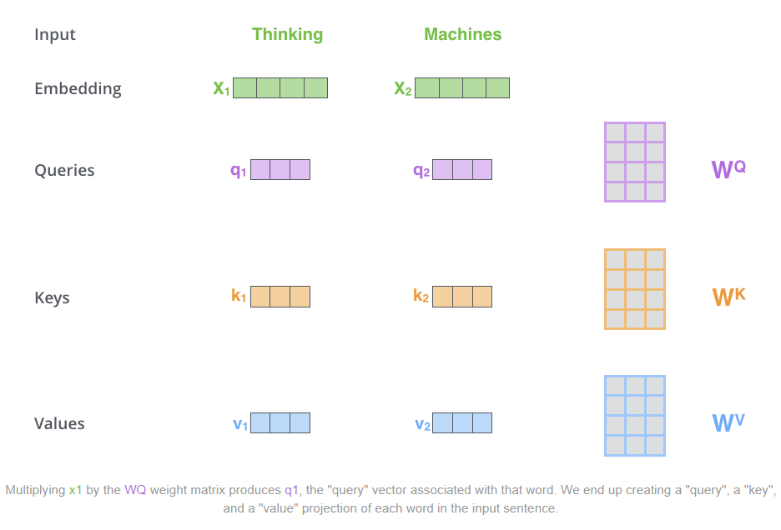
Transformer: Self-attention
Blog of Alammar

Slide 5
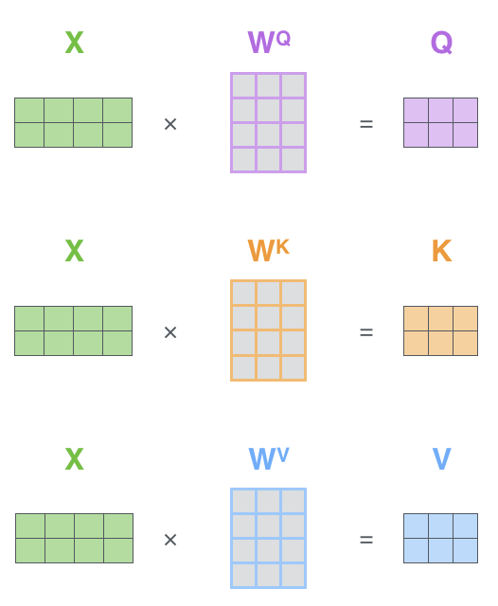
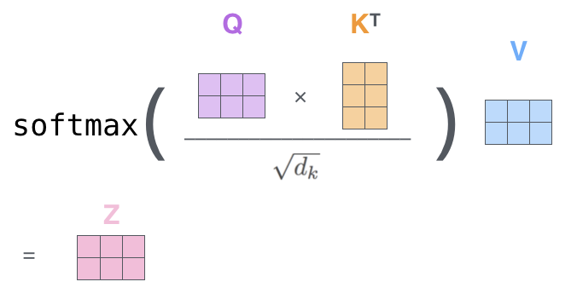
Transformer: Details for self-attention
Blog of Alammar

Slide 6
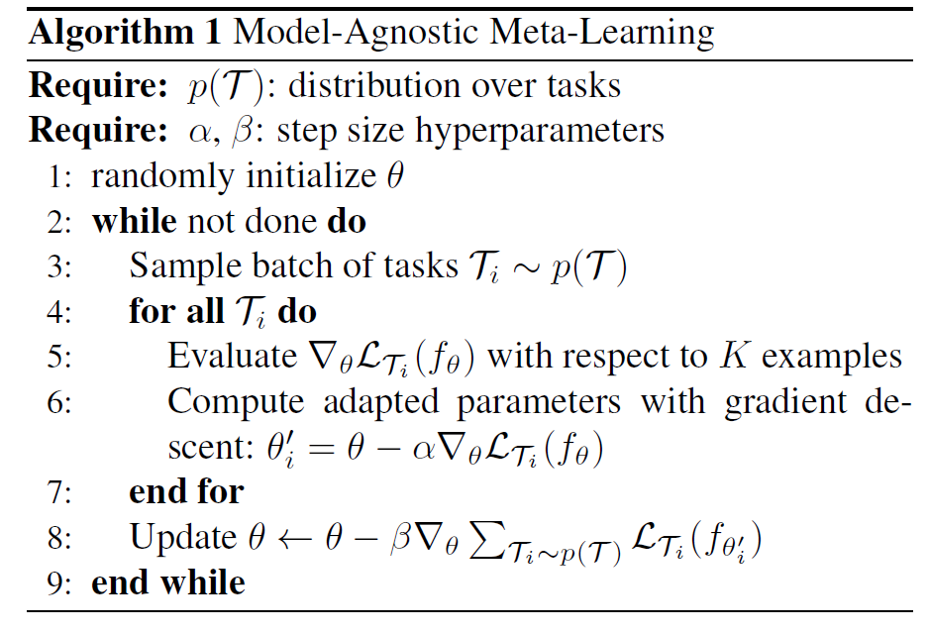
MAML
Training data
B
Test data
meta learner
Finn et al. MAML, 2017

Slide 7
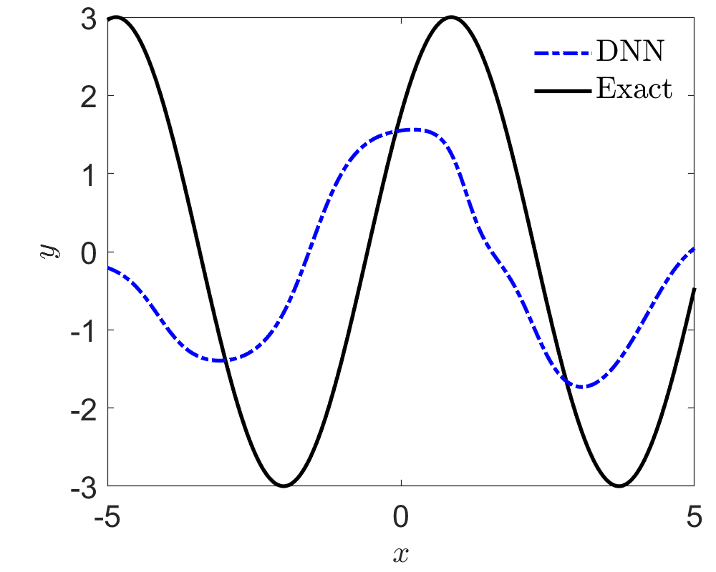
MAML for Function Approximation: few-shot learning
$$y=Asin\left(ωx+b\right), x∈[−5, 5]$$
$$A∈\left[0.1, 5\right], ω∈\left[0.8, 1.2\right], b∈[0, π]$$
Number of total tasks: N = 1000; Number of training data: K = 5;
Number of test data: K_{test} = 10; Number of training steps: 60000;
Number of batch size: B = 1; DNNs: $2×40, tanh$
Finn et al. MAML, 2017

Slide 8
Contents
Brief review on Transformer and meta-learning
Transformers learn in-context by gradient descent
…
…

Slide 9
Meta-learning vs Transformers
Oswald, et. al., arxiv, 2023

Slide 10
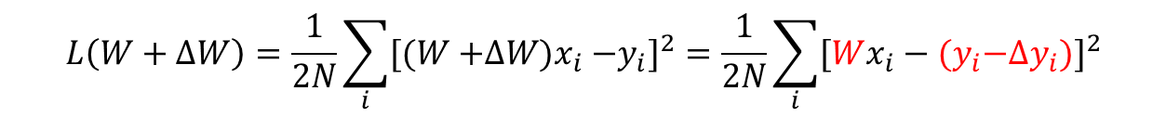




Meta-learning: Linear regression
$$D={\left\{x_{i},y_{i}\right\}}_{i=1}^{N}$$
$$y=Wx, W∈R^{{ N}_{y}×N_{x}}$$
$$L\left(W\right)=\frac{1}{2N}\sum_{i}{{\left(Wx_{i}−y_{i}\right)}^{2}}$$
One-step gradient descent with a learning rate $η$
$$ΔW=−η ∇_{W}L\left(W\right)=−\frac{η}{N}\sum_{i}{\left(Wx_{i}−y_{i}\right)x_{i}^{T}}$$
$$L\left(W+ΔW\right)=\frac{1}{2N}\sum_{i}{{[(W{+ΔW)x}_{i}−y_{i}]}^{2}}=\frac{1}{2N}\sum_{i}{{[Wx_{i}−{(y}_{i}−Δy_{i})]}^{2}}$$
$$Δy_{i}=ΔWx_{i}$$
Oswald, et. al., arxiv, 2023

Slide 11
Transformers: Linear attention
$$\left\{e_{1},e_{2},…,e_{N}\right\},e_{j}$$
Input tokens
Omit softmax operation
Only keep linear part in encoder
$$e_{j}←e_{j}+∑P_{h}V_{h}K_{h}^{T}q_{h,j}$$
Oswald, et. al., arxiv, 2023

Slide 12
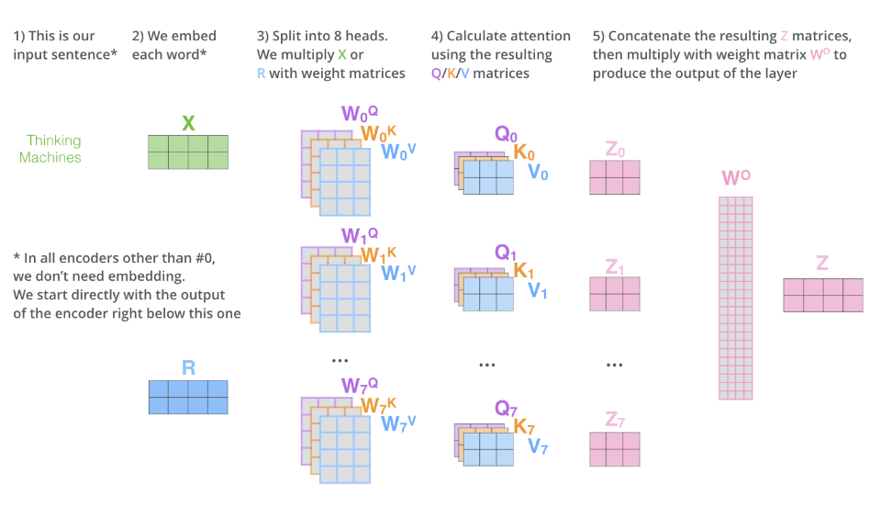
Transformer: Multi-headed attention
Blog of Alammar

Slide 13
Transformers: Linear attention-in-context learning
$$\left\{e_{1},e_{2},…,e_{N}\right\}+e_{N+1}$$
Input tokens
$$e_{1}=\left(x_{1},y_{1}\right), …, e_{j}=\left(x_{j},y_{j}\right), e_{N+1}=(x_{test},0)$$
$$e_{j}←e_{j}+∑P_{h}V_{h}K_{h}^{T}q_{h,j}$$
Oswald, et. al., arxiv, 2023

Slide 14
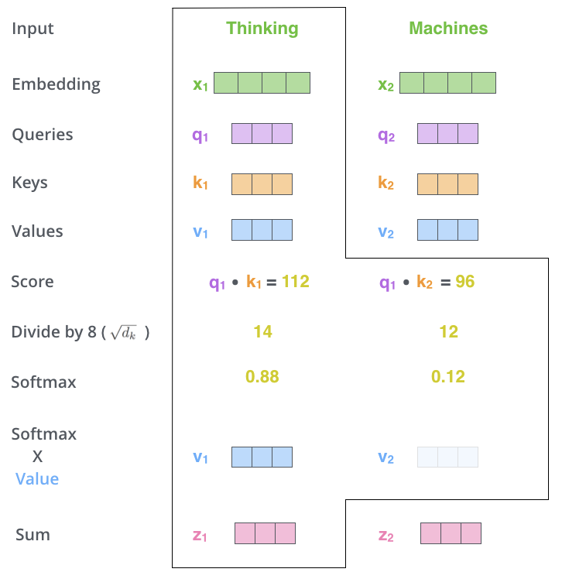
Transformer: Self-attention
Blog of Alammar

Slide 15
Transformers: Linear attention-in-context learning
$$\left\{e_{1},e_{2},…,e_{N}\right\}+e_{N+1}$$
Input tokens
$$e_{1}=\left(x_{1},y_{1}\right), …, e_{j}=\left(x_{j},y_{j}\right), e_{N+1}=(x_{test},0)$$
$$e_{j}←e_{j}+∑P_{h}V_{h}K_{h}^{T}q_{h,j}$$
Oswald, et. al., arxiv, 2023

Slide 16
Gradient descent vs Transformer
$$\left\{e_{1},e_{2},…,e_{N}\right\}+e_{N+1}$$
Input tokens
$$e_{1}=\left(x_{1},y_{1}\right), …, e_{j}=\left(x_{j},y_{j}\right), e_{N+1}=(x_{test},0)$$
$$e_{j}←e_{j}+∑P_{h}V_{h}K_{h}^{T}q_{h,j}←\left(x_{j},y_{j}\right)+∑P_{h}V_{h}K_{h}^{T}q_{h,j}$$
$$\left(x_{j},y_{j}\right)←\left(x_{j},y_{j}\right)+(0,−ΔWx_{j})$$
Oswald, et. al., arxiv, 2023

Slide 17
Gradient descent vs Transformer
Oswald, et. al., arxiv, 2023

Slide 18
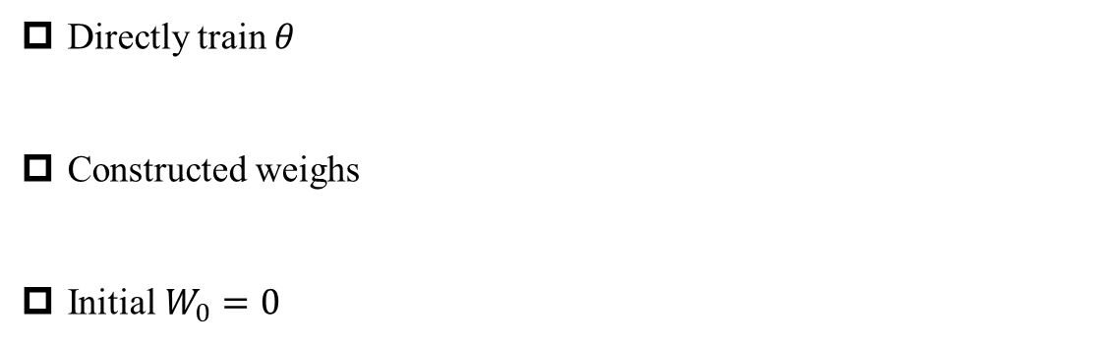
Test Case: Linear regression
$$y_{τ}=W_{τ}x_{τ,i}, x_{i}∈U{\left(−1, 1\right)}^{10},W_{τ}∈N(0,I)$$
$$\left\{e_{1},e_{2},…,e_{N}\right\}+e_{N+1}→y\left(\left\{e_{1},e_{2},…,e_{N}\right\},e_{N+1}\right),N=10$$
Directly train $θ$
Constructed weighs
Initial $W_{0}=0$
Oswald, et. al., arxiv, 2023

Slide 19
Test Case: Linear regression
Oswald, et. al., arxiv, 2023

Slide 20
Test Case: Linear regression
Oswald, et. al., arxiv, 2023

Slide 21
Test Case: Linear regression-----Multiple steps of GD
Oswald, et. al., arxiv, 2023

Slide 22
Test Case: Visualization of weights
Oswald, et. al., arxiv, 2023

Slide 23
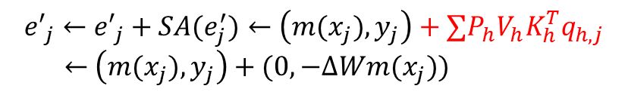






Transformers: Nonlinear regression
$$\left\{e_{1},e_{2},…,e_{N}\right\}+e_{N+1}$$
Input tokens
$$e_{j}$$
FNN
$$[m\left(x_{j}\right)=\tilde{m}\left(x_{j}\right)+x_{j},y_{j}]$$
$$e_{j}=(x_{j},y_{j})$$
$$\tilde{m}(x_{j})$$
$${e′}_{j}$$
SA
$${e′}_{j}=({m(x}_{j}),y_{j})$$
$${e′}_{j}←{e′}_{j}+SA(e_{j}^{′})←\left(m(x_{j}),y_{j}\right)+∑P_{h}V_{h}K_{h}^{T}q_{h,j}$$
$←$ $\left(m(x_{j}),y_{j}\right)+(0,−ΔWm(x_{j}))$
Oswald, et. al., arxiv, 2023

Slide 24



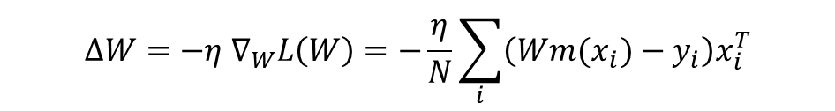
Meta-learning: Nonlinear regression
$$L\left(W\right)=\frac{1}{2N}\sum_{i}{{\left(W{m(x}_{i})−y_{i}\right)}^{2}}$$
One-step gradient descent with a learning rate $η$
$$ΔW=−η ∇_{W}L\left(W\right)=−\frac{η}{N}\sum_{i}{\left(W{m(x}_{i})−y_{i}\right)x_{i}^{T}}$$
$$L\left(W+ΔW\right)=\frac{1}{2N}\sum_{i}{{[(W{+ΔW)m(x}_{i})−y_{i}]}^{2}}=\frac{1}{2N}\sum_{i}{{[W{m(x}_{i})−{(y}_{i}−Δy_{i})]}^{2}}$$
$$Δy_{i}=−ΔWm(x_{i})$$
Oswald, et. al., arxiv, 2023

Slide 25



Meta-learning vs Transformers
$$L\left(W+ΔW\right)=\frac{1}{2N}\sum_{i}{{[(W{+ΔW)m(x}_{i})−y_{i}]}^{2}}=\frac{1}{2N}\sum_{i}{{[W{m(x}_{i})−{(y}_{i}−Δy_{i})]}^{2}}$$
$$Δy_{i}=−ΔWm(x_{i})$$
$${e′}_{j}←{e′}_{j}+SA(e_{j}^{′})←\left(m(x_{j}),y_{j}\right)+∑P_{h}V_{h}K_{h}^{T}q_{h,j}$$
$←$ $\left(m(x_{j}),y_{j}\right)+(0,−ΔWm(x_{j}))$
Oswald, et. al., arxiv, 2023

Slide 26
MAML vs Transformers
Oswald, et. al., arxiv, 2023

Slide 27
LayerNorm in Transformers
Oswald, et. al., arxiv, 2023

Slide 28

Thank you for your attention!

