Slide 1
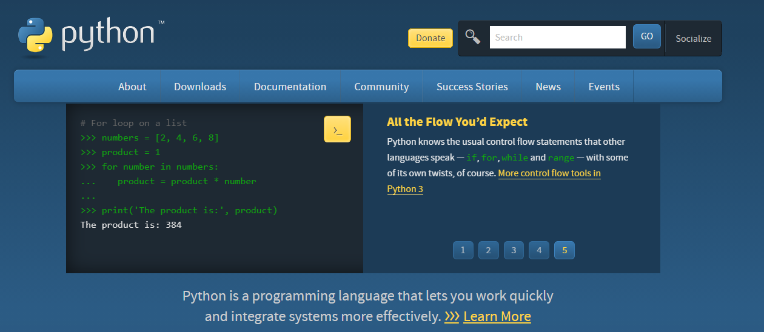

파이썬 기초 01
Socket(TCP)
Socket
Server and Client
Chatting
Standard Class 1 of 5

