Slide 1
FlaskCRM
Basic Overview

Slide 2

Arjun Sundram
Relationship

Slide 3
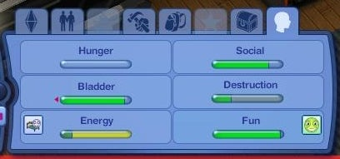
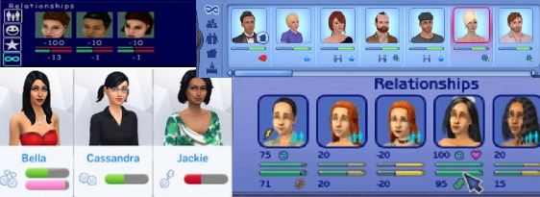
Reference Images – Sims 3
#7D9FDE
#1FC537
#6B8DD5
#21428B

