Slide 1

Integrating Quantum Computing with Music Theory
Using Qiskit to Generate Coltrane Changes
Presented by Alex ilgenfritz

Slide 2
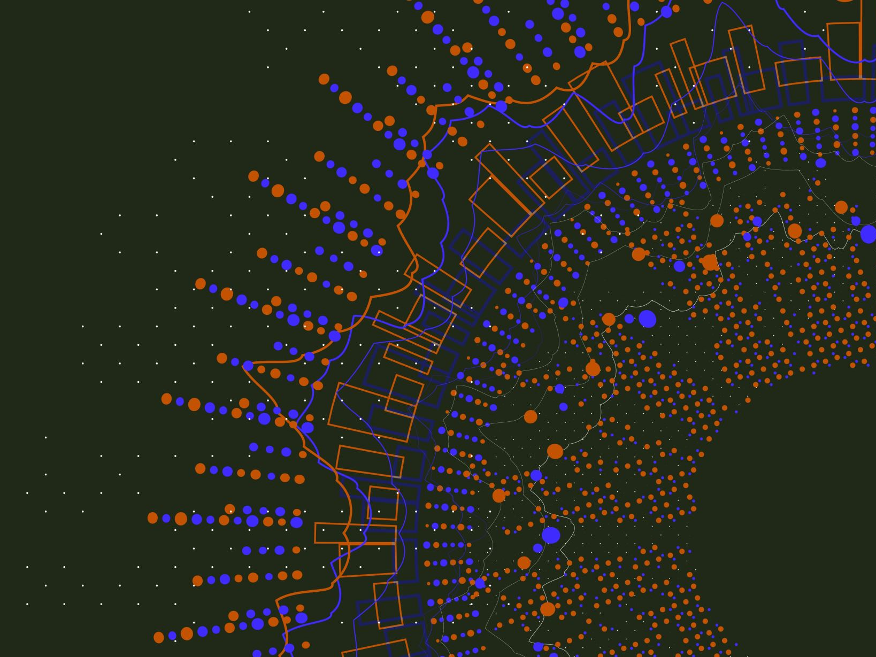
Overview
Basis for the Project: Integrating quantum computing principles with advanced musical theory concepts by exploring superposition methods for generating chord progressions.
Coltrane Changes: A harmonic progression used in jazz music that’s based on a cycle of major thirds, creating a unique and complex sound.
My Goal: To generate chord progressions using the same methodology, either major or minor thirds. Leveraging quantum circuits to probabilistically determine key centers and chord progressions. Then outputting progression in readable form for jazz improv practice and background track.

Slide 3

Quantum Computing Fundamentals used in this project
Hadamard (H) Gate: Used to place qubits in a superposition state. Allows exploration of multiple musical possibilities simultaneously
If I like the progression from step one:
CNOT Gate: Used to entangle qubits, creating correlations between musical notes. Enables complex interactions between notes in the progression.
Quantum Fourier Transform (QFT): Applied to generate similar chord progressions by transforming the states of qubits. Helps in creating variations of a given chord progression.

Slide 4

Music Theory Implementations
Key center
Breaking of octave
Permutations
Time Sig

Slide 5
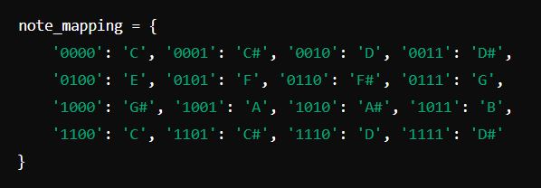
Mapping Qubits to Music Notes
Mapping Qubits to Notes: Each 4-qubit state (e.g., '0000', '0001', '0010') is mapped to a specific musical note (e.g., 'C', 'C#', ‘D’)
Note-to-MIDI Conversion: The mapped musical notes are then converted to MIDI numbers which represent the pitches in a format that music21 can interpret.

Slide 6
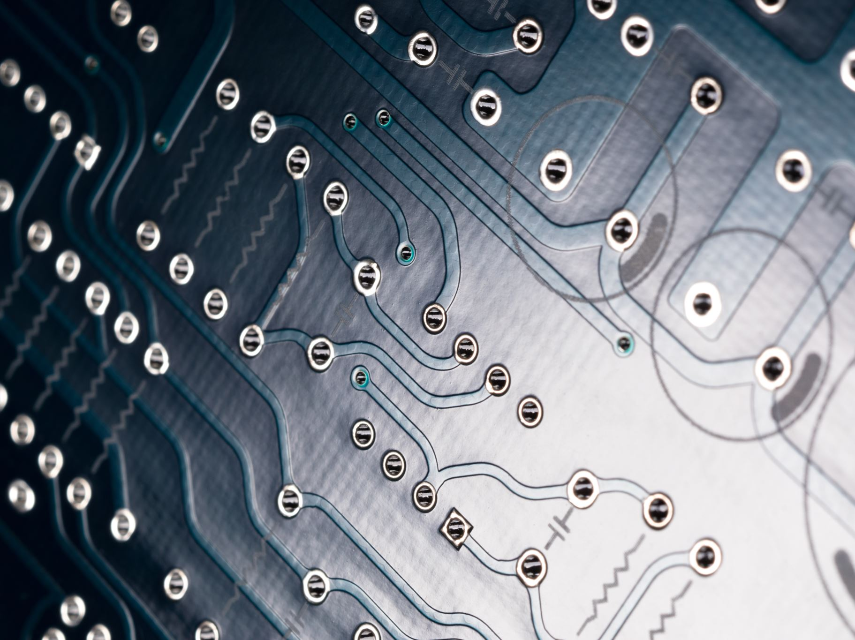
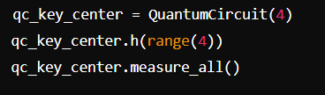
Quantum Circuit for Determining Key Center
- Create a 4-qubit quantum circuit to determine the key center.
- Use Hadamard gates to create superposition.
- Measure the circuit and map the result to a musical note.

Slide 7
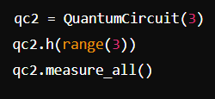
Quantum Circuit for Progression Type
Create a 3-qubit circuit to determine the breaking method (major/minor thirds)
Two qubits for the binary breaking decision and one qubit for the permutation
Use measurement results to select the progression type.

Slide 8
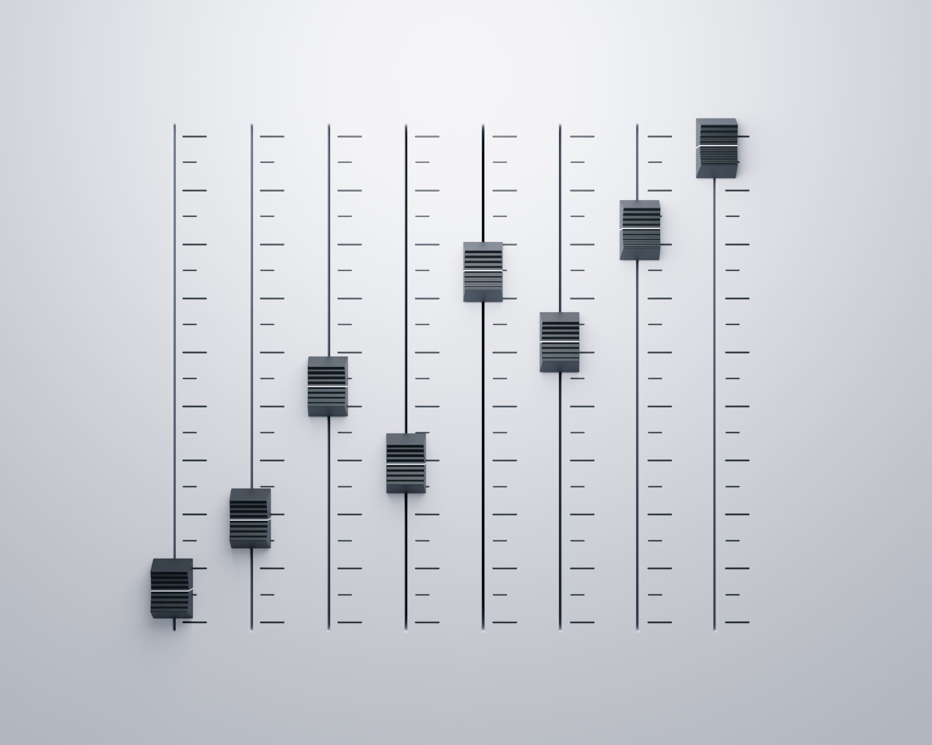

Generating Chord Progressions
Combine
- Combine results from key center and progression type circuits.
Generate
- Generate permutations of the chords.
Add
- Add V7 chords for transitions.

Slide 9
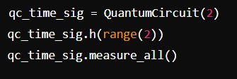
Determining Time Signature
- Create a 2-qubit circuit to determine the time signature since I only used four time-sigs.
- Use measurement results to map to 4/4, 3/4, 6/8, or 12/8

Slide 10
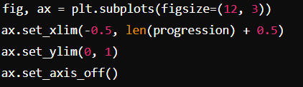
Visualizing Chord Progressions
- Use Matplotlib to plot the chord progression as a lead sheet.
-The x-axis represents the sequence of chords in the progression.
Chords are labeled and spaced evenly to resemble a lead sheet.
Tonal centers highlighted to indicate permutation.
The time signature is displayed at the beginning of the timeline.

Slide 11

Playing Chord Progressions
Use music21 and Pygame to play the generated chord progression (piano only).

Slide 12
Generating Similar Chord Progressions
Using QFT and Controlled Transformations: Quantum Fourier Transform (QFT) is applied to qubits to generate similar chord progressions.
Controlled transformations are used to modify the qubit states based on the original progression.
QFT transforms the original qubit states into their frequency components.
It helps create variations of the original chord progression by altering the phase and amplitude of qubit states. This allows us to generate new, yet harmonically related, chord progressions.

Slide 13

Example Usage and Live Demo
- Live demo of the code in action.

Slide 14

Next Steps
Expand the Project: Pursue the use of rhythm sections to create a backing track. Explore integration with music21 or Chuck for rhythm and percussion.
Future Enhancements: Add more complex harmonic structures and progressions. Experiment with different quantum algorithms for musical applications. Enhance the visualization and playback features for better user experience.

