Slide 1





Machine Learning approaches for accelerating antibiotic susceptibility testing (AST) in microfluidic systems
Eduarda Santos
PG 58815

Slide 2

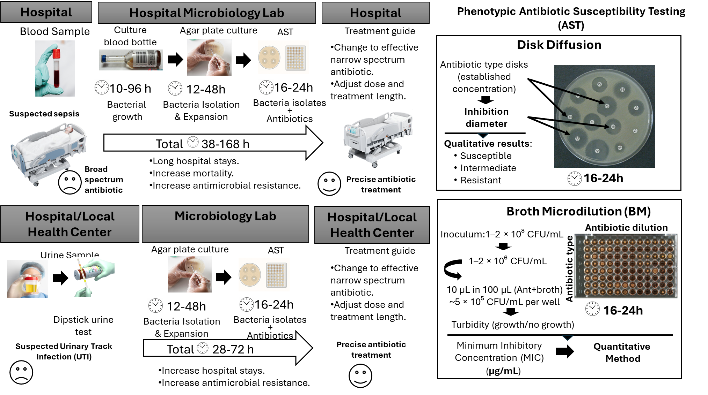
Why is AST important?
MIC value

Slide 3
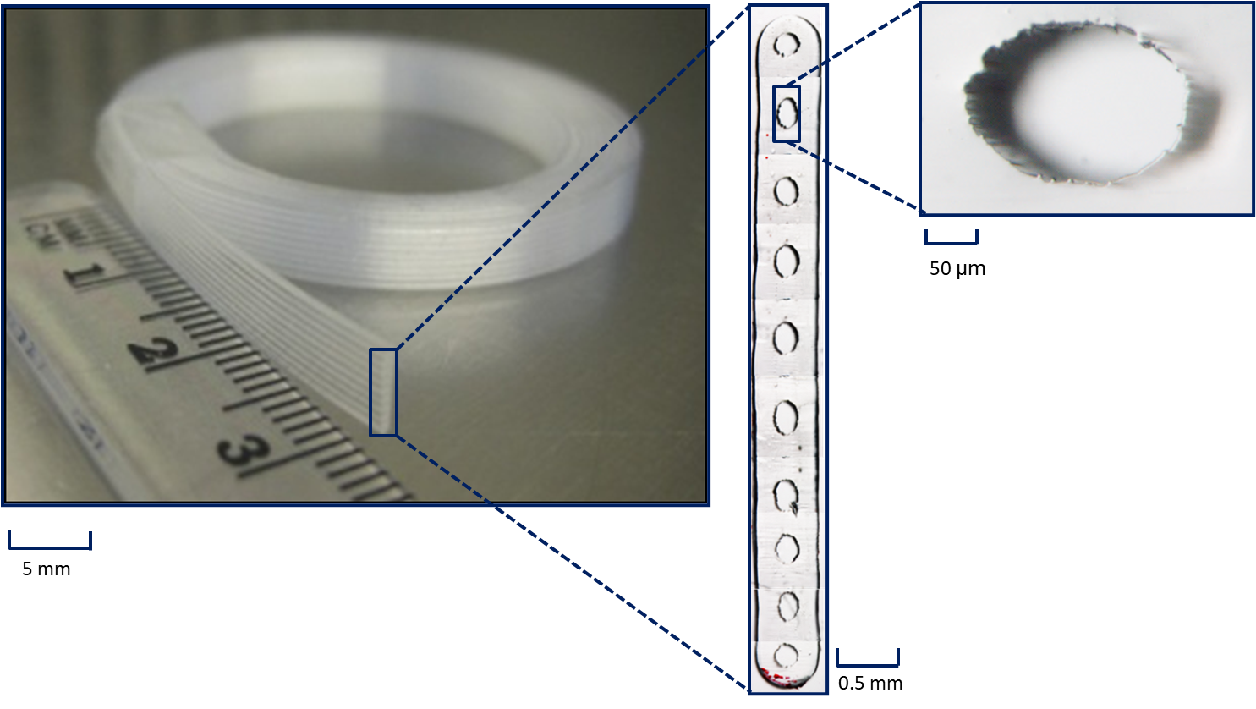
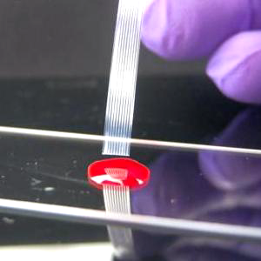
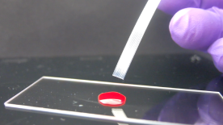
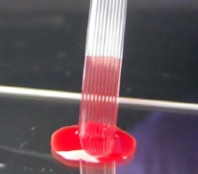
New technologies for AST
Continuous MicroCapillary FiIm (MCF)
Step 1: Bacteria loaded test dip strip
Step 2: Test strip dipped into sample
i. Sample drawn up by capillary action
Fluoropolymer capillary wall
ii. Reagent released and mixed into sample
Hydrophilic polymer coating
Antibiotic loaded in thin-film on hydrophilic polymer
Sample
Reis et al., Lab Chip, 2016

Slide 4
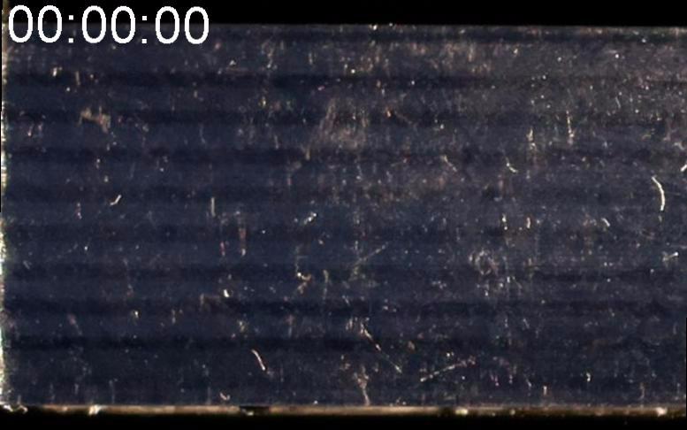
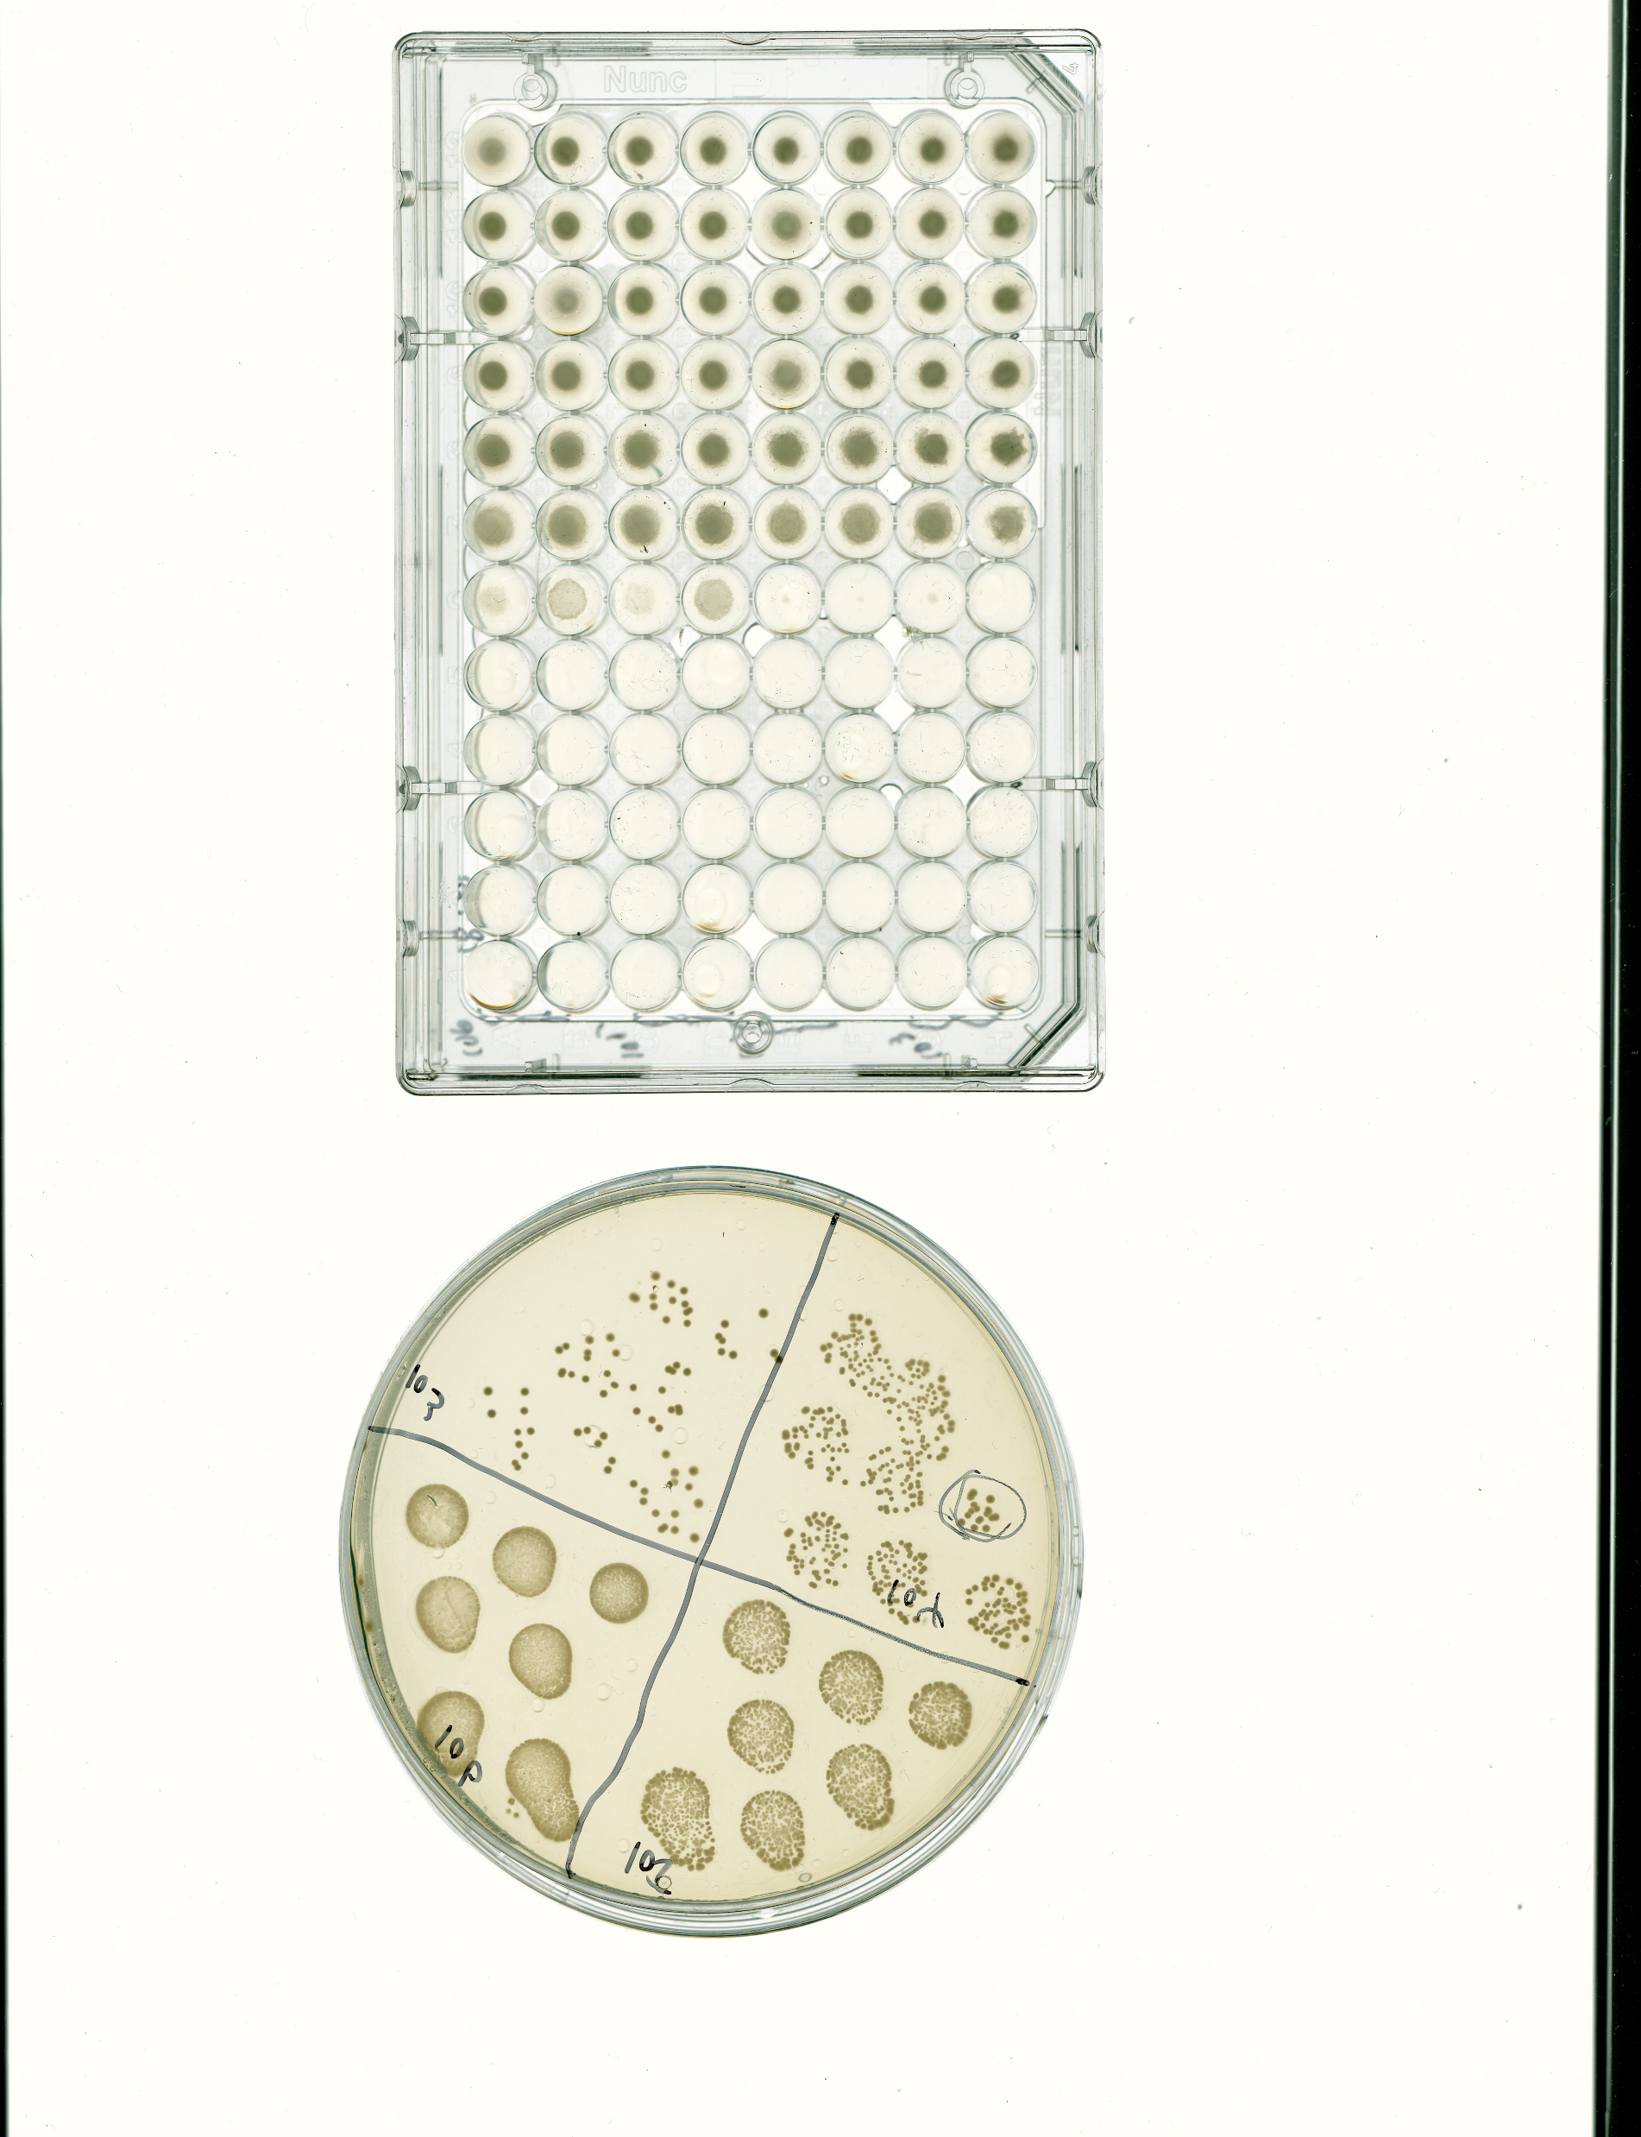
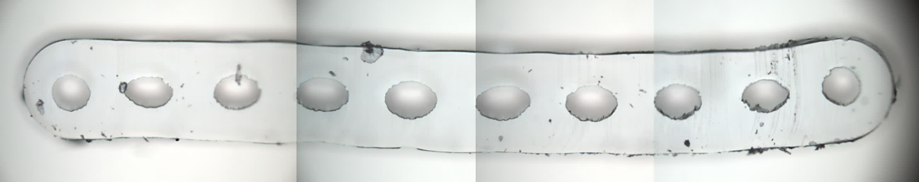
Rapid AST in the Microcapillary Film
Ampicillinconc. (µg/mL)
~5×10⁵ CFU/mL E. coli
BMD
PC
0.5
1
2
4
8
16
32
64
128
Current methods:
16-24h to determine MIC
MCF:
MIC
Time for interpretation of AST or MIC results was established to correspond to 2×tc (12h).
500 µm
5 mm
Reference mean time to reach the cut-off signal of 0.14 in non-antibiotic microcapillaries as tc, when the growth rate in antibiotic-containing microcapillaries dropped by 50% (comparison with the non-antibiotic capillary);

Slide 5
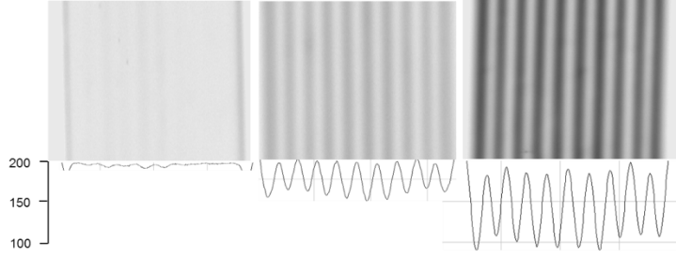
Research question and objectives
Can machine learning models use early GVR time-series data to predict which capillaries in an antibiotic concentration will remain inhibited at the endpoint, allowing early estimation of the MIC (minimum inhibitory concentration)?
GVR = (AbG(sample) – AbG(reference)) / AbG(reference)
AbG (sample): Colour intensity with bacteria and antibiotics.
AbG (reference): Colour intensity of the medium alone.
Objectives:
Organise data from experiments containing all the GVR related to several combinations of bacteria type, bacteria concentration, time, antibiotic type, and antibiotic concentration in Python.
Test different machine learning models using Python software;
Design features for the models;
Compare different models;
Evaluate the models and compare them with experimental data.
Signal Quantitation

Slide 6
Data organisation
Bacteria's
Antibiotics
Bacterial Concentrations
Experiments
Time Frame
5e6, 5e5, 5e4
9
11h – 18.17h
E. coli
ampicillin
5e6, 5e5, 5e4
5
33.17h – 59.83h
Dataframe Size
27 Experiments
5e5
3
21h – 39.67h
ciprofloxacin
5e6, 5e5, 5e4
5
22.83h – 41.17h
E. coli – Ampli: 8420 rows
E. coli : 45580 rows
5e5
3
21h – 39.67h
gentamicin
5e6, 5e5, 5e4
5
23.83h – 41.17h
Dataframe Size
tetracycline
5e6, 5e5, 5e4
9
29.17h – 42.5h
30 Experiments
5e6, 5e5, 5e4
19.17h – 40.0h
7
S. aureus: 65928 rows
trimethoprim
5e5
3
21h – 39.5h
S. aureus
5e6, 5e5, 5e4
5
25h – 41.17h
sulfamethoxazole
5e6, 5e5, 5e4
3
17h – 41.17h

Slide 7
Machine learning Features
Experience | Tube id | Antibiotic | Label
Concentration | Time | GVR | Inicial Std | Current Std
Tube Std | Slope | Delta | AUC | Derivative
Derivative Per Time | Delta Per Time | AUC Per Time | GVR Max Tube | GVR Min Tube
GVR Min Experience | GVR Max Experience | GVR Average | Growth Score Exp | Growth Score
Dataset shape: (8420, 13)
Raw dataset loaded successfully.
C:\Users\eduar\AppData\Local\Temp\ipykernel_26860\1061659367.py:3: RuntimeWarning: divide by zero encountered in scalar divide return ((atual - anterior) / anterior) * 100
Missing values per column: experiencia 0 tubo_id 0 tempo 0 antibiotico 0 concentração 0 gvr 0 std_inicial 0 std_atual 0 std_tubo 0 slope 0 delta 0 AUC 0 Derivada 0 auc_por_tempo 0 delta_por_tempo 0 Derivada_por_tempo 0 gvr_media 0 gvr_max_tubo 0 gvr_min_tubo 0 gvr_max_experiencia 0 gvr_min_experiencia 0 growth_score 0 growth_score_exp 0 label 0 dtype: int64 Dataset shape: (8420, 24)
experiencia 20230508_5e6 tubo_id 20230508_5e6_Positive control tempo 0.0 antibiotico Ampicillin concentração Positive control gvr 0.069883 std_inicial 0.008784 std_atual 0.008784 std_tubo 0.0 slope 0.0 delta 0.0 AUC 0.0 Derivada 0.0 auc_por_tempo 0.0 delta_por_tempo 0.0 Derivada_por_tempo 0.0 gvr_media 0.066011 gvr_max_tubo 0.069883 gvr_min_tubo 0.069883 gvr_max_experiencia 0.077113 gvr_min_experiencia 0.048811 growth_score 0.0 growth_score_exp 0.0 label 1 Name: 0, dtype: object
Dataset saved successfully. Shape : (8420, 24) Labels : {'1': 4949, '0': 3471}

Slide 8
Machine learning model training
Data Preparation | Identifiers and antibiotic concentration removed from feature set
Model Selection | Evaluate models - accuracy, ROC-AUC, F1, precision, recall, confusion matrix, cross validation
Temporal Analysis | Best model tested per time point to identify earliest reliable prediction
Feature Refinement | Iterative feature engineering and model optimisation
Validation Strategy | Pipeline developed on E. coli - ampicillin subset, then scaled to full E. coli dataset

Slide 9
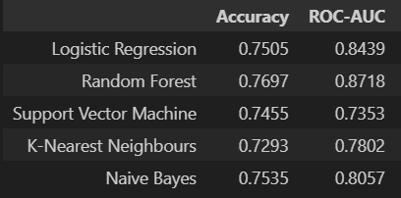

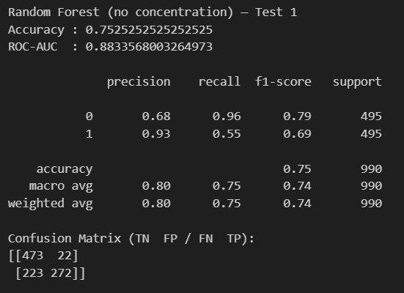
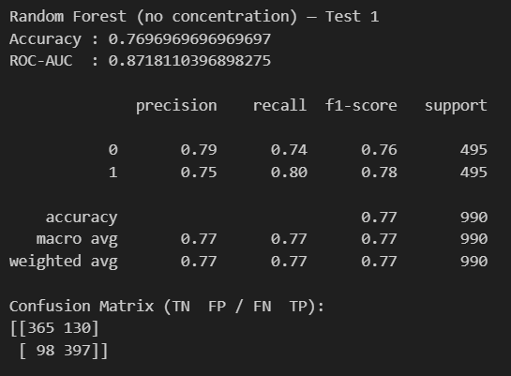
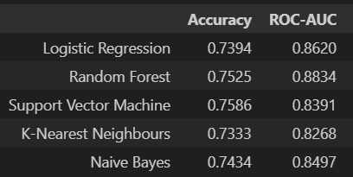

Model Comparison
E. coli - Ampicillin Models
E. coli Chosen Model
E. coli - Ampicillin Chosen Model
E. coli Models

Slide 10
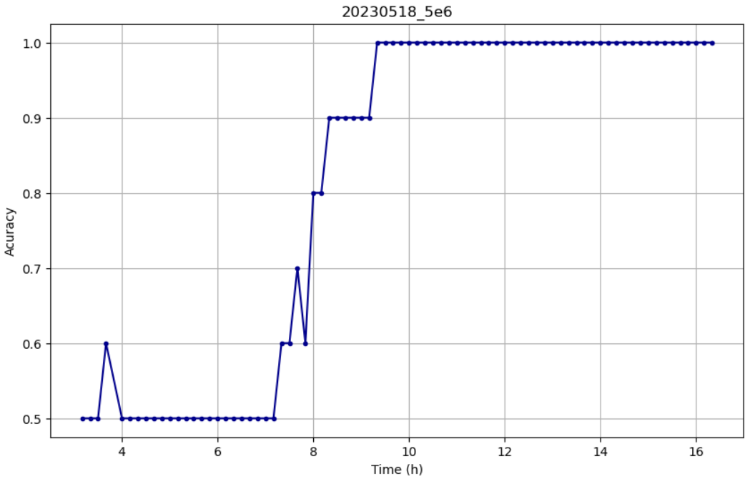
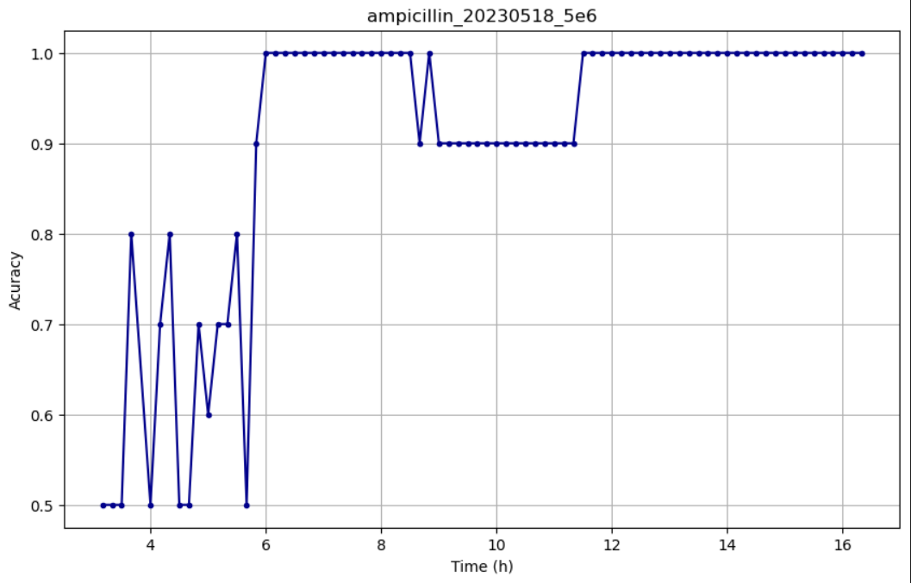
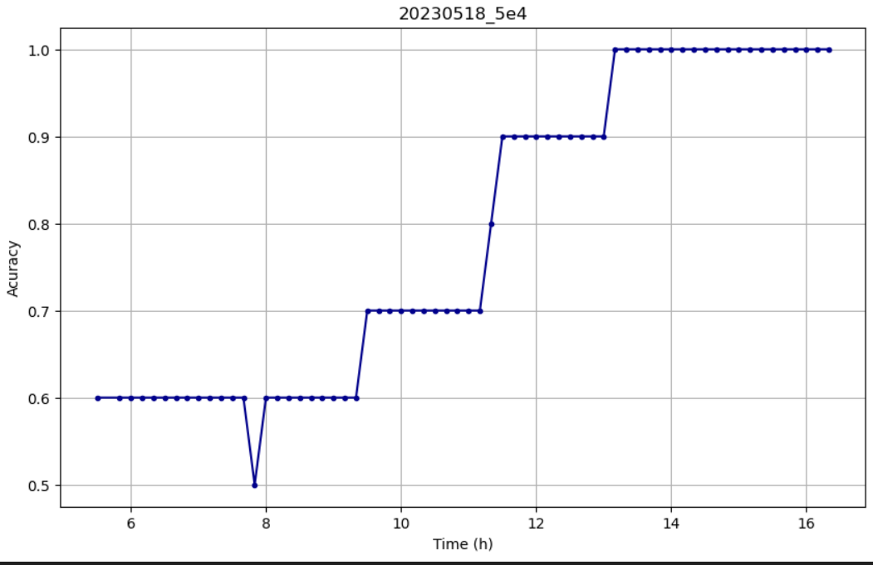
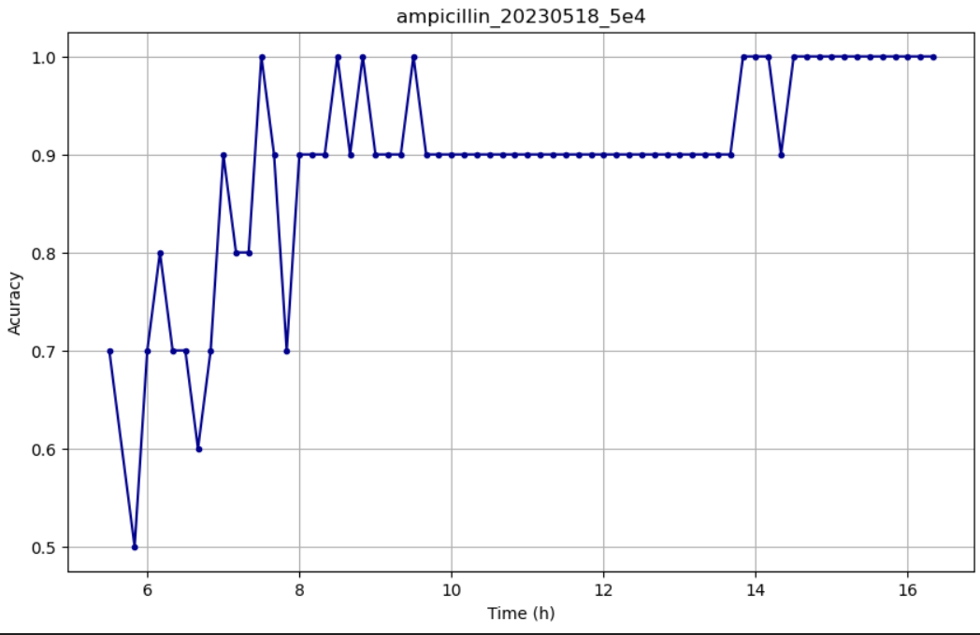
Ampicillin Testing
Accuracy over time: E. coli Ampicillin-only training (left) vs. All antibiotics training (right).

Slide 11
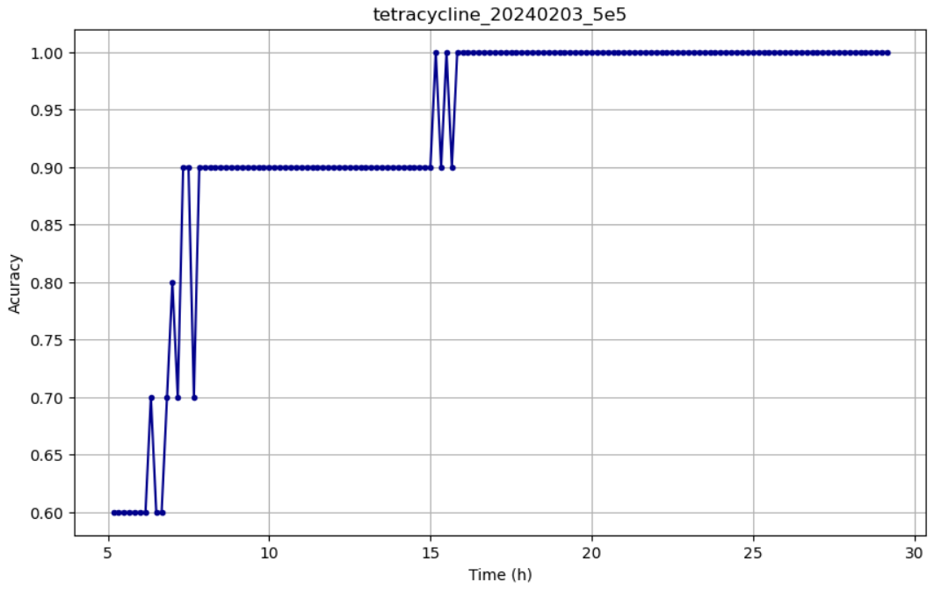
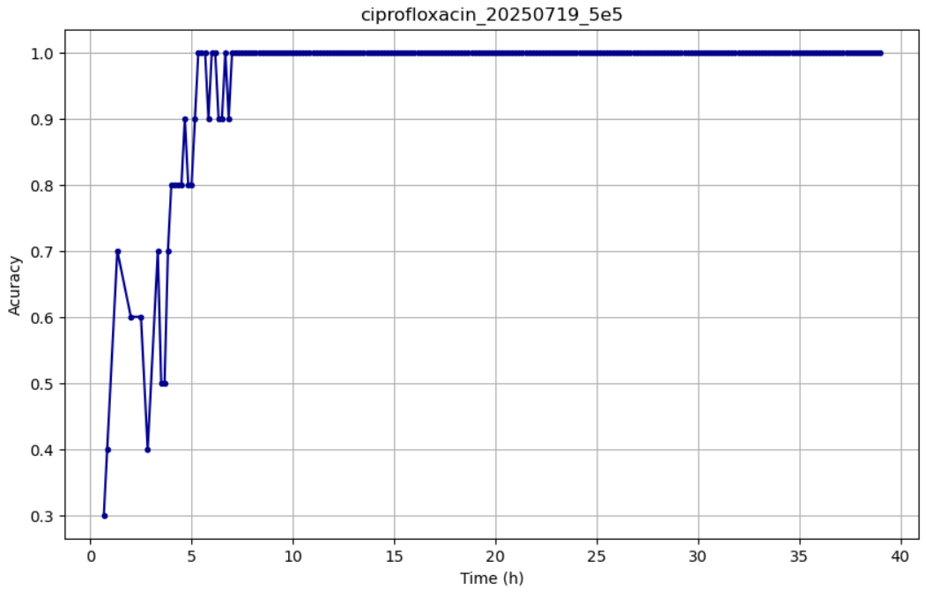
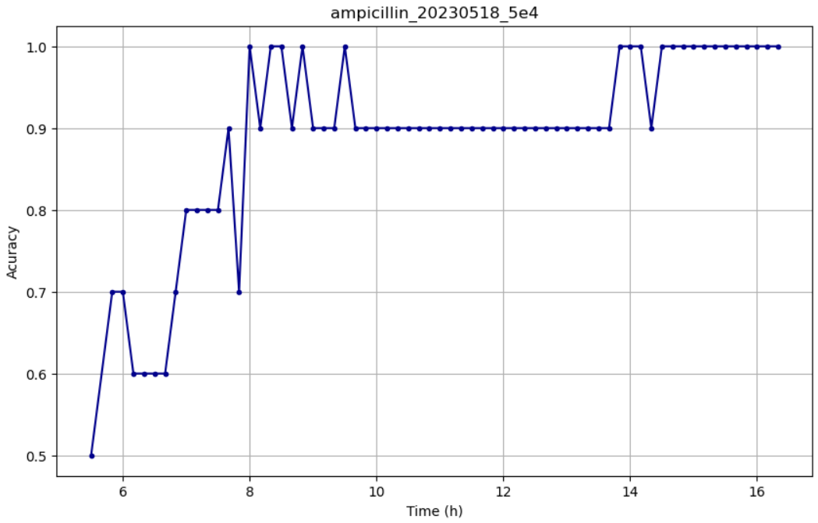
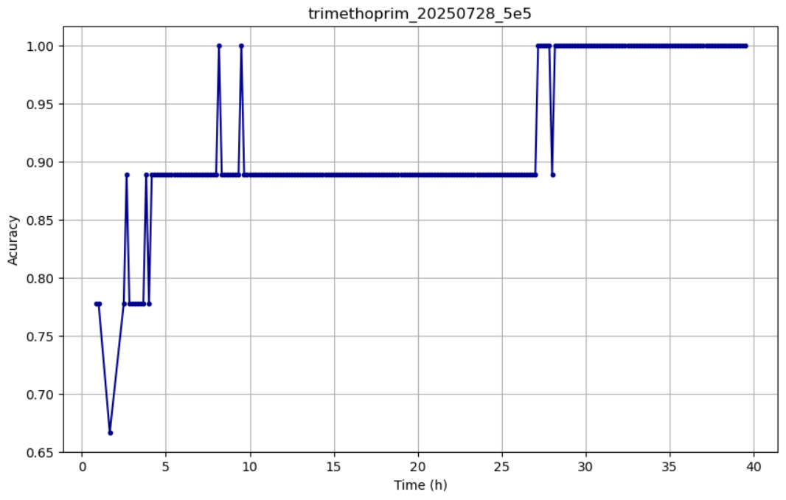
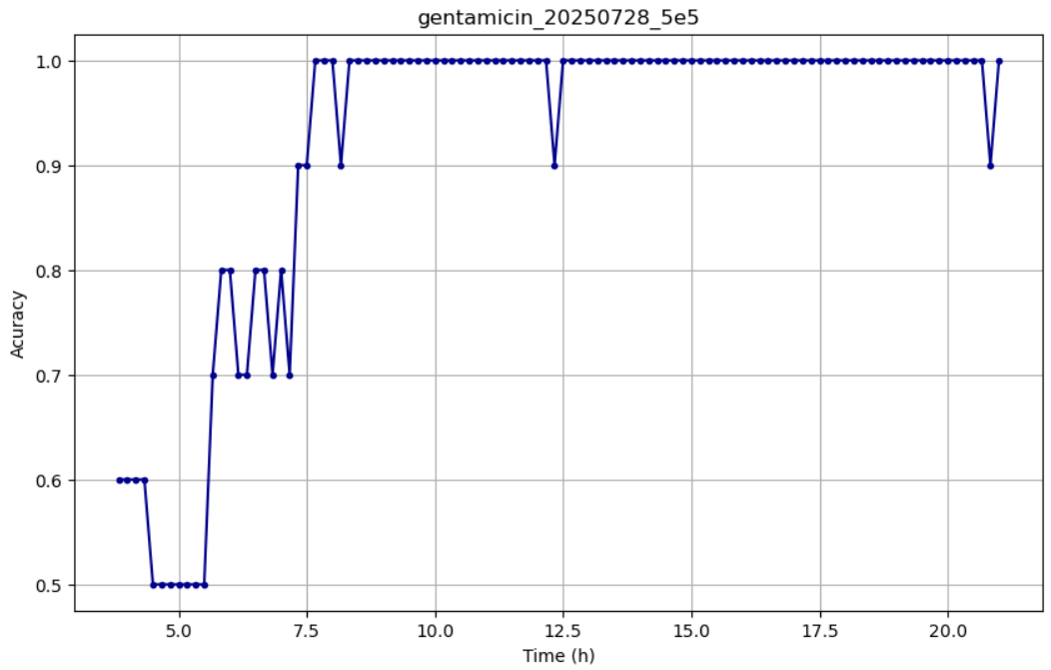
All antibiotics testing
Accuracy over time across the five antibiotics (Ciprofloxacin, Gentamicin, Tetracycline, Trimethoprim, Ampicillin) - Model trained with all E. coli data.

Slide 12
Conclusion
Traditional AST
MC-AST
ML Model
16h – 24h
12h
10h

