Slide 1
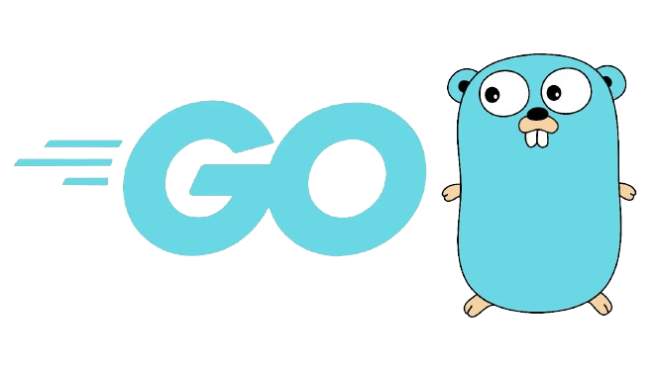

‘Go’ {
forbeginners.html
workshop.css
[Simplicity Efficiency]
< Welcome to the world of Go, a programming language designed for simplicity, efficiency, and concurrency. >
}
Rodrigo Aguiar - 108969
Alexandre Ribeiro - 108122
Diogo Almeida – 108902
CSLP 2023
Programming Language

Slide 2
History Of ‘Go’;
forbeginners.html
workshop.css
< Creators >
Golang most common known as Go was conceived by three prominent computer scientists at Google: Robert Griesemer, Rob Pike, and Ken Thompson.
< Motivation >
Go was born in 2007 out of the frustration with existing programming languages when dealing with large-scale systems and distributed computing at Google.
The goal was to create a language that combined efficiency, simplicity, and concurrency to address the challenges of developing scalable and maintainable software.
< Objectives >
Static typing and run-time efficiency (like C), readability and usability (like Python),
high-performance networking and multiprocessing.
Programming Language

Slide 3
Key Features of ‘Go’{
forbeginners.html
workshop.css
Simple
Fast
< Easy to learn and understand >
< Quick compilation to machine code >
Concurrent
Open Source
< Native concurrency support >
< Go is open source and free to use >
}
Programming Language

Slide 4
Paradigms of ‘Go’ {
forbeginners.html
workshop.css
Procedural
Functions-driven procedural language, emphasizing simplicity and efficiency
Concurrent
Supports concurrent programming with goroutines and channels
Imperative
Clear sequential execution and control structures
Obj-Oriented
Incorporates object-oriented features through structs, interfaces, and composition.
}
Programming Language

Slide 5
Compilation in ‘Go’ {
01
02
03
forbeginners.html
workshop.css
Go is a compiled language
< Go source code is translated into machine code or bytecode before execution >
Advantages of Compilation
< Compiled code is optimized for fast execution >
< Errors are identified during compilation, not during execution>
Compilation Command
}
- go build filename.go
Programming Language

Slide 6
Interpretation in ‘Go’ {
01
02
03
forbeginners.html
workshop.css
Go doesn’t have a traditional interpreter
< There is no direct interpretation of source code during execution >
Flexibility in Execution
< Allows quick testing of small code snippets without the need for separate compilation>
Go run
- go run filename.go
}
< The ‘go run’ command compiles and executes a temporary Go program >
Programming Language

Slide 7
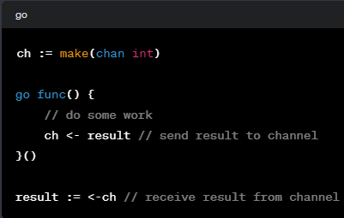
Concurrency in ‘Go’ {
forbeginners.html
workshop.css
Goroutines
Lightweight threads that enable concurrent execution of functions
Channels
Communication pathways for safe data exchange between goroutines
}
Programming Language

Slide 8
Go {
[Memory Managment]
forbeginners.html
workshop.css
< Go uses a tracing garbage collector that identifies and reclaims memory that is no longer in use. >
< The garbage collector operates concurrently with application threads, utilizing parallelism for efficiency. >
}
Programming Language

Slide 9
Disadvantages of ‘Go’{
forbeginners.html
workshop.css
Limited
< Less expressive syntax, lacks versatility >
Use of Pointers
< Can lead to unspecified runtime errors, even though pointer arithmetic is not allowed>
Young Language
< Fewer existing libraries and smaller community >
}
Programming Language

Slide 10
Syntax { Semantics;
forbeginners.html
workshop.css
}
Programming Language

Slide 11
Syntax/Semantics of ‘Go’{
forbeginners.html
workshop.css
Variable Declaration
< Go allows both static typing and type infering >
var x int = 1 // Like C
y := 2 // Like Python
}
Programming Language

Slide 12
Syntax/Semantics of ‘Go’{
forbeginners.html
workshop.css
Arrays
< Arrays have fixed size, slices have dynamic size >
arr := […]int{1, 2, 3, 4, 5} // var arr [5]int
sli := []int{2, 3, 4}
}
Programming Language

Slide 13
Syntax/Semantics of ‘Go’{
forbeginners.html
workshop.css
Flow Control – If & Switch
// Switch statement
switch a {
case “ab”, “bc”:
doThis()
case “ab”:
doThat()
default:
doWhatever()
}
// If statement
if a == “ab” || a == “bc”{
doThis()
} else if a == “ac” {
doThat()
} else {
doWhatever()
}
}
Programming Language

Slide 14
Syntax/Semantics of ‘Go’{
forbeginners.html
workshop.css
Flow Control – For & While
< There are no while loops, they must be done with for >
// For Loop
for i := 0; i <= 10; i++ {
doThis()
}
// Equivalent to while true
for {
doThat()
}
}
Programming Language

Slide 15
Cool { Features;
forbeginners.html
workshop.css
}
Programming Language

Slide 16
Cool Features {
forbeginners.html
workshop.css
Defer Statement
< A statement that allows functions to be executed just before the surrounding function returns >
func processFile() {
file := openFile()
defer file.close()
// …
}
}
Programming Language

Slide 17
Cool Features {
forbeginners.html
workshop.css
Semicolon
< Although discouraged, semicolons can be used to separate statements >
x := 10; y := 20
// conventional way
x := 10
y := 20
}
Programming Language

Slide 18
Cool Features {
forbeginners.html
workshop.css
switch num {
case 3:
fmt.Println(3)
fallthrough
case 2:
fmt.Println(2)
fallthrough
case 1:
fmt.Println(1)
default:
doWhatever()
}
Fallthrough
< Used in switches, for executing the code block of the next case >
}
Programming Language

Slide 19
Cool Features {
forbeginners.html
workshop.css
Ellipsis
< Represented by three dots, used in variadic functions >
func Sum(nums ...int) int {
res := 0
for _, n := range nums {
res += n
}
return res
}
}
Programming Language

Slide 20
Exercises {
forbeginners.html
workshop.css
Clone the GitHub Repository and get started!
}
Programming Language

