Slide 1


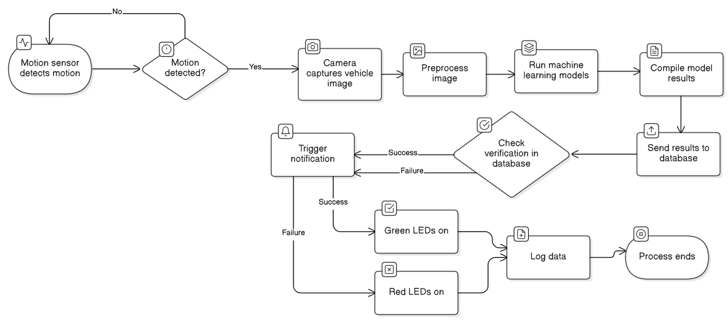
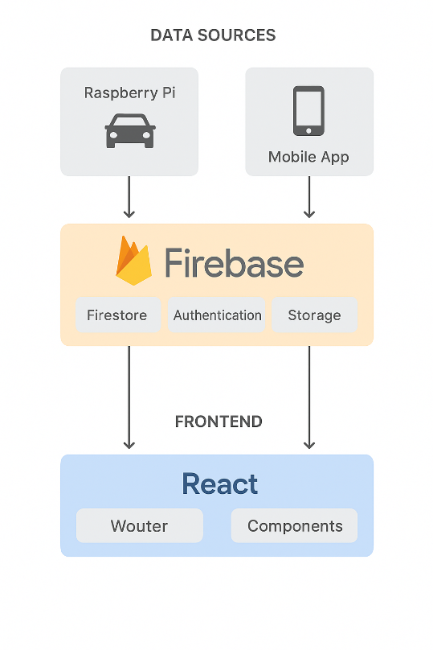
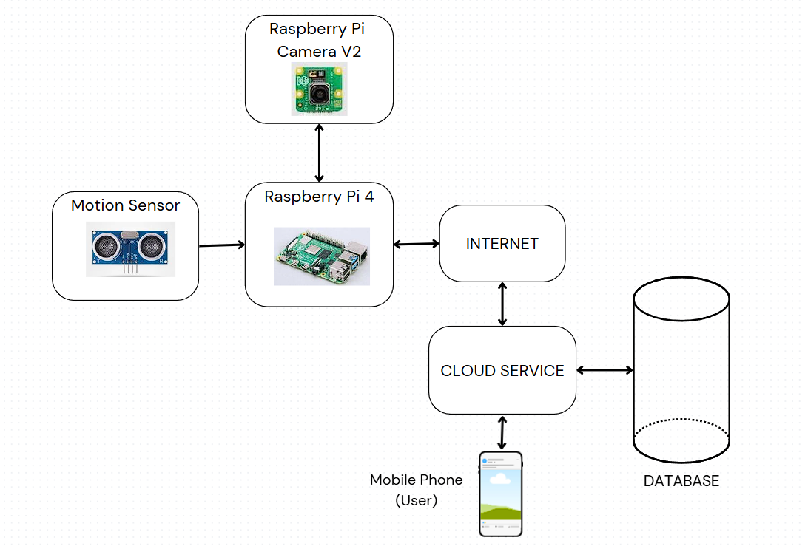
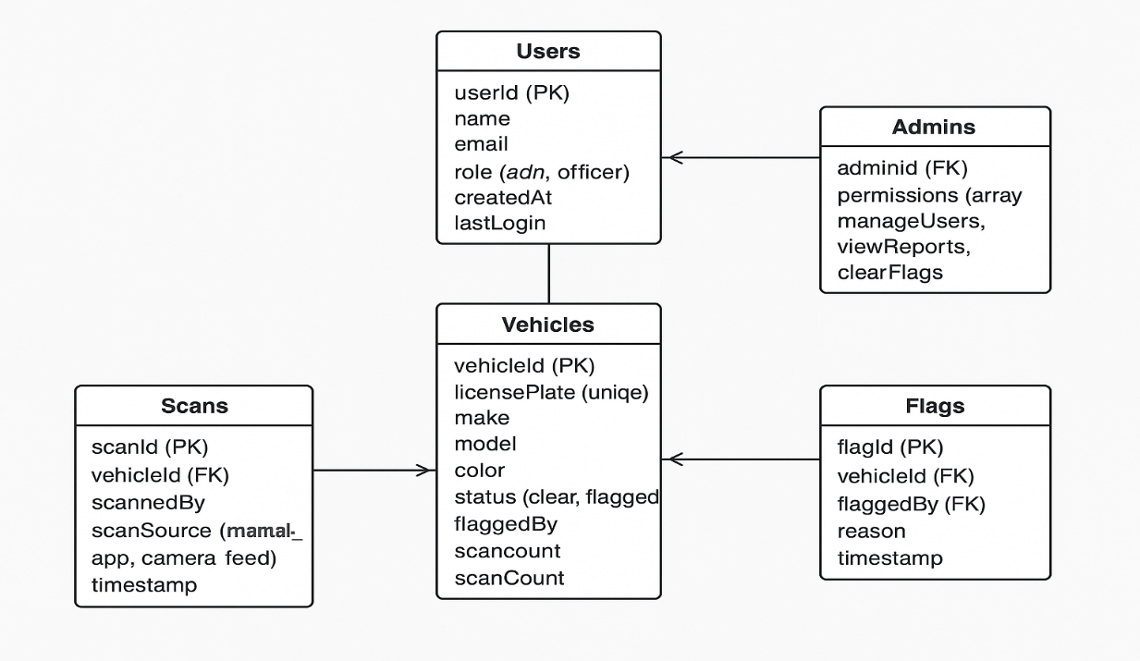
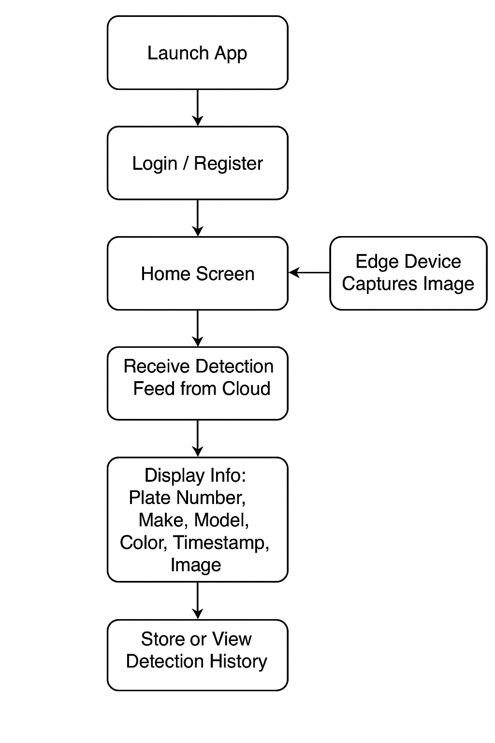
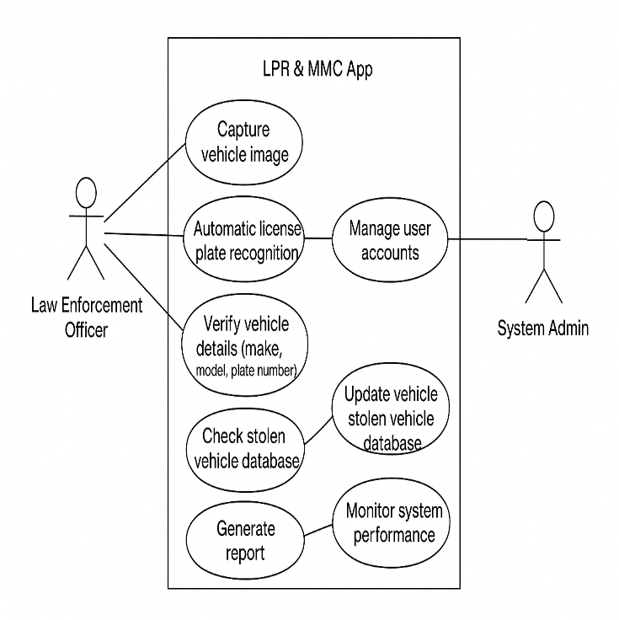
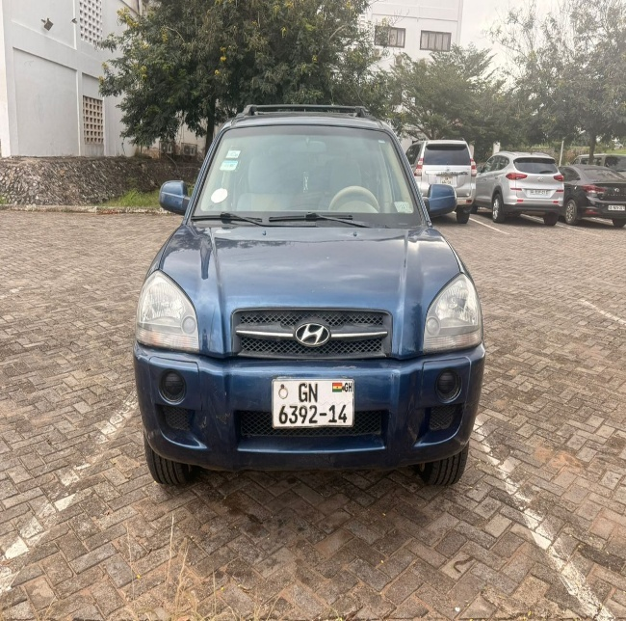
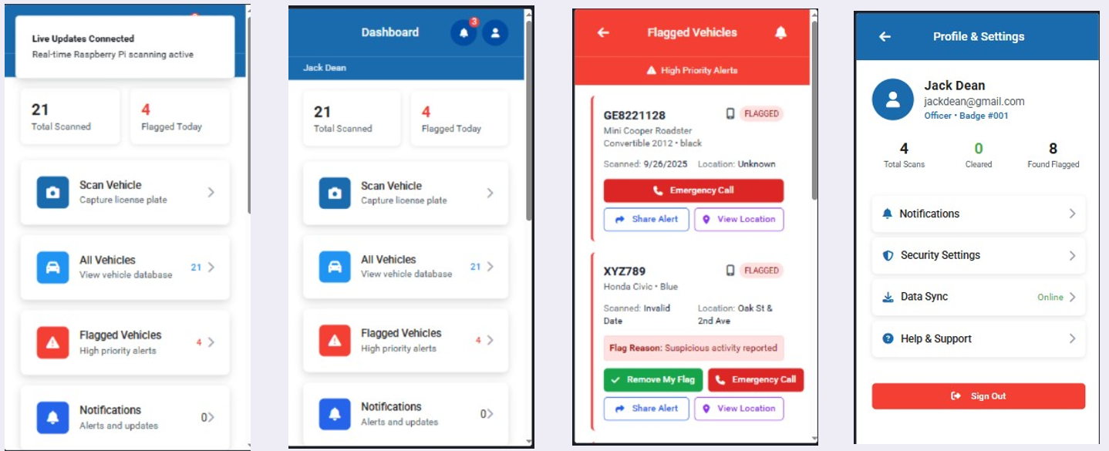
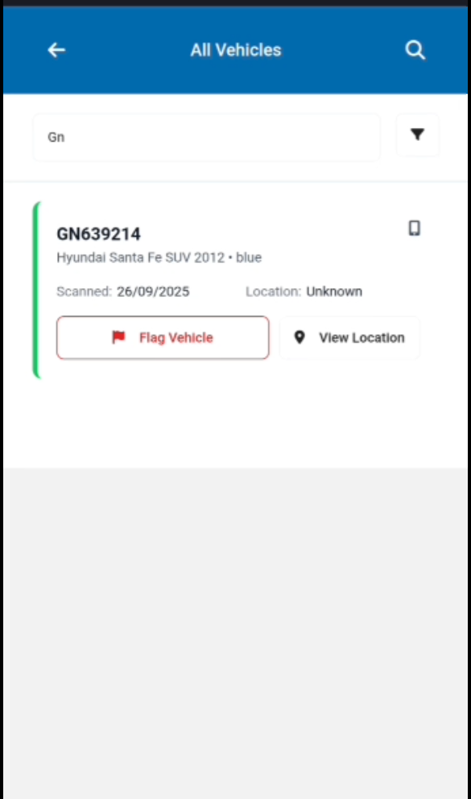
AUTOMATED LICENSE PLATE RECOGNITION AND VEHICLE IDENTIFICATION FOR SECURITY MONITORING USING ARTIFICIAL INTELLIGENCE
Kelvin Fiador, Prince Benneh, Prof. Godfrey Mills
Department of Computer Engineering, University of Ghana, Legon, Ghana
Emails: fiadorkelvin9@gmail.com, princebenson37@gmail.com
Introduction
Problem Definition
Objectives
Growing urban areas and rising vehicle-related crimes, like theft and unauthorized access, demand better vehicle monitoring. Traditional License Plate Recognition (LPR) systems, used for tolls and traffic enforcement, struggle with tampered plates and poor image quality. This project integrates Make, Model, and Color (MMC) detection of vehicles together with LPR to improve identification accuracy. Using computer vision, machine learning, and sensors, the system automates real-time vehicle detection, processes images, and matches features against a database for secure, efficient monitoring, enhancing security and safety by extension.
Current vehicle monitoring systems rely heavily on License Plate Recognition (LPR), which falters with tampered plates or low visibility. This reduces their reliability for tasks like tracking stolen vehicles or securing restricted areas. Manual verification is slow and prone to errors making it tedious in high-traffic areas. This creates a need for an automated system integrating LPR with Make, Model, and Color (MMC) detection to boost accuracy and security. This project develops a solution using sensor-based detection and advanced image processing to verify license plates and vehicle attributes, enhancing traffic and access control.
Design a machine learning-based system for recognizing authorized vehicles via License Plate Recognition (LPR) and Make, Model, and Color (MMC) attributes.
Train models to identify license plate characters and MMC attributes from vehicle images.
Develop a user-friendly mobile app for interaction and real-time notifications on vehicle identification results.
Integrate a database to store, compare, and verify vehicle data, flagging unauthorized entries.
System Design
The vehicle identification system comprises five main features: License Plate Recognition (LPR), Make and Model Detection, Color (MMC) Detection, Real-Time Notification via Mobile App, Database Integration
Figure 1: System Design Overview
Figure 2: System Flow Diagram
Figure 3: Data Flow Diagram
Figure 4: Entity Relational Diagram
Figure 5: Flow Diagram of the Mobile Application
Figure 6: Use Case Model of Mobile Application
System Development and Testing
The system was developed incrementally over time. In line with the design outlined in the preceding section, the license plate detection module using YOLOv11, custom OCR for text recognition, custom CNN for color classification, and ResNet50 for make/model identification were implemented separately before being integrated into the core image processing pipeline on the Raspberry Pi.
Following successful individual testing, the pipeline was merged with the HC-SR04 sensor for vehicle detection, Firebase database for verification, and mobile application for real-time notifications. These components were then evaluated alongside the LED indicators and overall workflow to ensure functionality
We tested the vehicle identification system on a sample of 10 vehicles to evaluate its performance in real-world scenarios. The tests involved vehicles approaching at 5-10 km/h, triggering the HC-SR04 sensor at 2-3 meters, with images captured by the Raspberry Pi Camera Module V2 and processed for license plate recognition (LPR), make, model, and color (MMC) detection. The system achieved an overall accuracy of 60%, with YOLOv11 detecting plates in all cases (100%), custom OCR achieving 87.02%-character accuracy and 60% sequence accuracy, custom CNN identifying colors at 80% accuracy, and ResNet50 recognizing make/model at 60% accuracy. Errors were noted in low-light conditions and with models absent from the training dataset, such as the Nissan Sentra. These results helped identify areas for improvement, guiding future enhancements in dataset expansion and processing optimization.
Figure 8: Test Vehicle Image
Figure 7: Final Implementation of Mobile App
Figure 9: Mobile App Response
Conclusion
Future Extension
References
Based on the test results, all project objectives were successfully achieved. The system effectively integrated License Plate Recognition (LPR) and Make, Model, and Color (MMC) detection into a robust vehicle identification platform. A user-friendly mobile app provided real-time notifications, and the Firebase database enabled secure vehicle data verification. System evaluation confirmed 60% overall accuracy, with reliable plate detection and areas identified for improvement in low-light conditions and dataset coverage. Overall, the system enhances urban security and vehicle monitoring.
To improve the LPR-MMC system, we recommend: First, using a Jetson Nano or Google Coral TPU to reduce latency. Second, expanding the dataset with more Ghanaian vehicles to boost make/model accuracy. Third, adding night vision cameras to improve low-light performance.
[1] W.-C. Li, T.-H. Hsu, K.-N. Huang and C.-C. Wang, "A YOLO-Based Method for Oblique Car License Plate Detection and Recognition," 2021 IEEE/ACIS 22nd International Conference on Software Engineering, Artificial Intelligence, Networking and Parallel/Distributed Computing (SNPD), Taichung, Taiwan, 2021, pp. 134-139, doi: 10.1109/SNPD51163.2021.9704935.
[2] M. Al-Mheiri, O. Kais and T. Bonny, "Car Plate Recognition Using Machine Learning," 2022 Advances in Science and Engineering Technology International Conferences (ASET), Sharjah, United Arab Emirates, 2022, pp. 1-6, doi: 10.1109/ASET53988.2022.9734830.

