Slide 1
Beyond the Cluster
Which Israeli local authorities out- and under-perform their socio-economic standing in national achievement tests?
official socio-economic cluster, 1 to 10
Stav Tchizik (316062835) · Or Cohen (206631509)
Introduction to Data Science, Final Project
Ministry of Education Meitzav scores, 2016 to 2018 × CBS Socio-Economic Index of Local Authorities, 2017 edition

Slide 2
Why ask this at the authority level
1
Money and staff move by authority
Education budgets, staffing and intervention programmes in Israel are allocated to local authorities, so the authority is the unit a decision actually attaches to.
Who the answer is for
• the Ministry of Education and RAMA
• heads of local authorities
• anyone setting policy on educational gaps
2
The gradient is already known
RAMA publishes a Meitzav report for every authority that already compares it against socio-economically similar authorities. Reproducing that gradient would add nothing.
243
3
The open question is who departs from it
local authorities in the merged table, from 1,749 authority by year by grade by subject rows
Which authorities score above or below what their circumstances predict, how reliably, and what sets them apart.
2 sources
Ministry of Education test scores and the CBS socio-economic index, joined on a key we had to build
What this project adds: a ranking of the departures from that gradient across all authorities, and a test of what distinguishes them.
Beyond the Cluster · Tchizik & Cohen
2

Slide 3
The question
Which local authorities in Israel score higher or lower on national tests than their socio-economic level would predict, and what sets those authorities apart?
SUPPORTING QUESTION
SUPPORTING QUESTION
How closely does the socio-economic index track test scores in the first place?
Does grouping authorities by their achievement profiles reproduce the official CBS clusters?
That relationship is the baseline the deviations are measured against, so it has to be fitted well before any authority can be called an over- or under-performer.
If the two systems were interchangeable, the official 1 to 10 clusters would already tell us everything the test results do.
Stated as association throughout. The data are observational and cross-sectional, so nothing in this design can support a claim that socio-economic standing produces a score.
Beyond the Cluster · Tchizik & Cohen
3

Slide 4
Two official sources, and the work to join them
Ministry of Education: Meitzav
CBS: Socio-Economic Index, 2017
National assessment in grades 5 and 8, in Arabic or Hebrew as a first language, English, Mathematics and Science. One row per authority, year, sector, grade and subject: 3,067 rows, 251 authorities, 2015 to 2019.
All 255 local authorities ranked by factor analysis of 14 variables covering demography, schooling, employment and standard of living, published as a continuous value and as ten clusters.
Three things the raw files forced on us
1
Two code systems
The files number authorities differently. For cities and local councils the education code is the CBS code with one extra digit, so rashut // 10 recovers it; a regional council's code is its council number × 100,000; four merged cities were mapped by hand. All 250 matched, verified by name.
2
The same pupils twice
norm_id is the sector, and value 1 is the two sectors combined, which exists only for the 19 mixed authorities. Haifa grade 5 English in 2016: 859 = 768 + 91. We keep the combined row where it exists and the single sector row everywhere else.
3
Years that miss the index
The index edition is 2017, so we keep 2016 to 2018 and drop 2015 and 2019 rather than compare scores to an index measured years off. Scores still drift a median of 13.5 points across the three years, so year stays in the models as a variable.
3,067 rows to 1,749 · 251 authorities to 243 · 44 rows have no score, almost all of them groups of under 30 pupils the Ministry suppresses as too small to publish
Beyond the Cluster · Tchizik & Cohen
4

Slide 5
How the analysis is built
Split by authority
Baselines
Two model tracks
Out-of-fold gaps
Clustering
every row of an authority goes to one set, stratified by cluster
the overall mean, and the mean of that subject and grade
linear and forest; logistic and forest on a High / Low label
every authority predicted by a model that never saw it
K-Means on grade 8 scores, and on the gaps
Why split by authority, and what it cost
Set-up at a glance
1,749 rows come from only 243 authorities, so the rows are not independent. In a plain split by row, 236 of the 243 authorities land in more than one set, and predicting each test row from nothing but its own authority's training average already reaches R² = 0.30. Splitting by authority removes that shortcut, and GroupKFold keeps it out of the tuning folds too.
• 20 features: 16 about the authority, 4 about the test
• 50 / 20 / 30 by authority, stratified by cluster
• GroupKFold(5) tuning, median imputation in the pipeline
• pandas, numpy, matplotlib, scikit-learn, seed 42
R² = 0.30
0 of 74
R² = 0.530
what memorising an authority's average buys in a row split, with no socio-economic variable at all
test authorities the model had already seen, under the split we use
the chosen forest on the held-out authorities, against 0.281 for the subject and grade baseline
Beyond the Cluster · Tchizik & Cohen
5

Slide 6
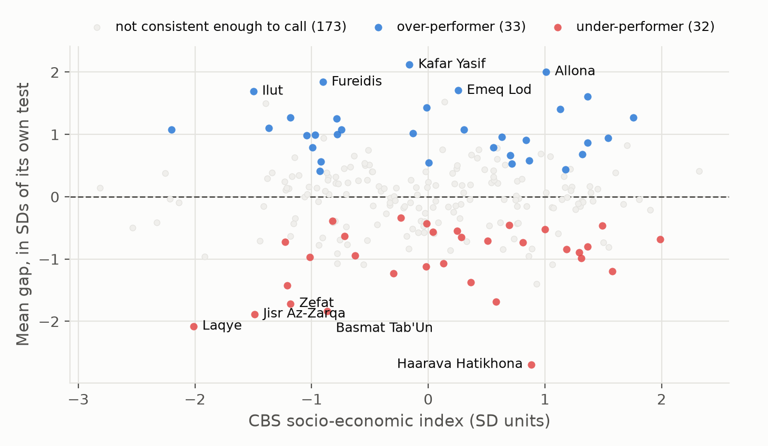
Deviation does not follow socio-economic standing
r = 0.011
between an authority's mean gap and its socio-economic index, across all 238 eligible authorities. The cloud is flat.
65 of 238
authorities where every single row falls on the same side of its prediction: 33 above, 32 below
20
of those 65 survive all seven rebuilds of the analysis, and no authority ever changed direction
The gaps are out-of-fold, with GroupKFold on the authority, and standardized within subject and grade. A gap of 1.0 means one standard deviation better than predicted for that test, which is about 26 score points.
Fig 8. Mean standardized gap against the socio-economic index, one point per authority, the extremes labelled.
An authority's cluster tells you nothing about whether it beats or misses its own prediction.
Beyond the Cluster · Tchizik & Cohen
6

Slide 7
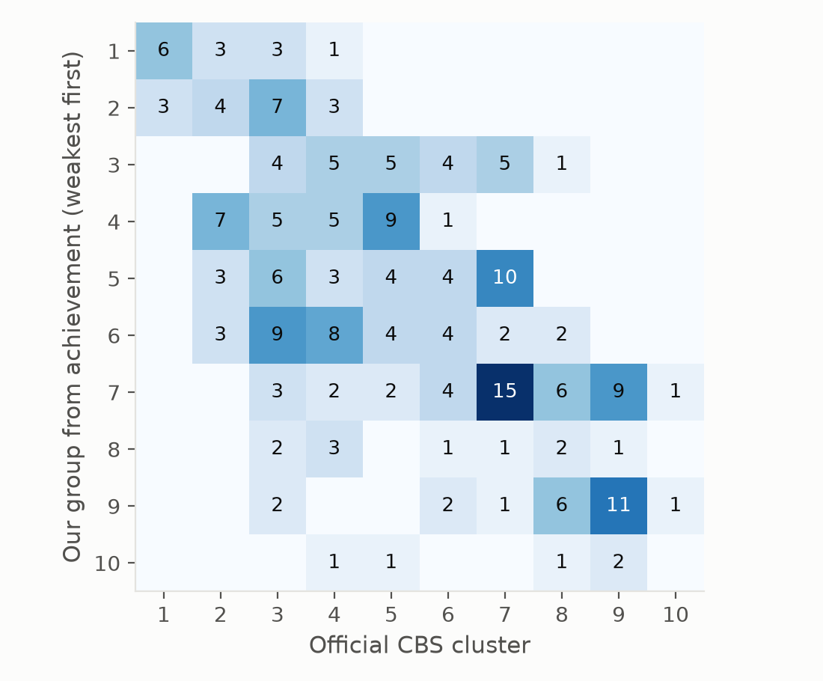
The official clusters are not interchangeable
1.54 clusters
the average distance between an authority's official cluster and the group its grade 8 results put it in, against 2.70 if the two were unrelated
55 of 223
land on the same number, and 43 sit three or more clusters away. The two systems agree on direction and disagree on the details
The same test on the gaps
Clustering the gaps instead of the scores gives a distance of 2.59 against 2.78 if unrelated, which is as close to no relationship as this measure gets. That is the check working: the gaps were built to be independent of socio-economic standing.
Fig 10. Our achievement groups (k = 10) against the official CBS clusters, 223 authorities.
Six of the eight authorities furthest below their official cluster are regional councils, which average several separate communities into one number.
Beyond the Cluster · Tchizik & Cohen
7

Slide 8
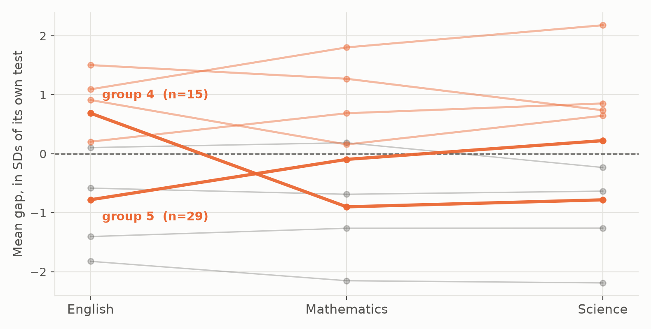
Deviation is not the same in every subject
15
authorities in group 4: above prediction in English and below it in Mathematics and Science, a spread of 1.59 SD. Group 5 is its mirror image
6 of 10
groups are tilted rather than flat. At k = 2 both groups are flat, so at that resolution the clustering adds nothing
A single gap per authority could never have shown this. For a policy reader it matters: an authority strong in English and weak in Mathematics needs something different from one that is uniformly behind.
Fig 11. Mean gap per achievement group across the three grade 8 subjects taught in both sectors, k = 10.
Over-performing is not one thing.
Beyond the Cluster · Tchizik & Cohen
8

Slide 9
The twenty authorities that survive everything
Over-performing: 13
Under-performing: 7
Authority | Cluster | Mean gap
Kafar Yasif | 4 | +2.12
Har Hevron | 5 | +1.43
Giv'at Shemu'el | 8 | +1.40
Har Adar | 9 | +1.27
Yirka | 3 | +1.25
Kisra-Sumei | 3 | +1.00
Arrabe | 3 | +0.99
Bet Dagan | 7 | +0.96
Yoqne'am Illit | 7 | +0.91
Tel Mond | 9 | +0.87
Efrat | 7 | +0.79
Binyamina-Giv'at Ada | 9 | +0.68
Qiryat Yam | 5 | +0.55
Authority | Cluster | Mean gap
Laqye | 1 | -2.08
Jisr az-Zarqa | 2 | -1.88
Basmat Tab'un | 3 | -1.83
Hagalil Haelyon | 7 | -1.69
Lehavim | 10 | -0.69
Emeq Hama'ayanot | 6 | -0.65
Be'er Sheva | 5 | -0.56
Why twenty and not sixty-five
Requiring every row of an authority to agree is an all-or-nothing test. Dropping the two smallest rows in the whole table moves eight of the 65 on or off the list, so its membership is a snapshot. These 20 are flagged under all seven rebuilds, so they are the list we would stand behind.
Both lists mix sectors, clusters from 1 to 10 and all three authority types. Nothing we measured separates them: that is the finding, and the limit of it.
Mean gap is in standard deviations of that subject and grade, averaged over the authority's rows. Positive is above prediction. Full ranking of all 243 in data/authority_gaps.xlsx.
Beyond the Cluster · Tchizik & Cohen
9

Slide 10
What we can say
1
About half of an authority's score is predictable
The random forest reaches R² = 0.530 on authorities it has never seen, against 0.281 for a baseline that knows only the subject and the grade. The documented gradient is there, strongest in English grade 8 (r = 0.75) and weakest in Arabic grade 5 (r = 0.10).
2
Which test it is outweighs everything we know about the authority
Shuffling the four test-identity variables costs 0.609 of R²; shuffling all sixteen socio-economic variables costs 0.374. So the answer to the proposal's question is no, though socio-economic standing is still the second of two large blocks.
3
Twenty authorities deviate robustly, and none ever flips
Sixty-five of 238 deviate consistently under the pre-specified analysis, 33 above and 32 below. Twenty survive all seven rebuilds, and across every variation no authority ever changed direction. That is the strongest claim this project can make.
4
Nothing we measured explains why
Across 22 variables, the 16 the model used and 6 it never saw, the strongest relationship with an authority's gap is r = 0.162. Whatever drives the gaps is plausibly school-level and organisational, and it is in neither dataset.
Beyond the Cluster · Tchizik & Cohen
10

Slide 11
What this cannot say
The ecological fallacy
Every number in this project describes a local authority, not a pupil. Kafar Yasif over-performs its prediction, and that does not mean every pupil there scores above expectation: the authority contains strong and weak results and we never see them separately. Relationships measured between group averages are also usually stronger than the same relationship between individuals, so our correlations would overstate what holds for any one pupil. The findings support decisions about authorities, not claims about the pupils in them.
No causality
Observational and cross-sectional data. The index and the score move together and nothing here identifies a cause: sector composition, geography and school-level resourcing are all plausible confounders.
What the grouped split cost
A split by row would have scored better, and 0.30 of that R² is memorising the authority rather than anything that carries over to a new one. We report the lower, honest number.
Coverage and years
Of the 44 rows with no score, 40 are groups of under 30 pupils, so the smallest authorities are under-represented. 215 of 243 authorities appear in a single year, so year-to-year consistency is only checkable for 28.
A sharp threshold
Three authorities carry median-imputed CBS variables, and the all-or-nothing flagging rule is sensitive at the margin, which is why the list we report is the 20 rather than the 65.
What we would do differently: school-level or pupil-level data to escape the aggregation problem and test the organisational explanation, a real multi-year panel with authority fixed effects, and district and peripherality variables for the geography this analysis lacks.
Beyond the Cluster · Tchizik & Cohen
11

Slide 12
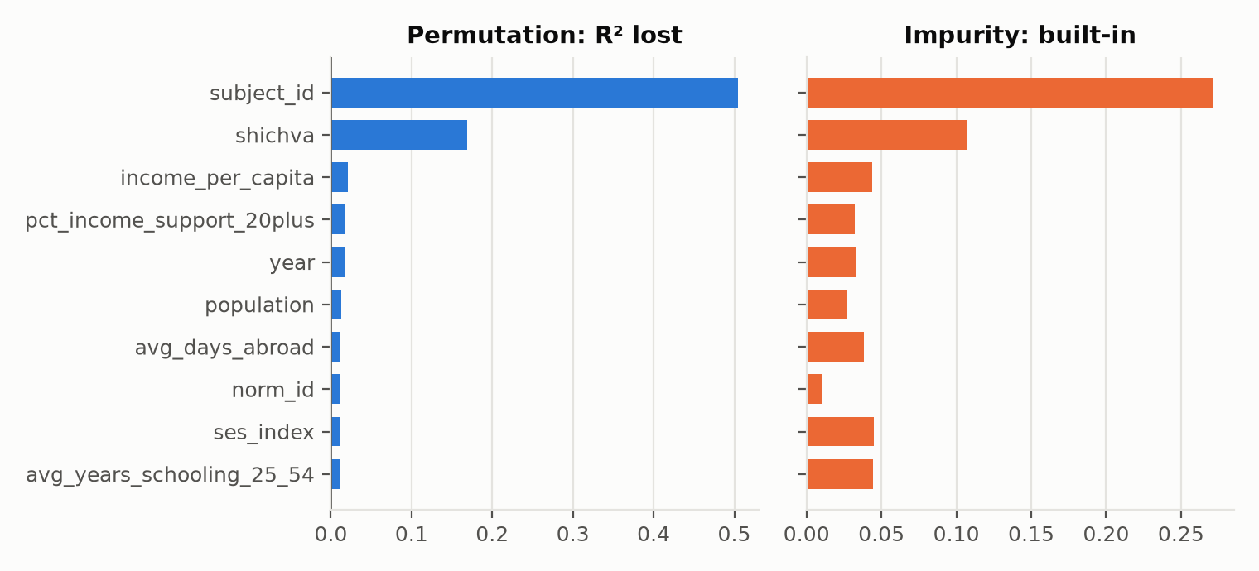
Backup: which variables carry the model
Table 10. Block permutation
Block shuffled | Vars | R² lost
Test identity | 10 | 0.609
Subject and grade only | 6 | 0.602
Socio-economic block | 16 | 0.374
ses_index alone | 1 | 0.012
Why both numbers are needed
ses_index correlates above 0.8 with eight of the CBS variables, so shuffling it alone does almost nothing: the other fifteen rebuild it. Per-variable permutation says socio-economic standing is worth 0.011, the block says 0.374, and both are correct. Reporting only the first would have been misleading.
Fig 13. Per-variable importance, impurity against permutation, with the one-hot dummies summed back per variable.
Subject and grade dominate, and it is not close. Shuffling subject costs 0.505 of R² and grade 0.169; the next variable down is income per capita at 0.021 and ses_index itself ranks ninth, at 0.011.
Beyond the Cluster · Tchizik & Cohen
12

Slide 13
Backup: every rebuild of the pipeline
Table 11. Each row rebuilds the analysis from the raw files to the flagged list, reusing the baseline's tuned settings.
Variation | Rows | Out-of-fold R² | Flagged | Kept of the 65 | Changed direction
Baseline, as reported | 1,749 | 0.537 | 65 | 65 | 0
Sector rows instead of combined totals | 1,826 | 0.515 | 53 | 52 | 0
All years 2015 to 2019 | 2,540 | 0.570 | 44 | 38 | 0
Drop cells under 30 pupils tested | 1,747 | 0.536 | 64 | 57 | 0
Drop cells under 50 pupils tested | 1,653 | 0.560 | 68 | 55 | 0
ses_cluster instead of ses_index | 1,749 | 0.541 | 62 | 61 | 0
Linear regression instead of the forest | 1,749 | 0.400 | 51 | 36 | 0
The last column is zero on every row
Across six rebuilds, including one that changes the model family and one that adds two years of data, no authority ever flips from over-performing to under-performing. Everything else is more qualified: the choice of socio-economic measure barely matters (61 of 65 kept), the data-shape choices cost a handful each, and the year window matters most. Adding 2015 and 2019 keeps only 38, which is mechanical: more years means more rows per authority, and the rule needs every one of them to agree.
Beyond the Cluster · Tchizik & Cohen
13

