Slide 1
Introduction to machine learning
Fiammetta Caccavale

Slide 2
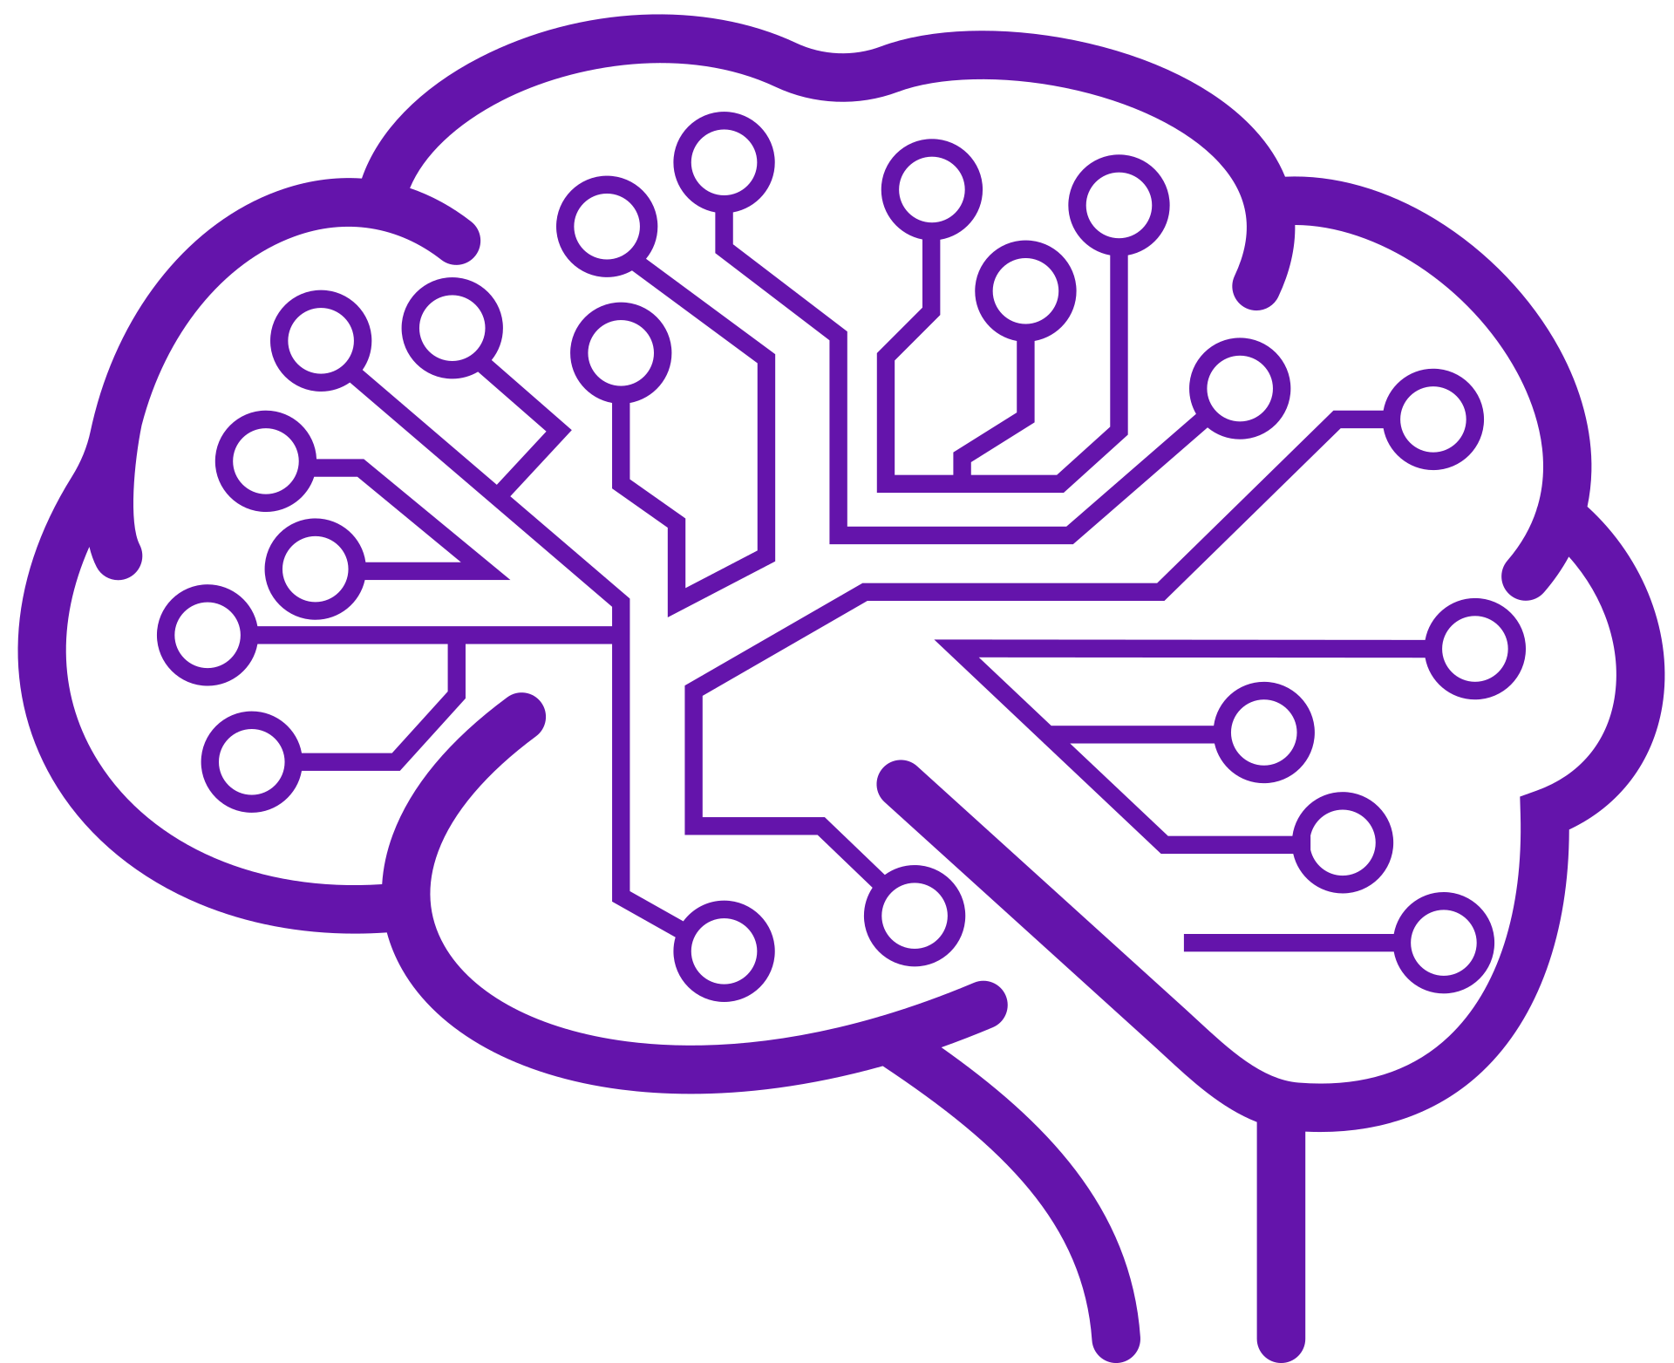
What is AI?
Long History:
The work in this field started soon after the end of World War II, and the term itself was coined in 1956.
Inspired by the human brain:
Current SOTA models are neural networks, which are a very simplified, mathematical model of how our brains work. They contain a vast network of interconnected neurons, which share numerical signals like synapses.
Mimicking Human Intelligence:
AI is a field of computer science dedicated to creating systems that can perform tasks normally requiring human intelligence.
Different AI Types:
AI can be categorized into various types, from narrow AI designed for one specific task (self-driving cars, writing poetry, medical diagnostics) to more general AI that can handle a wide range of tasks.
Learning and Reasoning:
It involves giving machines the ability to learn from data, reason, and make decisions without being explicitly programmed for every scenario.

Slide 3

Historical moments for AI
1950
1956
1965
1969
1980s
1986
"Can machines think?", Turing Test
AI term coined, academic discipline
Eliza, first chatbot is created
Perceptron paper published
Development of expert systems
Backpropagation in neural networks
2016
2014
2011
2011
1998
1997
AlphaGo defeats Go champion
Generative adversarial networks
Apple integrates SIRI
IBM’s Watson wins in Jeopardy
Kismet robot for social interactions
IBM’s Deep Blue victory in chess
2017
2018
2018
2020
2022
2023
Transformer architecture
OpenAI's GPT-1, first LLM
Google’s BERT, transfer learning
OpenAI's GPT-3, scale and power
OpenAI's ChatGPT launch
Claude and Gemini

Slide 4
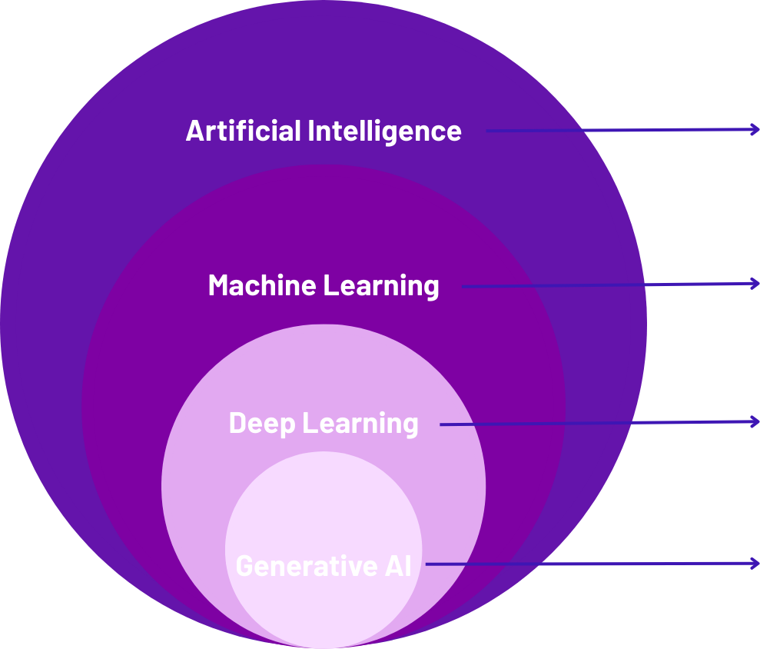
What AI do people refer to?
Artificial Intelligence
Aims to create machines mimicking human intelligence
Machine Learning
Specific branch of AI using algorithms enabling computers to learn from data
Deep Learning
Specialized subfield using neural networks for hierarchical representation learning
Subset of deep learning models that generate outputs like text, images, code

Slide 5
Deep dive into ML

Slide 6
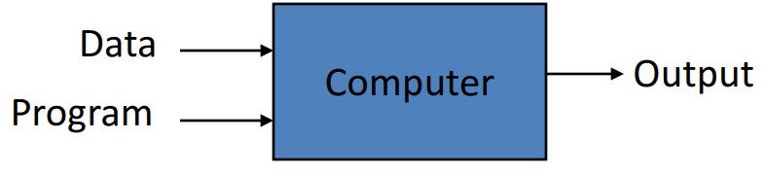
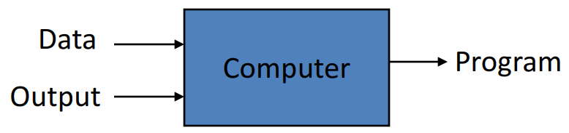
Introduction – Machine learning (ML)
Machine learning Vs. Classical modeling: the main difference between the two approaches resides in the communication between the user and the “computer”.
Classical approach
ML approach

Slide 7
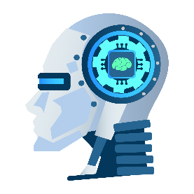
Key concepts in Machine learning (ML)
Supervised & Unsupervised learning
Supervised
Learning
Unsupervised
Learning
Classification
Regression
Clustering
Association

Slide 8
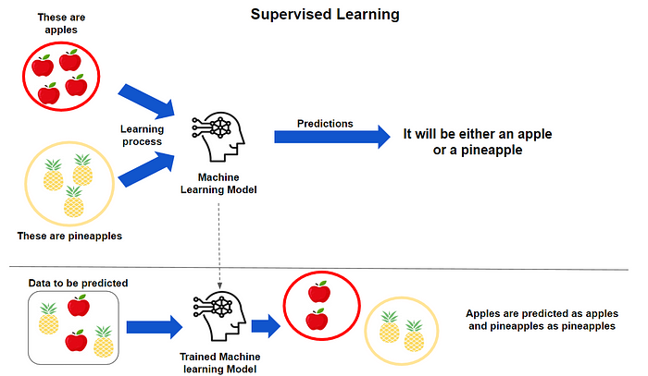
Key concepts in Machine learning (ML)
Classes of machine learning:
Supervised learning: is a machine learning approach where labeled datasets are available. These datasets are used to train (or supervise) the algorithms for predicting an outcome. The labeled inputs and outputs are therefore used for the model to learn over time, and metrics can be calculated to estimate how accurate the model is. Supervised learning can be further divided into classification and regression tasks.
https://medium.datadriveninvestor.com/exploring-the-basics-of-supervised-learning-bfc18fe5ce72

Slide 9
Key concepts in Machine learning (ML)
Classes of machine learning:
Unsupervised learning: is a machine learning approach that uses algorithms to analyze or cluster unlabeled data. The algorithms are used to discover patterns in the data, without the need for human labeling (and are therefore "unsupervised")

Slide 10
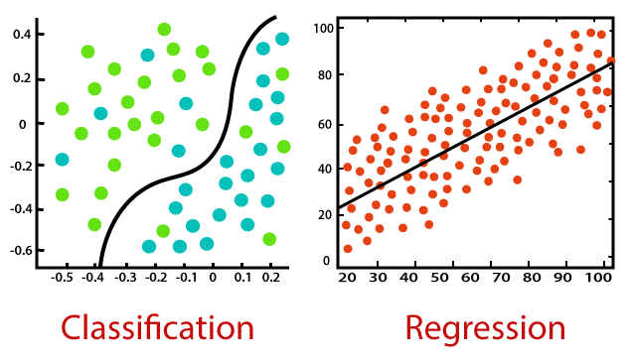
Key concepts in Machine learning (ML)
Supervised learning: classification vs regression
Classification is a process of finding a function that helps in dividing the dataset into classes based on different parameters.
In Classification, a computer program is trained on the training dataset and based on that training, it categorizes the data into different classes.
https://www.javatpoint.com/regression-vs-classification-in-machine-learning

Slide 11
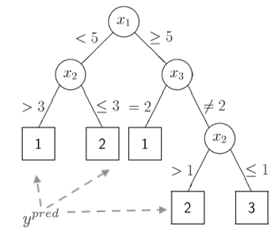
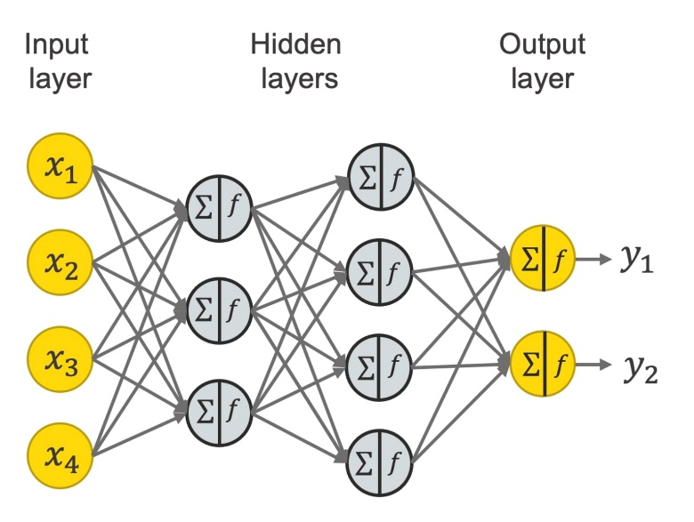
Key concepts in Machine learning (ML)
Algorithms for classification
Decision tree
Deep Neural Networks
Trees (DTs) are a non-parametric supervised learning method used for classification and regression. The goal is to create a model that predicts the value of a target variable by learning simple decision rules inferred from the data features. A tree can be seen as a piecewise constant approximation.
Principle: calculate the gradient of loss function with respect to the weights and biases, and adjust the weights and biases accordingly by backpropagating the error.

Slide 12
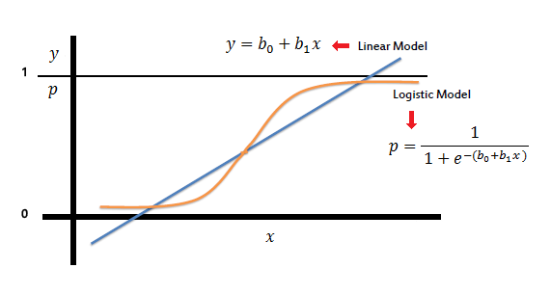
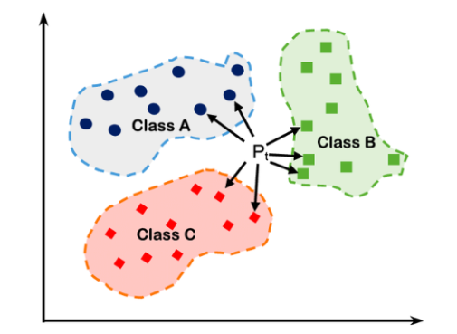
Key concepts in Machine learning (ML)
Algorithms for classification
Logistic regression (binary)
K-nearest neighbors
A linear model for classification rather than regression. The logistic regression is also known in the literature as logit regression, maximum-entropy classification (MaxEnt) or the log-linear classifier. In this model, the probabilities describing the possible outcomes of a single trial are modeled using a logistic function.
A non-parametric, supervised learning classifier, which uses proximity to make classifications or predictions about the grouping of an individual data point. The KNN algorithm works based on the idea that similar things are closer to each other.

Slide 13





Key concepts in Machine learning (ML)
Algorithms for classification – Python
There are many tools developed in Python that allow for ML generic modeling
  Scikit-learn: https://scikit-learn.org/stable/
  Pytorch: https://pytorch.org/
  TensorFlow: https://www.tensorflow.org/
Some packages are very specialized
  Pyro (probabilistic ML): https://pyro.ai/
  GPyTorch (Gaussian processes): https://gpytorch.ai/

Slide 14
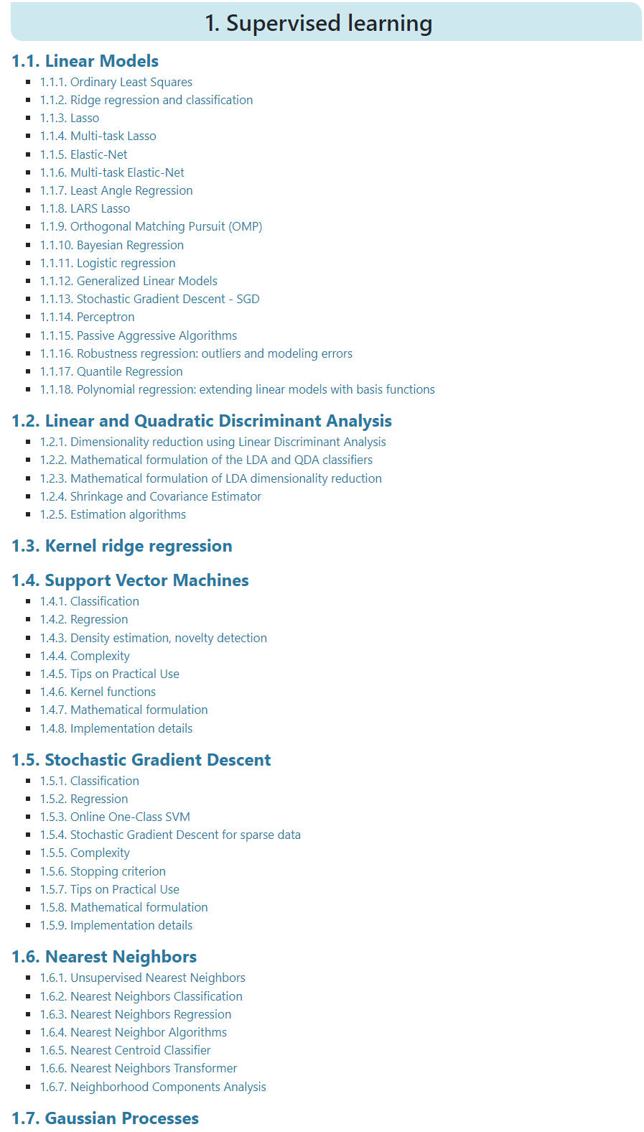

Key concepts in Machine learning (ML)
Algorithms for classification – Python – Scikit-learn
One of the most versatile toolboxes available in Python and offers a wide range of pre-implemented algorithms.
  Gradient boosting
  Linear and Quadratic Discriminant Analysis
  Support vector machine
  Bayesian ridge classification
  Logistic regression - classifier
  Nearest neighbours
  Gaussian processes
  Decision trees
  Neural Networks
  Etc,
https://scikit-learn.org/stable/supervised_learning.html

Slide 15
Key concepts in Machine learning (ML)
Supervised learning: classification vs regression
Regression is a process of finding the correlations between dependent and independent variables. It helps in predicting continuous variables such as prediction of Market Trends, prediction of House prices, process yields, etc.
In regression, a computer program is trained on the training dataset and based on that training, it aims to extrapolate to unseen events present in the validation or test data
https://www.javatpoint.com/regression-vs-classification-in-machine-learning

Slide 16
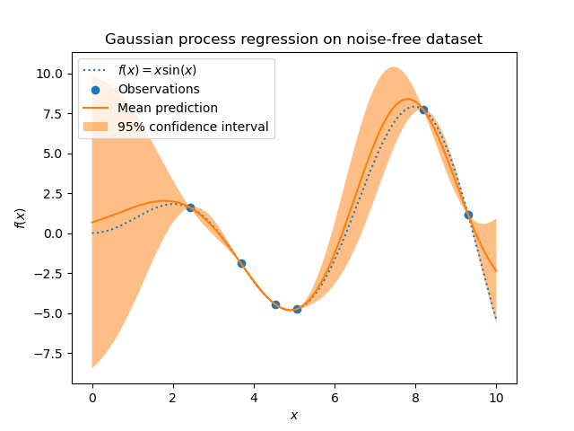
Key concepts in Machine learning (ML)
Algorithms for regression: examples
Gaussian process
Deep Neural Networks
For this, the prior of the GP needs to be specified. GP will combine this prior and the likelihood function based on training samples. It allows to give a probabilistic approach to prediction by giving the mean and standard deviation as output when predicting
Principle: calculate the gradient of loss function with respect to the weights and biases, and adjust the weights and biases accordingly by backpropagating the error
https://www.knime.com/blog/a-friendly-introduction-to-deep-neural-networks

Slide 17
Key concepts in Machine learning (ML)
Algorithms for regression – Python
There are many tools developed in Python that allow for ML generic modeling
  Scikit-learn: https://scikit-learn.org/stable/
  Pytorch: https://pytorch.org/
  TensorFlow: https://www.tensorflow.org/
Some packages are very specialized
  Pyro (probabilistic ML): https://pyro.ai/
  GPyTorch (Gaussian processes): https://gpytorch.ai/

Slide 18
Key concepts in Machine learning (ML)
Algorithms for regression – Python – Scikit-learn
One of the most versatile toolboxes available in Python and offers a wide range of pre-implemented algorithms.
  Gradient boosting
  Elastic net regression
  Support vector machine
  Bayesian ridge regression
  CatBoost regression
  Kernel ridge regression
  XGBoost regression
  Gaussian processes
  Decision trees
  Neural Networks
  Etc,
https://scikit-learn.org/stable/supervised_learning.html

Slide 19
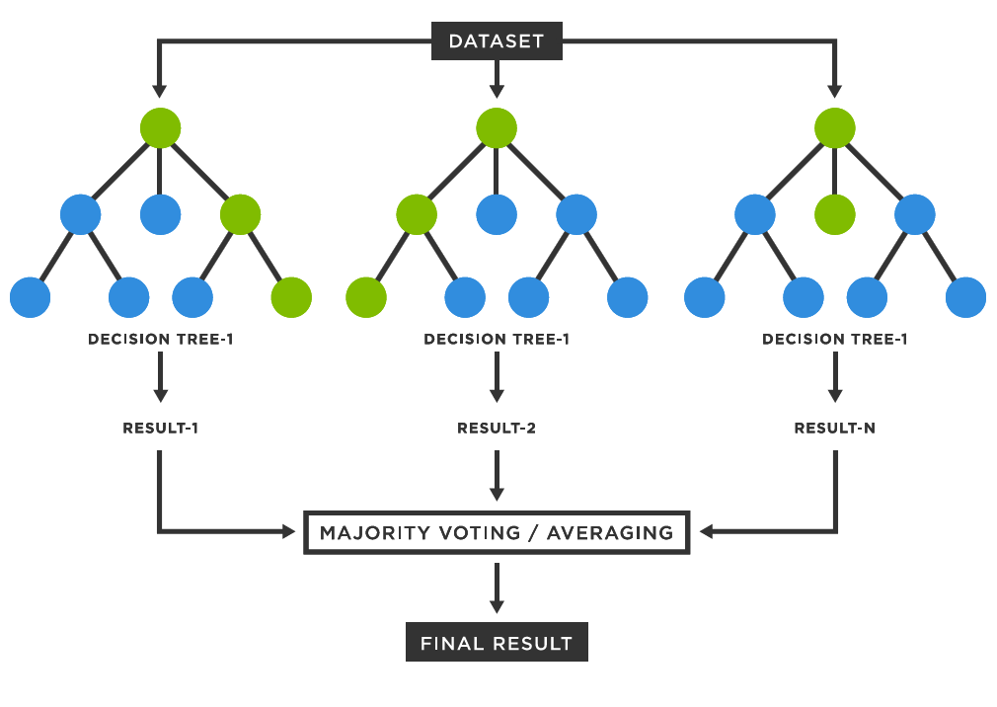
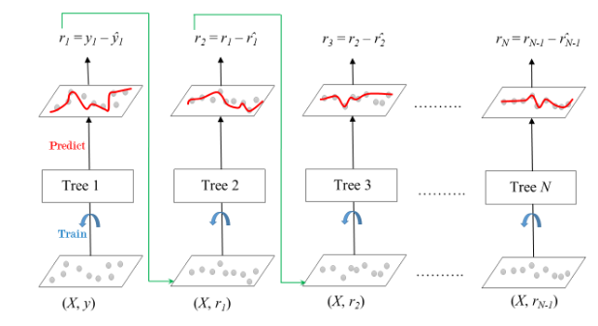
Key concepts in Machine learning (ML)
Algorithms for ensembles: wisdom of the crowd
Random Forest
Gradient Boosting

Slide 20
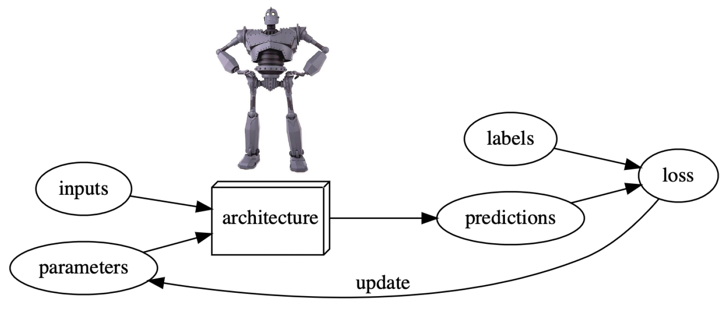
Key concepts in Machine learning (ML)
How to train your dragon ML model

Slide 21
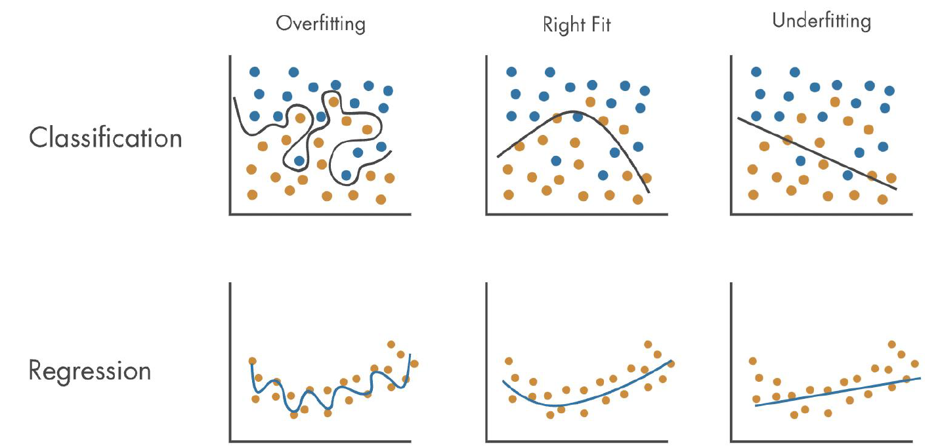
Key concepts in Machine learning (ML)
How to train your ML model
As for any other model, the ML models usually are at risk for either overfitting and underfitting

Slide 22
Key concepts in Machine learning (ML)
How to train your ML model
As for any other model, the ML models usually are at risk for either overfitting and underfitting

Slide 23
Key concepts in Machine learning (ML)
How to train your ML model
Training an ML model usually goes through the following steps:
  Data preprocessing:
    Scaling
    Data spilling
  Model training
    Adjust the weights to achieve the best outcome
    Hyperparameter tuning
  Model testing
    Test the model on a holdout dataset
  Model deployment
Data preprocessing
Model training
Model testing
Deployment

Slide 24
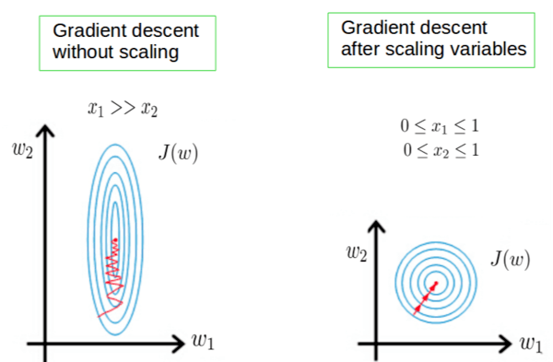
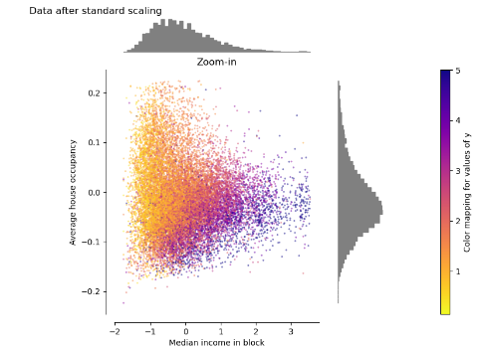
Key concepts in Machine learning (ML)
How to train your ML model
Scaling the model input and output

Slide 25
Key concepts in Machine learning (ML)
How to train your ML model
Data splitting is important to prevent data leakage (information from the test set going into the model training)
https://scikit-learn.org/stable/modules/classes.html#module-sklearn.model_selection

Slide 26
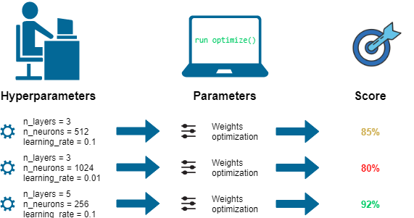
Key concepts in Machine learning (ML)
How to train your ML model
Systematically adjust the hyperparameters in order to achieve good performance.
  Bayesian optimization
  Grid search
  Random search

Slide 27
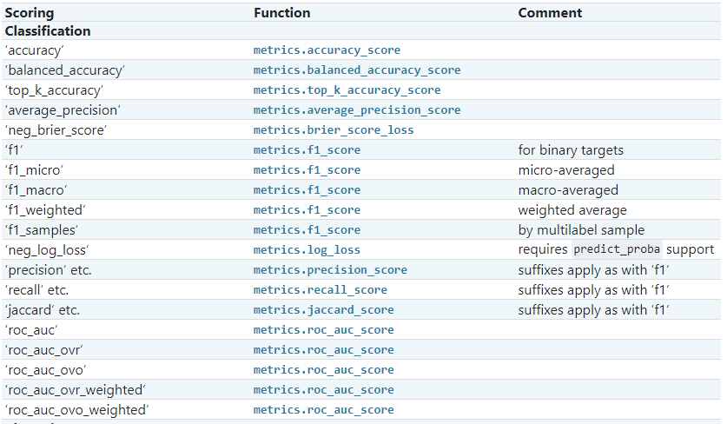
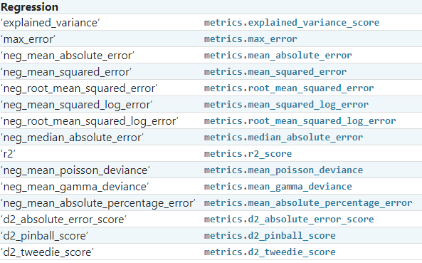
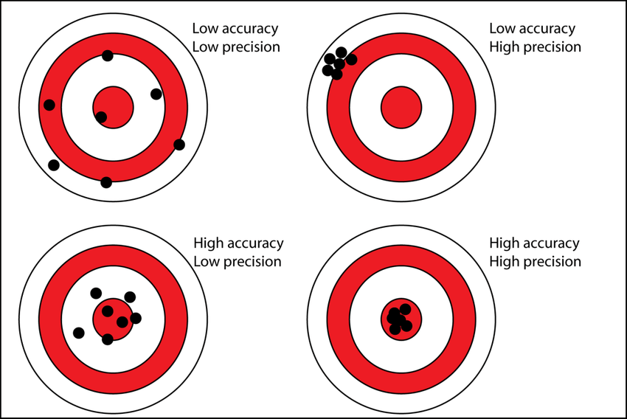
Key concepts in Machine learning (ML)
How to train your ML model
Model evaluation
Classification
Regression
https://scikit-learn.org/stable/modules/model_evaluation.html

Slide 28
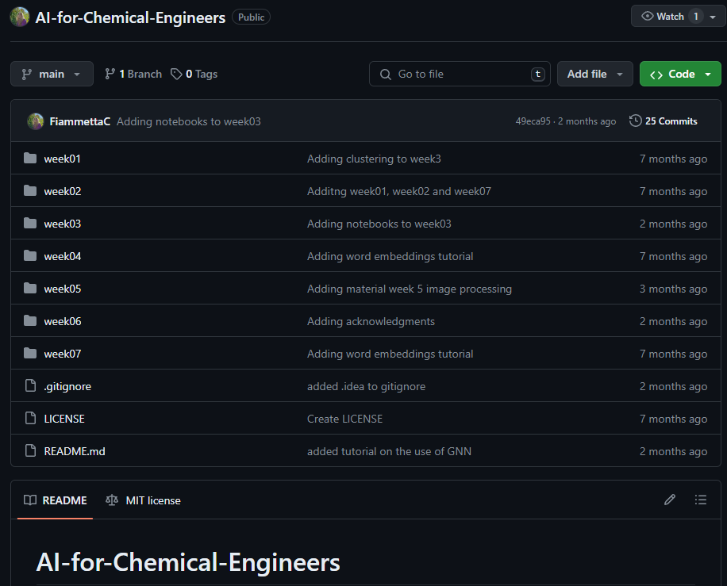

Want to get started on Python and ML
Open-source course in Python
Tailor-made course for chemical engineering
Scan me

Slide 29
Tutorials
Classification and regression materials and exercises at:
AI-for-Chemical-Engineers/week03 at main · FiammettaC/AI-for-Chemical-Engineers · GitHub

Slide 30
If you have questions, feel free to write Fiammetta Caccavale at fiacac@dtu.dk
Slides credits: Fiammetta Caccavale, Sebastian Topalian, Adem R. N. Aouichaoui

