Slide 1

Exploratory Data Analysis Using Epic Games Repository Data
By : Muhammad Daffiano Rahmatullah (Fian)

Slide 2
The Purpose is..
The purpose of analyzing this dataset is to determine the development games released on the epic games platform by exploratory using SQL as well as visualize by creating a dashboard.

Slide 3
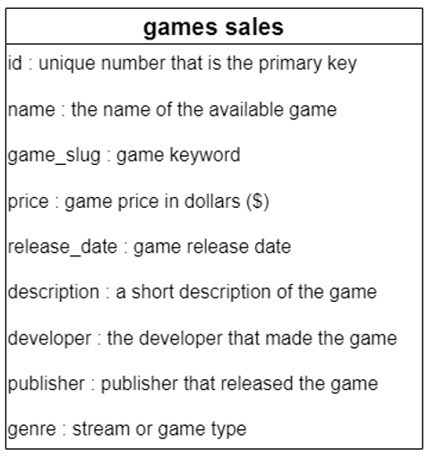
About Dataset

Slide 4

Let’s Cleaning Dataset with :

Slide 5
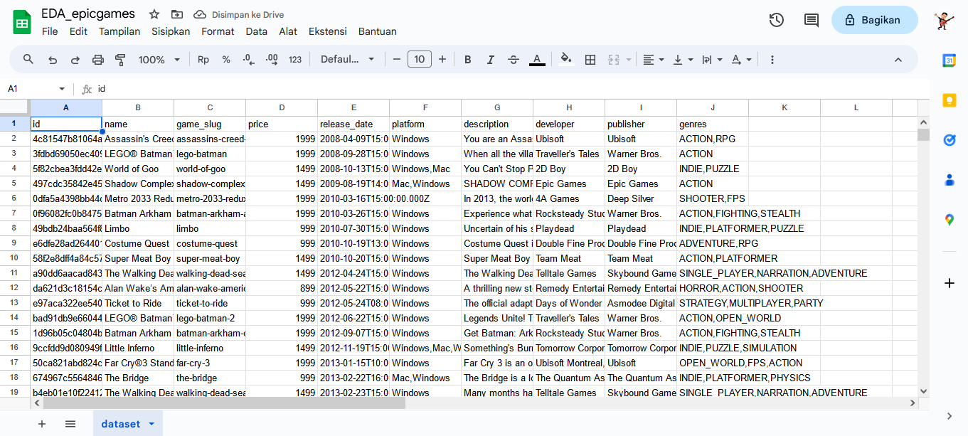
Import The Dataset

Slide 6
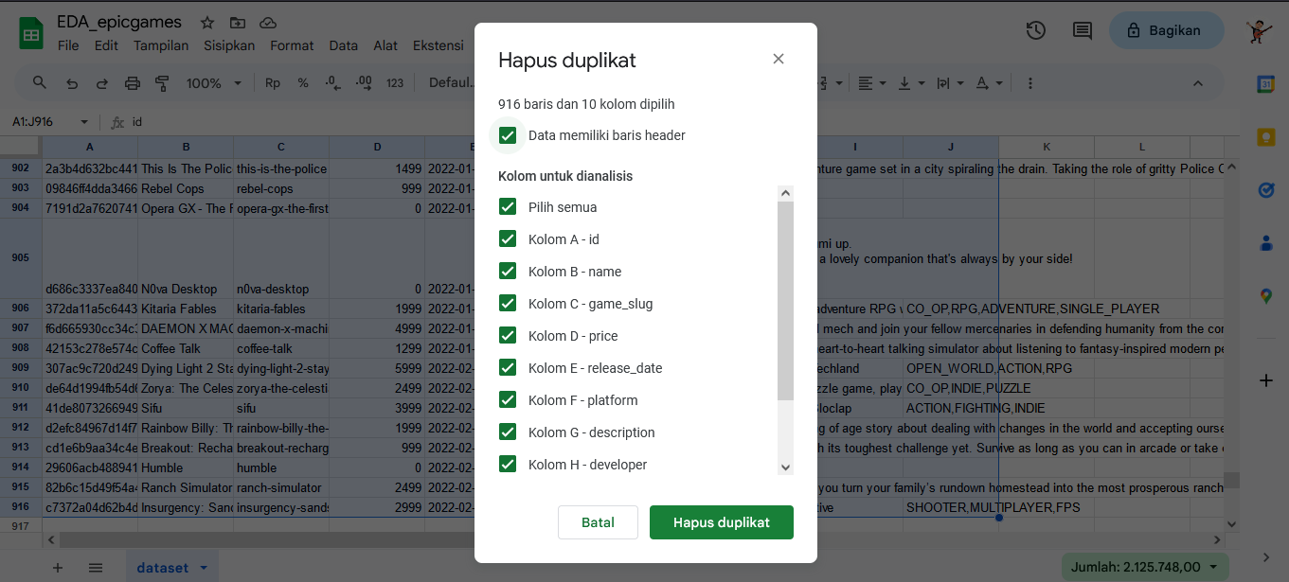
Remove Duplicates Data

Slide 7
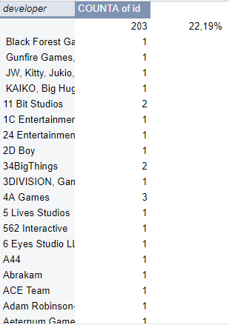
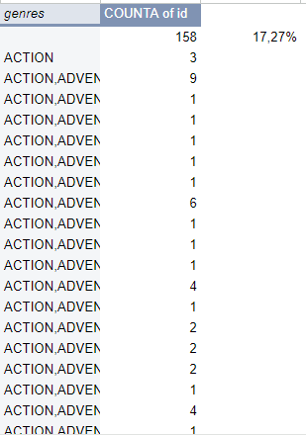
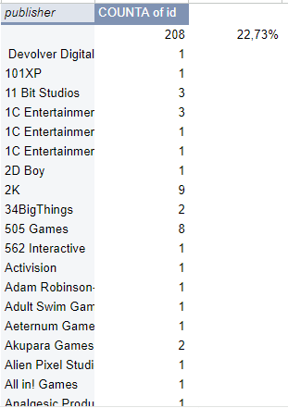
Find Missing Data

Slide 8
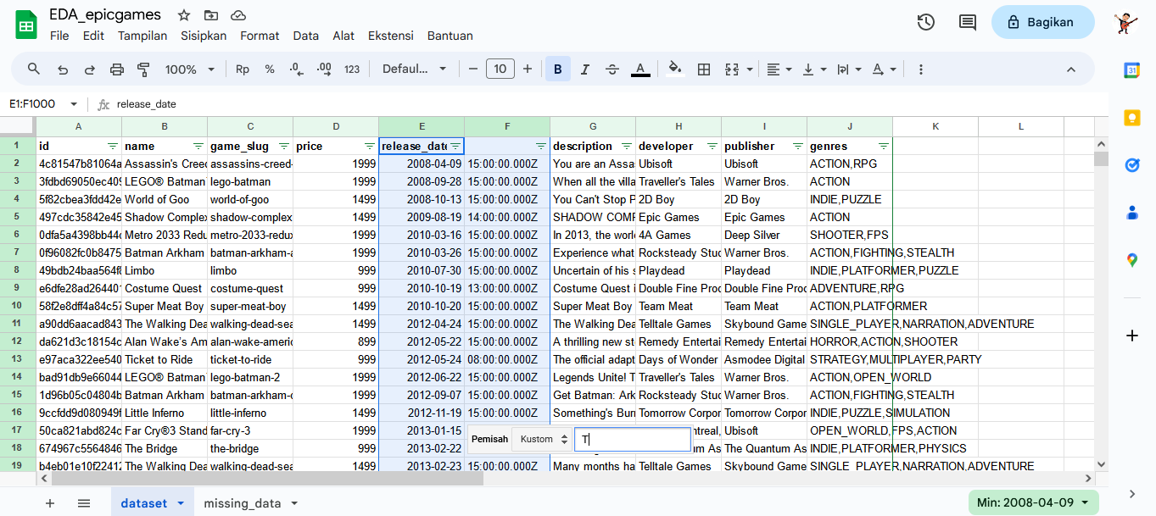
Handle Release Date Column

Slide 9
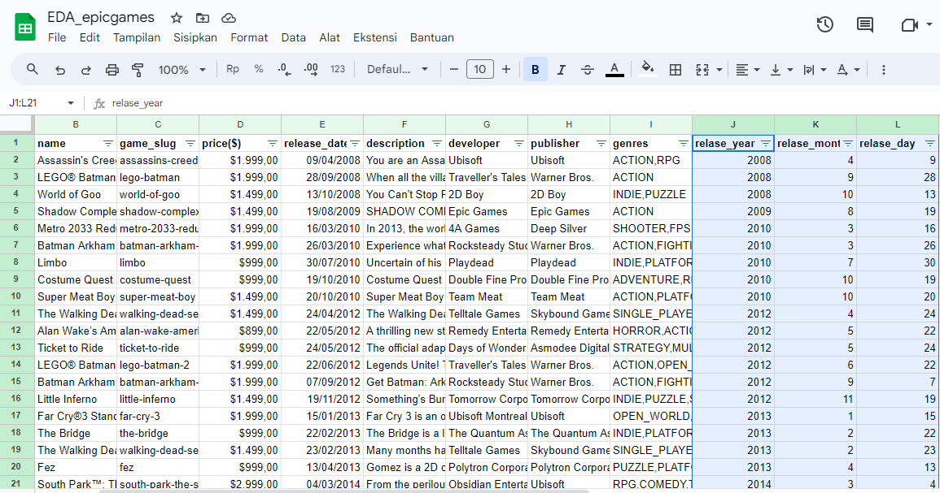
Adding Release Year, Month, and Day

Slide 10
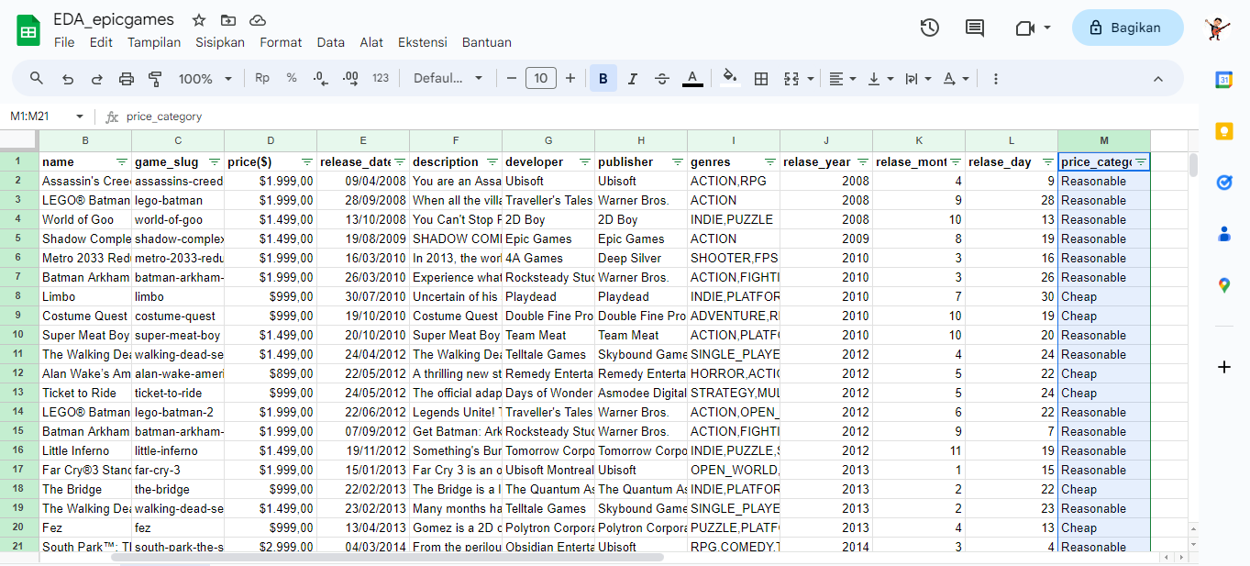
Adding Price Category

Slide 11


Let’s Exploratory This Dataset With :

Slide 12

Showing Games Containing Batman Elements
Problem solving:
shows the game that contains the elements of batman along with the price.
selects the games that contain the batman elements.

Slide 13
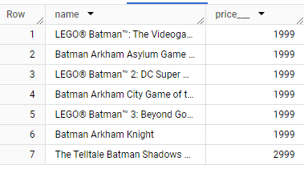
Results

Slide 14

Showing Games With Specific Genres Along With Prices and Price Categories
Problem solving :
shows the game that has a specific genre.
adds the price and price category of each game.
filters the game genre that will be displayed

Slide 15
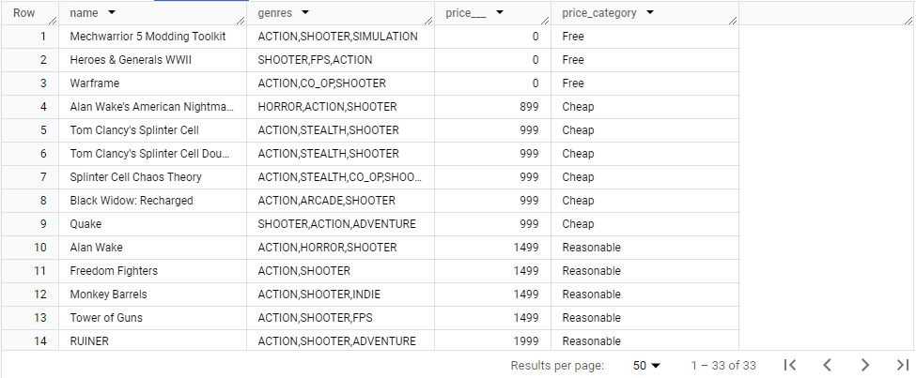
Results

Slide 16

Showing Horror Games where price Between 1000 to 2500
Problem solving :
showing horror games
filter by game price
sort games by price

Slide 17
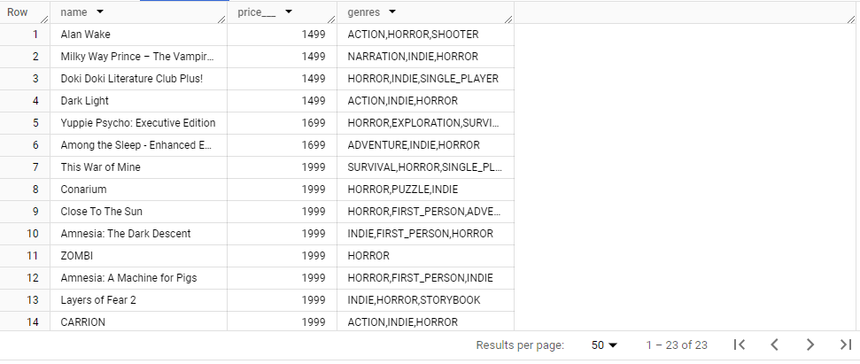

Slide 18

Showing Games From 01/2021 to 05/2021 With Cheap Price Categories
Problem solving :
showing all games
filter date from 01/2021 to 05/2021
filter price category by cheap
sort games by price

Slide 19
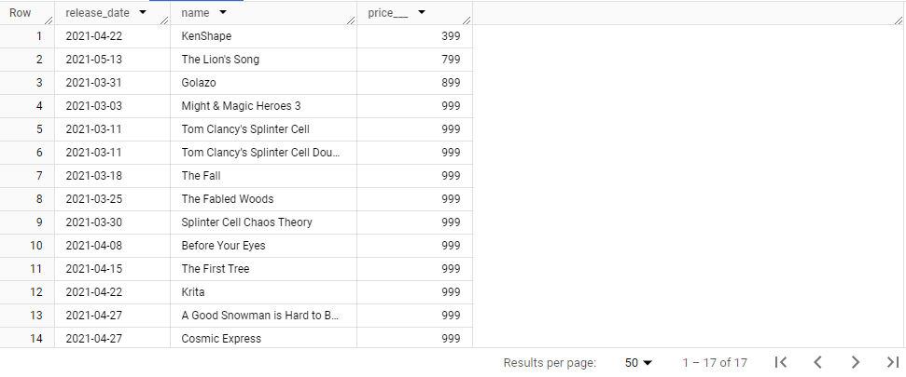

Slide 20

Showing Comparison About Price Category
Problem solving :
displays the price categories in the data set.
calculates the game based on the price category.
orders the data.

Slide 21
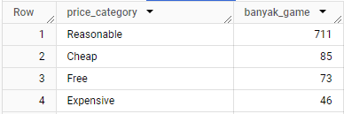
Results

Slide 22

Showing The Number of Games Based on The Year of Release With The Total Price and Averages That Have Been Generated
Problem solving :
show year of release.
count the number of games.
count the total price and average game price.
sort the data

Slide 23
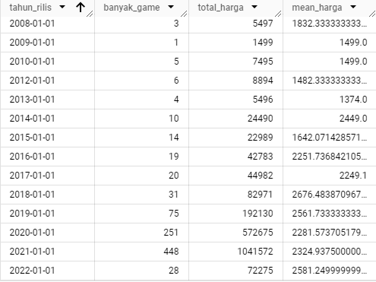
Results

Slide 24

Let’s make visualization with :

Slide 25
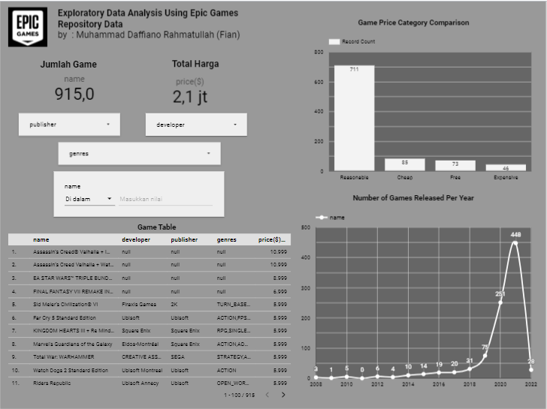

Slide 26
Dashboard Link
https://lookerstudio.google.com/reporting/1af7574a-e121-4157-bcb9-abd760a1c53b

Slide 27
Conclusion
Epic Games has 4 categories of games free, cheap, Reasonable, and Expensive as well as total games in epic games platform have 915 games released in our platform. In The Year 2021 is the year with the highest number of games released, namely 448 game. Meanwhile, in 2009 the number of games released only as much as 1 game. On our platform, we dominate the Reasonable category with a total of 711 games. While the game with Cheap category as many as 85 games and free category 73 games. For the Expensive category, there are only 46 games. In the dataset that I use is still found missing values contained in developer, publisher, and genres. So that most developers are Ubisoft has 27 games. While the most publishers are Ubisoft with 58 games.

