Slide 1
Exploratory Data Analysis Using Games Sales Repository Data
by : Muhammad Daffiano R (Fian)

Slide 2
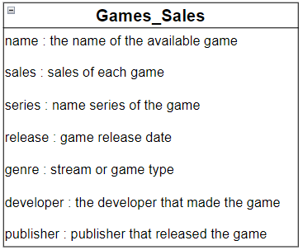
About Dataset

Slide 3


Let’s exploratory this dataset with :

Slide 4

Import Library

Slide 5
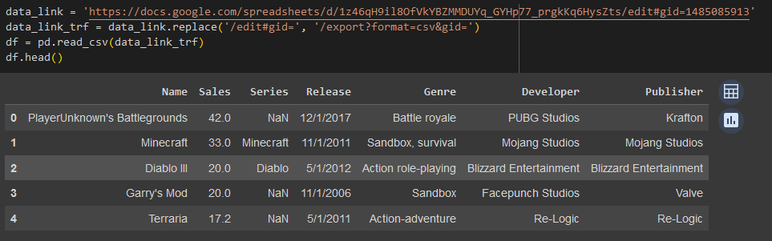
Import Dataset

Slide 6
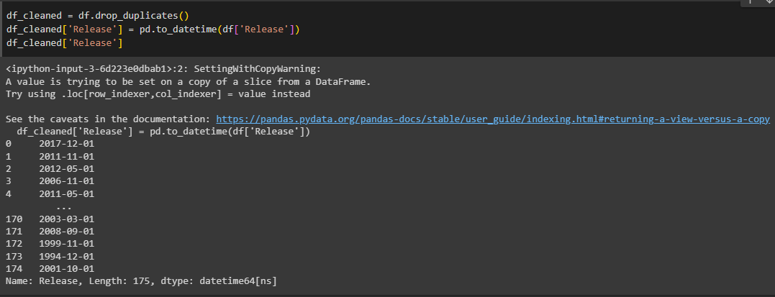
Changing The Release Column Data Type

Slide 7
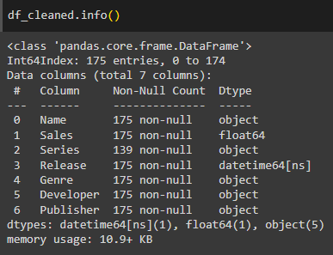
Getting The Information About Dataset

Slide 8
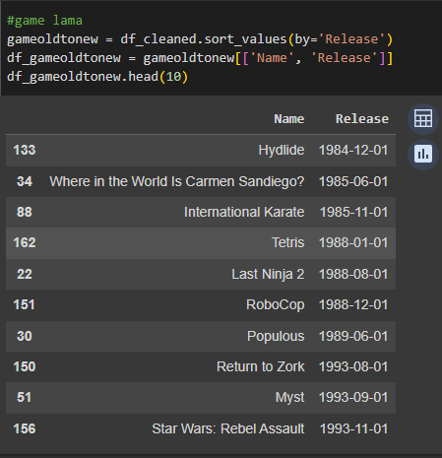
Showing The Oldest Games In The Dataset

Slide 9
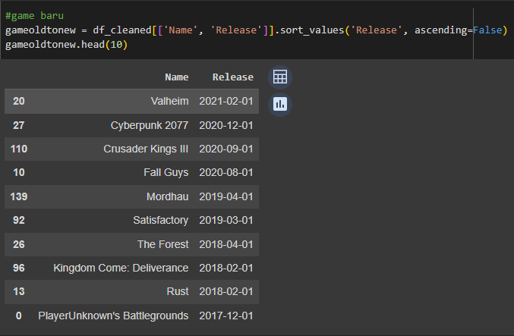
Showing The Newest Games In The Dataset

Slide 10
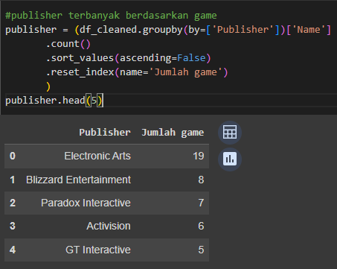
Showing The Publishers Who Released The Most Games

Slide 11
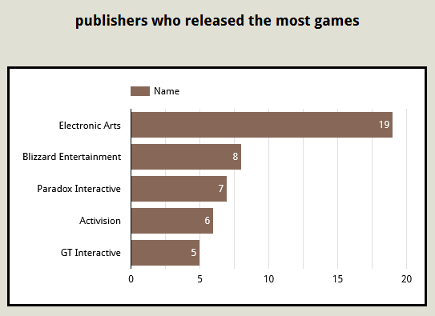
Publisher Electronic Arts has released 19 games on our platform. Blizzard Entertainment only released 8 games and Paradox released 7 games. Publisher Activision only released 6 games and GT Interactive only released 5 games.

Slide 12
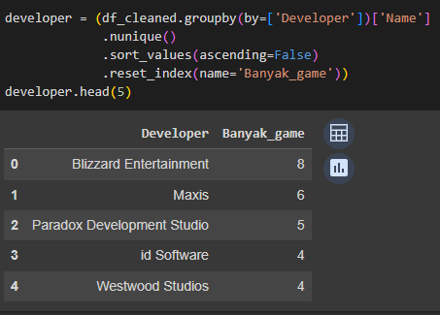
Showing Developers Who Make The Most Games

Slide 13
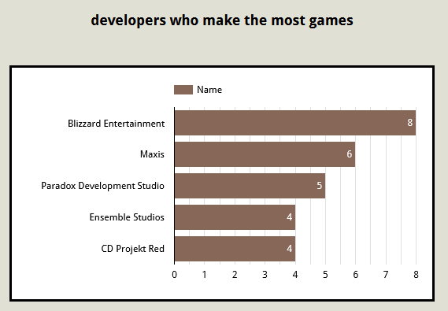
Blizzard Entertainment is the largest game developer, with 8 games. Maxis produced 6 games and Paradox produced 5 games. Developers Ensemble and CD Projekt Red each produced only 4 games

Slide 14
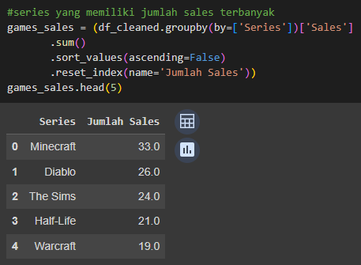
Showing Series Has The Most Sales
The series that generated the most sales was the Minecraft series with 33 sales. The Diablo Series came in second with 26 sales. The Sims has 24 sales, making it third. Half-Life came in third with 21 sales. StarCraft have 19 sales, making it fifth

Slide 15
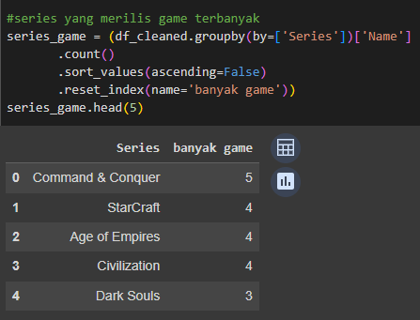
Showing Series Have The Most Games
The Series that has many games is Command & Conquer which has 5 games. In the second place is the StarCraft series with 5 games. Age of Empires is third with 4 games. This is the same number as the Civilization Series but comes in fourth. In fifth place is the Dark Souls series with 3 games

Slide 16
Python link:
https://colab.research.google.com/drive/1kVxpvJrIdVlKHeRRtLQ7mdEaqzyFzdWv?usp=sharing

