Slide 1
Exploratory Data Analysis Using e-Commerce Repository Data
By : Muhammad Daffiano Rahmatullah

Slide 2
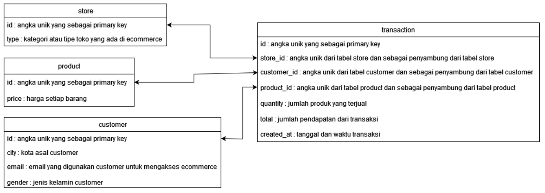
Dataset
In the portfolio that I'm going to create, I use an e-commerce dataset consisting of four tables. As for the draft table can be seen on the following ERD diagram

Slide 3



Slide 4

Showing Product id With Price < 1000
problem solving
filters the product price < 1000
displays the id with the price of the product < 1000
sort the data

Slide 5
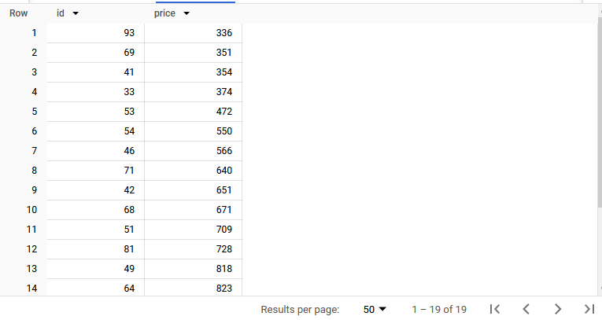
Description:
The above table contains the product id data that has a price < 1000. The data in the table is already ordered ascending by price. The number of products that have a price< 1000 is 19 products.

Slide 6

Showing The Amount of Transactions, Revenue and Amount of Products Sold Monthly
problem solving :
count the number of transactions
sum up the total revenue and goods sold
change the format of the date to the month
collecting data

Slide 7
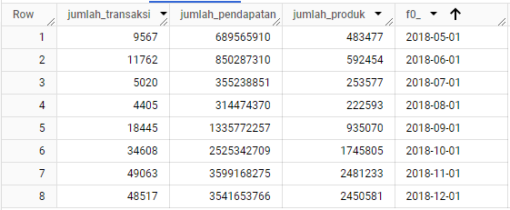
Description :
The data in the table above are already sorted by the month of May to December. The number of transactions, revenue, and products in June has increased. In July and August the number of trades has decreased along with the amount of revenue and products. Furthermore, in September to November the volume of transaction, income, and product has risen again.

Slide 8
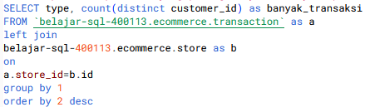
Showing the type of store that mostly serves buyers
problem solving :
group the store type
show the number of customers in each store
merge the transaction table with the store
sort the data

Slide 9
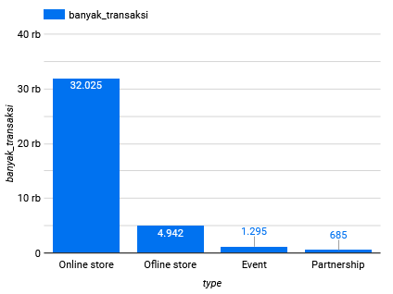
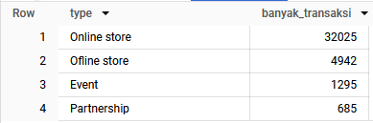
Description :
In the table above, the number of transactions by store type has been described. In the visualization that has appeared, it can show the store with the type of online store that serves the most buyers. Stores that serve the least buyers are stores with partnership type

Slide 10



Slide 11

Python library
In this case study, three Python built-in libraries will be used:
a numpy library used to analyze and manipulate structured data
a pandas library for processing numerical and scientific computing
a matplotlib library that is used to visualize data.

Slide 12
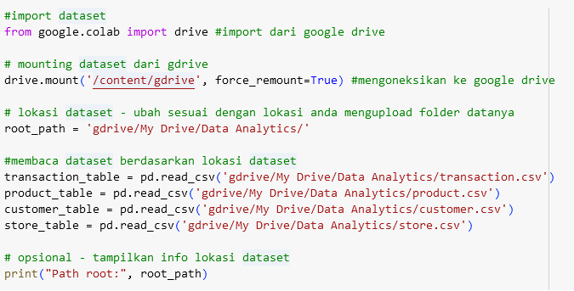
Import dataset
In data processing using python dataset used is still the same as SQL processing. It's just that the storage location of this dataset for python processing is located in google drive. The coding to import the dataset is :

Slide 13
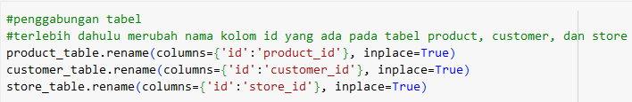
Rename row id
Before merging the data, first change the name of the id column in the product, customer, and store tables. This is to prevent data redundancy. The coding to change the name of the id column is :

Slide 14
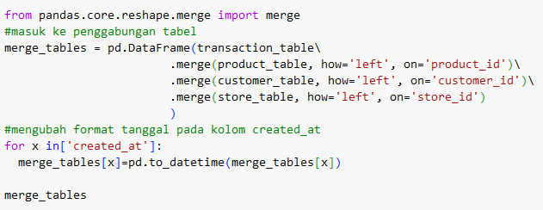
Merge table
Then combine all four tables into one table. This table merge implements a left join and uses the help of the pandas library. Not only does the table merge, the entity or created_at column in the transaction table will be converted to a date format. The codingan merging tables are :

Slide 15
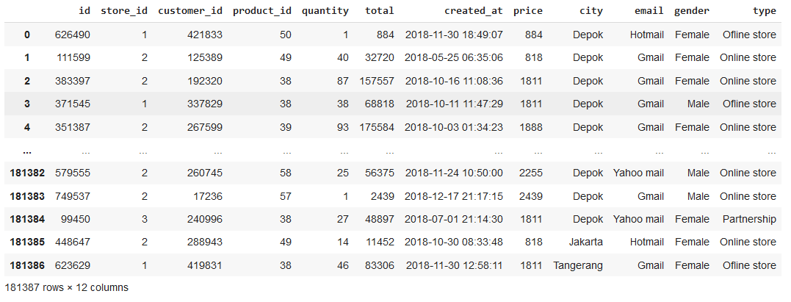
The table above is the output of the table merger. It shows that entities or columns in the table customer, store, and product have been merged.

Slide 16
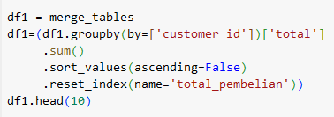
Showing 10 customer id with the largest total overall purchase.
Problem solving :
displays 10 ids each of the largest purchases
summarizes total based on customer id
sorted up data (descending)

Slide 17
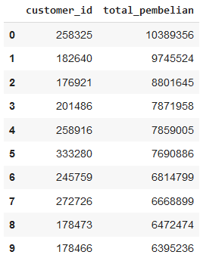
Description:
From the table that has been generated, the data is visible in decreasing order. As well as the id that generated the largest total purchase is 258325.

Slide 18
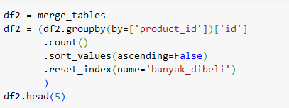
Showing the 5 most purchased product id
Problem solving :
showing the 5 most sold product id
counting the number of purchases each product id
sorting the data upwards (descending)

Slide 19
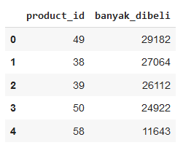
Description :
The table and diagram above has shown the 5 most bought product ids. The 49 most purchased product ID are shown. To calculate the total number of purchases, use the count() function. Use this function because id is a unique number and not to be summed.

Slide 20
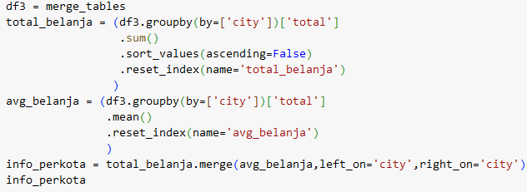
Showing total purchases and average purchases from customers per city
Problem solving :
show each city with total and average spending
sum total spending of each city
calculate the average for each city
sort data

Slide 21
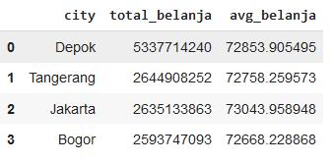
Description :
The city with the highest total spending is Depok but has an average spending of 72853,905. While the city that has the highest average shopping is Jakarta but has a total of 2635133863 shopping. To find out the total expenditure using the function sum (). As well as to find the average using the mean () function.

Slide 22
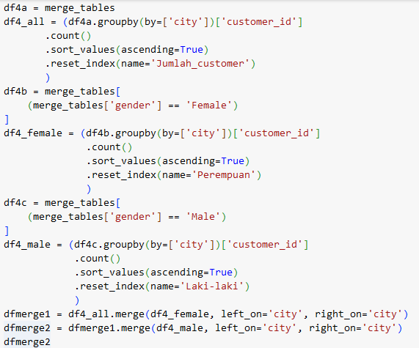
Comparing the most male or female customers per city
Problem solving :
counting the number of male and female customers per city
sorting the data

Slide 23
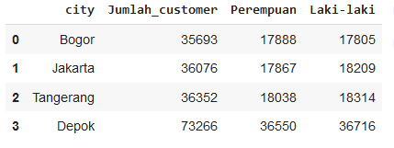
Description:
As in previous results, Depok City has the highest total purchases. The results showed Depok city has the number of customers 73266. As well as for male buyers more than female.

Slide 24
TERIMA KASIH

