Slide 1
Finding Optimal Stations for NYY Hat Sales
By: William Paulson

Slide 2
Introduction
Hat Hawkers House (HHH) wants to increase revenue
Perform exploratory data analysis on New York MTA turnstile data
Find best stations
Deploy Hat Hawkers efficiently to maximize sales potential

Slide 3
Methodology
Focus on Exit Data for Weekday Night Games
Find Exit Traffic Information for Summer 2019 (May-August)
Isolate days during timeframe when fans would be most likely to travel
Differentiate the data between Game days and regular days
Analyze the results
Data
New York MTA turnstile Data
NY Yankees 2019 Schedule
Tools
Python
Pandas
Datetime
Matplotlib
SQLite
SQLalchemy

Slide 4
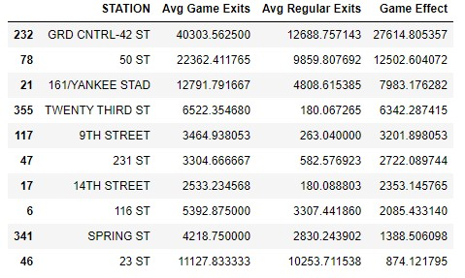
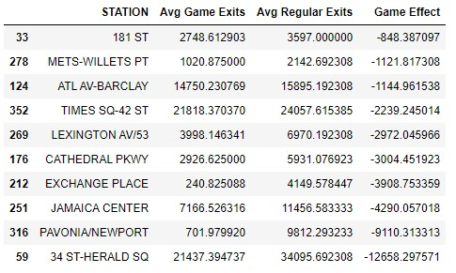
Biggest “Game Day” Effect

Slide 5
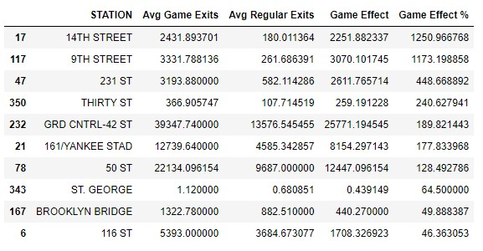
Game Day Effect as Percentage

Slide 6
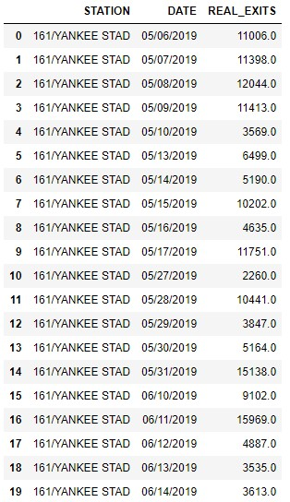
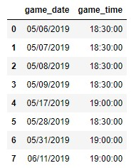
Best Station – 161st-Yankee Stadium

Slide 7
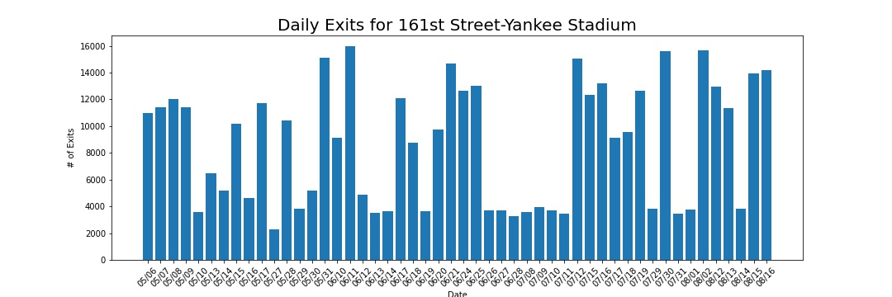
Plot of Exits over Time

Slide 8
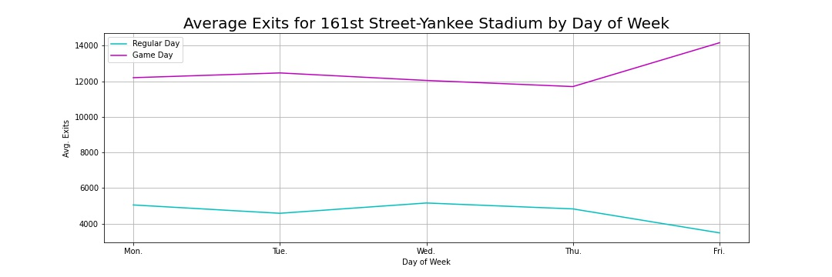
Traffic by Day of the Week

Slide 9
Conclusions
Best Places to Sell
Grand Central Station- 42nd St
161st St-Yankee Stadium
Worst Places
Jamaica Center
Pavonia-Newport
Best Time to Sell
Fridays showed 14% higher traffic

Slide 10
Future Work
Effect of double-headers
Wednesday Day Games
Weekend Games
Effect of weather on subway traffic

Slide 11
Appendices

Slide 12
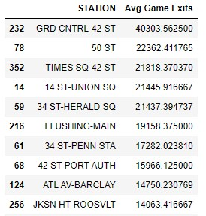
Highest Exit Traffic

Slide 13
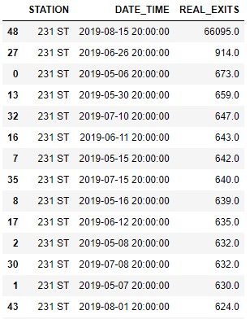
Outlier Skew

