Slide 1
Building and Deploying a Home Run Model
By: William Paulson

Slide 2
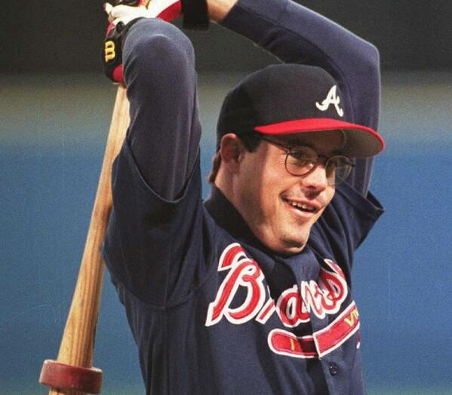
The Home Run Model App
Linear Regression to Predict Home Runs
The most exciting part of every game
Huge asset to Fantasy Baseball Managers
Home Runs have been increasing
2017 – 6105 home runs
2019 – 6776 home runs

Slide 3
Methodology
Web Scrapping
Grab stats of every batter since 1946
Curate list to exclude duplicate entries
Clean data for better storage and modelling
Database Management
MongoDB to handle large database size
Pandas to handle smaller dataframes for coding
Linear Regression
Evaluate models to get best fit
Web Deployment
Flask and HTML to make an accessible app
Data
Baseball Reference
Scraping
Beautiful Soup & Requests
Database
Pandas, Numpy, MongoDB
Linear Regression
Statsmodels
Seaborn
Matplotlib
Sklearn
Web Deployment
Flask
Pickle

Slide 4
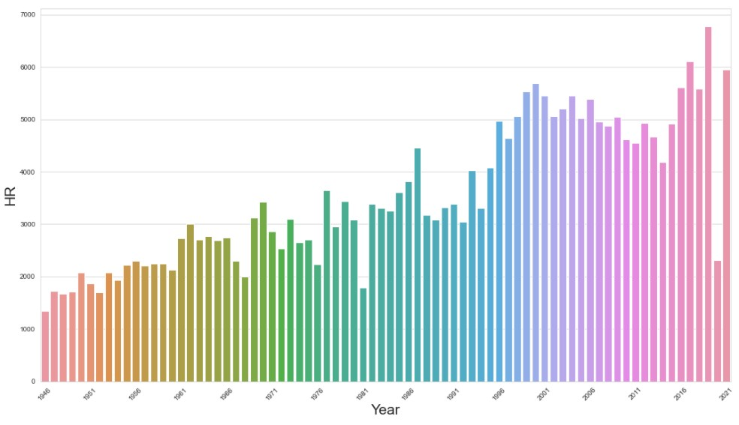
Home Runs are Bigger Part of Game

Slide 5
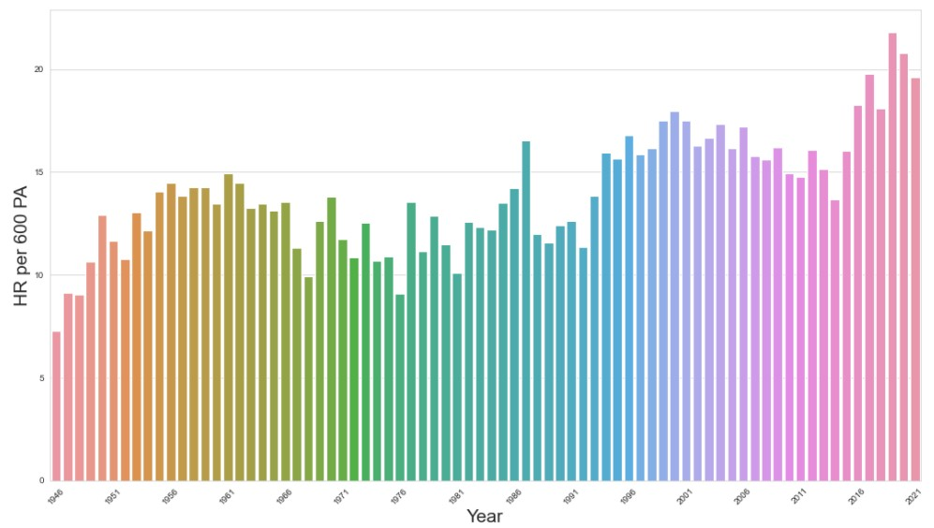
Normalizing for changes to league over time

Slide 6
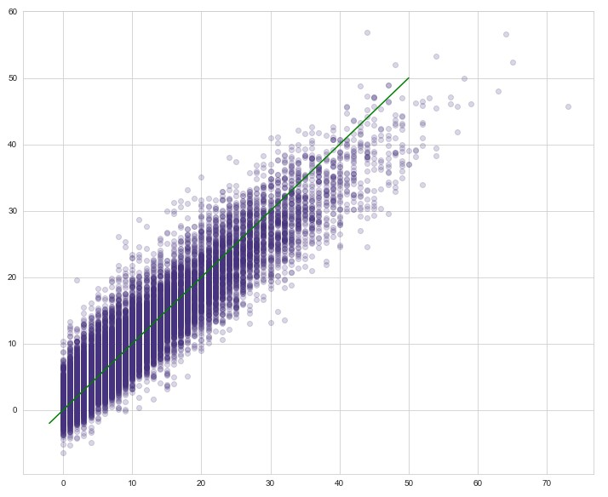
Fitted vs Actual

Slide 7
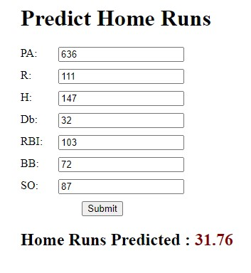
Flask Web App

Slide 8
Conclusions
Final Model = Linear Model
Training set: R-squared = .892
Testing set: R-squared = .897
Chosen variables
PA, R, H, RBI, Db, BB, SO
More accessible to wider audience
Surprises
How many more players there are now than even 20 years ago
How dramatic the increase in Home Runs has been in past 8 years

Slide 9
Future Work
Test new variables
Test more models
Continue to style Web App
Evaluate model differences between different time periods

