Slide 1
Understanding the Changes to Baseball
By: William Paulson

Slide 2
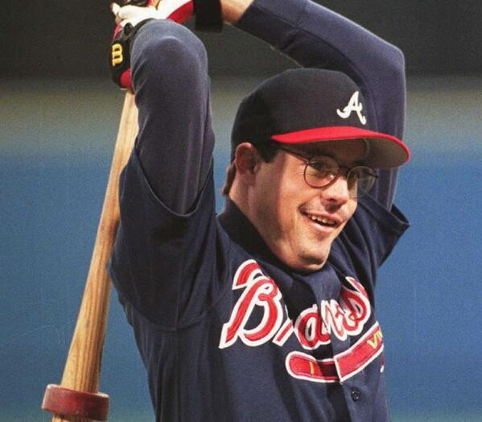
Essential for remaining competitive in new era
Baseball is changing
Understanding trends for baseball changes
Leads to better decision making by management, scouts, and coaches
Creates definitive benchmarks for players to judge themselves against

Slide 3





Pipeline
Scraped using Beautiful Soup
Every season since 1914
Stored in scaleable database
Aggregated for visualization
Cleaned using Pandas and Numpy
95,909 data entries
Summary statistics of how game has changed

Slide 4
Methodology
Data
Baseball Reference
Scraping
Beautiful Soup & Requests
Database
Pandas, Numpy, MongoDB
Web Deployment
Streamlit
Plotly
Web Scrapping
Grab stats of every batter since 1914
Curate list to exclude duplicate entries
Clean data for better storage and modelling
Database Management
MongoDB to handle large database size
Pandas to handle smaller dataframes for coding
Web Deployment
Visualization of summary statistics

Slide 5
Conclusions
Baseball is becoming a more volatile game
After normalizing for Plate Appearances
Home Runs and Strikeouts are dramatically increasing
Walks are slowly increasing
Hits are decreasing
Surprises
How many more players there are now than even 20 years ago
How dramatic the increase in Home Runs has been in past 8 years

Slide 6
Future Work
Incorporate Linear Regression Model for Predicting Home Runs
Test more models
Continue to style Web App
Create more summary Statistics to emphasize different changes to baseball

Slide 7
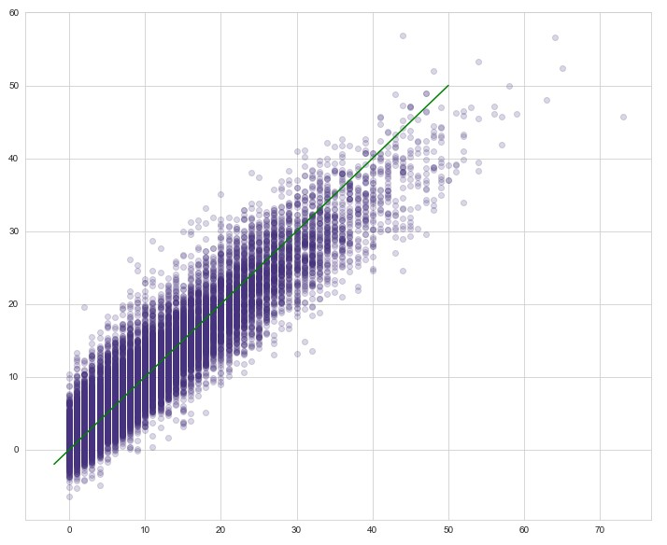
Fitted vs Actual

