Slide 1
UE24CS352A · MACHINE LEARNING · MINI-PROJECT
Bird Species Identification using Deep Learning
Objective: name the species in a bird photograph (200 classes) and reach at least 85% accuracy on the official CUB-200-2011 test split.
Bhavyaa Garg
PES1UG24CS116
Bhavesh Velluru
PES1UG24CS115
Section B, CSE
PES University, Bengaluru
Notes:
We built a classifier that names the species in a bird photograph. We compared four models, from a small CNN trained from scratch to a frozen DINOv2 feature extractor with logistic regression. Our target was at least 85% test accuracy, and only the DINOv2 model reached it.

Slide 2
DATASET
CUB-200-2011: 200 look-alike species
Official train/test split kept: 5,994 train and 5,794 test images
900 validation images (15%) carved from the training split, stratified by class, seed 42
All model selection (epochs, learning rates, regularisation) used validation only
The test split was used once, for final evaluation
11,788
images in total
200
bird species (classes)
5,094
train + 900 validation
5,794
official test images
Bhavyaa Garg · Bhavesh Velluru · Section B, CSE
2
Notes:
CUB-200-2011 has 11,788 images of 200 bird species, and we kept its official 5,994 / 5,794 train/test split. With only about 25 training images per species, the task is hard. We chose epochs, learning rates and regularisation on the 900-image validation split and touched the test split once at the end.

Slide 3
PIPELINE AND METHODOLOGY
Four models, one validation protocol
1 · CNN BASELINE
From scratch
TensorFlow. 3 conv layers (32/64/128), dropout 0.3. Adam 1e-3, 12 epochs.
2 · MOBILENETV2
Frozen transfer
TensorFlow. ImageNet backbone frozen, new head, dropout 0.25. Adam 1e-4, 8 epochs.
3 · MOBILENETV2
Fine-tuned
Stage 1: head at 1e-3 with extra augmentation. Stage 2: top 40 layers unfrozen at 1e-5.
4 · DINOV2 (BEST)
Frozen + logistic regression
PyTorch + scikit-learn. ViT-B/14 features (768-d), flip-averaged. C = 0.01 chosen on validation.
Shared: 224 × 224 input, seed 42. Hardware: Apple M2 (8 GB); TensorFlow on CPU, PyTorch on the M2 GPU.
Bhavyaa Garg · Bhavesh Velluru · Section B, CSE
3
Notes:
The first three models are TensorFlow/Keras; the fourth uses a frozen DINOv2 ViT-B/14 from timm with a standardised, multinomial logistic-regression classifier. The regularisation strength C was picked from four values on validation (88.56%, 88.33%, 88.33%, 88.22%), and the strongest regularisation, 0.01, won. DINOv2 feature extraction for all 11,788 images took about 40 minutes.

Slide 4
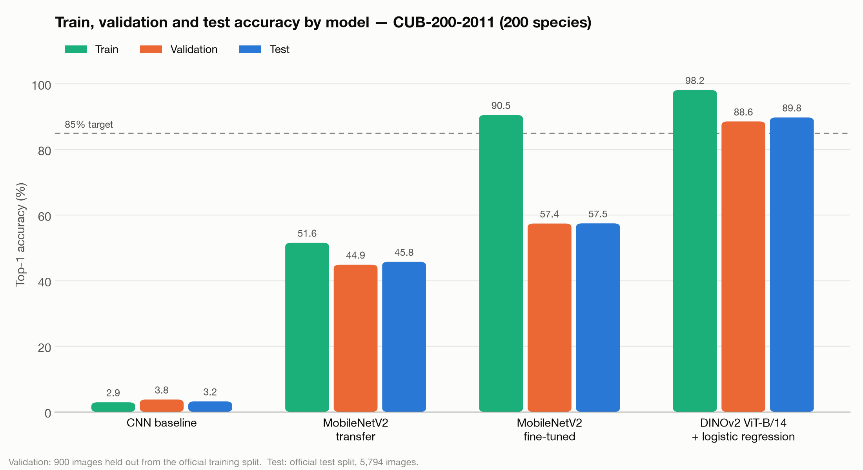
EXPERIMENTS AND RESULTS
Only DINOv2 reaches the 85% target
TEST SPLIT, 5,794 IMAGES
Model | Top-5 | Macro F1
CNN baseline | 13.0% | 0.018
MobileNetV2 transfer | 77.2% | 0.444
MobileNetV2 fine-tuned | 85.8% | 0.579
DINOv2 + LogReg | 98.7% | 0.897
Fine-tuned MobileNetV2 overfits: 90.5% train vs 57.5% test
DINOv2 cuts the train–test gap to about 8 points
Keras train accuracy is logged during training (augmentation and dropout on); chance is 0.5%.
4
Notes:
Test top-1 goes from 3.2% for the CNN to 45.8% for frozen MobileNetV2, 57.5% after fine-tuning, and 89.8% for DINOv2 with logistic regression. Fine-tuning mostly helped through the head training; unfreezing added only about 2 points. Validation and test agree closely for every model, so the evaluation looks reliable.

Slide 5
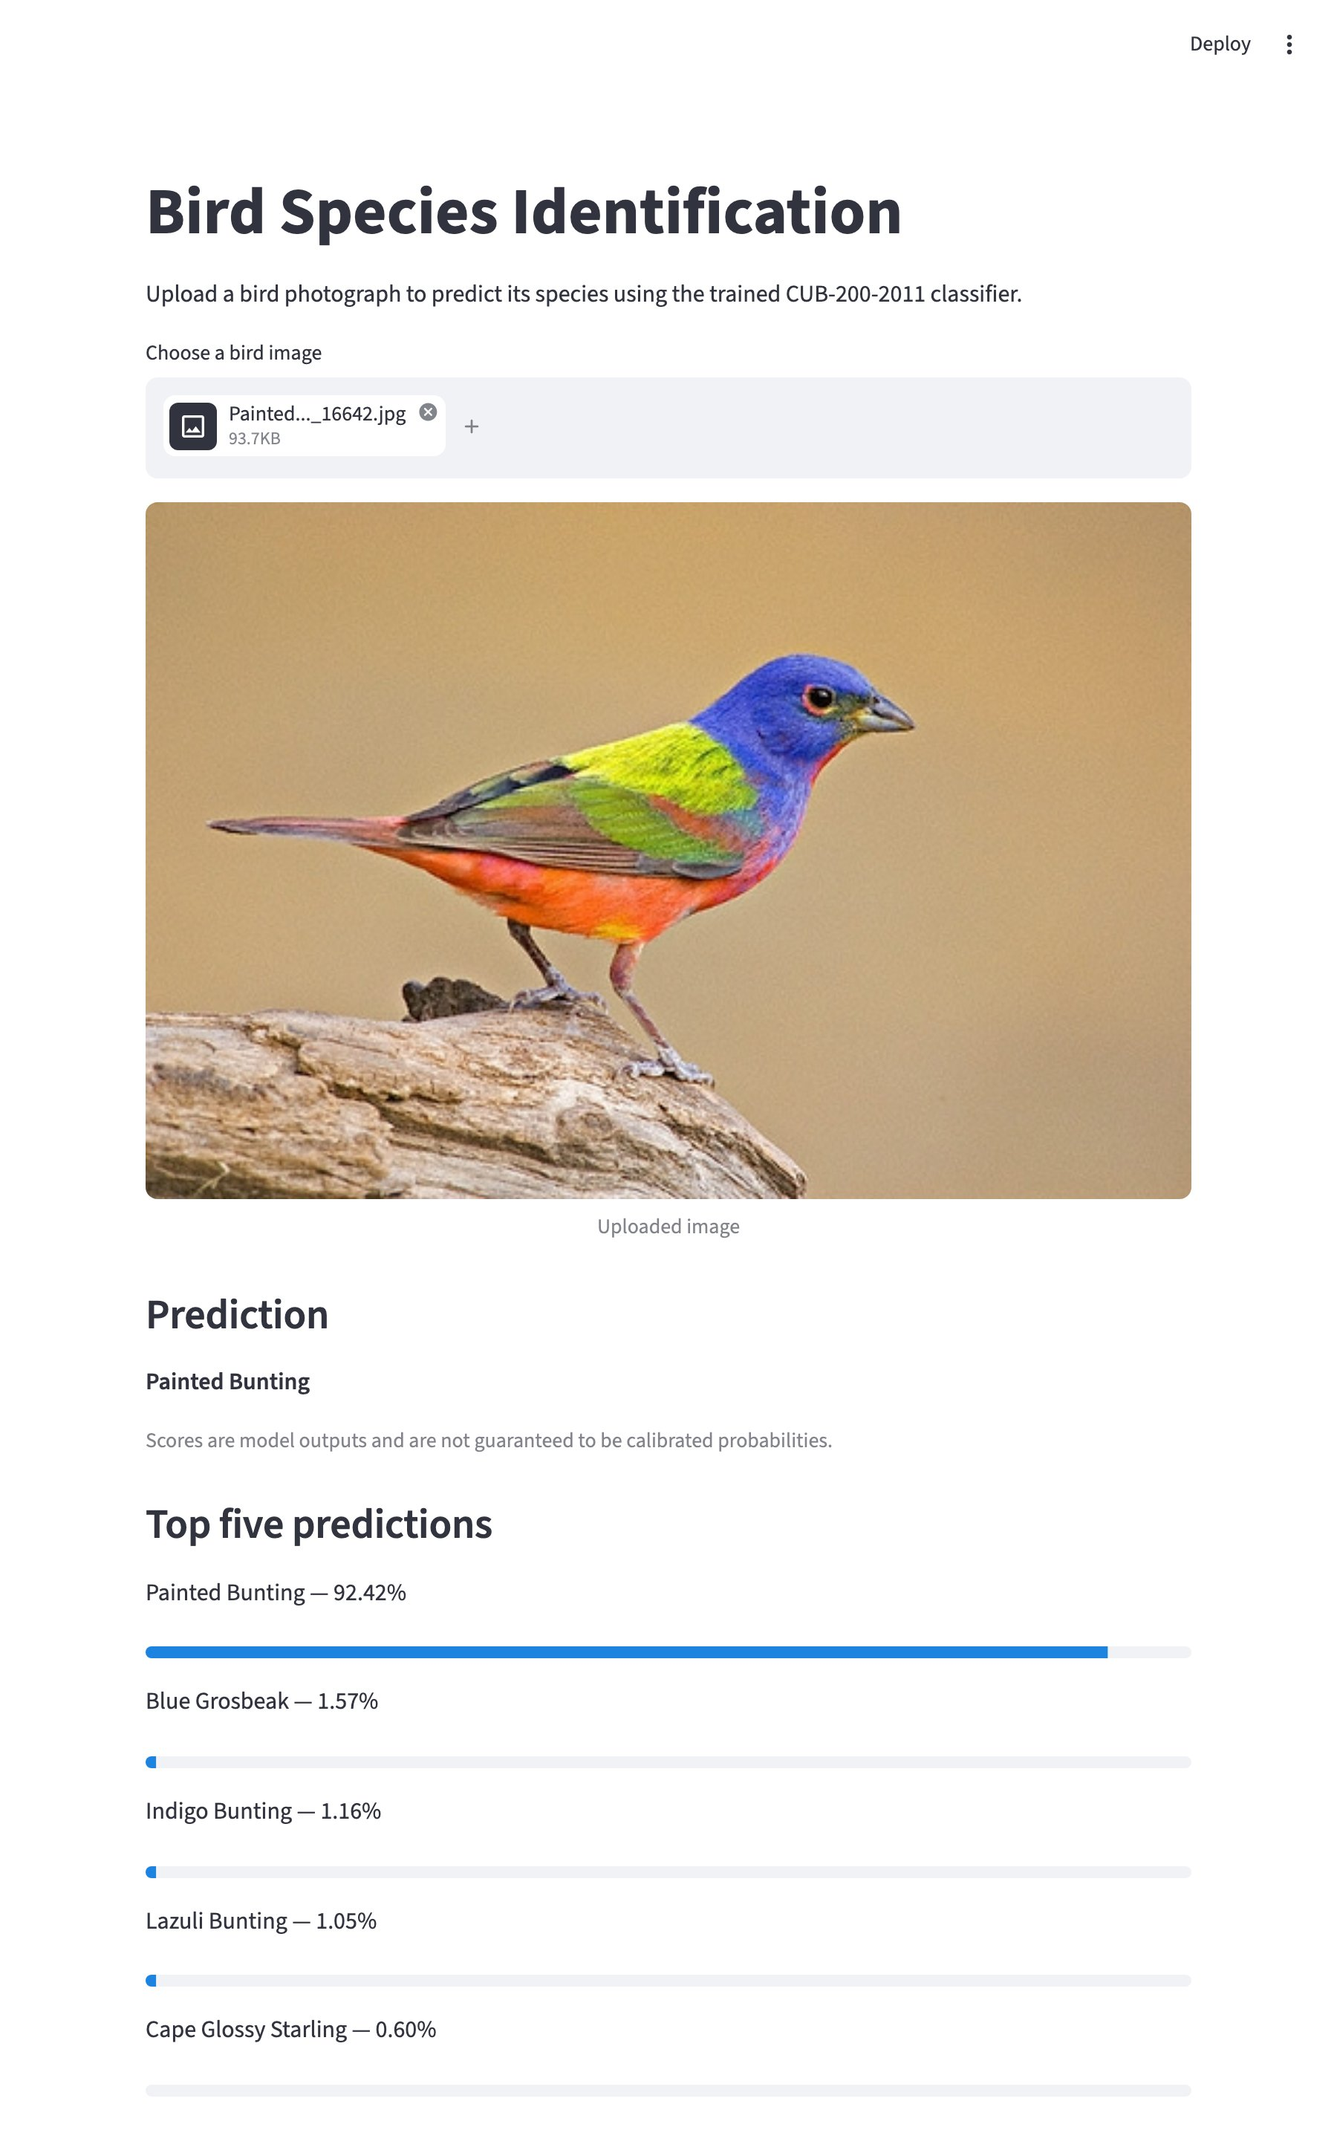
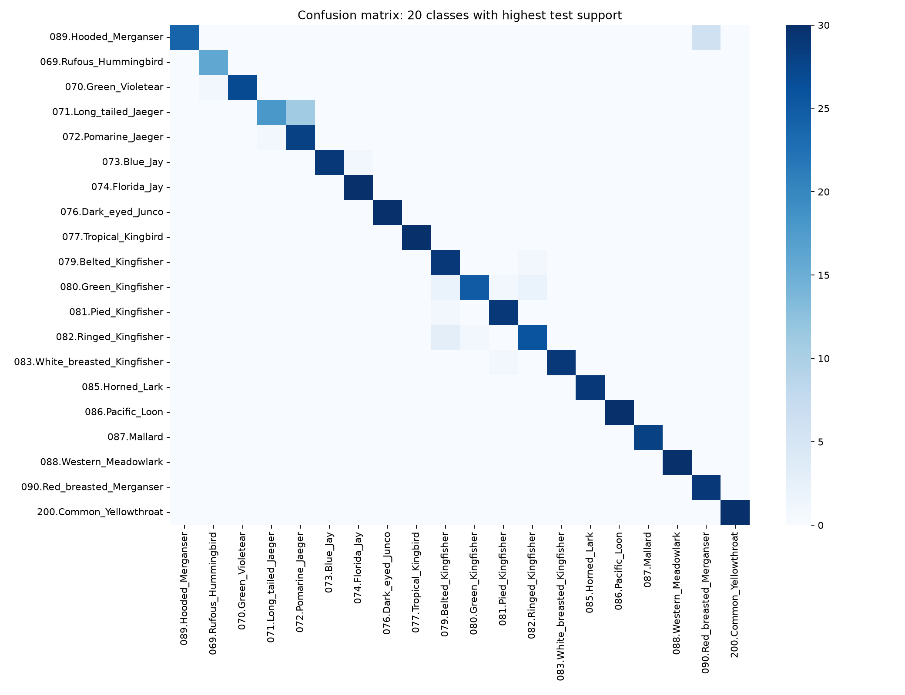
DEMO AND ERROR ANALYSIS
Look-alike species cause the errors
Streamlit app: upload a photo, get the species and top-five scores in under 0.1 s
Painted Bunting at 92.4%; runners-up are look-alikes (Blue Grosbeak 1.6%, Indigo Bunting 1.2%)
Main confusions: Long-tailed vs Pomarine Jaeger, Hooded vs Red-breasted Merganser, kingfishers
Scores are model outputs, not calibrated probabilities
Failure case: a blurry in-flight Long-tailed Jaeger is predicted as Pomarine Jaeger (87.9%); the true species is second at 3.3%
Bhavyaa Garg · Bhavesh Velluru · Section B, CSE
5
Notes:
Run the app live: upload a photo and show the top-five bars. In the confusion matrix (rows are true species, columns predicted) the errors sit between similar species, such as Long-tailed and Pomarine Jaeger. Example: a Cedar Waxwing is predicted correctly at 78.6%, with the very similar Bohemian Waxwing second at 14.9%.

Slide 6
CONCLUSION AND LIMITATIONS
Feature quality was the limit
Conclusion
DINOv2 + logistic regression is best: 89.8% test top-1, 98.7% top-5
From scratch, about 25 images per species is too few to learn
Better regularisation of MobileNetV2 alone could not reach 85%
Limitations and next steps
Pretraining data (ImageNet, LVD-142M) may overlap CUB, so accuracy may be optimistic
DINOv2 is frozen: we learn the classifier, not a network end to end
Single run (seed 42); two frameworks; look-alike species still cause errors
Next: fine-tune DINOv2, crop with CUB bounding boxes, try ViT-L/14
INDIVIDUAL CONTRIBUTIONS
Bhavesh (CS115): data pipeline and splits; CNN baseline; training-curve and overfitting analysis
Bhavyaa (CS116): DINOv2 feature pipeline and classifier; evaluation and error analysis; Streamlit demo
Both: MobileNetV2 transfer learning and fine-tuning; model comparison, report, presentation and repository
Bhavyaa Garg · Bhavesh Velluru · Section B, CSE
6
Notes:
The baseline barely beat chance, frozen MobileNetV2 underfit, and fine-tuning overfit by 33 points; switching to better pretrained features is what finally crossed 85%. Validation (88.6%) and test (89.8%) agree closely. Be honest that DINOv2 is a frozen feature extractor, so our contribution is the classifier and the model comparison. Each of us should be ready to explain any file in the repository.

