Slide 1
Music Popularity Analysis
Exploring factors influencing track popularity using Excel, SQL, Python, and Tableau

Slide 2
Introduction
Objective: This project explores the factors that impact the popularity of music tracks. By analyzing variables such as genre, duration, tempo, and explicit content, we aim to uncover trends and actionable insights.
Tools Used:
SQL: For database creation, querying, and cleaning.
Python: For advanced data analysis and hypothesis testing.
Tableau: For data visualization and dashboard creation.
Excel: For initial data preparation and normalization.
Dataset Overview:
Source: Spotify Tracks Dataset
Size: 50,000+ tracks with attributes including genre, duration, tempo, explicit content, and popularity.
Goal: Understand what influences track popularity.

Slide 3
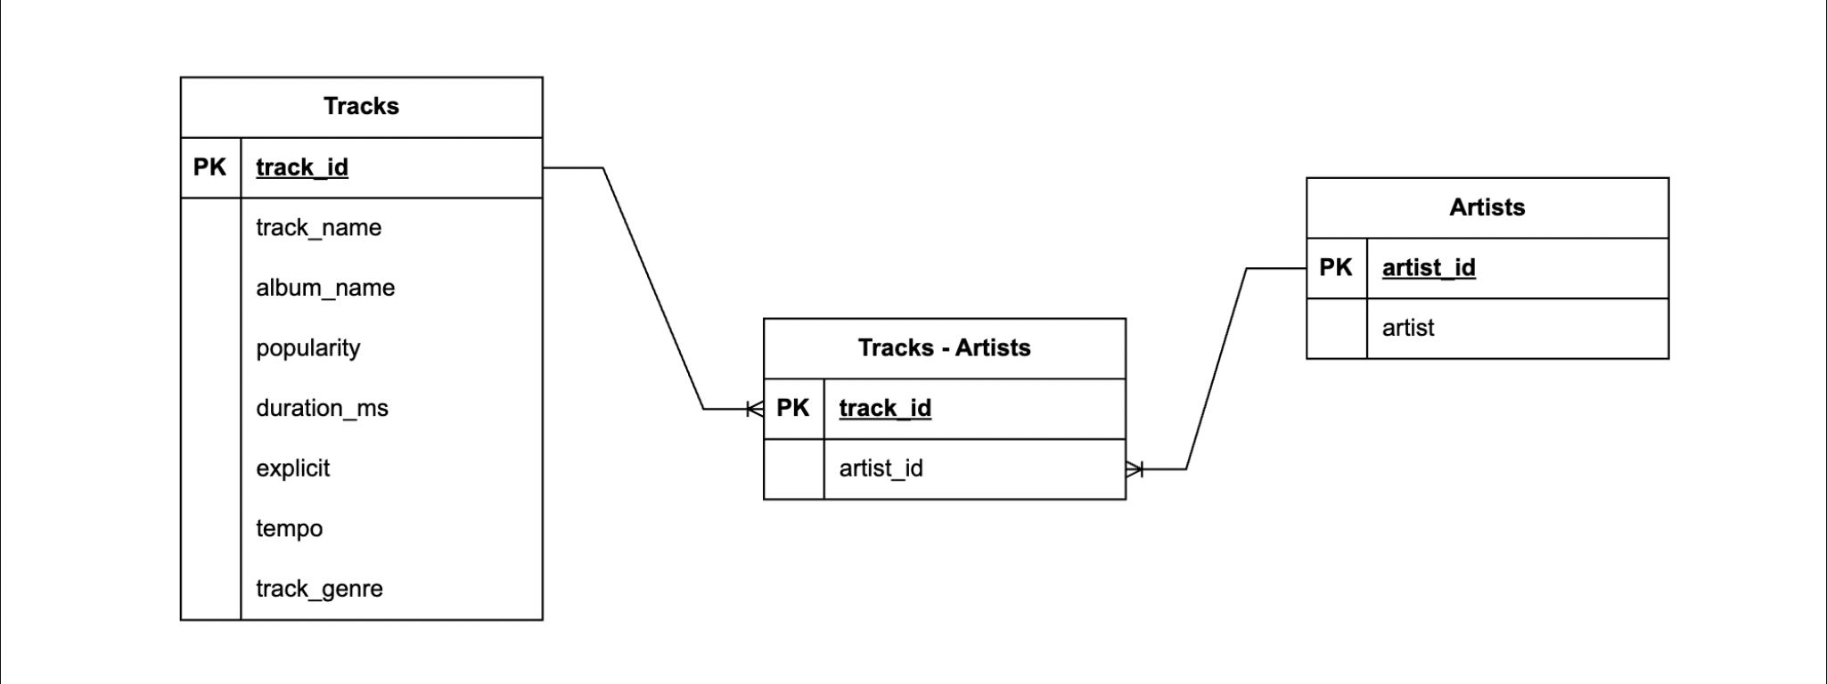
Data Preparation
Initial Data Challenges:
Duplicate tracks with similar attributes.
Multiple artists in a single field.
Missing values and inconsistent formatting.
Normalization Process:
Split data into three tables: Tracks, Artists, and Track-Artist relationships.
Defined primary and foreign keys for relational integrity.
Key Cleaning Steps:
Removed duplicate tracks.
Categorized tempo into slow, moderate, and fast.
Categorized duration into short, moderate, and long.

Slide 4
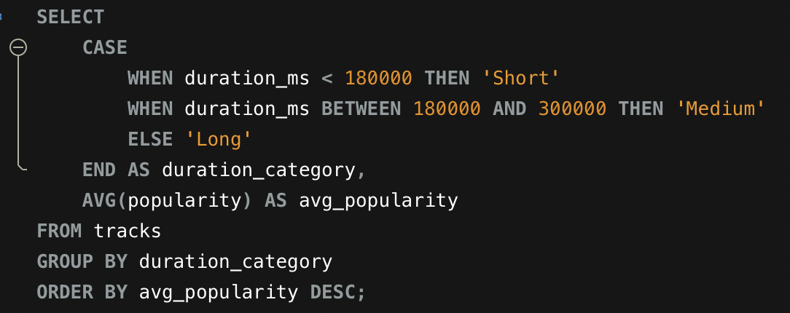
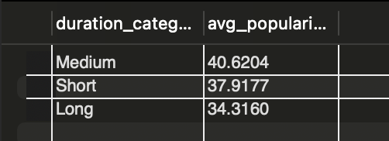
SQL Analysis
Query Examples:
Key Findings:
Explicit songs are more popular on average than non-explicit songs.
Genres like Pop and Hip-Hop dominate the popularity rankings.
Medium duration songs are the most popular on average.

Slide 5
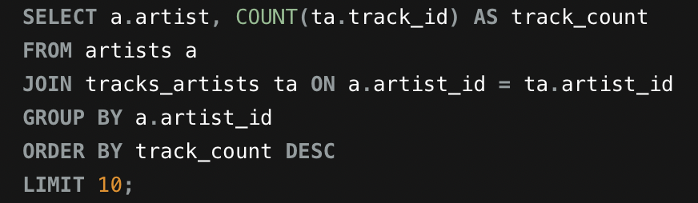
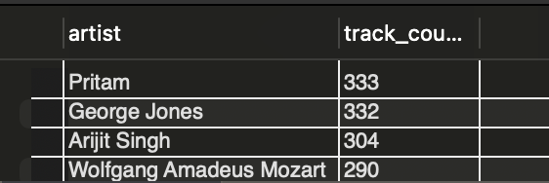
SQL Analysis Continued
Query Examples:
Key Findings:
Most prolific artists are Pritam, George Jones, and Arijit Singh.
Pritam and Arijit Singh have the highest song collaboration count.

Slide 6
Python Analysis
Visualizations:
Box Plot: Popularity by Tempo Categories (Slow, Moderate, Fast).
Violin Plot: Popularity distribution by Track Genre.
Regression Plot: Duration vs. Popularity.
Statistical Insights:
Significant difference in popularity across Tempo Categories (ANOVA, p < 0.05).
Significant difference in popularity between explicit and non-explicit tracks (Independent T-Test, p < 0.05).
Significant difference in popularity across Track Genres (ANOVA, p < 0.05).

Slide 7
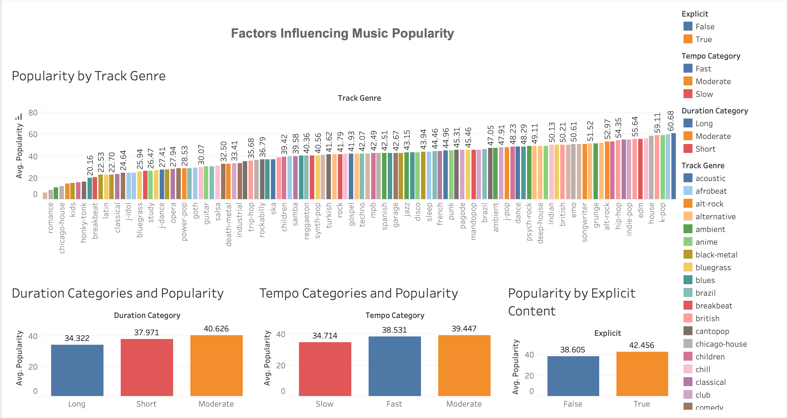
Tableau Dashboard

Slide 8
Insights and Conclusions
Major Findings:
Popular genres dominate the charts, with Pop, Pop-Film, and K-Pop leading in popularity.
Explicit tracks tend to be more popular than non-explicit tracks.
Tracks with moderate tempos tend to perform better.
Actionable Recommendations:
Record labels should focus on producing tracks in trending genres.
Consider having some explicit content in the tracks.
Optimize track duration to fit between 3 to 5 minutes for better engagement.

Slide 9
Learning Experience
Skills Gained:
Database creation and querying using SQL.
Statistical hypothesis testing and visualizations in Python.
Building an interactive Tableau dashboard.
Resourcefulness through doing research to overcome challenges as they came up.
Challenges Overcame:
Dealing with inconsistent and missing data.
Properly formatting data to be imported to SQL.
Communicating insights effectively through visualizations.

